Slide 1
Chapter 9 Iterative design
Assoc. Prof. Dr. Thacha Lawanna

Slide 2
Objective of the Study:
To examine how iterative design cycles—comprising prototyping, testing, feedback integration, and refinement—enhance the effectiveness, usability, and adaptability of digital innovation solutions across diverse user contexts.

Slide 3
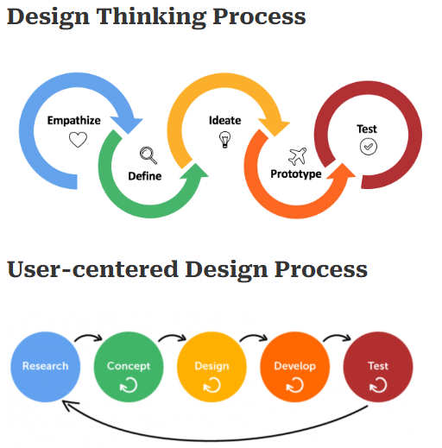
1. User-Centered Iteration
Iterative design emphasizes continual improvements based on real user needs. Each cycle gathers insights from actual user behavior, correcting design assumptions and aligning solutions with user expectations. This ensures that the final product is relevant, usable, and context-appropriate, improving overall adoption and satisfaction.

Slide 4
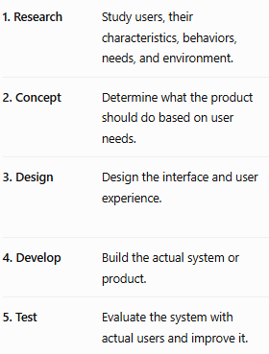

Slide 5
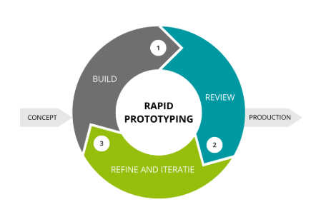
2. Rapid Prototyping
Rapid prototyping allows designers to quickly visualize concepts, test ideas, and identify early flaws before full development.
Low-fidelity and high-fidelity prototypes support different exploration needs, enabling teams to compare alternative solutions efficiently and ensure that design choices are grounded in evidence rather than assumptions.

Slide 6
Develop a simple prototype showing calendar, reminders, and task functions.
Students test the prototype and provide feedback about usability problems.
Create an app helping students organize assignments and study schedules.
Launch the completed application for students to use in practice.
Improve features based on feedback, then repeatedly test updated prototypes.

Slide 7
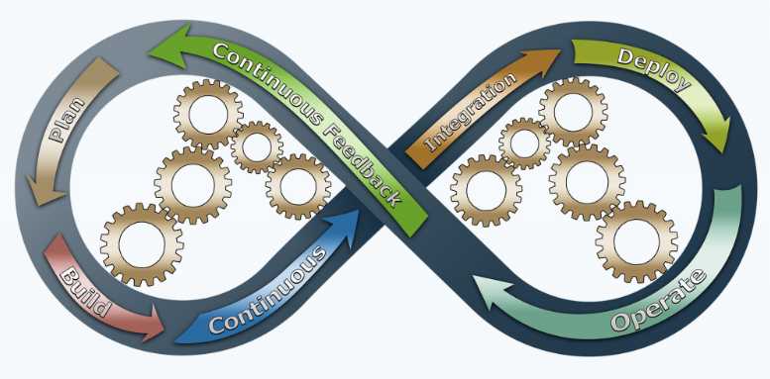
3. Continuous Feedback Integration
Feedback collected from users, stakeholders, and testing sessions drives every iteration. This feedback identifies usability issues, unmet needs, and new opportunities. By integrating feedback continuously, designers ensure that solutions evolve responsively, reducing project risks and fostering a product that is both functional and user-friendly.

Slide 8
Connect all application modules together.
Release application for student use.
Identify student needs and requirements.
Develop essential student application features.
Combine and test code continuously.
Monitor and maintain application performance.

Slide 9
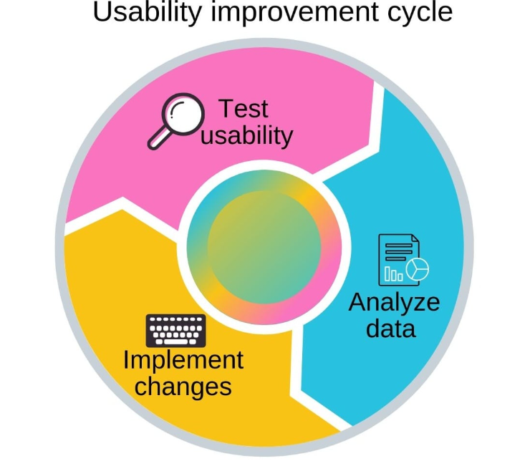
4. Usability Testing Cycles
Usability testing is repeated at key stages to evaluate how users interact with evolving prototypes. Insights from these cycles reveal navigation issues, cognitive load challenges, and unclear interfaces. Testing ensures the solution becomes more intuitive over time, improving efficiency and reducing user frustration.

Slide 10
Students test application usability features.
Analyze student feedback and performance.
Improve application based on feedback.

Slide 11
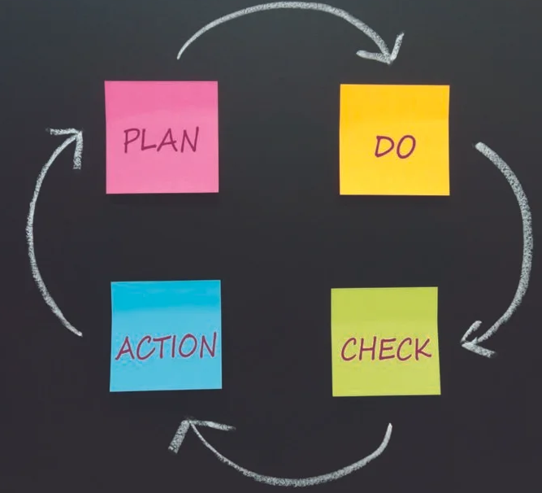
5. Design Refinement
Each iteration sharpens the product by addressing identified weaknesses and enhancing strengths. Refinement may involve adjusting interface elements, simplifying workflows, or improving visual hierarchy. Through repeated adjustments, the final product becomes polished, consistent, and aligned with user expectations and design standards.

Slide 12
Identify problems and plan improvements.
Implement the planned application improvements.
Apply improvements and standardize changes.
Evaluate results and user feedback.

Slide 13
Thanks

Slide 14
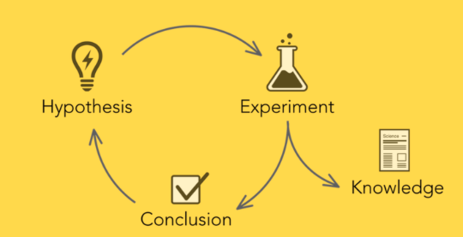
6. Hypothesis-Driven Experimentation
Iterative design often involves forming hypotheses about user behavior or expected improvements. Designers test these hypotheses using prototypes, A/B tests, or controlled studies. This scientific approach ensures decisions are supported by evidence, enabling teams to validate assumptions and prioritize enhancements that truly improve user experience.
Transportation
Industries> IoT, cloud computing, robots
Hospital

Slide 15
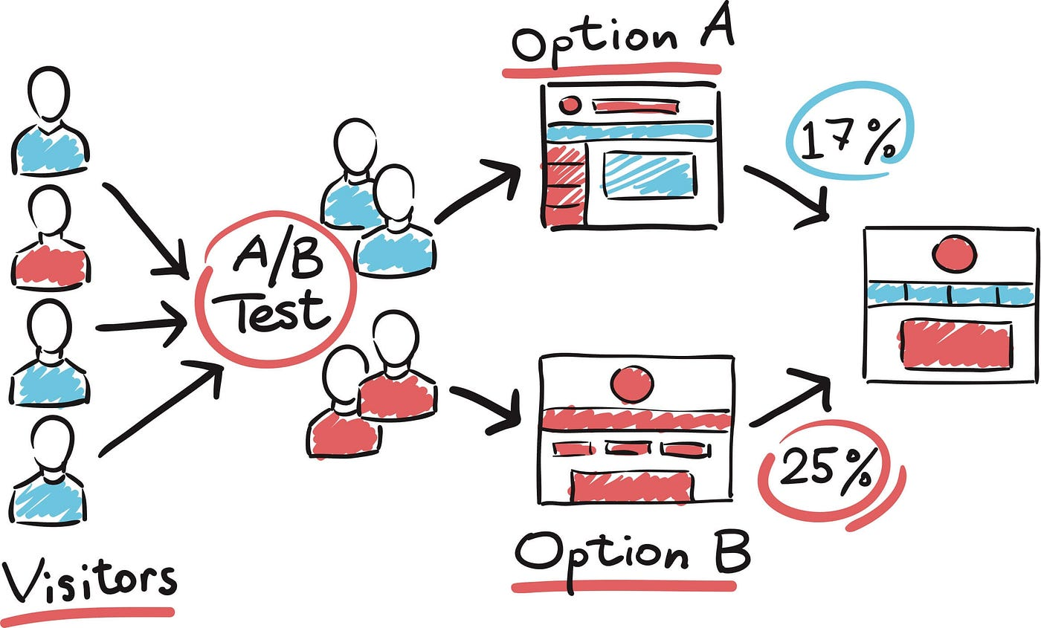
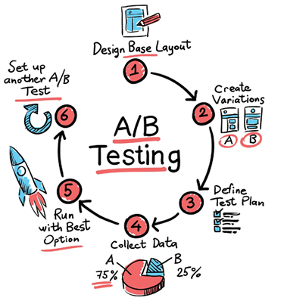
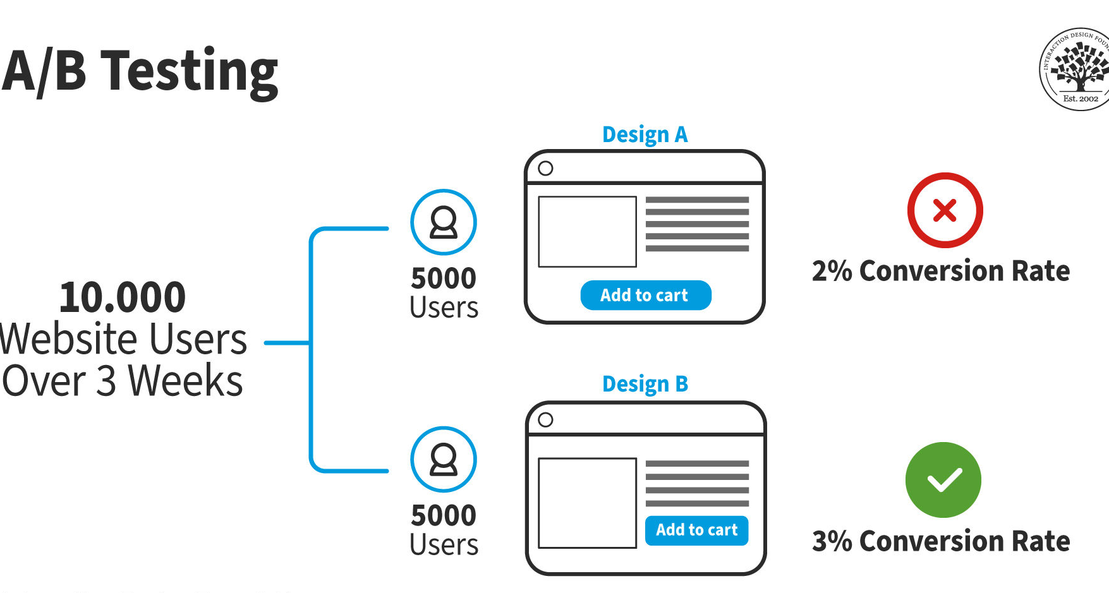

Slide 16
For example, in iterative design of a mobile banking application, the design team may form the following hypothesis:
Hypothesis: “If the money-transfer process is reduced from five steps to three steps, users will complete transactions faster and make fewer errors.”
The team then creates a prototype with the simplified process and tests it with users. If the results show faster completion times and fewer mistakes, the design change is retained. If not, the team revises the interface and tests another version.
Another simple example is: “If the ‘Buy Now’ button is made more visible, more users will complete their purchases.” The hypothesis can be tested through A/B testing, and the findings are then used in the next design iteration.

Slide 17
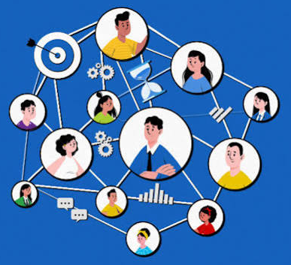
7. Cross-Functional Collaboration
Effective iteration requires communication between designers, developers, researchers, and stakeholders. Collaboration allows diverse perspectives to inform decisions, catching potential issues early. Cross-functional teamwork strengthens creativity, aligns technical and design constraints, and ensures that solutions are feasible, scalable, and user-centered.

Slide 18
Example of Cross-Functional Collaboration:
In developing a mobile banking application, people from different departments work together:
UX/UI designers design an easy-to-use interface.
Software developers build the application and its features.
Cybersecurity specialists ensure transactions are secure.
Marketing teams provide information about customer needs.
Customer service teams share common problems reported by users.
For example, if customers complain that the money-transfer process is too complicated, the UX designers simplify the interface, developers implement the changes, cybersecurity specialists verify that the new process remains secure, and customer service collects feedback after the update.

Slide 19
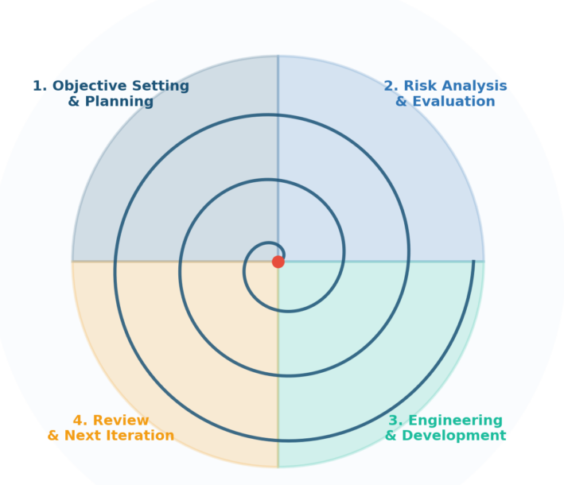
8. Risk Reduction Through Iteration
Iterative design minimizes risks by uncovering problems early and allowing adjustments before final implementation. Small, incremental changes are easier and cheaper to fix compared to late-stage revisions. This approach prevents costly redesigns, strengthens product reliability, and ensures development stays aligned with goals and user needs.

Slide 20
Example of Risk Reduction Through Iteration:
In developing a mobile banking application, instead of building the entire system at once, the development team creates and tests it in several small stages.
For example, the team first develops a prototype of the money-transfer feature and tests it with 20 users. Testing reveals that some users accidentally enter the wrong account number. The team then improves the interface by adding account-name confirmation before the transfer is completed. The revised version is tested again before being released to more users.
This iterative process helps identify problems early, before they become expensive or dangerous.
In simple terms: Risk reduction through iteration means designing, testing, learning from problems, and improving repeatedly to reduce the chance of major failure.
Process:
Design → Test → Identify Problems → Improve → Test Again → Release

Slide 21
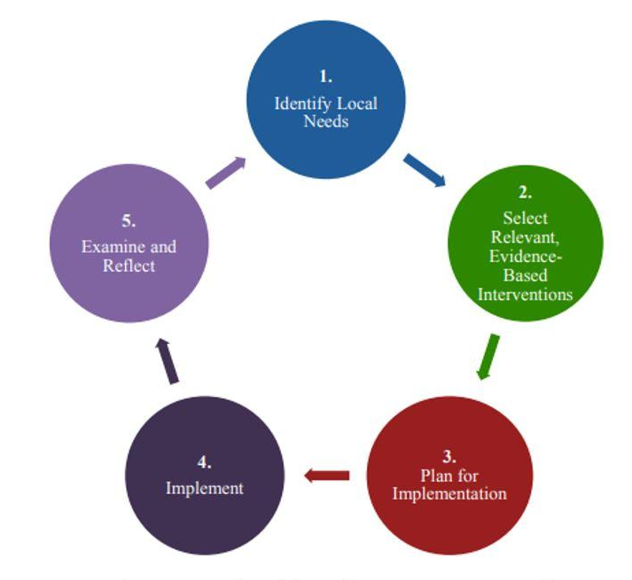
9. Evidence-Based Improvements
Every iteration uses data—from user tests, analytics, or interviews—to guide enhancements. This ensures improvements are measurable, meaningful, and justified. Evidence-based decision-making prevents subjective or biased design choices, resulting in a high-quality solution that supports continuous learning and systematic improvement.

Slide 22
Example of Evidence-Based Improvements:
In developing a mobile banking application, the team uses actual user data and feedback to decide what should be improved rather than relying only on assumptions.
For example, usability testing shows that 40% of users have difficulty finding the “Transfer Money” button. The design team moves the button to a more visible position on the home screen. After testing the new design, the percentage of users experiencing difficulty decreases to 10%.
The team therefore has evidence that the design change improved usability.
In simple terms: Evidence-based improvements mean making design decisions based on real data, user feedback, testing results, and observations.
Process:
Collect Evidence → Analyze Results → Identify Problems → Make Improvements → Test Again

Slide 23
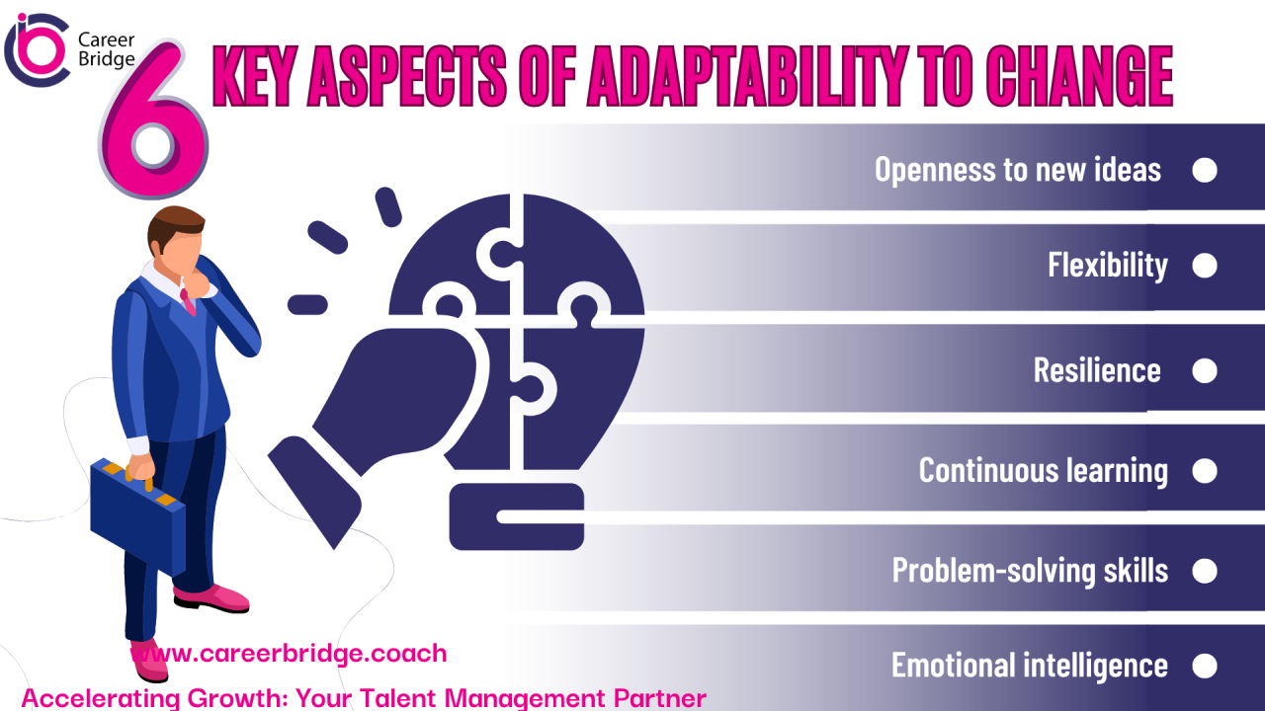
10. Adaptation to Changing Requirements
Iterative design supports flexibility when user needs or project requirements change. Instead of locking into rigid plans, teams adjust direction based on new insights or emerging technologies. This adaptability ensures that the final product remains relevant and capable of meeting evolving demands.

Slide 24
Example of Adaptation to Changing Requirements:
In developing a mobile banking application, customer needs, technology, or regulations may change during development.
For example, the application was originally designed to support password-based login. Later, users requested a faster and more convenient login method. The development team responded by adding fingerprint and facial recognition. The new features were tested with users and refined before release.
This demonstrates how the design can be modified when new requirements emerge.
In simple terms: Adaptation to changing requirements means adjusting a product or system when user needs, technology, business conditions, or requirements change.
Process:
Identify Change → Evaluate New Requirement → Modify Design → Test → Implement

Slide 25
Thanks

