Slide 1
Chapter 10 Technology Digital Agile Project Management
Fast
Flexible
Team
Assoc. Prof. Dr. Thacha Lawanna

Slide 2
Objective of the Study:
To examine how technology-enhanced agile methodologies—such as AI-assisted planning, real-time data analytics, and automation tools—improve project efficiency, adaptability, and decision-making in digital innovation environments.

Slide 3
1. Agile Principles in Digital Environments
Agile principles emphasize collaboration, iterative development, and responsiveness to change. In digital environments, these principles support rapid adaptation to technological shifts, continuous software updates, and user-centered improvements. Teams can quickly test, refine, and deploy features, ensuring high project relevance and alignment with evolving digital innovation goals.
Agile principles in digital environments mean developing digital products through small, flexible, and continuous improvements based on user feedback and changing requirements.

Slide 4
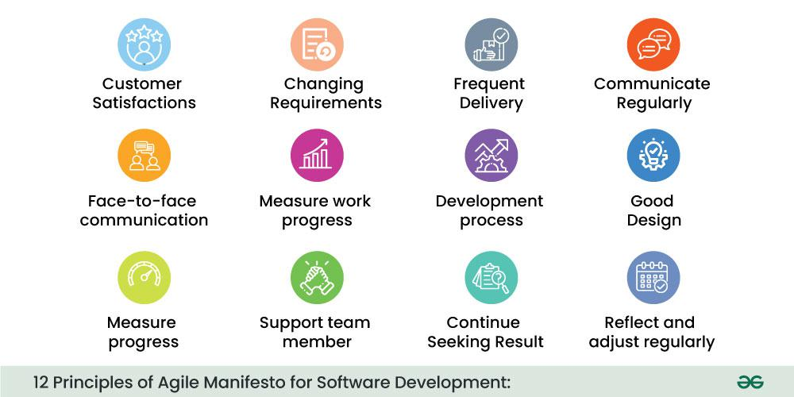

Slide 5
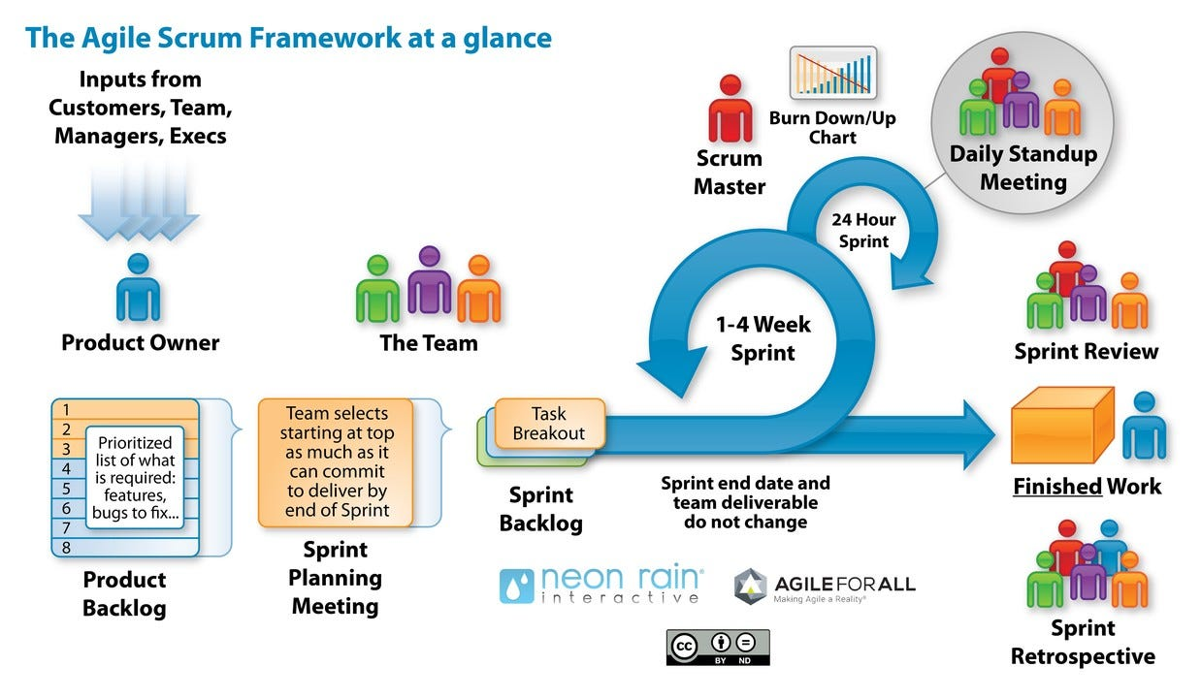

Slide 6
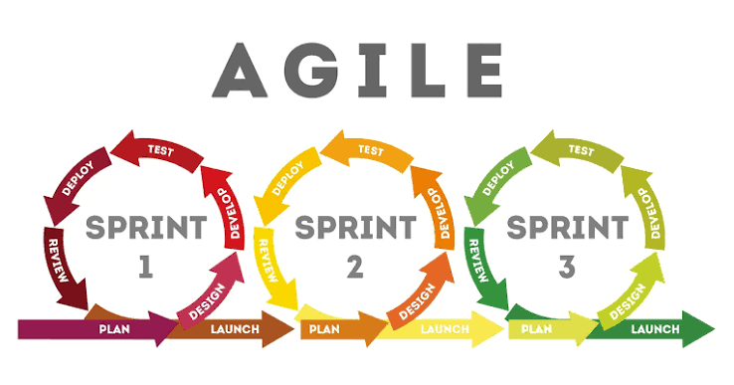
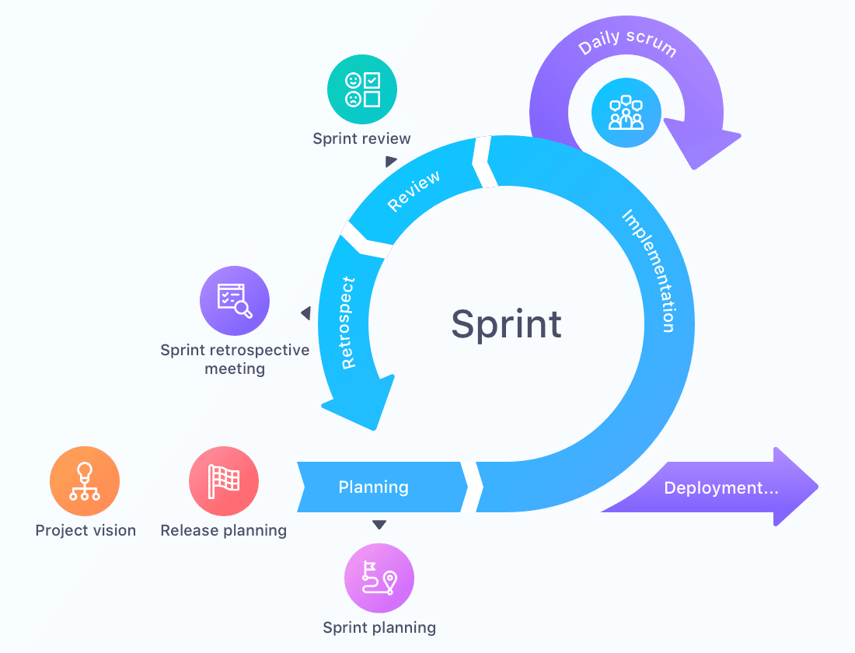

Slide 7
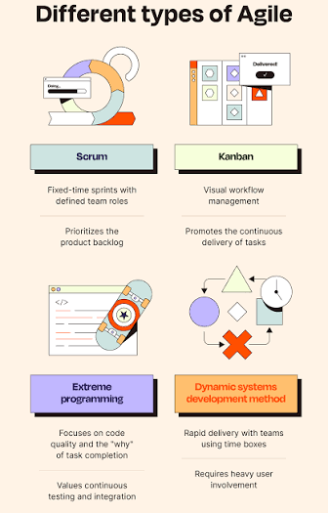

Slide 8
A company is developing a mobile shopping application. Instead of developing every feature before launching, the team releases a basic version first.
After the first release, customers report that the checkout process is too complicated. The Agile team collects this feedback, discusses the problem, and improves the checkout process during the next short development cycle, or sprint. The updated version is then released and tested again.
This demonstrates key Agile principles such as:
Customer collaboration — listening to users and understanding their needs.
Iterative development — improving the application through repeated development cycles.
Responding to change — adjusting features when requirements change.
Frequent delivery — releasing useful improvements regularly.
Team collaboration — designers, developers, testers, and business teams working together.
In simple terms: Agile means develop a little → test → get feedback → improve → repeat.
Process:
Plan → Develop → Test → Release → Collect Feedback → Improve → Repeat

Slide 9
2. Role of Automation in Agile Workflows
Automation accelerates routine tasks such as testing, integration, deployment, and monitoring. It reduces human errors and ensures consistent output during each development cycle. By automating repetitive work, agile teams focus on strategic decision-making and creative problem-solving, significantly improving project speed, reliability, and time-to-market.
using technology to perform repetitive tasks automatically, helping Agile teams work faster, reduce errors, and deliver digital products more frequently.

Slide 10
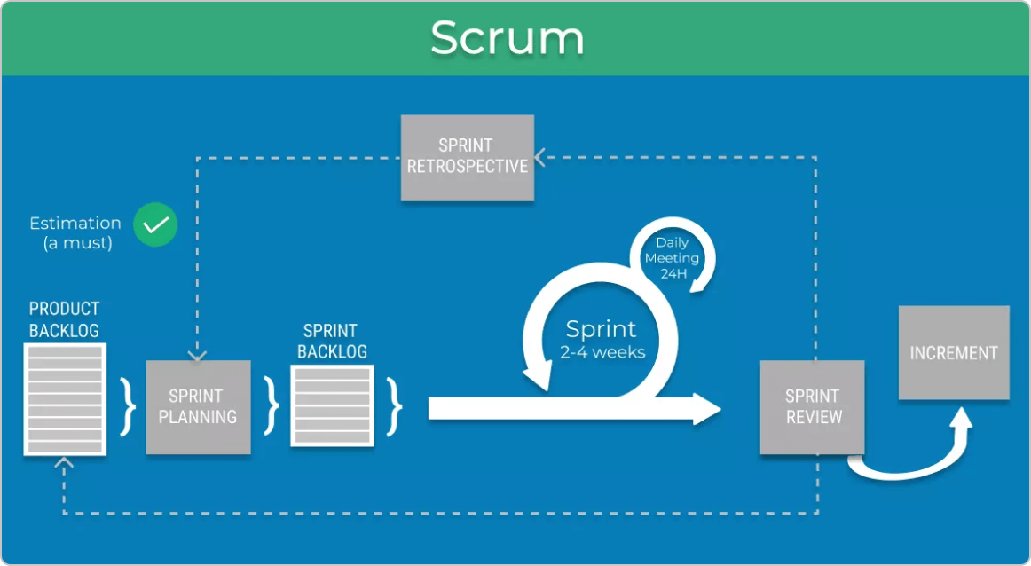
Discuss how to improve next sprint.
Deliver a working version.
List all app features.
Choose features for this sprint.
List tasks to complete.
Develop features for 2–4 weeks.
Show completed work to users.

Slide 11
Example:
A team is developing a mobile banking application. Every time developers add new code, an automated system can test the application, identify errors, check security requirements, and prepare the new version for deployment.
For example, if a developer changes the money-transfer feature, automated testing immediately checks whether users can still log in, transfer money, and receive transaction confirmations correctly. If an error is detected, the development team receives feedback quickly and can fix it during the same sprint.
Automation supports Agile workflows through:
Automated testing — quickly checks whether features work correctly.
Continuous Integration (CI) — automatically checks and integrates new code.
Continuous Delivery/Deployment (CD) — prepares or releases new versions efficiently.
Automated monitoring — identifies system problems after deployment.
Task automation — reduces repetitive administrative and development work.
In simple terms: Automation helps Agile teams work faster, detect problems earlier, reduce human errors, and continuously improve products.
Process:
Develop → Automatically Test → Detect Problems → Fix → Deploy → Monitor → Improve

Slide 12
3. Digital Collaboration Tools for Agile Teams
Tools like Jira, Trello, Slack, and Confluence enable real-time communication, task tracking, and documentation. These platforms support transparency, faster feedback cycles, and remote collaboration. Digital tools streamline sprint planning, backlog management, and progress monitoring, helping distributed teams maintain efficiency and alignment throughout the project lifecycle.
software platforms that help Agile team members communicate, share information, manage tasks, and work together effectively, especially when team members work remotely or in different locations.

Slide 13
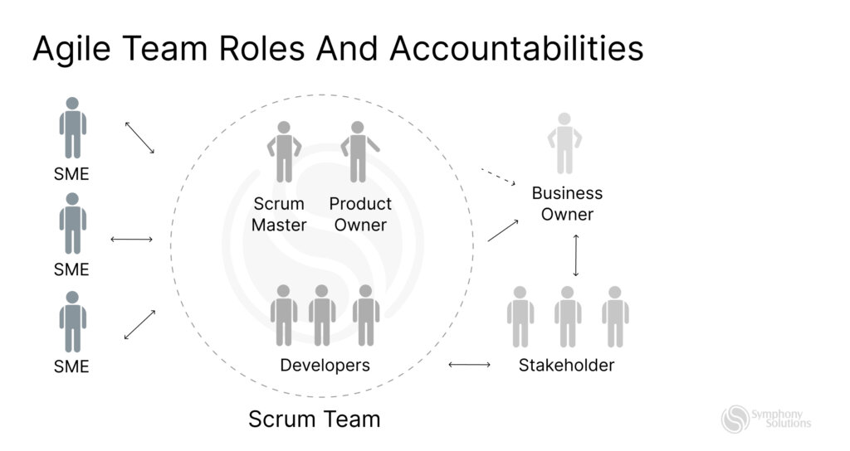

Slide 14
Example:
A team is developing a mobile banking application. The developers, designers, testers, and project managers work from different locations. They use digital collaboration tools to coordinate their Agile activities.
For example, the team may use Slack for daily communication, Jira to manage sprint tasks and track progress, GitHub to collaborate on software code, and Zoom for sprint meetings and discussions.
These tools support Agile teams by enabling:
Real-time communication — team members can quickly discuss problems and decisions.
Task management — tasks can be assigned and monitored during each sprint.
File and knowledge sharing — documents, designs, and project information can be shared easily.
Progress tracking — everyone can see what has been completed and what remains.
Remote collaboration — team members can work effectively from different locations.
In simple terms: Digital collaboration tools help Agile teams communicate → coordinate → share → track → improve together.

Slide 15
4. AI-Assisted Project Planning
Artificial intelligence enhances planning accuracy by analyzing historical data, predicting workloads, estimating sprint durations, and identifying risks. AI-driven insights help project managers allocate resources, optimize schedules, and anticipate obstacles earlier. This improves the adaptability and foresight of agile teams working in rapidly changing technology environments.
using Artificial Intelligence (AI) to help teams plan, organize, predict, and manage project activities more effectively.

Slide 16
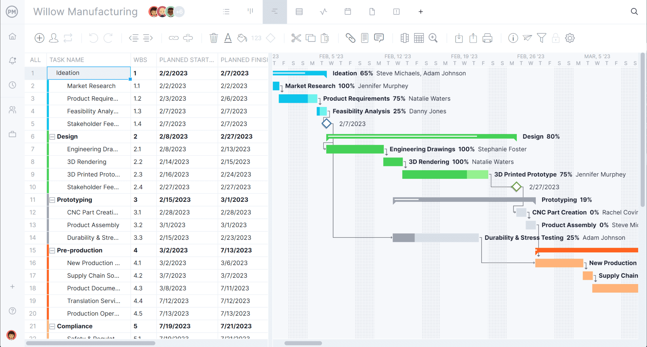

Slide 17
Example:
A company is developing a mobile banking application. The project manager uses an AI-assisted system to analyze information from previous software projects, including task duration, team performance, costs, delays, and common risks.
For example, AI may predict that developing a new money-transfer feature will take three weeks instead of the originally planned two weeks because similar projects experienced delays during security testing. The project manager can then adjust the schedule and assign additional resources before problems occur.
AI can support project planning through:
Time estimation — predicts how long tasks may take.
Resource allocation — recommends how people and resources should be assigned.
Risk prediction — identifies activities that may cause delays or problems.
Cost estimation — helps predict project expenses.
Task prioritization — recommends which activities should be completed first.
Progress forecasting — predicts whether the project is likely to meet its deadlines.
In simple terms: AI-assisted project planning means using AI to analyze past data → predict future problems → recommend actions → improve project decisions.
Process:
Collect Project Data → AI Analysis → Predict → Recommend → Plan → Monitor → Adjust

Slide 18
5. Real-Time Data Analytics for Decision-Making
Real-time analytics allow teams to monitor performance metrics, user behaviors, and system feedback instantly. With immediate insights, agile teams can adjust priorities, refine features, and address issues proactively. Data-driven decision-making enhances project accuracy, supports continuous improvement, and ensures alignment with end-user needs.
collecting, analyzing, and using data immediately as it is generated, allowing organizations to make faster and more informed decisions.

Slide 19
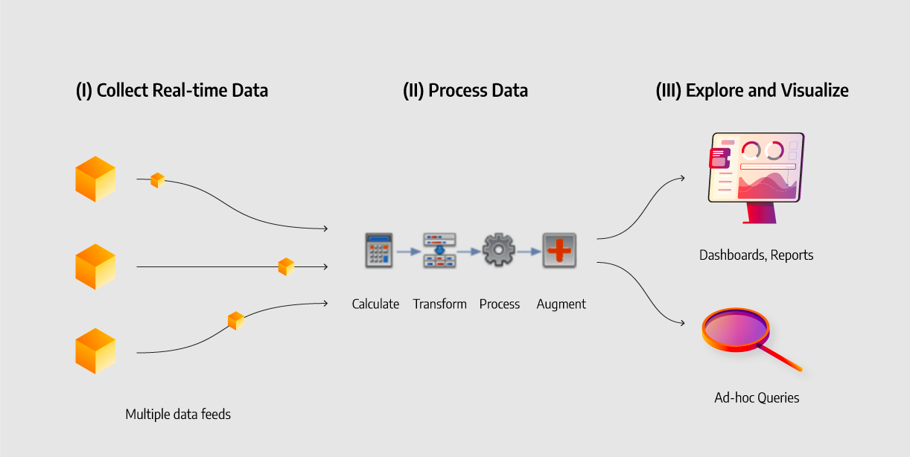

Slide 20
Example:
A company operates an e-commerce platform. The system continuously collects real-time information about customer visits, product searches, purchases, inventory levels, and payment transactions.
For example, the system detects that a particular product is receiving a sudden increase in customer demand. Real-time analytics immediately identifies this trend and alerts managers. The company can then increase inventory, adjust promotions, or recommend similar products before the opportunity is lost.
Real-time data analytics supports decision-making through:
Immediate insights — managers can see what is happening now.
Trend detection — emerging patterns can be identified quickly.
Faster decisions — organizations can respond without waiting for periodic reports.
Risk detection — unusual activities or potential problems can be identified early.
Customer personalization — recommendations can be adjusted based on current customer behavior.
Operational optimization — resources, inventory, and processes can be adjusted dynamically.
In simple terms: Real-time data analytics means using current data to Monitor → Analyze → Identify → Decide → Act immediately.
Example:
Customer demand suddenly increases → System analyzes live sales data → High-demand product identified → Manager receives alert → Inventory is increased → Sales opportunity is captured.

Slide 21
Thanks

Slide 22
6. Cloud Computing for Agile Scalability
Cloud platforms provide flexible infrastructure that scales according to project demands. Agile teams benefit from rapid deployment, resource elasticity, and seamless integration with development tools. Cloud computing reduces operational overhead, supports distributed work environments, and ensures high availability, enabling smoother sprint cycles and continuous delivery.
using cloud-based computing resources that can be quickly increased or decreased according to changing business and user demands.

Slide 23
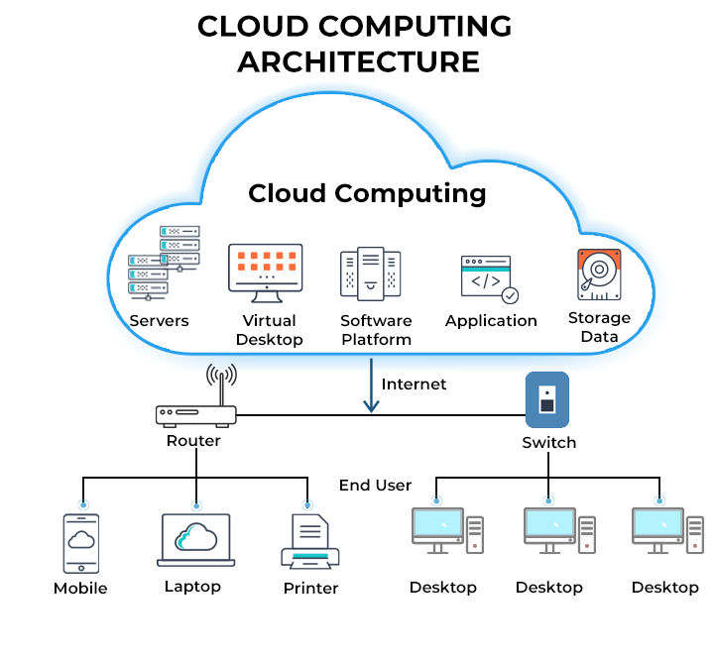

Slide 24
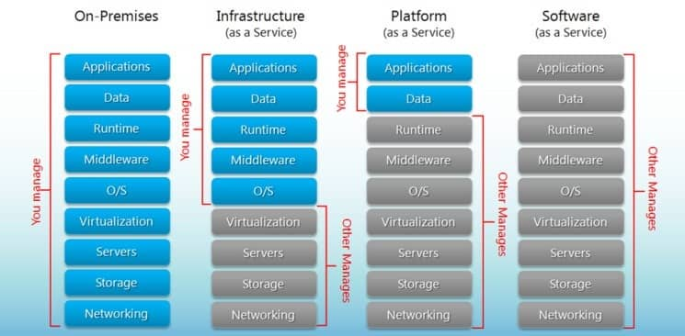

Slide 25
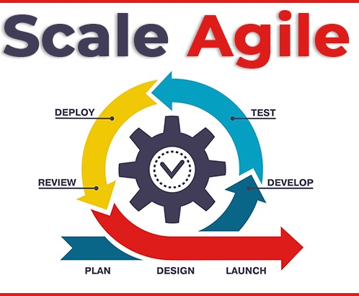
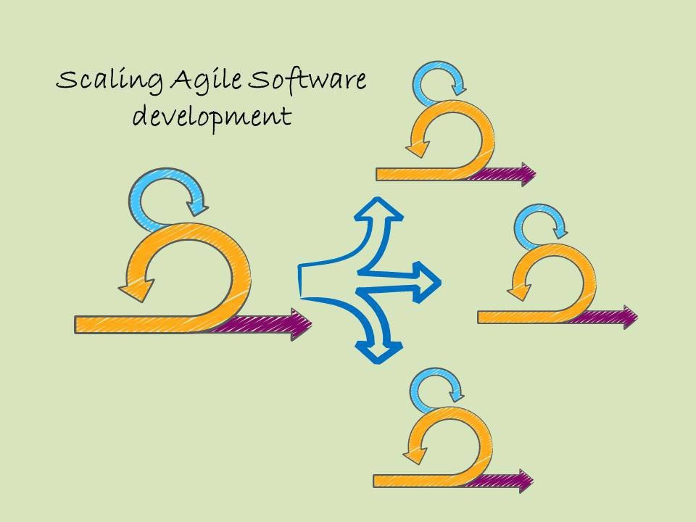

Slide 26
Example:
A company develops an online shopping application using an Agile approach. Normally, the application serves 10,000 users per day, but during a major promotion, the number suddenly increases to 100,000 users.
Instead of purchasing new physical servers, the company uses cloud computing to automatically increase computing capacity to handle the additional users. After the promotion ends, the resources can be reduced again.
Cloud computing supports Agile scalability through:
Rapid scaling — computing resources can expand when demand increases.
Flexibility — teams can quickly create development and testing environments.
Faster deployment — new features can be released more frequently.
Cost efficiency — organizations pay for resources according to usage.
Remote collaboration — Agile teams can access systems and resources from different locations.
Automation — cloud resources can automatically respond to changing workloads.

Slide 27
7. DevOps Integration with Agile Methods
DevOps unifies development and operations to streamline software delivery. When integrated with agile, DevOps accelerates release cycles, enhances collaboration, and improves quality through continuous integration and deployment (CI/CD). This combination ensures faster value delivery, reliable updates, and improved responsiveness to user feedback.
combining Agile development practices with collaboration between development and IT operations teams to deliver software faster, more reliably, and continuously.

Slide 28
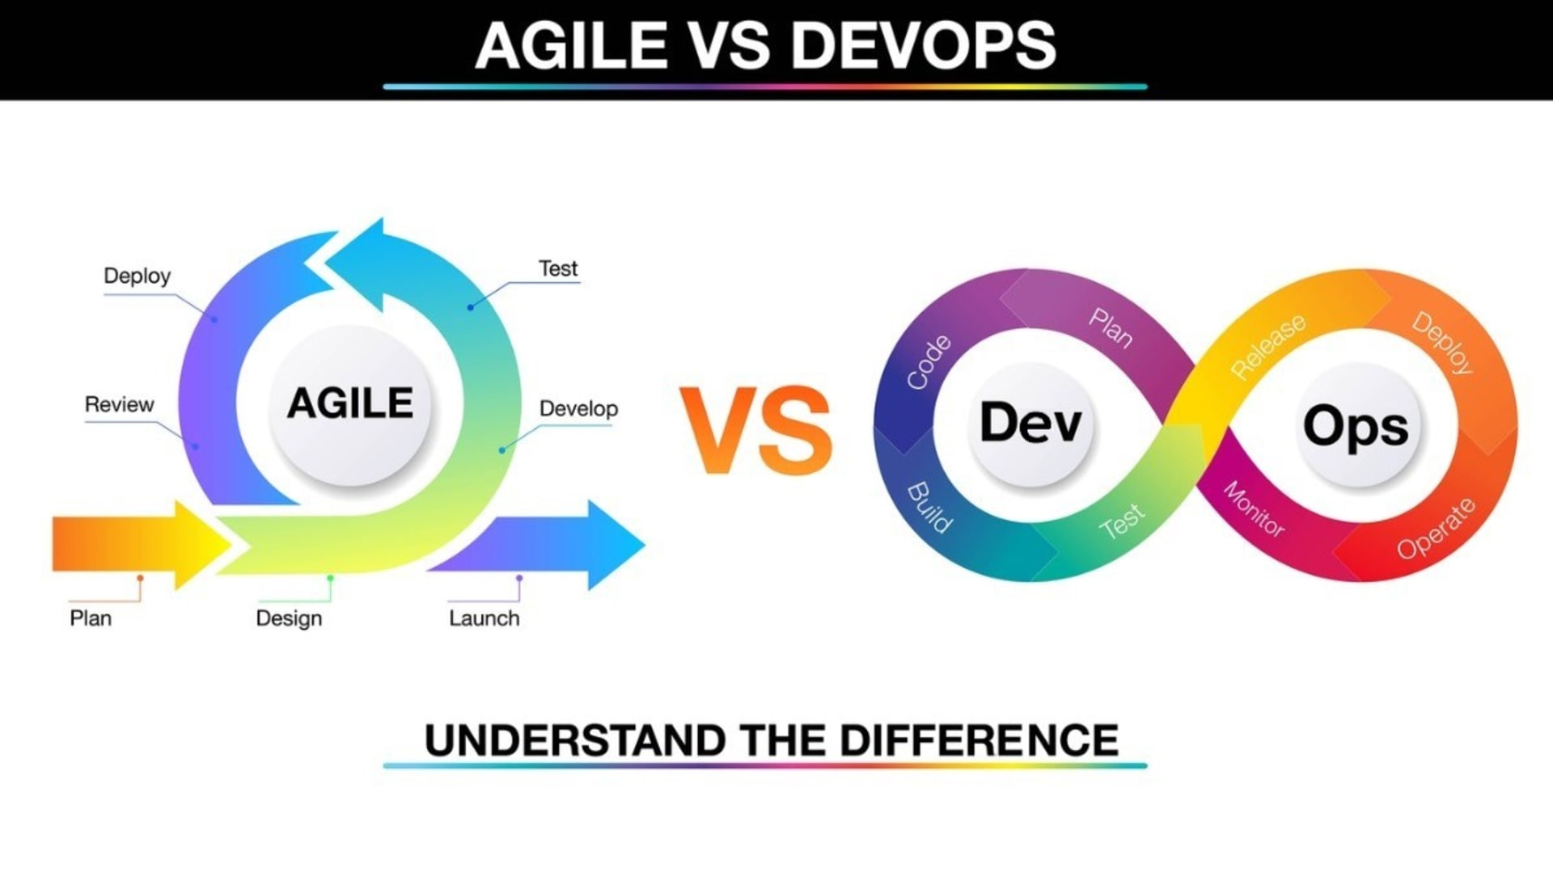

Slide 29
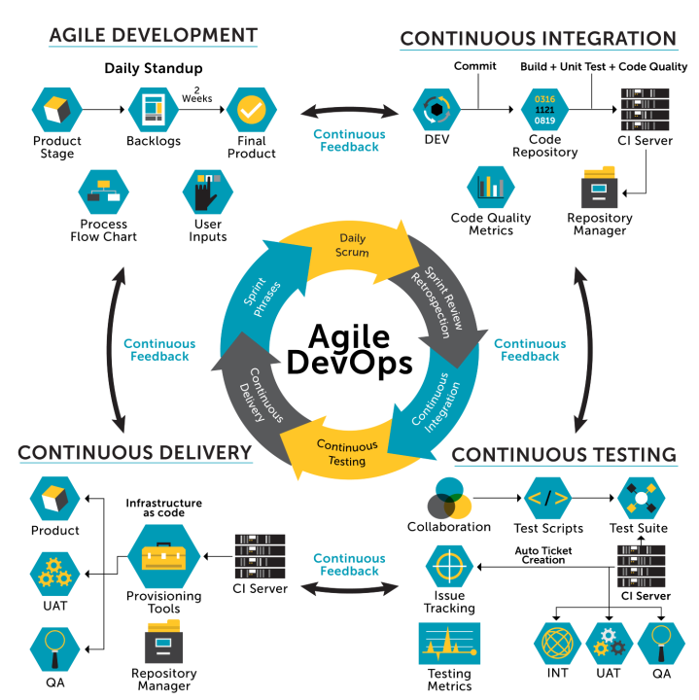

Slide 30
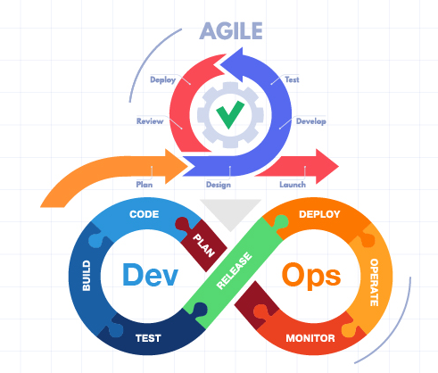
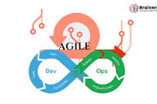

Slide 31
Example:
A company is developing a mobile banking application using Agile. During each two-week sprint, developers create and improve features such as money transfers, bill payments, and account notifications.
After developers complete a new money-transfer feature, DevOps practices automatically build, test, and deploy the new code to a testing environment. If automated tests identify a problem, developers receive immediate feedback and fix it within the sprint. Once the feature passes testing, it can be safely released to users.
DevOps supports Agile methods through:
Continuous Integration (CI) — developers frequently integrate new code.
Continuous Delivery/Deployment (CD) — software updates can be released quickly.
Automated testing — problems are identified earlier.
Continuous monitoring — system performance is monitored after release.
Team collaboration — development and operations teams share responsibilities.
Rapid feedback — teams receive information quickly and make improvements.

Slide 32
8. Digital Risk Management in Agile Projects
Digital projects face risks such as security threats, data breaches, and system failures. Agile risk management involves continuous assessment, rapid mitigation, and iterative testing. Technologies like automated security scans and predictive analytics help teams identify vulnerabilities early, reducing disruptions and ensuring smoother project execution.
continuously identifying, evaluating, and responding to digital risks throughout short development cycles, rather than waiting until the project is completed.

Slide 33
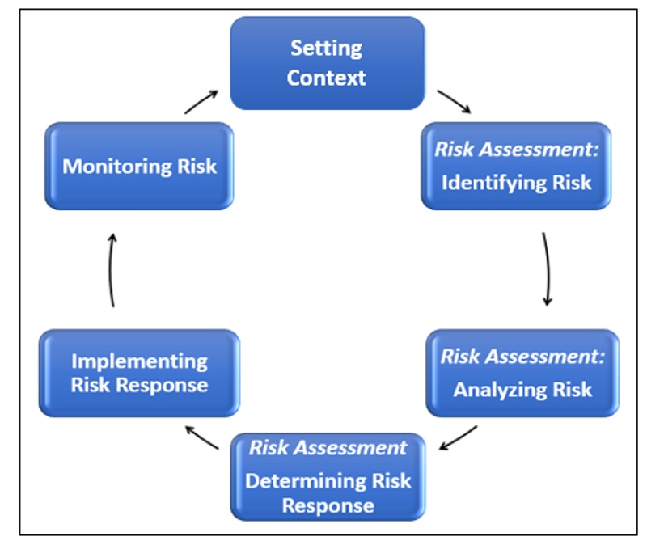

Slide 34
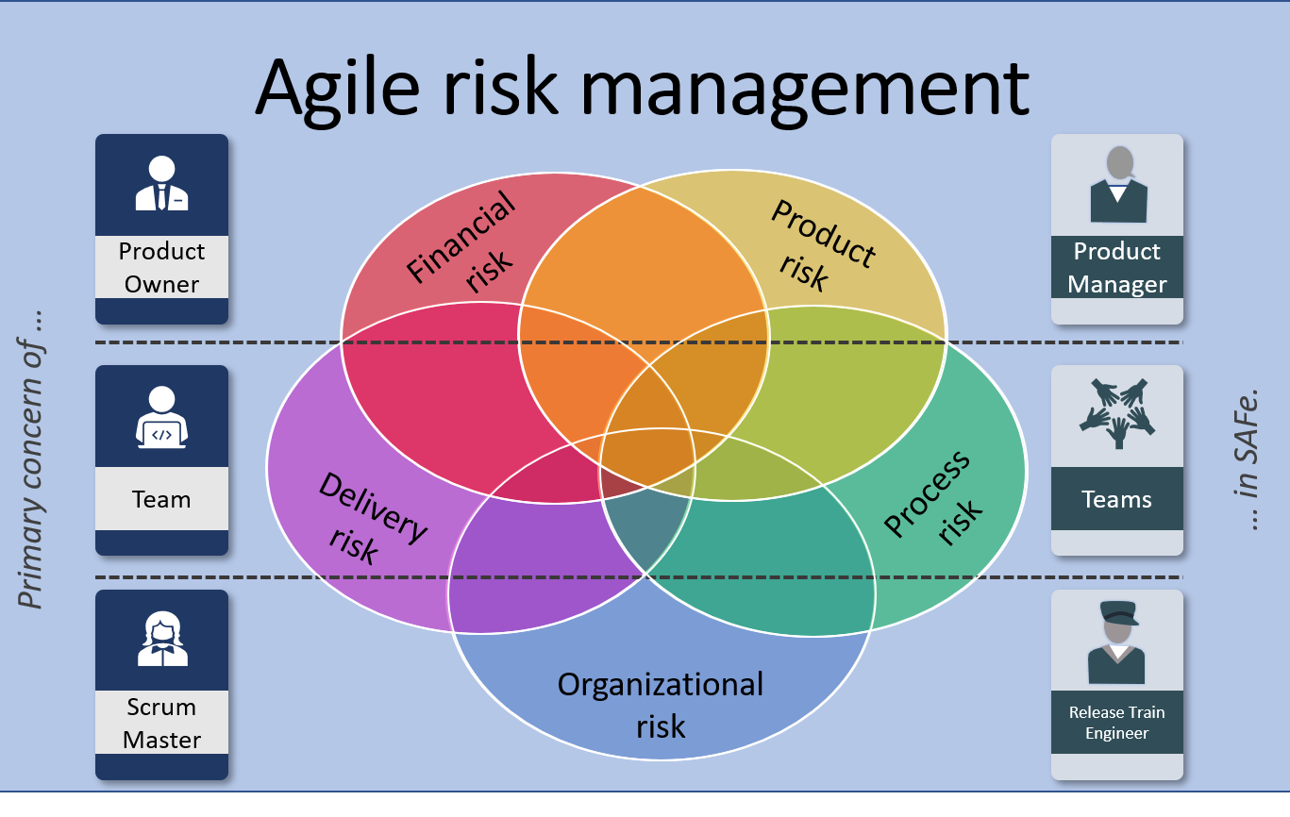

Slide 35
Example:
A team is developing a mobile banking application using Agile methods. During one sprint, the team introduces a new online payment feature.
Before releasing the feature, the team identifies a potential cybersecurity risk: unauthorized users might gain access to customer transactions. The team evaluates the risk, introduces multi-factor authentication and additional security testing, and tests the feature again before deployment.
If new risks appear after release, the team uses monitoring data and customer feedback to address them in the next sprint.
Digital risk management can address:
Cybersecurity risks — hacking, malware, and unauthorized access.
Data privacy risks — exposure or misuse of customer information.
Technical risks — system failures, bugs, or integration problems.
Operational risks — disruptions to digital services.
Compliance risks — failure to meet legal or regulatory requirements.
Project risks — delays, budget problems, or changing requirements.

Slide 36
9. Remote Agile Team Management
Remote work requires strong communication, digital tools, and clear workflows. Agile methodologies ensure structure through daily stand-ups, sprint reviews, and retrospectives. Technology supports remote coordination, maintaining productivity and collaboration despite physical distance. This approach enhances team flexibility and access to global talent.
organizing and coordinating Agile teams whose members work from different locations while maintaining effective communication, collaboration, and continuous delivery.

Slide 37
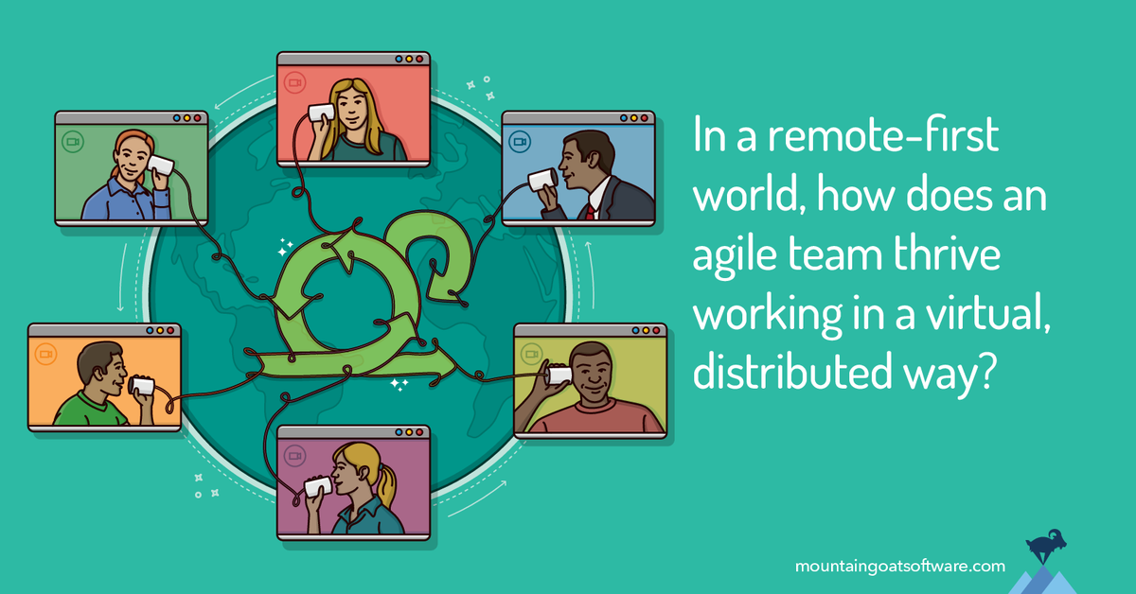

Slide 38
Example:
A company is developing a mobile banking application with team members working in different locations. Developers work in Thailand, UX/UI designers work in Singapore, and software testers work in China.
The team uses Microsoft Teams for daily meetings, Jira for sprint and task management, and GitHub for software development collaboration. During each sprint, team members conduct daily stand-ups, share progress, identify problems, and review completed work online.
Remote Agile team management involves:
Regular communication — conducting virtual stand-ups and sprint meetings.
Clear task allocation — ensuring everyone understands their responsibilities.
Progress tracking — monitoring sprint tasks and project milestones.
Digital collaboration — sharing documents, code, and information online.
Time-zone coordination — scheduling important activities at suitable times.
Team engagement — maintaining trust and collaboration despite physical distance.

Slide 39
10. Continuous Improvement through Digital Feedback Loops
Digital feedback loops gather real-time user data, performance metrics, and system events to refine features continuously. Agile teams use this information to make iterative enhancements and prioritize valuable tasks. Technology-enabled feedback improves user satisfaction, product quality, and overall project success in dynamic digital environments.
using continuously collected digital data and user feedback to identify problems, make improvements, and evaluate whether those improvements are successful.

Slide 40
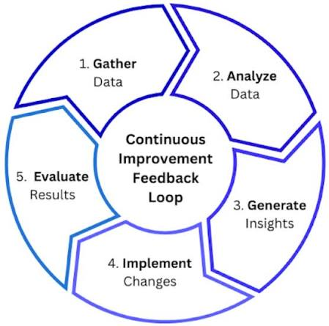

Slide 41
Example:
A company operates a mobile banking application. After releasing a new money-transfer feature, the system continuously collects information such as user feedback, transaction errors, completion time, customer complaints, and application performance.
For example, analytics show that 30% of users leave the transfer process at the confirmation page. The development team investigates and discovers that the confirmation page is confusing. During the next Agile sprint, the team simplifies the page and releases the improved version. New data then shows that the abandonment rate has decreased to 10%.
This creates a digital feedback loop, because the results of one improvement become new information for the next improvement.
Digital feedback loops support:
Continuous monitoring — collecting performance and user data regularly.
User feedback — understanding customer needs and problems.
Rapid problem identification — detecting issues quickly.
Data-driven decisions — making improvements based on evidence.
Iterative improvement — making small improvements repeatedly.
Performance measurement — determining whether changes actually work.

Slide 42
Thanks

