Slide 1
Chapter 11 Implementation and deployment
Assoc. Prof. Dr. Thacha Lawanna

Slide 2
Objective of the Study:
To examine the practical processes, tools, and methodologies required to transform a designed system or model into an operational, fully deployed solution, ensuring reliability, scalability, usability, and real-world performance.

Slide 3
1. System Architecture Preparation
Before deployment, the system architecture must be finalized, including hardware, software components, network configuration, and database structures. This ensures the solution is scalable, efficient, and robust. Proper architectural planning reduces integration challenges and supports smooth deployment in production environments.
planning the overall structure of a digital system before full development begins, including how its components, databases, applications, networks, and external services will work together.

Slide 4
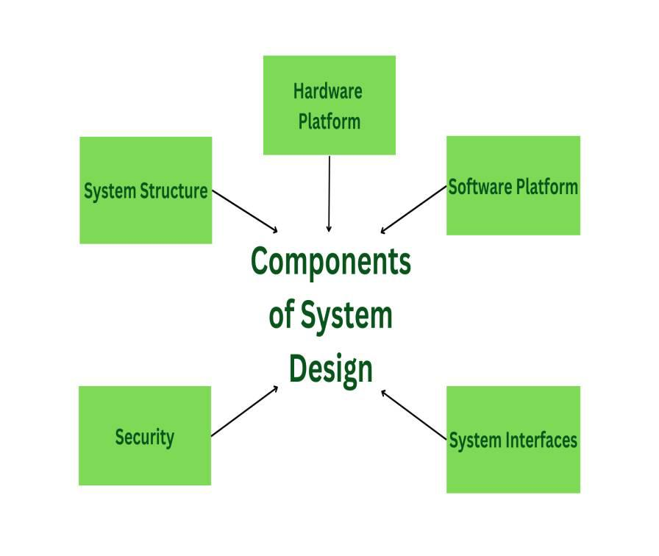

Slide 5
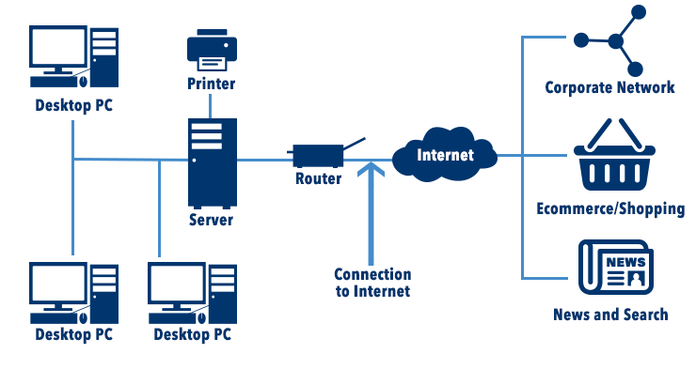

Slide 6
Example:
A company plans to develop a mobile banking application. Before programmers begin building all features, the technical team prepares the system architecture.
They decide that the system will include a mobile application, API layer, authentication service, transaction-processing module, customer database, security controls, and cloud infrastructure.
For example, when a customer transfers money, the mobile application sends the request to the API, the authentication service verifies the user, the transaction module processes the payment, and the database records the transaction.
System architecture preparation typically includes:
System components — identifying the major modules and services.
Data architecture — deciding how information will be stored and accessed.
Integration design — defining how different systems communicate.
Security architecture — planning authentication, access control, and data protection.
Scalability planning — ensuring the system can handle future growth.
Technology selection — choosing suitable platforms, databases, cloud services, and frameworks.

Slide 7
2. Environment Setup and Configuration
Deployment requires preparing development, testing, staging, and production environments. Each environment must be configured with consistent settings, security controls, and version management. Proper setup ensures reliable testing, minimizes configuration drift, and supports seamless transitions from development to live systems.
preparing the software, hardware, tools, databases, networks, and settings required for a development team to build, test, and run a digital system correctly.

Slide 8
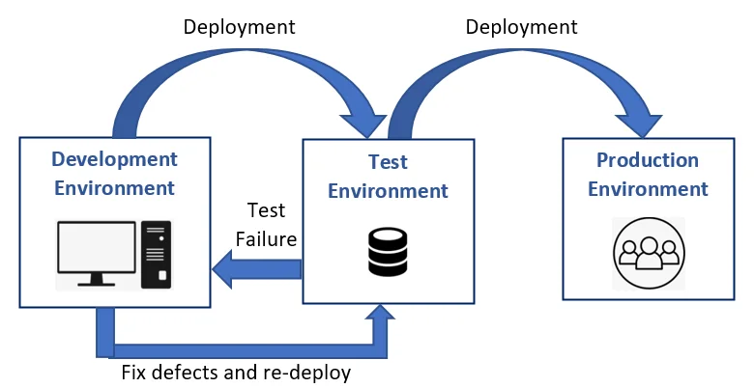

Slide 9
Example:
A team is developing a mobile banking application. Before developers start programming, they prepare a development environment by installing the required programming tools, databases, APIs, security settings, and cloud services.
For example, the team creates separate environments for development, testing, and production. Developers first build the money-transfer feature in the development environment. It is then moved to the testing environment, where security and functionality are checked. After successful testing, the feature is deployed to the production environment for customers.
Environment setup and configuration includes:
Development tools — installing programming and collaboration tools.
Database configuration — preparing databases and data connections.
Server or cloud setup — configuring computing infrastructure.
Security configuration — setting permissions and access controls.
Testing environment — creating a safe environment for testing new features.
Production environment — preparing the live system for actual users.

Slide 10
3. Data Migration and Integration
Data migration involves transferring existing data from legacy systems into the new platform. This includes cleaning, validating, mapping, and integrating data sources. A successful migration ensures continuity, accuracy, and compatibility with new features, enabling the system to perform effectively from day one.
moving data from an old system to a new system and connecting different systems so they can exchange and use data correctly.

Slide 11
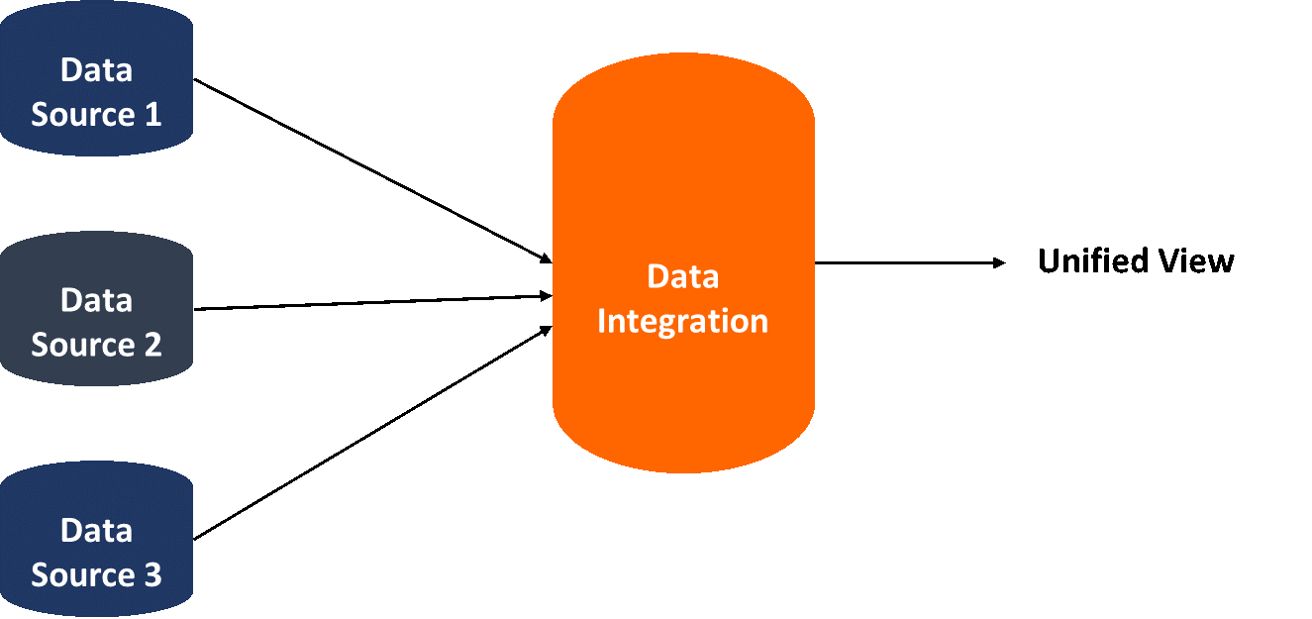

Slide 12
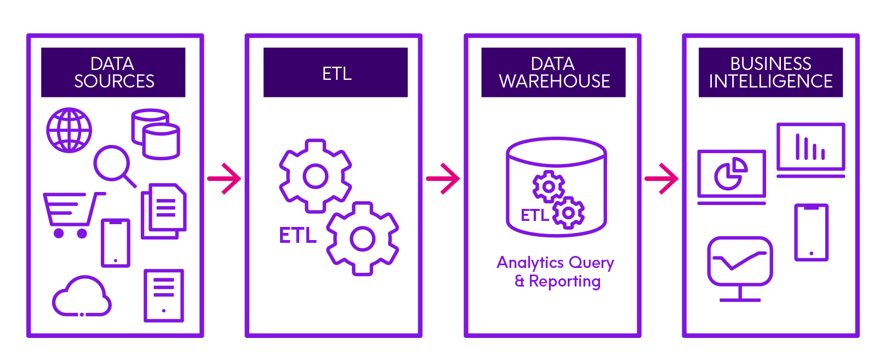
Data Integration

Slide 13
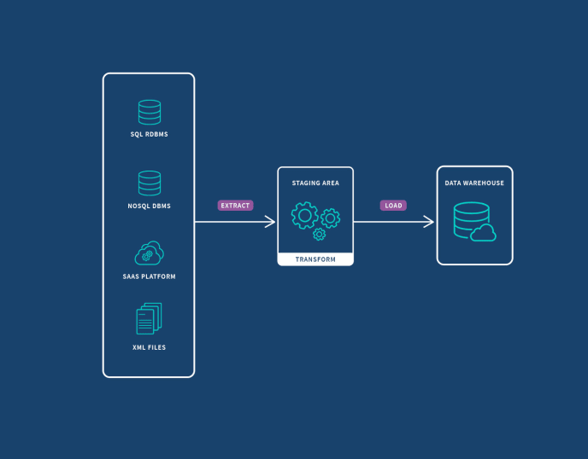

Slide 14
Example:
A bank is replacing its old banking system with a new digital banking platform. The bank needs to transfer existing customer information, including customer profiles, account balances, transaction histories, and payment records, from the old database to the new system.
For example, before launching the new mobile banking application, the technical team extracts customer data from the old system, cleans and validates it, transforms it into the required format, and loads it into the new database. The new platform is also integrated with payment gateways and other banking services through APIs.
Data migration and integration involve:
Data extraction — collecting data from existing systems.
Data cleaning — correcting incomplete, duplicated, or incorrect information.
Data transformation — converting data into the format required by the new system.
Data loading — transferring the prepared data into the new system.
System integration — connecting applications, databases, APIs, and external services.
Data validation — checking that transferred data is accurate and complete.
Security and privacy — protecting sensitive information during migration.

Slide 15
4. API Integration and Connectivity
Modern deployments depend on APIs to communicate between services. Ensuring stable API integration, secure endpoints, authentication, and error handling is essential. Proper connectivity testing ensures smooth data exchange and prevents system downtime caused by broken integrations or incompatible API versions.
connecting different software systems through Application Programming Interfaces (APIs) so they can communicate, exchange data, and perform functions automatically.

Slide 16
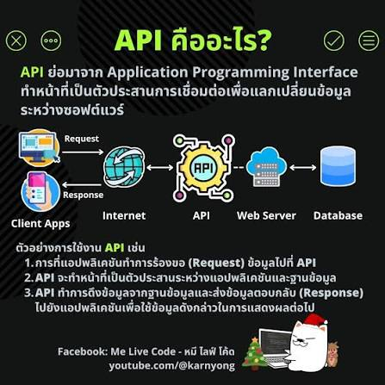
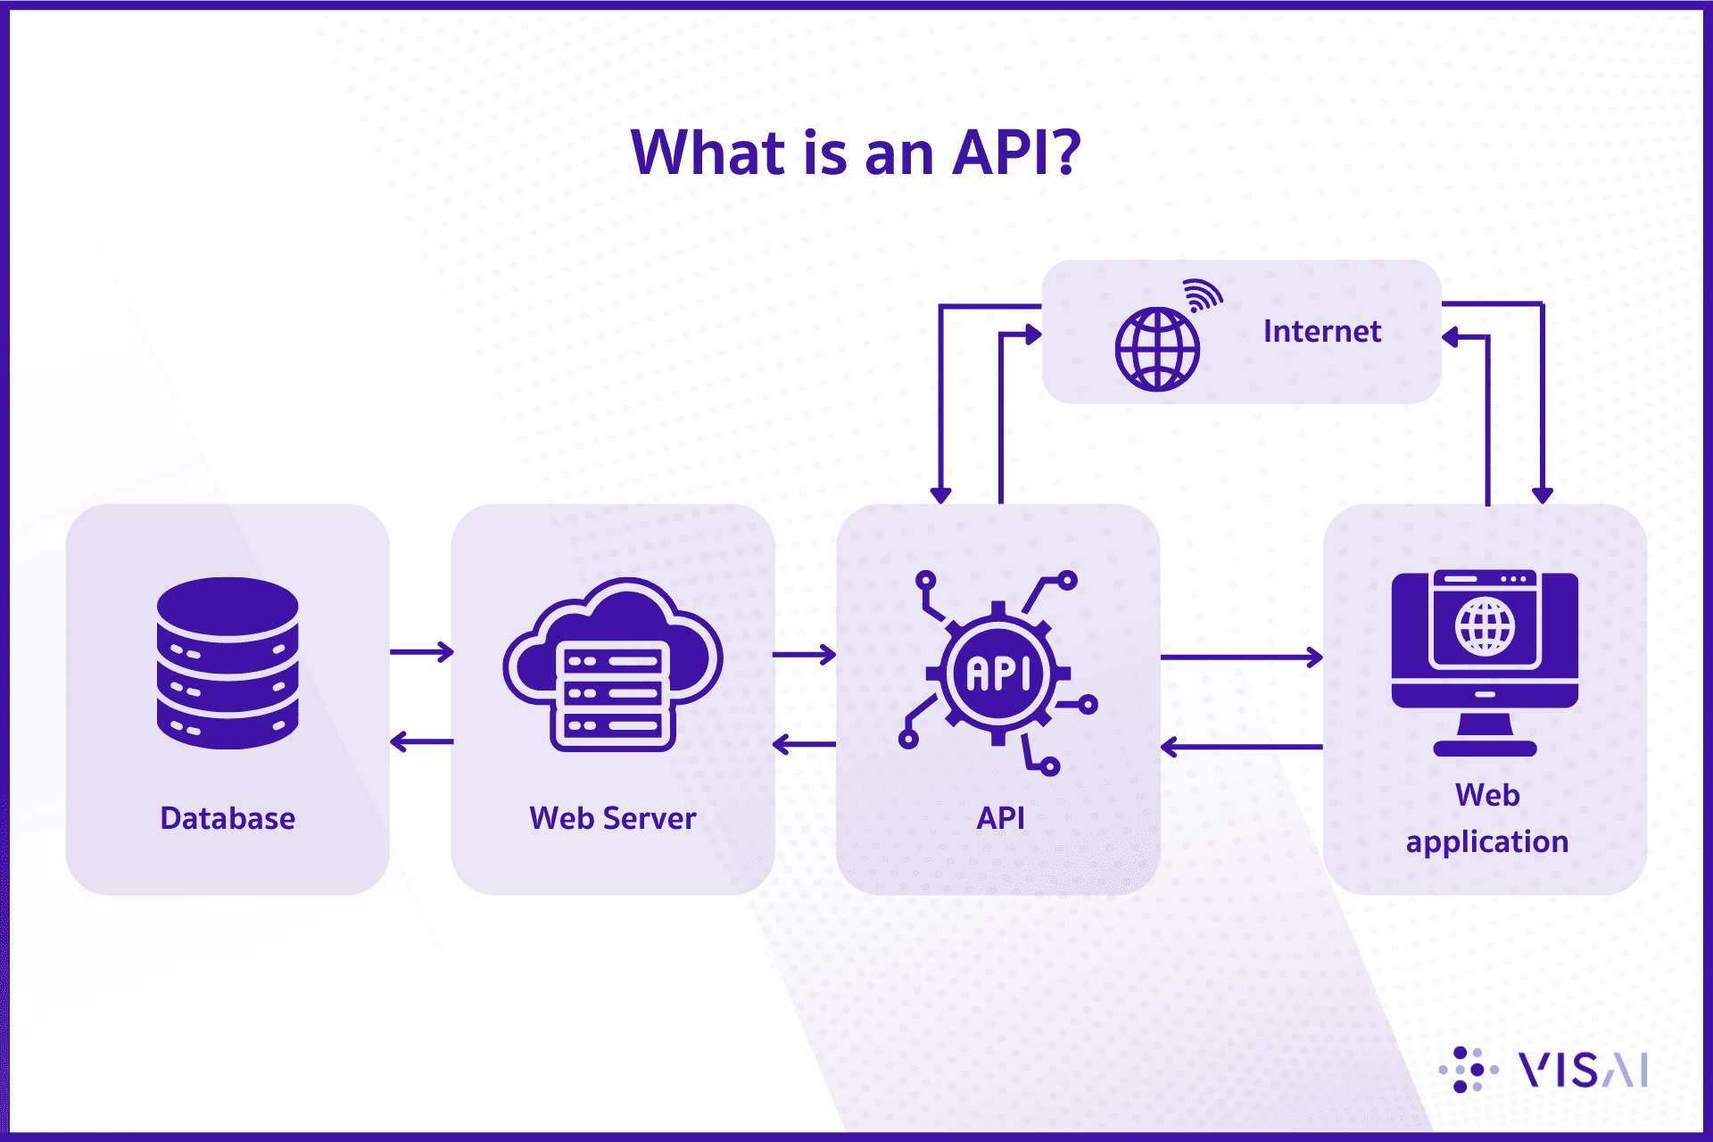

Slide 17
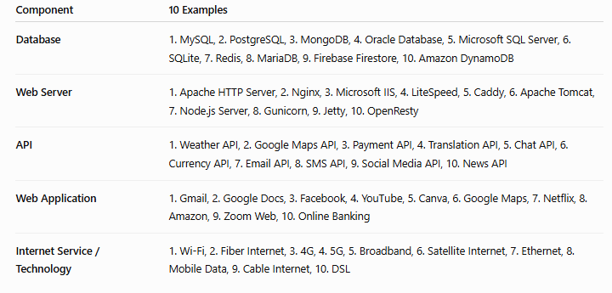

Slide 18
Example:
A company is developing a mobile banking application. The application needs to connect with external services such as payment gateways, identity verification systems, currency exchange services, and notification platforms.
For example, when a customer transfers money, the mobile banking application sends transaction information through an API to the payment system. The payment system processes the transaction and sends the result back to the application. The customer then receives a confirmation message.
API integration and connectivity support:
Data exchange — applications can send and receive information.
System connectivity — different platforms can work together.
Automation — information can move between systems without manual work.
Real-time services — systems can provide updated information immediately.
Third-party integration — applications can use external services and capabilities.
Scalability — new services can be connected as the system grows.
Security — authentication and authorization help protect API communication.

Slide 19
5. Security Implementation
Security measures—such as encryption, authentication, authorization, and vulnerability testing—must be integrated before deployment. Implementing security at every layer protects data, prevents attacks, and ensures compliance with standards. A secure system builds user trust and reduces long-term operational risks.
applying security measures, technologies, and procedures to protect a digital system, its data, and its users from unauthorized access, cyberattacks, and other security threats.

Slide 20
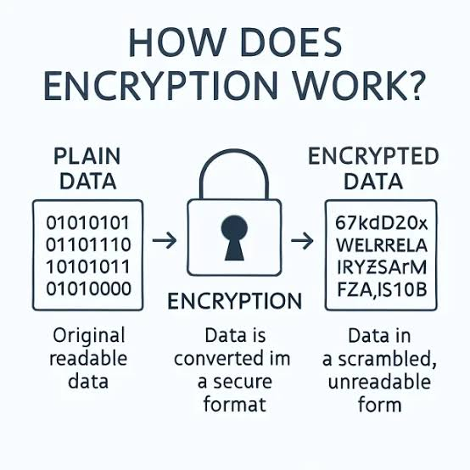
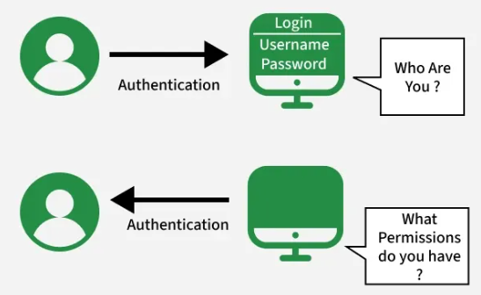

Slide 21
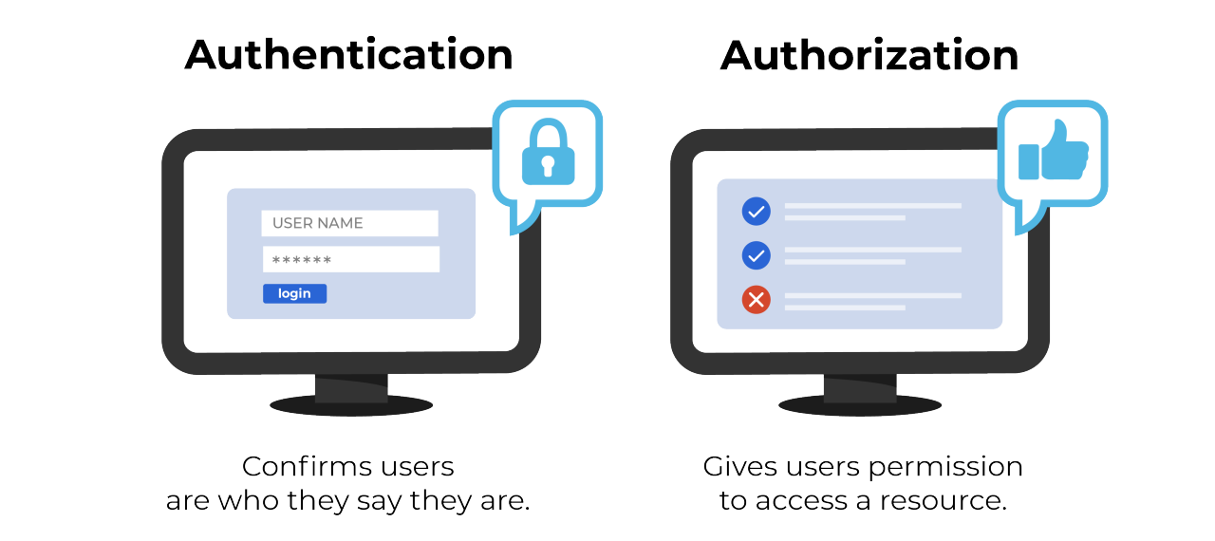

Slide 22


Slide 23
Example:
A bank is developing a mobile banking application. Because the application handles sensitive customer and financial information, the development team implements several security controls before releasing it.
For example, when a customer logs in, the system requires multi-factor authentication (MFA). Customer information is encrypted, and access controls ensure that users can only access authorized information. The system also monitors unusual activities, such as repeated failed login attempts.
Security implementation includes:
Authentication — verifying that users are who they claim to be.
Authorization — controlling what each user is allowed to access.
Data encryption — protecting sensitive information during storage and transmission.
Access control — restricting access to systems and data.
Security testing — identifying vulnerabilities before deployment.
Threat monitoring — detecting suspicious activities and potential attacks.
Backup and recovery — protecting information against loss or system failure.

Slide 24
Thanks

Slide 25
6. Performance Optimization
Optimization ensures the deployed system runs efficiently under real-world workloads. Techniques include load balancing, caching, query optimization, and resource tuning.
Performance tuning improves speed, responsiveness, and stability, ensuring high user satisfaction and effective system operation at scale.
improving a digital system so that it operates faster, uses resources efficiently, handles more users, and provides a better user experience.
Optimization is the process or methodology of making something as functional, perfect, or effective as possible.

Slide 26
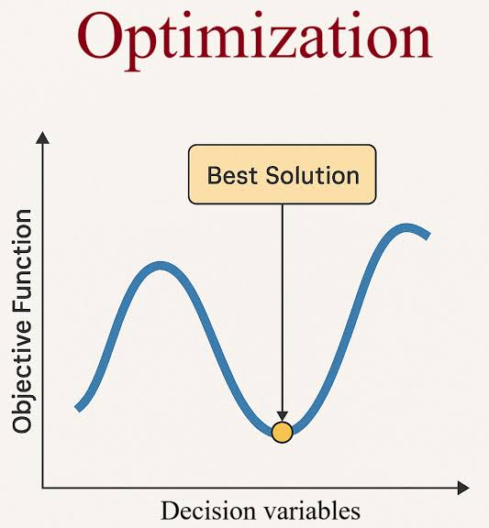
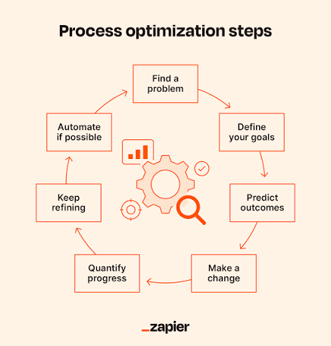

Slide 27


Slide 28
Performance tuning is the systematic process of improving system, software, or engine efficiency by identifying and removing bottlenecks.
Key Steps in Performance Tuning
Measure: Record baseline metrics to understand current behavior.
Identify: Find the specific constraint or bottleneck slowing down the system.
Modify: Adjust code, configuration, or hardware parameters to fix the issue.
Verify: Test again to confirm the change improved performance.

Slide 29
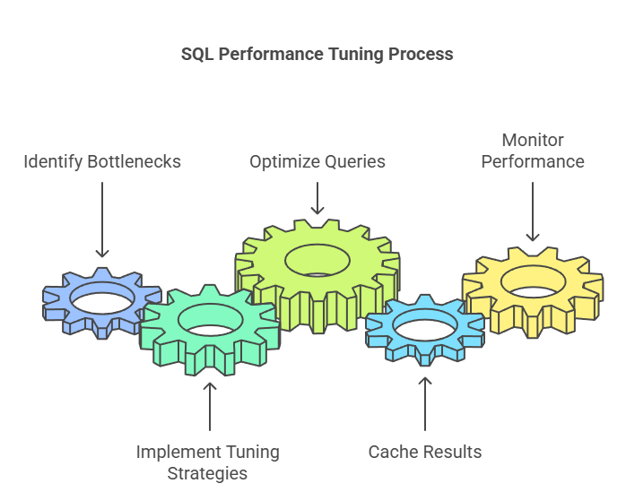
SQL Performance Tuning: How to Optimize Your Database Performance

Slide 30
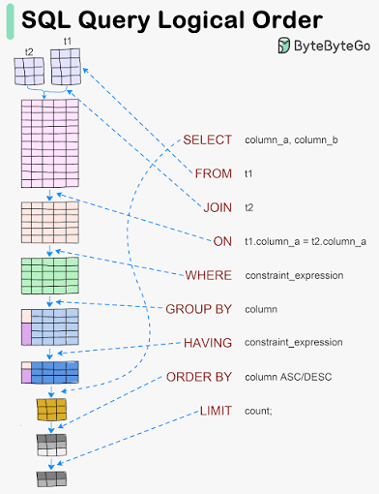

Slide 31
Example:
A bank operates a mobile banking application. During busy periods, such as payday, thousands of customers may log in simultaneously. Users begin experiencing slow loading times when checking balances or transferring money.
The development team analyzes the system and discovers that database queries are taking too long. They optimize the database, introduce caching, improve the application code, and adjust cloud resources. After these changes, transaction processing becomes faster and the system can support more simultaneous users.
Performance optimization includes:
Code optimization — improving software efficiency (faster).
Database optimization — making data retrieval faster.
Caching — temporarily storing frequently requested information.
Load balancing — distributing workloads across multiple servers.
Resource optimization — efficiently managing CPU, memory, storage, and network resources.
Scalability improvement — preparing the system for increasing numbers of users.
Performance monitoring — continuously measuring speed and system behavior.

Slide 32
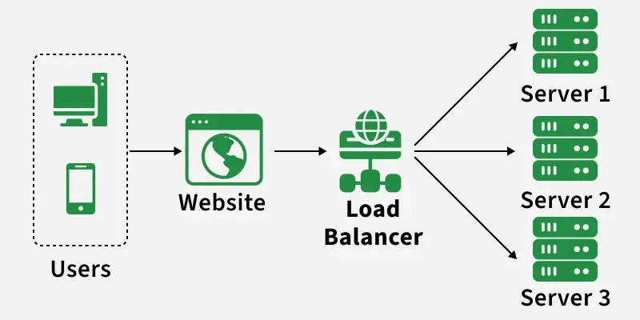

Slide 33


Caching
Caching
ตู้เย็นก็คือ Caching หรือเป็น local storage

Slide 34
7. Testing and Quality Assurance
Thorough testing—unit, integration, system, and user acceptance testing—validates the system’s functionality and performance. QA ensures all components work reliably before release. Effective testing reduces bugs, prevents failures, and increases the overall quality of the deployed solution.
checking a digital system to ensure that it works correctly, meets user requirements, performs reliably, and is free from critical errors before being released.

Slide 35
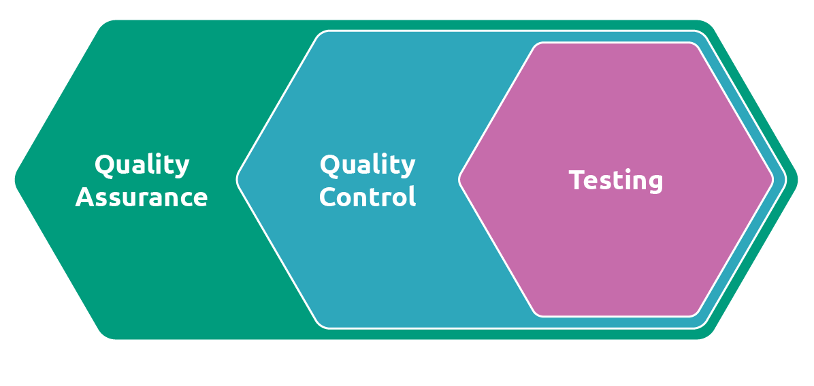

Slide 36
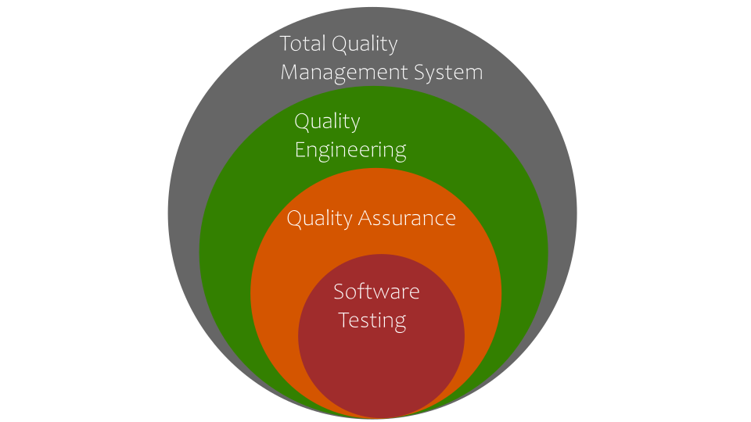

Slide 37
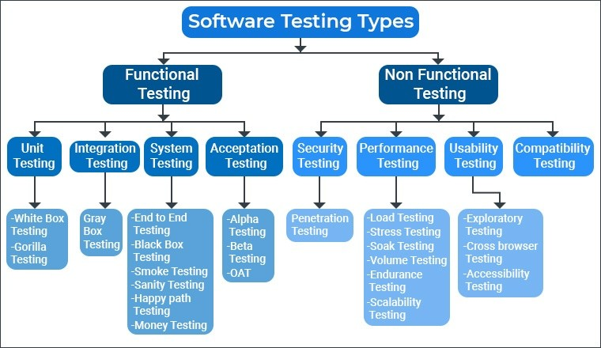

Slide 38
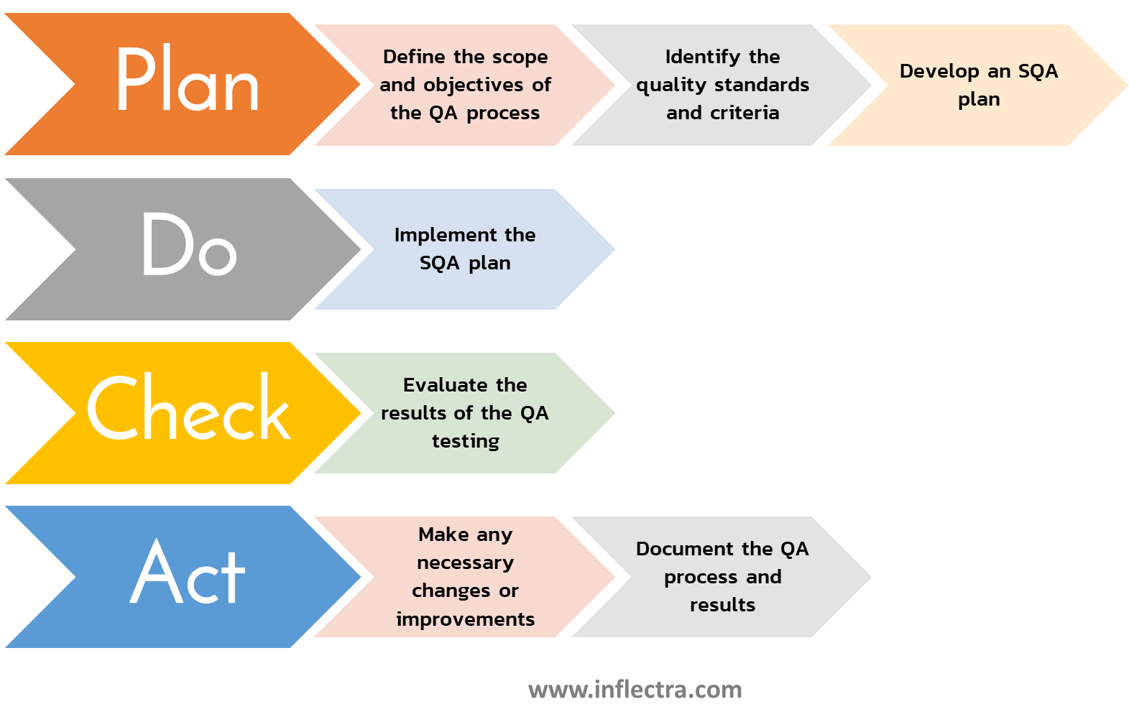
Software Quality Assurance

Slide 39
Example:
A bank is preparing to launch a new mobile banking application. Before release, the QA team tests important functions such as user login, balance checking, money transfers, bill payments, and transaction notifications.
For example, testers check whether a customer can transfer 5,000 baht from one account to another. They verify that the correct amount is deducted, the receiving account gets the money, and both users receive accurate transaction information. If an error occurs, it is reported to the development team for correction and then tested again.
Testing and Quality Assurance include:
Functional testing — verifies that features work correctly.
Usability testing — checks whether the system is easy to use.
Performance testing — determines whether the system performs well under different workloads.
Security testing — identifies vulnerabilities and security problems.
Integration testing — ensures different systems and APIs work together.
User Acceptance Testing (UAT) — confirms that the system meets users' and business requirements.
Regression testing — ensures new changes do not break existing functions.

Slide 40
8. Deployment Strategy and Automation
Deployment strategies like rolling updates, blue-green deployment, and continuous integration/continuous deployment (CI/CD) ensure smooth releases.
Automation reduces human error, speeds up deployment, and enhances consistency across environments. A strong strategy ensures predictable and safe system rollout.
planning how new software or system updates will be released and using automated tools to make the deployment faster, safer, and more consistent.

Slide 41
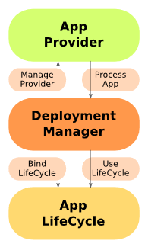
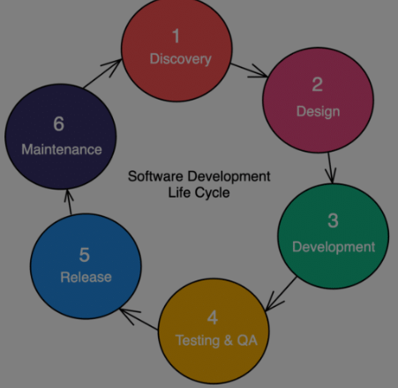

Slide 42
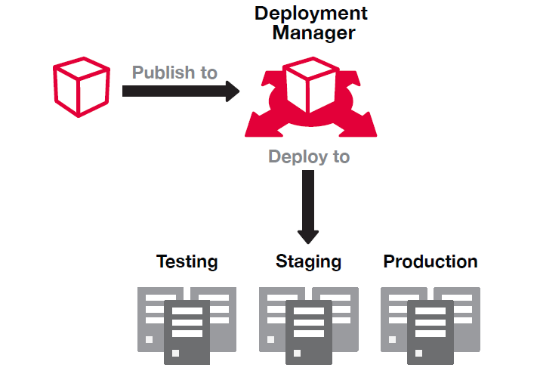

Slide 43
Example:
A bank is preparing to release a new version of its mobile banking application. Instead of releasing the update manually to all users at once, the development team uses a gradual deployment strategy.
For example, the new version is first released to 10% of users. Automated monitoring checks system performance, transaction errors, and application crashes. If the system operates correctly, the update is gradually released to more users. If serious problems appear, the deployment can be stopped or rolled back to the previous stable version.
Deployment strategy and automation include:
Continuous Deployment/Delivery (CI/CD) — automates software building, testing, and release.
Phased deployment — releases updates gradually to reduce risk.
Automated configuration — ensures environments are configured consistently.
Automated testing — checks software before deployment.
Monitoring — tracks system performance after release.
Rollback mechanisms — restores the previous version when serious problems occur.
Version control — manages different versions of software.

Slide 44
9. Monitoring and Logging Setup
Deployments require monitoring tools and logging systems to track performance, errors, and user activities. These tools help detect issues early, support troubleshooting, and improve system stability. Effective monitoring ensures the system remains healthy and reliable after launch.
configuring tools and processes to continuously observe a digital system’s performance, record important activities, and detect problems after deployment.

Slide 45
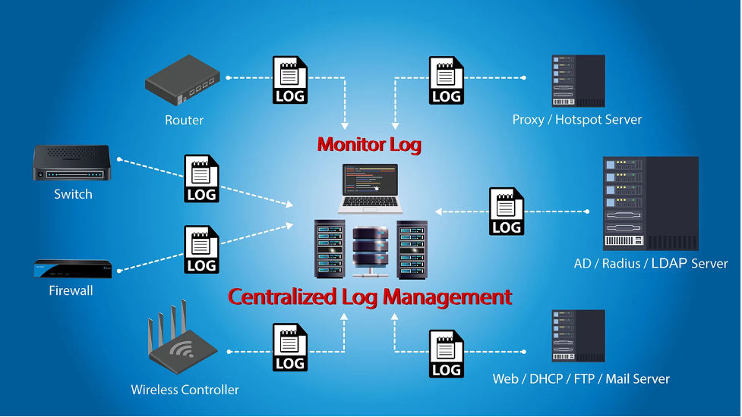
collecting system metrics and aggregating application logs into centralized dashboards for real-time visibility and troubleshooting.
กระบวนการติดตั้งและกำหนดค่าระบบเพื่อติดตามสถานะ (Monitoring) และบันทึกเหตุการณ์ (Logging) ของระบบคอมพิวเตอร์หรือแอปพลิเคชันแบบเรียลไทม์ เพื่อให้ผู้ดูแลระบบรู้เท่าทันปัญหาและวิเคราะห์ความผิดพลาดได้รวดเร็ว

Slide 46
Example:
A bank operates a mobile banking application used by thousands of customers. The technical team sets up monitoring and logging to track login attempts, transaction processing, system errors, API response times, server performance, and unusual activities.
For example, the monitoring system detects that money-transfer transactions are suddenly taking 10 seconds instead of the normal 2 seconds. At the same time, system logs show repeated database connection errors. The technical team uses this information to quickly identify the cause and fix the database problem.
Monitoring and logging setup includes:
Performance monitoring — tracks response time, CPU, memory, and network usage.
Application monitoring — observes application behavior and errors.
Transaction logging — records important system activities and transactions.
Error logging — records technical errors for investigation.
Security monitoring — detects suspicious activities and unauthorized access attempts.
Automated alerts — informs the technical team when problems occur.
Log analysis — uses recorded information to identify causes of problems.

Slide 47
10. User Training and Change Management
Successful deployment includes preparing users through training, manuals, and support resources. Change management ensures users adapt to new workflows and system features. Proper user onboarding reduces resistance, improves adoption, and maximizes the system’s impact in real operational settings.
helping users understand, accept, and effectively use a new digital system while managing the transition from old processes to new ways of working.

Slide 48
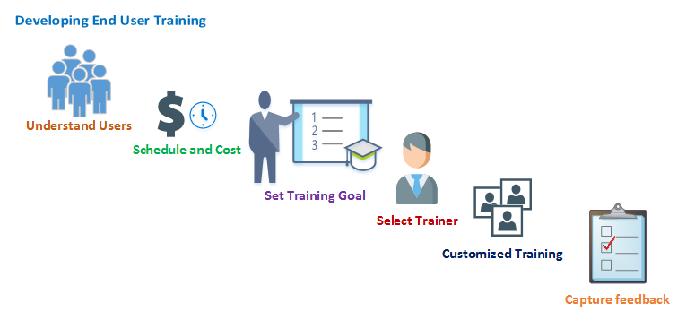

Slide 49


Slide 50
Example:
A bank introduces a new digital banking system for its employees. Previously, employees used an older system to manage customer accounts and transactions. Because the new system has different functions and workflows, employees need support before and after implementation.
For example, the bank provides training workshops, video tutorials, user manuals, and hands-on practice sessions. At the same time, managers explain why the new system is being introduced, communicate its benefits, collect employee feedback, and provide technical support during the transition.
User training and change management include:
Training programs — teaching users how to operate the new system.
Communication — explaining the purpose, benefits, and impact of the change.
User manuals and tutorials — providing learning materials and guidance.
Stakeholder engagement — involving users and managers in the change process.
Feedback collection — identifying user concerns and difficulties.
Resistance management — addressing concerns about adopting new technology.
Ongoing support — helping users after the system is launched.

Slide 51
Thanks

