Slide 1
Chapter 12 Continuous improvement
Assoc. Prof. Dr. Thacha Lawanna

Slide 2
Objective of the Study:
To analyze and understand the principles, methods, and iterative processes of continuous improvement that enable organizations to enhance performance, optimize workflows, and achieve long-term efficiency and innovation.

Slide 3
1. Kaizen Philosophy
Kaizen emphasizes ongoing, small improvements involving everyone in the organization. It encourages employees to consistently identify inefficiencies, suggest enhancements, and take ownership of outcomes. This philosophy builds a culture of continuous learning, teamwork, and incremental progress that collectively leads to significant long-term organizational transformation and sustained competitiveness.
making small, regular improvements to processes, products, and work practices rather than waiting for one major change.

Slide 4
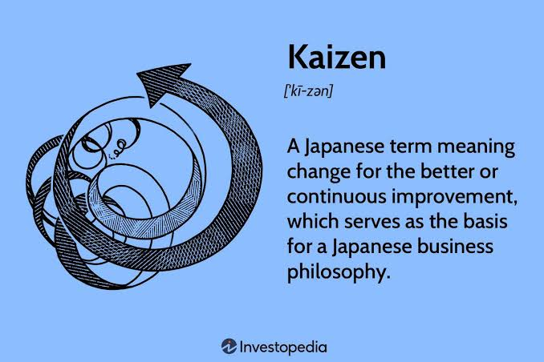
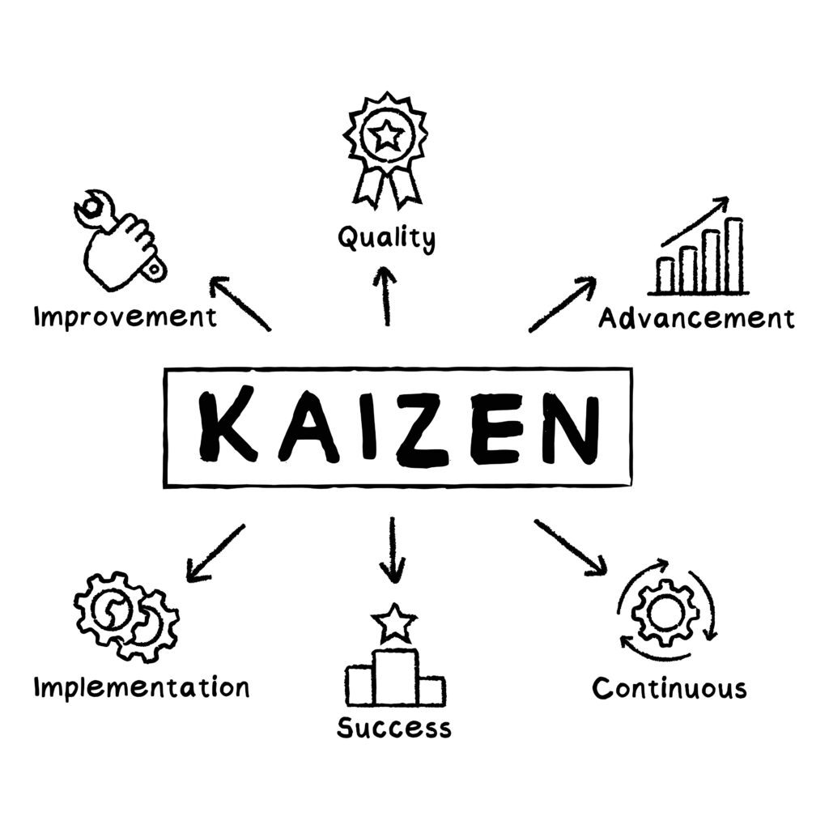

Slide 5
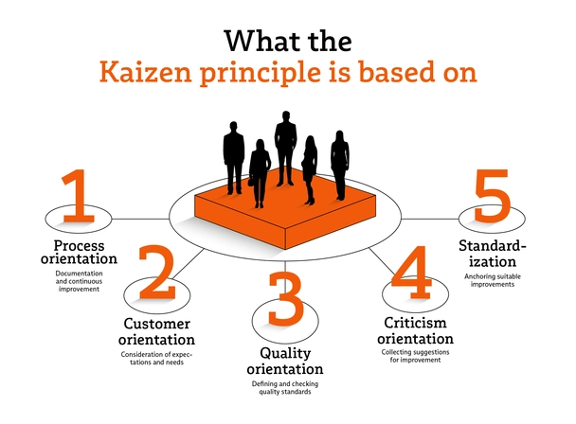

Slide 6
Example:
A company operates a mobile banking application. Instead of completely redesigning the application every year, the team continuously looks for small improvements based on customer feedback and system data.
For example, customers report that the money-transfer process takes too many steps. The team reduces the process from five steps to four steps. Later, they improve the confirmation screen and make transaction information easier to understand. Each small improvement contributes to a better overall customer experience.
Kaizen emphasizes:
Continuous improvement — improvement is an ongoing activity.
Small changes — many small improvements can create significant results.
Employee participation — everyone can suggest improvements.
Problem solving — teams identify and eliminate causes of inefficiency.
Customer focus — improvements should create greater value for users.
Waste reduction — unnecessary activities, time, and resources are minimized.
Standardization — successful improvements become part of normal working practices.

Slide 7
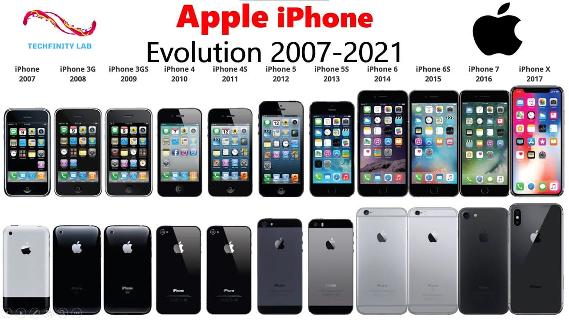

Slide 8
2. PDCA Cycle (Plan–Do–Check–Act)
The PDCA cycle provides a structured, iterative approach to problem-solving and improvement. Teams plan a change, implement it on a small scale, evaluate results, and standardize successful solutions. This cycle supports learning from experiments, reducing risk, and driving consistent performance enhancement over time through systematic adjustments.
continuous improvement method used to identify problems, test solutions, evaluate results, and make successful improvements part of normal operations.

Slide 9
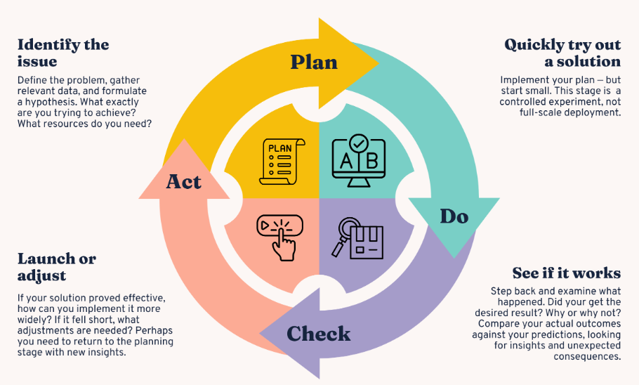

Slide 10
Example:
A bank discovers that customers are taking too long to complete money transfers through its mobile banking application. The development team applies the PDCA cycle to improve the process.
Plan — Analyze customer feedback and identify that the transfer process has too many steps. The team plans to reduce it from five steps to three steps.
Do — Develop the simplified transfer process and test it with a small group of users.
Check — Compare results before and after the change. For example, average completion time decreases from 90 seconds to 50 seconds.
Act — If the new design is successful, implement it for all users and make it the new standard. If results are unsatisfactory, revise the solution and repeat the cycle.

Slide 11
3. Root Cause Analysis (RCA)
Root Cause Analysis identifies the underlying causes of problems rather than focusing on symptoms. Tools like the 5 Whys and Fishbone Diagram help teams explore issues deeply. Eliminating root causes prevents recurring problems, improves reliability, and strengthens operational processes, resulting in more sustainable solutions and performance stability.
Root Cause Analysis (RCA) is a problem-solving method used to identify the fundamental cause of a problem rather than only fixing its symptoms. The objective is to prevent the same problem from happening again.

Slide 12
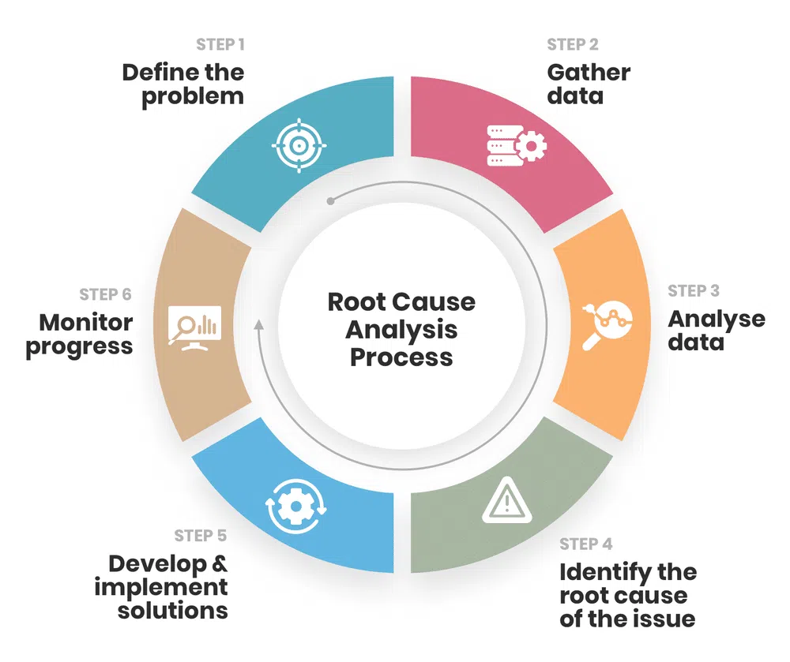

Slide 13
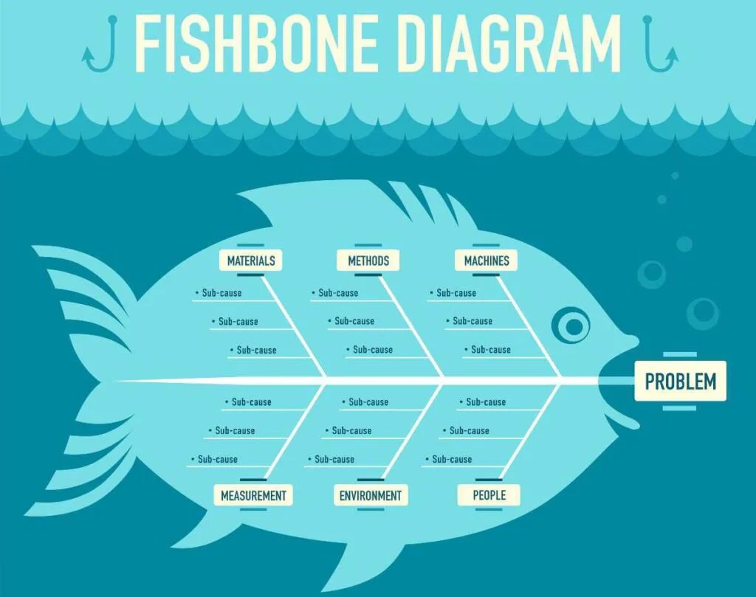

Slide 14
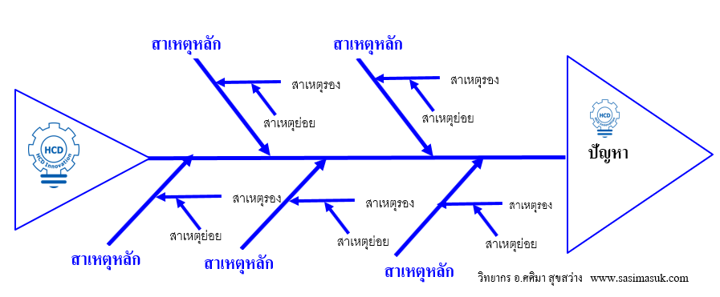
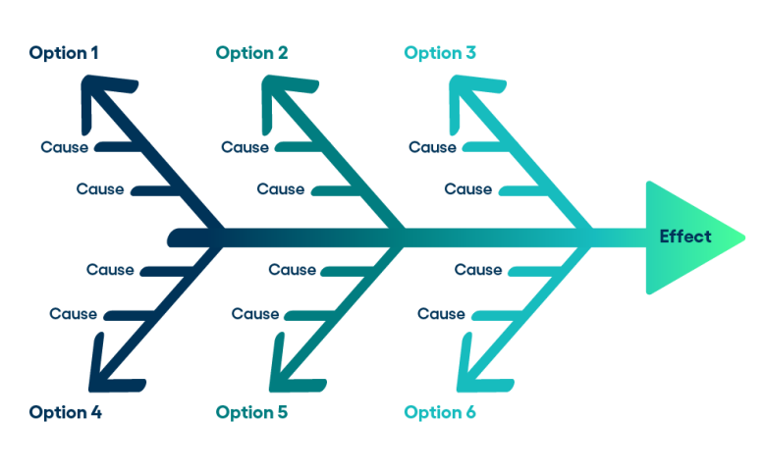

Slide 15
?
?
?
?
?
?
Thailand-China
logistics
?
?
?
?
?
?
?>main cause
?> sub

Slide 16
Create and explain “fishbone diagram” as Root Cause Analysis
for continuous improvement in term of design thinking concept when
Problem is about “long queue at public hospital”

Slide 17
Example:
A bank discovers that customers are frequently experiencing failed money transfers in its mobile banking application.
Instead of simply asking customers to retry the transaction, the technical team conducts RCA.
Problem: Customers experience failed money transfers.
Immediate symptom: The application displays a “Transaction Failed” message.
Investigation: The team analyzes system logs and transaction data.
Root cause: The payment API frequently times out during periods of high transaction volume.
Solution: The team improves API timeout handling, increases system capacity, and introduces automatic retry mechanisms.
Result: The number of failed transactions decreases significantly.

Slide 18
4. Lean Thinking
Lean focuses on creating value for customers by reducing waste in processes. It eliminates activities that do not add value, enhances workflow efficiency, and improves quality. Lean encourages continuous assessment of operations to streamline tasks, shorten cycle times, and optimize resource utilization for greater productivity and customer satisfaction.
creating maximum value for customers while minimizing waste, unnecessary activities, time, and resources.

Slide 19
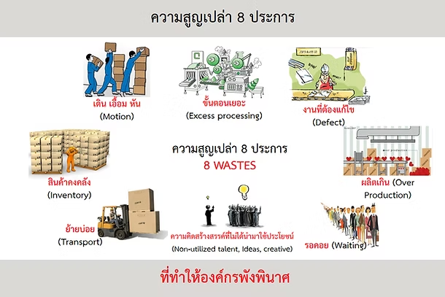

Slide 20
Example:
A bank examines the customer account-opening process in its mobile banking application. Customers currently need to complete 10 steps, including entering some information more than once.
Using Lean Thinking, the team analyzes each step and discovers that several activities do not add value. The team removes duplicated data entry, automates identity verification, and simplifies the process from 10 steps to 6 steps.
As a result, customers can open accounts faster, employees spend less time correcting information, and the bank reduces operating costs.
Lean Thinking emphasizes:
Customer value — focus on activities that provide value to customers.
Waste elimination — remove unnecessary steps, delays, errors, and duplication.
Process flow — make work move smoothly from beginning to end.
Pull principle — perform work according to actual customer demand.
Continuous improvement — regularly identify opportunities to improve processes.
Employee involvement — encourage employees to identify and solve problems.

Slide 21
5. Six Sigma Methodology
Six Sigma uses data-driven techniques to reduce process variability and defects. Its DMAIC framework helps organizations analyze performance, control deviations, and achieve measurable improvement. By applying statistical tools, Six Sigma enhances product quality, minimizes errors, and strengthens decision-making, promoting continuous and predictable operational excellence.
Six Sigma is a data-driven methodology for improving process quality by identifying and reducing defects, errors, and variations. It emphasizes measurable evidence rather than assumptions.
A common Six Sigma framework is DMAIC: Define, Measure, Analyze, Improve, and Control.

Slide 22
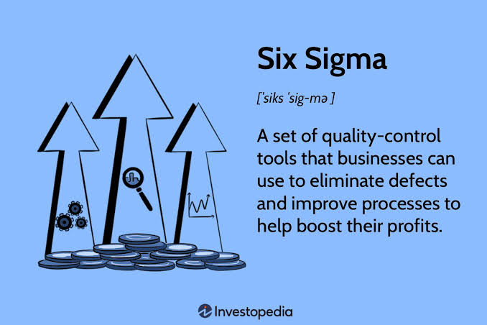
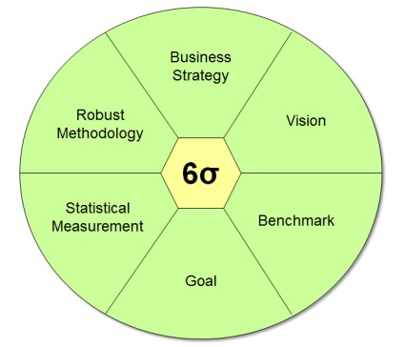

Slide 23
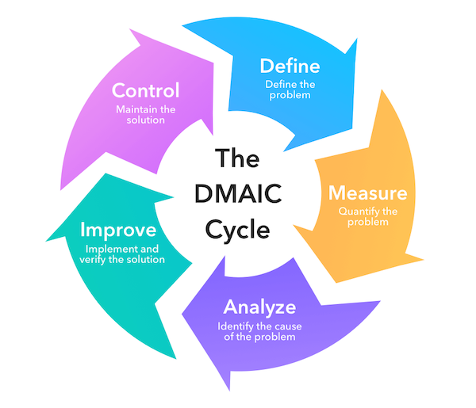

Slide 24
Example:
A bank discovers that some customers experience failed money transfers in its mobile banking application. The bank uses Six Sigma to improve the process.
Define — Identify the problem: too many failed digital transactions.
Measure — Collect data and find that 5% of transactions fail.
Analyze — Examine transaction data and discover that many failures are caused by payment API timeouts.
Improve — Optimize API connections, introduce automatic retries, and improve server capacity.
Control — Continuously monitor transaction failure rates to ensure the improvement is maintained.
After improvement, for example, the transaction failure rate decreases from 5% to 1%.
Six Sigma emphasizes:
Data-driven decisions — uses measurable evidence.
Defect reduction — minimizes errors and failures.
Process consistency — reduces variation in performance.
Root cause identification — finds the underlying causes of problems.
Customer satisfaction — improves quality from the customer's perspective.
Continuous monitoring — ensures improvements are maintained.

Slide 25
Thanks

Slide 26
6. Benchmarking
Benchmarking compares an organization’s performance with industry leaders or competitors. It helps identify gaps, adopt best practices, and set realistic improvement targets. By studying high-performing organizations, companies learn effective strategies that can be adapted to their own context, driving continuous growth, innovation, and competitive advantage.
Benchmarking is a systematic process of comparing an organization’s products, services, processes, or performance with high-performing organizations or established standards to identify opportunities for improvement.

Slide 27
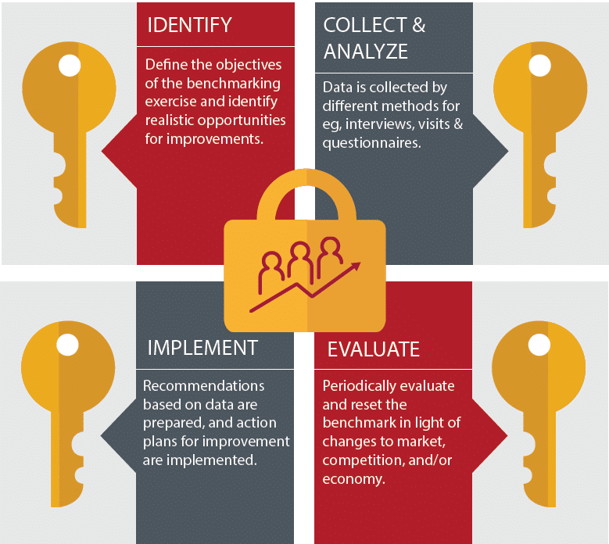

Slide 28
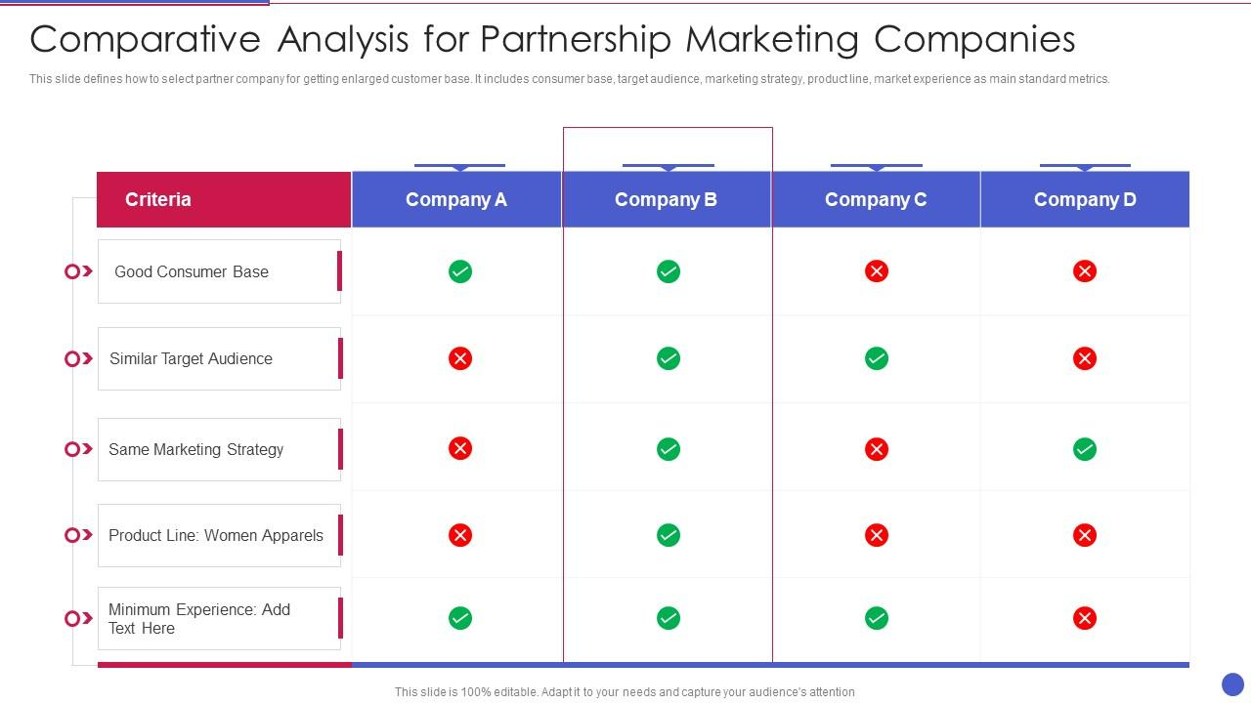

Slide 29
Example:
A bank wants to improve the speed of its mobile banking application. It discovers that customers need an average of 90 seconds to complete a money transfer.
The bank compares its performance with leading digital banking applications and finds that similar transactions can be completed in approximately 45 seconds. The development team studies the differences and identifies unnecessary steps in its transfer process. After redesigning the process, the average transaction time decreases to 50 seconds.
Benchmarking can include:
Internal benchmarking — comparing departments, branches, or teams within the same organization.
Competitive benchmarking — comparing performance with direct competitors.
Functional benchmarking — comparing a particular function with organizations that perform it well.
Best-practice benchmarking — studying leading practices regardless of industry.
Performance benchmarking — comparing measurable indicators such as cost, speed, quality, or customer satisfaction.

Slide 30
7. Continuous Feedback Systems
Continuous feedback mechanisms collect real-time insights from employees, customers, and stakeholders. This information helps identify issues early, evaluate progress, and guide improvements. Feedback loops strengthen communication, enhance responsiveness, and support cultures where learning and refinement are constant, enabling quicker adaptation to changing conditions and expectations.
mechanisms that continuously collect, analyze, and use feedback from users, employees, customers, or digital systems to support ongoing improvement.

Slide 31
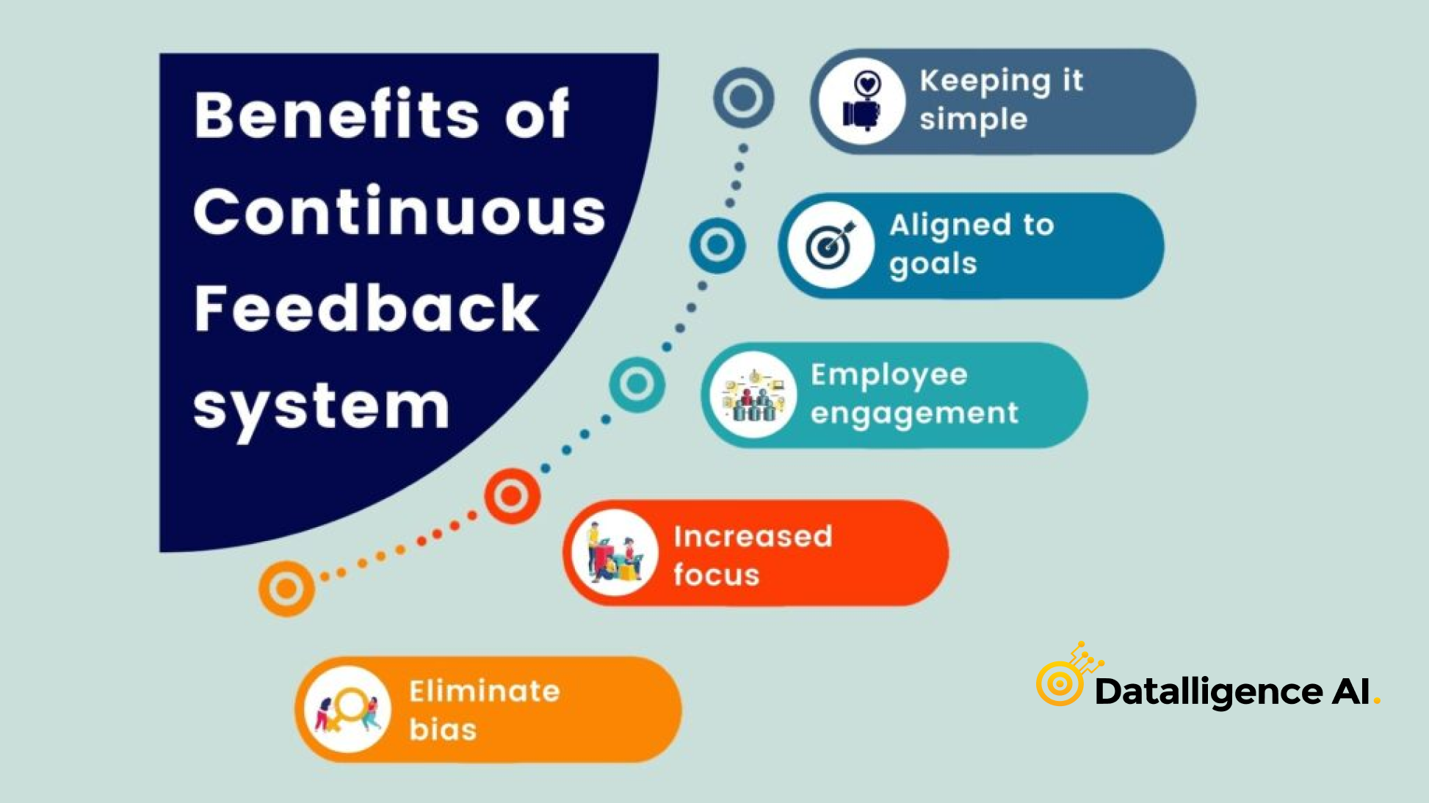

Slide 32
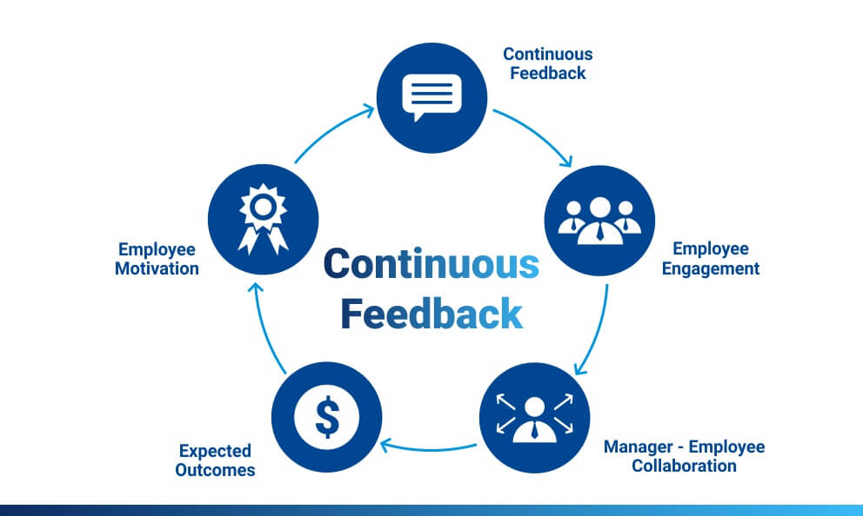

Slide 33
Example:
A bank operates a mobile banking application. After customers complete a money transfer, the application asks them to rate their experience and provide comments.
The bank also automatically collects data such as transaction completion time, error rates, abandoned transactions, and application crashes.
For example, feedback shows that many customers find the money-transfer confirmation page confusing. The development team redesigns the page and releases the improved version. The system then continues collecting feedback to determine whether the change has improved customer experience.
Continuous feedback systems include:
User feedback — ratings, surveys, comments, and complaints.
Real-time analytics — continuously monitors user behavior.
Performance monitoring — tracks system speed, errors, and reliability.
Automated alerts — informs teams when important problems occur.
Feedback analysis — identifies common issues and improvement opportunities.
Rapid response — enables teams to make improvements quickly.
Continuous measurement — evaluates whether changes produce better results.

Slide 34
8. Process Mapping and Analysis
Process mapping visualizes workflows to identify inefficiencies, redundancies, and bottlenecks. By understanding each step clearly, organizations can redesign processes to enhance coherence and performance. Process analysis supports smoother coordination, reduced delays, and improved quality, making it a key tool in continuous improvement initiatives.
a method used to visually represent each step of a business or digital process and analyze it to identify delays, duplication, bottlenecks, errors, and opportunities for improvement.

Slide 35
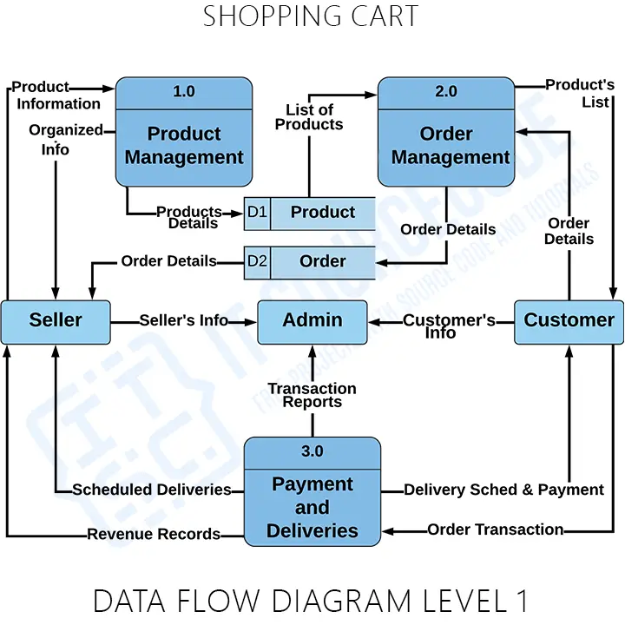

Slide 36
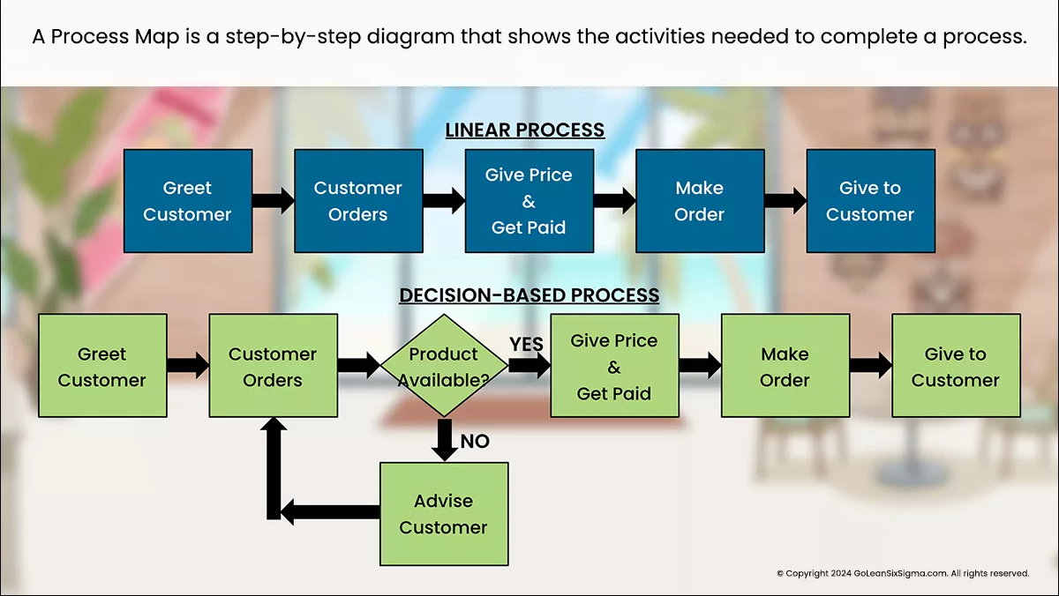

Slide 37
Example:
A bank wants to improve its digital loan application process. The team creates a process map showing every step a customer must complete.
Current process:
Customer Applies → Enter Personal Data → Upload Documents → Staff Review → Credit Check → Manager Approval → Customer Notification
After analyzing the process, the team discovers that employees are manually entering customer information twice, creating delays and increasing the possibility of errors.
The bank improves the process by integrating the systems so that customer information is automatically transferred between departments.
Improved process:
Customer Applies → Upload Documents → Automatic Data Verification → Credit Check → Digital Approval → Customer Notification
Process Mapping and Analysis helps organizations:
Visualize workflows — clearly understand how work moves through a process.
Identify bottlenecks — find stages that cause delays.
Detect duplication — identify unnecessary repeated activities.
Reduce waste — eliminate activities that do not create value.
Clarify responsibilities — show who is responsible for each activity.
Improve efficiency — simplify and automate processes where appropriate.
Standardize processes — establish consistent ways of performing activities.

Slide 38
9. Performance Measurement Metrics
Performance metrics such as KPIs, quality indicators, and efficiency ratios help track organizational progress and identify improvement areas. Regular measurement ensures transparency, accountability, and data-driven decision-making. These metrics enable stakeholders to evaluate trends, set targets, and drive continuous enhancement of operations and outcomes.
quantifiable indicators used to evaluate how effectively and efficiently a system, process, project, or organization is achieving its objectives.

Slide 39
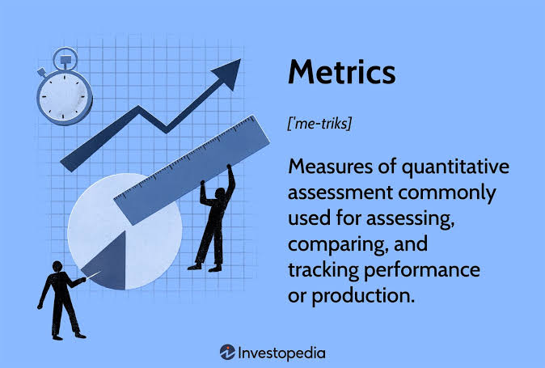

Slide 40
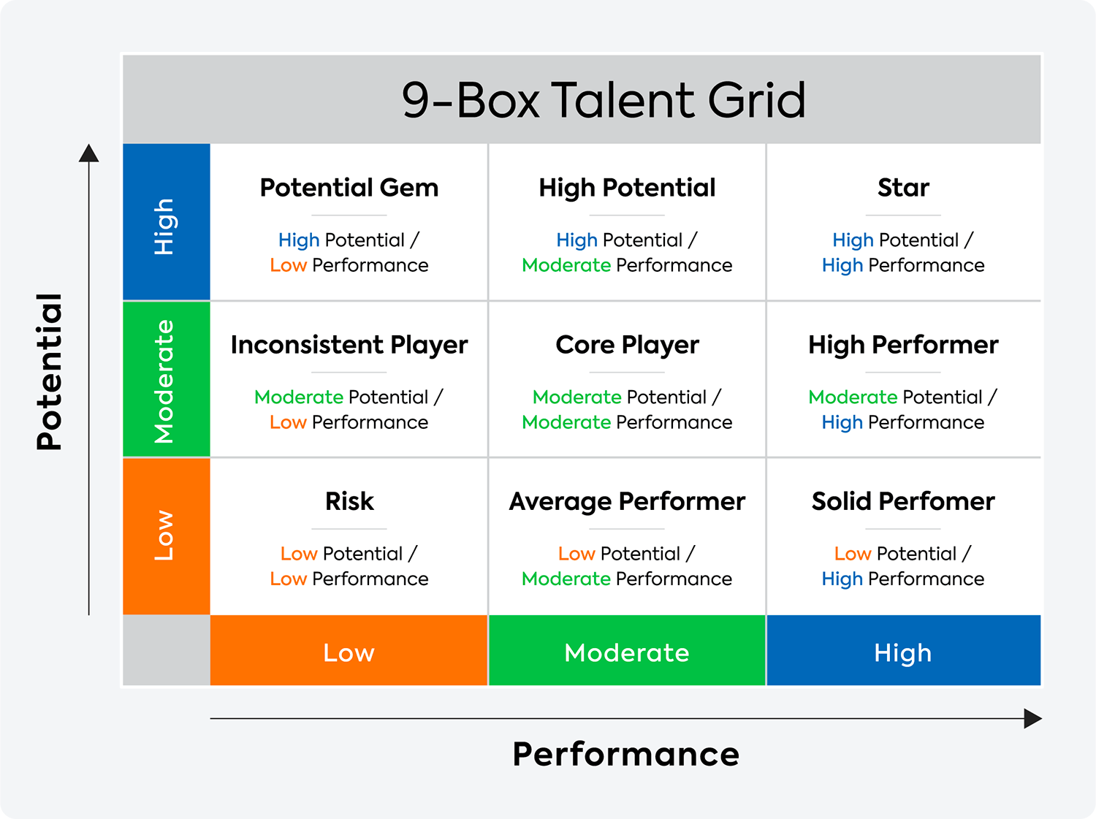

Slide 41
Example:
A bank wants to evaluate the performance of its mobile banking application. Instead of simply assuming that the application is performing well, the bank defines specific metrics and regularly measures them.
For example, the bank may monitor:
Transaction success rate — percentage of transactions completed successfully.
Average response time — how quickly the application responds to users.
Error rate — percentage of transactions or activities that produce errors.
System uptime — percentage of time the application remains available.
Customer satisfaction score — measures users' satisfaction with the service.
Task completion time — measures how long users take to complete activities.
User retention rate — percentage of users who continue using the application.
Cost per transaction — measures the operational cost of processing each transaction.
Simple example:
Suppose the bank sets the following targets:
Transaction Success Rate: Target = 99% → Actual = 97%
Average Response Time: Target = 2 seconds → Actual = 3.5 seconds
Customer Satisfaction: Target = 90% → Actual = 85%

Slide 42
10. Employee Empowerment in Improvement
Employee empowerment encourages workers to participate actively in generating ideas, solving problems, and implementing improvements. Empowered employees are more motivated, creative, and committed to organizational success. Their involvement strengthens continuous improvement efforts by leveraging frontline insights, building ownership, and fostering a collaborative culture of excellence.
giving employees the authority, responsibility, skills, and opportunities to identify problems, suggest solutions, and participate directly in improving organizational processes.

Slide 43
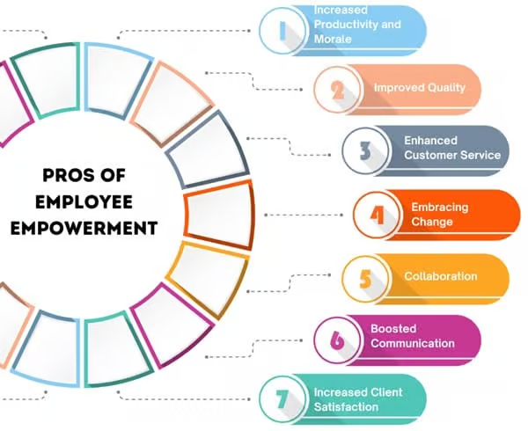

Slide 44
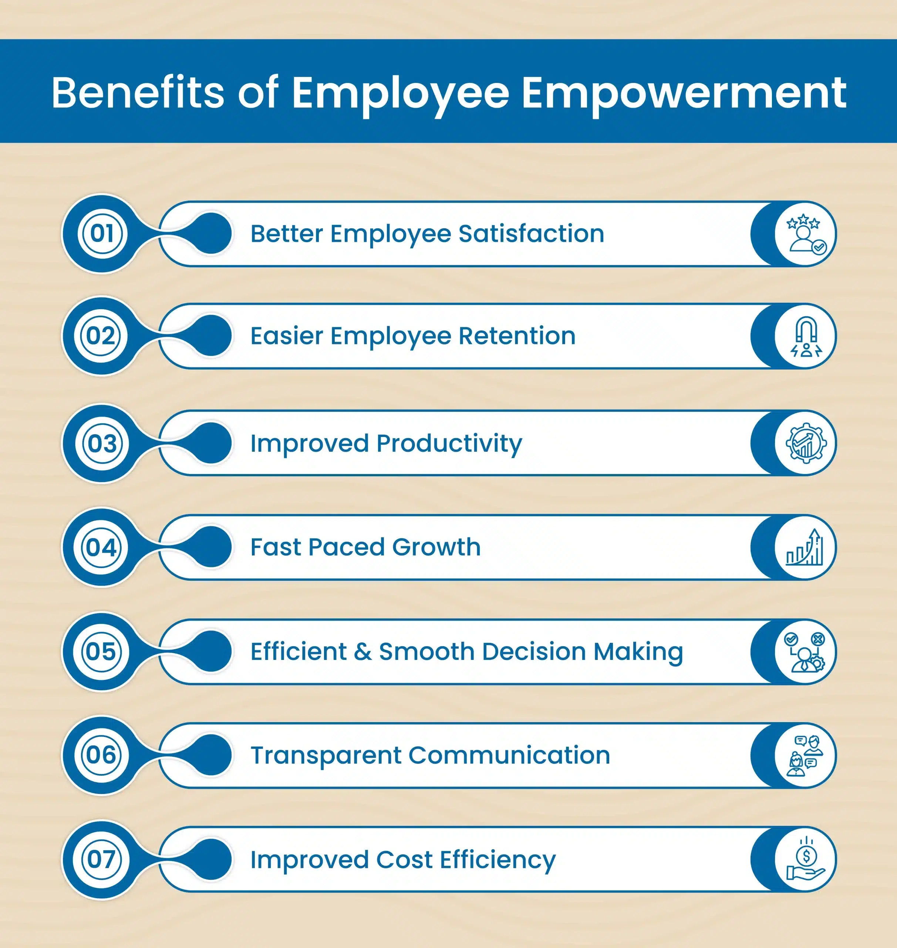

Slide 45
Example:
A bank's customer service employees notice that customers frequently complain about the long process for resetting mobile banking passwords. Because these employees communicate with customers every day, they understand the problem well.
Instead of requiring all improvement ideas to come from senior management, the bank encourages employees to propose solutions. The customer service team suggests introducing automated identity verification and a simpler password-reset process. Management reviews the idea, tests it, and implements the improved process.
As a result, customers can reset their passwords faster, while employees receive fewer repetitive support requests.
Employee empowerment supports improvement through:
Decision-making authority — employees can make appropriate decisions within their responsibilities.
Idea sharing — employees are encouraged to suggest improvements.
Problem-solving participation — employees help identify and solve operational problems.
Training and development — employees receive skills needed to contribute effectively.
Team collaboration — employees work together to improve processes.
Recognition and support — useful improvement ideas are acknowledged and encouraged.
Ownership — employees feel responsible for the quality of their work and processes.

Slide 46
Thanks

