Slide 1
Preliminary analysis of EHR data for studying care networks
Thadryan J. Sweeney

Slide 2
Comments: could be even shorter, read and cite a care density paper as most people in the group haven’t used it. Last meeting on the 21st.

Slide 3
Introduction

Slide 4
Overview
What are some basic dispersion metrics we can infer from the EHRs?
What proportion of patients saw differnt providers of interest?
What is the distribution of weights in the provider-provider network?
What is the distribution of care density in our cohort?
For any of the above, do we observe variation between cancer types?
What is the distribution of weights in the provider-provider network?
What is the distribution of care density in our cohort?
For any of the above, do we observe variation between cancer types?

Slide 5
Table 1

Slide 6
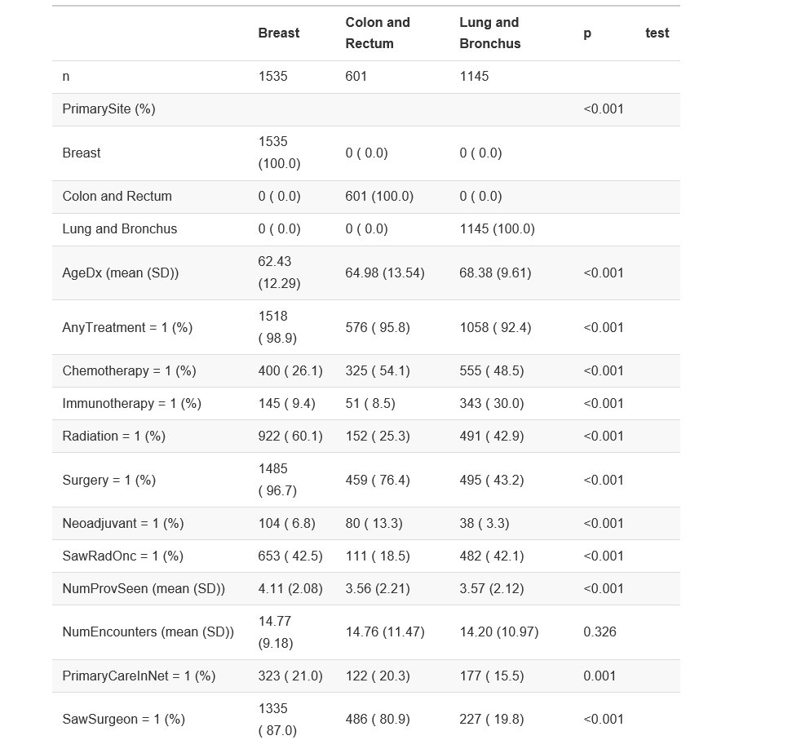
Table 1(a)

Slide 7
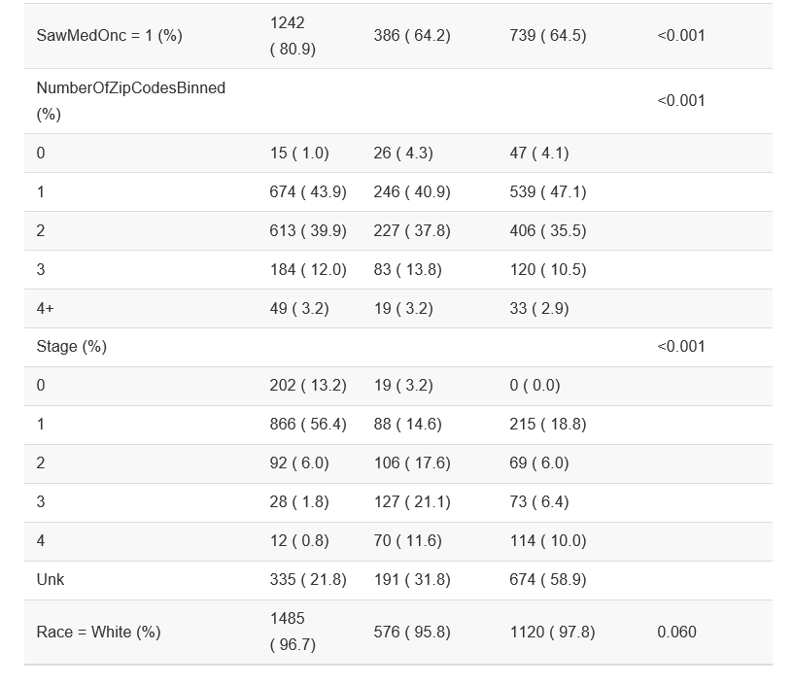
Table 2(b)

Slide 8
The network

Slide 9
Distribution of weights in the provider-provider network
What is the distribution of care density in our cohort?
For any of the above, do we observe variation between cancer types?

Slide 10
Zip codes as a proxy for geographic dispersion

Slide 11
Motivation & Logic
Get a rough approximation of dispersion of patients in the network using the number of zipcode they have encounters in.
By patient ID, how many unique zip code strings are observed?
We observe a skewed distribution ranging from ???.

Slide 12
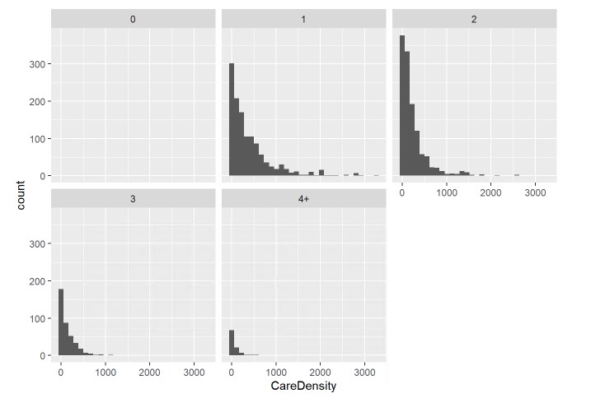
Histogram of zip codes by patient and
Will see more on care density later
Number of zip codes range from 1-7

Slide 13
Care-team variables of interest

Slide 14
Creating variables of interest
Did they see a surgeon?
Did they see a radiation oncologist?
Did they see a medical oncologist?
Determined by:
Getting a list of all providers they saw by NPI
Extracting the specialty names associated with those IDs
String matching relevant titles in “uniquified” list

Slide 15
Creating variables of interest 2
Do they have a primary care in our network?
Get a list of all the providers they saw as in the last slide
Checking if a general practicioner or family care title appears
Did they get surgery?
Did they get hormone therapy?

Slide 16
Creating the network

Slide 17
The preliminary network analysis
Created a physician-physician network using igraph for R
Extracted the weights to asses relationships between physicians

Slide 18
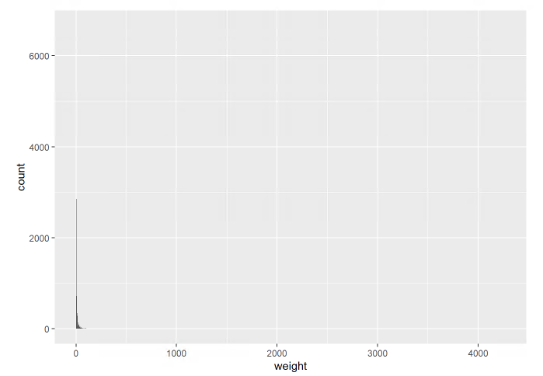
Edge weights between providers
Extremely skewed distribution

Slide 19
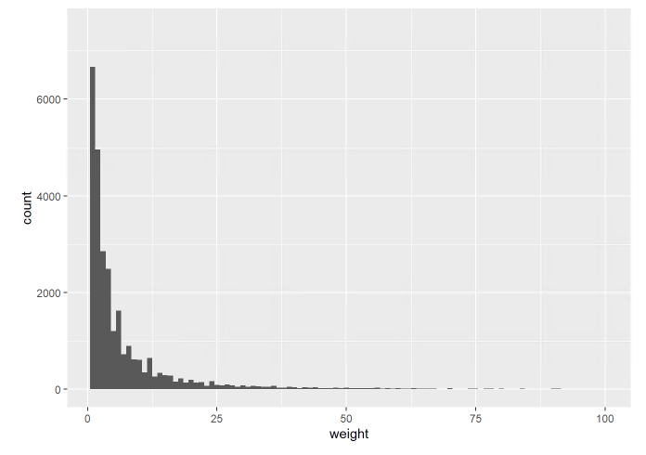
Edge weights between providers (zoomed)
Skewed, but comprehensible with viewed without outliers

Slide 20
Care density

Slide 21
Pollack et al
“To test whether patients whose providers frequently share patients with one another — what we term ‘care density’ — tend to have lower costs of care and likelihood of hospitalization.”
“9,596 patients with congestive heart failure (CHF) and 52,688 with diabetes who received care during 2009 - enrolled in five large, private insurance plans across the US covering employer-sponsored and Medicare Advantage enrollees”

Slide 22
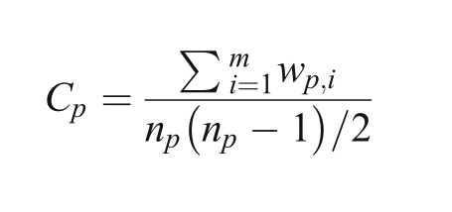
What is the metric - the formula?
“Where n is the number of distinct doctors that patient p saw”
“m is the total number of possible pairs of doctors”
“w is the number of shared patients for each pair of doctors”

Slide 23
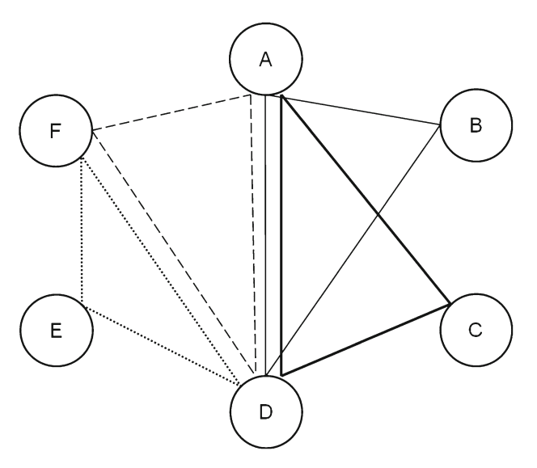
Simple example
“The numerator is the total number of instances of patient sharing over a time period (e.g. a year) among a patient’s doctors. The denominator is the total number of pairs of doctors for that patient.”

Slide 24
Findings 1
“CHF and diabetes patients receiving care from doctors with higher levels of shared patients (i.e. higher care density) had significantly lower total and inpatient costs and rates of hospitalization.”
“…high care density was associated with a $3,310 reduction in total costs compared to the lowest tertile (p<0.001).”

Slide 25
Findings 2
“…associated with significantly lower inpatient costs ($2,563, p=0.001) but not lower outpatient or pharmacy costs.”
“The adjusted annual rate of hospitalization for the high care density group was 83.4% of the rate in the low density group (p<0.001).”
“We observed a low correlation between care density and existing measures that assess visit concentration and fragmentation. This suggests that care density may measure a unique aspect of care that is not captured by existing measures.”

Slide 26
Limitations 1
“First, as with all claims-based measures of coordination, we are unable to evaluate whether care was truly coordinated for a given patient.”
“Second, although we applied a well-tested case-mix adjustment methodology, we were unable to assess the severity of the clinical conditions (e.g. ejection fraction in CHF and hemoglobin A1c in diabetes).”

Slide 27
Limitations 2
“Third, we were unable to determine structural features of the relationships between physicians (e.g. being members of a group practice or IPA).
“Fourth, we relied on total costs as the primary outcome measure as claims data are limited in their ability to attribute costs to particular conditions.”

Slide 28
Care Density in our study

Slide 29
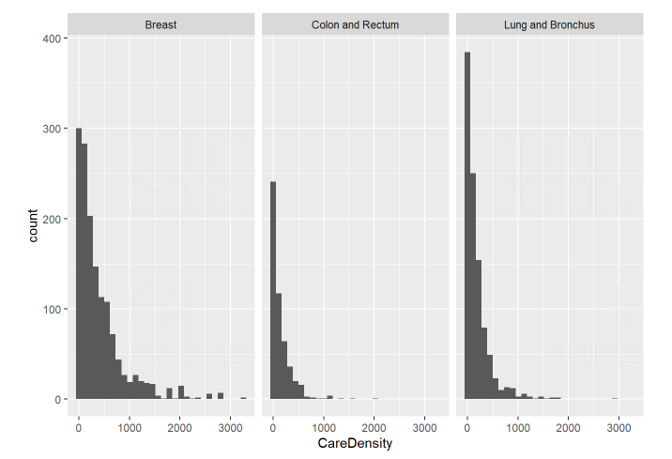
Care Density by diagnosis
Skewed distribution
Similar overall shape

Slide 30
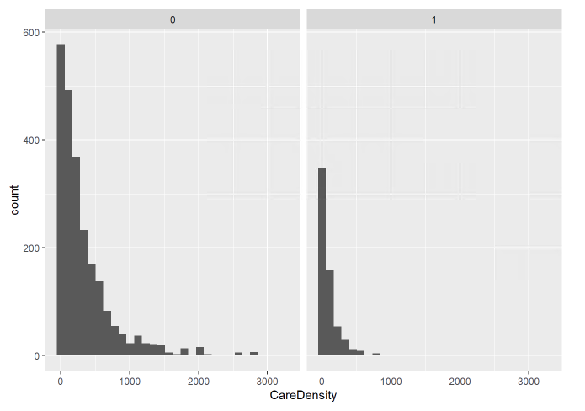
Care Density by PCP in-network
Skewed distribution
Similar overall shape

Slide 31
Care Density by number of providers
Skewed distribution
Similar overall shape ::: {.column width=“35%”}
Here
There
Everywhere

Slide 32
::::

Slide 33
Templates
Here
There
Everywhere

