Slide 1
[Footer]

Slide 2
Instructions for using this template
PowerPoint 2007, 2010, 2013 & 2016

Slide 3
Slides in this template
The following slides are instructions for using this PowerPoint template.
They also contain examples of programmed styles, charts and diagrams.
When you are ready to begin your presentation, delete the slides by selecting them in the left thumbnail window and pressing ‘Delete’ on your keyboard.
If you are unsure of how to use the template, you can leave these slides in the presentation and insert new slides before or after. Remember to delete them before finalizing your presentation.

Slide 4
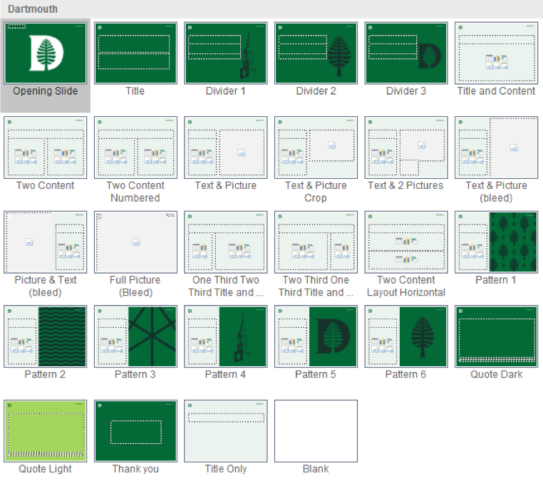
Slides in this template

Slide 5
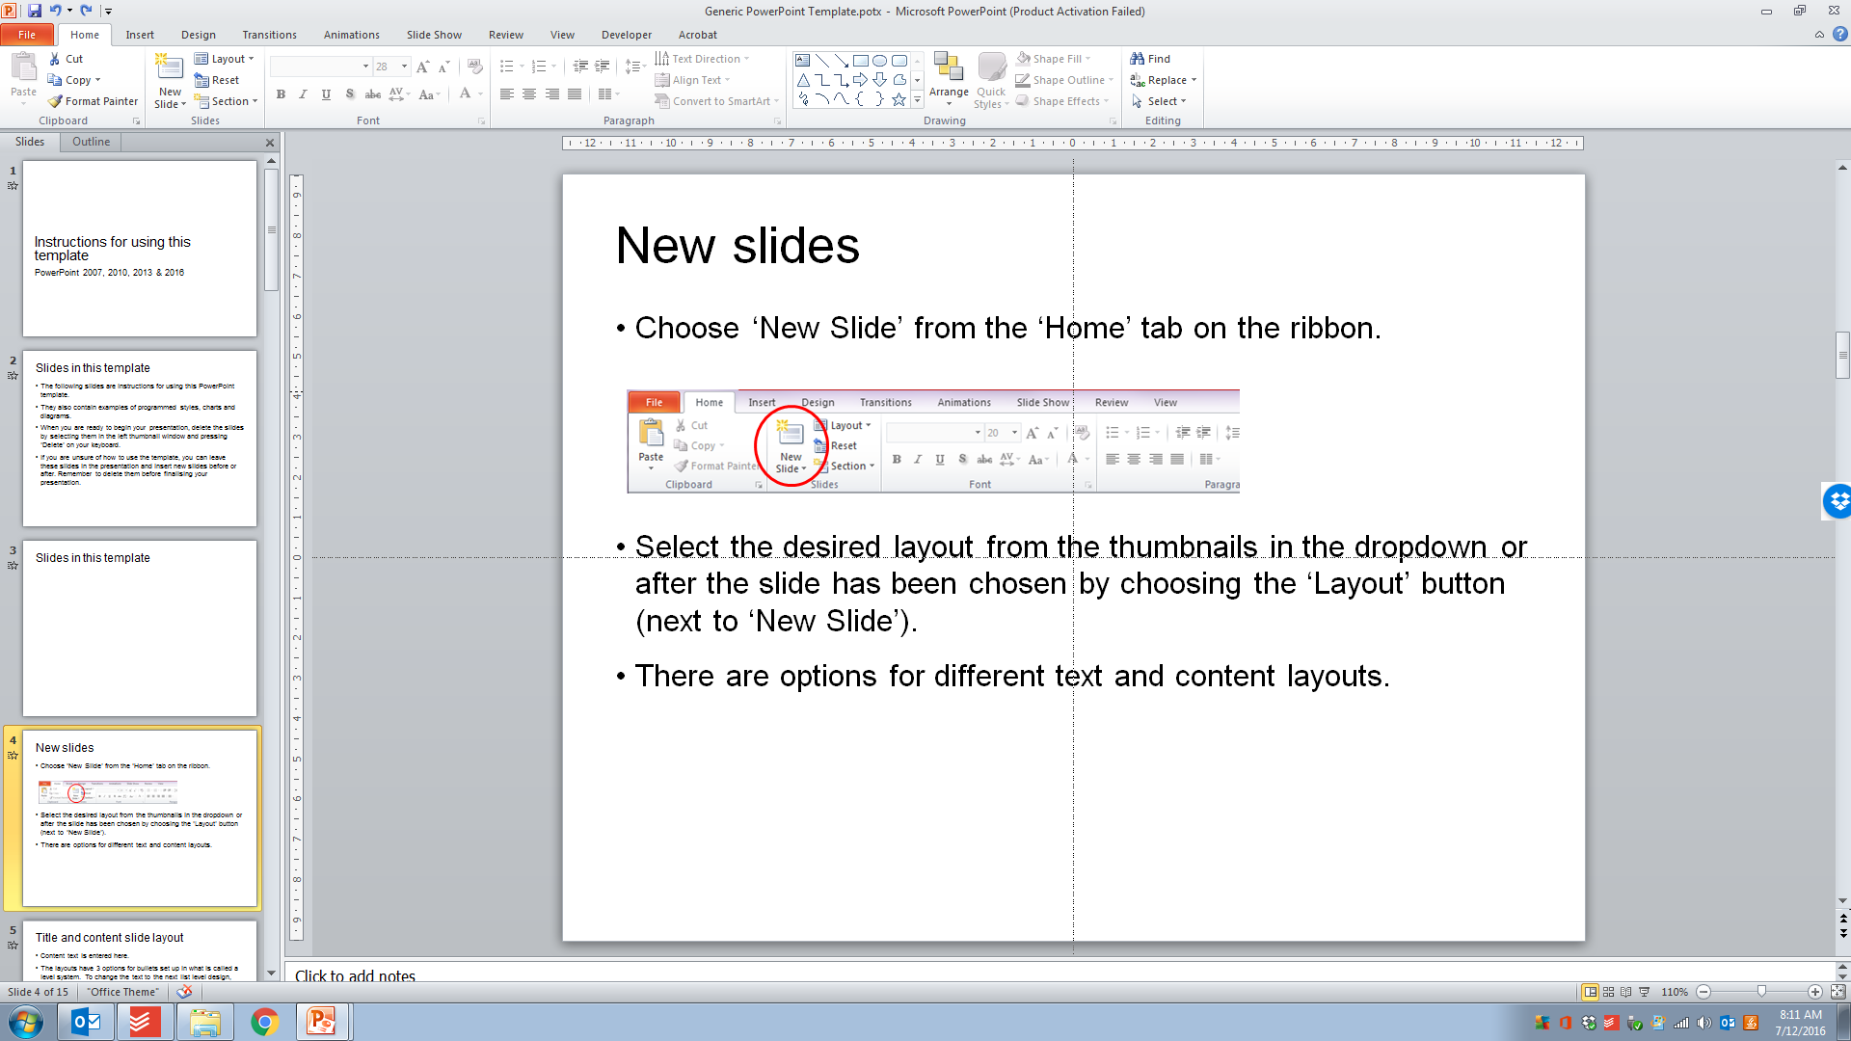
New slides
Choose ‘New Slide’ from the ‘Home’ tab on the ribbon.
Select the desired layout from the thumbnails in the dropdown or after the slide has been chosen by choosing the ‘Layout’ button (next to ‘New Slide’).
There are options for different text and content layouts.

Slide 6
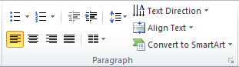
Title and content slide layout
Content text is entered here.
The layouts have 3 options for bullets set up in what is called a level system. To change the text to the next list level design, press ‘Tab’ at the start of the line (or use the ‘Increase List Level’ button).
Pressing ‘Shift+Tab’ (or the ‘Decrease List Level’ button) will take you back through the bullet list levels.

Slide 7
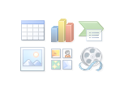
Text levels and content areas
This is the first level (you can remove the bullet to create a regular paragraph by clicking the bullets button on the Home tab)
This is the second level
This is the third level
This is the fourth level
This is the fifth and final level
In any of the slides, the text area can also contain other content.
You will notice under the “Click to enter text” line are icons displaying options to insert graphs, pictures, Excel tables etc.

Slide 8
Formatting existing presentations
You can easily insert and re-format slides from existing presentations.
Select the slides in the existing presentation via the slide thumbnails panel to the left of the program
Copy, then paste into the template presentation slide thumbnails panel
Choose the ‘Layout’ for each slide as appropriate
Make sure to select the Slides once more and choose ‘Reset’. This will ensure all items within the slide are forced to adopt the new layout.
Any custom slide layout masters in old presentations/templates will copy through. In these cases it is best to copy content from inside text areas rather than the whole slide.

Slide 9
Footers & file size
Inserting/deleting a footer or slide number
Go to the ‘Insert’ tab
Select ‘Header & Footer’
Tick or untick the footer and/or page numbers checkboxes as required
Type text in the footer section if required
‘Apply to all’.
To reduce the file size of the presentation:
Go to the ‘Save As’ function
‘Tools’ dropdown (next to the ‘Save’ button)
‘Compress Pictures’
Select the option you want. The lower the resolution the smaller the file.
‘OK’
‘Save’

Slide 10
File Size / Image Resolution
File size issues - compress all pictures
To reduce the file size of the presentation:
Go to the ‘Save As’ function
‘Tool’s dropdown (next to the ‘Save’ button)
‘Compress Pictures’
Select the option you want. ‘Print 220 ppi’ ensures the images will print in high quality. The lower the resolution the smaller the file but this can affect logo quality if applied to all images.
‘OK’
‘Save’
File size issues - compress single pictures
If you know of a single image that is large in file size, you can reduce that particular image to a very low compression. This will mean there won’t be any quality reduction in the logos and other imagery in the presentation.
Select the image
Click on the ‘Compress Pictures’ button in the ‘Picture Tools’ menu
Ensure ‘Apply only to this picture’ is ticked
Choose ‘Email 96 ppi’
‘OK’

Slide 11
File Size / Image Resolution
File size issues – external image compression
Sometimes the inserted images were too large to begin with. There is only so much PowerPoint can do to compress the images when in the program.
It is recommended that you reduce the large image files before inserting them to the presentation. This will ensure you don’t suffer slow computer performance.
As a guide, a photographic image at full slide size should be no more than 1mb.

Slide 12
Chart examples

Slide 13
SmartArt examples
Data 1
Data 2
Data 3
Data 4
Data 5
Data 6
Data 1
Data 2
Data 3
Data 4
Data 5
Data 6

Slide 14
Thank you

