Slide 1
Preliminary analysis of EHR data for studying care networks
Thadryan J. Sweeney

Slide 2
Comments: could be even shorter, read and cite a care density paper as most people in the group haven’t used it. Last meeting on the 21st.

Slide 3
Introduction

Slide 4
Overview
What are some basic dispersion metrics we can infer from the EHRs?
What proportion of patients saw differnt providers of interest?
What is the distribution of weights in the provider-provider network?
What is the distribution of care density in our cohort?
For any of the above, do we observe variation between cancer types?
What is the distribution of weights in the provider-provider network?
What is the distribution of care density in our cohort?
For any of the above, do we observe variation between cancer types?

Slide 5
What is the distribution of weights in the provider-provider network?
What is the distribution of care density in our cohort?
For any of the above, do we observe variation between cancer types?

Slide 6
Zip codes as a proxy for geographic dispersion

Slide 7
Motivation & Logic
Get a rough approximation of dispersion of patients in the network using the number of zipcode they have encounters in.
By patient ID, how many unique zip code strings are observed?
We observe a skewed distribution ranging from ???.

Slide 8

Histogram of zip codes by patient
What the here

Slide 9
Care-team variables of interest

Slide 10
Creating variables of interest
Did they see a surgeon?
Did they see a radiation oncologist?
Did they see a medical oncologist?
Determined by:
Getting a list of all providers they saw by NPI
Extracting the specialty names associated with those IDs
String matching relevant titles in “uniquified” list

Slide 11
Creating variables of interest 2
Do they have a primary care in our network?
Get a list of all the providers they saw as in the last slide
Checking if a general practicioner or family care title appears
Did they get surgery?
Did they get hormone therapy?

Slide 12
Creating the network

Slide 13
The preliminary network analysis
Created a physician-physician network using igraph for R
Extracted the weights to asses relationships between physicians

Slide 14
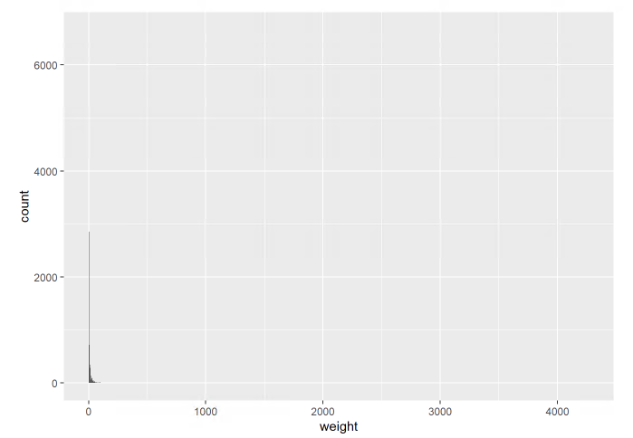
Edge weights between providers
Extremely skewed distribution

Slide 15
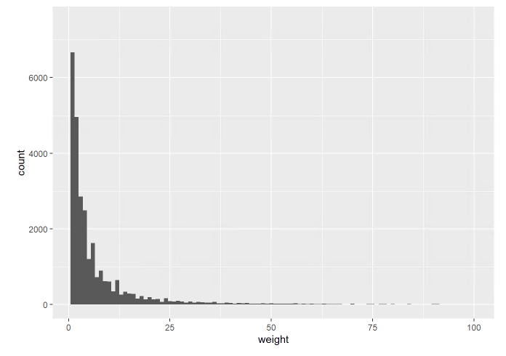
Edge weights between providers (zoomed)
Skewed, but comprehensible with viewed without outliers

Slide 16
Care density

Slide 17
Pollack et al
“To test whether patients whose providers frequently share patients with one another — what we term ‘care density’ — tend to have lower costs of care and likelihood of hospitalization.”
“9,596 patients with congestive heart failure (CHF) and 52,688 with diabetes who received care during 2009 - enrolled in five large, private insurance plans across the US covering employer-sponsored and Medicare Advantage enrollees”

Slide 18
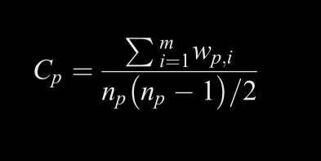
What is the metric?
Where:
“n is the number of distinct doctors that patient p saw”
“m is the total number of possible pairs of doctors”
“w is the number of shared patients for each pair of doctors”

Slide 19
What is the metric1?
Where: - “n is the number of distinct doctors that patient p saw” - “m is the total number of possible pairs of doctors” - “w is the number of shared patients for each pair of doctors”

Slide 20
More
Content
What is the distribution of weights in the provider-provider network? - What is the distribution of care density in our cohort? - For any of the above, do we observe variation between cancer types?

