Slide 1
Summer Internship – Mid-Term Review
FREE WORK
A freelancer website
Presented by:
23A91A4433 - M.Hari - Data Science
23A91A4434 - M.Kalyan - Data Science
23A91A4439 - M.V.Sai Krishna - Data Science
23A91A4453 - S.N.V.S.swami - Data Science
24A95A4406- K.B.S.V.shanker – Data Science

Slide 2
Problem Statement:
In many regions, individuals and small businesses require offline services such as plumbing, electrical repairs, carpentry, event management, tutoring, and other hands-on jobs. However, there is a significant gap in connecting skilled offline workers (freelancers) with local clients who need their services. Existing platforms primarily focus on online freelancing or are not tailored to local, in-person job requirements, making it difficult for clients to find trustworthy, nearby professionals efficiently.
This lack of a centralized, reliable platform for offline freelance work leads to lost opportunities for skilled workers and frustration for clients due to inconsistent service quality, poor communication, or lack of verified professionals.

Slide 3
Objectives & Scope:
The primary objective of this project is to develop a canteen food delivery system that improves the food ordering experience for both students and faculty in a college environment.
Key Objectives:
Local Service Booking Enable users to find and book nearby offline freelancers for various hands-on tasks through a simple and user-friendly web application.
Skill-Based Search & Categories Allow clients to browse professionals by service categories (e.g., home repair, tutoring, event work) and filter by location, availability, or ratings.
Verified Freelancer Profiles Ensure service quality and trust by allowing freelancers to create verified profiles with ID proof, skill certifications, and user reviews.

Slide 4
Efficient Job Matching Match clients with relevant freelancers based on location, service type, and availability — reducing time and effort in finding the right person.
Real-Time Communication Provide chat or messaging features for direct communication between clients and freelancers to discuss job details, pricing, and schedules

Slide 5
Scope :
Functional Scope:
User Registration and Login System Secure sign-up and login for both clients and freelancers with role-based access.
Service Categories and Listings Display various offline service categories with dynamic listings of freelancers.
Job Posting and Booking System Clients can post job requirements, browse profiles, and book available freelancers.
Freelancer Profile Management Freelancers can create and update their profiles with skills, experience, location, and availability.
Order Tracking and Status Updates Real-time updates on booking status (e.g., pending, accepted, completed).
.

Slide 6
Operational Scope:
Local Deployment for Offline Services Can be used in urban and semi-urban areas to connect local freelancers with nearby clients.
Supports Multiple Concurrent Users Scalable system that handles many clients and freelancers using the platform simultaneously.
Reduces Manual Coordination Automates the process of finding, scheduling, and confirming offline work — reducing calls, miscommunication, and delays.
Improves Job Opportunities Helps skilled freelancers gain visibility and access more local work opportunities efficiently.

Slide 7
Methodology / Tools Used:
Front-end : React JS, Bootstrap
Back-end : Node JS , Express JS
Database : MongoDB Atlas
Authentication : JWT(JavaScript Web Token) , Bcrypt
Real Time messaging : Socket.io
Testing Tools : Postman (for API testing)
Development Tools : Vs code

Slide 8
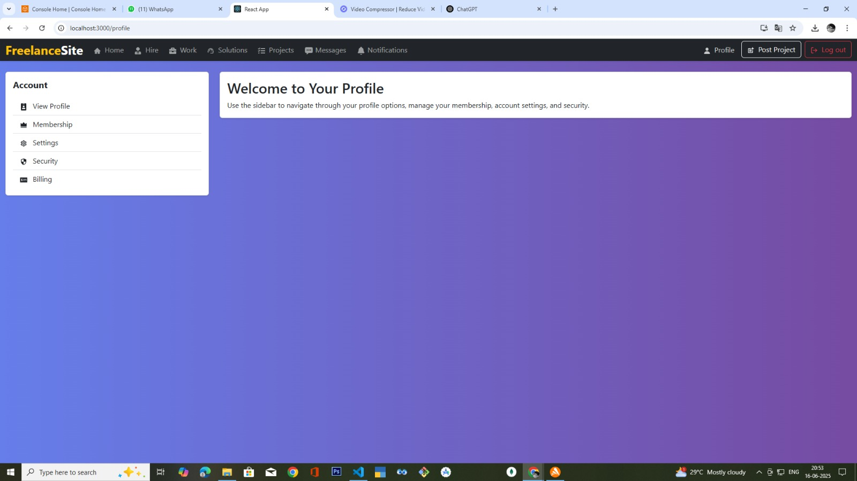
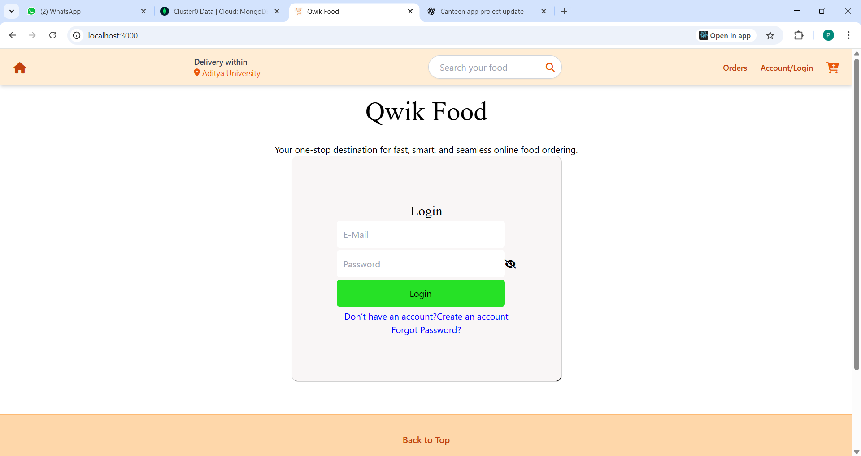
Progress Made (Milestones Achieved) -Execution Demonstration:

Slide 9
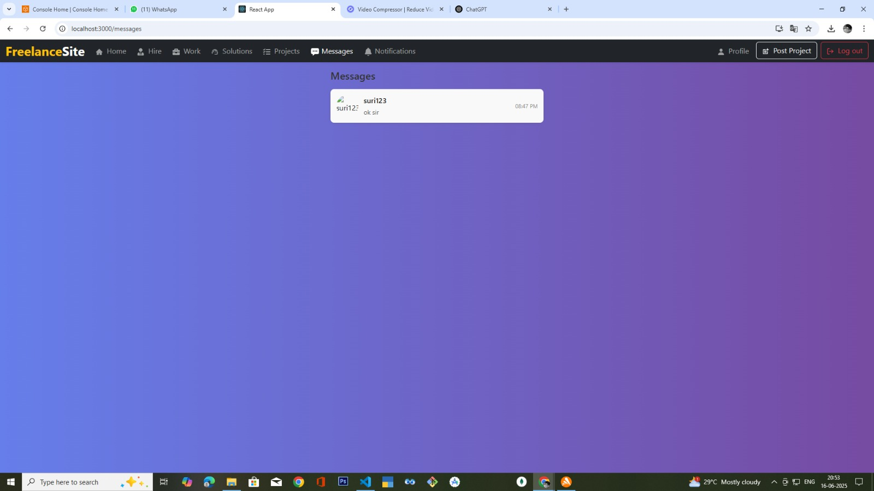

Slide 10
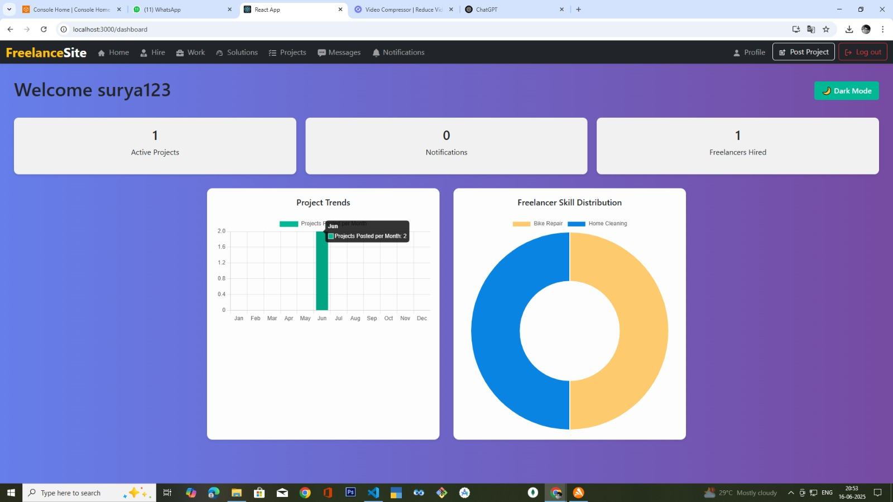

Slide 11
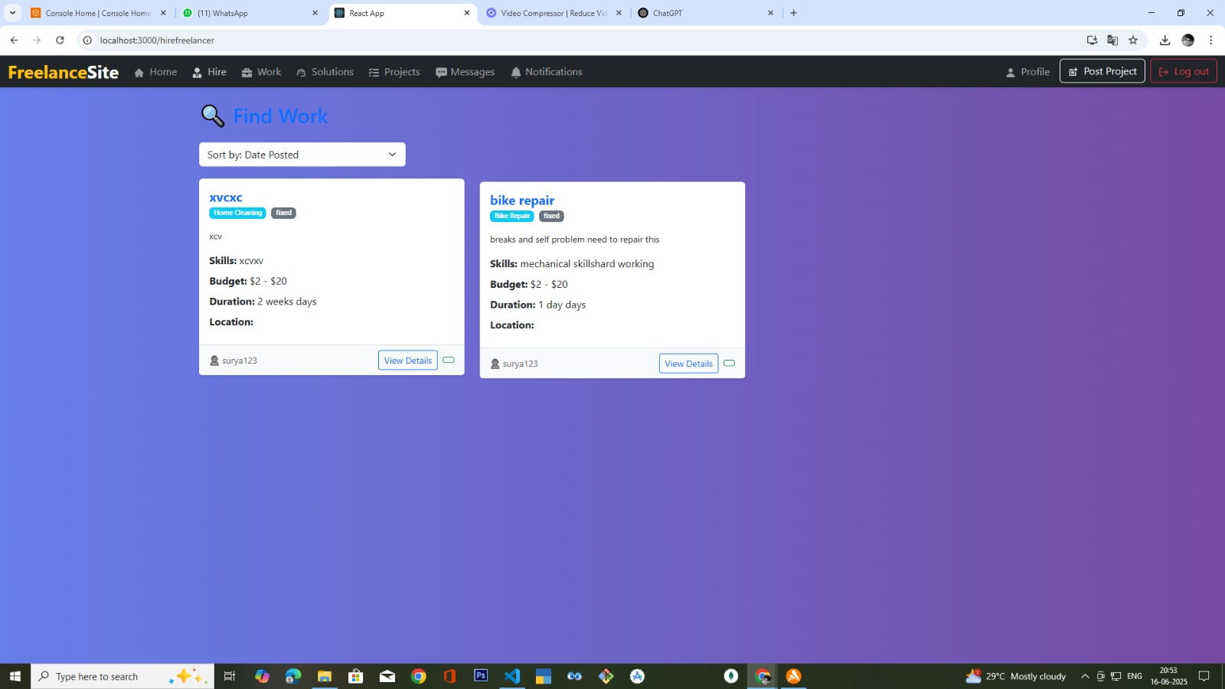

Slide 12
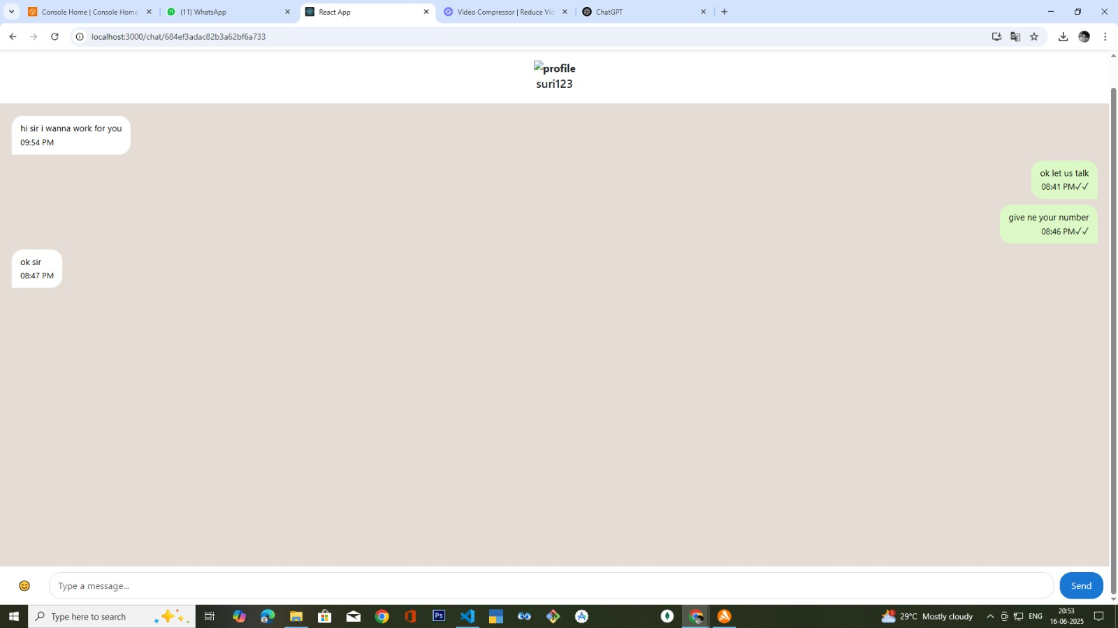

Slide 13
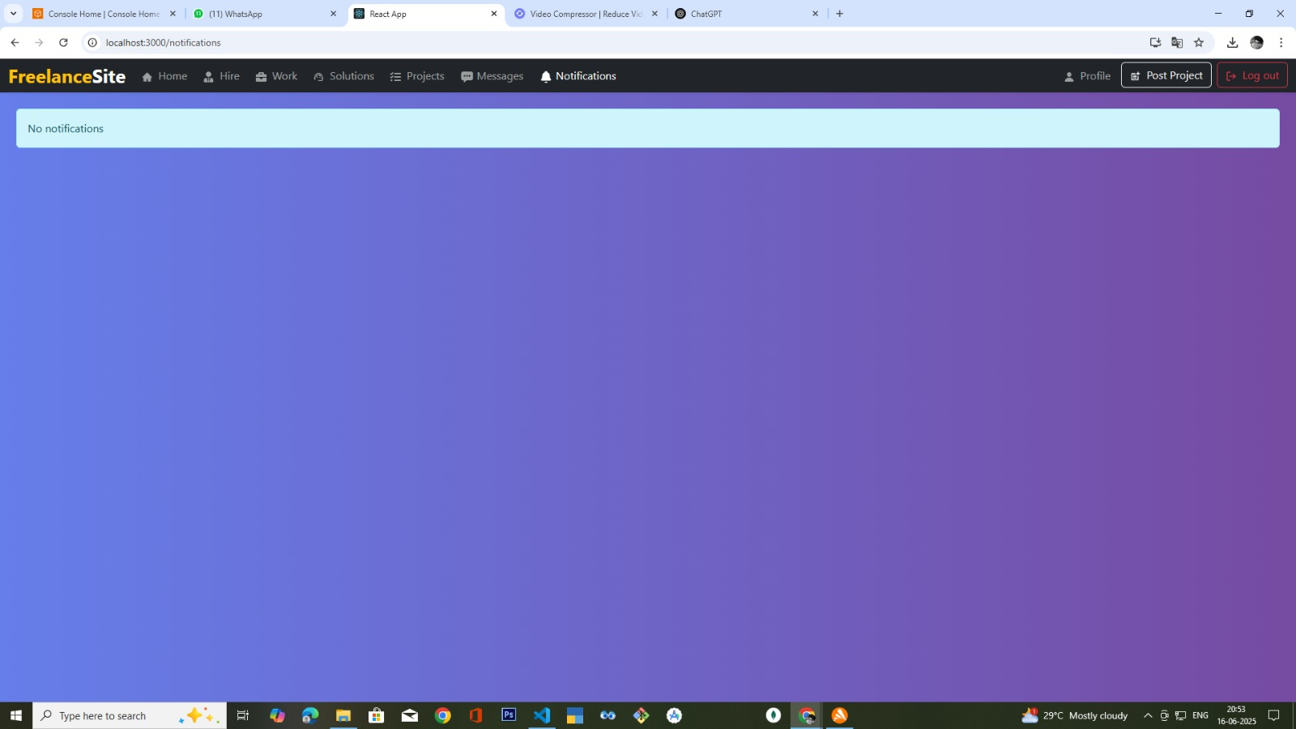

Slide 14
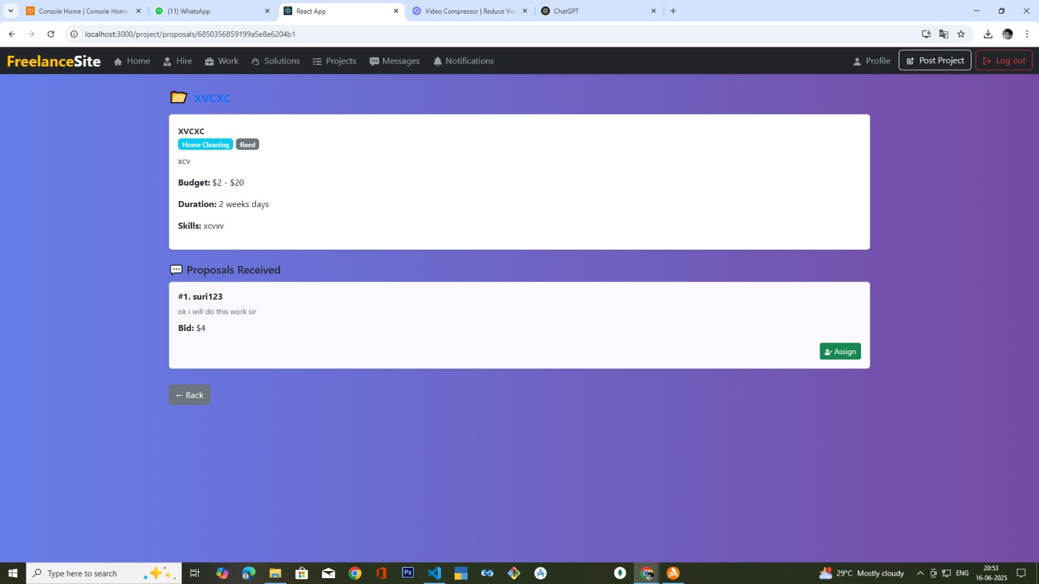

Slide 15
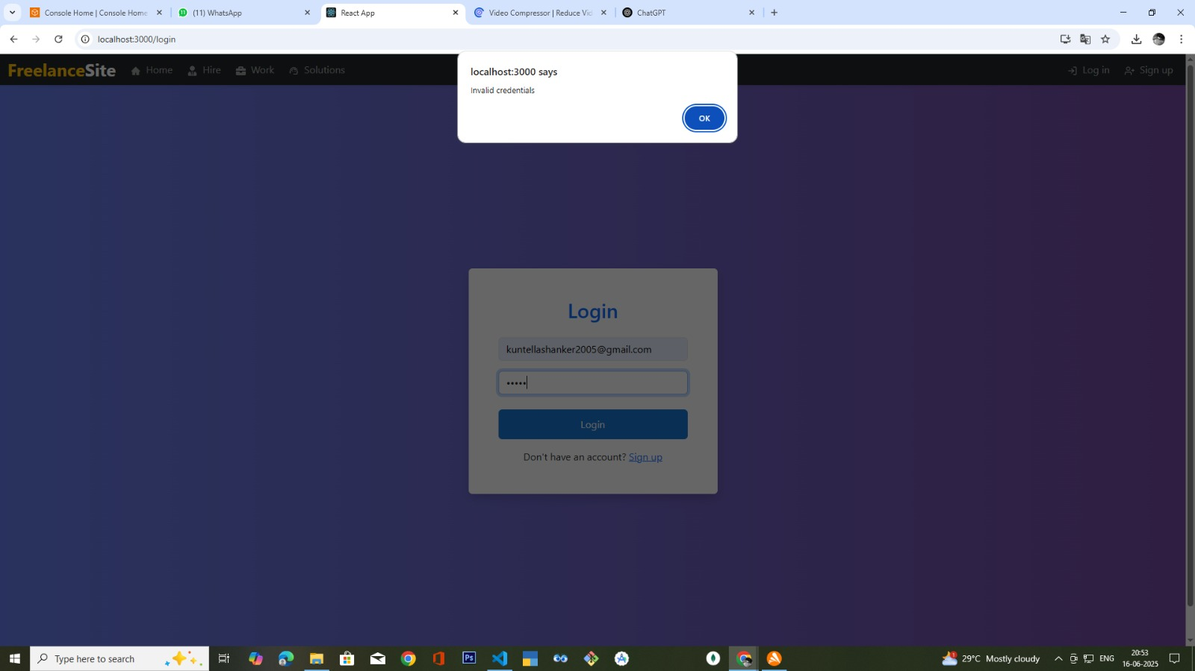

Slide 16
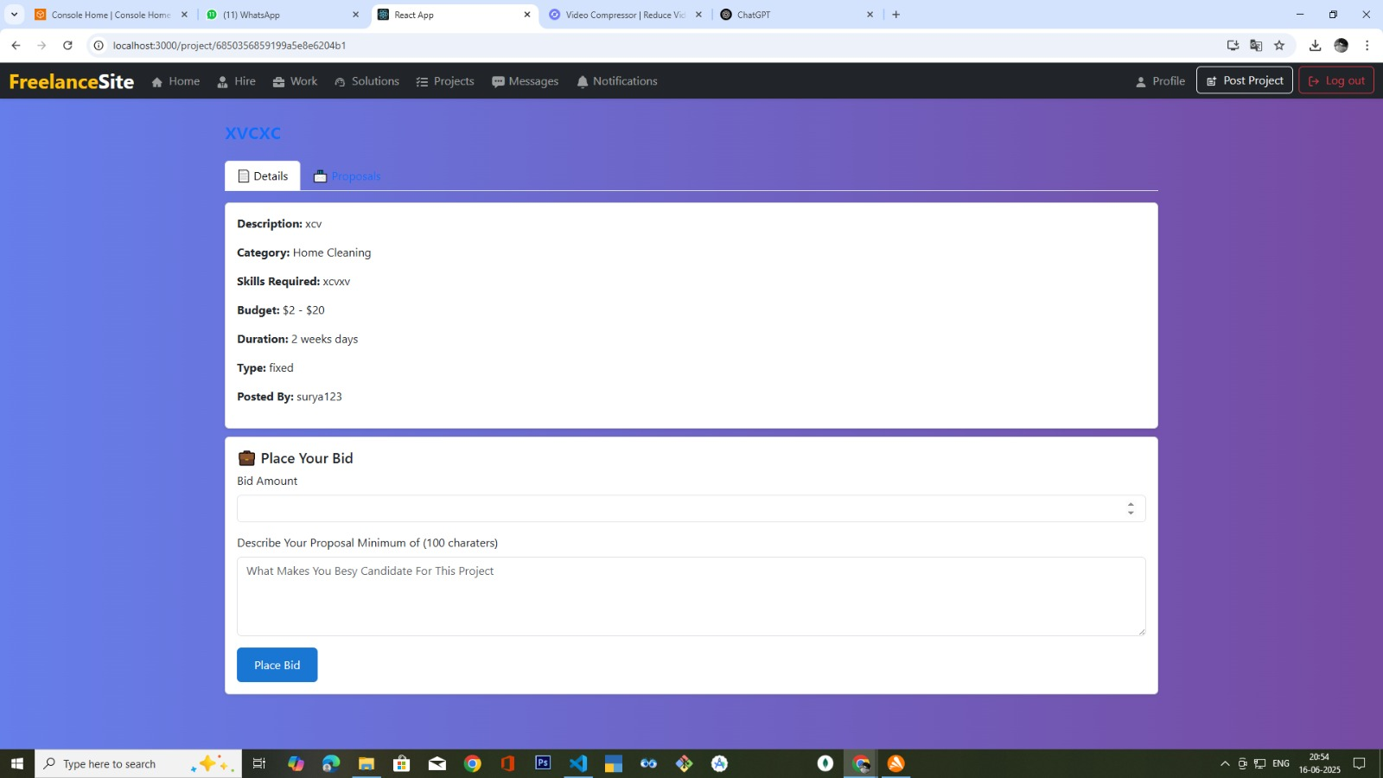

Slide 17
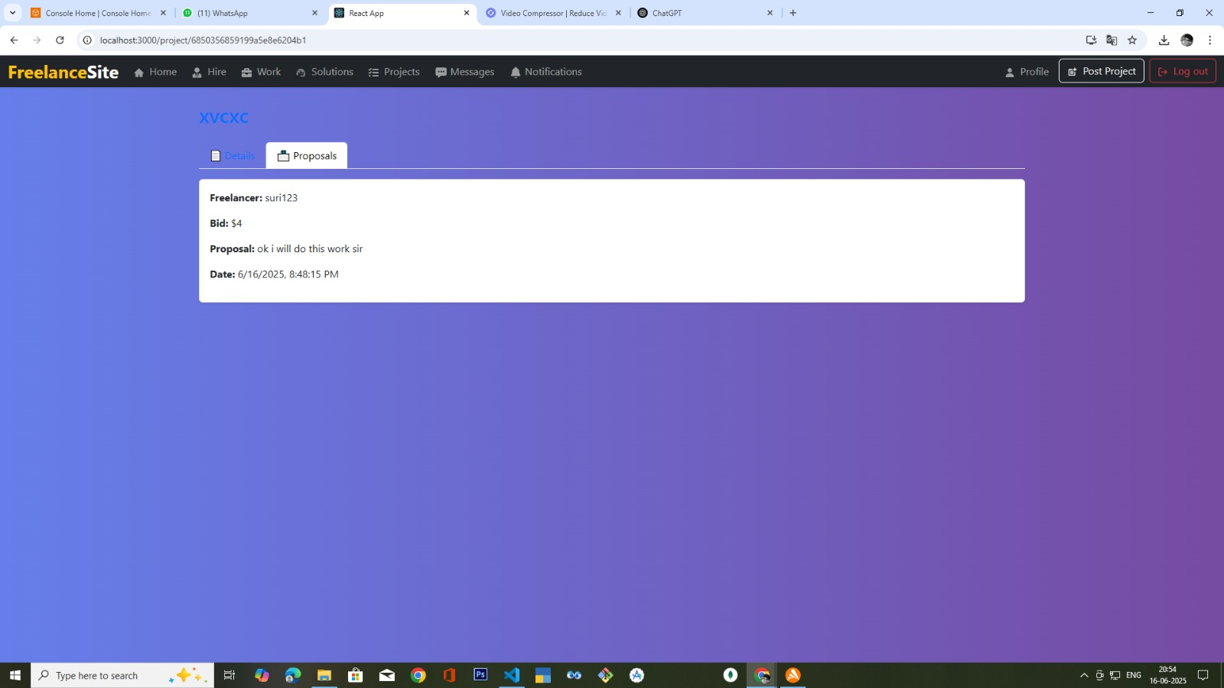

Slide 18
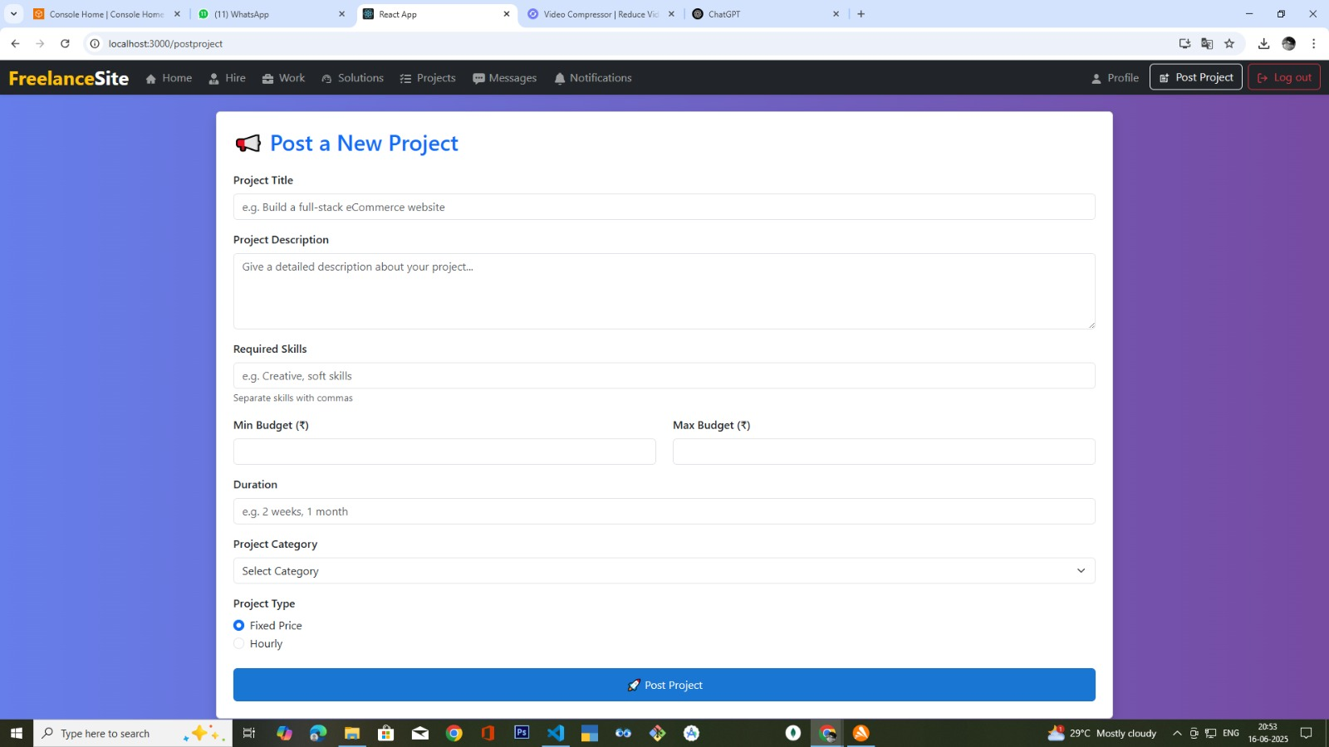

Slide 19
Challenges Faced:
API Communication Ensuring smooth and consistent data exchange between frontend and backend using REST APIs was a key challenge, especially when handling real-time job updates and user actions.
Job Status Management Managing real-time updates for different job statuses such as "Pending", "Accepted", "Completed", and "Cancelled" required precise synchronization between the client-side UI and backend logic.
Responsive UI Design Creating a clean and user-friendly interface that works well across all screen sizes — from desktops to smartphones — involved multiple iterations and extensive cross-device testing.
.

Slide 20
Freelancer-Client Coordination Implementing a seamless interaction flow between freelancers and clients, including messaging, job acceptance, and scheduling, required careful design of both frontend and backend systems

Slide 21
Next Steps (Action Plan):
Week 1: Planning & Initial Setup
Finalized feature list and system requirements.
Designed high-fidelity UI wireframes and page layouts.
Set up the React.js project environment with ESLint, Prettier, and Tailwind CSS.
Configured client-side routing using react-router-dom.
Set up GitHub repo and development workflow with Git branches.
Week 2: Backend Initialization & Authentication
Set up Express.js backend server with middleware structure.
Connected MongoDB database using Mongoose.
Created initial MongoDB schemas for:
Users (freelancer, client)
Projects / Orders
Categories or Tags
Implemented secure user signup & login with JWT-based authentication.
Integrated password hashing using bcrypt.

Slide 22
Week 3: User Dashboard & Profile Management
Built freelancer and client dashboards with conditional rendering.
Added forms for editing user profile info and uploading profile pictures.
Developed backend routes for updating and retrieving user profiles.
Introduced protected routes in the frontend using JWT tokens and context/state.
Week 4: Project Posting & Browsing
Created UI components for clients to post new freelance projects.
Built browsing interface for freelancers to explore available projects.
Added filtering/sorting features (by category, budget, etc.).
Developed backend APIs for posting, updating, and listing jobs.
Linked jobs to user accounts (client → posted, freelancer → applied).

Slide 23
Queries / Support Required if any :
Real-time Message Integration
How to implement real-time chat or notifications when the app is offline and sync later when online?
Best ways to use Socket.IO or alternatives for seamless offline-online transition?
Handling message queues or local storage for messages created offline before sending them to the server.
2. Data Access & Sync
Strategies to allow offline access to user profiles, projects, proposals, etc.
How to sync updates (new jobs, messages, payments) when the user comes online?
Conflict resolution when data is updated offline and online simultaneously.

Slide 24
3. Testing & Feedback
How to simulate offline scenarios for testing your app’s reliability?
Tools or methodologies to get real-time feedback from users while offline.
Setting up beta testing groups with controlled network conditions.
4. Security & Maintenance
Securing local data storage on users’ devices (e.g., encryption for cached data).
Secure handling of login tokens and session data in offline mode.
Best practices for protecting APIs when syncing data after offline use.

Slide 25
THANK YOU

