Slide 1

HLOOKUP AND VLOOKUP

Slide 2

Introduction
Both VLOOKUP(vertical lookup) and HLOOKUP(horizontal lookup) are functions in excel that helps you to search for a specific value in a table and retrieve information based on that value.

Slide 3
HLOOKUP
Syntax:
=HLOOKUP(lookup_value,table_array,row_index_num,[range_lookup])
Explanation
lookup_value: The value you want to search for in the first row of the table.
table_array:The range of cells that contains the data.The first row of this range should contain the lookup_values.
row_index_num: The row number in the table from which to retrieve the value.
range_lookup:A logical ( T or F) indicating whether to find an exact match (F) or an appropriate match (T).

Slide 4
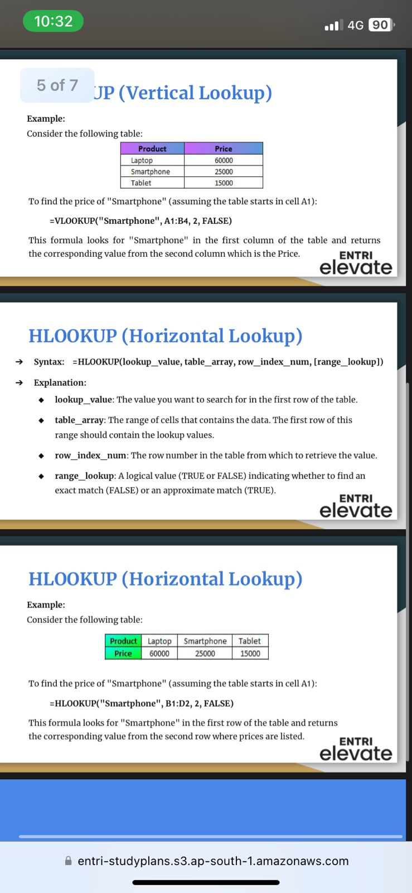
Working of HLOOKUP
Consider the table
To find the price of “Smartphone”(assuming the table starts in the cell A1):
=HLOOKUP(“Smartphone”,B1:D2,2,FALSE)
This formula looks for “Smartphone” in the first row of the table and returns the corresponding value from the second row where prices are listed.

Slide 5
VLOOKUP
Syntax:
=VLOOKUP(lookup_value,table_array,col_index_num,[range_lookup])
Explanation
lookup_value: The value you want to search for in the first column of the table.
table_array:The range of cells that contains the data.The first column of this range should contain the lookup_values.
Col_index_num: The column number in the table from which to retrieve the value.
range_lookup:A logical ( T or F) indicating whether to find an exact match (F) or an appropriate match (T).

Slide 6
The working of VLOOKUP
Consider the table
To find the price of “Smartphone”(assuming the table starts in the cell A1):
=VLOOKUP(“Smartphone”,A1:B4,2,FALSE)
This formula looks for “Smartphone” in the first column of the table and returns the corresponding value from the second column which is the price.

Slide 7
INDEX MATCH
The INDEX MATCH function in Excel is a combination of the INDEX and MATCH functions that allows users to find a cell's value in a table based on both horizontal and vertical criteria:
INDEX: Returns a cell's value in a table based on its row and column number
MATCH: Finds the position of a cell in a row or column

Slide 8
Syntax for INDEX =INDEX(array, row_num, [column_num])
=MATCH(lookup_value, lookup_array, [match_type]):
Array: The range of cells that contains the data.
Row_num: The row number of the cell that contains the desired value.
Column_num: The column number of the cell that contains the desired value.
Syntax for MATCH
=MATCH(lookup_value, lookup_array, [match_type])
lookup_value: The value you want to find
lookup_array: The range of cells to search in
match_type: An optional argument that defines the match type. It can be set to 1, 0, or -1.

Slide 9
Conclusion
Lookup functions in Excel mean referencing a cell to match values in another row or column against the cell and thereby retrieving the corresponding results from the respective rows and columns.

Slide 10

Thank you.
If you have any questions?
thahliyamist@gmail.com

