Slide 1
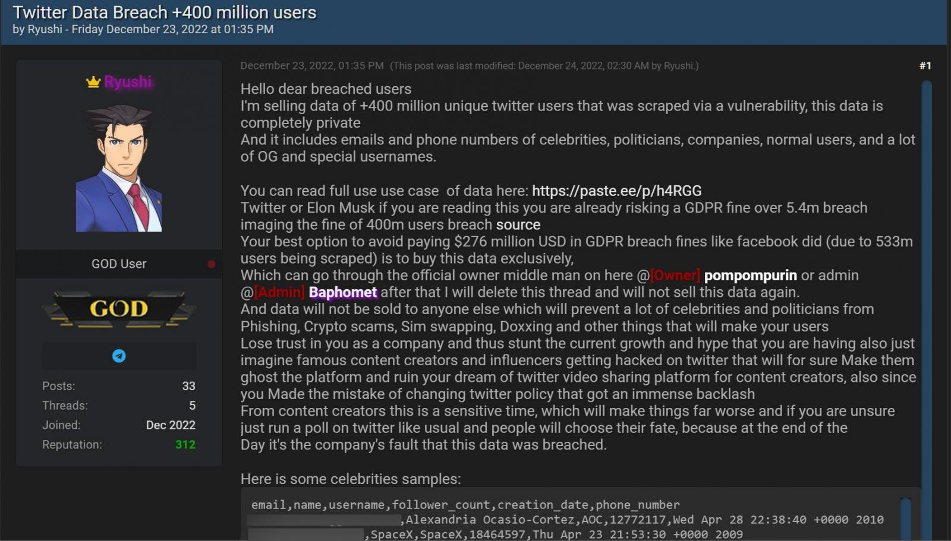

Slide 2

Twitter Account Activities (Nov 2022)
100%
Total Leaked Twitter Accounts
5,485,635
24%
0 following
1,301,033
12%
0 following, 0 follower
636,231
8%
0 following, 0 follower, 0 like, 0 post
418,090

Slide 3
Twitter Account LIKES (Nov 2022)
100%
Total Leaked Twitter Accounts
5,485,635
63%
< 5 Likes
3,433,211
55%
< 2 likes
3,033,350
48%
0 like
2,656,856

Slide 4
Twitter VERIFIED Account (Nov 2022)
0.06%
Verified
3,352
99.94%
Non-Verified
5,482,283

