Slide 1
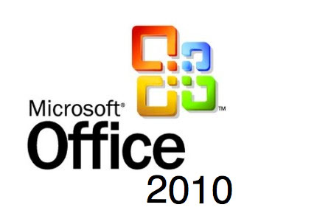
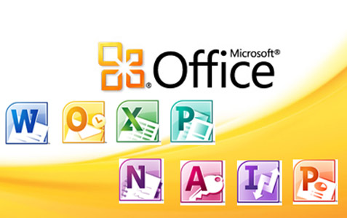
Microsoft office 2010
Powerpoint
Word
Excel
Access
16 September 2013
http://www.thaiall.com/office/teaching_office_2010.pptx

Slide 2
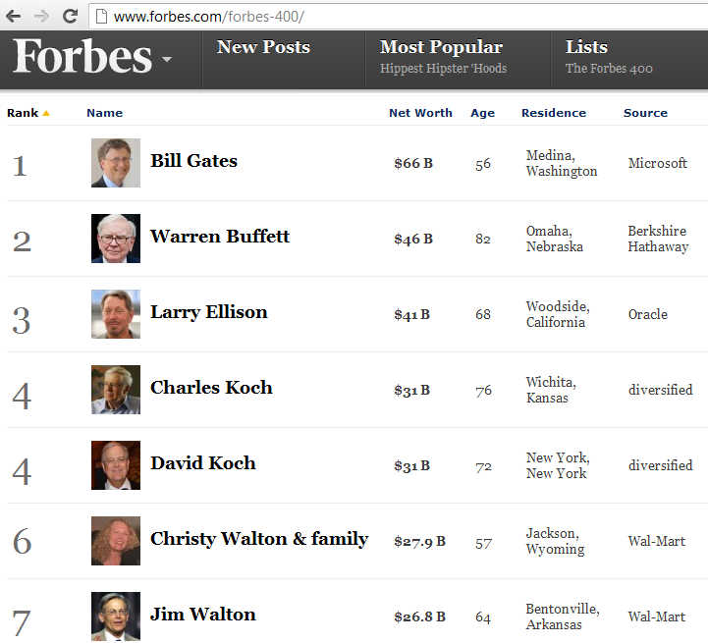
Microsoft Office
Microsoft Word
Microsoft Excel
Microsoft Powerpoint
Microsoft Access
Microsoft Outlook
Microsoft Publisher
Microsoft Onenote
Microsoft Sharepoint
Microsoft Infopath
Microsoft Frontpage

Slide 3

1. Microsoft Word
Microsoft Word is a non-free commercial word processor designed by Microsoft. It was first released in 1983 under the name Multi-Tool Word for Xenix systems. Subsequent versions were later written for several other platforms including IBM PCs running DOS (1983), the Apple Macintosh (1984), the AT&T Unix PC (1985), Atari ST (1986), SCO UNIX, OS/2, and Microsoft Windows (1989). It is a component of the Microsoft Office system; it is also sold as a standalone product and included in Microsoft Works Suite.
http://encyclopedia.thefreedictionary.com/microsoft+word

Slide 4

2. Microsoft Excel
Microsoft Excel is a commercial spreadsheet application written and distributed by Microsoft for Microsoft Windows and Mac OS X. It features calculation, graphing tools, pivot tables and a macro programming language called Visual Basic for Applications. It has been a very widely applied spreadsheet for these platforms, especially since version 5 in 1993.
Microsoft Excel has the basic features of all spreadsheets (กระดาษทำการ), using a grid of cells arranged in numbered rows and letter-named columns to organize data manipulations like arithmetic operations.
http://encyclopedia.thefreedictionary.com/microsoft+excel

Slide 5

3. Microsoft Powerpoint
Microsoft PowerPoint is a commercial presentation program developed by Microsoft. PowerPoint presentations consist of a number of individual pages or "slides". The "slide" analogy (การเปรียบเทียบ) is a reference to the slide projector, a device that can be seen as obsolete (ล้าสมัย), within the context of widespread use of PowerPoint and other presentation software. Slides may contain text, graphics, movies, and other objects, which may be arranged freely on the slide.
http://encyclopedia.thefreedictionary.com/Microsoft+powerpoint

Slide 6

4. Microsoft Access
Microsoft Access is a pseudo-relational database management system from Microsoft that combines the relational Microsoft Jet Database Engine with a graphical user interface and software-development tools. It is a member of the Microsoft Office suite of applications, included in the Professional and higher editions or sold separately. Access stores data in its own format based on the Access Jet Database Engine. It can also import or link directly to data stored in other applications and databases.
http://encyclopedia.thefreedictionary.com/Microsoft+access

Slide 7

5. Microsoft Outlook
Microsoft Outlook is a personal information manager from Microsoft, available both as a separate application as well as a part of the Microsoft Office suite. Although often used mainly as an e-mail application, it also includes a calendar, task manager, contact manager, note taking, a journal and web browsing.
http://encyclopedia.thefreedictionary.com/Microsoft+outlook

Slide 8

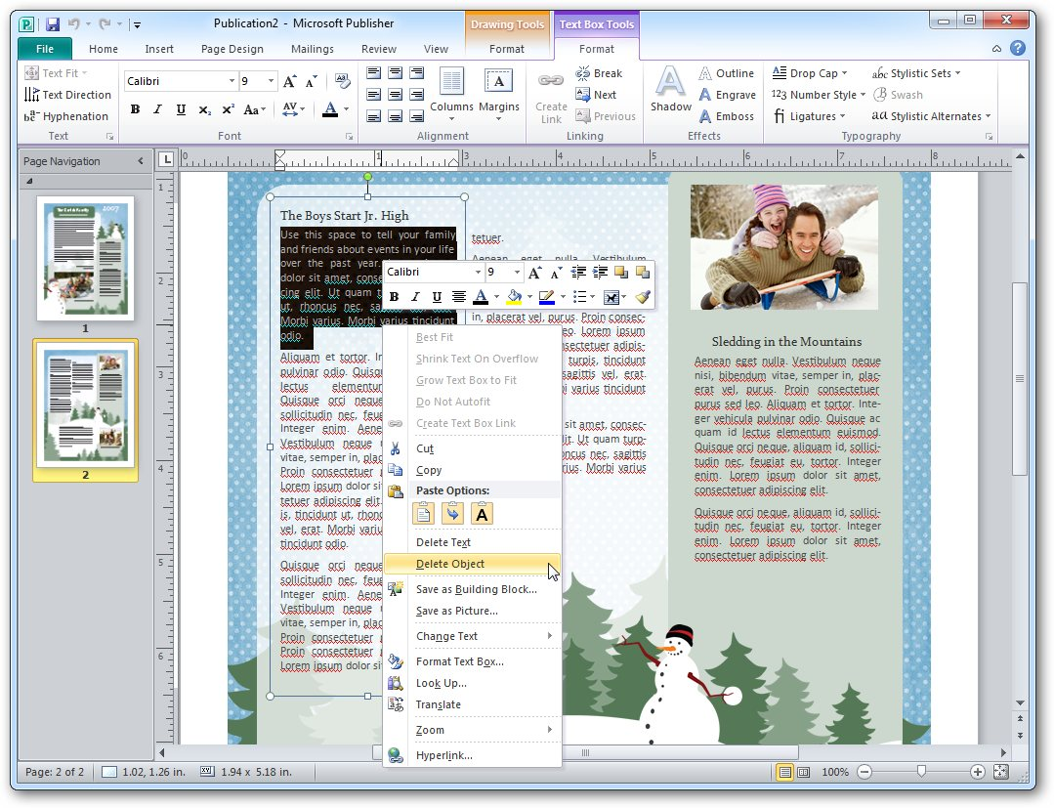
6. Microsoft Publisher
Microsoft Publisher, is a desktop publishing application from Microsoft. It is an entry-level application, differing from Microsoft Word in that the emphasis is placed on page layout and design rather than text composition and proofing.
http://encyclopedia.thefreedictionary.com/Microsoft+publisher

Slide 9

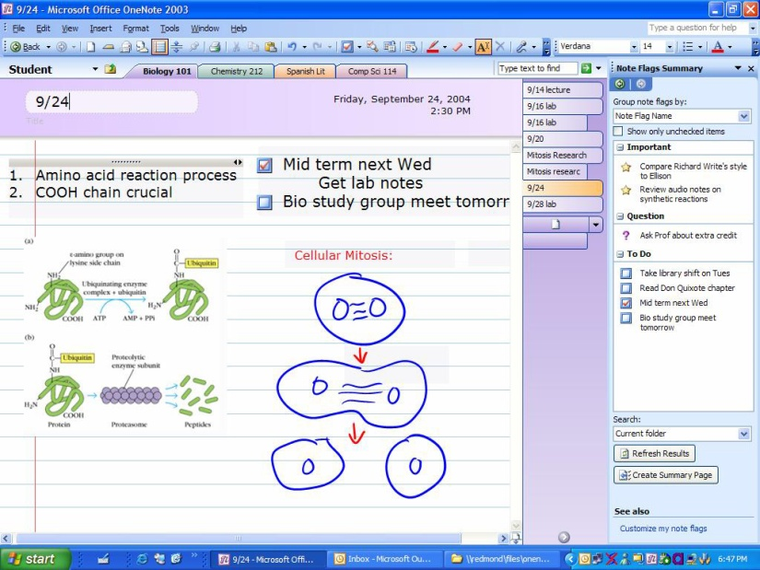
7. Microsoft Onenote
Microsoft OneNote is a software package for free-form information gathering and multi-user collaboration. While OneNote is most commonly used on laptops or desktop PCs, it has additional features for use on pen-enabled Tablet PCs, in environments where pen, audio or video notes are more appropriate than an intensive use of keyboard. OneNote's interface is an electronic version of the familiar tabbed ring binder which can be used directly for making notes, but also to gather material obtained from other applications.
http://encyclopedia.thefreedictionary.com/Microsoft+onenote

Slide 10

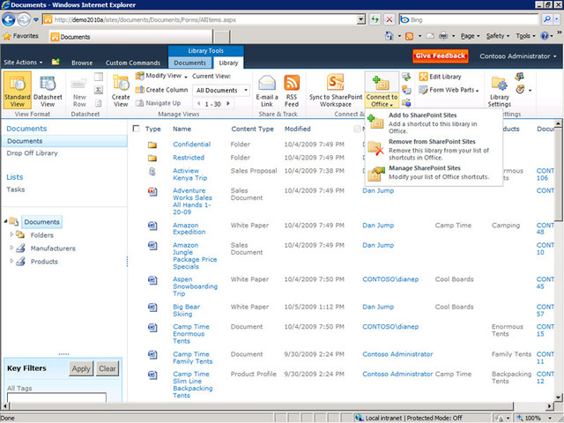
8. Microsoft Sharepoint
Microsoft SharePoint is a web-based collaboration and document management platform from Microsoft. It can be used to host web sites that access shared workspaces and documents, as well as specialized applications like wikis and blogs from a browser. SharePoint does not intend to replace an entire file server. SharePoint functionality is exposed (เปิดเผย) as web parts, such as a task list or discussion pane. These web parts are composed into web pages, which are then hosted in the SharePoint portal. SharePoint sites are actually ASP.NET 2.0 applications, which are served using IIS and use a SQL Server database as data storage backend.
http://encyclopedia.thefreedictionary.com/Microsoft+sharepoint
http://y30.wikidot.com/sharepoint-5310221041

Slide 11

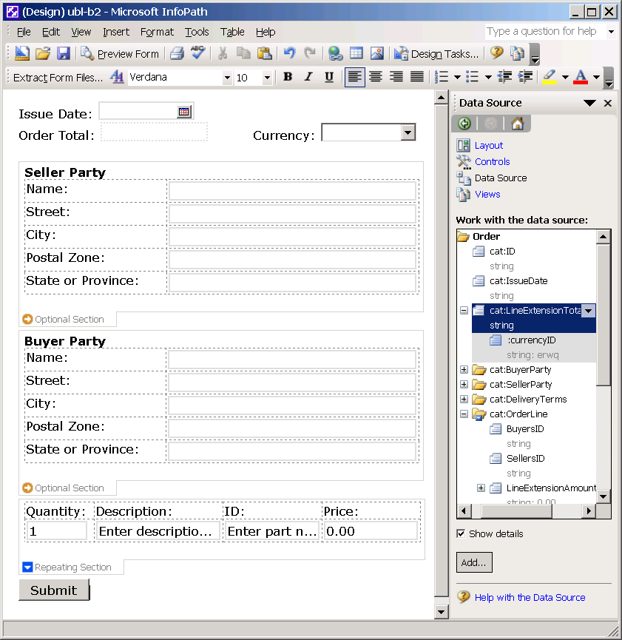
9. Microsoft Infopath
Microsoft InfoPath is an application used for developing XML-based data entry forms. The main feature of InfoPath is its ability to author and view XML documents with one-to-many links among different data groups (schema). InfoPath, a member of Office products, features a different usage scenario from the other applications, such as Word and Excel. In order to use InfoPath to fill in a form, a user must have a designer develop an InfoPath template first.
http://encyclopedia.thefreedictionary.com/Microsoft+infopath

Slide 12

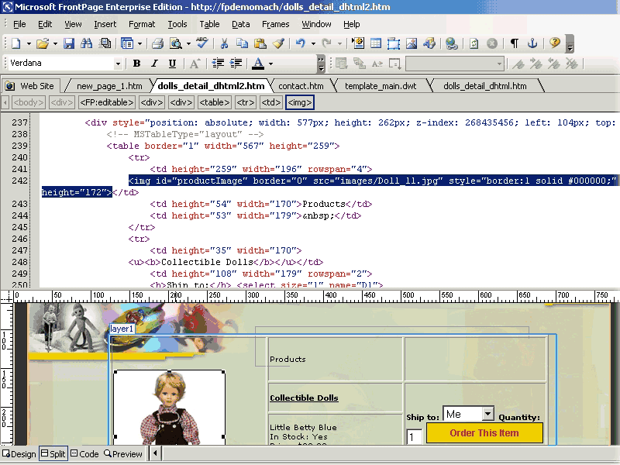
10. Microsoft Frontpage
Microsoft FrontPage is a WYSIWYG HTML editor and web site administration tool from Microsoft for the Microsoft Windows line of operating systems. It was branded as part of the Microsoft Office suite from 1997 to 2003. Microsoft FrontPage has since been replaced by Microsoft Expression Web and Sharepoint Designer, which were first released in December 2006. [What you see is what you get]
http://encyclopedia.thefreedictionary.com/Microsoft+frontpage

Slide 13
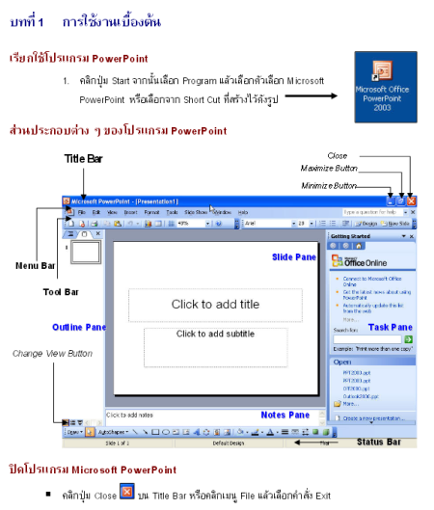
Powerpoint
Preparation
Slide planning
Slide design
Ribbon menu
Layout
Smartart
Graph & Table
Others
Exercise
http://www.thaiall.com/pdf/textbookpowerpoint2003.pdf
http://www.thaiall.com/office/2010/sample2010.pptx

Slide 14
การเตรียมการนำเสนอ (Preparation)
การวางแผน (Planning)
ประสานผู้รับผิดชอบในส่วนต่าง ๆ (Colaboration)
ทดสอบอุปกรณ์ และการนำเสนอ ก่อนนำเสนอจริง (Test)
สภาพห้องเหมาะสม และมีปฏิสัมพันธ์กับผู้ฟังเป็นระยะ (Relation)
ประเมินตนเองหลังการอบรม แล้วปรับแก้เพื่อครั้งต่อไป (Evaluation)
Plan
Do
Check
Action

Slide 15
การวางแผนจัดทำสไลด์ (Slide Planning)
กำหนดวัตถุประสงค์ (Objective)
จัดหาสื่อ และเนื้อหา ทั้งเอกสาร ภาพ เสียง และคลิ๊ป (Acquire)
กลั่นกรองเนื้อหา และจัดหมวดหมู่ (Synthesis)
การออกแบบภาพรวม จุดสนใจ และองค์ประกอบในสไลด์ (Design)
การใช้เวลาประมาณ 1 - 3 นาทีต่อสไลด์ (Time)
แนะนำตัว เนื้อหา และหัวข้อ (Introduction)
ออกแบบการเชื่อมโยงแต่ละสไลด์ (Link)
เตรียมการนำไปใช้ แสง และเสียง (Application)
introduction
process
conclusion

Slide 16
ลักษณะเอกสารนำเสนอ (Slide Design)
สีพื้น และ สีตัวอักษร ตัดกันชัดเจน (Contrast)
ขนาดตัวอักษร ควรใหญ่ > 28 pt (Size)
ภาพประกอบควรเกี่ยวข้องกับเรื่องที่นำเสนอ (Image)
เน้นการนำเสนอหัวข้อ มากกว่ารายละเอียด (Topic)
ใช้ภาพ กราฟ หรือตาราง มากกว่าข้อความ (Graph)
จำนวนบรรทัดต่อหน้าไม่ควรเกิน 8 (Line per page)
ภาพเคลื่อนไหว (Animation)
http://www.scribd.com/doc/105061925
Notes:
http://www.scribd.com/doc/105061925

Slide 17
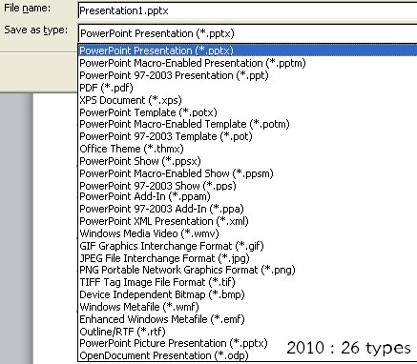
Save as

Slide 18
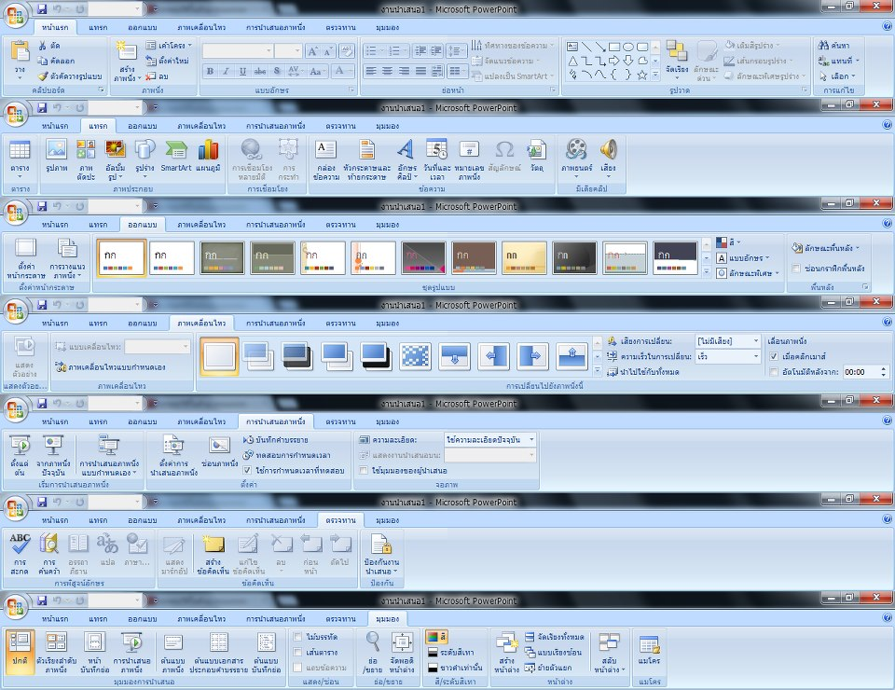
Ribbon menu of Powerpoint

Slide 19
Diagram
A diagram is a two-dimensional geometric (ทางเรขาคณิต) symbolic representation of information according to some visualization technique.
Sometimes, the technique uses a three-dimensional visualization which is then projected onto the two-dimensional surface.
Notes:
http://en.wikipedia.org/wiki/Diagram

Slide 20
SmartArt
SmartArt is a feature first introduced in Microsoft Office 2007. SmartArt was designed to create simple and effective diagrams, organization charts or flow charts with many more options than in past versions of the Office programs.
ชาย
แข็งแรง
หัวหน้าครอบครัว
หญิง
มีทายาทให้
ทำงานบ้าน
ร้อน
ฝน
หนาว
Notes:
http://presentationsoft.about.com/od/s/g/110221-smartart-definition.htm

Slide 21
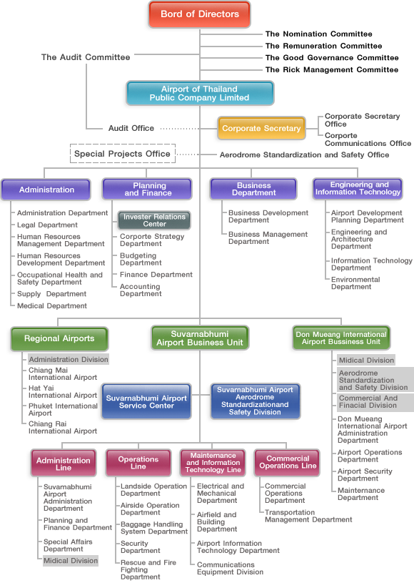
Organization Chart
An organizational chart (often called organization chart, org chart, organigram, or organogram) is a diagram that shows the structure of an organization and the relationships and relative ranks of its parts and positions/jobs.
Notes:
http://en.wikipedia.org/wiki/Organizational_chart

Slide 22
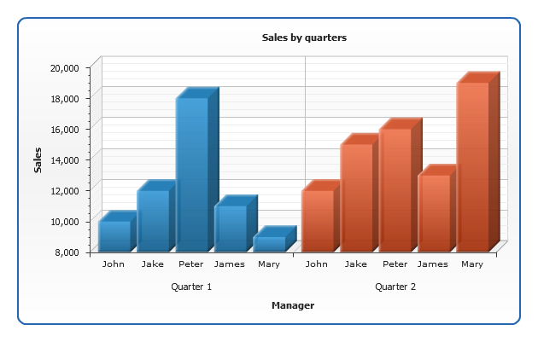
Chart
A chart is a graphical representation of data, in which "the data is represented by symbols, such as bars in a bar chart, lines in a line chart, or slices in a pie chart“.
A chart can represent tabular numeric data, functions or some kinds of quantitative (ปริมาณ) structures.

Slide 23
ภาพตัดแปะ (Clipart)
Clip art is a collection of pictures or images that can be imported into a document or another program. The images may be either raster graphics (Bitmap picture) or vector graphics.
Clip art galleries many contain anywhere from a few images to hundreds of thousands of images.
Notes:
http://www.techterms.com/definition/clipart http://www.edu-mine.com/photoshop/lesson1_RasterVector.html

Slide 24
Wordart
WordArt is a text modifying feature in Microsoft Word, a popular word processing program. It includes effects such as shadows, outlines, colors, gradients, and 3D effects that can be added to a word or phrase.
WordArt can also bend (โค้ง), stretch (ยืด หด), skew (เอียง) , or otherwise modify the shape of the text.
อักษรศิลป์ ขององค์กร สวยงาม
Notes:
http://www.techterms.com/definition/wordart

Slide 25
ภาพรวม (Layout)
มุมมอง (View) , ต้นแบบภาพนิ่ง (Slide Master)
ออกแบบ(Design) , ชุดรูปแบบ (Template)
ลำดับเลขไทย หรือสัญลักษณ์ (Symbol)
ระยะห่างบรรทัดและย่อหน้า (Line and paragraph spacing)
คอลัมน์ (Column)
ทิศทางของข้อความ (Direction)
การจัดแนว (Arrange)
ค้นหา และแทนที่ (Search & Replace)
การตัด (Crop)

Slide 26
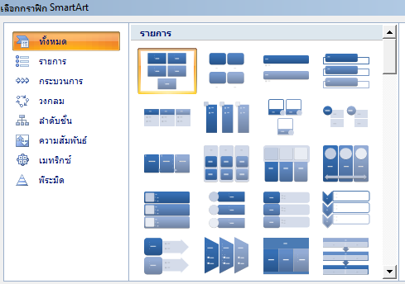
Smartart
List
Process
Circle
Relation
Organization Chart
Pyramid

Slide 27
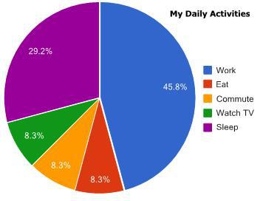
Graph & Table
Bar chart
Line chart
Pie chart
Table
การเดินทาง

Slide 28
Others
Clipart
Animation => Movie
Rehearse timing => WMV
WordArt => logo
Markup : Create
Markeup : Show/Hide
Notes:
http://www.thaiall.com/office/2010/mycar.pptx

Slide 29
Exercise
Time schedule
Logo
Seminar advertising
Flow of working
Organization of company
Sound
Movie
Animation
http://www.thaiall.com/office/2010/sample2010.pptx
http://www.thaiall.com/vdoteach

Slide 30
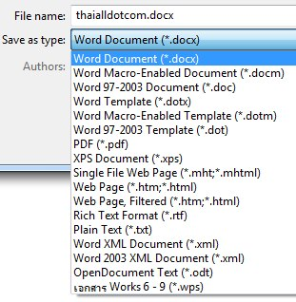
Microsoft word
Save as
Ribbon menu
Brochure
Webpage
PDF
JPG

Slide 31
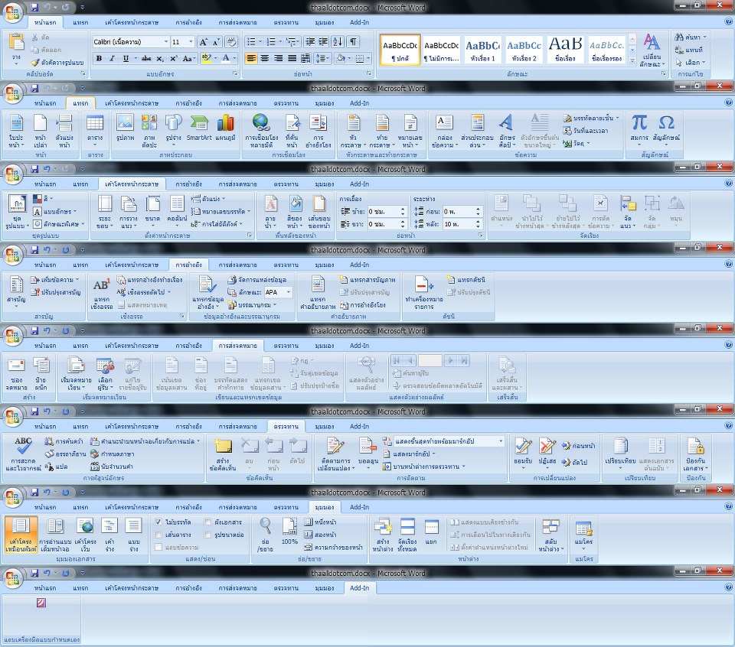
Ribbon menu

Slide 32
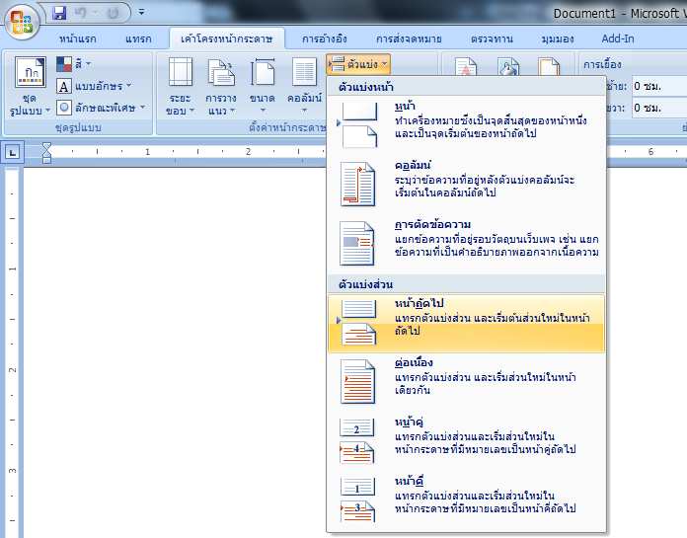
Split section

Slide 33
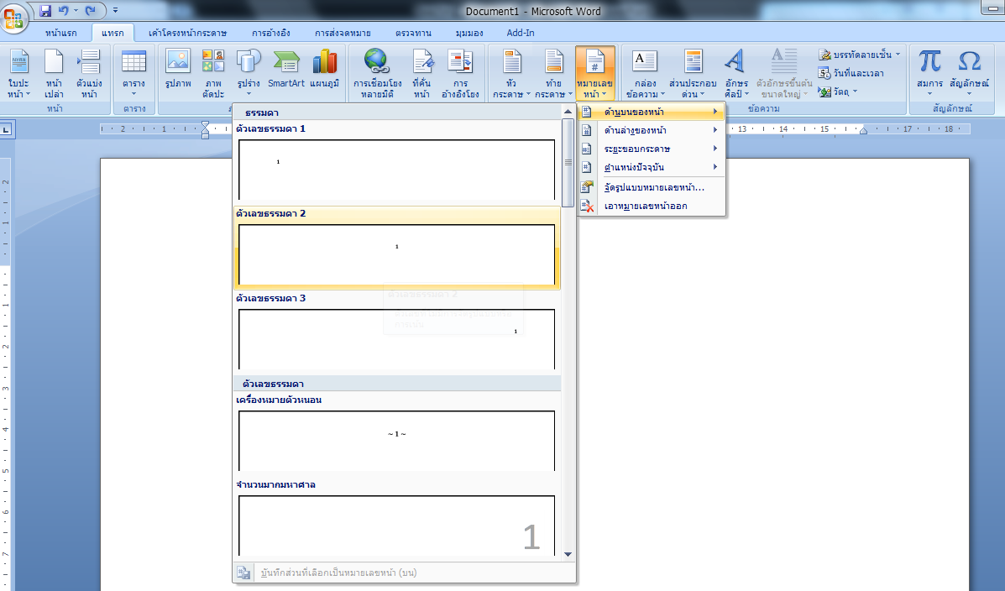
Insert page number

Slide 34
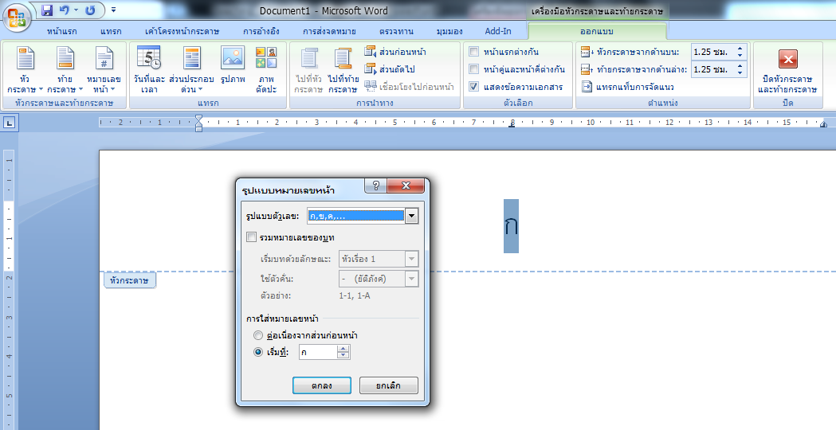
Page difference
- หน้าแรกไม่มีเลขหน้า
- ก่อนเริ่มบทที่ 1 เป็นหน้า ก ข ค
- ทุกการเริ่มบทใหม่ ไม่มีเลขหน้า
- ภาคผนวกเป็นหน้า i

Slide 35
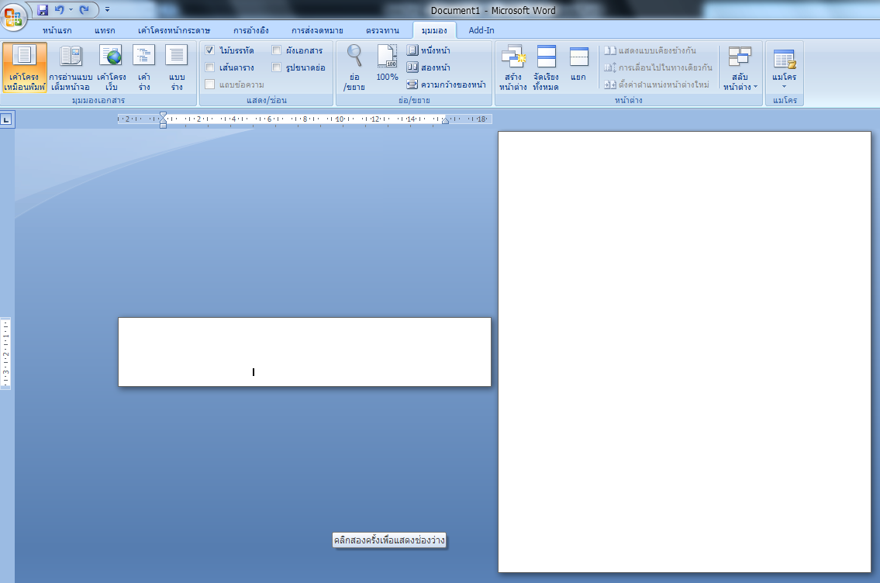
Viewing

Slide 36
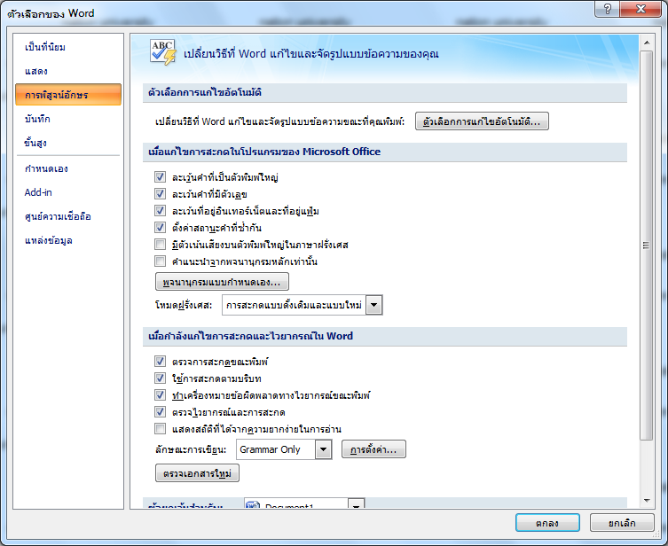
Switch for spelling check

Slide 37
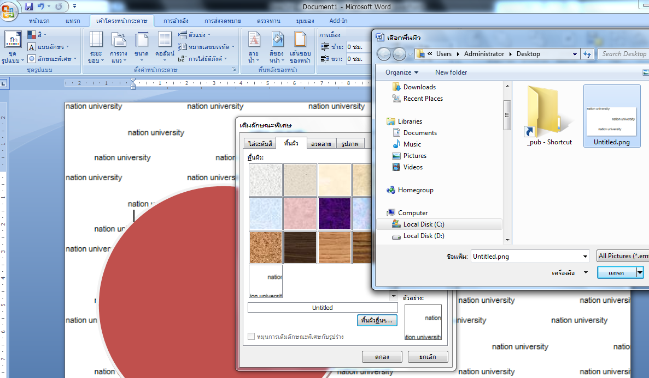
Background with character
สร้างข้อความสำหรับเป็น background ด้วย microsoft paint

Slide 38
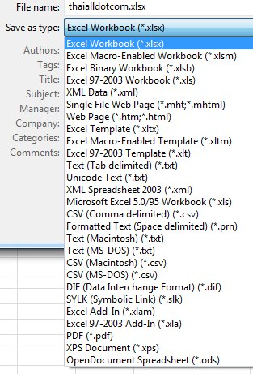
Microsoft Excel
Ribbon menu
Save as
Function
Pivot table

Slide 39
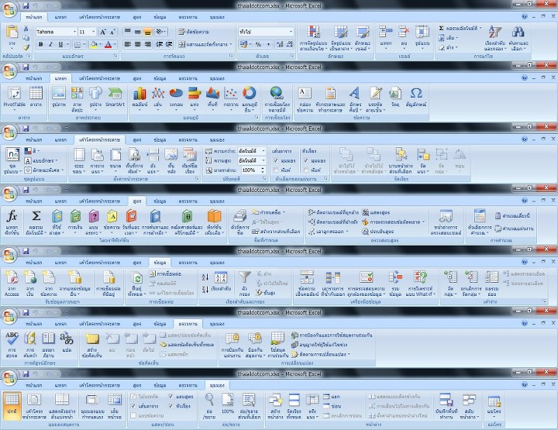
Ribbon menu

Slide 40
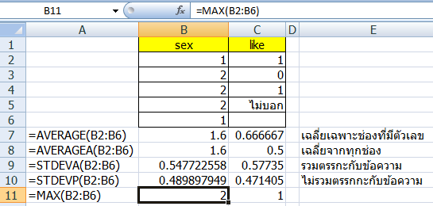
Function
=AVERAGE(A1:A10)
=MIN(A1:A10)
=COUNT(A1:A10,B1:B10) only number
=COUNTA(A1:A10) if not blank
=COUNTIF(B1:B10,A1>80)

Slide 41
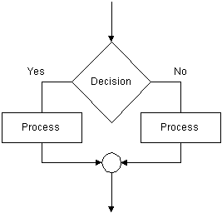
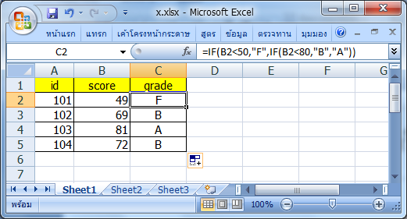
if
=IF(B2<50,"F", "A")
=IF(B2<50,"F",IF(B2<80,"B","A"))

Slide 42
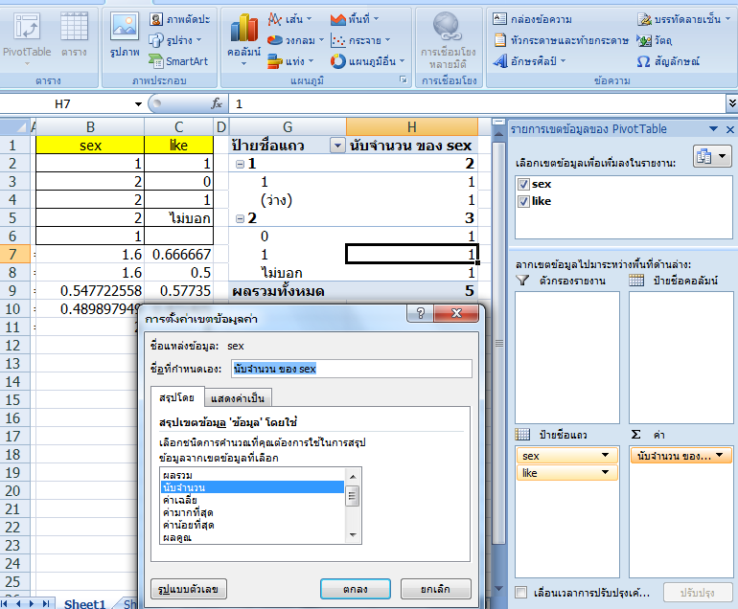
Pivot table : Rows & Value

Slide 43
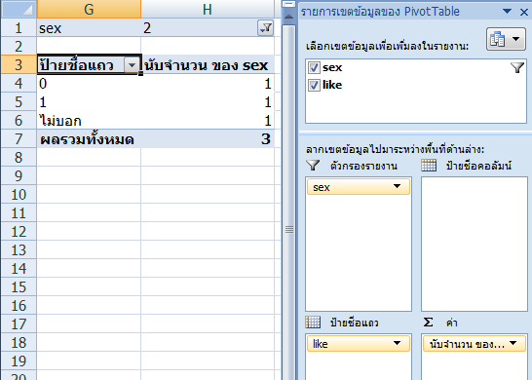
Pivottable : filter

Slide 44
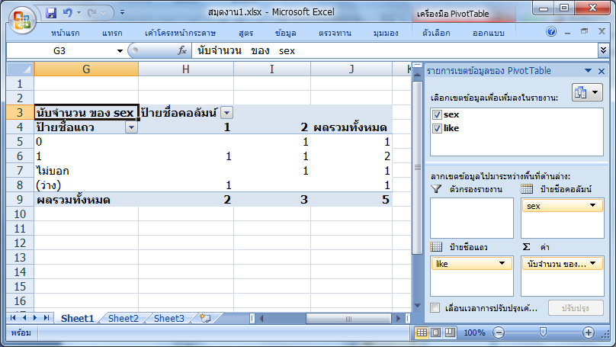
Pivottable : column

Slide 45
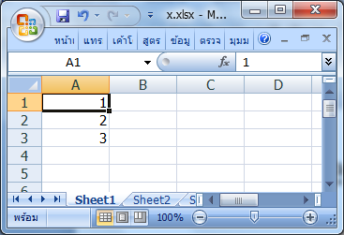
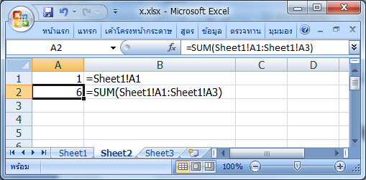
Sheet reference
=SUM(Sheet1!A1:Sheet1!A3)

Slide 46
Term: Embed
In computing, an embedded system is a special-purpose system in which the computer is completely encapsulated by the device it controls
In computing, embedding media into a text document, forming a compound document
In computing, font embedding is inclusion of font files inside an electronic document

Slide 47
Term: CSV application
Comma Separated Variable
Comma Delimited
Database
File, Record, Field
Microsoft Access
SPSS

Slide 48
Q & A

