Slide 1

BIRCH:
Balanced Iterative Reducing and Clustering using Hierarchies
Tian Zhang, Raghu Ramakrishnan, Miron Livny
Presented by Zhao Li
2009, Spring
Notes:
Data Mining and Knowledge Discovery, Volume 1, Issue 2, 1997, pp. 141-182

Slide 2
Introduction to BIRCH
Designed for very large data sets
Time and memory are limited
Incremental and dynamic clustering of incoming objects
Only one scan of data is necessary
Does not need the whole data set in advance
Two key phases:
Scans the database to build an in-memory tree
Applies clustering algorithm to cluster the leaf nodes
September 1, 2017

Slide 3



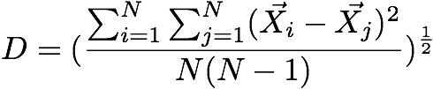
Similarity Metric(1)
Given a cluster of instances , we define:
Centroid:
Radius: average distance from member points to centroid
Diameter: average pair-wise distance within a cluster
September 1, 2017

Slide 4

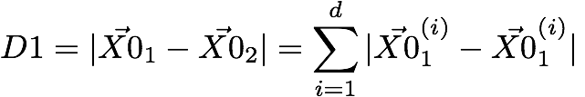

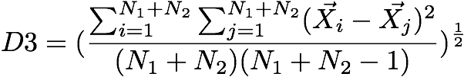
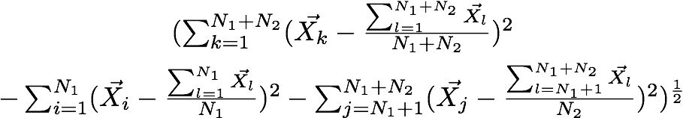
Similarity Metric(2)
centroid Euclidean distance:
centroid Manhattan distance:
average inter-cluster:
average intra-cluster:
variance increase:
September 1, 2017

Slide 5
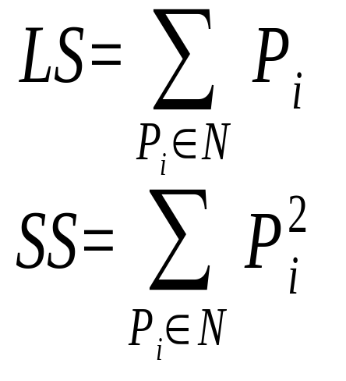
Clustering Feature
The Birch algorithm builds a dendrogram called clustering feature tree (CF tree) while scanning the data set.
Each entry in the CF tree represents a cluster of objects and is characterized by a 3-tuple: (N, LS, SS), where N is the number of objects in the cluster and LS, SS are defined in the following.
September 1, 2017
Notes:
N is the number of data points
LS is the linear sum of the N points
SS is the square sum of the N points

Slide 6
Properties of Clustering Feature
CF entry is more compact
Stores significantly less than all of the data points in the sub-cluster
A CF entry has sufficient information to calculate D0-D4
Additivity theorem allows us to merge sub-clusters incrementally & consistently
September 1, 2017
Notes:
CF Additivity Theorem: if CF_1 and CF_2 are disjoint, merging them is equal to the sum of their parts

Slide 7
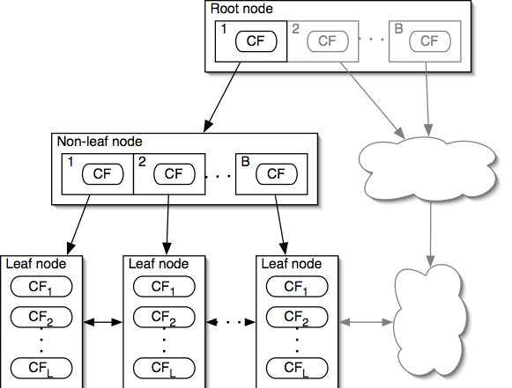
CF-Tree
Each non-leaf node has at most B entries
Each leaf node has at most L CF entries, each of which satisfies threshold T
September 1, 2017
Notes:
CF tree can be viewed as a multilevel compression of the data that tries to preserve the inherent clustering structure of the data
A non-leaf node entry is a CF triplet and a child node link
Each non-leaf node contains a number of child nodes. The number of children that a non-leaf node can contain is limited by a threshold called the branching factor.
A leaf node is a collection of CF triplets and links to the next and previous leaf nodes
Each leaf node contains a number of subclusters that contains a group of data instances
The diameter of a subcluster under a leaf node can not exceed a threshold.

Slide 8
CF-Tree Insertion
Recurse down from root
    Find the appropriate leaf
Follow the "closest"-CF path, w.r.t. D0 / … / D4
Modify the leaf
If the closest-CF leaf cannot absorb, make a new CF entry. If there is no room for new leaf, split the parent node
Traverse back
Update CFs on the path or splitting nodes
September 1, 2017
Notes:
Closest CF is determined by any of D0-D4
Leaf node split: take two farthest CFs and create two leaf nodes, put the remaining CFs (including the new one that caused the split) into the closest node.
Splitting the root on the traverse back increases tree height by one

Slide 9
CF-Tree Rebuilding
If we run out of space, increase threshold T
By increasing the threshold, CFs absorb more data
Rebuilding "pushes" CFs over
The larger T allows different CFs to group together
Reducibility theorem
Increasing T will result in a CF-tree smaller than the original
September 1, 2017
Notes:
Bigger T = Smaller CF-tree
The rebuild will also take no more than h (height of the original tree) extra pages of memory (nodes)

Slide 10
Example of BIRCH
New subcluster
sc8
sc3
sc1
sc4
sc5
sc6
sc7
sc2
LN2
LN3
Root
LN1
LN1
LN2
LN3
sc8
sc1
sc3
sc4
sc5
sc6
sc7
sc2
September 1, 2017

Slide 11
Insertion Operation in BIRCH
If the branching factor of a leaf node can not exceed 3, then LN1 is split.
sc8
sc3
sc1
sc4
sc5
sc6
sc7
sc2
LN1’
LN2
LN3
LN1”
Root
LN1’
LN2
LN3
LN1”
sc8
sc1
sc3
sc4
sc5
sc6
sc7
sc2
September 1, 2017

Slide 12
If the branching factor of a non-leaf node can not
exceed 3, then the root is split and the height of
the CF Tree increases by one.
sc8
sc3
sc1
sc4
sc5
sc6
sc7
sc2
LN1’
LN2
LN3
LN1”
Root
NLN1
NLN2
LN1’
LN2
LN3
LN1”
sc8
sc1
sc2
sc3
sc4
sc5
sc6
sc7
September 1, 2017

Slide 13
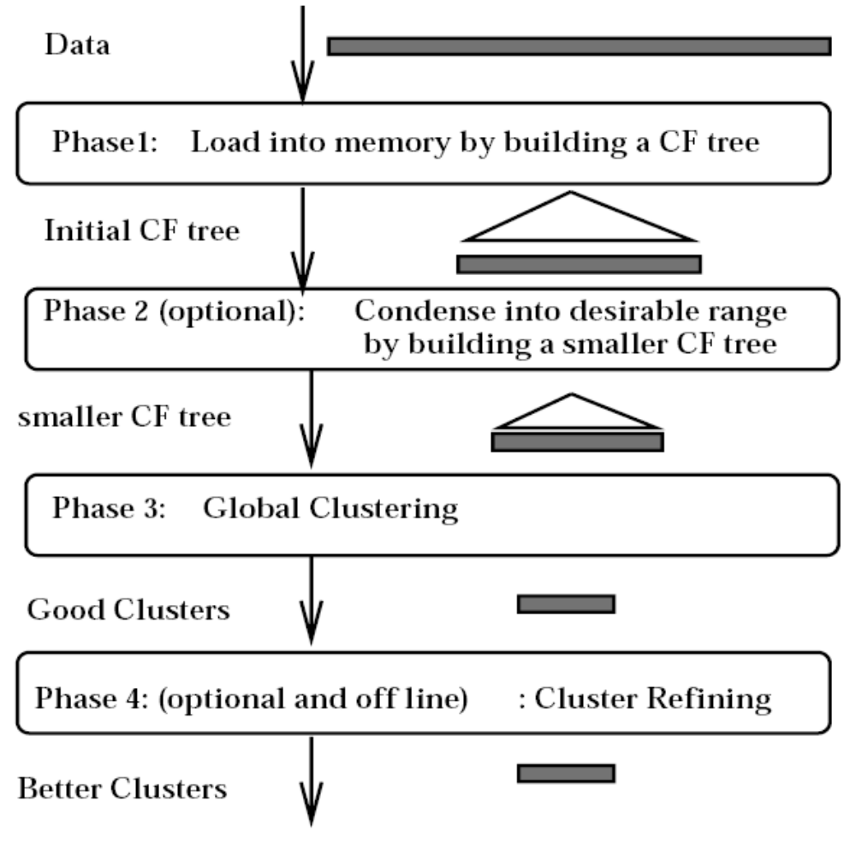
BIRCH Overview
September 1, 2017
Notes:
Phase 1: Load data into memory
Build an initial in-memory CF-tree with the data (one scan)
Subsequent phases become fast, accurate, less order sensitive
Phase 2: Condense data
Rebuild the CF-tree with a larger T
Condensing is optional
Phase 3: Global clustering
Use existing clustering algorithm on CF leafs
Phase 4: Cluster refining
Do additional passes over the dataset & reassign data points to the closest centroid from phase 3
Refining is optional

Slide 14
Experimental Results
Input parameters:
  Memory (M): 5% of data set
  Disk space (R): 20% of M
  Distance equation: D2
  Quality equation: weighted average diameter (D)
  Initial threshold (T): 0.0
  Page size (P): 1024 bytes
September 1, 2017
Notes:
Node size is determined by dimensionality of data space and input parameter P (page size)

Slide 15
Experimental Results
KMEANS clustering
DS | Time | D | # Scan | DS | Time | D | # Scan
1 | 43.9 | 2.09 | 289 | 1o | 33.8 | 1.97 | 197
2 | 13.2 | 4.43 | 51 | 2o | 12.7 | 4.20 | 29
3 | 32.9 | 3.66 | 187 | 3o | 36.0 | 4.35 | 241
BIRCH clustering
DS | Time | D | # Scan | DS | Time | D | # Scan
1 | 11.5 | 1.87 | 2 | 1o | 13.6 | 1.87 | 2
2 | 10.7 | 1.99 | 2 | 2o | 12.1 | 1.99 | 2
3 | 11.4 | 3.95 | 2 | 3o | 12.2 | 3.99 | 2
September 1, 2017
Notes:
Page size
When using Phase 4, P can vary from 256 to 4096 without much effect on the final results
Memory vs. Time
Results generated with low memory can be compensated for by multiple iterations of Phase 4

Slide 16
Exam Questions
What is the main limitation of BIRCH?
Since each node in a CF tree can hold only a limited number of entries due to the size, a CF tree node doesn’t always correspond to what a user may consider a nature cluster. Moreover, if the clusters are not spherical in shape, it doesn’t perform well because it uses the notion of radius or diameter to control the boundary of a cluster.
September 1, 2017

