Slide 1
Mock Project
Group 3
Phạm Thái Hà
Đặng Hải Dương
Lê Văn Hưng

Slide 2
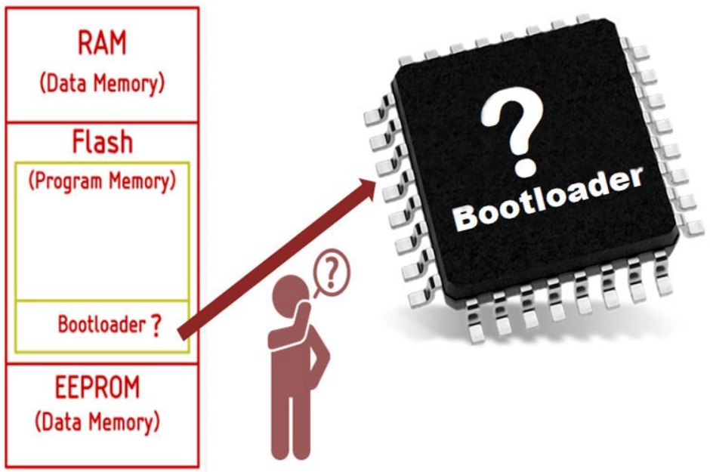
Definition
A bootloader is an application whose primary objective is to upgrade/modify system software without the intervention of specialized firmware upgrade tools. Bootloaders can have many functionalities, but it's mainly used to manage the application.
They can also utilize different protocols such as UART, CAN, I2C, I2S, Ethernet, or USB to establish communication and initial a firmware upgrade.

Slide 3
Why we need bootloader?
The bootloader is needed when you need to have the possibility to update your firmware without having specialized software or tool and without the need to re-enable the security settings to allow this.

Slide 4
How it work?
There are three crucial parts in any bootloader: branching code, on startup, it decides whether to execute the bootloader code or the application code.
In bootloader mode it starts initializing basic instruction and peripherals (system clocks, interrupts and communication channels) to prepare for a firmware upgrade . These allow the bootloader to accept instruction from outside, and it starts the upgrade process; once done, it soft-resets the chip, and when it boots up again, it goes to the normal operation mode.

Slide 5
Firmware
Requirement:
Application 1:
Read Temperature Sensor each 1s and save 10 times of data
When PC send a command (0x55) to MCU, it send last 10 times of data to PC.
Flashing to Sector 10
Application 2:
New Firmware is new version of Old Firmware
It can change the time of Sensor Reading from 1s to 1.5s
It can change UART code from 0x55 to 0xAA
NOTE:
New Firmware will load to a new position on Flash (Ex Sector 20) ,
Now Bootloader Program will jump to New Firmware on Sector 20
Old Firmware on Sector 10 is Backup Firmware

Slide 6
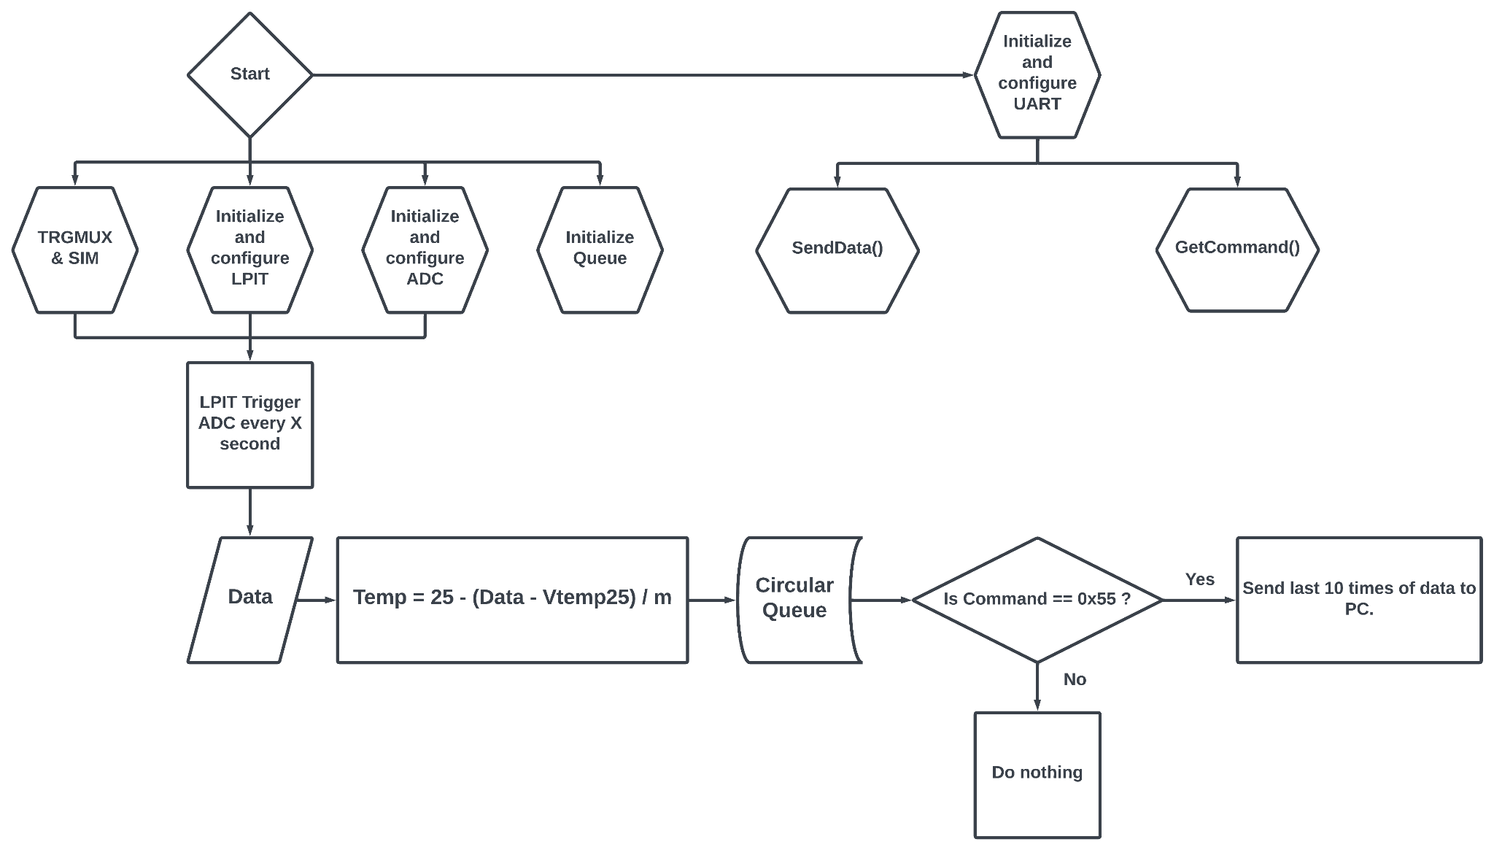
Flowchart

Slide 7
Flash - FTFA
• Sector size of 1 KB
• Program flash protection scheme prevents accidental program or erase of stored data
• Automated, built-in, program and erase algorithms with verify

Slide 8
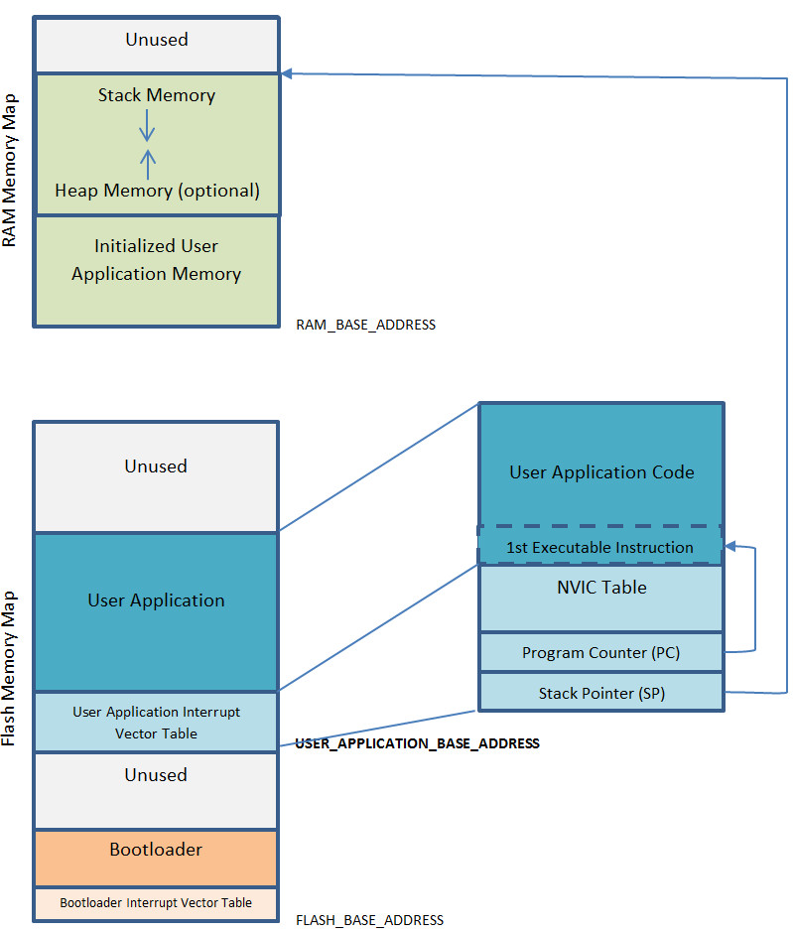
Jump app

Slide 9
Jump app
static void BootJump( uint32_t *Address )
{
Make sure, the CPU is in privileged mode.
if( CONTROL_nPRIV_Msk & __get_CONTROL( ) )
{ /* not in privileged mode */
EnablePrivilegedMode( ) ;
}
2. Disable all enabled interrupts in NVIC.
NVIC->ICER[ 0 ] = 0xFFFFFFFF ;
NVIC->ICER[ 1 ] = 0xFFFFFFFF ;
NVIC->ICER[ 2 ] = 0xFFFFFFFF ;
NVIC->ICER[ 3 ] = 0xFFFFFFFF ;
NVIC->ICER[ 4 ] = 0xFFFFFFFF ;
NVIC->ICER[ 5 ] = 0xFFFFFFFF ;
NVIC->ICER[ 6 ] = 0xFFFFFFFF ;
NVIC->ICER[ 7 ] = 0xFFFFFFFF ;

Slide 10
Jump app
3. Clear all pending interrupt requests in NVIC.
NVIC->ICPR[ 0 ] = 0xFFFFFFFF ;
NVIC->ICPR[ 1 ] = 0xFFFFFFFF ;
NVIC->ICPR[ 2 ] = 0xFFFFFFFF ;
NVIC->ICPR[ 3 ] = 0xFFFFFFFF ;
NVIC->ICPR[ 4 ] = 0xFFFFFFFF ;
NVIC->ICPR[ 5 ] = 0xFFFFFFFF ;
NVIC->ICPR[ 6 ] = 0xFFFFFFFF ;
NVIC->ICPR[ 7 ] = 0xFFFFFFFF ;
4. Disable SysTick and clear its exception pending bit, if it is used in the bootloader, e. g. by the RTX.
SysTick->CTRL = 0 ;
SCB->ICSR |= SCB_ICSR_PENDSTCLR_Msk ;

Slide 11
Jump app
5. Disable individual fault handlers if the bootloader used them.
SCB->SHCSR &= ~( SCB_SHCSR_USGFAULTENA_Msk | \
SCB_SHCSR_BUSFAULTENA_Msk | \
SCB_SHCSR_MEMFAULTENA_Msk ) ;
6. Activate the MSP, if the core is found to currently run with the PSP. As the compiler might still use the stack, the PSP needs to be copied to the MSP before this.
if( CONTROL_SPSEL_Msk & __get_CONTROL( ) )
{ /* MSP is not active */
__set_MSP( __get_PSP( ) ) ;
__set_CONTROL( __get_CONTROL( ) & ~CONTROL_SPSEL_Msk ) ;
}

Slide 12
Jump app
7. Load the vector table address of the user application into SCB->VTOR register. Make sure the address meets the alignment requirements.
SCB->VTOR = ( uint32_t )Address ;
8. The final part is to set the MSP to the value found in the user application vector table and then load the PC with the reset vector value of the user application. This can't be done in C, as it is always possible, that the compiler uses the current SP. But that would be gone after setting the new MSP. So, a call to a small assembler function is done.
BootJumpASM( Address[ 0 ], Address[ 1 ] ) ;

Slide 13
Jump app
Define the starting address for the main application, and call the jump function with the address as a parameter:
#define USER_APPLICATION_BASE_ADDRESS 0x00008000 /* as example */
BootJump( ( uint32_t * )USER_APPLICATION_BASE_ADDRESS ) ;

Slide 14
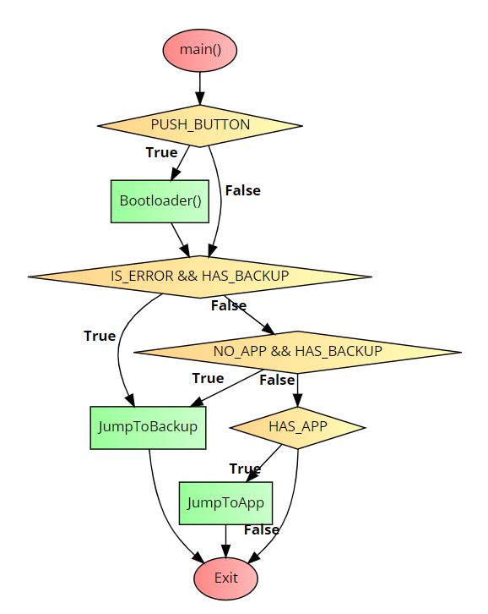
main()

Slide 15
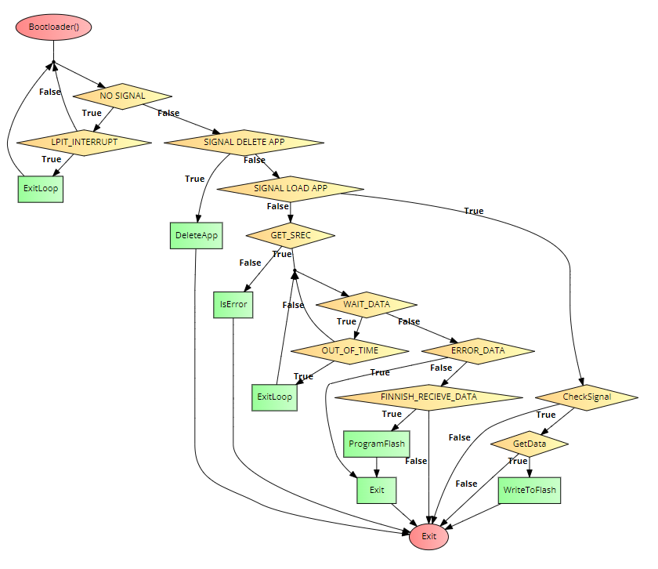
Bootloader()

