Slide 1


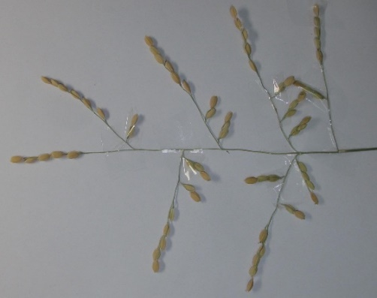
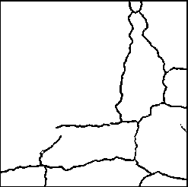
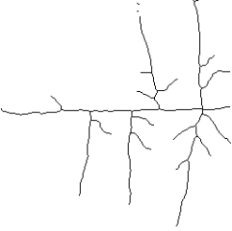
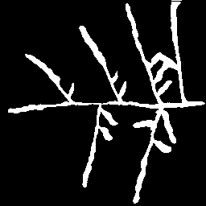
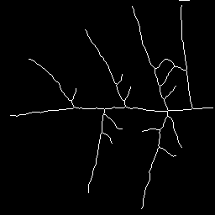
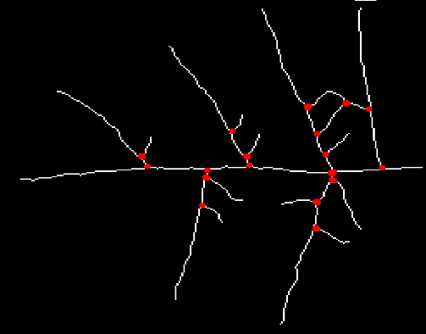
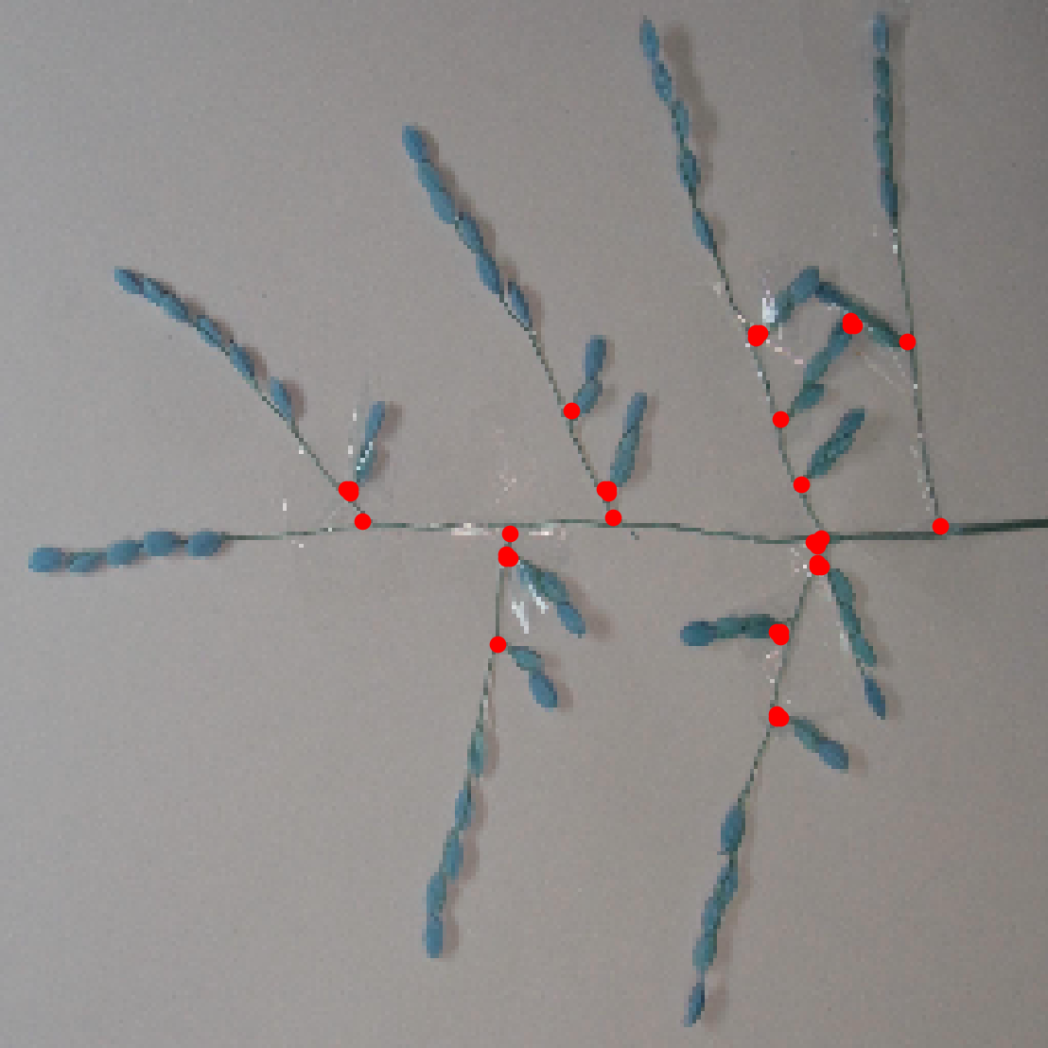



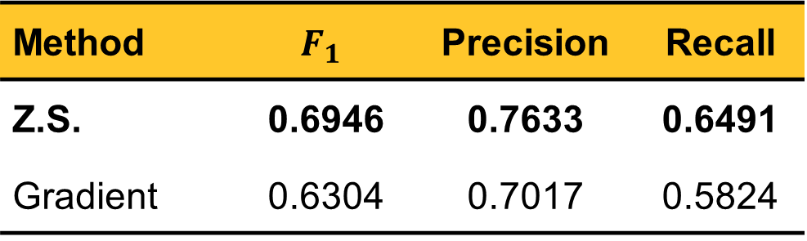
VIETNAM NATIONAL UNIVERSITY, HANOI
​ University of Engineering and Technology
Architecture Analysis of Rice Panicle
using Deep Learning
Lam Thai Nguyen & Trung Kien Pham
thainguyen2893@gmail.com & kienyb305@gmail.com
Faculty of Engineering Mechanics and Automation
1 - Motivation
2 - Method
Plant phenotyping involves the analysis of observable traits in plants, crucial for tasks like breeding and yield optimization.
Rice panicle phenotyping [1] includes examining ecological features such as panicle length and branch count.
Traditional methods for trait measurement and junction detection are labor-intensive and time-consuming.
We utilize a crack detection Deep Learning model named RUC-Net [2], together with Clustering and Skeletonization algorithms to effectively extract the desired junctions.
The image processing procedure consists of the following steps:
1
Original image
Visual similarities between concrete cracks and rice panicles.
Binarizing
(RUC-Net [2])
2
Binary image
Skeletonizing
Concrete crack
Rice panicle
3
Skeleton image
We propose a cross-domain vision-based approach to automatically detect rice panicle junctions.
Our method capitalizes on similarities between concrete cracks and rice panicles.
Clustering
4
Junction detection
$$F_{1}−score$$
3 - Results
5
Evaluation
We evaluate the accuracy of our proposed method using the $F_{1}−score$, which is the harmonic mean of precision and recall.
Obtained results show the optimal algorithm for each step.
Rice panicle junction detection process.
4 - Conclusion
Contribution
Method | $$F_{1}$$ | Precision | Recall
CN | 0.6946 | 0.7633 | 0.6491
BWMORPH | 0.6818 | 0.7022 | 0.6862
DBSCAN | 0.6930 | 0.6447 | 0.5085
Our proposed method, compared to P-TRAP [1], offers advantages in automatically detecting rice panicle junctions, addressing a crucial need in
plant phenotyping.
Quantitative results of participating Clustering algorithms.
Novelty
A cross-domain image-based approach utilizing Deep Learning and Machine Learning.
Method | $$F_{1}$$ | Precision | Recall
Z.S. | 0.6946 | 0.7633 | 0.6491
Gradient | 0.6304 | 0.7017 | 0.5824
Future Work
Fine-tuning participating algorithms for better accuracy.
Extending to rice grains/spikelets detection.
Quantitative results of participating Skeletonization algorithms.
70%
Bibliography
[1] F. AL-Tam, H. Adam, A. d. Anjos, M. Lorieux, P. Larmande, A. Ghesqui`ere, S. Jouannic, and H. R. Shahbazkia, “P-trap: a panicle trait phenotyping tool,” BMC Plant Biology, vol. 13, no. 1, p. 122, Aug 2013.
[2] G. Yu, J. Dong, Y. Wang, and X. Zhou, “Ruc-net: A residual-unet-based convolutional neural network for pixel-level pavement crack segmentation,” Sensors, vol. 23, no. 1, 2023.
Address: E3 building, 144 Xuan Thuy Road, Cau Giay District, Hanoi, Vietnam​
Tel.: +84-24-37547 461. Website: http://www.vnu.edu.vn

