Slide 1



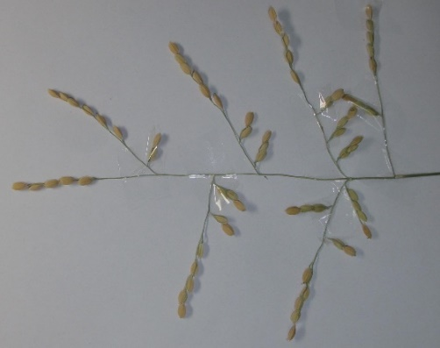

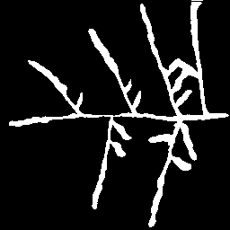

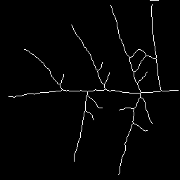

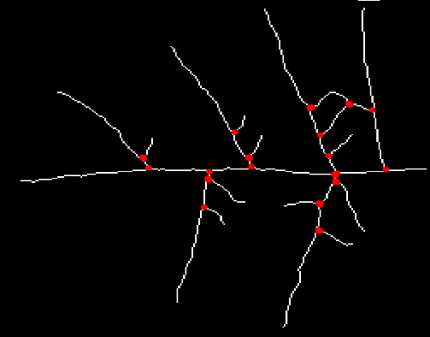
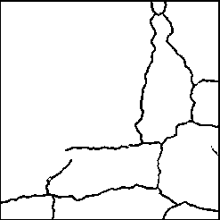
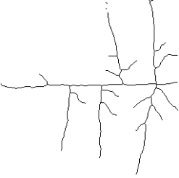
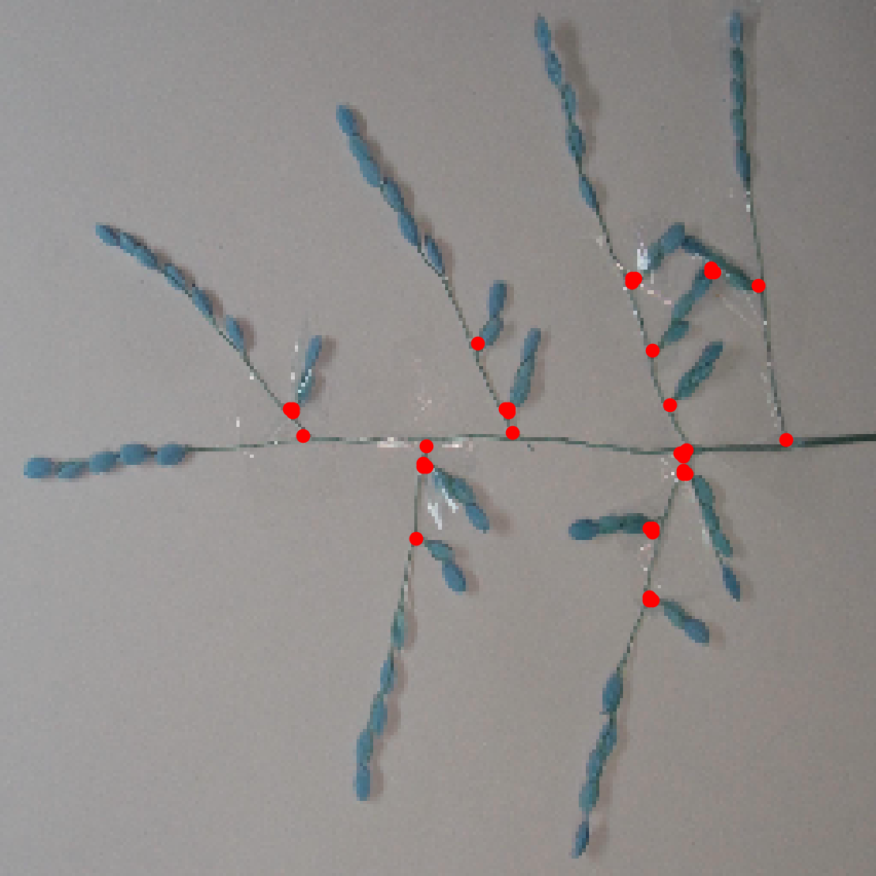

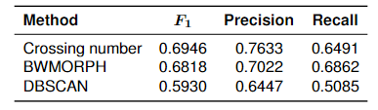
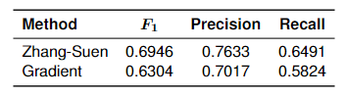

VIETNAM NATIONAL UNIVERSITY, HANOI
​ University of Engineering and Technology
thainguyen2893@gmail.com
Architecture Analysis of Rice Panicle
using Deep Learning
Lam Thai Nguyen & Trung Kien Pham
Faculty of Engineering Mechanics and Automation
1 - MOTIVATION
2 - METHOD
Plant phenotyping [1]
1
Original image
Breeding
Yield optimization
RUC-Net [2]
Ecological traits
2
Binary image
Junctions
Skeletonizing
Grains
Challenges
3
Skeleton image
Time-consuming
Clustering
Inaccurate
Proposed method
4
Junction detection
$$F_{1}−score$$
5
Evaluation
4 - CONCLUSION
Contribution
3 - RESULTS
Automatically detecting rice panicle junctions
Architecture analysis
Crop improvement
Novelty
A cross-domain image-based approach utilizing Deep Learning and Machine Learning
70%
Bibliography
[1] F. AL-Tam, H. Adam, A. d. Anjos, M. Lorieux, P. Larmande, A. Ghesqui`ere, S. Jouannic, and H. R. Shahbazkia, “P-trap: a panicle trait phenotyping tool,” BMC Plant Biology, vol. 13, no. 1, p. 122, Aug 2013.
[2] G. Yu, J. Dong, Y. Wang, and X. Zhou, “Ruc-net: A residual-unet-based convolutional neural network for pixel-level pavement crack segmentation,” Sensors, vol. 23, no. 1, 2023.
Address: E3 building, 144 Xuan Thuy Road, Cau Giay District, Hanoi, Vietnam​
Tel.: +84-24-37547 461. Website: http://www.vnu.edu.vn

