Slide 1
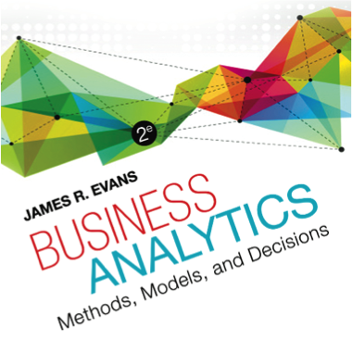

Chapter 9 Forecasting Techniques

Slide 2
Forecasting Techniques
Managers require good forecasts of future events.
Business Analysts may choose from a wide range of forecasting techniques to support decision making.
Three major categories of forecasting approaches:
1. Qualitative and judgmental techniques
2. Statistical time-series models
3. Explanatory/causal models

Slide 3
Qualitative and Judgmental Forecasting
Qualitative and Judgmental techniques rely on experience and intuition.
They are necessary when historical data is not available or when predictions are needed far into the future.
The historical analogy approach obtains a forecast through comparative analysis with prior situations.
The Delphi method questions an anonymous panel of experts 2-3 times in order to reach a convergence of opinion on the forecasted variable.

Slide 4
Example 9.1: Predicting the Price of Oil
Early 1988 – oil price was about $22 a barrel
Mid-1988 – oil price dropped to $11 a barrel because of oversupply, high production in non-OPEC regions, and lower than normal demand
In the past, OPEC would raise the price of oil.
Historical analogy would forecast a higher price.
However, the price continued to drop even though OPEC agreed to cut production.
Historical analogies cannot always account for current realities!

Slide 5
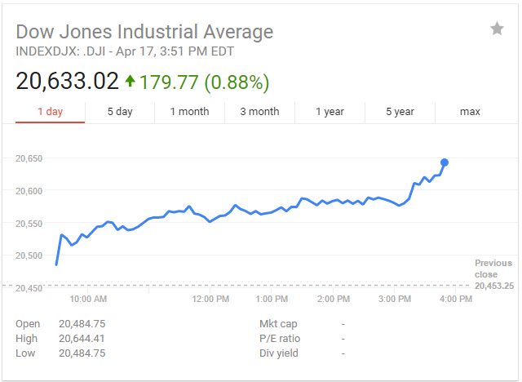
Indicators and Indexes
Indicators are measures that are believed to influence the behavior of a variable we wish to forecast.
Indicators are often combined quantitatively into an index, a single measure that weights multiple indicators, thus providing a measure of overall expectation.
Example: Dow Jones Industrial Average

Slide 6
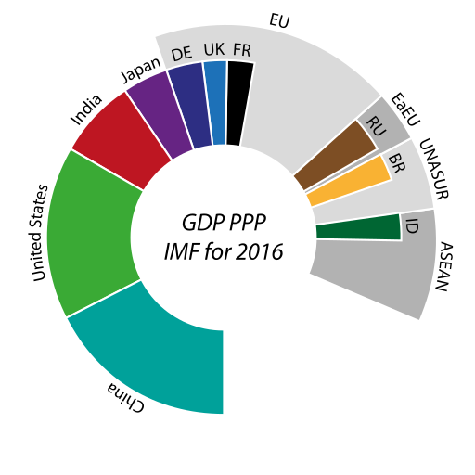
Example 9.2: Economic Indicators
GDP (Gross Domestic Product) measures the value of all goods and services produced.
GDP rises and falls in a cyclic fashion.
Forecasting GDP is often done using leading indicators (series that change before the GDP changes) and lagging indicators (series that follow changes in the GDP) indicators.
Examples
Leading - formation of business enterprises
- percent change in money supply (M1)
Lagging - business investment expenditures
- prime rate
- inventories on hand

Slide 7
Example 9.3: Leading Economic Indicators
An Index of Leading Indicators was developed by the Department of Commerce.
This index is related to the economic performance is available from www.conference-board.org.
It includes measures such as:
- average weekly manufacturing hours
- new orders for consumer goods
- building permits for private housing
- S&P 500 stock prices

Slide 8
Statistical Forecasting Models
Time Series – a stream of historical data, such as weekly sales
T = number of periods, t = 1, 2, …, T
Time series generally have components such as:
- random behavior
- trends (upward or downward)
- seasonal effects
- cyclical effects
Stationary time series have only random behavior.
A trend is a gradual upward or downward movement of a time series.

Slide 9
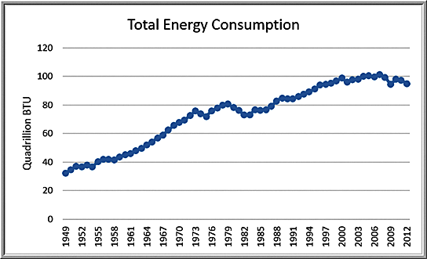
Example 9.4: Identifying Trends in a Time Series
The Energy Production & Consumption
General upward trend with some short downward trends; the time series is composed of several different short trends.

Slide 10
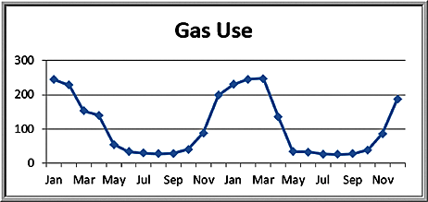
Seasonal Effects
A seasonal effect is one that repeats at fixed intervals of time, typically a year, month, week, or day.

Slide 11
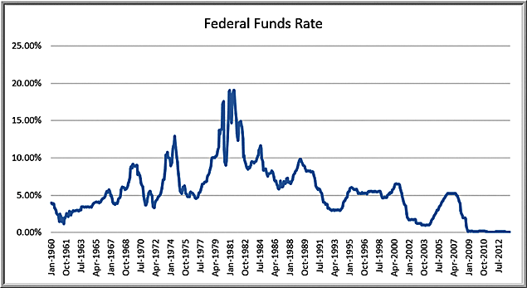
Cyclical Effects
Cyclical effects describe ups and downs over a much longer time frame, such as several years.

Slide 12
Forecasting Models for Stationary Time Series
Moving average model
Exponential smoothing model
These are useful over short time periods when trend, seasonal, or cyclical effects are not significant

Slide 13
Moving Average Models
The simple moving average method is a smoothing method based on the idea of averaging random fluctuations in the time series to identify the underlying direction in which the time series is changing.
The simple moving average forecast for the next period is computed as the average of the most recent k observations.
Larger values of k result in smoother forecast models since extreme values have less impact.

Slide 14
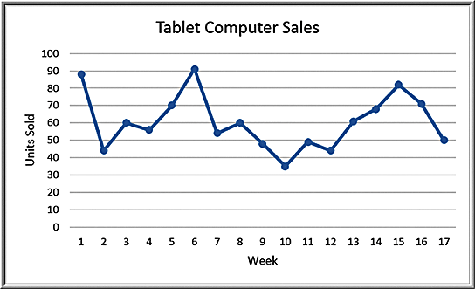

Example 9.5: Moving Average Forecasting
The Tablet Computer Sales data contains the number of units sold over the past 17 weeks.
Three-period moving average forecast for week 18:

Slide 15
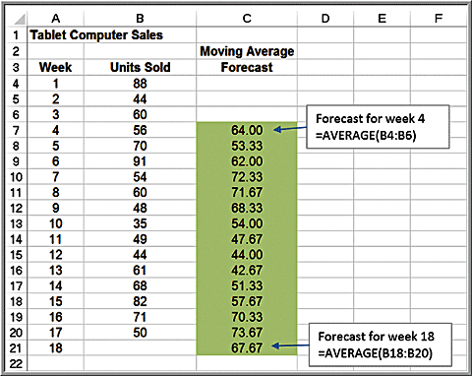
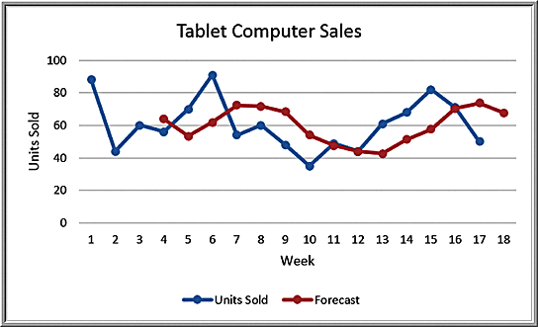
Spreadsheet Implementation of Moving Average Forecasting

Slide 16
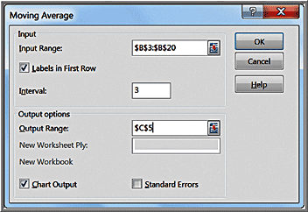
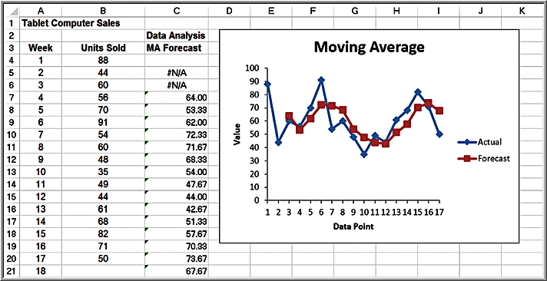
Excel Moving Average Tool
Data Analysis options
We do not recommend using the chart or error options because the forecasts generated by this tool are not properly aligned with the data

Slide 17
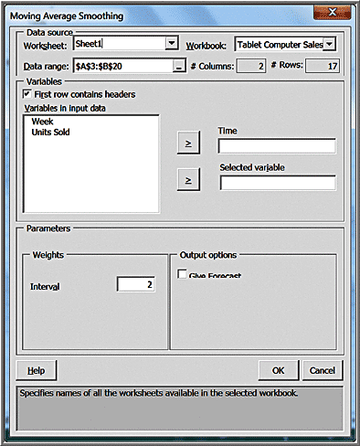
Example 9.7: Moving Average Forecasting with XLMiner
Select Smoothing from the Time Series group and select Moving Average
Enter the data range and move the time variable and dependent variable to the boxes on the right. Enter the interval (k).

Slide 18
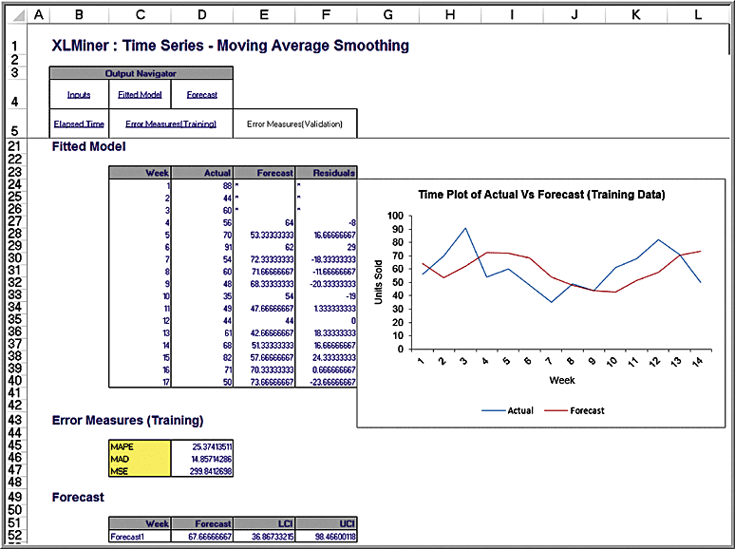
Examnle 9.7 Continued
XLMiner results

Slide 19




Error Metrics and Forecast Accuarcy
Mean absolute deviation (MAD)
Mean square error (MSE)
Root mean square error (RMSE)
Mean absolute percentage error (MAPE)

Slide 20
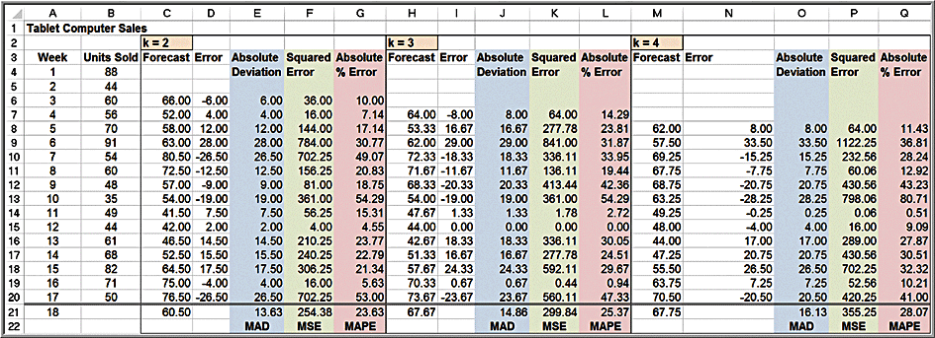
Example 9.8: Using Error Metrics to Compare Moving Average Forecasts
Tablet Computer Sales data
2-, 3-, and 4-period moving average models
2-period model has lowest error metric values

Slide 21

Exponential Smoothing Models
Simple exponential smoothing model:
where F_{t+1} is the forecast for time period t + 1, F_{t} is the forecast for period t, A_{t} is the observed value in period t, and α is a constant between 0 and 1 called the smoothing constant.
To begin, set F₁ and F₂ equal to the actual observation in period 1, A₁.

Slide 22
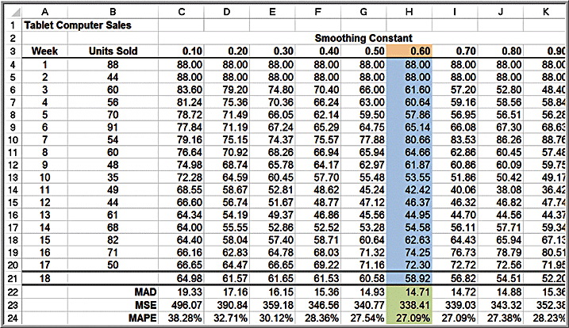
Example 9.9: Using Exponential Smoothing to Forecast Tablet Computer Sales
Forecast for week 3 when α = 0.7: (1 – 0.7)(88) + (0.7)(44) = 57.2

Slide 23
Example 9.10: Finding the Best Exponential Smoothing Model for Tablet Computer Sales
The forecast using α = 0.6 provides the lowest error metrics.

Slide 24
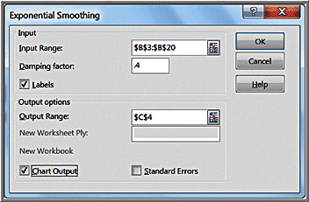
Example 9.11: Using Excel’s Exponential Smoothing Tool
Select Data Analysis from the Analysis group and then choose Exponential Smoothing
Note that Damping factor = 1−α
The first cell of the Output Range should be adjacent to the first data point
In R:
HoltWinters(Data, beta=FALSE, gamma=FALSE)

Slide 25
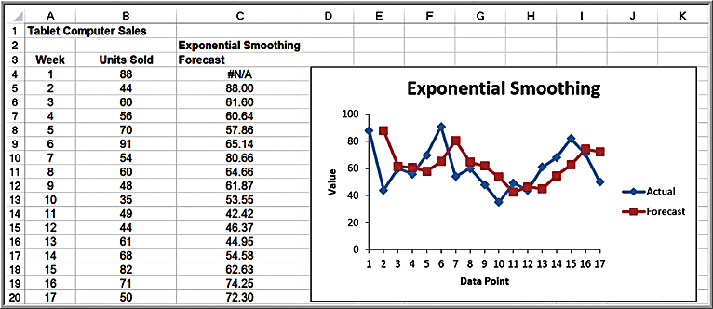
Example 9.11 Continued
Exponential Smoothing tool results

Slide 26
Exponential Smoothing in XLMiner
Select Exponential from the Time Series/Smoothing menu.
Within the Weights pane, it provides options to either enter the smoothing constant, Level (Alpha) or to check an Optimize box, which will find the best value of the smoothing constant.

Slide 27
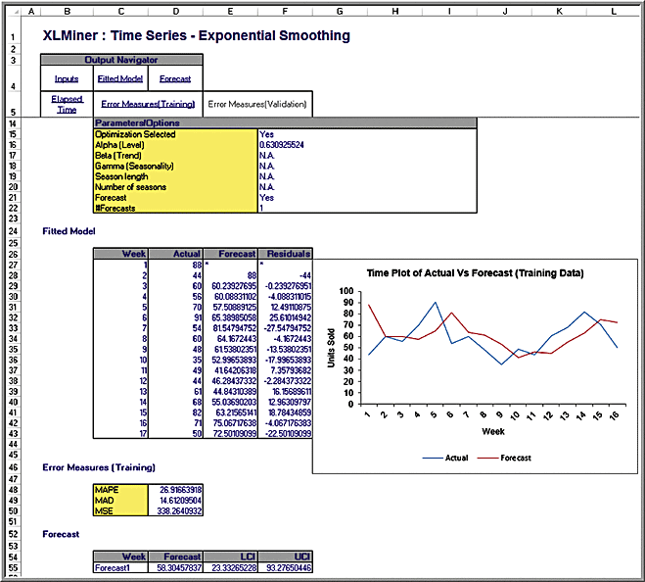
Example 9.12: Optimizing Exponential Smoothing Forecasts Using XLMiner
The best smoothing constant is 0.63

Slide 28

Forecasting Models for Time Series with a Linear Trend
Double moving average and double exponential smoothing
Based on the linear trend equation
The forecast for k periods into the future is a function of the level a_{t} and the trend b_{t}
The models differ in their computations of a_{t} and b_{t}
XLMiner does not support a procedure for double moving average; however, it does provide one for double exponential smoothing.

Slide 29

Double Exponential Smoothing
Estimates of the parameters are obtained from the following equations:
Initial values are chosen for a₁ as A₁ and b₁ as A₂ – A₁. Equation (9.7) must then be used to compute a_{t} and b_{t} for the entire time series to be able to generate forecasts into the future.

Slide 30
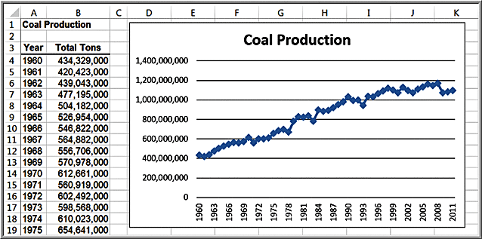
Example 9.13: Double Exponential Smoothing with XLMiner
Excel file Coal Production

Slide 31
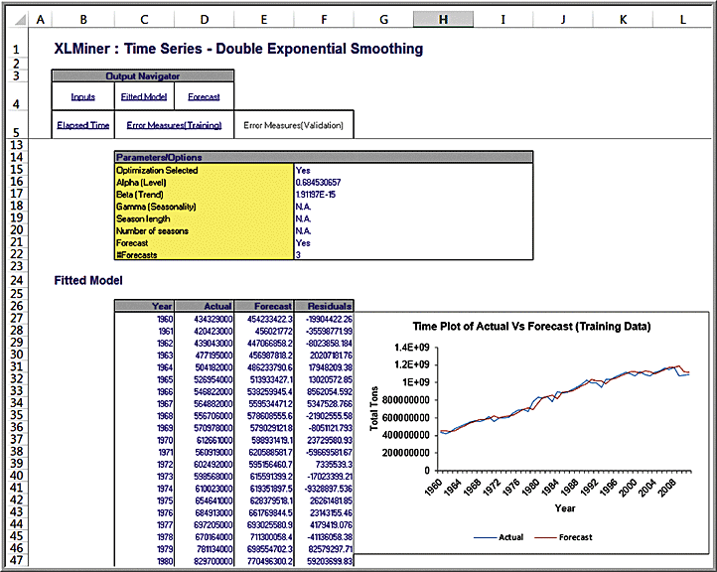
Example 9.13 Continued
XLMiner optimization results
the best values of α and β are 0.684 and 0.00

Slide 32
Regression-Based Forecasting for Time Series with a Linear Trend
Simple linear regression can be applied to forecasting using time as the independent variable.

Slide 33
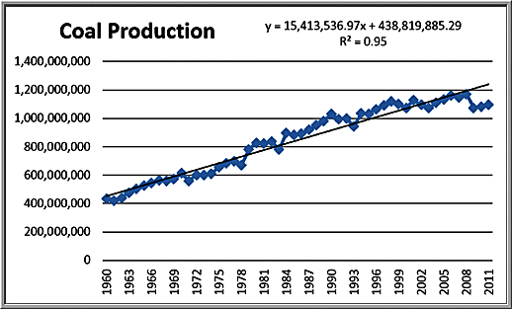
Example 9.14: Forecasting Using Trendlines
Coal Production data with a linear trendline
Note that the linear model does not adequately predict the recent drop in production after 2008.

Slide 34
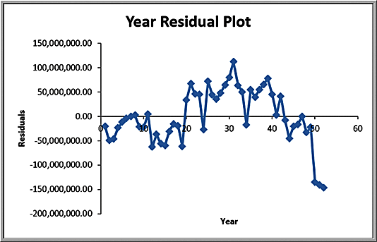
Autocorrelation in Time Series
When autocorrelation is present, successive observations are correlated with one another; for example, large observations tend to follow other large observations, and small observations also tend to follow one another.
In such cases, other approaches, called autoregressive models, are more appropriate.

Slide 35
Forecasting Time Series with Seasonality
When time series exhibit seasonality, different techniques provide better forecasts than the ones we have described:
Multiple regression models with categorical variables for the seasonal components
Holt-Winters models, similar to exponential smoothing models in that smoothing constants are used to smooth out variations in the level and seasonal patterns over time. For time series with seasonality but no trend, XLMiner supports a Holt-Winters method but does not have the ability to optimize the parameters.

Slide 36

Example 9.15: Regression-Based Forecasting for Natural Gas Usage
Gas & Electric Excel file
Use a seasonal categorical
variable with k = 12 levels.
Construct the regression model using k - 1 dummy variables, with January being the reference month.

Slide 37
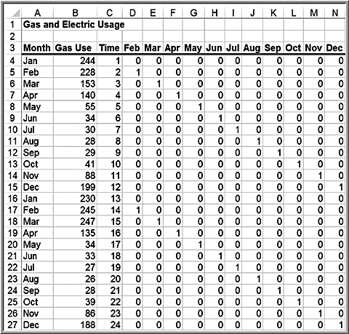
Example 9.15 Continued
Data matrix

Slide 38
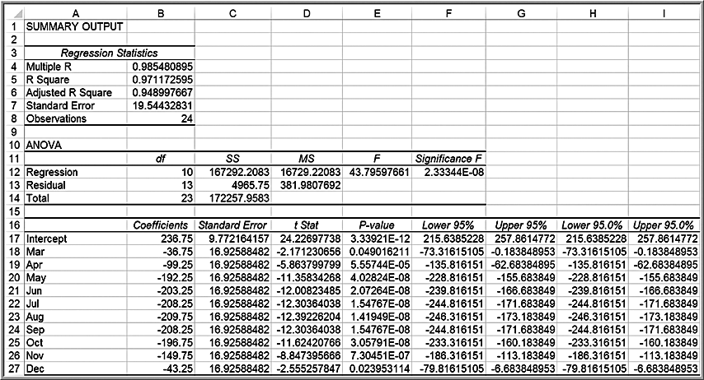
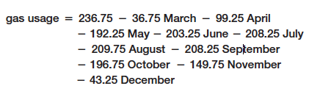
Example 9.15 Continued
Final regression results (time and February were insignificant)

Slide 39


Holt-Winters Models for Forecasting Time Series with Seasonality and Trend
The Holt-Winters additive model applies to time series with relatively stable seasonality and is based on the equation
The Holt-Winters multiplicative model applies to time series whose amplitude increases or decreases over time and is
A chart of the time series should be viewed first to identify the appropriate type of model to use.

Slide 40
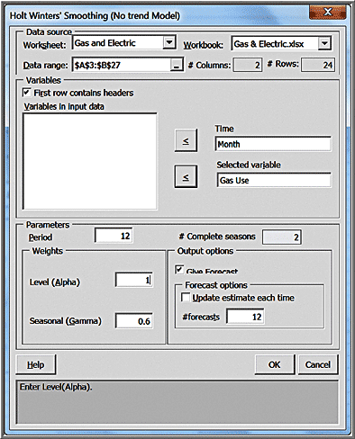
Example 9.16: Forecasting Natural Gas Usage Using Holt-Winters No-Trend Model
XLMiner > Time Series > Smoothing >Holt Winter No Trend…
In the Parameters pane, the value of Period is the length of the season, in this case, 12 months.
You will generally have to experiment with the smoothing constants to identify the best model.

Slide 41
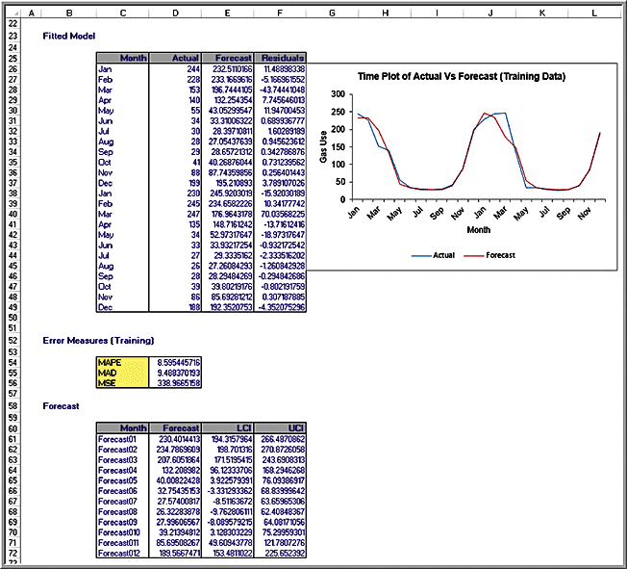
Example 9.16 Continued
XLMiner results

Slide 42
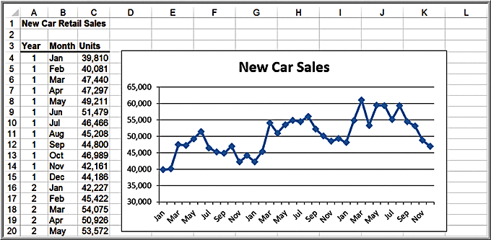
Example 9.17: Forecasting New Car Sales Using Holt-Winters Models
There is clearly a stable seasonal factor in the time series, along with an increasing trend; therefore, the Holt-Winters additive model would appear

Slide 43
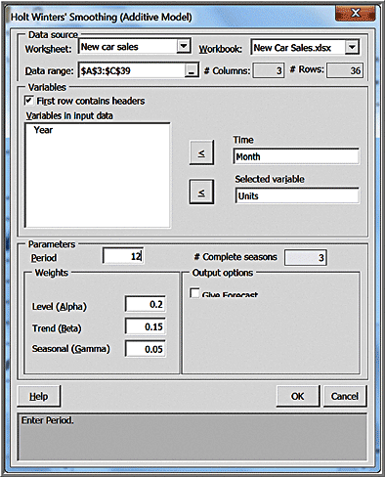
Example 9.17: Continued
XLMiner > Time Series > Smoothing > Holt Winter Additive…

Slide 44
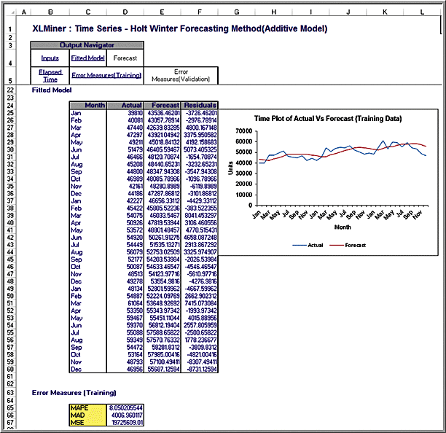
Example 9.17 Continued
XLMiner results

Slide 45
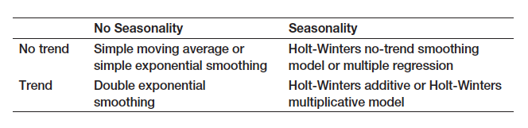
Selecting Appropriate Time-Series-Based Forecasting Methods

Slide 46
Regression Forecasting with Causal Variables
In many forecasting applications, other independent variables besides time, such as economic indexes or demographic factors, may influence the time series.
Explanatory/causal models, often called econometric models, seek to identify factors that explain statistically the patterns observed in the variable being forecast, usually with regression analysis

Slide 47
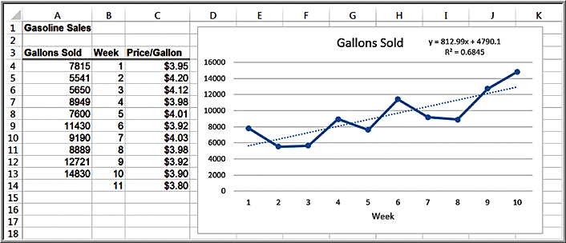
Example 9.18: Forecasting Gasoline Sales Using Simple Linear Regression
Excel file Gasoline Sales
Simple trendline using week as the independent variable
Predicted sales for week 11 = 812.99(11) + 4790.1 = 13,733 gallons

Slide 48
Example 9.19: Incorporating Causal Variables in a Regression-Based Forecasting Model
The average price per gallon changes each week, and this may influence consumer sales. Average price per gallon is a causal variable.
Develop a multiple linear regression model to predict gasoline sales using both time and price per gallon.

Slide 49

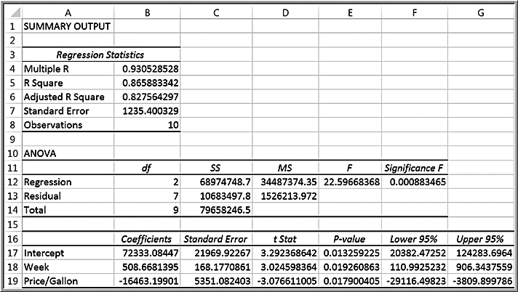
Example 9.19 Continued
Multiple regression model
Predicted sales for week 11
= 72,333 + 508.7(11) − 16,463(3.80) = 15,368 gallons

Slide 50
The Practice of Forecasting
Judgmental and qualitative methods are used for forecasting sales of product lines and broad company and industry forecasts.
Simple time-series models are used for short- and medium-range forecasts.
Regression methods are typically used for long-term forecasts.

