Slide 1
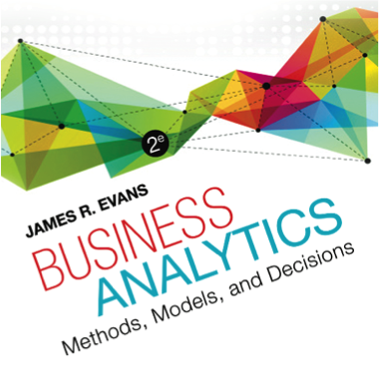

Chapter 8 Trendlines and Regression Analysis

Slide 2
Modeling Relationships and Trends in Data
Create charts to better understand data sets.
For cross-sectional data, use a scatter chart.
For time series data, use a line chart.

Slide 3
Common Mathematical Functions Used n Predictive Analytical Models
Linear y = a + bx
Logarithmic y = ln(x)
Polynomial (2nd order) y = ax² + bx + c
Polynomial (3rd order) y = ax³ + bx² + dx + e
Power y = ax^{b}
Exponential y = ab^{x}
(the base of natural logarithms, e = 2.71828…is often used for the constant b)

Slide 4
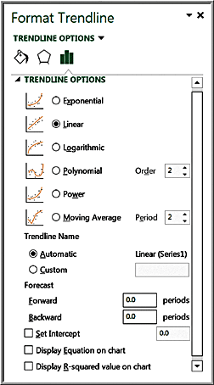
Excel Trendline Tool
Right click on data series and choose Add trendline from pop-up menu
Check the boxes Display Equation on chart and Display R-squared value on chart

Slide 5
R²
R² (R-squared) is a measure of the “fit” of the line to the data.
The value of R² will be between 0 and 1.
A value of 1.0 indicates a perfect fit and all data points would lie on the line; the larger the value of R² the better the fit.

Slide 6
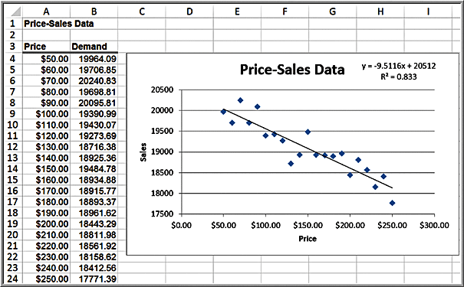
Example 8.1: Modeling a Price-Demand Function
Linear demand function:
Sales = 20,512 - 9.5116(price)

Slide 7
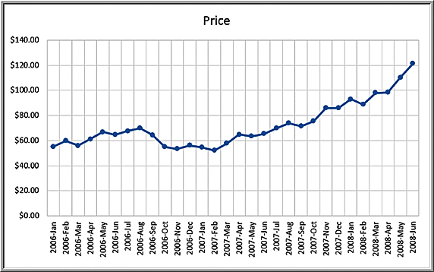
Example 8.2: Predicting Crude Oil Prices
Line chart of historical crude oil prices

Slide 8
Example 8.9 Continued
Excel’s Trendline tool is used to fit various functions to the data.
Exponential y = 50.49e^{0.021x} R² = 0.664
Logarithmic y = 13.02ln(x) + 39.60 R² = 0.382
Polynomial 2° y = 0.13x² − 2.399x + 68.01 R² = 0.905
Polynomial 3° y = 0.005x³ − 0.111x²
+ 0.648x + 59.497 R² = 0.928 *
Power y = 45.96x^{0.0169} R² = 0.397

Slide 9
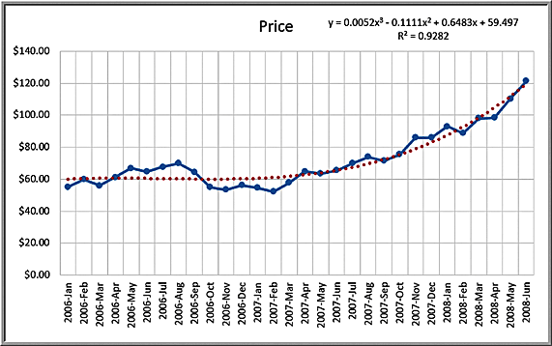
Example 8.2 Continued
Third order polynomial trendline fit to the data
Figure 8.11

Slide 10
Caution About Polynomials
The R² value will continue to increase as the order of the polynomial increases; that is, a 4th order polynomial will provide a better fit than a 3rd order, and so on.
Higher order polynomials will generally not be very smooth and will be difficult to interpret visually.
Thus, we don't recommend going beyond a third-order polynomial when fitting data.
Use your eye to make a good judgment!

Slide 11
Regression Analysis
Regression analysis is a tool for building mathematical and statistical models that characterize relationships between a dependent (ratio) variable and one or more independent, or explanatory variables (ratio or categorical), all of which are numerical.
Simple linear regression involves a single independent variable.
Multiple regression involves two or more independent variables.

Slide 12
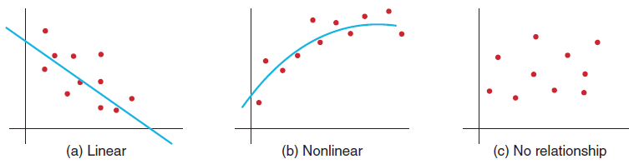
Simple Linear Regression
Finds a linear relationship between:
- one independent variable X and
- one dependent variable Y
First prepare a scatter plot to verify the data has a linear trend.
Use alternative approaches if the data is not linear.

Slide 13
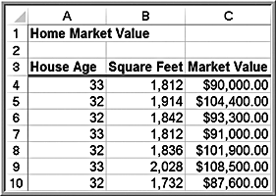
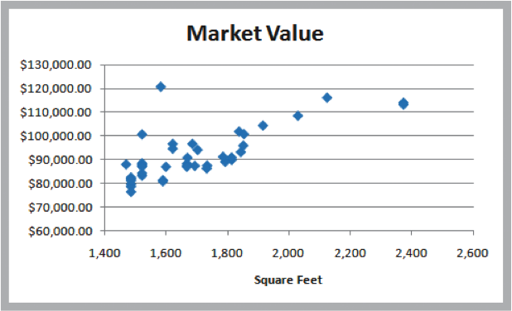
Example 8.3: Home Market Value Data
Size of a house is typically related to its market value.
X = square footage
Y = market value ($)
The scatter plot of the full data set (42 homes) indicates a linear trend.

Slide 14
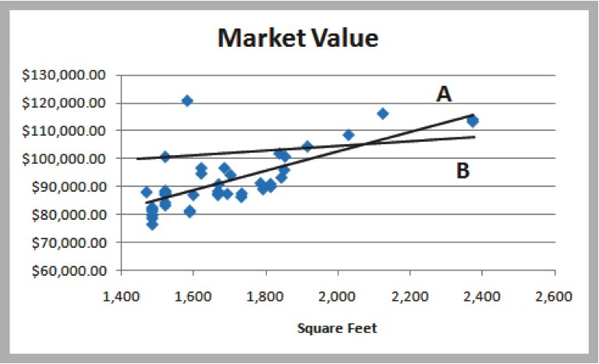
Finding the Best-Fitting Regression Line
Market value = a + b × square feet
Two possible lines are shown below.
Line A is clearly a better fit to the data.
We want to determine the best regression line.

Slide 15
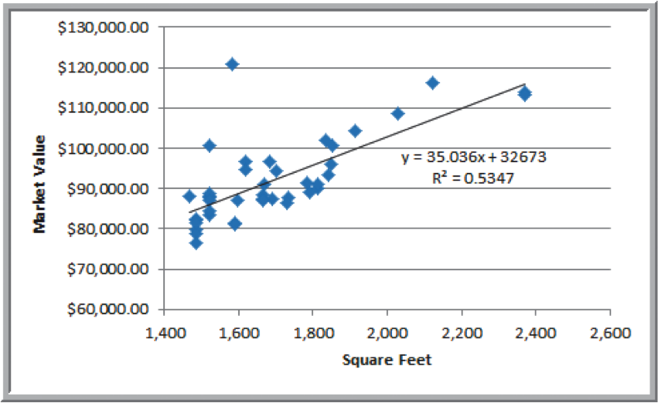
Example 8.4: Using Excel to Find the Best Regression Line
Market value = 32,673 + $35.036 × square feet
The estimated market value of a home with 2,200 square feet would be: market value = $32,673 + $35.036 × 2,200 = $109,752
The regression model explains variation in market value due to size of the home.
It provides better estimates of market value than simply using the average.

Slide 16

Least-Squares Regression
Simple linear regression model:
We estimate the parameters from the sample data:
Let X_{i} be the value of the independent variable of the i^{th} observation. When the value of the independent variable is X_{i}, then Y_{i} = b₀ + b₁X_{i} is the estimated value of Y for X_{i}.

Slide 17

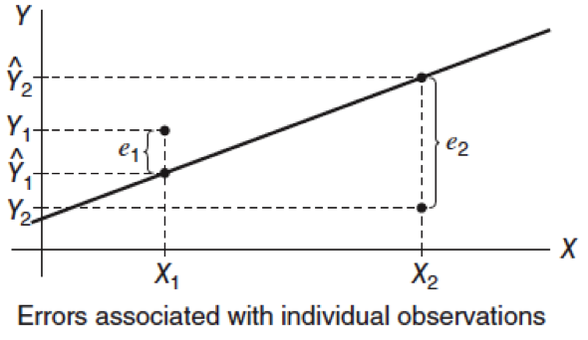
Residuals
Residuals are the observed errors associated with estimating the value of the dependent variable using the regression line:

Slide 18

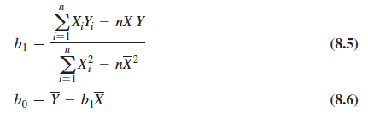
Least Squares Regression
The best-fitting line minimizes the sum of squares of the residuals.
Excel functions:
=INTERCEPT(known_y’s, known_x’s)
=SLOPE(known_y’s, known_x’s)
In R use function lm

Slide 19
Example 8.5: Using Excel Functions to Find Least-Squares Coefficients
Slope = b₁ = 35.036
=SLOPE(C4:C45, B4:B45)
Intercept = b₀ = 32,673
=INTERCEPT(C4:C45, B4:B45)
Estimate Y when X = 1750 square feet
Y = 32,673 + 35.036(1750) = $93,986
=TREND(C4:C45, B4:B45, 1750)

Slide 20
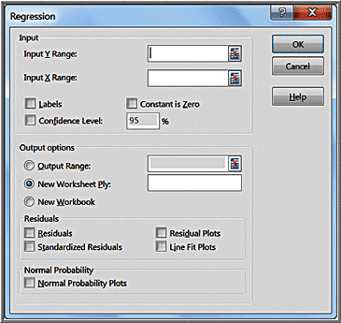
Simple Linear Regression With Excel
Data > Data Analysis >
Regression
Input Y Range (with header)
Input X Range (with header)
Check Labels
Excel outputs a table with many useful regression statistics.

Slide 21
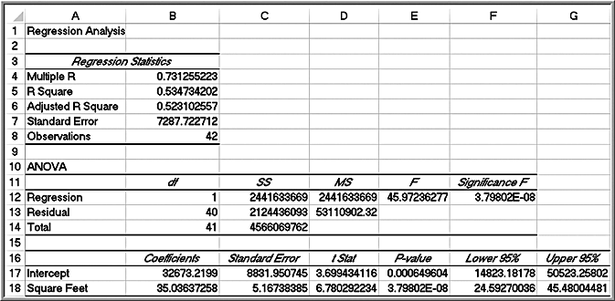
Home Market Value Regression Results

Slide 22
Regression Statistics
Multiple R - | r |, where r is the sample correlation coefficient. The value of r varies from -1 to +1 (r is negative if slope is negative)
R Square - coefficient of determination, R², which
varies from 0 (no fit) to 1 (perfect fit)
Adjusted R Square - adjusts R² for sample size and number of X variables
Standard Error - variability between observed and predicted Y values. This is formally called the standard error of the estimate, S_{YX}.

Slide 23
Example 8.6: Interpreting Regression Statistics for Simple Linear Regression
53% of the variation in home market values can be explained by home size.
The standard error of $7287 is less than standard deviation (not shown) of $10,553.

Slide 24
Regression as Analysis of Variance
ANOVA conducts an F-test to determine whether variation in Y is due to varying levels of X.
ANOVA is used to test for significance of regression:
H₀: population slope coefficient = 0
H₁: population slope coefficient ≠ 0
Excel reports the p-value (Significance F).
Rejecting H₀ indicates that X explains variation in Y.

Slide 25
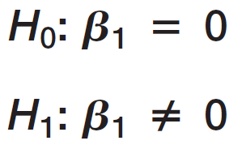
Example 8.7: Interpreting Significance of Regression
Home size is not a significant variable
Home size is a significant variable
p-value = 3.798 x 10⁻⁸
Reject H₀: The slope is not equal to zero. Using a linear relationship, home size is a significant variable in explaining variation in market value.

Slide 26

Testing Hypotheses for Regression Coefficients
An alternate method for testing whether a slope or intercept is zero is to use a t-test:
Excel provides the p-values for tests on the slope and intercept.

Slide 27
Example 8.8: Interpreting Hypothesis Tests for Regression Coefficients
Use p-values to draw conclusion
Neither coefficient is statistically equal to zero.

Slide 28

Confidence Intervals for Regression Coefficients
Confidence intervals (Lower 95% and Upper 95% values in the output) provide information about the unknown values of the true regression coefficients, accounting for sampling error.
We may also use confidence intervals to test hypotheses about the regression coefficients.
To test the hypotheses
check whether B₁ falls within the confidence interval for the slope. If it does, reject the null hypothesis.

Slide 29
Example 8.9: Interpreting Confidence Intervals for Regression Coefficients
For the Home Market Value data, a 95% confidence interval for the intercept is [14,823, 50,523], and for the slope, [24.59, 45.48].
Although we estimated that a house with 1,750 square feet has a market value of 32,673 + 35.036(1,750) =$93,986, if the true population parameters are at the extremes of the confidence intervals, the estimate might be as low as 14,823 + 24.59(1,750) = $57,855 or as high as 50,523 + 45.48(1,750) = $130,113.
In R to find these confidence intervals you can use confint command

Slide 30
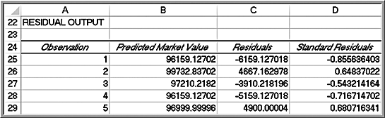
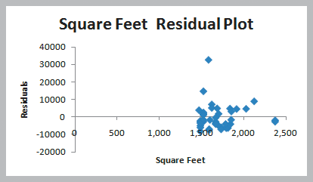
Residual Analysis and Regression Assumptions
Residual = Actual Y value − Predicted Y value
Standard residual = residual / standard deviation
Rule of thumb: Standard residuals outside of ±2 or ±3 are potential outliers.
Excel provides a table and a plot of residuals.
The command resid and rstandard does the same thing in R
This point has a standard residual of 4.53

Slide 31
Checking Assumptions
Linearity
examine scatter diagram (should appear linear)
examine residual plot (should appear random)
Normality of Errors
view a histogram of standard residuals
regression is robust to departures from normality
Homoscedasticity: variation about the regression line is constant
examine the residual plot
Independence of Errors: successive observations should not be related.
This is important when the independent variable is time.

Slide 32
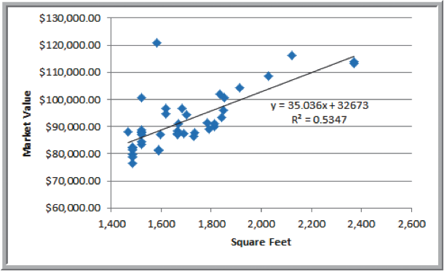
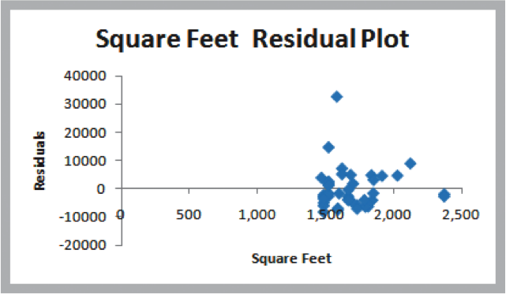
Example 8.11: Checking Regression Assumptions for the Home Market Value Data
Linearity - linear trend in scatterplot
- no pattern in residual plot

Slide 33
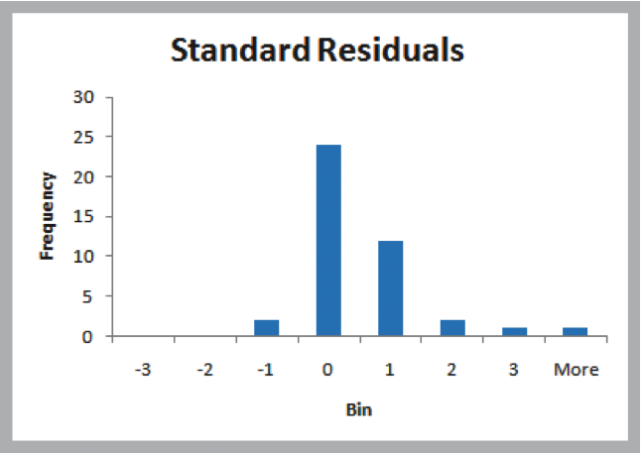
Example 8.11 Continued
Normality of Errors – residual histogram appears slightly skewed but is not a serious departure

Slide 34
Example 8.11 Continued
Homoscedasticity – residual plot shows no serious difference in the spread of the data for different X values.

Slide 35
Example 8.11 Continued
Independence of Errors – Because the data is cross-sectional, we can assume this assumption holds.
Cross-sectional data refers to data collected by observing many subjects (such as individuals, firms or countries/regions) at the same point of time, or without regard to differences in time.

Slide 36
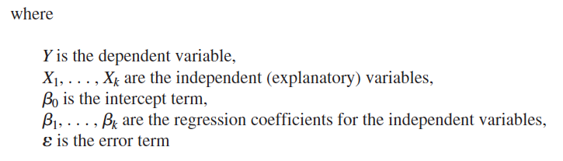
Multiple Linear Regression
A linear regression model with more than one independent variable is called a multiple linear regression model.

Slide 37

Estimated Multiple Regression Equation
We estimate the regression coefficients—called partial regression coefficients — b₀, b₁, b₂,… b_{k}, then use the model:
The partial regression coefficients represent the expected change in the dependent variable when the associated independent variable is increased by one unit while the values of all other independent variables are held constant.

Slide 38
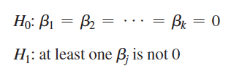
Excel Regression Tool
The independent variables in the spreadsheet must be in contiguous columns.
So, you may have to manually move the columns of data around before applying the tool.
Key differences:
Multiple R and R Square are called the multiple correlation coefficient and the coefficient of multiple determination, respectively, in the context of multiple regression.
ANOVA tests for significance of the entire model. That is, it computes an F-statistic for testing the hypotheses:

Slide 39
ANOVA for Multiple Regression
ANOVA tests for significance of the entire model. That is, it computes an F-statistic for testing the hypotheses:
The multiple linear regression output also provides information to test hypotheses about each of the individual regression coefficients.
If we reject the null hypothesis that the slope associated with independent variable i is 0, then the independent variable i is significant and improves the ability of the model to better predict the dependent variable. If we cannot reject H0, then that independent variable is not significant and probably should not be included in the model.

Slide 40
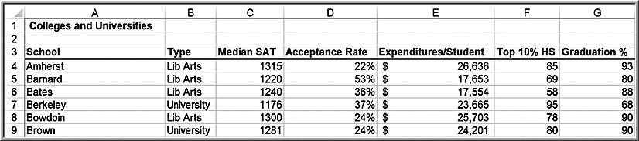
Example 8.12: Interpreting Regression Results for the Colleges and Universities Data
Predict student graduation rates using several indicators:

Slide 41
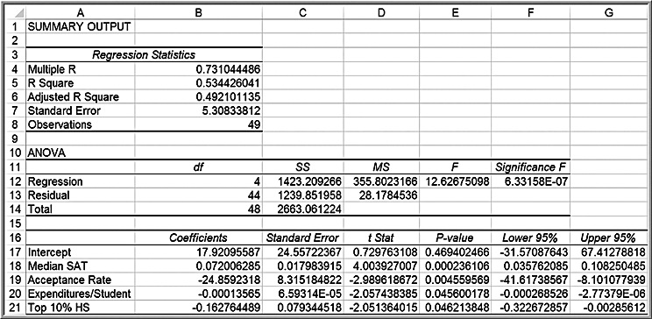

Example 8.12 Continued
Regression model
The value of R² indicates that 53% of the variation in the dependent variable is explained by these independent variables.
All coefficients are statistically significant.

Slide 42
Model Building Issues
A good regression model should include only significant independent variables.
However, it is not always clear exactly what will happen when we add or remove variables from a model; variables that are (or are not) significant in one model may (or may not) be significant in another.
Therefore, you should not consider dropping all insignificant variables at one time, but rather take a more structured approach.
Adding an independent variable to a regression model will always result in R² equal to or greater than the R² of the original model.
Adjusted R² reflects both the number of independent variables and the sample size and may either increase or decrease when an independent variable is added or dropped. An increase in adjusted R² indicates that the model has improved.

Slide 43
Systematic Model Building Approach
Construct a model with all available independent variables. Check for significance of the independent variables by examining the p-values.
Identify the independent variable having the largest p-value that exceeds the chosen level of significance.
Remove the variable identified in step 2 from the model and evaluate adjusted R².
(Don’t remove all variables with p-values that exceed a at the same time, but remove only one at a time.)
Continue until all variables are significant.
CHAID implementation can be found here:
https://r-forge.r-project.org/R/?group_id=343

Slide 44
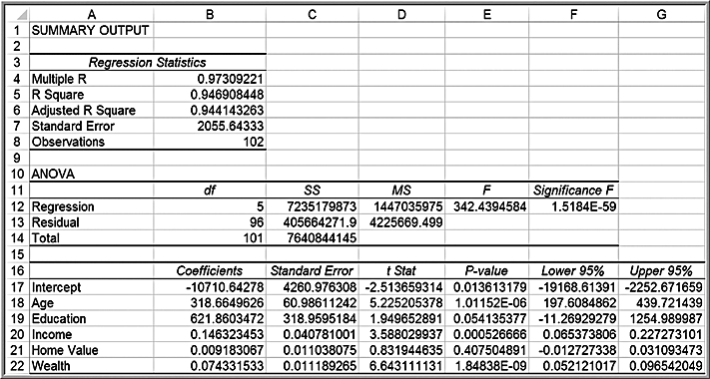
Example 8.13: Identifying the Best Regression Model
Banking Data
Home value has the largest p-value; drop and re-run the regression.

Slide 45
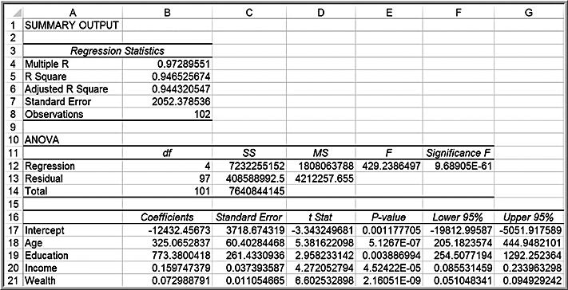
Example 8.13 Continued
Bank regression after removing Home Value
Adjusted R² improves slightly.
All X variables are significant.

Slide 46
Alternate Criterion
Use the t-statistic.
If | t | < 1, then the standard error will decrease and adjusted R² will increase if the variable is removed. If | t | > 1, then the opposite will occur.
You can follow the same systematic approach, except using t-values instead of p-values.

Slide 47
Multicollinearity
Multicollinearity occurs when there are strong correlations among the independent variables, and they can predict each other better than the dependent variable.
When significant multicollinearity is present, it becomes difficult to isolate the effect of one independent variable on the dependent variable, the signs of coefficients may be the opposite of what they should be, making it difficult to interpret regression coefficients, and p-values can be inflated.
Correlations exceeding ±0.7 may indicate multicollinearity
The variance inflation factor is a better indicator, but not computed in Excel but in R the command is vif.

Slide 48
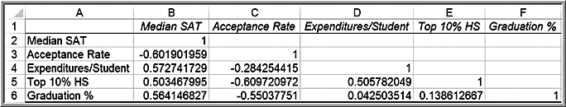
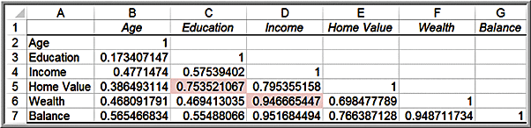
Example 8.14: Identifying Potential Multicollinearity
Colleges and Universities correlation matrix; none exceed the recommend threshold of ±0.7
Banking Data correlation matrix; large correlations exist

Slide 49
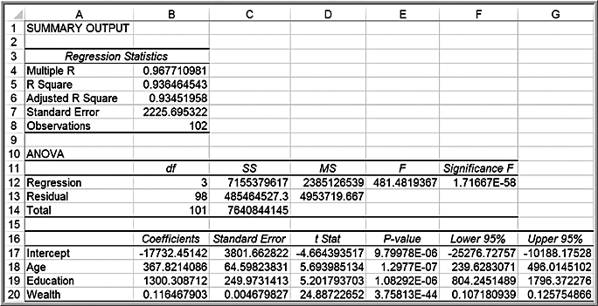
Example 8.14 Continued
If we remove Wealth from the model, the adjusted R² drops to 0.9201, but we discover that Education is no longer significant.
Dropping Education and leaving only Age and Income in the model results in an adjusted R² of 0.9202.
However, if we remove Income from the model instead of Wealth, the Adjusted R² drops to only 0.9345, and all remaining variables (Age, Education, and Wealth) are significant.

Slide 50
Practical Issues in Trendline and Regression Modeling
Identifying the best regression model often requires experimentation and trial and error.
The independent variables selected should make sense in attempting to explain the dependent variable
Logic should guide your model development. In many applications, behavioral, economic, or physical theory might suggest that certain variables should belong in a model.
Additional variables increase R² and, therefore, help to explain a larger proportion of the variation.
Even though a variable with a large p-value is not statistically significant, it could simply be the result of sampling error and a modeler might wish to keep it.
Good models are as simple as possible (the principle of parsimony).

Slide 51
Overfitting
Overfitting means fitting a model too closely to the sample data at the risk of not fitting it well to the population in which we are interested.
In fitting the crude oil prices in Example 8.2, we noted that the R²-value will increase if we fit higher-order polynomial functions to the data. While this might provide a better mathematical fit to the sample data, doing so can make it difficult to explain the phenomena rationally.
In multiple regression, if we add too many terms to the model, then the model may not adequately predict other values from the population.
Overfitting can be mitigated by using good logic, intuition, theory, and parsimony.

Slide 53
Regression with Categorical Variables
Regression analysis requires numerical data.
Categorical data can be included as independent variables, but must be coded numeric using dummy variables.
For variables with 2 categories, code as 0 and 1.

Slide 54
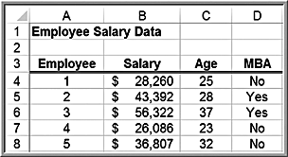
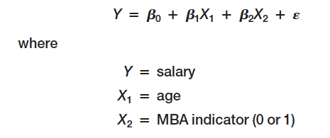
Example 8.15: A Model with Categorical Variables
Employee Salaries provides data for 35 employees
Predict Salary using Age and MBA (code as yes=1, no=0)

Slide 55
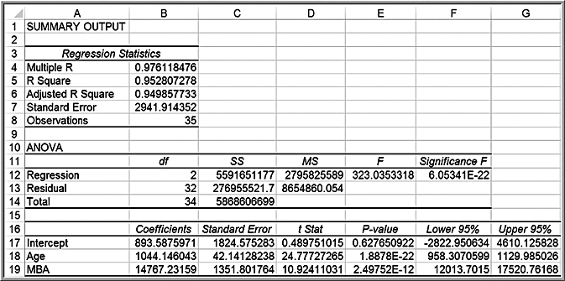
Example 8.15 Continued
Salary = 893.59 + 1044.15 × Age + 14767.23 × MBA
If MBA = 0, salary = 893.59 + 1044 × Age
If MBA = 1, salary =15,660.82 + 1044 × Age

Slide 56

Interactions
An interaction occurs when the effect of one variable is dependent on another variable.
We can test for interactions by defining a new variable as the product of the two variables, X3 = X1 × X2 , and testing whether this variable is significant, leading to an alternative model.

Slide 57
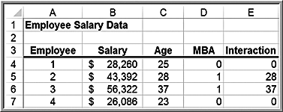
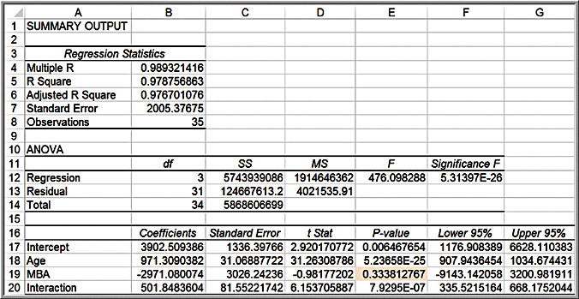
Example 8.16: Incorporating Interaction Terms in a Regression Model
Define an interaction between Age and MBA and re-run the regression.
The MBA indicator is not significant; drop and re-run.

Slide 58
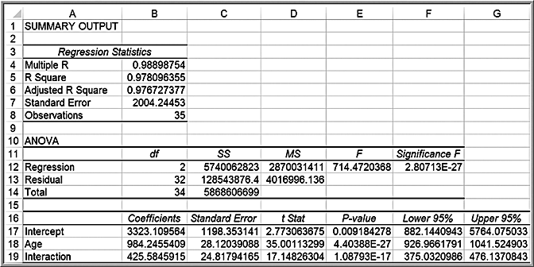
Example 8.16 Continued
Adjusted R² increased slightly, and both age and the interaction term are significant. The final model is
salary = 3,323.11 + 984.25 × age + 425.58 × MBA × age

Slide 59
Categorical Variables with More Than Two Levels
When a categorical variable has k > 2 levels, we need to add k - 1 additional variables to the model.

Slide 60
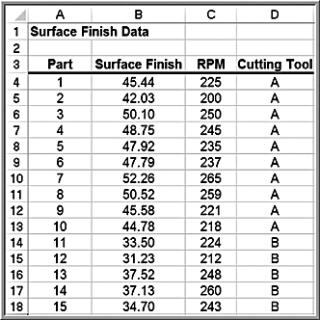
Example 8.17: A Regression Model with Multiple Levels of Categorical Variables
The Excel file Surface Finish provides measurements of the surface finish of 35 parts produced on a lathe, along with the revolutions per minute (RPM) of the spindle and one of four types of cutting tools used.

Slide 61
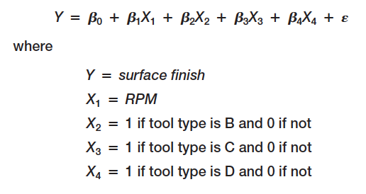
Example 8.17 Continued
Because we have k = 4 levels of tool type, we will define a regression model of the form

Slide 62
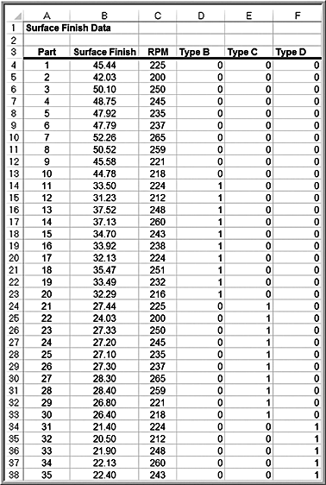
Example 8.17 Continued
Add 3 columns to the data, one for each of the tool type variables

Slide 63
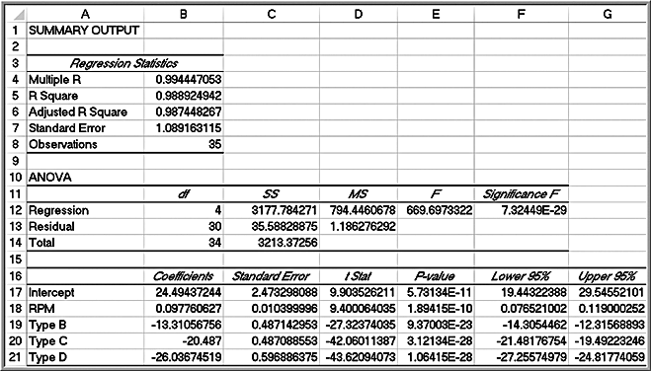
Example 8.17 Continued
Regression results
Surface finish = 24.49 + 0.098 RPM - 13.31 type B - 20.49 type C - 26.04 type D

Slide 64
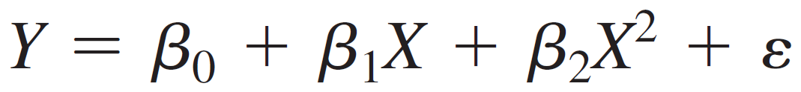
Regression Models with Nonlinear Terms
Curvilinear models may be appropriate when scatter charts or residual plots show nonlinear relationships.
A second order polynomial might be used
Here β₁ represents the linear effect of X on Y and β₂ represents the curvilinear effect.
This model is linear in the β parameters so we can use linear regression methods.

Slide 65
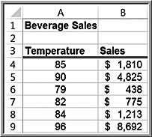
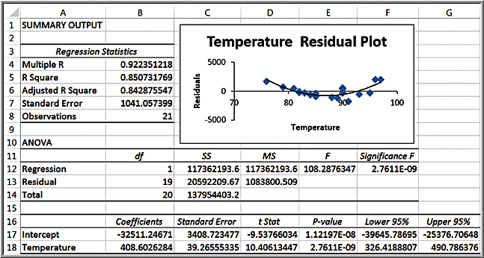
Example 8.18: Modeling Beverage Sales Using Curvilinear Regression
The U-shape of the residual plot (a second-order polynomial trendline was fit to the residual data) suggests that a linear relationship is not appropriate.

Slide 66
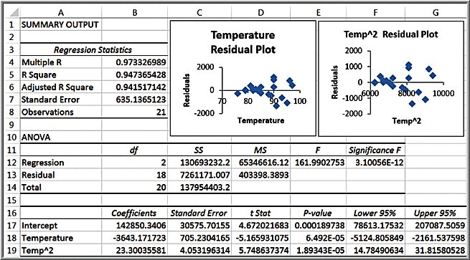
Example 8.18 Continued
Add a variable for temperature squared.
The model is:
sales = 142,850 - 3,643.17 × temperature + 23.3 × temperature²

Slide 67
Advanced Techniques for Regression Modeling using XLMiner
The regression analysis tool in XLMiner has some advanced options not available in Excel’s Descriptive Statistics tool.
Best-subsets regression evaluates either all possible regression models for a set of independent variables or the best subsets of models for a fixed number of independent variables.

Slide 68
Evaluating Best Subsets Models
Best subsets evaluates models using a statistic called Cp, (the Bonferroni criterion).
Cp estimates the bias introduced in the estimates of the responses by having an underspecified model (a model with important predictors missing).
If Cp is much greater than (the number of independent variables plus 1), there is substantial bias. The full model always has Cp = k + 1.
If all models except the full model have large Cps, it suggests that important predictor variables are missing. Models with a minimum value or having Cp less than or at least close to are good models to consider.

Slide 69
Best-Subsets Procedures
Backward Elimination begins with all independent variables in the model and deletes one at a time until the best model is identified.
Forward Selection begins with a model having no independent variables and successively adds one at a time until no additional variable makes a significant contribution.
Stepwise Selection is similar to Forward Selection except that at each step, the procedure considers dropping variables that are not statistically significant.
Sequential Replacement replaces variables sequentially, retaining those that improve performance. These options might terminate with a different model.
Exhaustive Search looks at all combinations of variables to find the one with the best fit, but it can be time consuming for large numbers of variables.

Slide 70
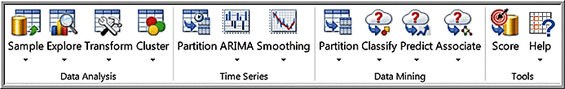
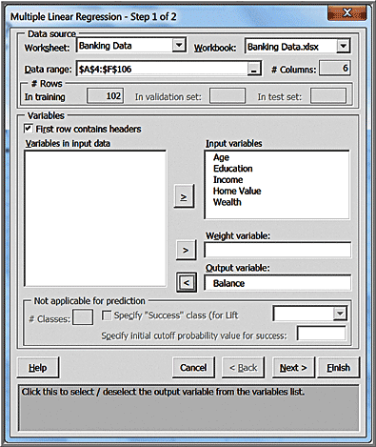
Example 8.19: Using XLMiner for Regression
Click the Predict button in the Data Mining group and choose Multiple Linear Regression.
Enter the range of the data (including headers)
Move the appropriate variables to the boxes on the right.

Slide 71
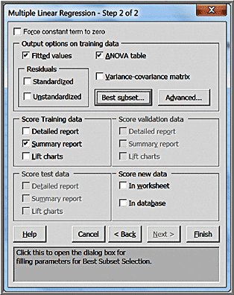
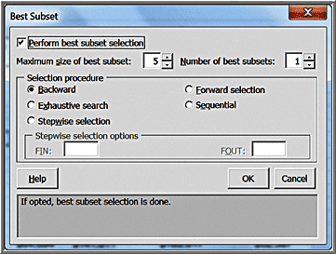
Example 8.19 Continued
Select the output options and check the Summary report box. Before clicking Finish, click on the Best subsets button.
Select the best subsets option:

Slide 72
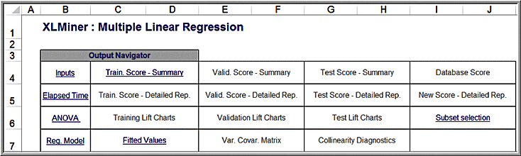
Example 8.19 Continued
View results from the “Output Navigator” links.

Slide 73
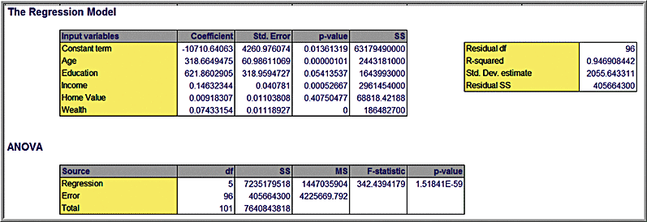
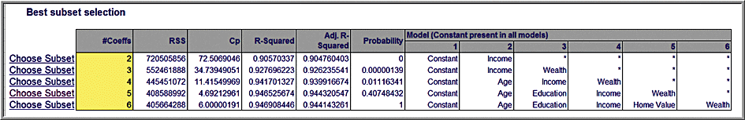
Example 8.19 Continued
Regression output (all variables)
Best subsets results
If you click “Choose Subset,” XLMiner will create a new worksheet with the results for this model.

Slide 74
Interpreting XLMiner Output
Typically choose the model with the highest adjusted R².
Models with a minimum value of Cp or having Cp less than or at least close to k + 1 are good models to consider.
RSS is the residual sum of squares, or the sum of squared deviations between the predicted probability of success and the actual value (1 or 0).
Probability is a quasi-hypothesis test that a given subset is acceptable; if this is less than 0.05, you can rule out that subset.

