Slide 1
Automatic Calibration of Camera and Range Sensors Using Polygonal Planar Boards
Thai K. Nguyen, Xuan Truong Nguyen, Hyuk-Jae Lee
Seoul National University, CAPP Lab
2017.11.24

Slide 2
Content
Introduction
Previous Research
Proposed Approach
Evaluation
Conclusion
References

Slide 3
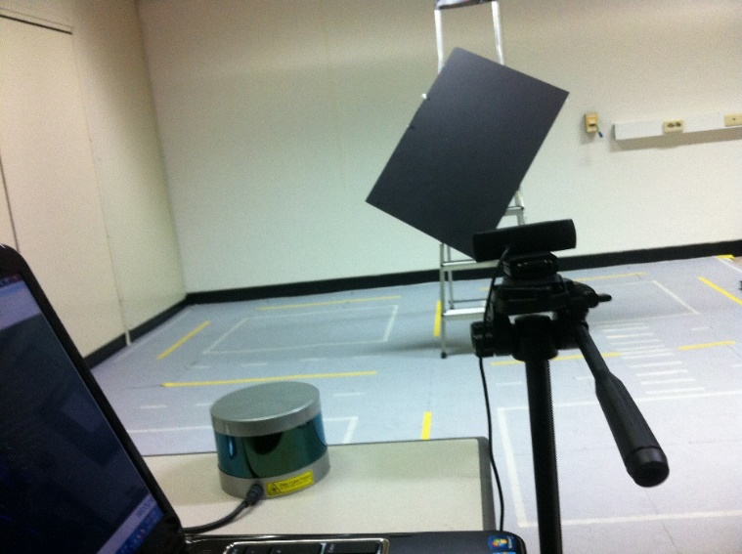
Introduction
LiDAR (Light Detection And Ranging) has ben widely used in Advanced driver-assistance systems
Has advantages due to its accuracy
It is usually used along with cameras
Has advantages of their resolution
To fuse data from these sensors, calibration is required
Here, we focus on calibration between a LiDAR and a Camera
Specifies how to convert measurements from a LiDAR to the image coordinate
LIDAR
Camera
Our setup of LiDAR and Camera

Slide 4
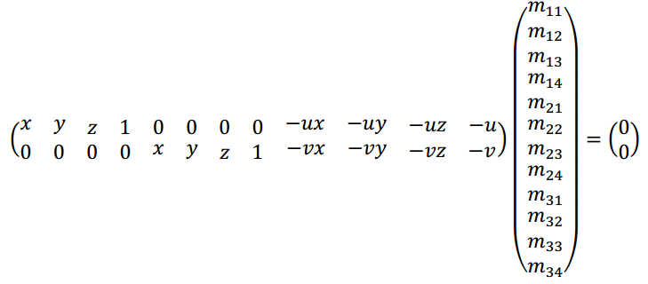
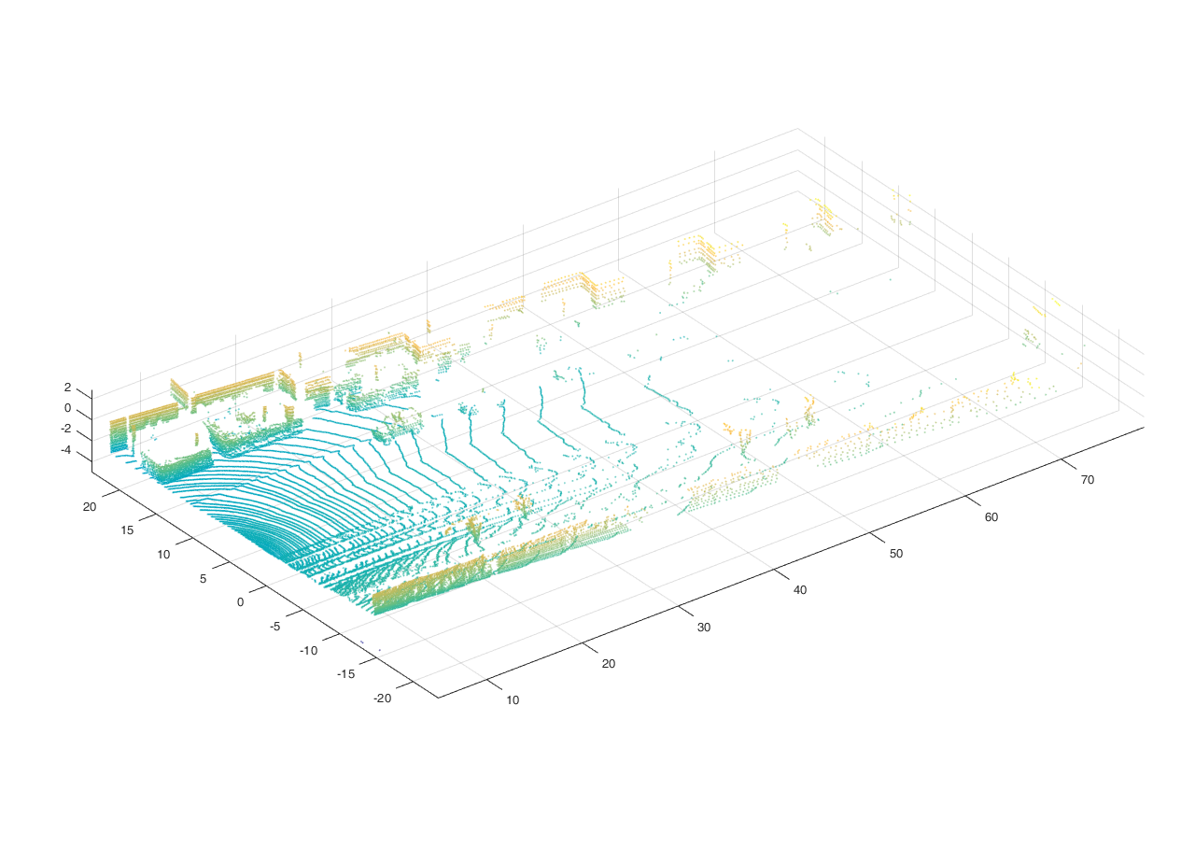
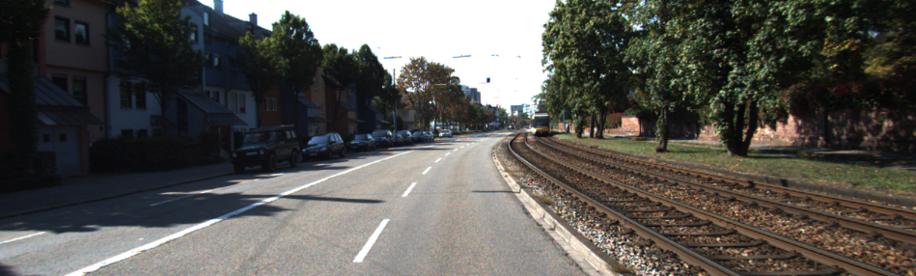
Introduction
Calibration problem
Inputs: Lidar scan{(x_{n}, y_{n}, z_{n})} and image {(u_{m}, v_{m})}
Output: Calibration matrix M
Method: With matching points, it can be solved using:
How to find matching points between 2 system coordinates
How to handle errors?
z
y
x
Only front view
Front image
LiDAR scan

Slide 5
Previous Research
Many calibration algorithms use checkerboards as target
However, they are often observed with range discrepancies
Checkerboard (a), monochromatic board (c) and their measurements on LiDAR

Slide 6
Previous Research
Some methods using monochromatic board are proposed
In [3], Park uses a monochromatic polygonal board
Estimates its edges and intersects them to find the vertices
However, with the monochromatic board, the process is more challenging to automate
This paper still requires manual interventions
Triangle monochromatic board, estimated edges and vertices
Y. Park et al., “Calibration between Color Camera and 3D LIDAR Instruments with a Polygonal Planar Board”, Journal of Sensors, Vol. 14 no. 3, 2014.

Slide 7
Proposed Approach
Method: Adopt background subtraction method for automating
Take two samples with and without the board
Subtract on both 2D image and 3D Lidar data
Board area is the largest segment of the subtraction output
Frame 2.5D data
Background 2.5D data
Images
Background Subtraction
Background Subtraction
Board Segmentation
Corner Detection
Corner Detection
Matrix Estimation
Refinement

Slide 8
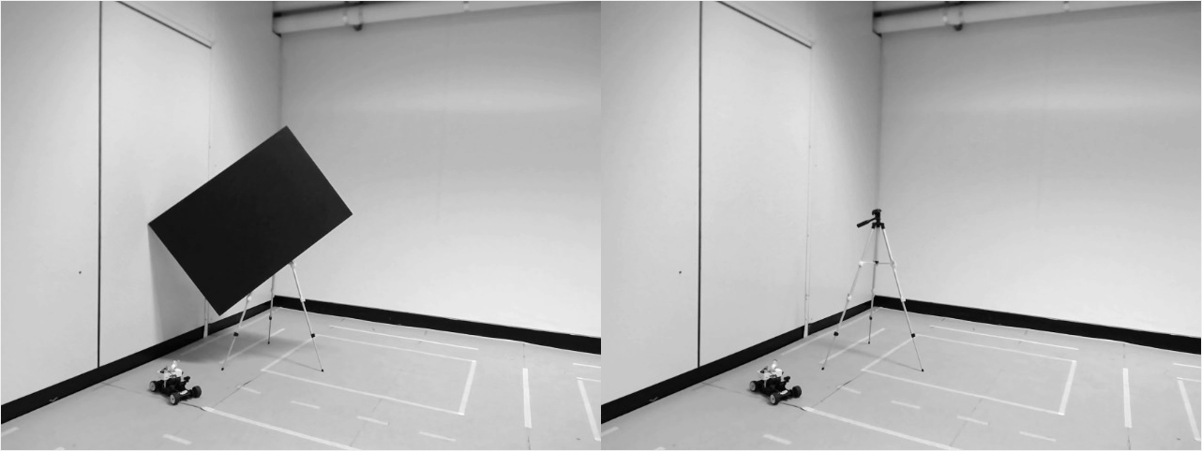
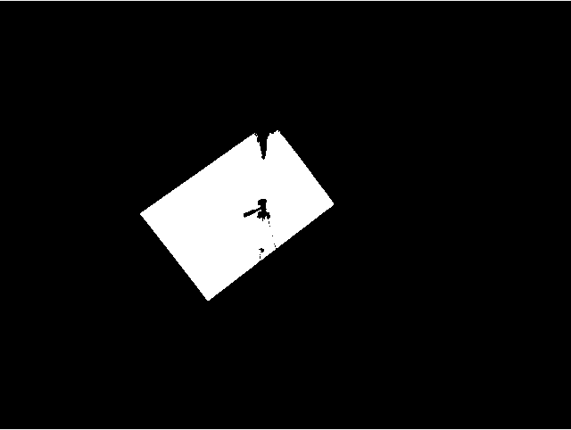
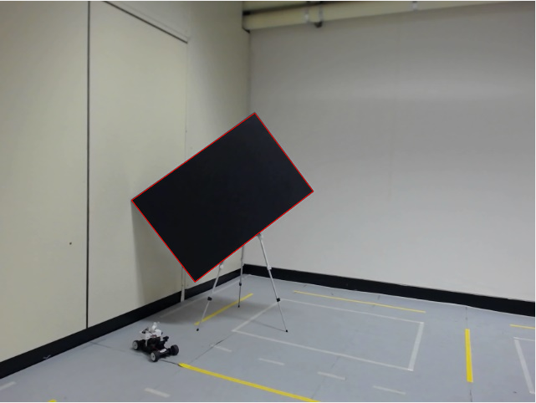

Proposed Approach
Board corners detection on the images
Input and background image are subtracted
Corners are calculated by intersecting estimated edges
image
background
subtraction
edge and corner estimation result
board segment

Slide 9
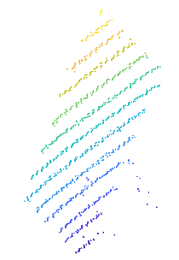
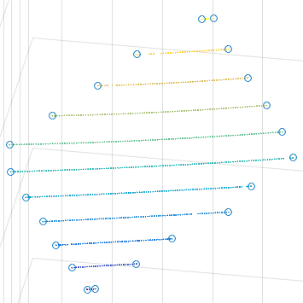
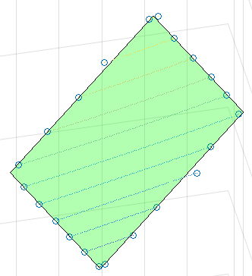
Proposed Approach
Board corners detection on LiDAR data
Background subtraction on 2.5D images are performed as above
Board area is then expanded to full segment in 3D space
Board border points are detected to estimate its edges
Corner is estimated by intersecting edges
v1
v2
v1
outliers
Board segment
Border points
Estimated edges and corners

Slide 10
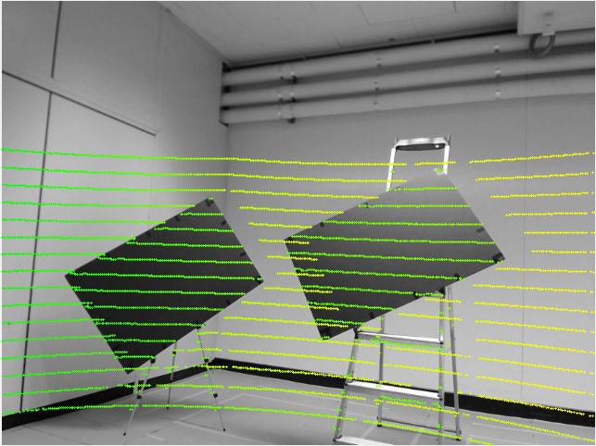
Proposed Approach
Result
Occluded area
Occlusion. 3D points of the wall
Camera-LiDAR Fusion Results

Slide 11
Proposed Approach
Result
Estimated compared between multiple evaluations
Differences is small. The Estimation M is robust
-0.25537 | -0.66648 | -0.07779 | 0.207338
0.182066 | -0.28306 | 0.559492 | -0.12347
0.00073 | -0.00095 | -0.00012 | -9.10E-05
-0.25841 | -0.66448 | -0.07331 | 0.197904
0.181116 | -0.2858 | 0.564159 | -0.11992
0.000729 | -0.00096 | -9.76E-05 | -6.46E-05
-0.25755 | -0.66597 | -0.07707 | 0.201721
0.181622 | -0.28465 | 0.560895 | -0.1221
0.00073 | -0.00095 | -0.00011 | -7.83E-05
-0.25537 | -0.66648 | -0.07779 | 0.207338
0.182066 | -0.28306 | 0.559492 | -0.12347
0.00073 | -0.00095 | -0.00012 | -9.10E-05
-0.26139 | -0.66142 | -0.08091 | 0.182558
0.185615 | -0.29203 | 0.568633 | -0.10601
0.000727 | -0.00094 | -0.00011 | -0.00014
-0.25358 | -0.66517 | -0.07531 | 0.209922
0.182305 | -0.28996 | 0.561667 | -0.10351
0.000729 | -0.00096 | -0.00011 | -4.65E-05
Evaluation 1
data 1
Evaluation 2
data 2
Evaluation 3
data 3
Calibration matrix over 3 evaluation of same data
Calibration matrix over 3 different data

Slide 12
Evaluation
12 positions of the board => 48 correspondences
Use k positions to calculate matrix (k=3,4,5…)
Project all 3D vertex to its images
Calculate distance from projected point to ground truth
Obtain the mean projection errors
 | Estimated (m) |  | Ground truth (m)
 | Mean | std
Width | 0.656575 | 0.017681 | 0.609
Height | 0.980834 | 0.016232 | 0.906
2
3
4
5
Number of positions
Estimation width and height of the board

Slide 13
Conclusion
By using background subtraction the calibration process is automated in our implementation
No manual intervention required
The final result is robust
Robust for low-resolution
Mean projection error reaches under 2pixel

Slide 14
References
[1] Nguyen Van Thang, Hyuk-Jae Lee, "Car detection with a cascad-ed HOG classifier and a deformable part model," International Conf-erence on Green and Human Information Technology 2015, Feb. 2015.
[2] Xuan Truong Nguyen, Dinh Van Luan, Hyun Kim, Hyuk-Jae Lee, "A High-Definition LIDAR System Based on Two-Mirror Deflection Scanners," IEEE Sensors Journal, 2017.
[3] Park Y, Yun S, Won CS, Cho K, Um K and Sim S, "Calibration between color camera and 3D LIDAR instruments with a polygonal planar board", Sensors (Basel) , 2014.
[4] H. Alismail, L. D. Baker and B. Browning, "Automatic Calibration of a Range Sensor and Camera System," 2012 Second International Conference on 3D Imaging, Modeling, Processing, Visualization & Transmission, Zurich, 2012.

