Slide 1
Machine learning Team 24
Dinh Van Luan
Nguyen Khac Thai

Slide 2
Classification
First model
Decision tree
Discrete attributes
Continuous attributes
Choose one value as separator
The one give maximum gains
Random Forest
Construct 99 decision tree
Each tree with 9 attributes
Result
In-sample error rate: 7.5%
Error rate on testing data: 18.462%

Slide 3
Classification
Second Model
Naïve Bayesian: convert input to likelihood table
Character attributes
Frequency table
Numeric attributes
Standard deviation
Frequency table
Feedforward network
Input: likelihood table
Hidden layer:
Size: [15]
activation function: Tanh.
Output layer:
activation function: softmax
Input
Naïve Bayesian
Feedforward net
Chose the best model
Output

Slide 4
Classification
Second Model
Training
Randomly generate 20 training/testing dataset
Compute corresponding model for each dataset
Chose the best model with smallest error on testing data
Results
In-sample error rate: 1.190476%
Error rate on testing data: 5.555556%
Input
Naïve Bayesian
Feedforward net
Output

Slide 5
Dimension reduction
Remove Near-zero variance predictors
few unique values relative to the number of samples
large ratio of the frequency of the most common value to the frequency of the second most common value
Results
Naïve Bayes + Feed forward: Not better. Relatively the same
In-sample error rate: 1.587302%
Error rate on testing data: 5.952381%
Random Forest: Not better. Relatively the same
In-sample error rate: 5.6%
Error rate on testing data: 20.385%

Slide 6
Regression
Split data into small ranges by the second model of classification problem
For each sub-data, build a linear regression model
Input
Naïve Bayesian
Linear regression 1
Feedforward net
Linear regression 3
Linear regression 2
Output

Slide 7
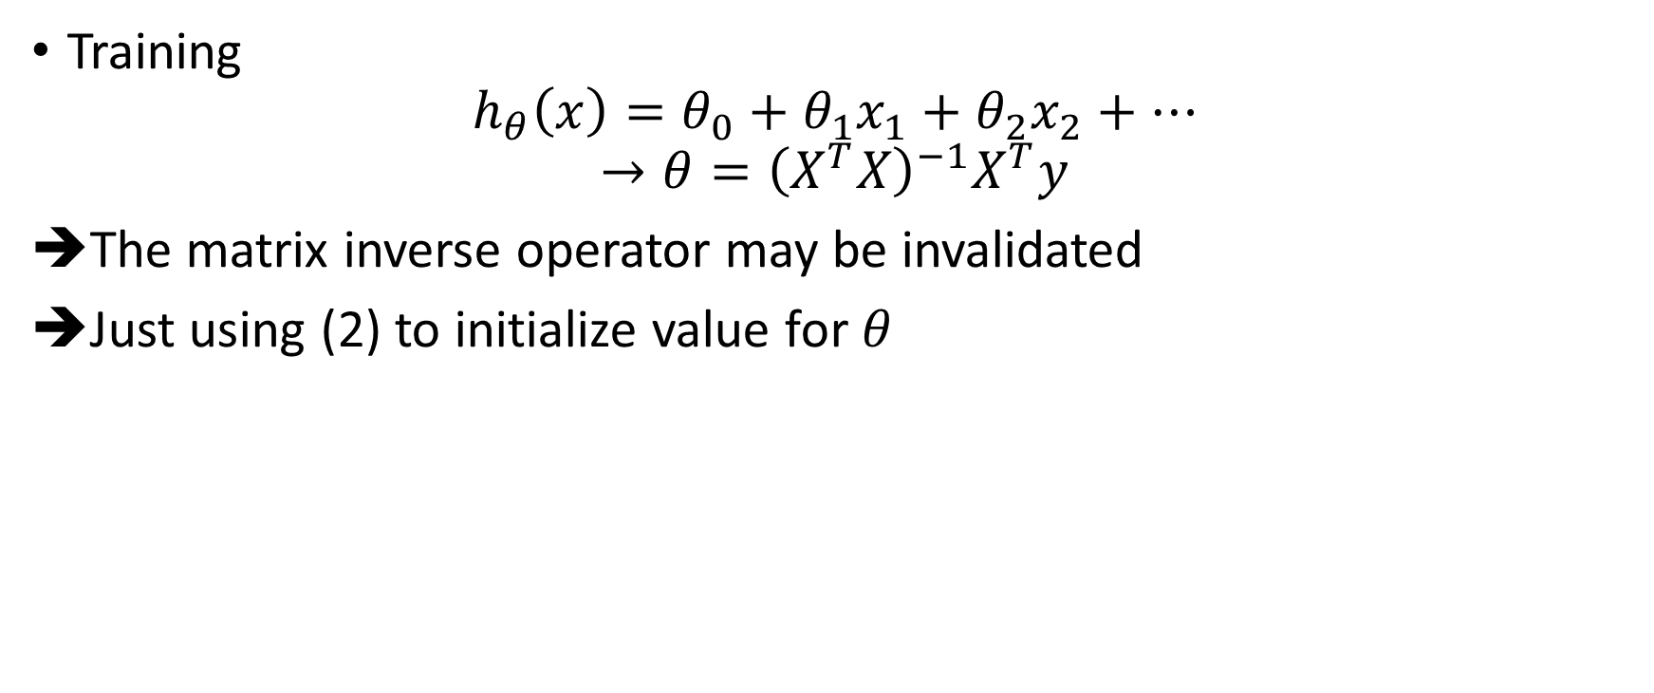
Regression
Training
$$h_{θ}\left(x\right)=θ_{0}+θ_{1}x_{1}+θ_{2}x_{2}+…$$
$$→θ={\left(X^{T}X\right)}^{−1}X^{T}y$$
The matrix inverse operator may be invalidated
Just using (2) to initialize value for $θ$
(1)
(2)

Slide 8
Regression
bias: -215.7332
Max deviation: 199 450
Mean absolute deviation: 16 524
bias: 183.4305
Max deviation: 190 730
Mean absolute deviation: 14 340

Slide 9

The best attribute
Choosing the attribute which has largest value of $θ$ in each range
The attribute appears the most (over all ranges) is the best.

