Slide 1
LOCAL SECRET EXPOSURE SCANNER
Find it. Mask it.
See it live.
A local-file detector with persistent findings and a browser dashboard
ABES Engineering College, Ghaziabad
Kunal Thainua | Roll 2400320100632 | Guide Sarath · Session 2026–27
Version 1.0 · 1 October 2026
Notes:
0:00–0:20. Introduce the project as a local scanner that detects selected secret-like assignments, masks results, and displays them in a browser. Today’s demonstration focuses on the implemented Day 2 and Day 3 behavior.
Sources: scanner.py; index.html; evidence/day_frontend_live.png

Slide 2
LOCAL SECRET EXPOSURE SCANNER
Project goal
The problem
What this demonstrator does
A credential can sit in a config or notes file, outside source code. A search hit alone does not show how the file is stored.
Scans one selected file
Matches visible key=value rules
Masks each value
Labels likely plaintext formats
Saves findings for a live view
Scope: local files only. Extension-based exposure is a proxy, not an encryption test.
Project demonstration · 1 October 2026
Notes:
0:20–0:50. Explain the gap this small project addresses: configuration and notes can contain secrets too. The scanner combines a narrow pattern check with a file-format exposure label, then masks the result. Be precise that the suffix check is a proxy and does not inspect encryption.
Sources: scanner.py; Day 2 and Day 3 project instructions; SRS scope

Slide 3
LOCAL SECRET EXPOSURE SCANNER
Detection and display flow
01
02
03
04
05
Selected file
→
Pattern scan
→
Safe finding
→
Local history
→
Browser view
secrets.env
password · API key · token
masked + severity
findings.json
3 second refresh
The detector runs when invoked. The browser polls the saved JSON; it does not scan files itself.
Project demonstration · 1 October 2026
Notes:
0:50–1:25. Walk through the flow from the user-selected file to the browser. The scanner processes the file line by line and saves masked summaries. The static page polls the JSON every three seconds, so a new result appears after another scan writes it.
Sources: scanner.py; index.html; findings.json

Slide 4
LOCAL SECRET EXPOSURE SCANNER
Rules and safeguards
Visible detector rules
Exposure label
Key pattern
Severity
Configured suffixes: .env, .txt, .ini, .cfg, .config, .yml, .yaml
password=value
Medium
api_key / api-key=value
High
Masking happens before console output and JSON persistence. The history keeps at most 50 findings.
token=value
High
This rule set is deliberately small and inspectable; it does not cover every credential format.
Project demonstration · 1 October 2026
Notes:
1:25–1:55. Point out the rules and severity mapping. Explain that short values are fully hidden and longer values retain only limited edge characters. The plaintext classification uses filename suffixes and should not be mistaken for cryptographic or ACL verification.
Sources: scanner.py; SRS requirements FR-03 through FR-07

Slide 5
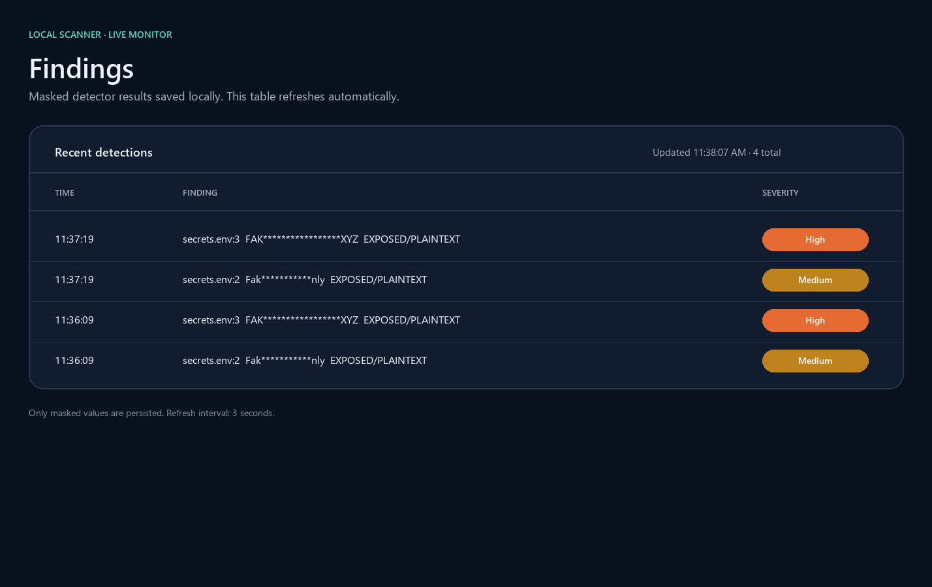
LOCAL SECRET EXPOSURE SCANNER
Observed results
Positive detection
Fake password
Medium · exposed plaintext
Fake API key
High · exposed plaintext
Negative control
ordinary_notes.txt
No findings.
Dashboard screenshot from the live local viewer
Project demonstration · 1 October 2026
Notes:
1:55–3:00. Show the dashboard evidence. The fixture produced two results: the fake password is Medium, and the fake API key is High. Both values are masked and labeled EXPOSED/PLAINTEXT. The ordinary notes file returned “No findings.” Pause long enough for the audience to read the masked rows and severity labels.
Sources: evidence/day3_findings.txt; evidence/day3_negative_control.txt; evidence/day_frontend_detection.txt; evidence/day_frontend_live.png

Slide 6
LOCAL SECRET EXPOSURE SCANNER
Live demonstration run sheet
0:00–0:10
Open the local dashboard
0:10–0:25
Run scanner.py against secrets.env
0:25–0:40
Show the masked console results
0:40–0:50
Wait for the 3 second refresh and point to the new rows
Backup: keep the saved dashboard screenshot and findings.json available.
Project demonstration · 1 October 2026
Notes:
3:00–4:00. The live scan takes about 50 seconds, with the rest reserved for slide transition. Leave the page open, run python scanner.py secrets.env from the project folder, confirm two masked console lines, and wait for the dashboard polling cycle. Narrate that the scan writes JSON and the page reads it.
Sources: scanner.py; index.html; evidence/day_frontend_detection.txt; findings.json

Slide 7
LOCAL SECRET EXPOSURE SCANNER
Limits and next steps
Current limits
Next improvements
Single file per run
Small set of patterns
Extension-based exposure proxy
Local JSON history without encryption
Development server, not a production service
Expand and test detection rules
Inspect real access and encryption controls
Add directory scanning and exclusions
Harden storage and the viewer boundary
Takeaway: a real local detection is masked, labeled, persisted, and visible in the browser.
Project demonstration · 1 October 2026
Notes:
4:00–5:00. Close with the evidence-backed takeaway and state the limits. The current version proves a small local workflow, not comprehensive secret detection or secure storage. The next step is to expand rules, verify storage protections directly, and add automated checks. Leave the final few seconds for questions.
Sources: SRS limitations and future work; scanner.py; index.html

