Slide 1

Classification of Infected RBCs
P THAISEER
SC13B175
PHYSICAL SCIENCES
Dept. of Earth and Space Sciences, Indian Institute of Space Science and Technology

Slide 2
Overview
Introduction
Method of Classification
1D PCA
2D PCA
Statistical Features
PCANet
Dept. of Earth and Space Sciences, Indian Institute of Space Science and Technology

Slide 3
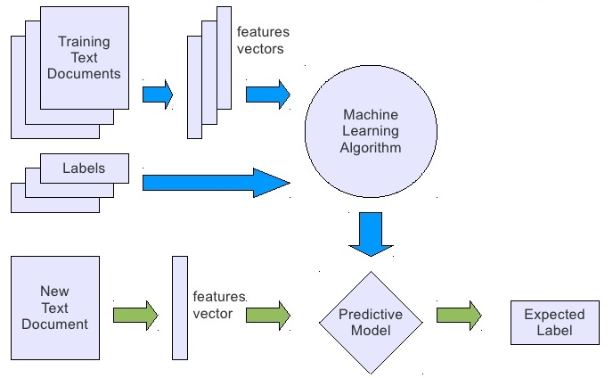
Classification
What is classification ?
Dept. of Earth and Space Sciences, Indian Institute of Space Science and Technology
Image Courtesy: www.stackexchange.com

Slide 4
Problem of Interest
Detection of Malaria infected RBCs from the segmented slide images of Full blood.
Dept. of Earth and Space Sciences, Indian Institute of Space Science and Technology

Slide 5
Introduction
Medical image analysis and classification has great significance in the field of medicine.
The accurate interpretation and analysis of medical images are time consuming because there is much detail in such images.
Dept. of Earth and Space Sciences, Indian Institute of Space Science and Technology

Slide 6
Method of Classification
1. Support Vector Machine (SVM)
A classifier derived from statistical learning theory by Vladimir N. Vapnik, Isabel M. Guyon and Bernhard E. Boser in 1992
Currently, SVM is widely used in object detection & recognition, content-based image retrieval, text recognition, biometrics, speech recognition, etc.
The goal of SVM is to find the optimal separating hyperplane which maximizes the margin of training data.
Dept. of Earth and Space Sciences, Indian Institute of Space Science and Technology

Slide 7
Support Vector Machine (SVM) (Cont.)
denotes +1
denotes -1
Dept. of Earth and Space Sciences, Indian Institute of Space Science and Technology

Slide 8
Support Vector Machine (SVM) (Cont.)
denotes +1
denotes -1
The maximum margin linear classifier is the linear classifier with the maximum margin.
This is the simplest kind of SVM (Called an LSVM)
Dept. of Earth and Space Sciences, Indian Institute of Space Science and Technology

Slide 9
Support Vector Machine (SVM) (Cont.)
Summary
Maximize the margin between positive and negative samples.
Non-linear Classification possible by mapping data into another space that can be separated linearly.
The support vectors contribute to the solution.
Kernels map examples into a new, usually non-linear space.
Dept. of Earth and Space Sciences, Indian Institute of Space Science and Technology

Slide 10



Feature Extraction
In case of malaria, only 2% of total population of RBCs are infected.
In order to distinguish between the infected and non infected cells, we extract features that could reflect the size, shape, internal complexity etc. those includes – contrast, correlation, min and max mean etc.
WBC
Infected RBC
Healthy RBC
Dept. of Earth and Space Sciences, Indian Institute of Space Science and Technology

Slide 11


Feature Extraction (Cont.)
Effective feature extraction requires accurate segmentation.
But in real world example, segmentation is applied on noisy images.
Noisy images will make the process of segmentation more difficult.
Cell With Dust
Cells In Clump
One way to circumvent the accurate segmentation is through use of Eigen features.
Dept. of Earth and Space Sciences, Indian Institute of Space Science and Technology

Slide 12
Principal Component Analysis (PCA)
PCA is the most popular feature extraction method which will give us the Eigen feature as output.
PCA consists of a transformation from a space of high dimension to another with reduced dimension.
If the data is highly correlated, there is redundant information.
PCA reduces redundancy by decorrelating the input vectors.
Dept. of Earth and Space Sciences, Indian Institute of Space Science and Technology

Slide 13
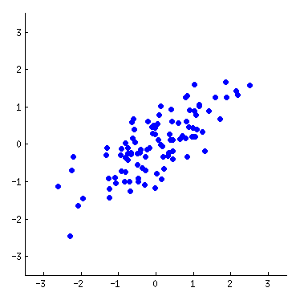
PCA (Cont.)
Direction of Principle component is direction of max scatter.
Dept. of Earth and Space Sciences, Indian Institute of Space Science and Technology
Image Courtesy: www.stackexchange.com

Slide 14
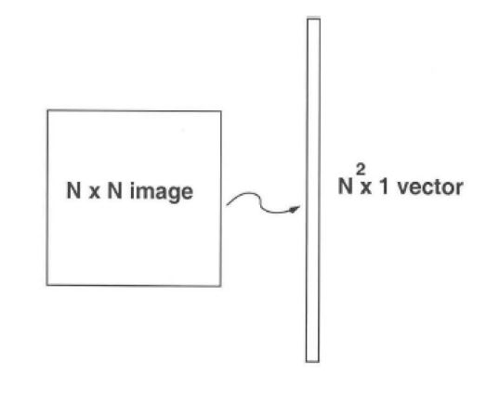

1D PCA
Computation of low –dimensional basis (i.e., Eigen images)
$\left\{I\right\}{M \atop i=1}$ be M training images of n x n pixels
Represent every Image as a vector Ί_{i}
Compute the average of training images as Ῑ
Dept. of Earth and Space Sciences, Indian Institute of Space Science and Technology

Slide 15
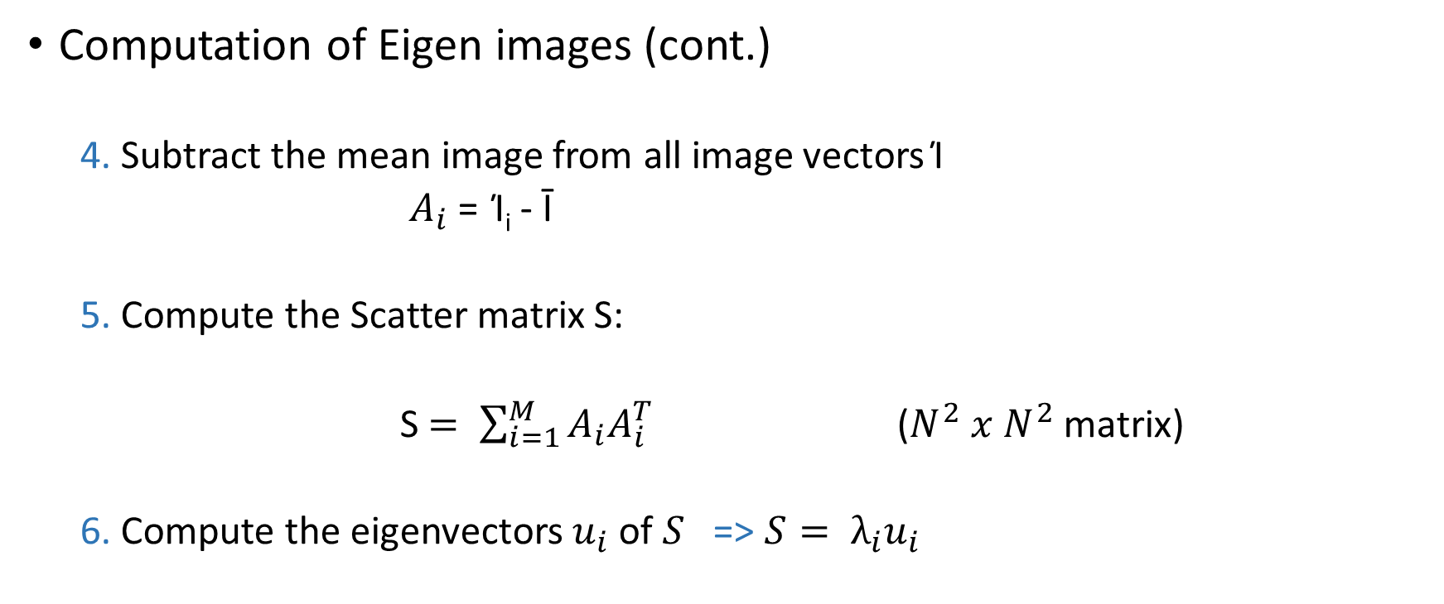
1D PCA (Cont.)
Computation of Eigen images (cont.)
4. Subtract the mean image from all image vectors Ί
$A_{i}$ = Ί_{i} - Ῑ
5. Compute the Scatter matrix S:
S $= \sum_{i=1}^{M}{A_{i}A_{i}^{T}}$ ($N^{2} x{ N}^{2}$ matrix)
6. Compute the eigenvectors $u_{i}$ of $S$ => $S= λ_{i}u_{i}$
Dept. of Earth and Space Sciences, Indian Institute of Space Science and Technology

Slide 16



1D PCA (Cont.)
Computation Eigen images (cont.)
7. Keep only K eigenvectors (Eigen Image)(corresponding to K largest eigenvalues )
(Imp. The eigenvectors should be normalized)
First Three Eigen Images:
Dept. of Earth and Space Sciences, Indian Institute of Space Science and Technology

Slide 17
1D PCA (Cont.)
8. Represent the Images onto this Eigen Image
Each Image – Mean of training images can be represented as a linear combination of the best K eigenvectors
Now principal component of image can be used as features for training the classifier – SVM
Dept. of Earth and Space Sciences, Indian Institute of Space Science and Technology

Slide 18




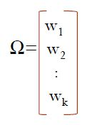
1D PCA (Cont.)
How to Test ?
Test Images
Convert the Image into a column vector
Normalize the image vector
Project Normalized image onto eigenspace
Class Label
Trained Classifier
SVM/NN
Weight vector of Test Image
Dept. of Earth and Space Sciences, Indian Institute of Space Science and Technology

Slide 19
1D PCA (Cont.)
Results After Classification
Class Label | No. of Samples | % of Training | Testing
Positive | 5600 | 60% (3360) | 1120
Negative | 331809 | 1% (3300) | 327409
Confusion Matrix for Testing
882 | 238
49361 | 278048
Method | Overall Accuracy
SVM | 84.90%
Dept. of Earth and Space Sciences, Indian Institute of Space Science and Technology

Slide 20
2D PCA
2D PCA to be applied on mxn training images
Y = A_{mxn}X_{nx1}
Y is m dimensional projected feature vector of image on to X
How to find X?
Total scatter of projected sample can be characterised by covariance matrix of projected samples
i.e. J(Y) = tr(S_{y}), S_{y} - covariance matrix of Y
S_{y} = E[ (Y - E(Y)) (Y - E(Y))^{T} ] = E{ [ (A - E(A))X ] [ (A - E(A))X ]^{T} }
Dept. of Earth and Space Sciences, Indian Institute of Space Science and Technology

Slide 21
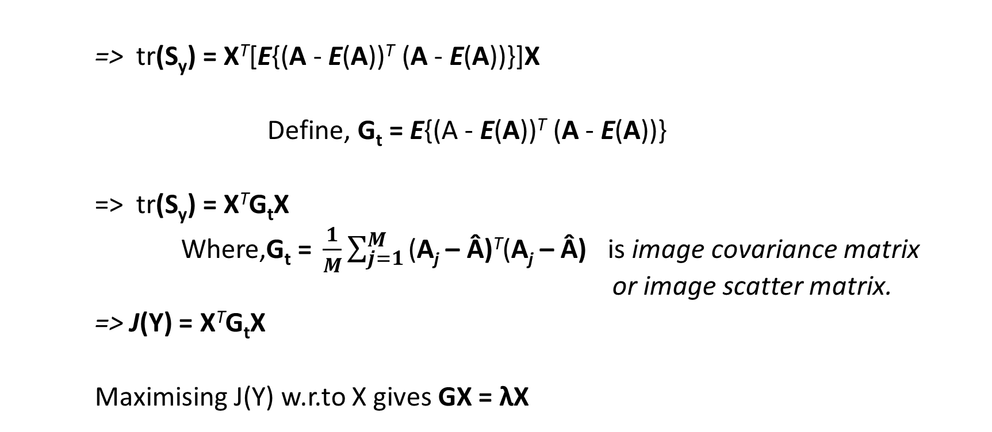
2D PCA (Cont.)
=> tr(S_{y}) = X^{T}[E{(A - E(A))^{T} (A - E(A))}]X
Define, G_{t} = E{(A - E(A))^{T} (A - E(A))}
=> tr(S_{y}) = X^{T}G_{t}X
Where,$\text{G}\text{t}\text{ = }\frac{1}{M}\sum_{j=1}^{M}{\text{(}\text{A}\text{j}\text{ – Â)}\text{T}\text{(}\text{A}\text{j}\text{ – Â)}}$ is image covariance matrix or image scatter matrix.
=> J(Y) = X^{T}G_{t}X
Maximising J(Y) w.r.to X gives GX = λX
Dept. of Earth and Space Sciences, Indian Institute of Space Science and Technology

Slide 22
2D PCA (Cont.)
=> Max ( X^{T}G_{t}X ) = Max λ , where λ is Eigen value of G.
=> Y = A_{mxn}X_{nx1} Where Y is m dimensional projected feature vector of A on to X
=> Y_{mx1} is the feature vector of one training sample.
=> Features of all training sample --> Train the classifier (SVM)
Dept. of Earth and Space Sciences, Indian Institute of Space Science and Technology

Slide 23

2D PCA (Cont.)
How to Test ?
Test Images
Difference Matrix of Test Image and Mean Train Image
Project Difference Matrix onto eigenspace
Weight vector of Test Image
MxN
MxN
Mx1
Class Label
Trained Classifier
SVM
Dept. of Earth and Space Sciences, Indian Institute of Space Science and Technology

Slide 24
2D PCA (Cont.)
Results After Classification
Class Label | No. of Samples | % of Training | Testing
Positive | 5600 | 60% (3360) | 1120
Negative | 331809 | 1% (3300) | 327409
Confusion Matrix for Testing
969 | 151
33078 | 288331
Method | Overall Accuracy
SVM | 88.05%
Dept. of Earth and Space Sciences, Indian Institute of Space Science and Technology

Slide 25
Classification using Features
Extraction of Feature
Effective Feature extraction is key in Classification using Features.
Each slide image of cells contain many cells.
We should segment out each cell separately to extract features more efficiently.
Features includes – Contrast, Correlation, Energy, Homogeneity, Min& Max Mean, Variance and Intensity.
Dept. of Earth and Space Sciences, Indian Institute of Space Science and Technology

Slide 26
Classification using Features
Extraction of Feature
A 3x3 window is used to find the min. and max. values of mean and variance.
A 15x15 window is used for finding the min. and max. Intensity
Dept. of Earth and Space Sciences, Indian Institute of Space Science and Technology

Slide 27
Feature Extraction (Cont.)
Results After Classification
Class Label | No. of Samples | % of Training | Testing
Positive | 5600 | 60% (3360) | 2240
Negative | 325101 | 1% (3360) | 321741
Confusion Matrix for Testing
1499 | 741
3184 | 318557
Method | Overall Accuracy
SVM | 98.78%
Dept. of Earth and Space Sciences, Indian Institute of Space Science and Technology

Slide 28
PCANet
Simple deep learning network for image classification.
Deep learning – to discover multiple levels of representation with the hope that higher level features can represent more abstract semantics.
The main algorithm includes cascading two filter bank convolutions with an intermediate mean normalization step, followed by a binary hashing step and a final histogram forming step.
Dept. of Earth and Space Sciences, Indian Institute of Space Science and Technology

Slide 29
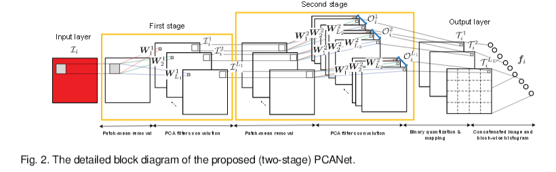
PCANet
Basic Block Diagram
Image Courtesy: IEEE Transaction on Image Processing, Vol 24, No. 12, pp. 5019, Dec 2015
Dept. of Earth and Space Sciences, Indian Institute of Space Science and Technology

Slide 30
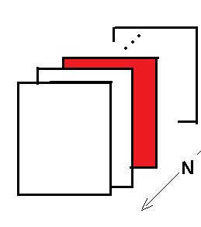
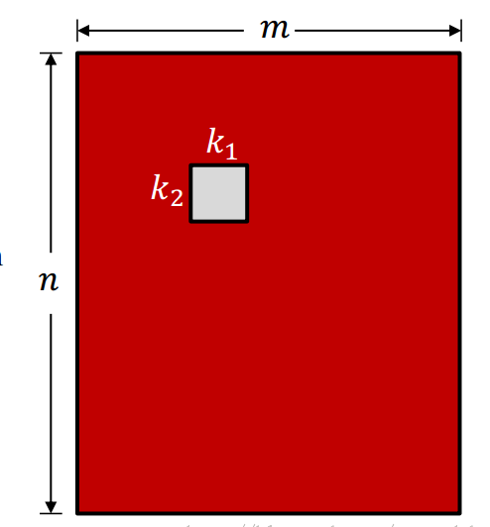

PCANet (Cont.)
STAGE 1
Suppose, there are N input training images of size m x n.
Consider ‘i’th image.
Take all patches of size k1 x k2 in the image.
Convert each patch into vector.
Find the mean patch and subtract it from all patches to obtain
Dept. of Earth and Space Sciences, Indian Institute of Space Science and Technology

Slide 31
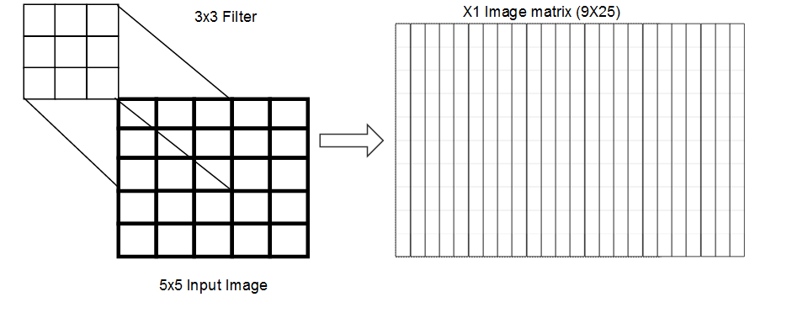
PCANet (Cont.)
STAGE 1 (Cont.)
X1 Image matrix 49x784
7x7 Patch
784 = 28*28
{ [32-ceil(7/2)
x
32-ceil(7/2) }
32x32 Input Image
Dept. of Earth and Space Sciences, Indian Institute of Space Science and Technology

Slide 32
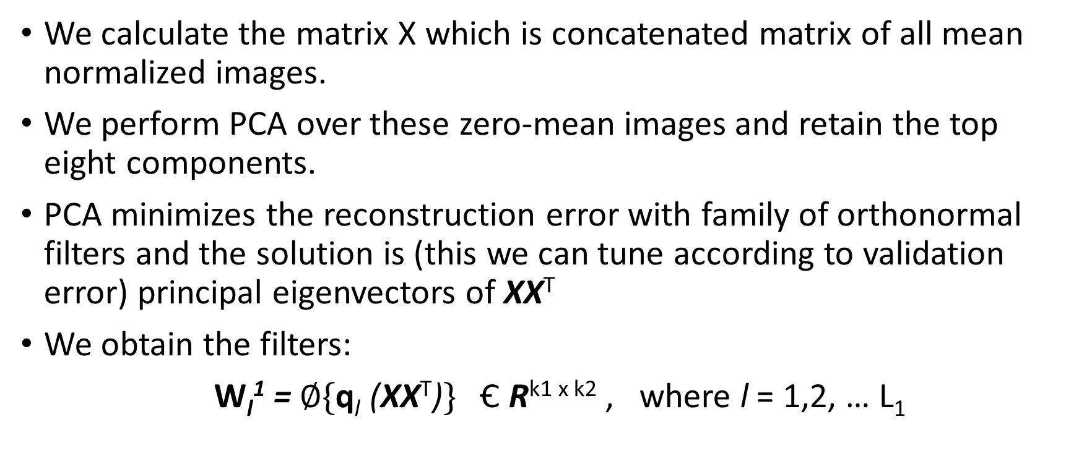
PCANet (Cont.)
We calculate the matrix X which is concatenated matrix of all mean normalized images.
We perform PCA over these zero-mean images and retain the top eight components.
PCA minimizes the reconstruction error with family of orthonormal filters and the solution is (this we can tune according to validation error) principal eigenvectors of XX^{T}
We obtain the filters:
$\text{W}\text{l}\text{1}\text{ =} ∅\text{\{}\text{q}\text{l}\text{ (}\text{XX}\text{T}\text{)}\text{\}}$ Ꞓ R^{k1 x k2} , where l = 1,2, … L₁
Dept. of Earth and Space Sciences, Indian Institute of Space Science and Technology

Slide 33
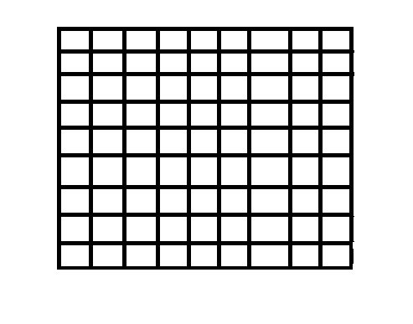
PCANet (Cont.)
STAGE 1 PCA Filter bank formation
PCA FILTER BANKS => PB ( 7X 7 X 8)
7x7 Filter Banks
_{A = TT’}
7x7 Filter Banks
7x7 Filter Banks
COVARIANCE MATRIX ( 49X 49)
Dept. of Earth and Space Sciences, Indian Institute of Space Science and Technology

Slide 34
PCANet (Cont.)
Stage 2
The 2nd layer is constructed by iterating the algorithm from the 1st layer over each of the output images obtained by convolving with
1st stage filters.
8 PCA Filters
V1 ( 32x32)
Input Image 1
(32 X 32)
V2 ( 32x 32)
Input Images
( 32 x32 x N)
V8( 32x 32)
Dept. of Earth and Space Sciences, Indian Institute of Space Science and Technology

Slide 35
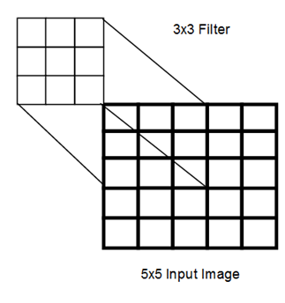
PCANet (Cont.)
For each output image (V1,… V8) we take the dense set of flattened patch vectors, remove the mean-component.
7x7 Patch
V1 ( 32x 32)
P ( 49x 784)
784 = 28*28 { [32-ceil(7/2)*32-ceil(7/2) }
32x32 Input Images
Dept. of Earth and Space Sciences, Indian Institute of Space Science and Technology

Slide 36
PCANet (Cont.)
The patches produced by the different filters are then concatenated together and we estimate another set of PCA filter bank (again eight filters).
Concatenate all the Resultant Matrices to form T =[P1,P2,…, P8]
P1 ( 49x784)
T = [ P1, P2, …, P8] ( 49x 6272x N)
P8 ( 49x784)
Now find the Covariance matrix TT’ (49x49)
Dept. of Earth and Space Sciences, Indian Institute of Space Science and Technology

Slide 37
PCANet (Cont.)
STAGE 2 PCA Filter bank formation
PCA FILTER BANKS => PB ( 7X 7 X 8)
7x7 Filter Banks
_{A = TT’}
7x7 Filter Banks
7x7 Filter Banks
COVARIANCE MATRIX ( 49X 49)
Dept. of Earth and Space Sciences, Indian Institute of Space Science and Technology

Slide 38
PCANet (Cont.)
Resultant Matrices after Convolution with V1 ( 32 x 32 x 8)
Set of Images V1,V2, …, V8
V
( 32 x32)
8 PCA Filters
V1 (1)
( 32x32)
V1 (2)
( 32x 32)
V1
(32 X 32)
V1 (8)
( 32x 32
Dept. of Earth and Space Sciences, Indian Institute of Space Science and Technology

Slide 39
PCANet (Cont.)
Resultant Matrices after Convolution with V2( 32 x 32 x 8)
Set of Images V1,V2, …, V8
V
( 32 x32)
8 PCA Filters
V2(1)
( 32x32)
V2 (2)
( 32x 32)
V2
(32 X 32)
V2 (8)
( 32x 32
Dept. of Earth and Space Sciences, Indian Institute of Space Science and Technology

Slide 40
PCANet (Cont.)
Resultant Matrices after Convolution with V8( 32 x 32 x8)
Set of Images V1,V2, …, V8
V
( 32 x32)
8 PCA Filters
V8(1)
( 32x32)
V8 (2)
( 32x 32)
V8
(32 X 32)
V8 (8)
( 32x 32
Dept. of Earth and Space Sciences, Indian Institute of Space Science and Technology

Slide 41
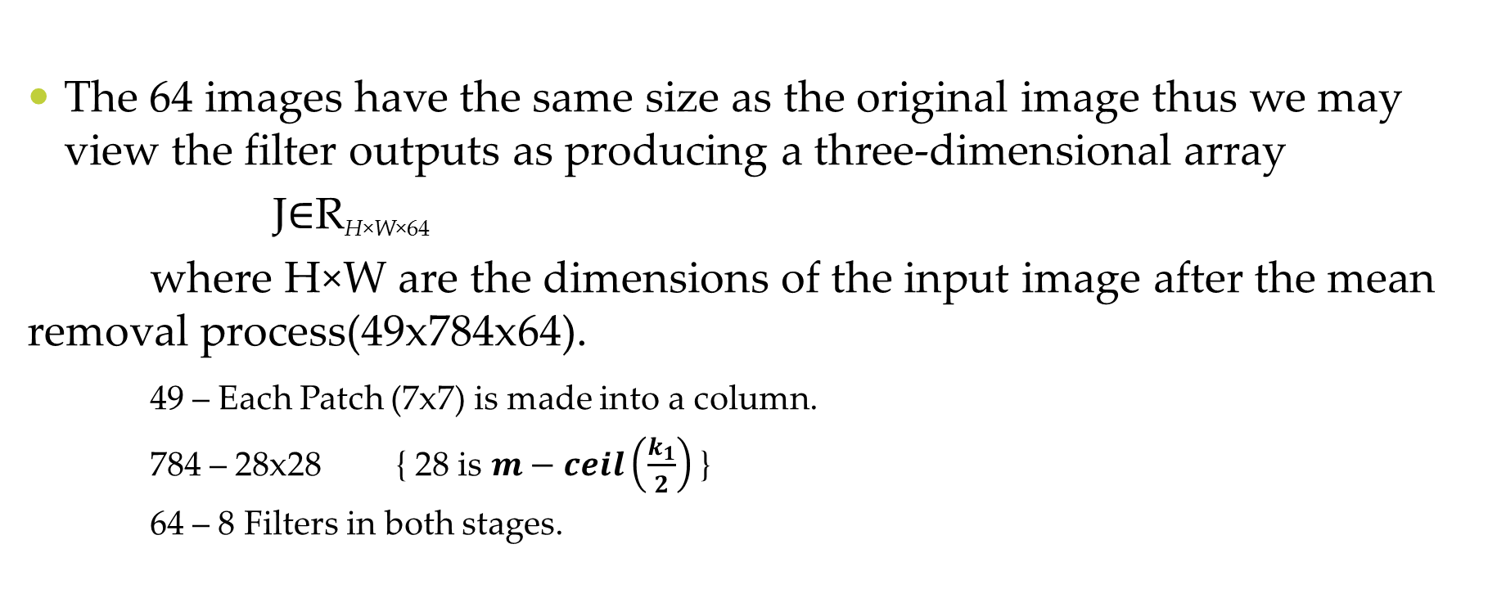
PCANet (Cont.)
The 64 images have the same size as the original image thus we may view the filter outputs as producing a three-dimensional array
J∈R_{H×W×64}
where H×W are the dimensions of the input image after the mean removal process(49x784x64).
49 – Each Patch (7x7) is made into a column.
784 – 28x28 { 28 is $m−ceil\left(\frac{k_{1}}{2}\right)$ }
64 – 8 Filters in both stages.
Dept. of Earth and Space Sciences, Indian Institute of Space Science and Technology

Slide 42
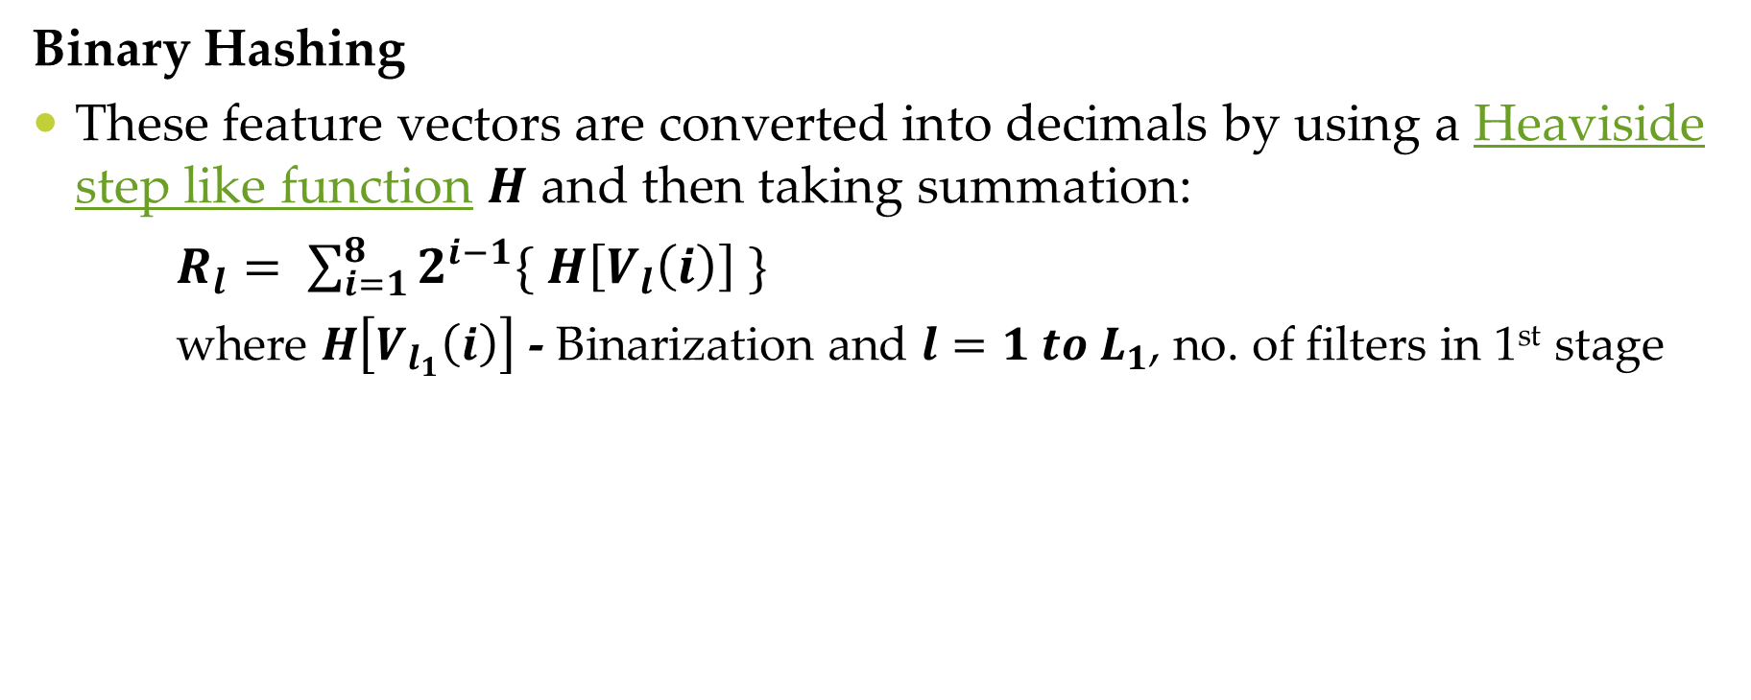
PCANet (Cont.)
Binary Hashing
These feature vectors are converted into decimals by using a Heaviside step like function $H$ and then taking summation:
$R_{l}= \sum_{i=1}^{8}{2^{i−1}\{ H\left[V_{l}\left(i\right)\right] \}}$
where $H\left[V_{l_{1}}\left(i\right)\right]$ - Binarization and $l=1 to L_{1}$, no. of filters in 1st stage
$R_{1}=\{ 2^{0}{∗V}_{1}\left(1\right) + 2^{1}∗V_{1}\left(2\right) + … +2^{7}∗V_{1}\left(8\right) \}$
V
( 32x32)
R ( 32 x 32 )
Dept. of Earth and Space Sciences, Indian Institute of Space Science and Technology

Slide 43
PCANet (Cont.)
R1
( 32 x 32 )
R2
( 32 x 32 )
V1
(32x32)
V2
(32x32)
R3
( 32 x 32 )
. . . .
V3
(32x32)
R8
( 32 x 32 )
V8
(32x32)
Dept. of Earth and Space Sciences, Indian Institute of Space Science and Technology

Slide 44
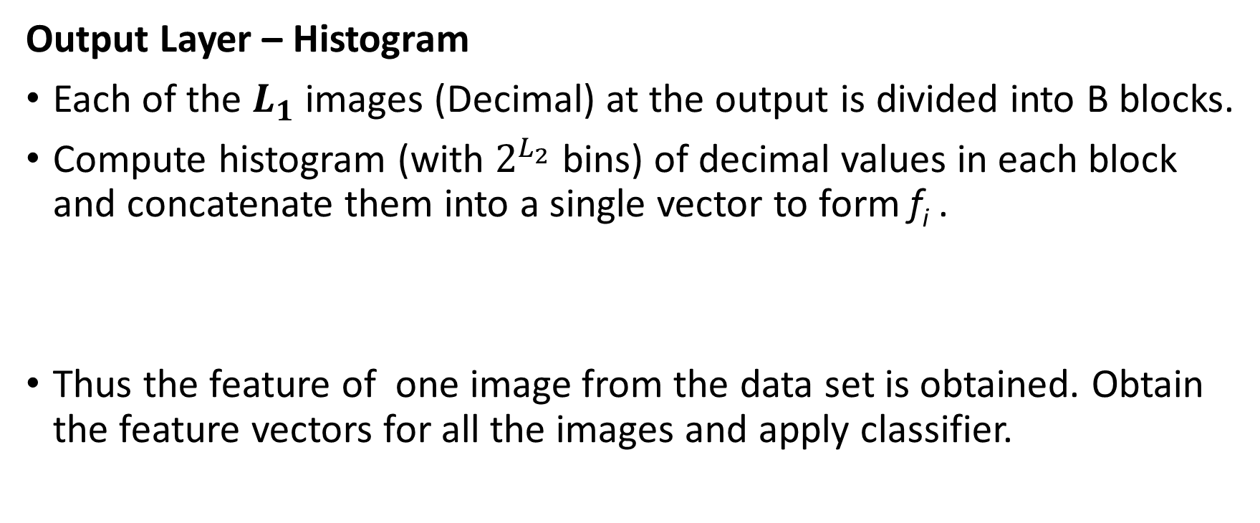
PCANet (Cont.)
Output Layer – Histogram
Each of the $L_{1}$ images (Decimal) at the output is divided into B blocks.
Compute histogram (with $2^{L_{2}}$ bins) of decimal values in each block and concatenate them into a single vector to form f_{i} .
Thus the feature of one image from the data set is obtained. Obtain the feature vectors for all the images and apply classifier.
Dept. of Earth and Space Sciences, Indian Institute of Space Science and Technology

Slide 45
PCANet (Cont.)
Results After Classification
Considering the large dataset used in previous cases, here a small dataset was used as per convenience.
Class Label | No. of Samples | % of Training | Testing
Positive | 2492 | 1300 | 1192
Negative | 56300 | 1300 | 55000
Confusion Matrix for Testing
972 | 220
1785 | 53215
Dept. of Earth and Space Sciences, Indian Institute of Space Science and Technology

Slide 46

PCANet (Cont.)
Results After Classification (Cont.)
Statistics
$Sensitivity or Recall or TPR= \frac{TP}{TP+FN} Specificity or True Negative Rate= \frac{TN}{TN+FP}$
Statistics from Confusion Matrix
Sensitivity | Specificity
0.81 | 0.97
Method | Overall Accuracy
SVM | 96.43
Dept. of Earth and Space Sciences, Indian Institute of Space Science and Technology

Slide 47
Conclusions
Method | Accuracy | TPR | TNR
1D PCA | 84.90% | 0.79 | 0.85
2D PCA | 88.90% | 0.86 | 0.88
Stat. Features | 98.78% | 0.66 | 0.99
Method | Accuracy | TPR | TNR
PCANet | 96.43% | 0.81 | 0.97
Dept. of Earth and Space Sciences, Indian Institute of Space Science and Technology

Slide 48
Questions?

Slide 49
Thank You

Slide 50
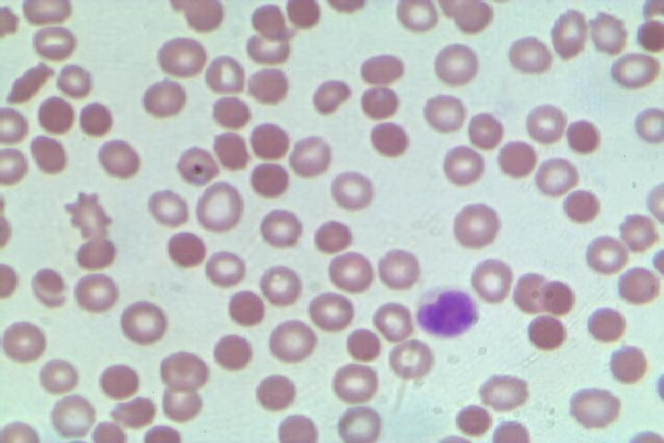
Malaria Plasmodium Falciparum Infected Cells
Dept. of Earth and Space Sciences, Indian Institute of Space Science and Technology

Slide 51
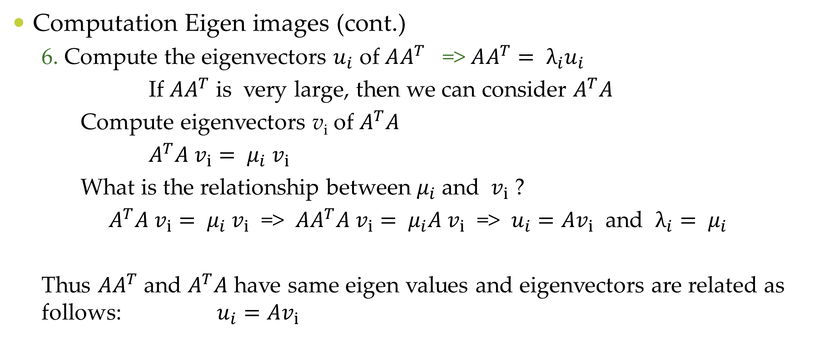
1D PCA (Cont.)
Computation Eigen images (cont.)
6. Compute the eigenvectors $u_{i}$ of $AA^{T}$ => $AA^{T}= λ_{i}u_{i}$
If $AA^{T}$ is very large, then we can consider $A^{T}A$
Compute eigenvectors v_{i} of $A^{T}A$
$A^{T}A v_{i}= μ_{i}{ v}_{i}$
What is the relationship between $μ_{i}$ and ${ v}_{i}$ ?
$A^{T}A v_{i}= μ_{i}{ v}_{i}$ => ${AA}^{T}A v_{i}= μ_{i}{A v}_{i}$ => $u_{i}=Av_{i}$ and ${λ_{i}= μ}_{i}$
Thus $AA^{T}$ and $A^{T}A$ have same eigen values and eigenvectors are related as follows: $u_{i}=Av_{i}$
Dept. of Earth and Space Sciences, Indian Institute of Space Science and Technology

