Slide 2
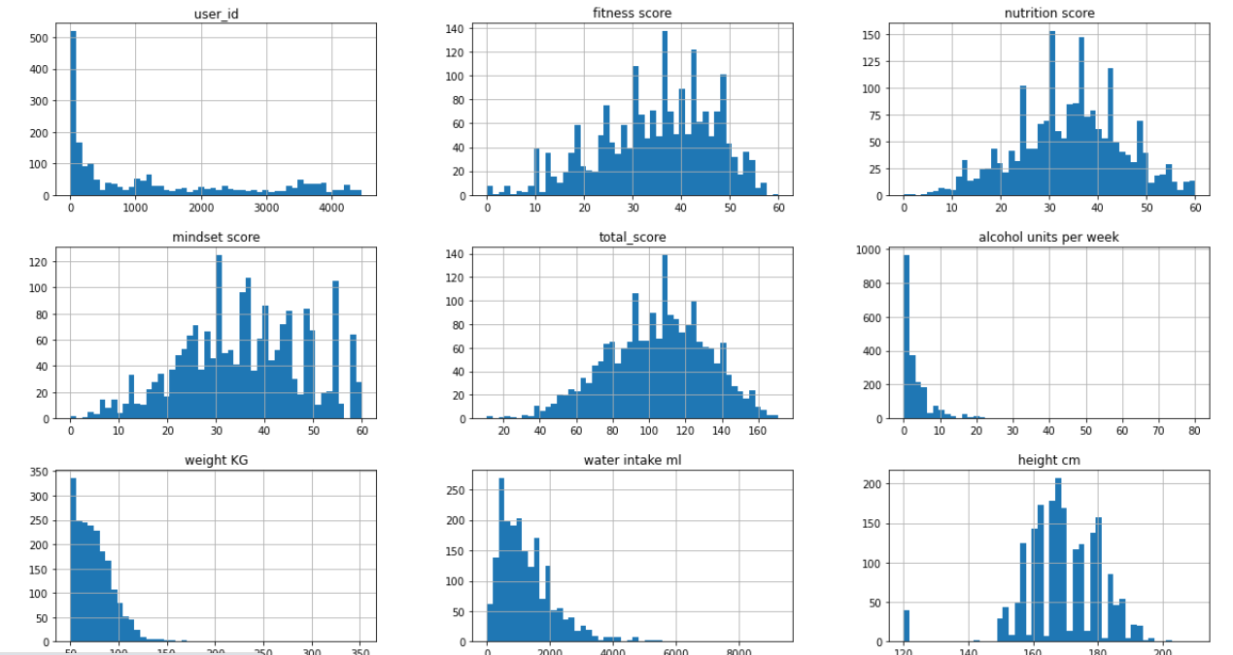
Overall data distribution
Below figure shows the overall data distribution is tail ended.
This data needs to be scaled to correct its skewed distribution

Slide 3
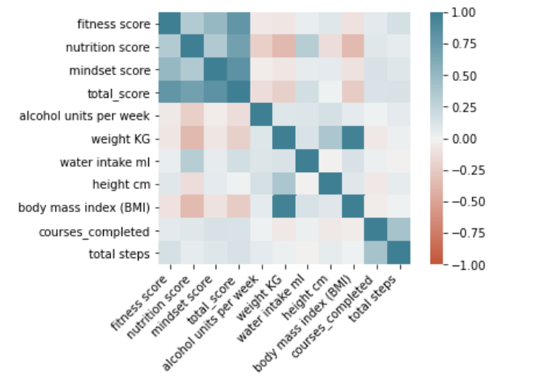
Numerical features correlations
Below figure shows the correlations between numerical attributes

Slide 4
Insights Drawn
Weight is directly proportional to BMI so as weight gained it impacts your health in terms of increased BMI
Interestingly, greater BMI leads to lower nutrition score
Most impacting factors contribute towards the total score
Mindset score
Nutrition score
Fitness score
Water intake affects the nutrition level. More water might leads to better nutrition score
Courses completed contributes to increased step count which might suggests that courses are related to some physical health

Slide 5
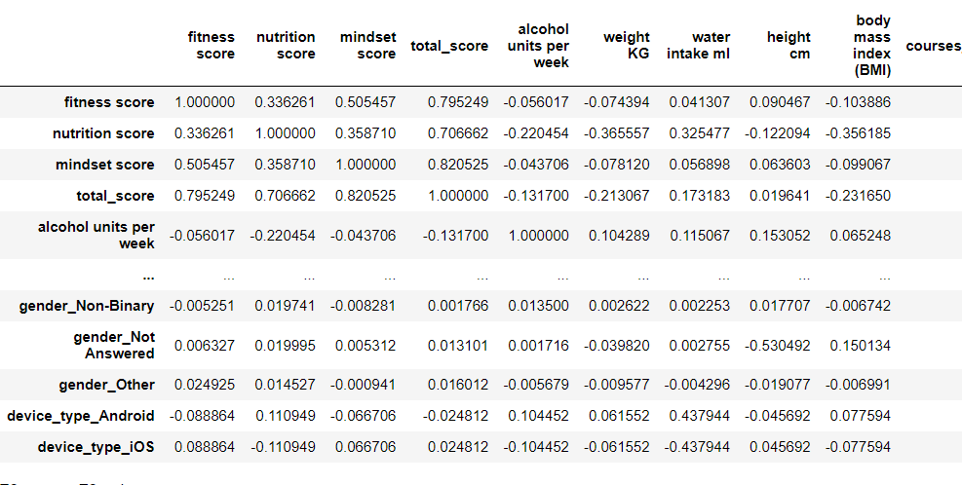
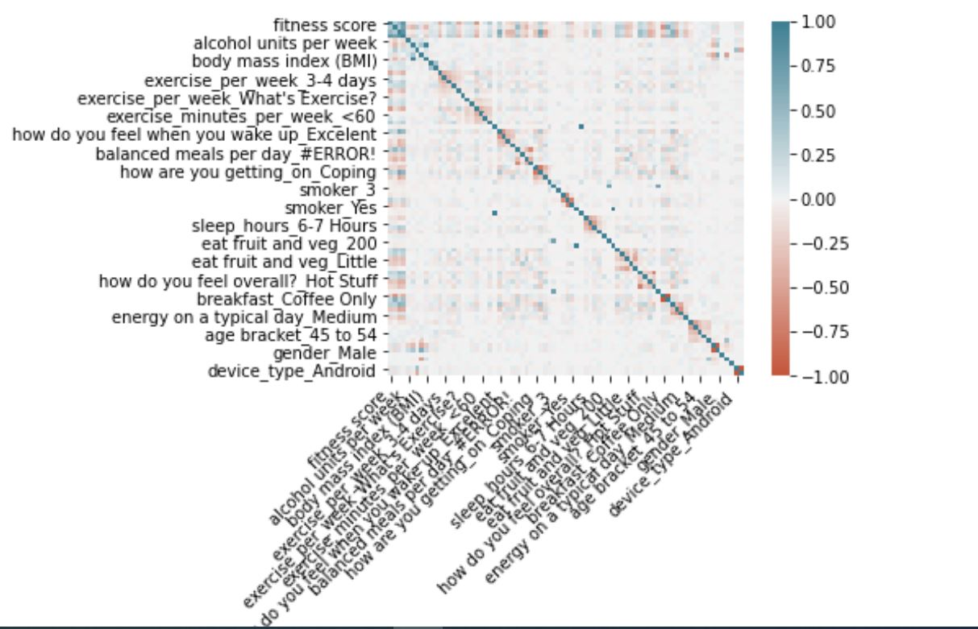
Categorical features correlations

Slide 6
Insights Drawn
If you are having only hot coffee for breakfast, it shows you are more intended to smoke
People who are sleeping 6-7 hours daily tend to feel overall good
People doing exercise 3-4 days a week can be observed with higher level of energy
What factors might impact nutrition score?
More alcohol consumption leads to decreased nutrition score
Greater weight contributes to lower nutrition score
Increased water intake impacts nutrition score positively

Slide 7
Suggestions
As per the figure and insights we can say that for overall health we need to focus on total score which is a combination of mental, physical & nutrition score
There are certain factors impacting each of these scores negatively as well as positively
In order to overall wellbeing, factors promoting individual scores should be made aware to everyone

