Slide 1
Chapter 2
Structure Query Language

Slide 2
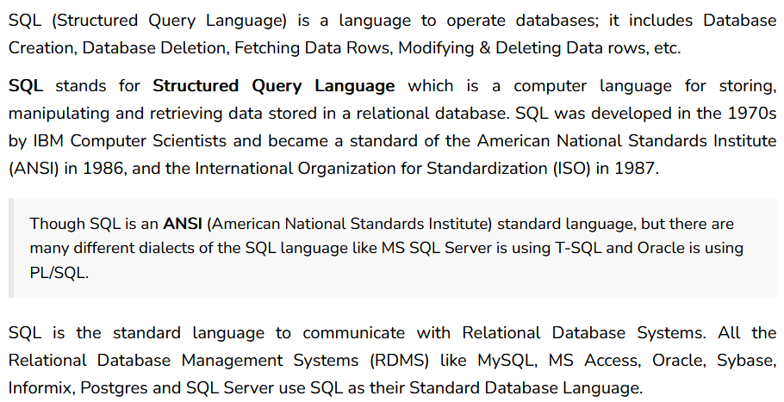
What is SQL

Slide 3
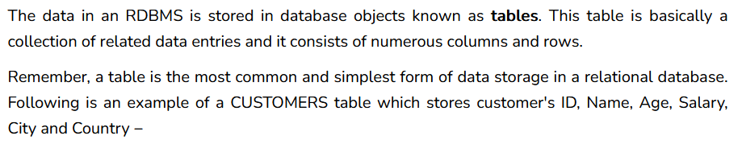
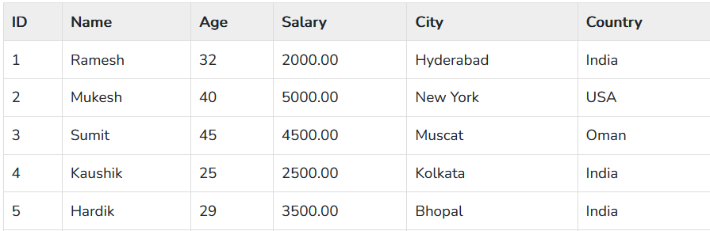
What is table

Slide 4
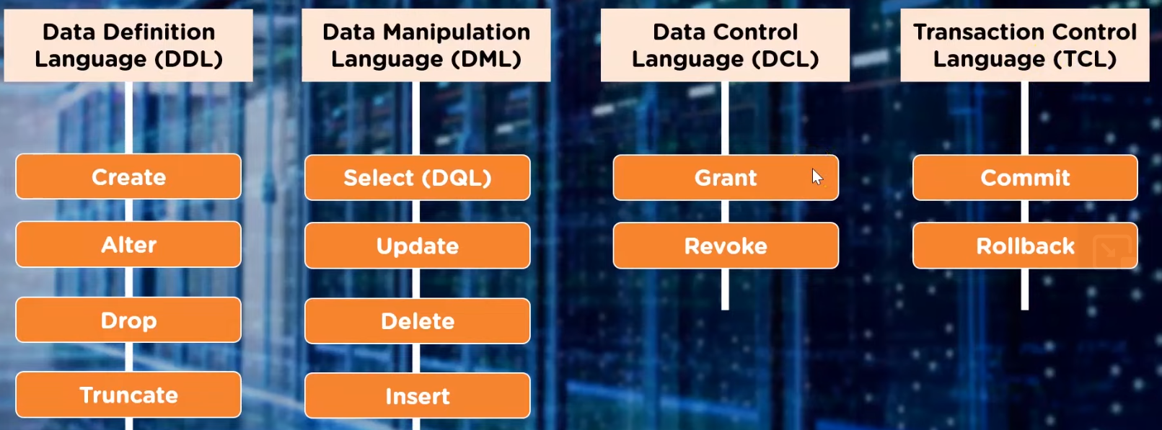
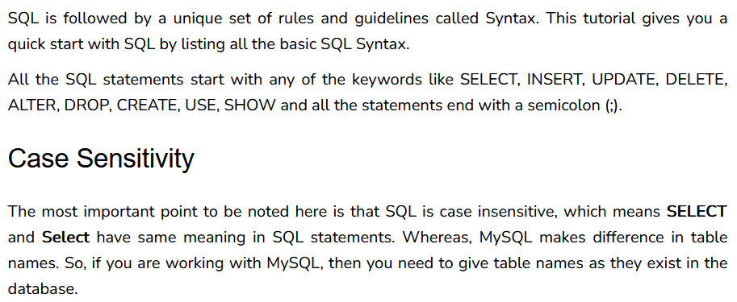
Types of SQL Commands
What is SQL Syntax

Slide 5
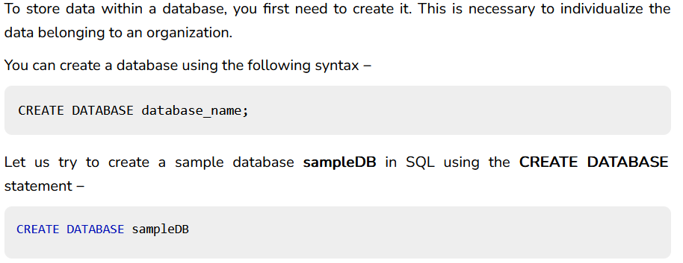
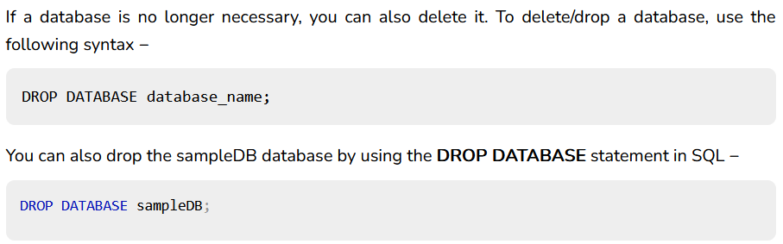
SQL Create / Drop Database Statement

Slide 6
SQL Server Data type
In SQL Server, data type specifies the type of data that can be stored in a column of a table such as integer data, string data, date & time, binary strings, etc.
Assigning an appropriate data type to columns in a table is crucial while designing a database. It affects the performance and efficiency of the database and the application using the database.
SQL Server provides built-in data types for all kinds of data that can be used within SQL Server.

Slide 7
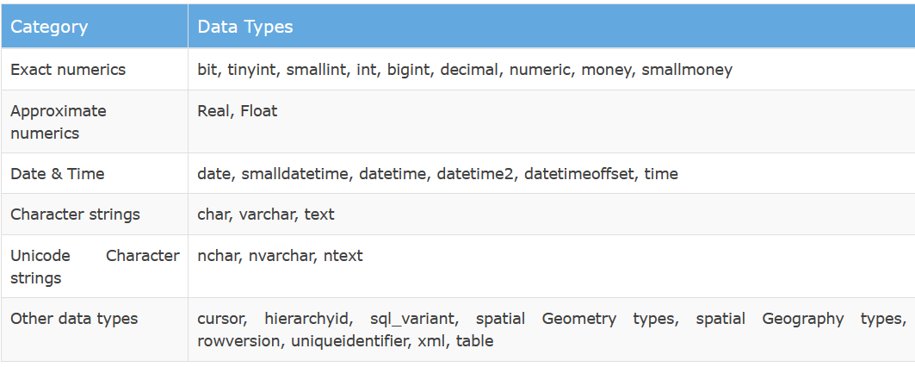
Data types Categories

Slide 8
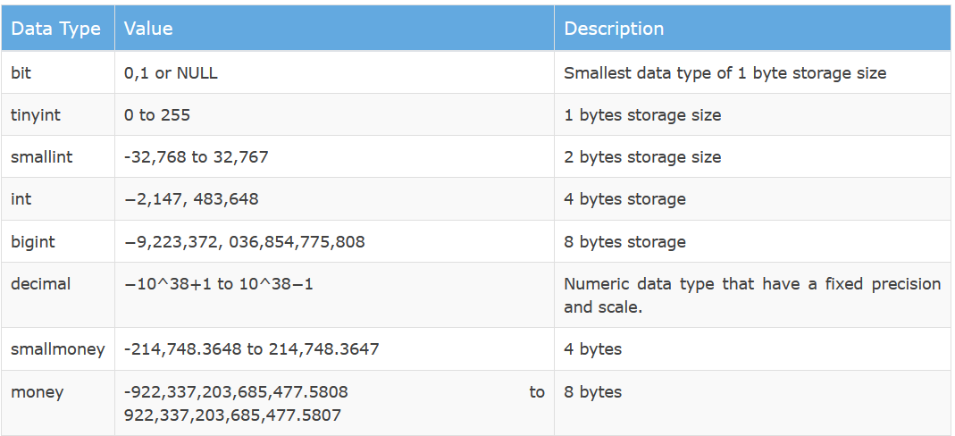
Exact Numeric

Slide 9
Writing SQL Commands
Most components of an SQL statement are case insensitive, except for literal character data.
Use extended form of BNF notation:
- Upper-case letters represent reserved words.
- Lower-case letters represent user-defined words.
- | indicates a choice among alternatives.
- Curly braces indicate a required element, { a }.
- Square brackets indicate an optional element, [a].
- … indicates optional repetition (0 or more).

Slide 10
Literals
Literals are constants used in SQL statements.
All non-numeric literals must be enclosed in single quotes (eg. ‘London’).
All numeric literals must not be enclosed in quotes (eg. 650.00).

Slide 11
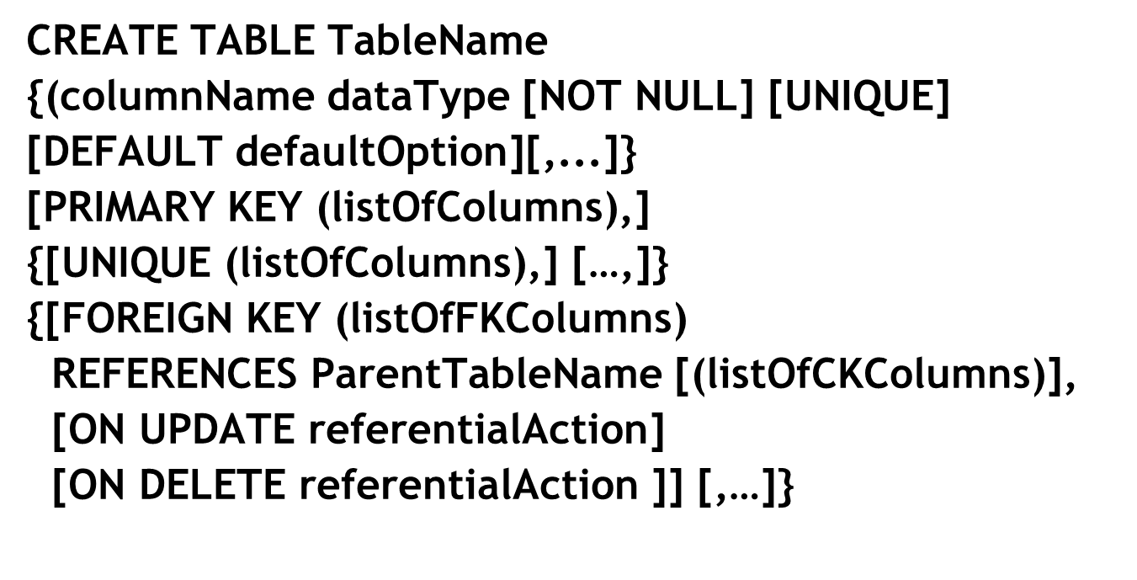
CREATE TABLE Statement

Slide 12
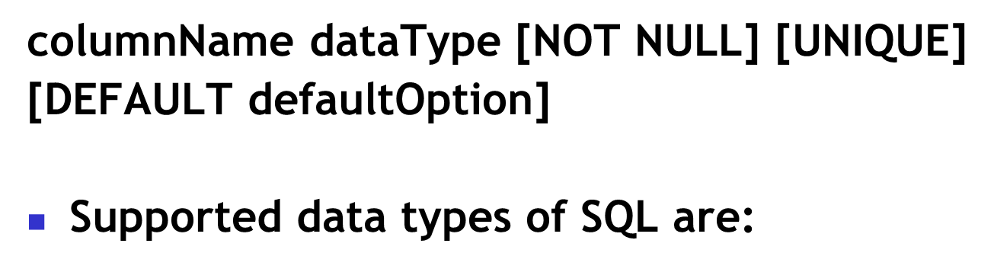
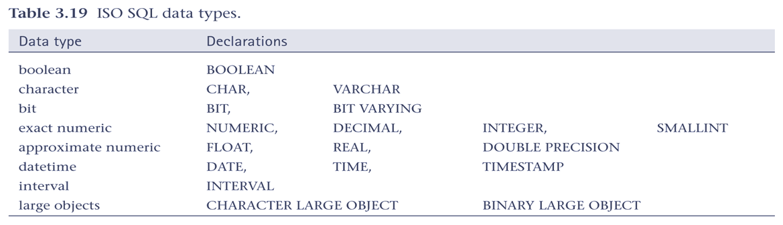
Defining a column

Slide 13
CREATE TABLE Example
CREATE TABLE Vedio (cataloNo number(10) PRIMARY KEY, title varchar(200) NOT NULL, category varchar (200) NOT NULL, dialyRental decimal (3,2) NOT NULL, price decimal (7,2) NOT NULL, directorNo varchar (5) NOT NULL);

Slide 14
PRIMARY KEY and entity integrity
Entity integrity supported by PRIMARY KEY clause.
For example:
  CONSTRAINT pk PRIMARY KEY (catalogNo)
  CONSTRAINT pk1 PRIMARY KEY (catalogNo, actorNo)

Slide 15
FOREIGN KEY and ref. integrity
Use FOREIGN KEY clause to define any foreign keys in the table.
SQL rejects any INSERT or UPDATE that attempts to create a FK value in child table without matching CK value in parent table.
The action SQL takes for any UPDATE or DELETE that attempts to update or delete a CK value in the parent table with some matching rows in child table is dependent upon specified referential action.

Slide 16
FOREIGN KEY and ref. integrity
Referential actions with ON UPDATE and ON DELETE subclauses. Possible values are:
  CASCADE – Update/delete row from parent and automatically update/ matching rows in child table, and so on in cascading manner.
  SET NULL - Update/delete row from parent and set FK values in child table to NULL.
  SET DEFAULT - Update/delete row from parent and set FK values in child table to specified default value.
  NO ACTION – Reject the update/delete.

Slide 17
CREATE VIEW Statement
CREATE VIEW ViewName [(newColumnName [,...]]
AS Subselect
CREATE VIEW StaffBranch1
  AS SELECT staffNo, name, position
  FROM Staff
  WHERE branchNo = ‘B001’;

Slide 18
SELECT Statement
SELECT [DISTINCT | ALL]
{* | [columnExprn [AS newName]] [,...] }
FROM TableName [alias] [, ...]
[WHERE condition]
[GROUP BY columnList] [HAVING condition]
[ORDER BY columnList]

Slide 19
SELECT Statement
FROM Specifies table(s) to be used.
WHERE Filters rows.
GROUP BY Forms groups of rows with same
column value.
HAVING Filters groups subject to some
condition.
SELECT Specifies which columns are to
appear in output.
ORDER BY Specifies the order of the output.

Slide 20
SELECT Statement
Order of the clauses cannot be changed.
Only SELECT and FROM are mandatory.

Slide 21
3.1 All Columns, All Rows
List full details of all videos.
SELECT catalogNo, title, category,
dailyRental, price, directorNo
  FROM Video;
Can use * as an abbreviation for ‘all columns’:
  SELECT *
  FROM Video;

Slide 22
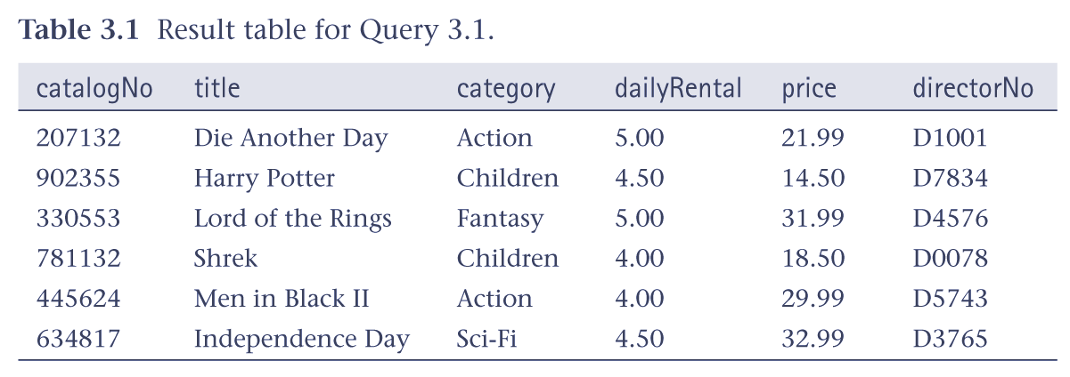
3.1 All Columns, All Rows

Slide 23
3.2 Specific Columns, All Rows
List the catalog number, title and daily rental rate of all videos.
  SELECT catalogNo, title, dailyRental
  FROM Video;

Slide 24
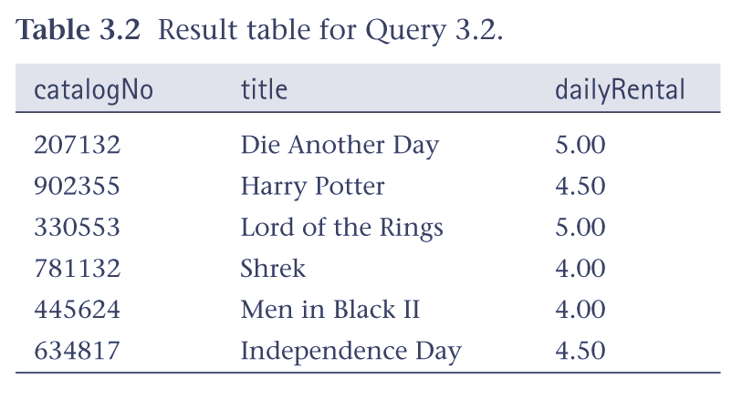
3.2 Specific Columns, All Rows

Slide 25
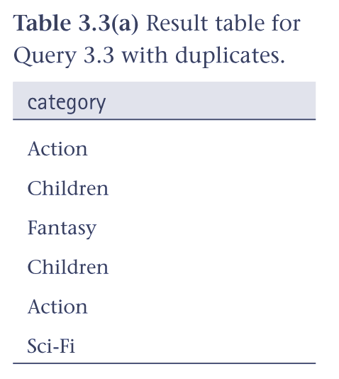
3.3 Use of DISTINCT
List all video categories.
SELECT category
  FROM Video;

Slide 26
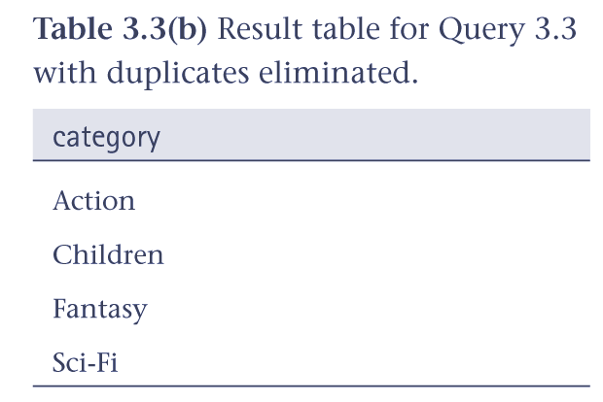
3.3 Use of DISTINCT
Use DISTINCT to eliminate duplicates:
SELECT DISTINCT category
  FROM Video;

Slide 27
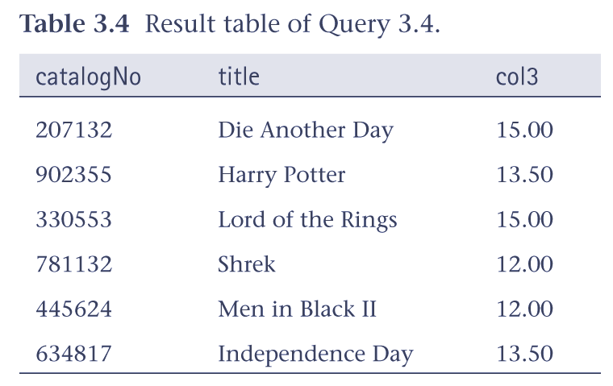
3.4 Calculated Fields
List rate for renting videos for 3 days.
SELECT catalogNo, title, dailyRental*3
  FROM Video;

Slide 28
3.4 Calculated Fields
To name column, use AS clause:
SELECT catalogNo, title,
dailyRental*3 AS threeDayRate
  FROM Video;

Slide 29
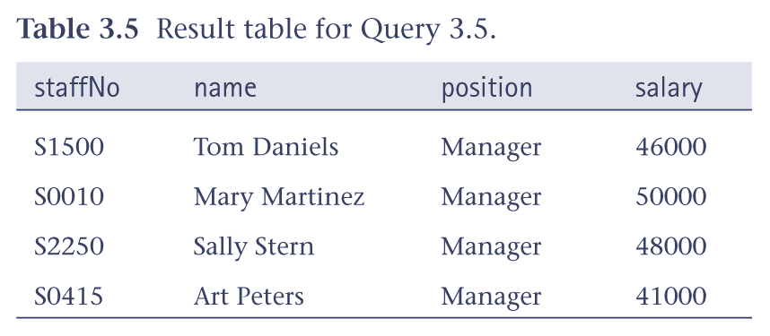
3.5 Comparison Search Condition
List all staff with a salary greater than $10,000.
SELECT staffNo, name, position, salary
  FROM Staff
  WHERE salary > 10000;

Slide 30
3.6 Range Search Condition
List all staff with a salary between $45,000 and $50,000.
SELECT staffNo, name, position, salary
  FROM Staff
  WHERE salary BETWEEN 45000 AND 50000;
BETWEEN test includes the endpoints of range.

Slide 31
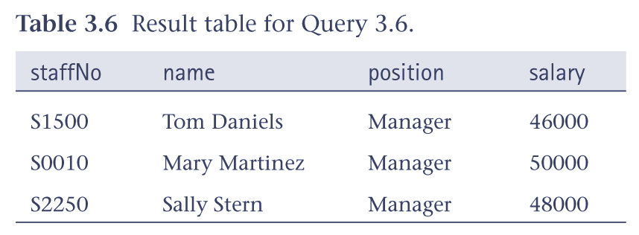
3.6 Range Search Condition

Slide 32
3.6 Range Search Condition
Also a negated version NOT BETWEEN.
BETWEEN does not add much to SQL’s expressive power. Could also write:
SELECT staffNo, name, position, salary
  FROM Staff
  WHERE salary >= 45000 AND salary <= 50000;
Useful, though, for a range of values.

Slide 33
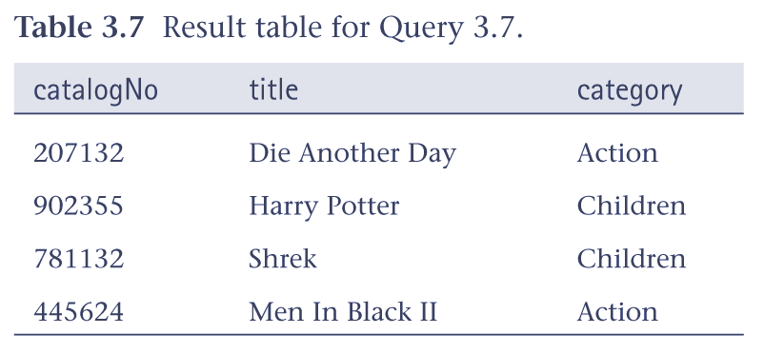
3.7 Set Membership
List all videos in the Action and Children categories.
  SELECT catalogNo, title, category
  FROM Video
  WHERE category IN (‘Action’, ‘Children’);
Notes:
3.7 Set Membership
Chapter Name
September 98

Slide 34
INSERT
INSERT INTO TableName [ (columnList) ]
  VALUES (dataValueList)
columnList is optional; if omitted, SQL assumes a list of all columns in their original CREATE TABLE order.
Any columns omitted must have been declared as NULL or a DEFAULT was specified when table was created.

Slide 35
INSERT
dataValueList must match columnList as follows:
  number of items in each list must be same;
  must be direct correspondence in position of items in two lists;
  data type of each item in dataValueList must be compatible with data type of corresponding column.

Slide 36
3.19 INSERT
Insert a row into the Video table.
INSERT INTO Video
  VALUES (‘207132’, ‘Die Another Day’, ‘Action’ 5.00, 21.99, ‘D1001’ );

Slide 37
UPDATE
  UPDATE TableName
  SET columnName1 = dataValue1
  [, columnName2 = dataValue2...]
  [WHERE searchCondition]
TableName can be name of a base table or an updatable view.
SET clause specifies names of one or more columns that are to be updated.

Slide 38
UPDATE
WHERE clause is optional:
  if omitted, named columns are updated for all rows in table;
  if specified, only those rows that satisfy searchCondition are updated.
New dataValue(s) must be compatible with data type for corresponding column.

Slide 39
3.20 UPDATE Rows in a Table
Modify the daily rental rate of videos in the ‘Thriller’ category by 10% .
UPDATE Video
  SET dailyRental = dailyRental*1.1
  WHERE category = ‘Thriller’;

Slide 40
DELETE
  DELETE FROM TableName
  [WHERE searchCondition]
TableName can be name of a base table or an updatable view.
searchCondition is optional; if omitted, all rows are deleted from table. This does not delete table. If searchCondition specified, only those rows that satisfy condition are deleted.

Slide 41
3.21 DELETE Specific Rows
Delete rental videos for catalog number 634817 .
DELETE FROM VideoForRent
  WHERE catalogNo = ‘634817’;

