Slide 1
Lecture 3
The Relational Model
Pearson Education © 2009

Slide 2
Relational Model Terminology
A relation is a table with columns and rows.
  Only applies to logical structure of the database, not the physical structure.
Attribute is a named column of a relation.
Domain is the set of allowable values for one or more attributes.
Pearson Education © 2009

Slide 3
Relational Model Terminology
Tuple is a row of a relation.
Degree is the number of attributes in a relation.
Cardinality is the number of tuples in a relation.
Relational Database is a collection of normalized relations with distinct relation names.
Pearson Education © 2009

Slide 4
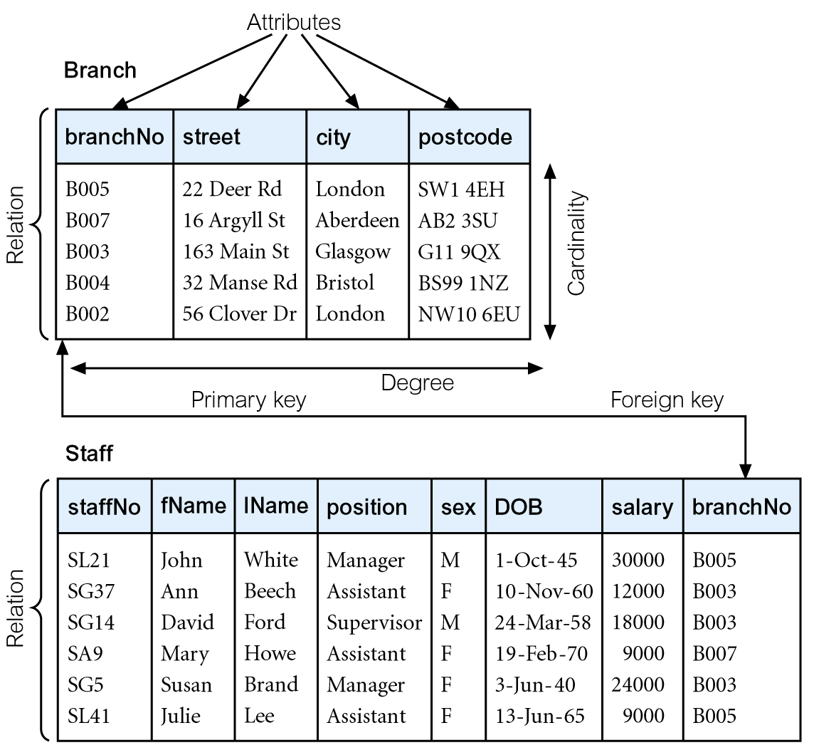
Instances of Branch and Staff Relations
Pearson Education © 2009

Slide 5
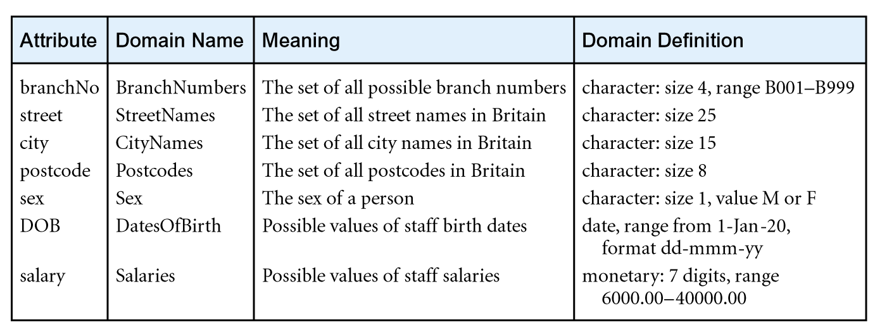
Examples of Attribute Domains
Pearson Education © 2009

Slide 6
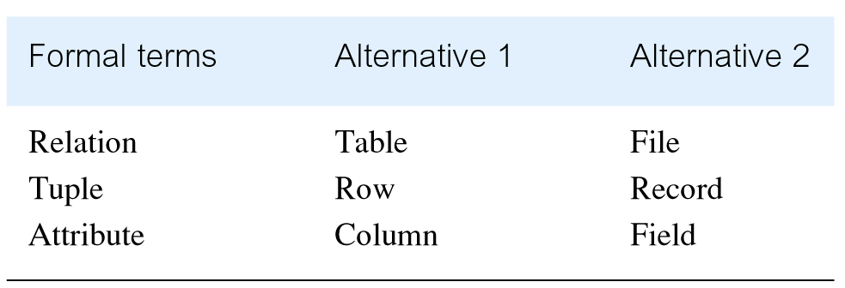
Alternative Terminology for Relational Model
Pearson Education © 2009

Slide 7
Database Relations
Relation schema
  Named relation defined by a set of attribute and domain name pairs.
Relational database schema
  Set of relation schemas, each with a distinct name.
Pearson Education © 2009

Slide 8
Properties of Relations
Relation name is distinct from all other relation names in relational schema.
Each cell of relation contains exactly one atomic (single) value.
Each attribute has a distinct name.
Values of an attribute are all from the same domain.
Pearson Education © 2009

Slide 9
Properties of Relations
Each tuple is distinct; there are no duplicate tuples.
Order of attributes has no significance.
Order of tuples has no significance, theoretically.
Pearson Education © 2009

Slide 10
Relational Keys
Superkey
  An attribute, or set of attributes, that uniquely identifies a tuple within a relation.
Candidate Key
  Superkey (K) such that no proper subset is a superkey within the relation.
  In each tuple of R, values of K uniquely identify that tuple (uniqueness).
  No proper subset of K has the uniqueness property (irreducibility).
Pearson Education © 2009

Slide 11
Relational Keys
Primary Key
  Candidate key selected to identify tuples uniquely within relation.
Alternate Keys
  Candidate keys that are not selected to be primary key.
Foreign Key
  Attribute, or set of attributes, within one relation that matches candidate key of some (possibly same) relation.
Pearson Education © 2009

Slide 12
Integrity Constraints
Null
  Represents value for an attribute that is currently unknown or not applicable for tuple.
  Deals with incomplete or exceptional data.
  Represents the absence of a value and is not the same as zero or spaces, which are values.
Pearson Education © 2009

Slide 13
Integrity Constraints
Entity Integrity
  In a base relation, no attribute of a primary key can be null.
Referential Integrity
  If foreign key exists in a relation, either foreign key value must match a candidate key value of some tuple in its home relation or foreign key value must be wholly null.
Pearson Education © 2009

Slide 14
Integrity Constraints
General Constraints
  Additional rules specified by users or database administrators that define or constrain some aspect of the enterprise.
Pearson Education © 2009

