Slide 1
Relational Algebra
Relational Algebra
Pearson Education © 2009

Slide 2
Relational Algebraالجب العلائقي
Relational algebra operations work on one or more relations to define another relation without changing the original relations.
Both operands and results are relations, so output from one operation can become input to another operation.
Allows expressions to be nested, just as in arithmetic. This property is called closure.
Pearson Education © 2009

Slide 3
Relational Algebra
Five basic operations in relational algebra: Selection الاختيار , Projectionالعرض , Cartesian productالضرب الكارتيزي , Union الاتحاد , and Set Difference الفرق بين المجموعات .
These perform most of the data retrieval operations needed.
Also have Joinالضم , Intersectionالتقاطع , and Division operations القسمة , which can be expressed in terms of 5 basic operations.
Pearson Education © 2009

Slide 4
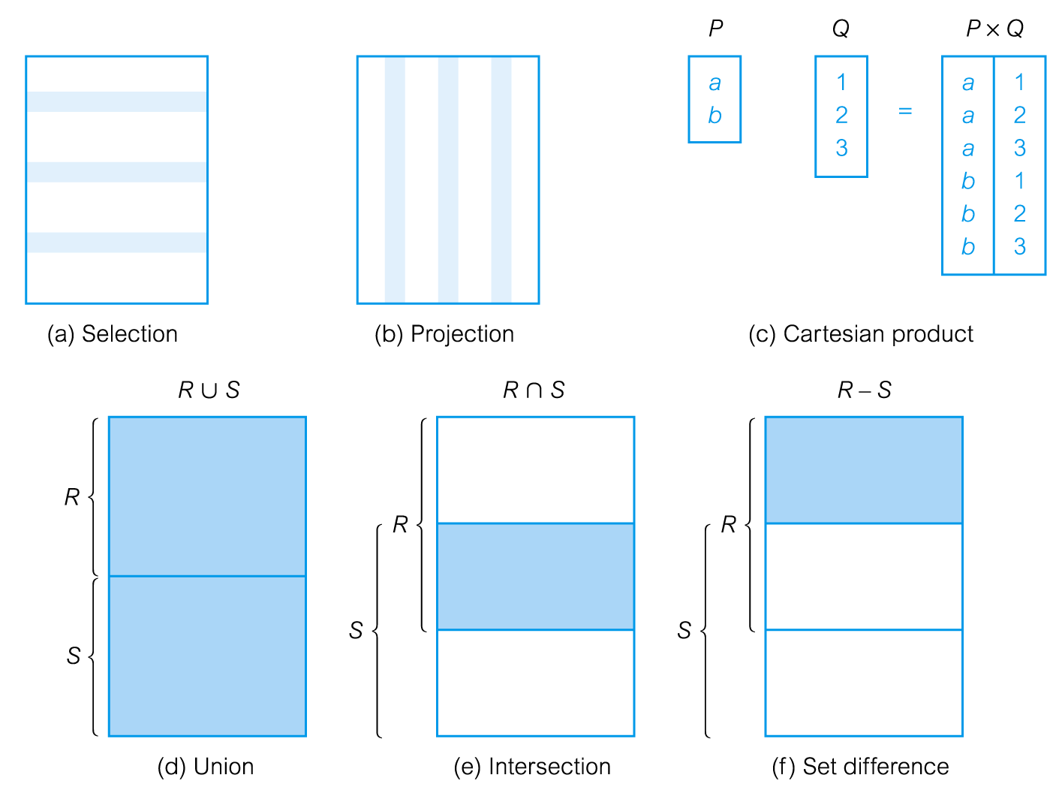
Relational Algebra Operations
Pearson Education © 2009

Slide 5
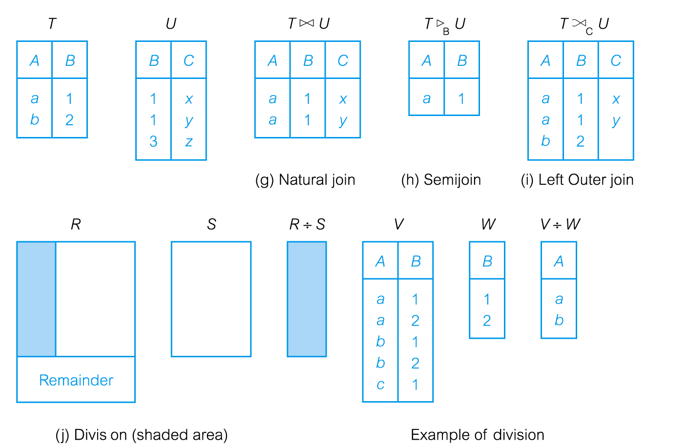
Relational Algebra Operations
Pearson Education © 2009

Slide 6
Selection (or Restriction)
σ_{predicate} (R)
  Works on a single relation R and defines a relation that contains only those tuples (rows) of R that satisfy the specified condition (predicate).
Pearson Education © 2009

Slide 7
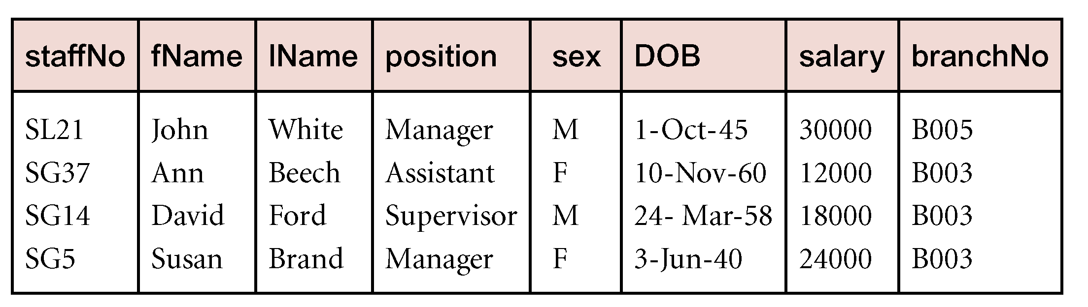
Example - Selection (or Restriction)
List all staff with a salary greater than £10,000.
  σ_{salary > 10000} (Staff)
  In SQL
  Select * from Staff
  Where salary > ‘10000’;

Slide 8
Projection
Π_{col1, . . . , coln}(R)
  Works on a single relation R and defines a relation that contains a vertical subset of R, extracting the values of specified attributes and eliminating duplicates.
Pearson Education © 2009

Slide 9
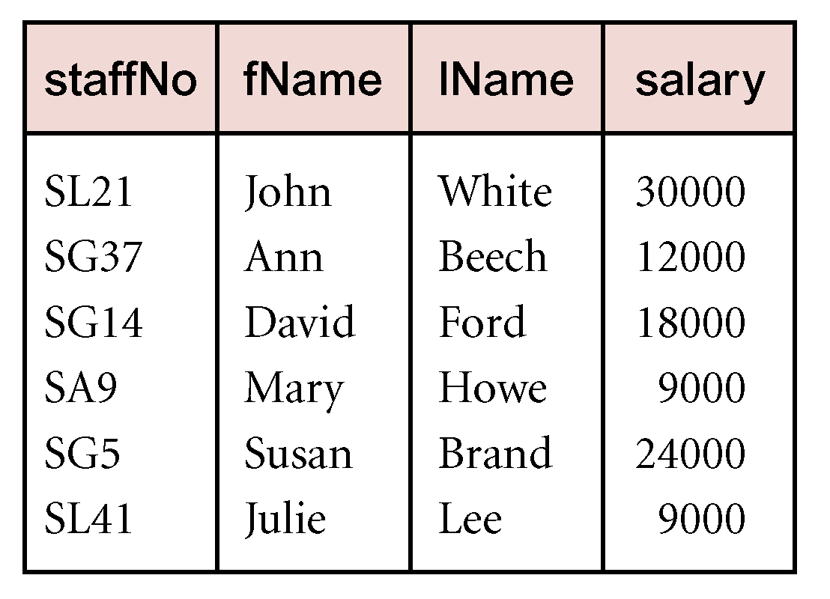
Example - Projection
Produce a list of salaries for all staff, showing only staffNo, fName, lName, and salary details.
  Π_{staffNo, fName, lName, salary}(Staff)
Pearson Education © 2009

Slide 10
Union
R ∪ S
  Union of two relations R and S defines a relation that contains all the tuples of R, or S, or both R and S, duplicate tuples being eliminated.
  R and S must be union-compatible.
If R and S have I and J tuples, respectively, union is obtained by concatenating them into one relation with a maximum of (I + J) tuples.
Pearson Education © 2009

Slide 11
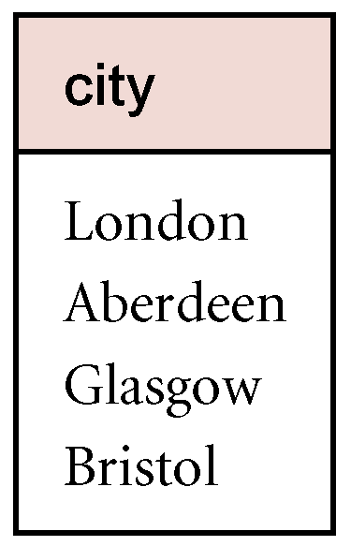
Example - Union
List all cities where there is either a branch office or a property for rent.
  Π_{city}(Branch) ∪ Π_{city}(PropertyForRent)

Slide 12
Set Difference
R – S
  Defines a relation consisting of the tuples that are in relation R, but not in S.
  R and S must be union-compatible.
Pearson Education © 2009

Slide 13
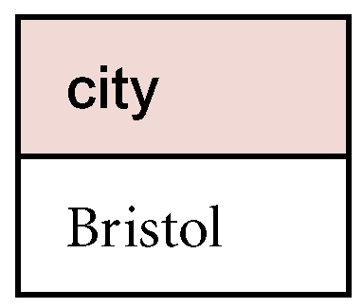
Example - Set Difference
List all cities where there is a branch office but no properties for rent.
  Π_{city}(Branch) – Π_{city}(PropertyForRent)
Pearson Education © 2009

Slide 14
Intersection
R ∩ S
  Defines a relation consisting of the set of all tuples that are in both R and S.
  R and S must be union-compatible.
Expressed using basic operations:
  R ∩ S = R – (R – S)
Pearson Education © 2009

Slide 15
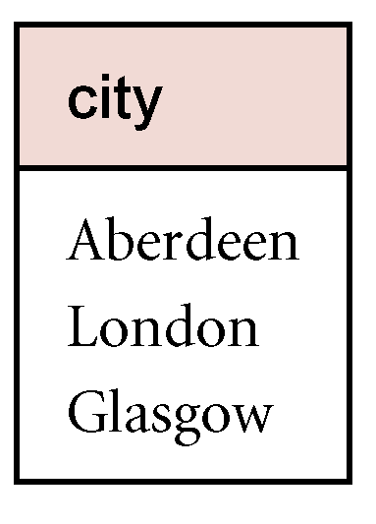
Example - Intersection
List all cities where there is both a branch office and at least one property for rent.
  Π_{city}(Branch) ∩ Π_{city}(PropertyForRent)
Pearson Education © 2009

Slide 16
Cartesian product
R X S
  Defines a relation that is the concatenation of every tuple of relation R with every tuple of relation S.
Pearson Education © 2009

Slide 17
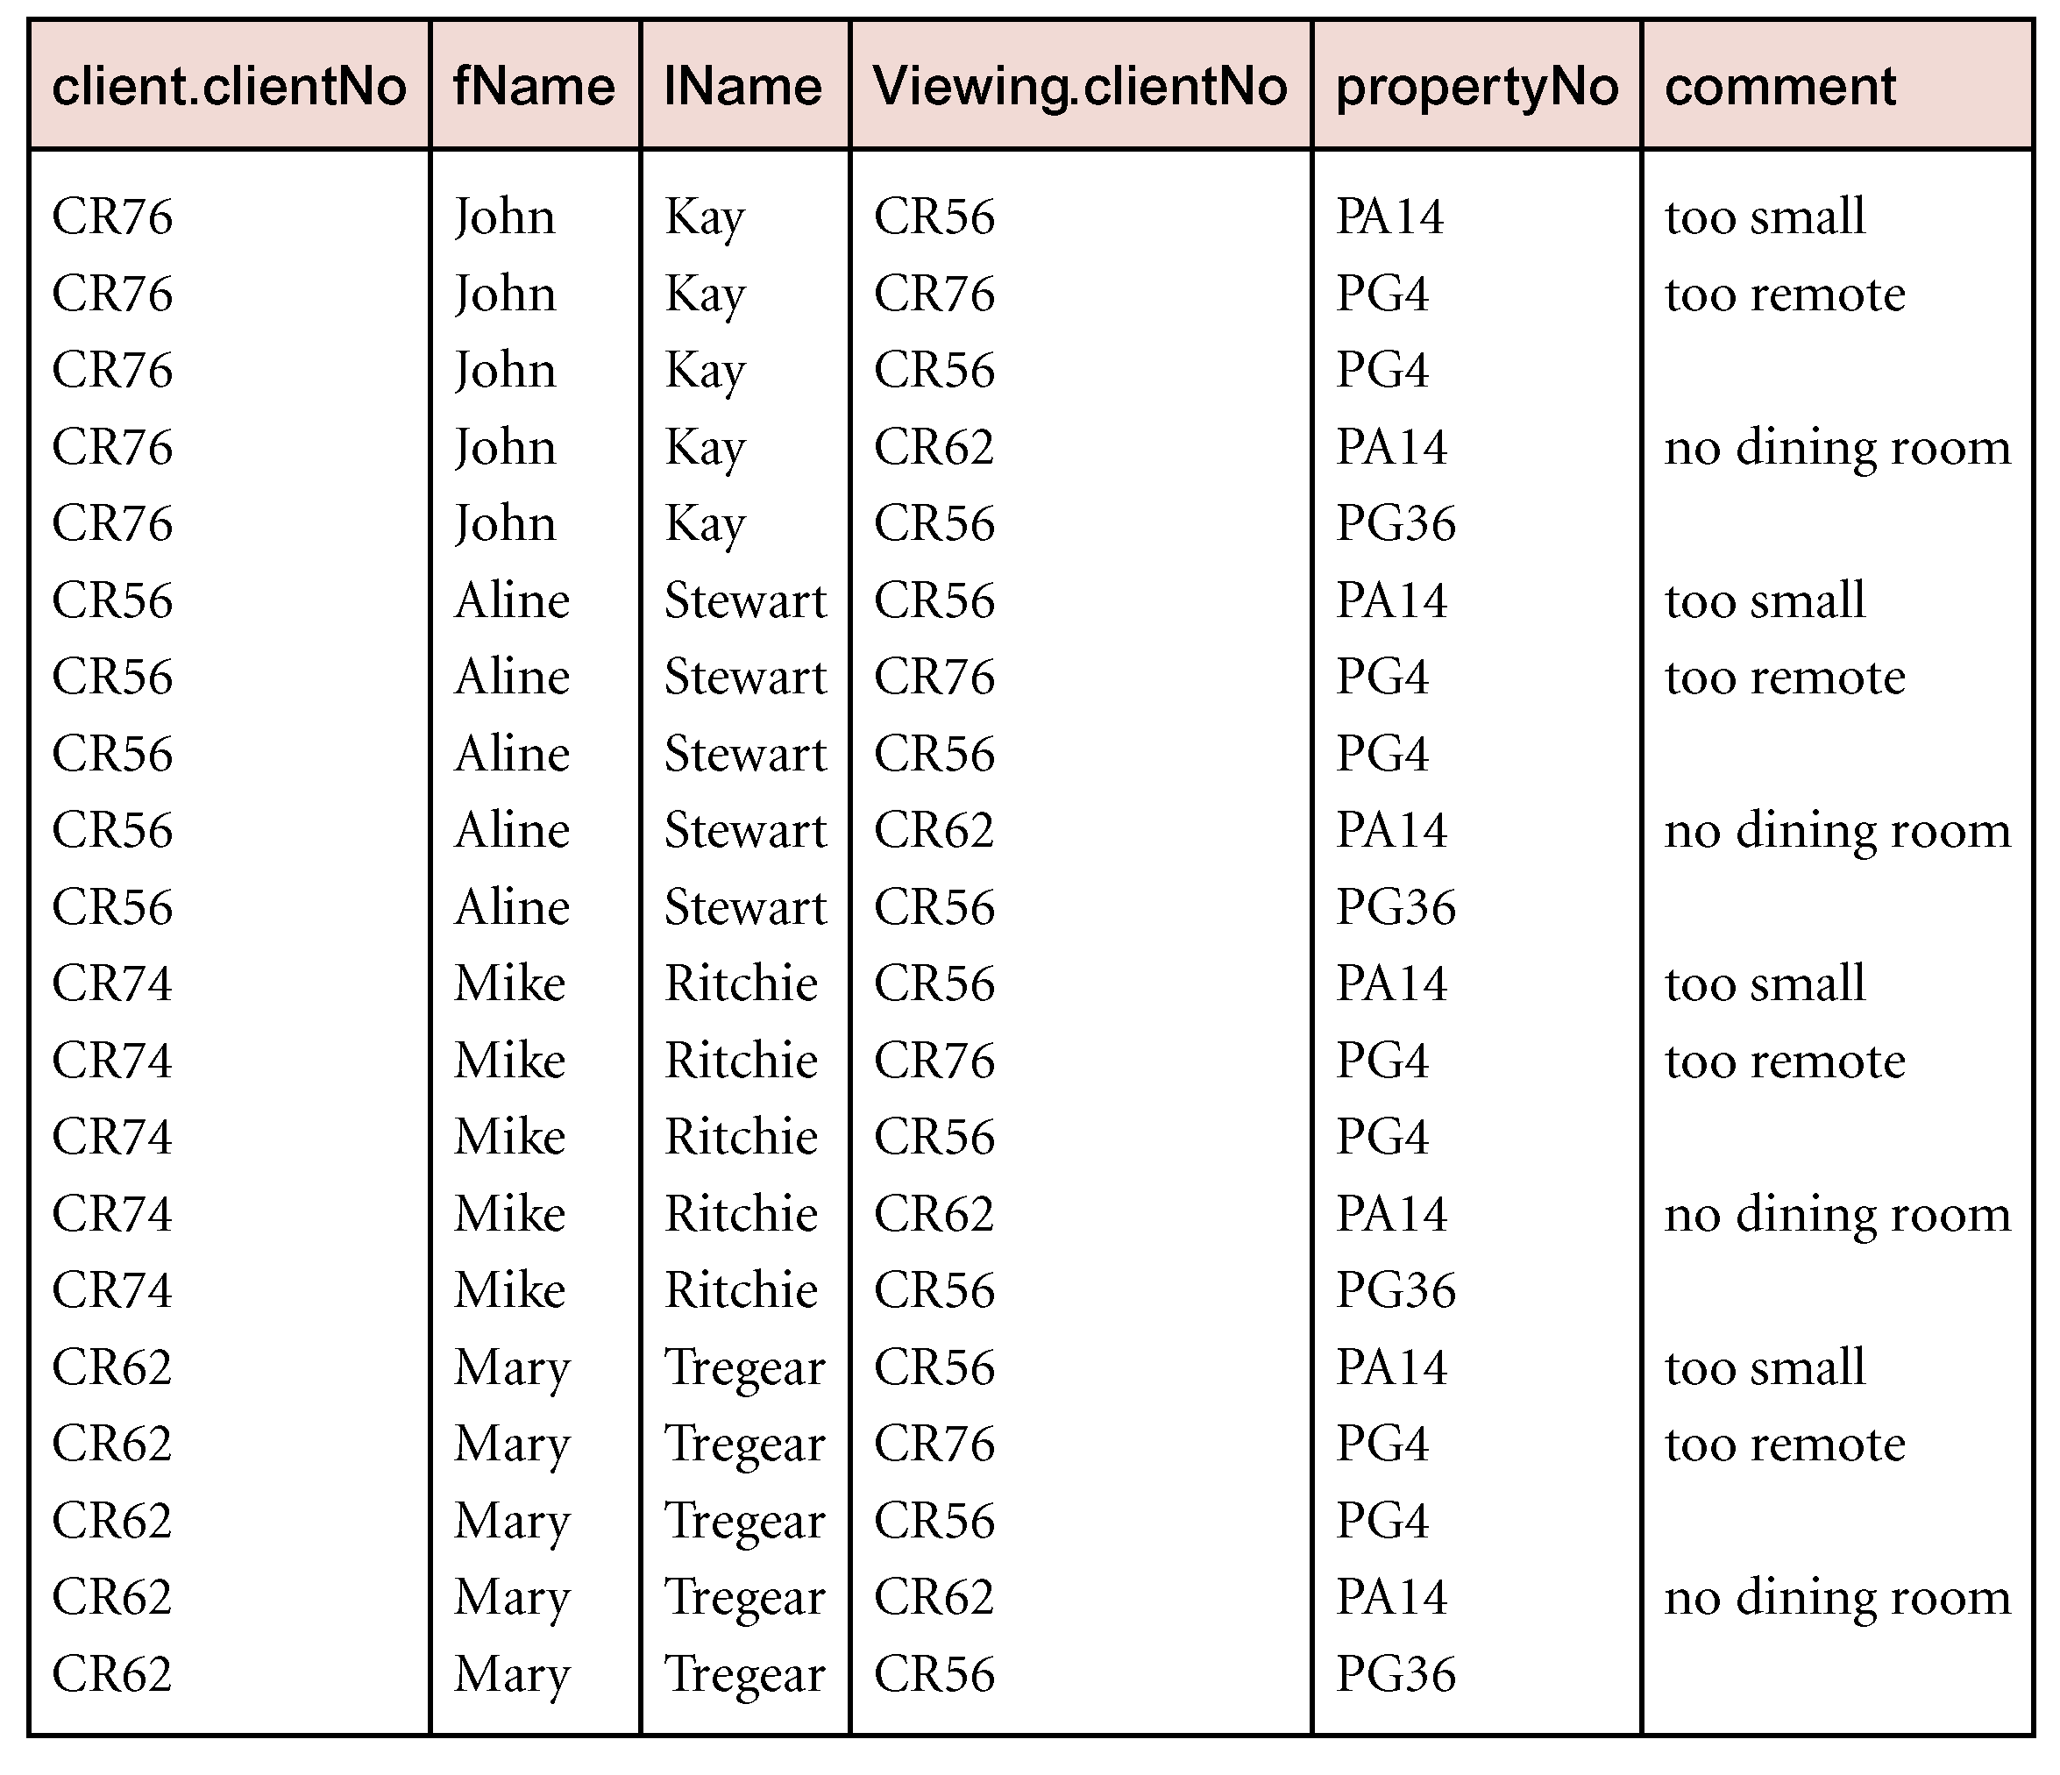
Example - Cartesian product
List the names and comments of all clients who have viewed a property for rent.
  (Π_{clientNo, fName, lName}(Client)) X (Π_{clientNo, propertyNo, comment} (Viewing))
Pearson Education © 2009

Slide 18
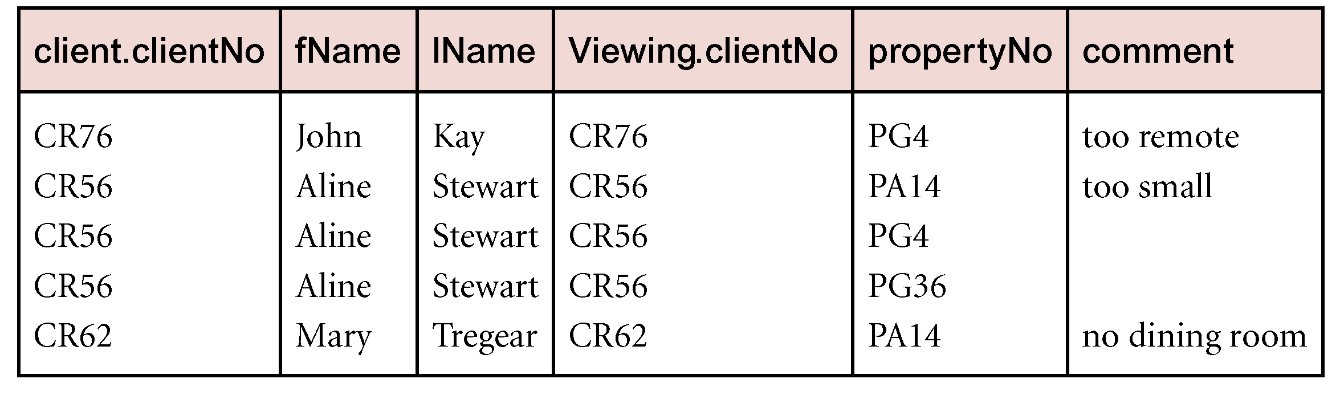
Example - Cartesian product and Selection
Use selection operation to extract those tuples where Client.clientNo = Viewing.clientNo.
  σClient.clientNo = Viewing.clientNo((∏_{clientNo, fName, lName}(Client)) Χ (∏_{clientNo, propertyNo, comment}(Viewing)))
Cartesian product and Selection can be reduced to a single operation called a Join.
Pearson Education © 2009

Slide 19
Join Operations
Join is a derivative of Cartesian product.
Equivalent to performing a Selection, using join predicate as selection formula, over Cartesian product of the two operand relations.
One of the most difficult operations to implement efficiently in an RDBMS and one reason why RDBMSs have intrinsic performance problems.
Pearson Education © 2009

Slide 20
Join Operations
Various forms of join operation
  Theta join
  Equijoin (a particular type of Theta join)
  Natural join
  Outer join
  Semijoin
Pearson Education © 2009

Slide 21
Theta join (θ-join)
R _{F}S
  Defines a relation that contains tuples satisfying the predicate F from the Cartesian product of R and S.
  The predicate F is of the form R.a_{i} θ S.b_{i} where θ may be one of the comparison operators (<, ≤, >, ≥, =, ≠).
Pearson Education © 2009

Slide 22
Theta join (θ-join)
Can rewrite Theta join using basic Selection and Cartesian product operations.
    R _{F}S = σ_{F}(R Χ S)
Degree of a Theta join is sum of degrees of the operand relations R and S. If predicate F contains only equality (=), the term Equijoin is used.
Pearson Education © 2009

Slide 23
Example - Equijoin
List the names and comments of all clients who have viewed a property for rent.
  (Π_{clientNo, fName, lName}(Client)) Client.clientNo = Viewing.clientNo (Π_{clientNo, propertyNo, comment}(Viewing))
Pearson Education © 2009

Slide 24
Natural join
R S
  An Equijoin of the two relations R and S over all common attributes x. One occurrence of each common attribute is eliminated from the result.
Pearson Education © 2009

Slide 25
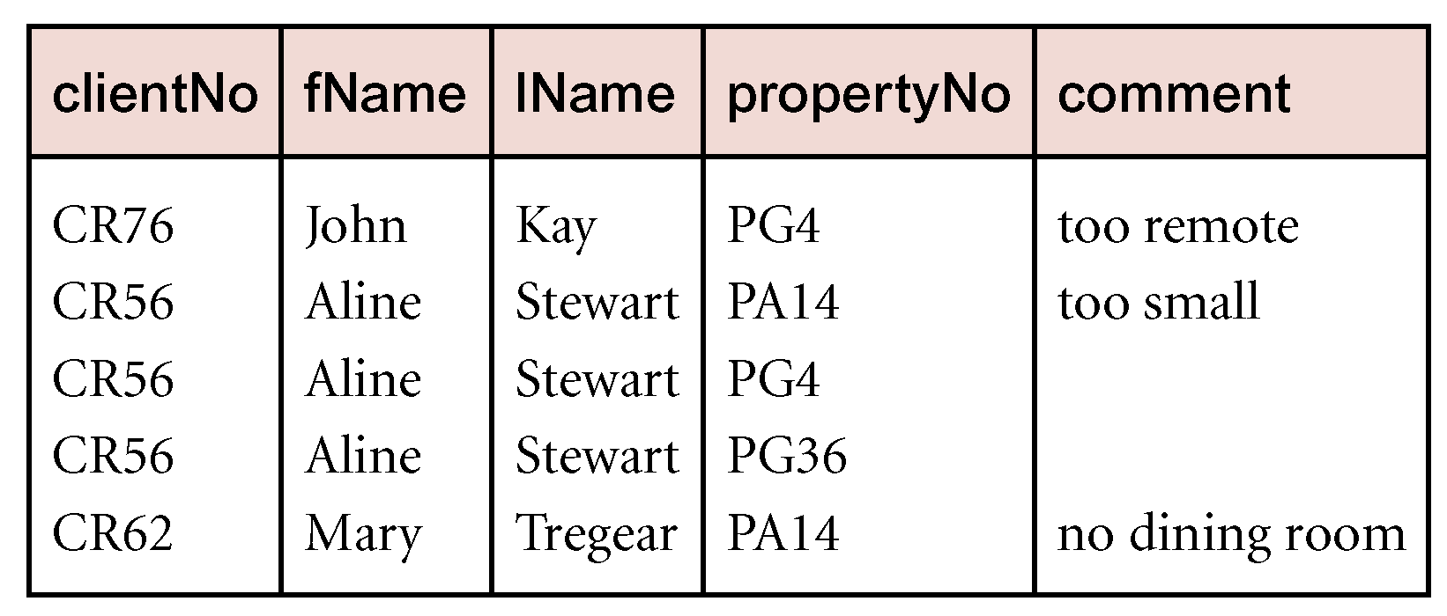
Example - Natural join
List the names and comments of all clients who have viewed a property for rent.
  (Π_{clientNo, fName, lName}(Client))
  (Π_{clientNo, propertyNo, comment}(Viewing))
Pearson Education © 2009

Slide 26
Outer join
To display rows in the result that do not have matching values in the join column, use Outer join.
R S
  (Left) outer join is join in which tuples from R that do not have matching values in common columns of S are also included in result relation.
Pearson Education © 2009

Slide 27
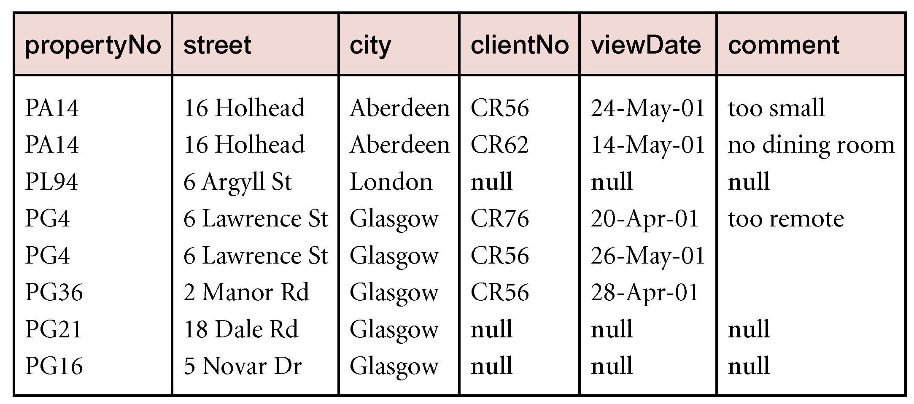
Example - Left Outer join
Produce a status report on property viewings.
  Π_{propertyNo, street, city}(PropertyForRent)
  Viewing
Pearson Education © 2009

Slide 28
Semijoin
R _{F} S
  Defines a relation that contains the tuples of R that participate in the join of R with S.
Can rewrite Semijoin using Projection and Join:
  R _{F} S = Π_{A}(R _{F} S)
Pearson Education © 2009

Slide 29
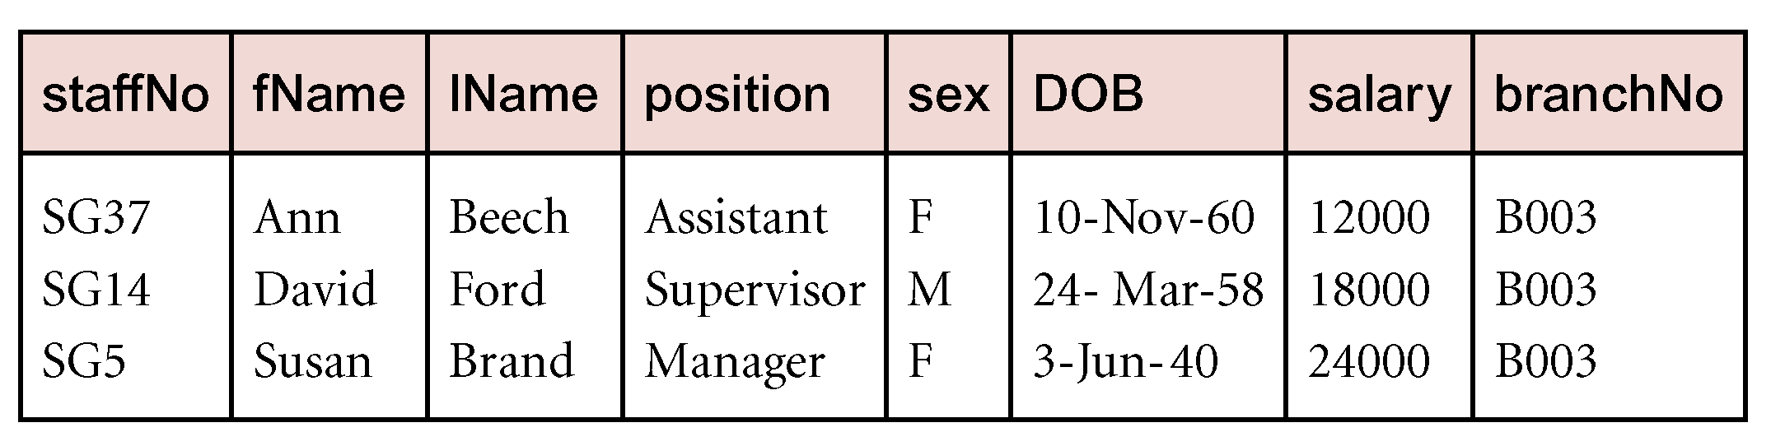
Example - Semijoin
List complete details of all staff who work at the branch in Glasgow.
  Staff _{Staff.branchNo=Branch.branchNo}(σ_{city=‘Glasgow’}(Branch))
Pearson Education © 2009

Slide 30
Division
R ÷ S
  Defines a relation over the attributes C that consists of set of tuples from R that match combination of every tuple in S.
Expressed using basic operations:
  T₁ ← Π_{C}(R)
  T₂ ← Π_{C}((S X T₁) – R)
  T ← T₁ – T₂
Pearson Education © 2009

Slide 31
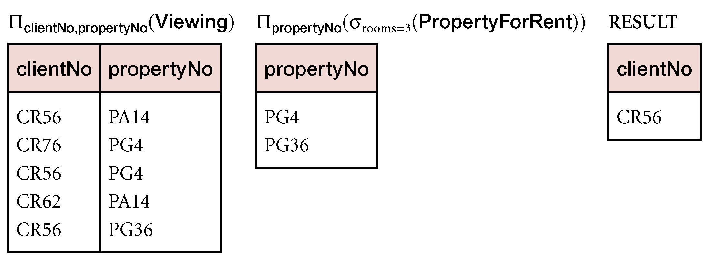
Example - Division
Identify all clients who have viewed all properties with three rooms.
  (Π_{clientNo, propertyNo}(Viewing)) ÷
  (Π_{propertyNo}(σ_{rooms = 3} (PropertyForRent)))
Pearson Education © 2009

Slide 32
Aggregate Operations
ℑ_{AL}(R)
  Applies aggregate function list, AL, to R to define a relation over the aggregate list.
  AL contains one or more (<aggregate_function>, <attribute>) pairs .
Main aggregate functions are: COUNT, SUM, AVG, MIN, and MAX.
Pearson Education © 2009

Slide 33
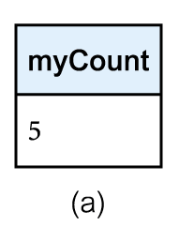
Example – Aggregate Operations
How many properties cost more than £350 per month to rent?
  ρ_{R}(myCount) ℑ_{COUNT} _{propertyNo} (σ_{rent > 350} (PropertyForRent))
Pearson Education © 2009

Slide 34
Grouping Operation
_{GA}ℑ_{AL}(R)
  Groups tuples of R by grouping attributes, GA, and then applies aggregate function list, AL, to define a new relation.
  AL contains one or more (<aggregate_function>, <attribute>) pairs.
  Resulting relation contains the grouping attributes, GA, along with results of each of the aggregate functions.
Pearson Education © 2009

Slide 35
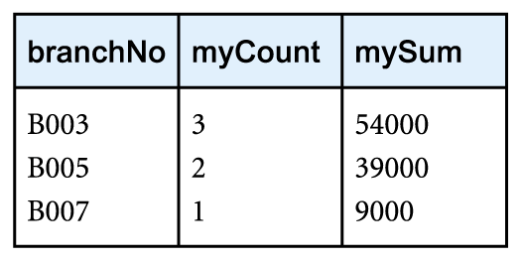
Example – Grouping Operation
Find the number of staff working in each branch and the sum of their salaries.
  ρ_{R}(branchNo, myCount, mySum)
  _{branchNo} ℑ _{COUNT staffNo,} _{SUM salary} (Staff)
Pearson Education © 2009

Slide 36
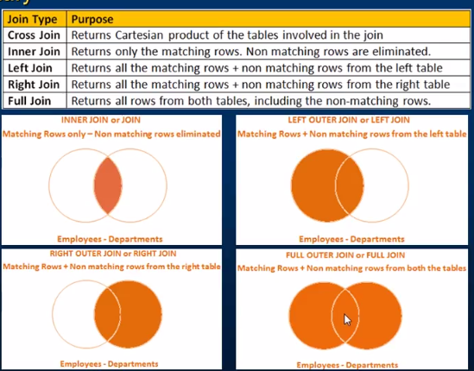
Joins in SQL Server - Summary

