Slide 1
Database Planning, Design, and Administration
Database Planning, Design,
and Administration
Transparencies
© Pearson Education Limited, 2004
Notes:
September 98
1
Chapter Name

Slide 2
Information system lifecycle
Structured approach to software development was proposed called information systems (IS) lifecycle or software development lifecycle (SDLC).
© Pearson Education Limited, 2004

Slide 3
Information system
Resources that enable collection, management, control, and dissemination of data/information throughout an organization.
Database is fundamental component of IS. Development/usage should be viewed from perspective of the wider requirements of the organization.
© Pearson Education Limited, 2004

Slide 4
Stages of database system development lifecycle
Database planning
System definition
Requirements collection and analysis
Database design
DBMS selection (optional)
© Pearson Education Limited, 2004

Slide 5
Stages of database system development lifecycle
Application design
Prototyping (optional)
Implementation
Data conversion and loading
Testing
Operational maintenance.
© Pearson Education Limited, 2004

Slide 6
Database planning
Involves the management activities that allow stages of database system development lifecycle to be realized as efficiently and effectively as possible.
Should be integrated with overall IS strategy of the organization.
© Pearson Education Limited, 2004

Slide 7
Database planning – mission statement
Mission statement for the database project defines major aims of database system.
Mission statement helps clarify purpose of the database project and provides clearer path towards the efficient and effective creation of required database system.
© Pearson Education Limited, 2004

Slide 8
Database planning – mission objectives
Once mission statement is defined, mission objectives are defined.
Each objective should identify a particular task that the database must support.
© Pearson Education Limited, 2004

Slide 9
Database planning – mission objectives
Should also include additional information that specifies the work to be done, the resources with which to do it, and the money to pay for it all.
© Pearson Education Limited, 2004

Slide 10
System definition
Describes scope and boundaries of database system, including its major user views.
Describes how database system will interface with other parts of the organization’s information system.
© Pearson Education Limited, 2004

Slide 11
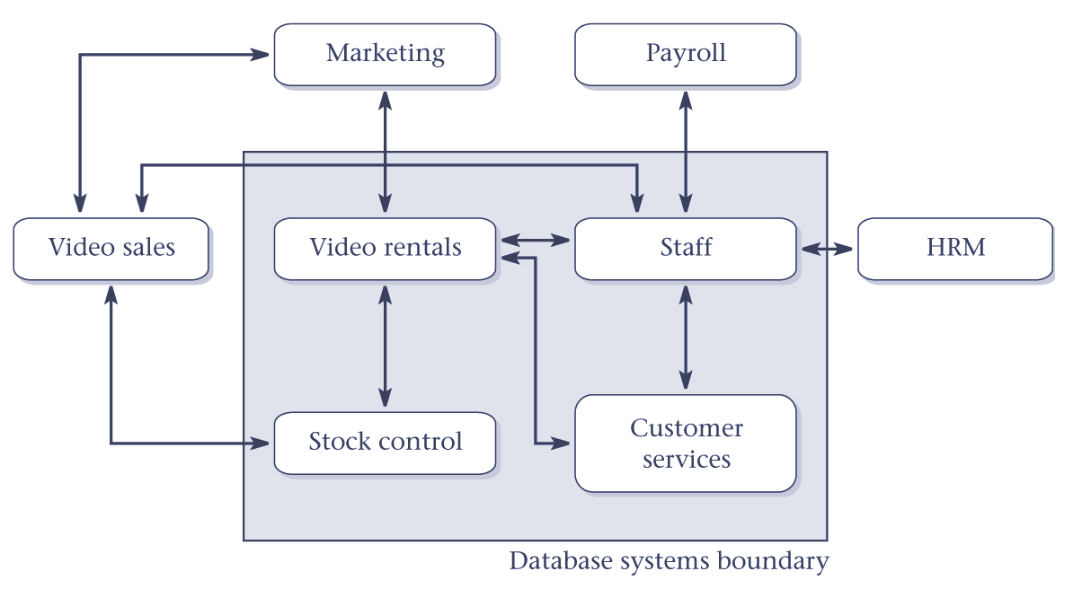
Boundary for database system of StayHome
© Pearson Education Limited, 2004

Slide 12
System definition
User view defines what is required of a database system from the perspective of:
  a particular job (such as Manager or Supervisor) or
  business application area (such as marketing, personnel, or stock control).
Database system may have one or more user views.
© Pearson Education Limited, 2004

Slide 13
Requirements collection and analysis
Process of collecting and analyzing information about the organization to be supported by the database system, and using this information to identify the requirements for the new system.
© Pearson Education Limited, 2004

Slide 14
Database design
Process of creating a design that will support the organization’s mission statement and objectives for the required database system.
© Pearson Education Limited, 2004

Slide 15
Database design
Two main phases of database design:
  Logical database design
  Physical database design.
© Pearson Education Limited, 2004

Slide 16
Database design
Logical database design identifies the important objects that need to be represented in the database and the relationships between these objects.
© Pearson Education Limited, 2004

Slide 17
Database design
Physical database design describes how the logical design is to be physically implemented (as tables) in the target DBMS.
© Pearson Education Limited, 2004

Slide 18

© Pearson Education Limited, 2004

Slide 19
DBMS selection
Selection of an appropriate DBMS to support the database system.
Undertaken at any time prior to logical design provided sufficient information is available regarding system requirements.
© Pearson Education Limited, 2004

