Slide 1
Fact-finding
Fact-finding
Transparencies
© Pearson Education Limited, 2004

Slide 2
Fact-finding
The formal process of using techniques such as interviews and questionnaires to collect facts about systems, requirements, and preferences.
© Pearson Education Limited, 2004

Slide 3
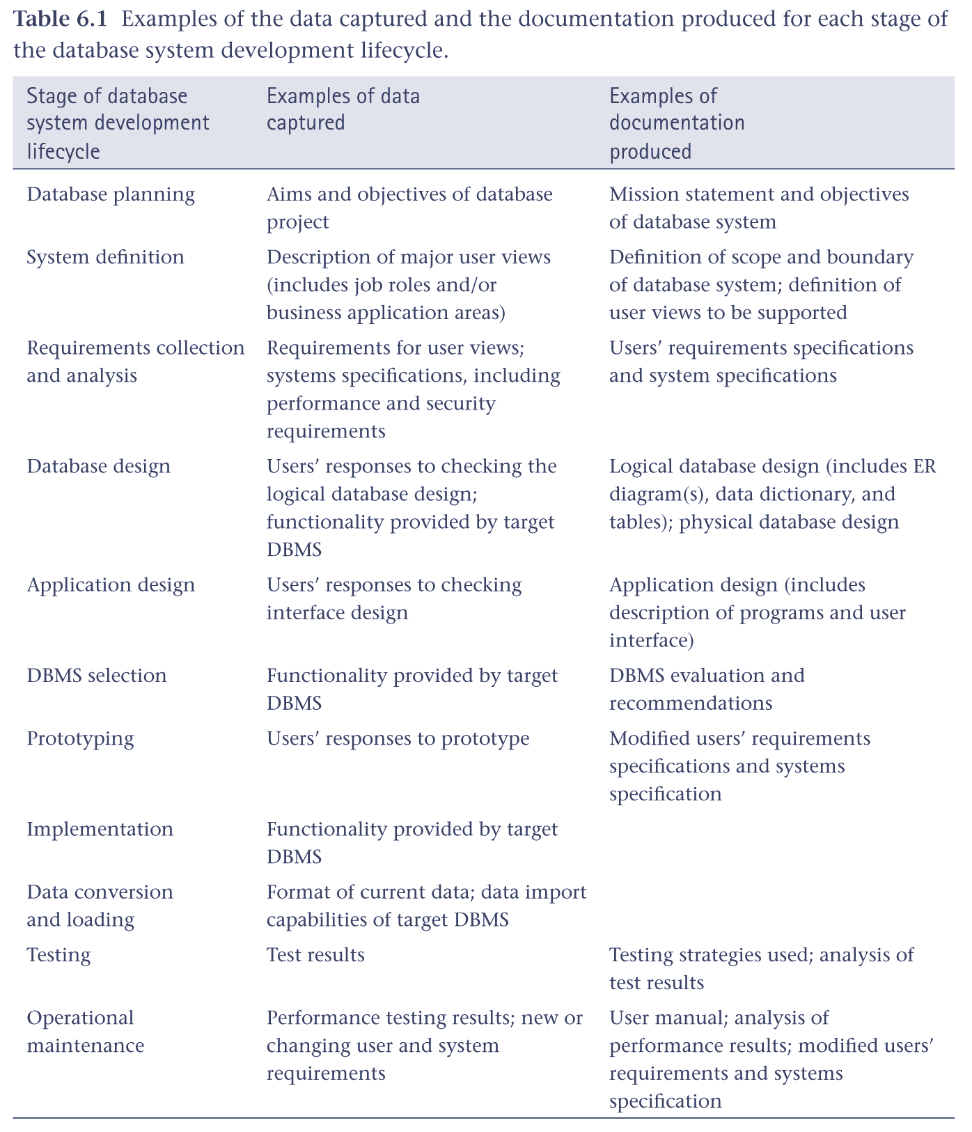
What facts are collected?
© Pearson Education Limited, 2004

Slide 4
Fact-finding techniques
A database developer normally uses several fact-finding techniques during a single database project, including:
  Examining documentation
  Interviewing
  Observing the business in operation
  Research
  Questionnaires
© Pearson Education Limited, 2004

Slide 5
Examining documentation
Examining documents, forms, reports, and files associated with the current system, is a good way to quickly gain some understanding of the system.
© Pearson Education Limited, 2004

Slide 6
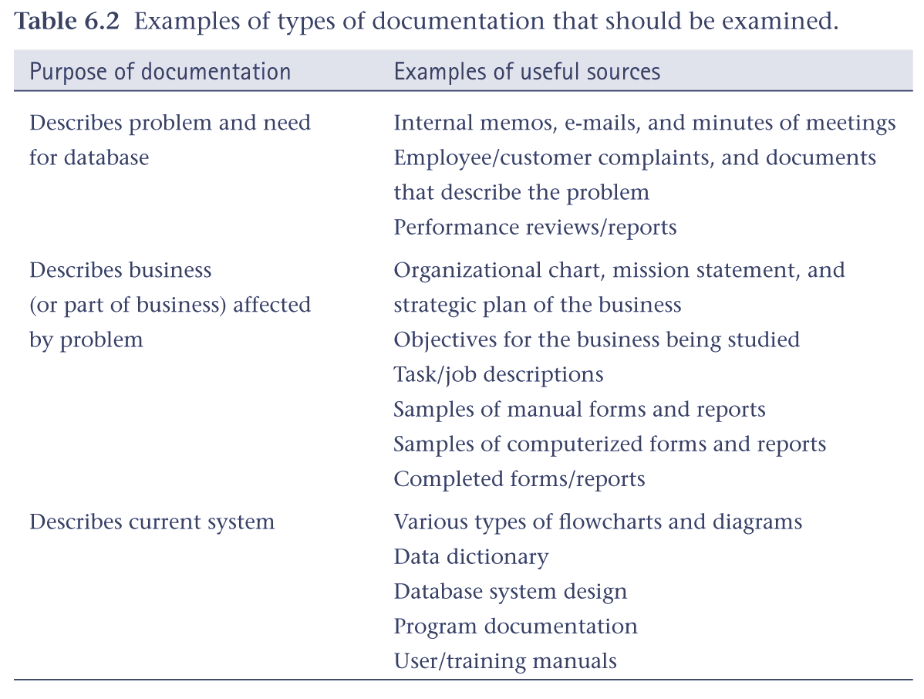
Examples of documentation to examine
© Pearson Education Limited, 2004

Slide 7
Interviewing
Interviewing is the most commonly used, and normally most useful, fact-finding technique.
Objectives include:
  finding out and/or checking facts
  generating user interest and/or feelings of involvement,
  identifying requirements and/or gathering ideas and opinions.
© Pearson Education Limited, 2004

Slide 8
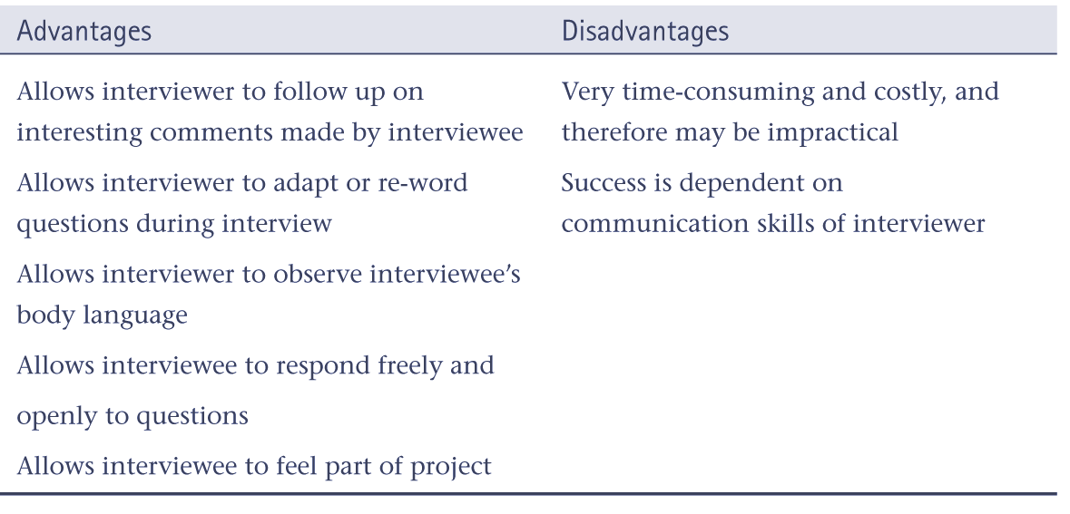
Advantages / disadvantages of interviewing
© Pearson Education Limited, 2004

Slide 9
Observing the business in operation
One of the most effective techniques.
Can either participate in, or watch a person perform activities to learn about the system.
© Pearson Education Limited, 2004

Slide 10
Research
Useful to research the application and problem.
Computer trade journals, reference books, and the Internet are good sources of information.
May find how others have solved similar problems, plus you can learn whether or not software packages exist to solve your problem.
© Pearson Education Limited, 2004

Slide 11
Questionnaires
Can conduct surveys through questionnaires.
Questionnaires are special-purpose documents that allow you to gather facts from a large number of people while maintaining some control over their responses.
© Pearson Education Limited, 2004

Slide 12
Questionnaires
There are two formats for questionnaires: free-format and fixed-format.
Free-format questionnaires offer the respondent greater freedom in providing answers.
Fixed-format questionnaires contain questions that require specific responses from individuals.
© Pearson Education Limited, 2004

Slide 13
The StayHome case study
This case study describes a company called StayHome, which rents out videos to its members. The first branch of StayHome was established in 1982 in Seattle but the company has now grown and has many branches throughout the United States.
© Pearson Education Limited, 2004

Slide 14
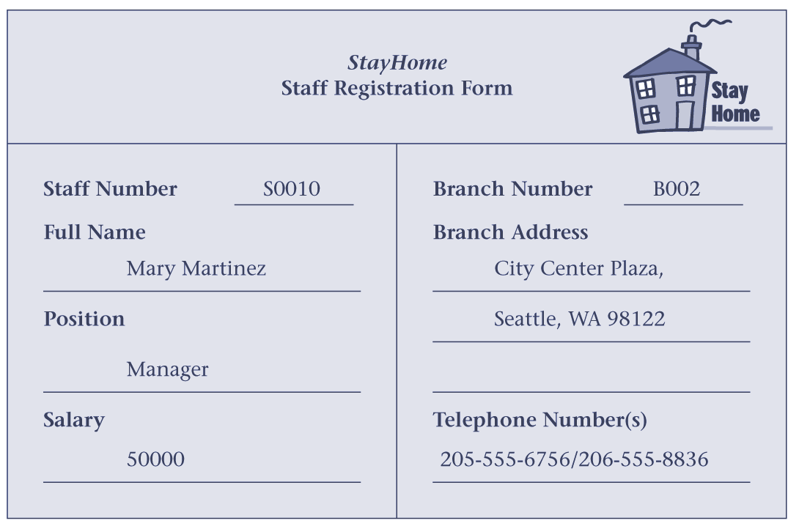
StayHome staff registration form
© Pearson Education Limited, 2004

Slide 15
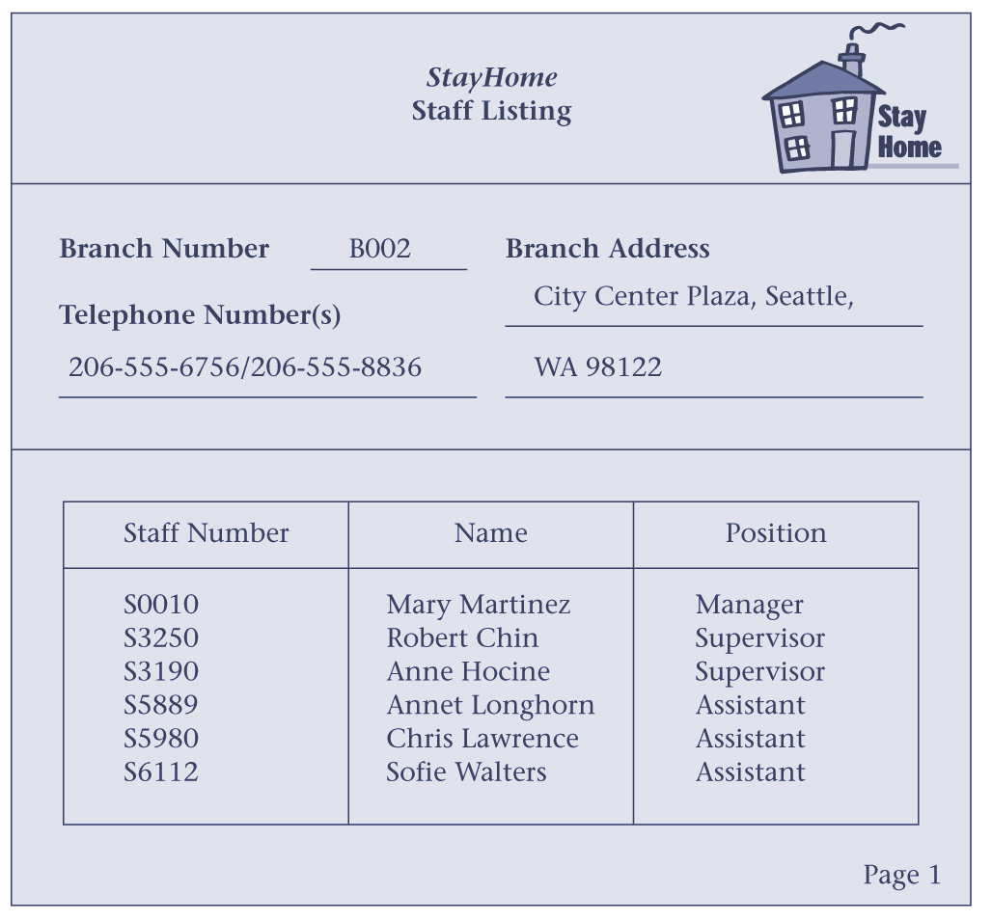
Page of report listing members of staff
© Pearson Education Limited, 2004

Slide 16
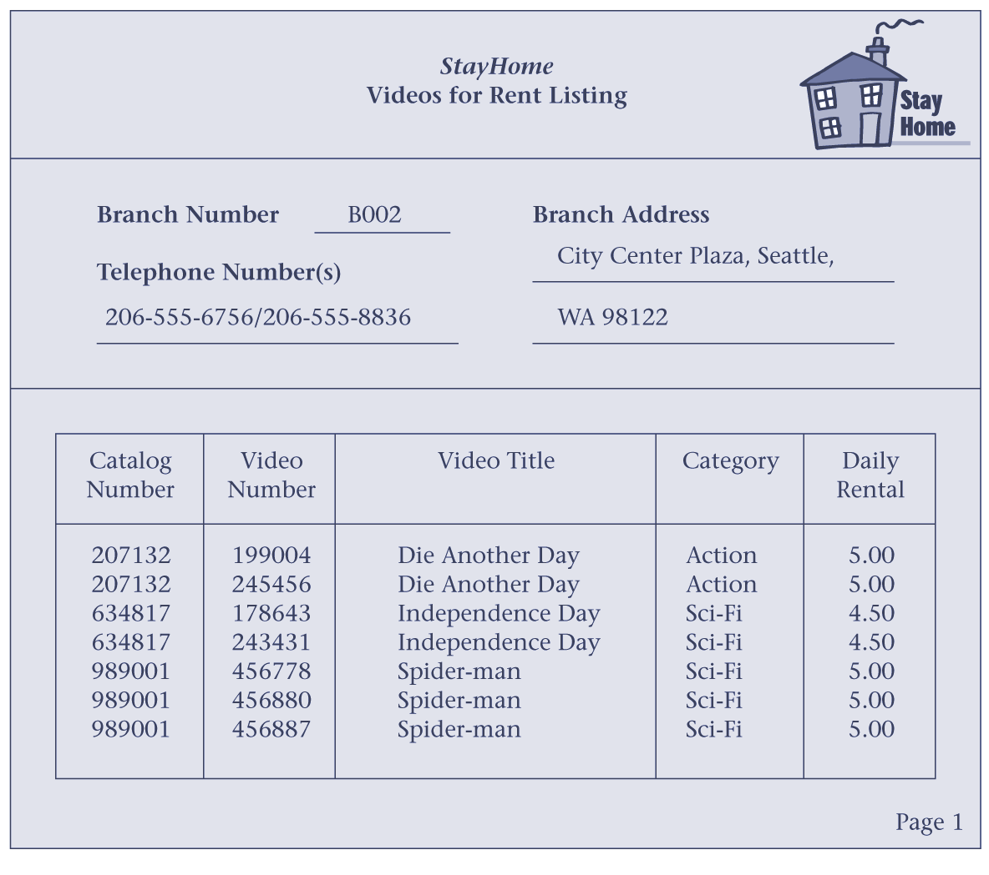
Page of report listing videos
© Pearson Education Limited, 2004

Slide 17
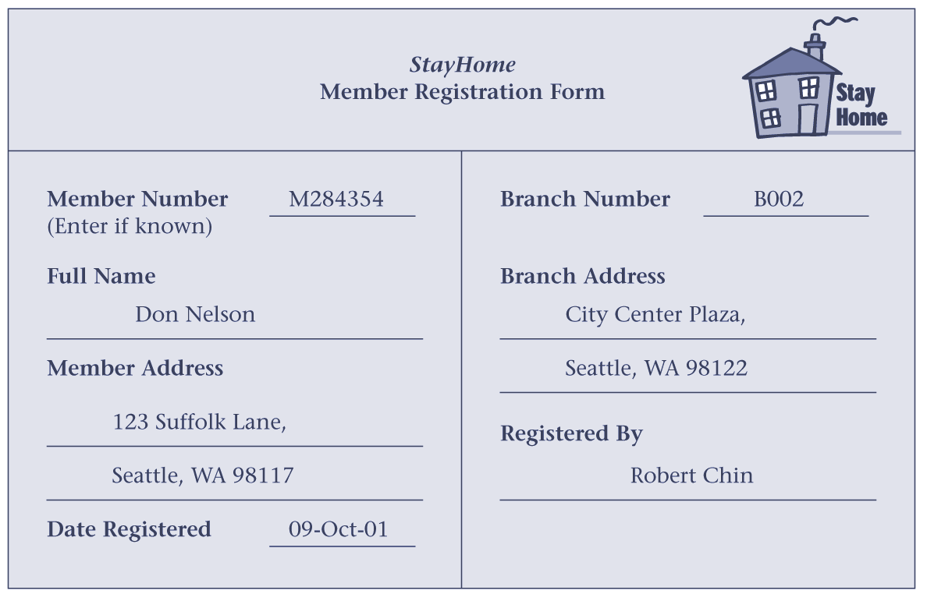
StayHome member registration form
© Pearson Education Limited, 2004

Slide 18
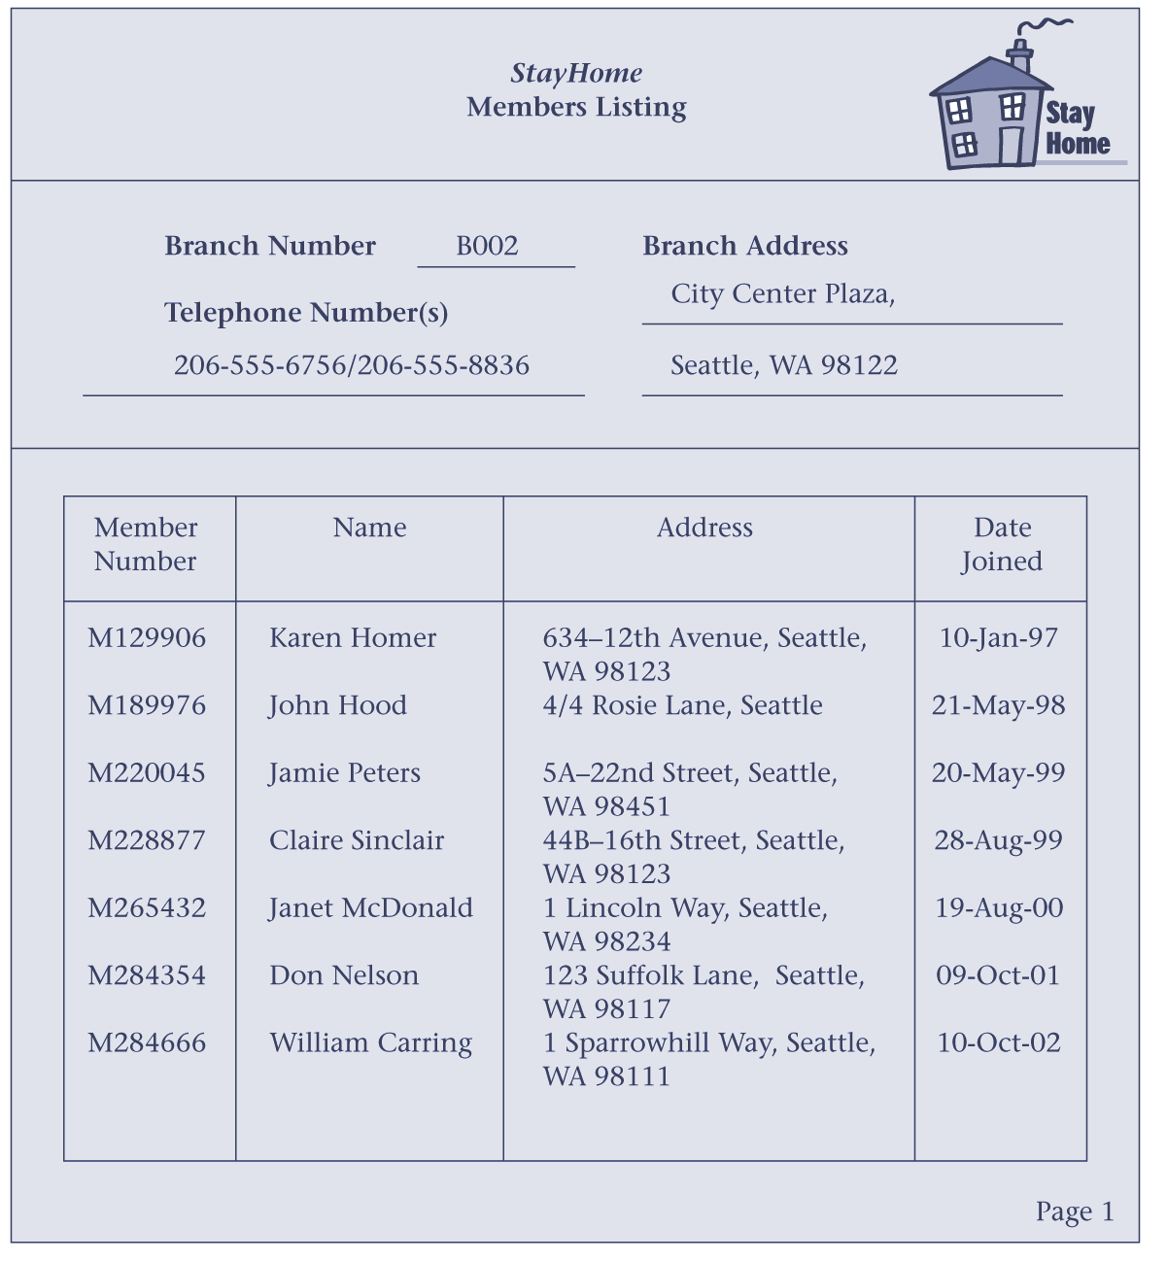
Page of report listing members
© Pearson Education Limited, 2004

Slide 19
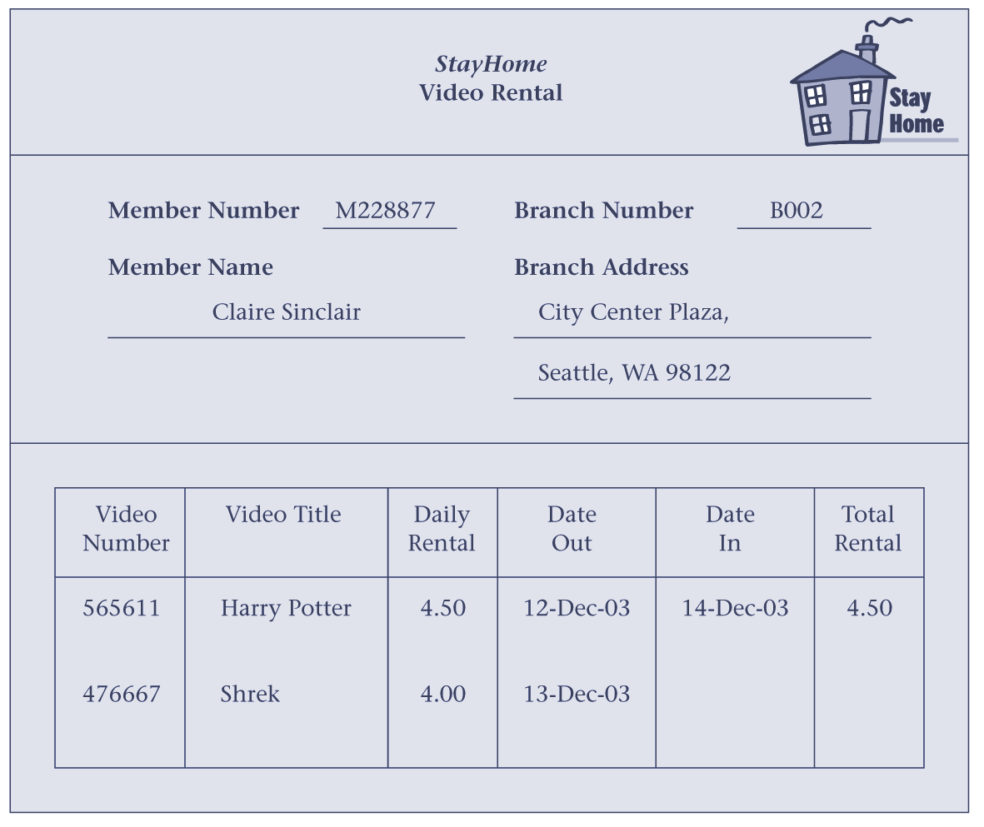
StayHome video rental form
© Pearson Education Limited, 2004

Slide 20
StayHome case study – database planning
Define mission statement for the database project.
Defines the major aims of the database system.
Clarifies purpose of database and provides clearer path towards the efficient and effective creation of the required database system.
© Pearson Education Limited, 2004

Slide 21
StayHome case study – database planning
Define mission objectives.
Each mission objective identifies a particular task that the database must support.
Additional information specifies, in general terms, the work to be done, the resources with which to do it, and the money to pay for it all.
© Pearson Education Limited, 2004

Slide 22
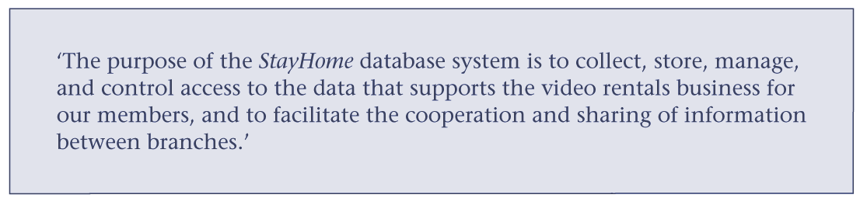
Mission statement for StayHome database system
© Pearson Education Limited, 2004

Slide 23
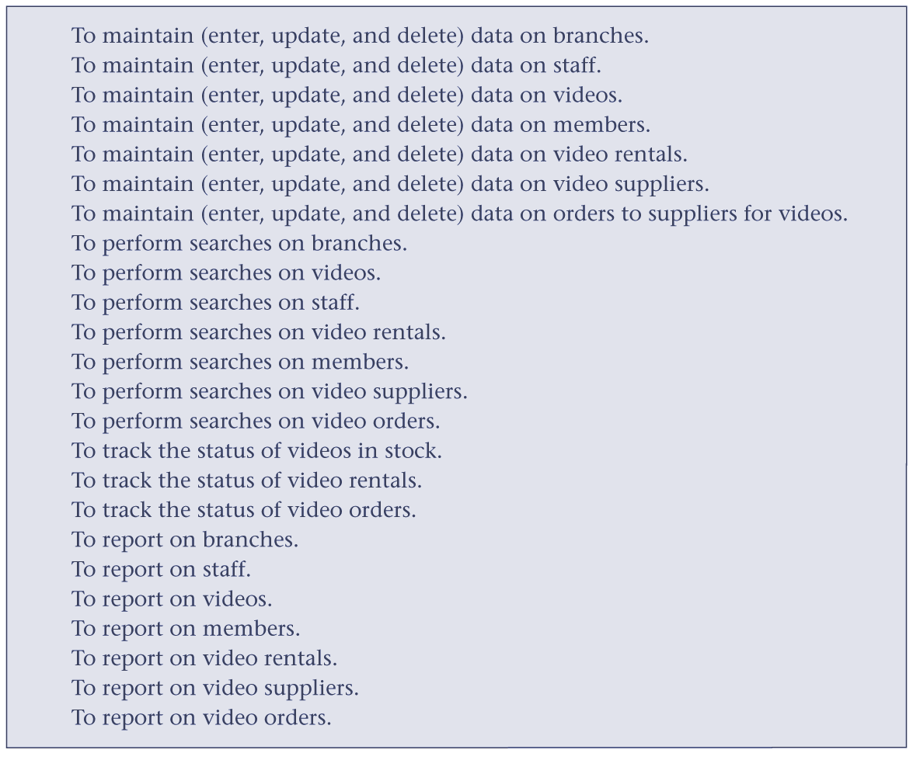
Mission objectives for StayHome database system
© Pearson Education Limited, 2004

Slide 24
StayHome case study – system definition
Define scope and boundary of database system and its major user views.
A user view represents requirements to be supported by a database system as defined by a particular job role (such as Manager or Assistant) or business application area (such as video rentals or stock control).
© Pearson Education Limited, 2004

Slide 25
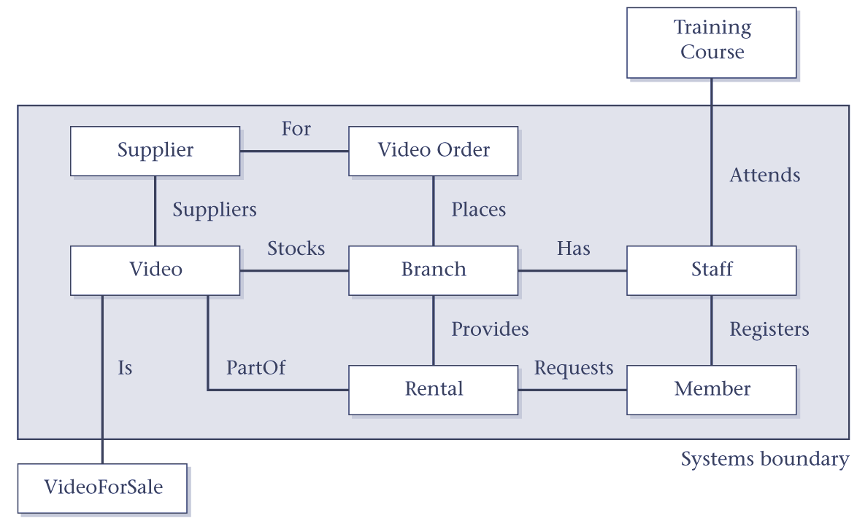
Boundary for the StayHome database system
© Pearson Education Limited, 2004

Slide 26
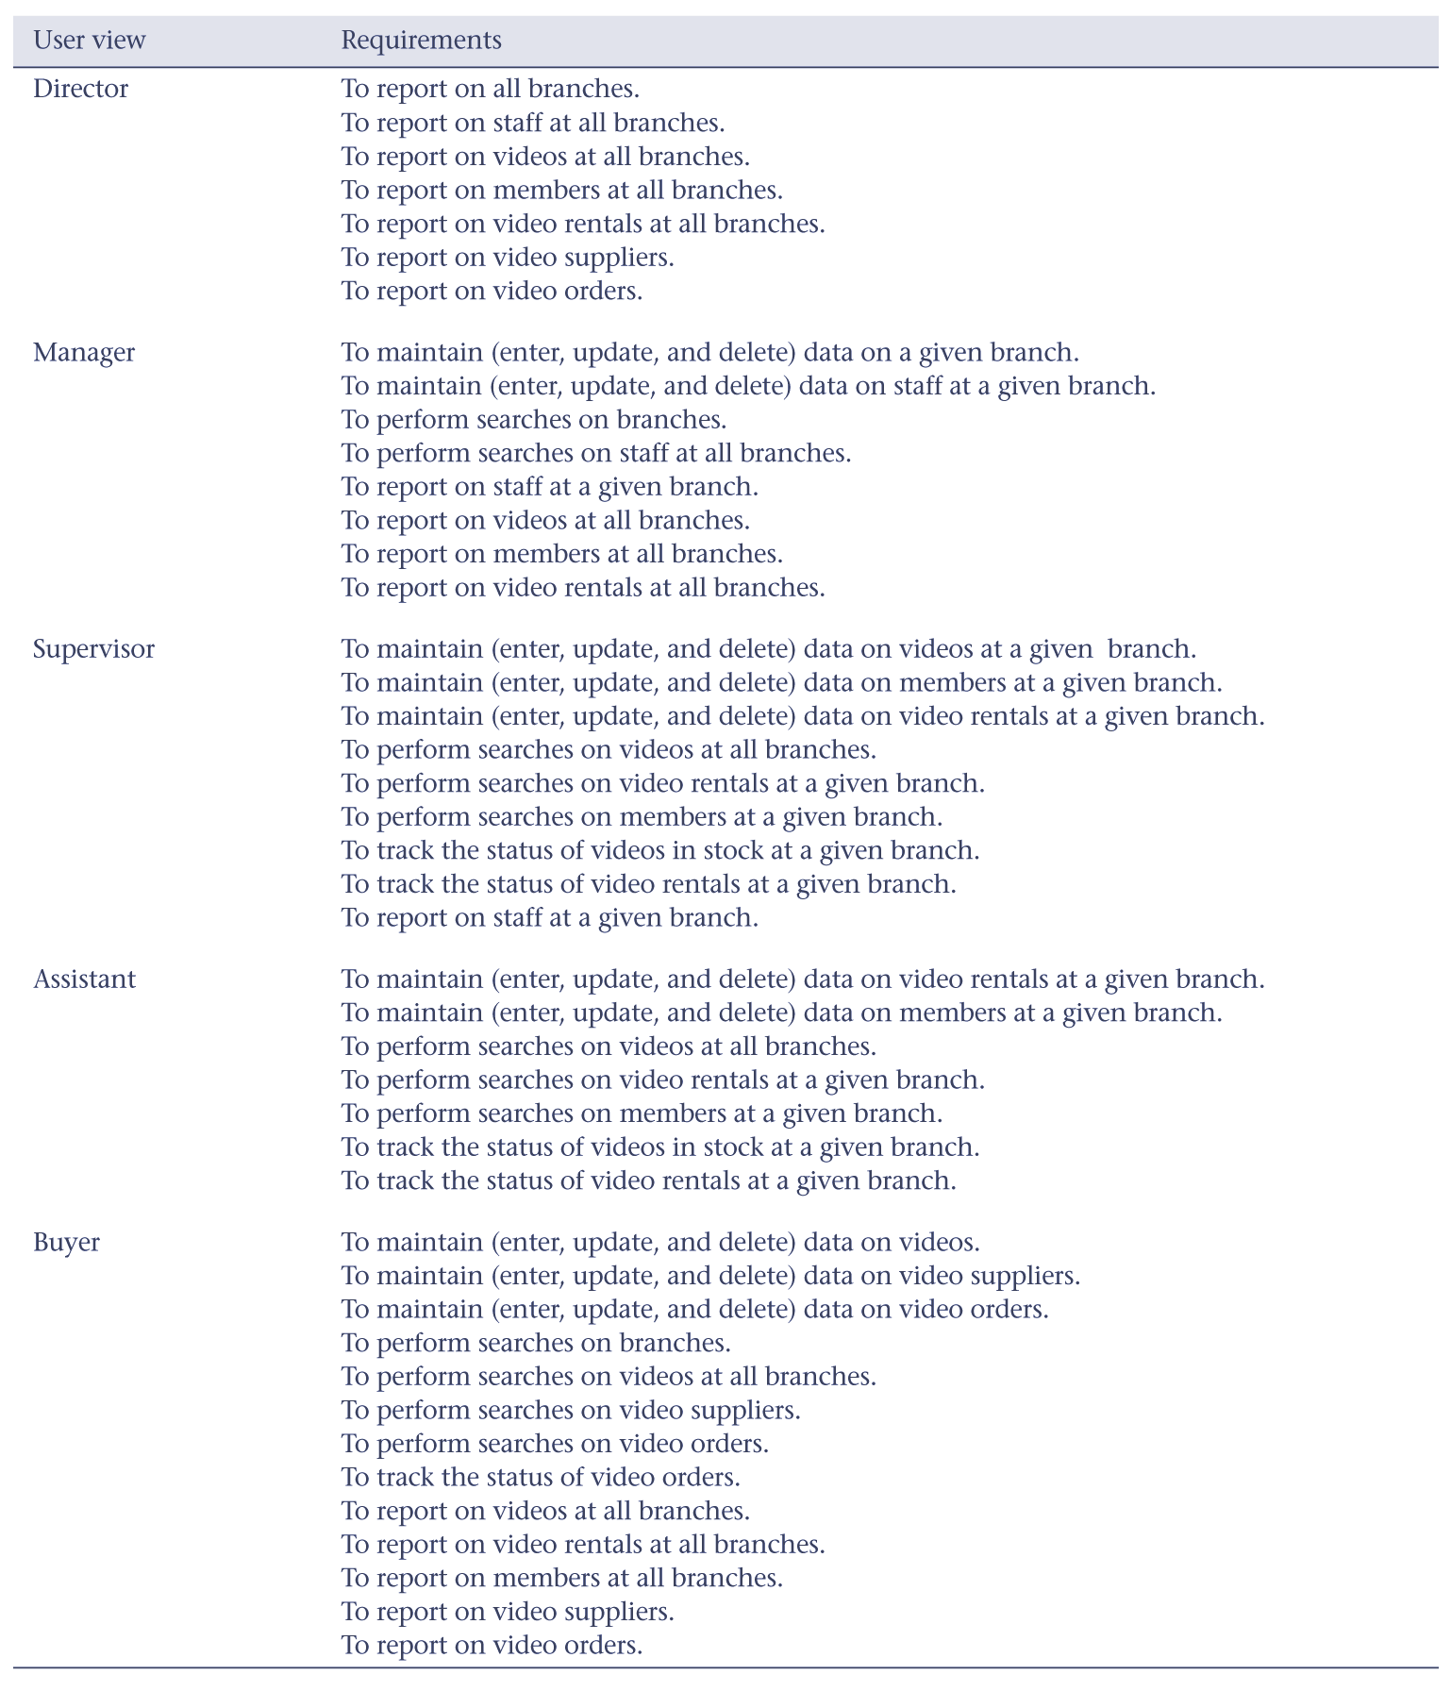
User views for StayHome database system
© Pearson Education Limited, 2004

Slide 27
StayHome case study – requirements collection and analysis
Gather more details on user views to create users’ requirements specification, which describes data to be held in database and how data is to be used.
© Pearson Education Limited, 2004

Slide 28
StayHome case study – requirements collection and analysis
Collect general requirements for the system to create - systems specification - describes features to be included in new database system such as networking, shared access, performance, and security requirements.
© Pearson Education Limited, 2004

Slide 29
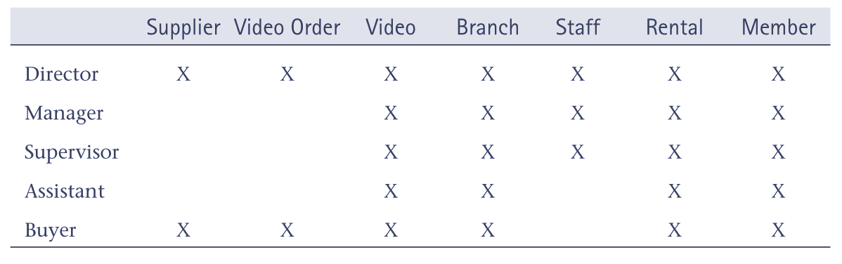
StayHome user views and data
© Pearson Education Limited, 2004

