Slide 1
Entity-Relationship modeling
Entity-Relationship modeling
Transparencies
© Pearson Education Limited, 2004

Slide 2
Entities
Entity
  Are a specific persons, places, objects in the user environment about which the user needs to keep data.
  For example EMPLOYEE, STUDENT, DEPARTMENT … etc.

Slide 3
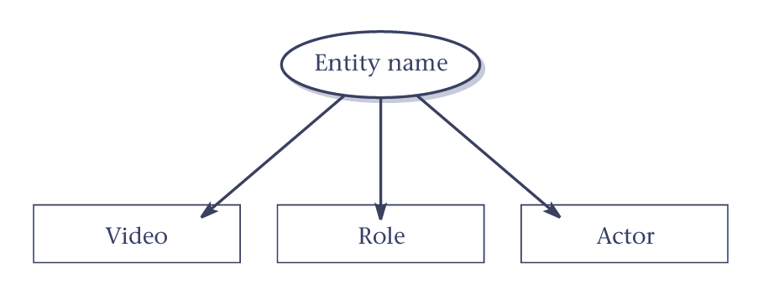
ER diagram of entities
© Pearson Education Limited, 2004

Slide 4
Relationships
Relationship
  A set of meaningful associations among entities.
  For example EMPLOYEE Ahmed works In PROJECT1 or EMPLOYEE Aziz Manages IT DEPARTMENT.
© Pearson Education Limited, 2004

Slide 5
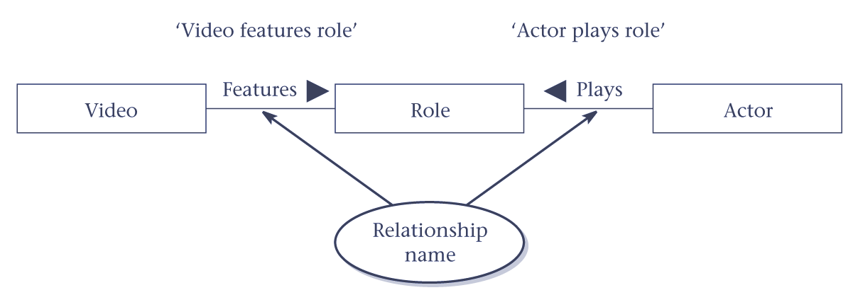
ER diagram of relationships
© Pearson Education Limited, 2004

Slide 6
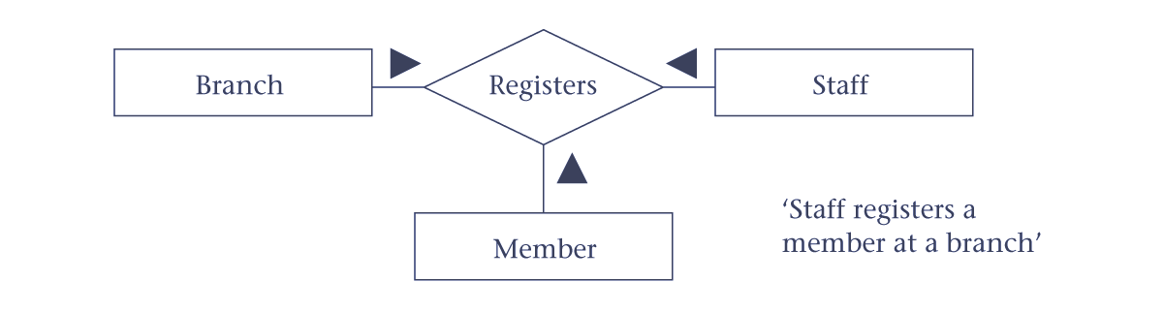
Example of ternary relationship
© Pearson Education Limited, 2004

Slide 7
Recursive relationships
Relationship where same entity participates more than once in different roles.
Relationships may be given role names to indicate purpose that each participating entity plays in a relationship.
© Pearson Education Limited, 2004

Slide 8
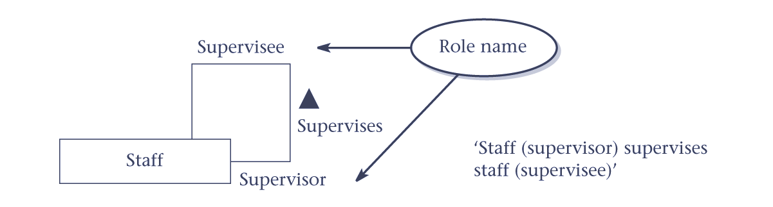
Example of a recursive relationship
© Pearson Education Limited, 2004

Slide 9
Attributes
Properties used to describe an entity.
For example EMPLOYEE entity may have the attributes like, ID, Name, Address, Sex … etc.
© Pearson Education Limited, 2004

Slide 10
Attributes
Attribute can be classified as being:
  simple or composite
  single-valued or multi-valued
  or derived
© Pearson Education Limited, 2004

Slide 11
Attributes
Simple attribute
  Attribute composed of a single component for example ID, Sex.
Composite attribute
  Attribute composed of multiple components for example Address, Name, DOB.
© Pearson Education Limited, 2004

Slide 12
Attributes
Single-valued attribute
  Attribute that holds a single value for an entity occurrence, for example ID.
Multi-valued attribute
  Attribute that holds multiple values for an entity occurrence, for example PhoneNO.
© Pearson Education Limited, 2004

Slide 13
Attributes
Derived attribute
  Attribute that represents a value that is derivable from value of a related attribute, or set of attributes, not necessarily in the same entity, for example Age, Net Salary.
© Pearson Education Limited, 2004

Slide 14
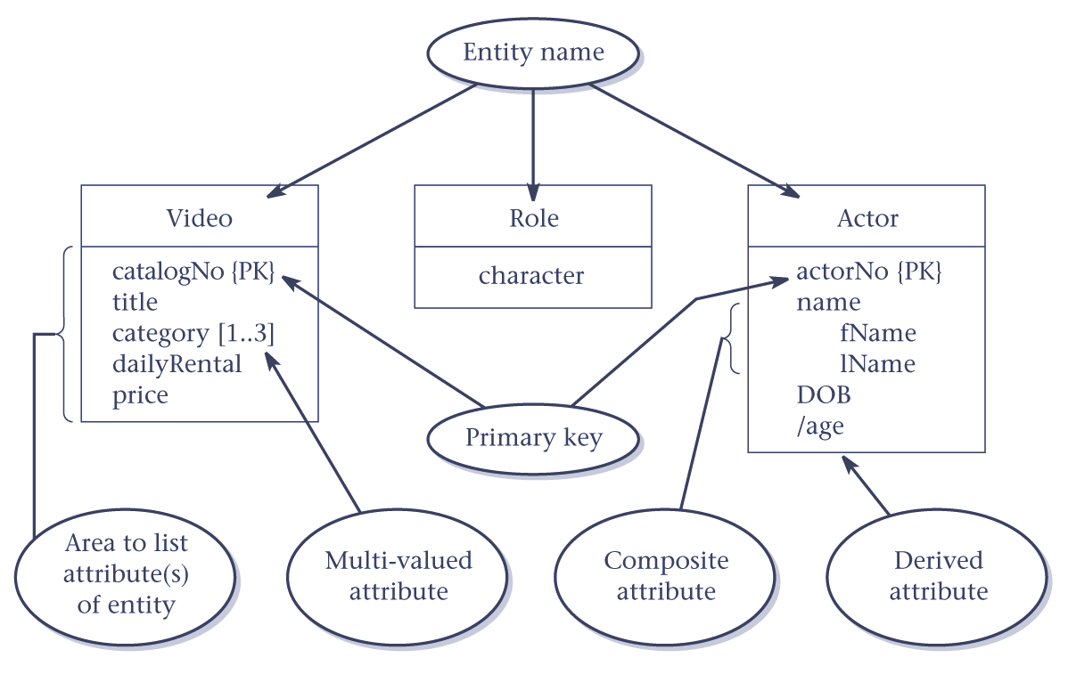
ER diagram of entities and their attributes
© Pearson Education Limited, 2004

Slide 15
Strong and weak entities
Strong entity
  Entity that is not dependent on the existence of another entity for its primary key, for example Student.
Weak entity
  Entity that is partially or wholly dependent on the existence of another entity, or entities, for its primary key, for example Order.

Slide 16
Multiplicity constraints on relationships
Represents the number of occurrences of one entity that may relate to a single occurrence of an associated entity.
Represents policies (called business rules) established by user or company.

Slide 17
Multiplicity constraints
The most common degree for relationships is binary.
Binary relationships are generally referred to as being:
  one-to-one (1:1)
  one-to-many (1:*)
  many-to-many (*:*)
© Pearson Education Limited, 2004

Slide 18
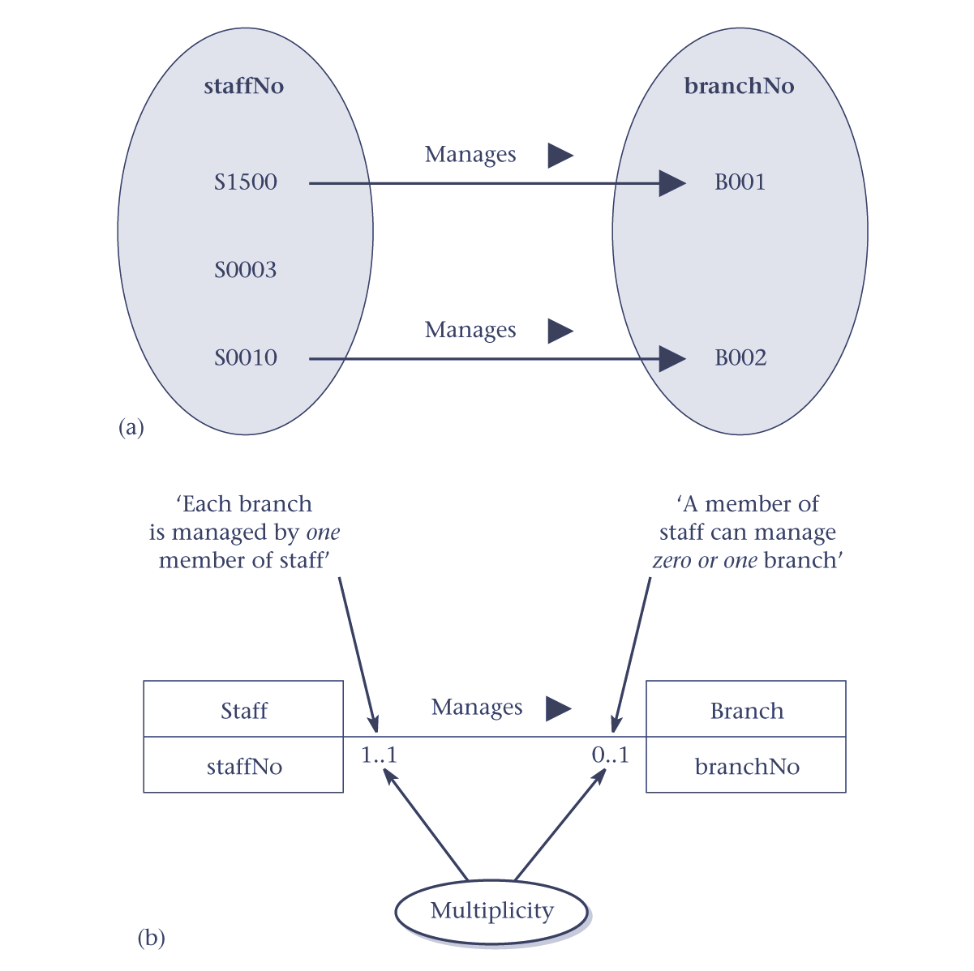
1:1 relationship
– individual examples
© Pearson Education Limited, 2004

Slide 19
1:1 relationship
– multiplicity
© Pearson Education Limited, 2004

Slide 20
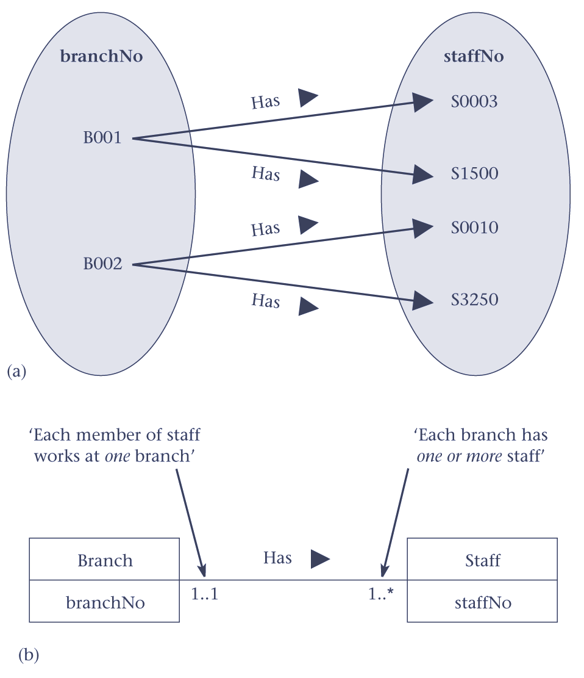
1:* relationship
– individual examples
© Pearson Education Limited, 2004

Slide 21
1:* relationship
– multiplicity
© Pearson Education Limited, 2004

Slide 22
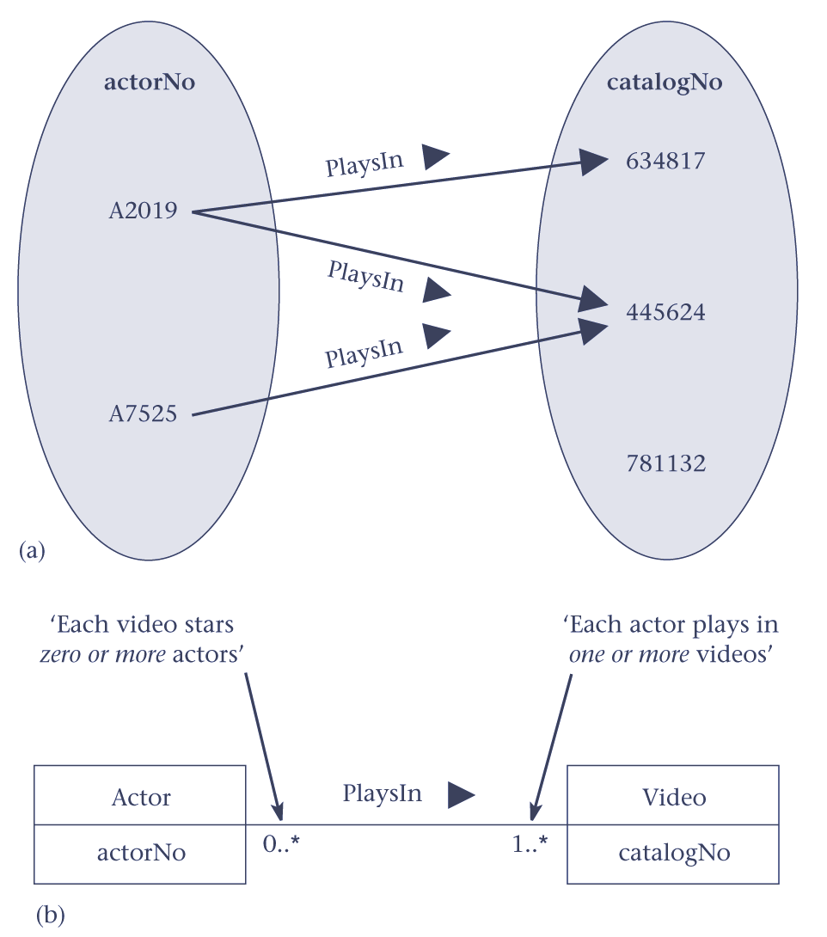
*:* relationship
– individual examples
© Pearson Education Limited, 2004

Slide 23
*:* relationship
– multiplicity
© Pearson Education Limited, 2004

Slide 24
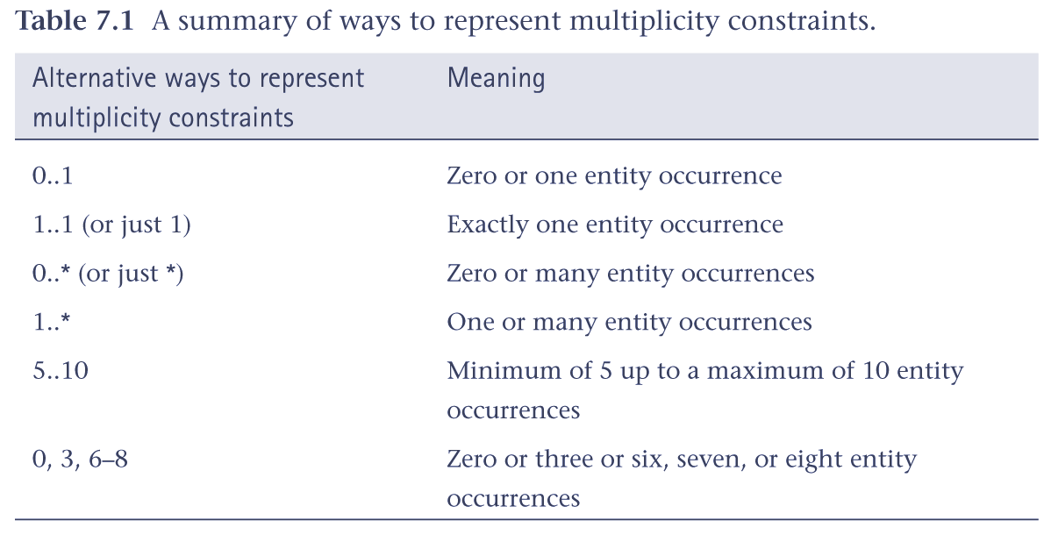
Summary of multiplicity constraints
© Pearson Education Limited, 2004

Slide 25
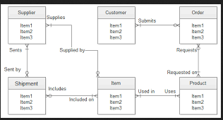

Database ERD Exmple
© Pearson Education Limited, 2004

