Slide 1


Elevate Labs
Task 8- Simple Sales Dashboard Design

Slide 2
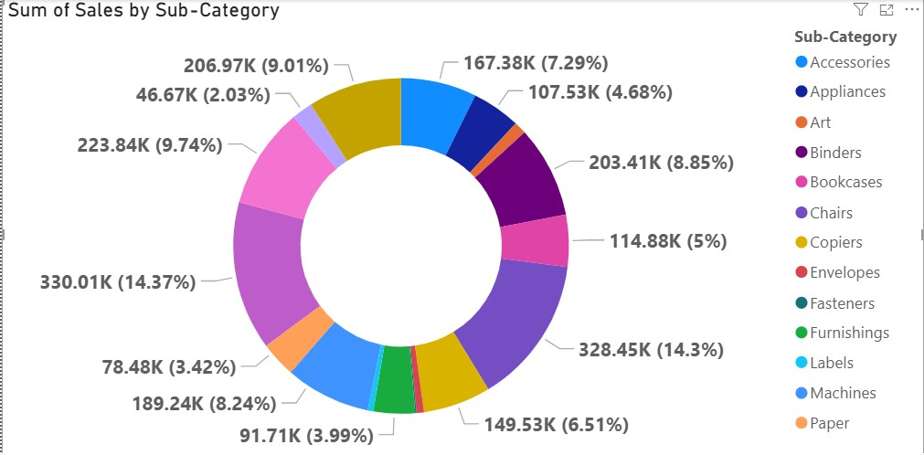
Sales by Sub-Category
This donut chart represents sales distribution across different sub-categories. Chairs (14.37%) and Phones (14.3%) contribute the highest sales, followed by Bookcases (9.74%) and Storage (9.01%). Envelopes (2.03%) contribute the least.

Slide 3
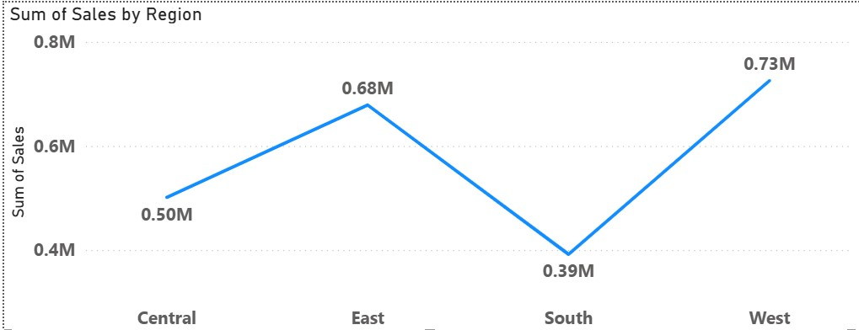
Sales by Region
This line chart shows sales performance across regions. The West region leads with 0.73M sales, followed by East with 0.68M. South records the lowest sales at 0.39M.

Slide 4
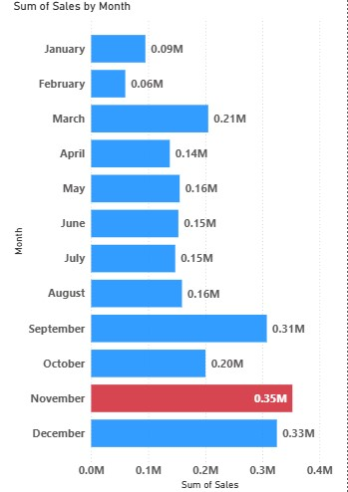
Sales by Month
This bar chart illustrates monthly sales trends. November shows the highest sales (0.35M), closely followed by December (0.33M). February has the lowest sales at just 0.06M.

