Slide 1
Image Convolution Application based on OpenACC
Zifan Wang, Haoxuan Jia, Boyang Zhou

Slide 2

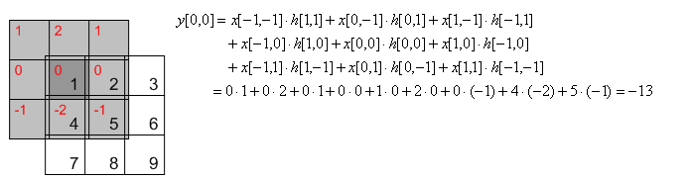
Basic Formula
g(x,y) is the filtered image, f(x,y) is the original image, w is the filter kernel. Every element of the filter kernel is considered by -a <= s <= a and -b<= s <= b
(https://en.wikipedia.org/wiki/Kernel_(image_processing))
No data dependency/hazard
Easy to parallel
Clearer results for debugging

Slide 3
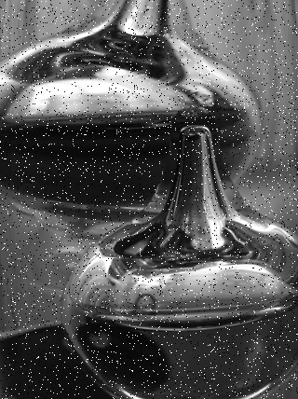
Things we want to cover
Sharpening
Applied to image reinforcement, fault detection and so on
Preprocess for training data
Smoothing
Smoothing is often used to reduce noise within an image or to produce an image with lower resolution
Reduce salt-pepper noise (Median filtering)
Inter-frame Difference
Motion detection with fixed background
Better performance on real-time video with higher processing speed.
** Do be careful with edge conditions

Slide 4
What’s going to be finished
Components for each method
Benchmark on time consuming with & without acceleration
Maybe a moving object detection using inter-frame difference method...

