Slide 1
Engines
S6 H2-cruiseship

Slide 2
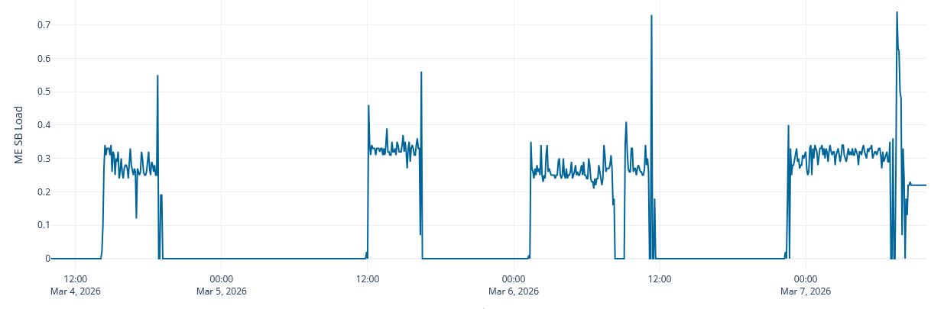
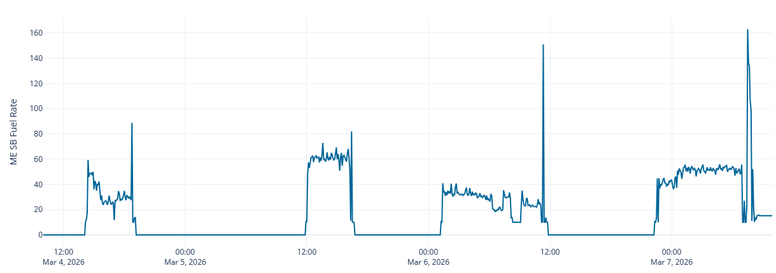
What is the Load (%) based on?
Fuel rate

Slide 3
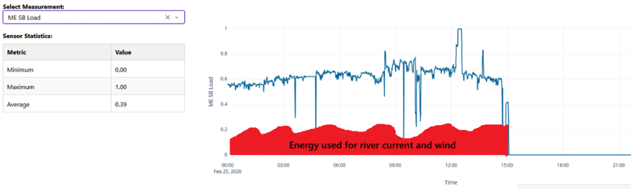
Model for the efficiency of the engines
How much energy from the diesel is transformed into work excluding external factors (current & wind)?
Model based on the measurements of the dashboard.

Slide 4
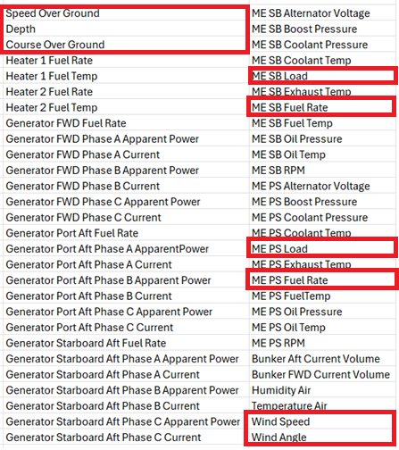
Dashboard measurements
Relevant measurements for calculation

