Slide 1

Prepared by 25-26J-525
Agile Sense AI
EMOTION-AWARE AGILE SYSTEM FOR PROGRESS TRACKING, EXPERTISE RECOMMENDATION, REQUIREMENT MANAGEMENT AND INCLUSIVE COMMUNICATION

Slide 2





Problem Statement & Stakeholders
Context
Stakeholders
Domain: Agile Software Development
Workflow: Sprint and task management using Jira or Trello
Collaboration: Team communication and meetings through Microsoft Teams
Primary Users:
Scrum Masters, Developers
Secondary Users:
Product Owners, QA Engineers
Decision Makers:
Engineering Managers, CTOs, Project Directors
Observed Issues
No Emotion Insight: Teams cannot understand meeting dynamics or team morale.
Requirement Changes: Mid-sprint changes make planning and delivery unpredictable.
Skill Mismatch: Tasks are not always assigned to the most suitable developers.
Poor Brainstorming: Ideas are often unstructured and not everyone gets a chance to contribute.
Impact
Time: Missed sprint deadlines and longer meetings.
Cost: Wasted resources due to poor task distribution.
Risk: Developer burnout and lower software quality.
Output: Reduced collaboration and team productivity.

Slide 3
The Gap: What’s Missing?
Main Objective: AgileSense AI Platform
Emotion Awareness Gap
Emotion Intelligence
01
Platforms like Microsoft Teams host team meetings but lack the ability to understand team emotions or meeting dynamics.
05
Analyze real-time team emotions and meeting dynamics during virtual meetings.
Sprint Replanning Gap
Sprint Impact Prediction
02
Current tools like Jira do not predict the impact of requirement changes during a sprint or suggest how to replan work.
06
Predict risks and impacts of requirement changes during a sprint to support better replanning.
Research Gap & Objectives
Expertise Allocation Gap
Expertise Recommendation
03
Task assignments are mostly manual and not based on developer skills or expertise.
07
Recommend the most suitable developer for each task based on skills and experience.
Collaboration Gap
Collaborative Brainstorming
04
Brainstorming sessions are unstructured and lack intelligent support to organize and refine ideas.
08
Support structured and inclusive idea generation to improve team collaboration.

Slide 4
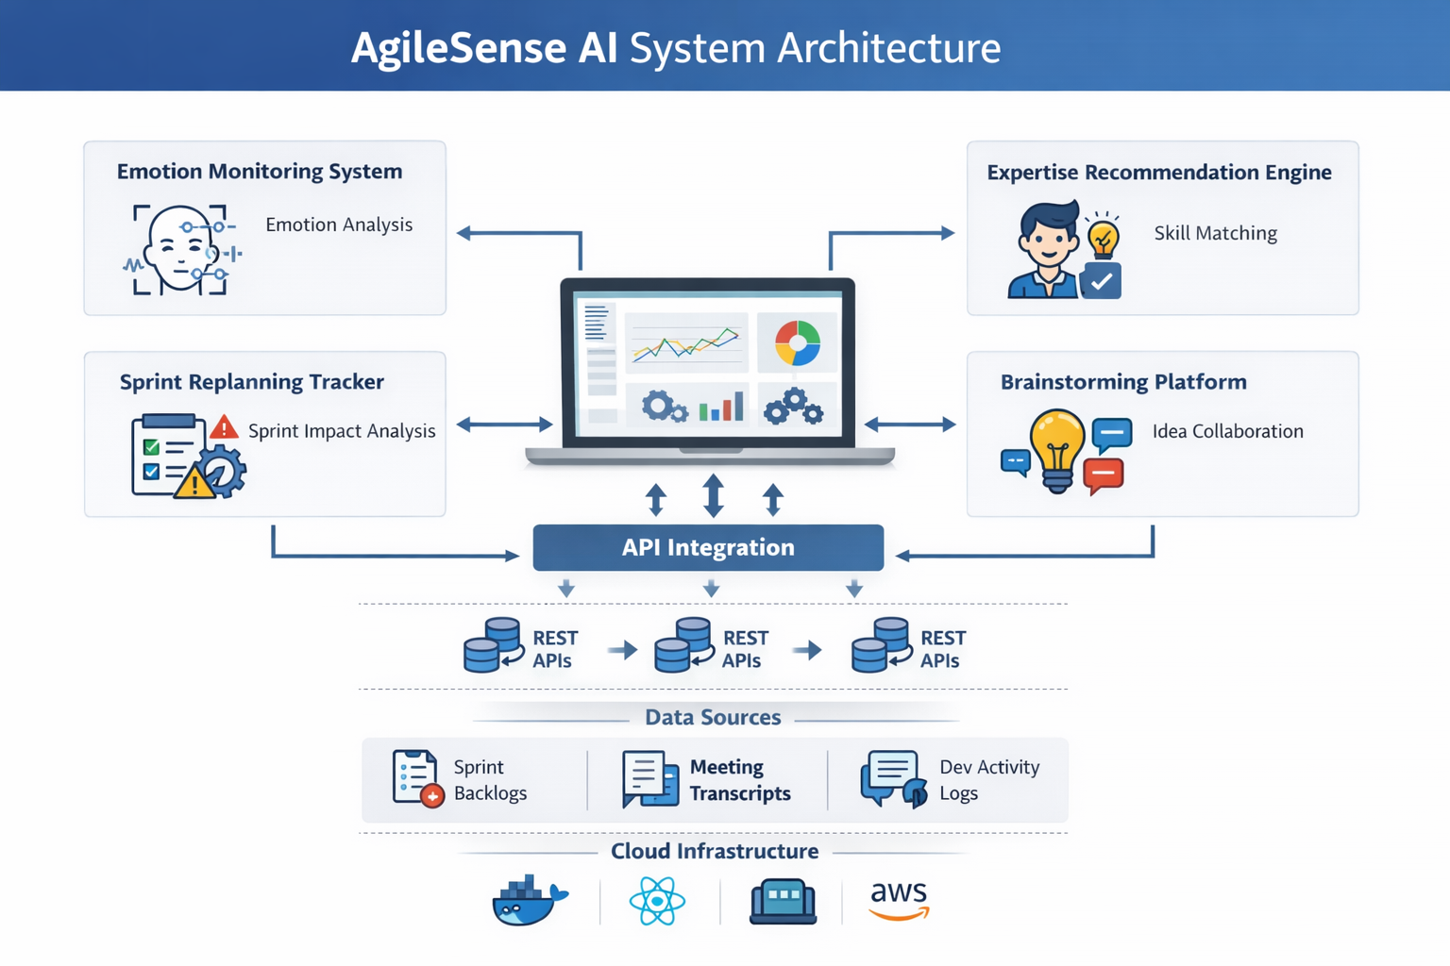
Component 1: IT22126092
Component 3: IT22115348
Component 2: IT22136688
Component 4: IT22602732

Slide 5
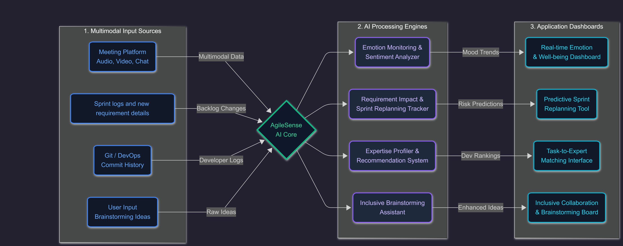
AgileSense AI: End-to-End Data Pipeline

Slide 6
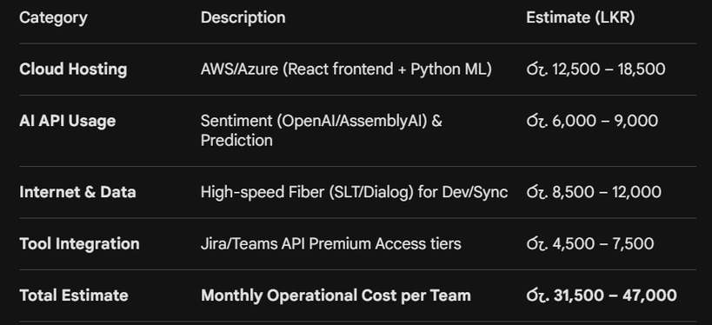



Commercialization & Impact
Target Market
Feasibility & Cost
Agile Teams: Software firms in Sri Lanka and globally using Jira/Scrum.
Remote-First Tech: Companies relying on MS Teams for virtual collaboration.
Scale: Versatile for High-Growth Startups and Enterprise Engineering divisions.
Value PropComponent-Based Value Propositionosition
Emotion Engine: First-to-market sentiment tracking to prevent developer burnout.
Sprint Predictor: Real-time risk forecasting instead of post-sprint reviews.
Expertise Matcher: Data-driven task allocation to maximize resource efficiency.
Inclusivity Bot: Automated support for diverse, structured brainstorming.
Adoption Strategy
Phase 1 (Pilot): 3-month trial with 2 local Agile squads for data baseline.
Phase 2 (Model Tuning): Refine NLP accuracy using local meeting dynamics.
Phase 3 (SaaS Launch): Tiered subscription model for Colombo-based IT firms.

Slide 7
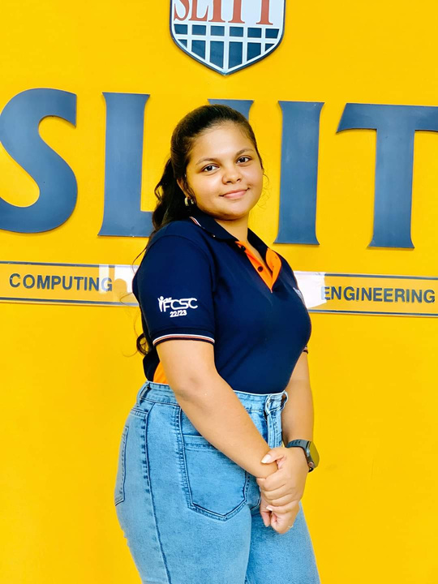



Team Members
Fonseka A.A.T.N.
Vithana P.I.
Amarasinghe C.N.
De Silva M.B.H.
IT22126092
IT22136688
IT22115348
IT22602732
Emotion Monitoring System
Sprint Replanning Tracker
Expertise Recommendation
Engine
Inclusive Brainstorming
Platform

