Slide 1
Bitwise Operators

Slide 2
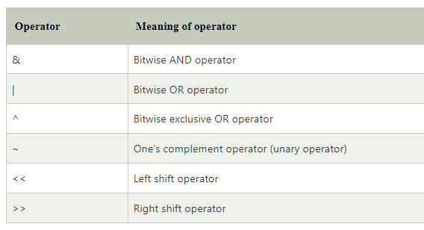

Slide 3
The & (bitwise AND) in C or C++ takes two numbers as operands and does AND on every bit of two numbers. The result of AND is 1 only if both bits are 1.
The | (bitwise OR) in C or C++ takes two numbers as operands and does OR on every bit of two numbers. The result of OR is 1 if any of the two bits is 1.
The ^ (bitwise XOR) in C or C++ takes two numbers as operands and does XOR on every bit of two numbers. The result of XOR is 1 if the two bits are different.
The << (left shift) in C or C++ takes two numbers, the left shifts the bits of the first operand, and the second operand decides the number of places to shift.
The >> (right shift) in C or C++ takes two numbers, right shifts the bits of the first operand, and the second operand decides the number of places to shift.
The ~ (bitwise NOT) in C or C++ takes one number and inverts all bits of it.

Slide 4
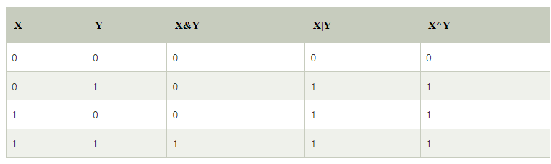
0

Slide 5
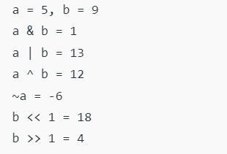

Slide 6
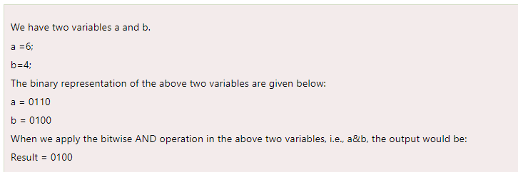
Bitwise AND

Slide 7
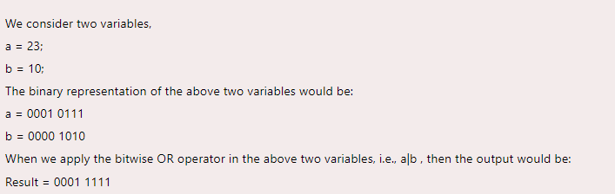
Bitwise OR

Slide 8
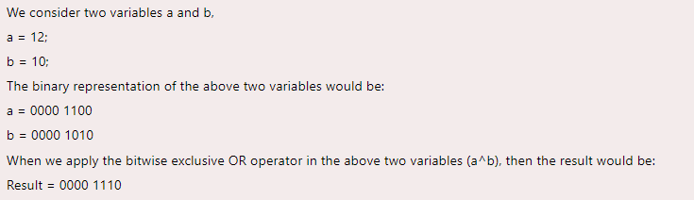
Bitwise XOR
00000110

Slide 9
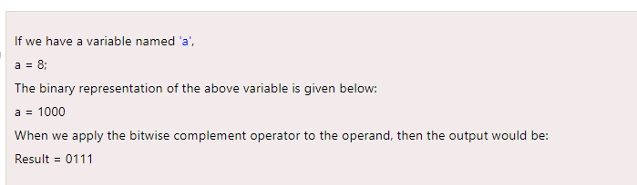
Bitwise Complement

Slide 10
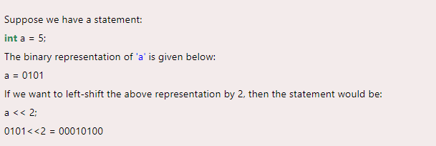
Bitwise left shift
In general, if we shift a number by n position to left, the output will be number * (2^{n}).

Slide 11
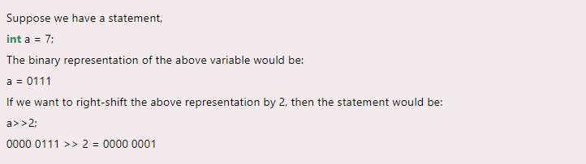
Bitwise right shift
In general, if we shift a number by n times to right, the output will be number / (2^{n}) .

Slide 12
To be noted!!
In C compilation,
For any integer n, the bitwise complement (~) of n will be
-(n+1).

