Slide 1

Mentorness
Machine Learning Intern
Task2: T-20 Cricket World Cup Analysis Project
Approach outline and key findings

Slide 2
Objective: Our mission is to unravel the stories hidden within this dataset by:
Approach Taken:
1. Data Exploration: Delve into the dataset to uncover trends, patterns, and insights. Analyze the
performance of teams, players, and key events within the matches.
2. In-Depth Analysis: Examine player statistics, including runs, wickets, and over-by-over progress,
to understand the dynamics of the game.
3. Event Inference: Identify and analyze critical match events, such as boundaries, wickets, and
strategic moments. Uncover the factors that contribute to the success or downfall of a team.
4. Performance Evaluation: Evaluate individual and team performances, including st andout
players, consistent run-scorers, and top wicket-takers. Discover what sets them apart.
5. Statistical Insights: Utilize statistical techniques to gain insights into team strategies, batting,
bowling, and match outcomes. Create visualizations that convey the story of the tournament.

Slide 3
Event Inference
Performance Evaluation
Statistical Insights
Data Exploration
In-Depth Analysis

Slide 4
Exploratory Data Analysis (EDA)
Performed basic summary statistics and tried to know more about the dataset

Slide 5
Data Cleaning
We remove the Null values and duplicates from the data for further analysis.

Slide 6
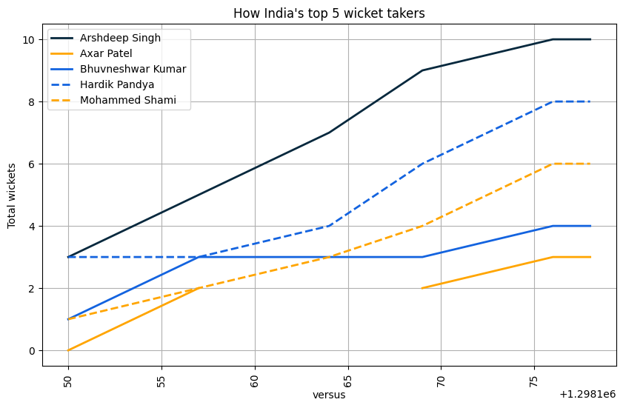
Insights(Bowling)
bowler1_name | bowling_team | bowler1_wkts
Arshdeep Singh | INDIA | 3
Hardik Pandya | INDIA | 3
Ravichandran Ashwin | INDIA | 3
Axar Patel | INDIA | 2
Bhuvneshwar Kumar | INDIA | 2
Mohammed Shami | INDIA | 2

Slide 7
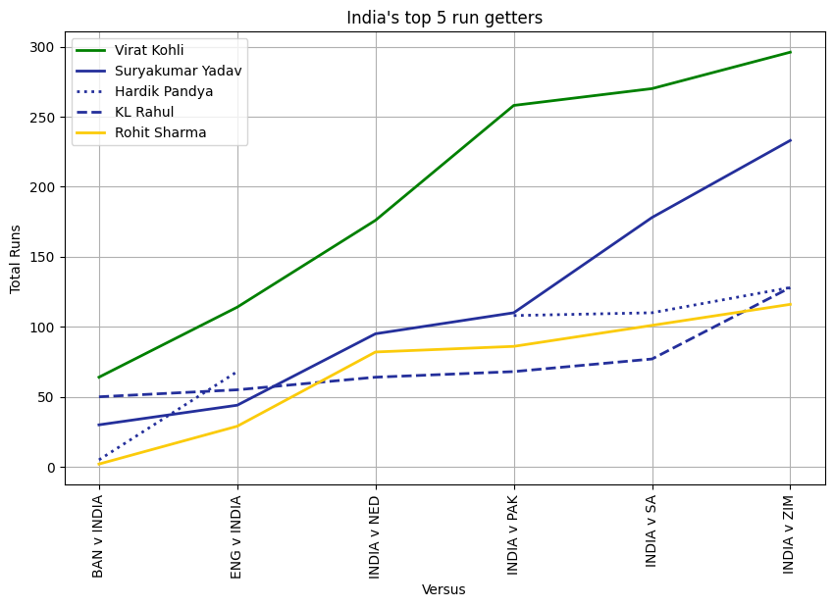
Insights (Batting)
batsman1_name | batsman_team | runs
Virat Kohli | INDIA | 82
Suryakumar Yadav | INDIA | 68
Hardik Pandya | INDIA | 63
Rohit Sharma | INDIA | 53
KL Rahul | INDIA | 51
Ravichandran Ashwin | INDIA | 13

Slide 8
THANK YOU

