Slide 1
Badminton-Sense
Stroke Classification from Monocular Badminton Video
BWF Video → Clip Segments → MediaPipe Pose → Normalize → LSTM / Transformer → Stroke Class
Project
Objective
Course: CS 535 — Pattern Recognition
Institution: Rutgers University
Type: Individual Project
Participant: Abhay Singh Thakur
End-to-end pipeline that takes raw BWF broadcast video and classifies individual stroke types (smash, drop, clear, serve, etc.) using 2D pose estimation as the intermediate representation. Compares a BiLSTM baseline against a Spatial-Temporal Transformer on the ShuttleSet benchmark (36,492 strokes / 44 matches).
CS 535 — Progress Update — May 2026

Slide 2
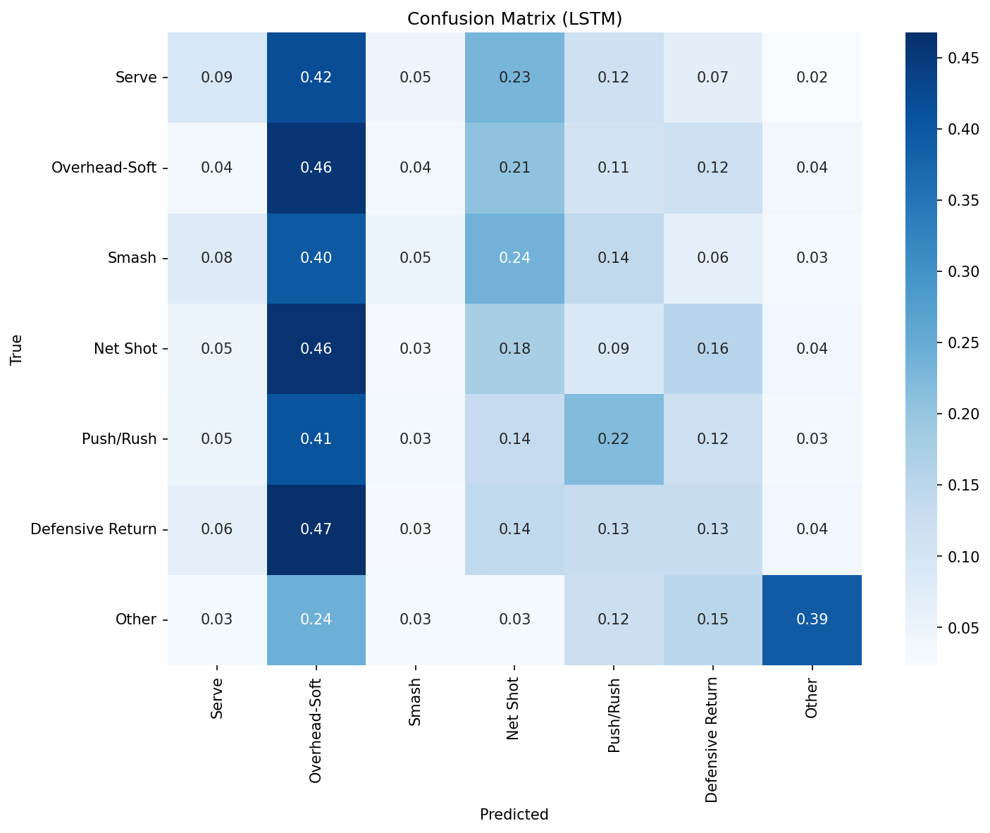
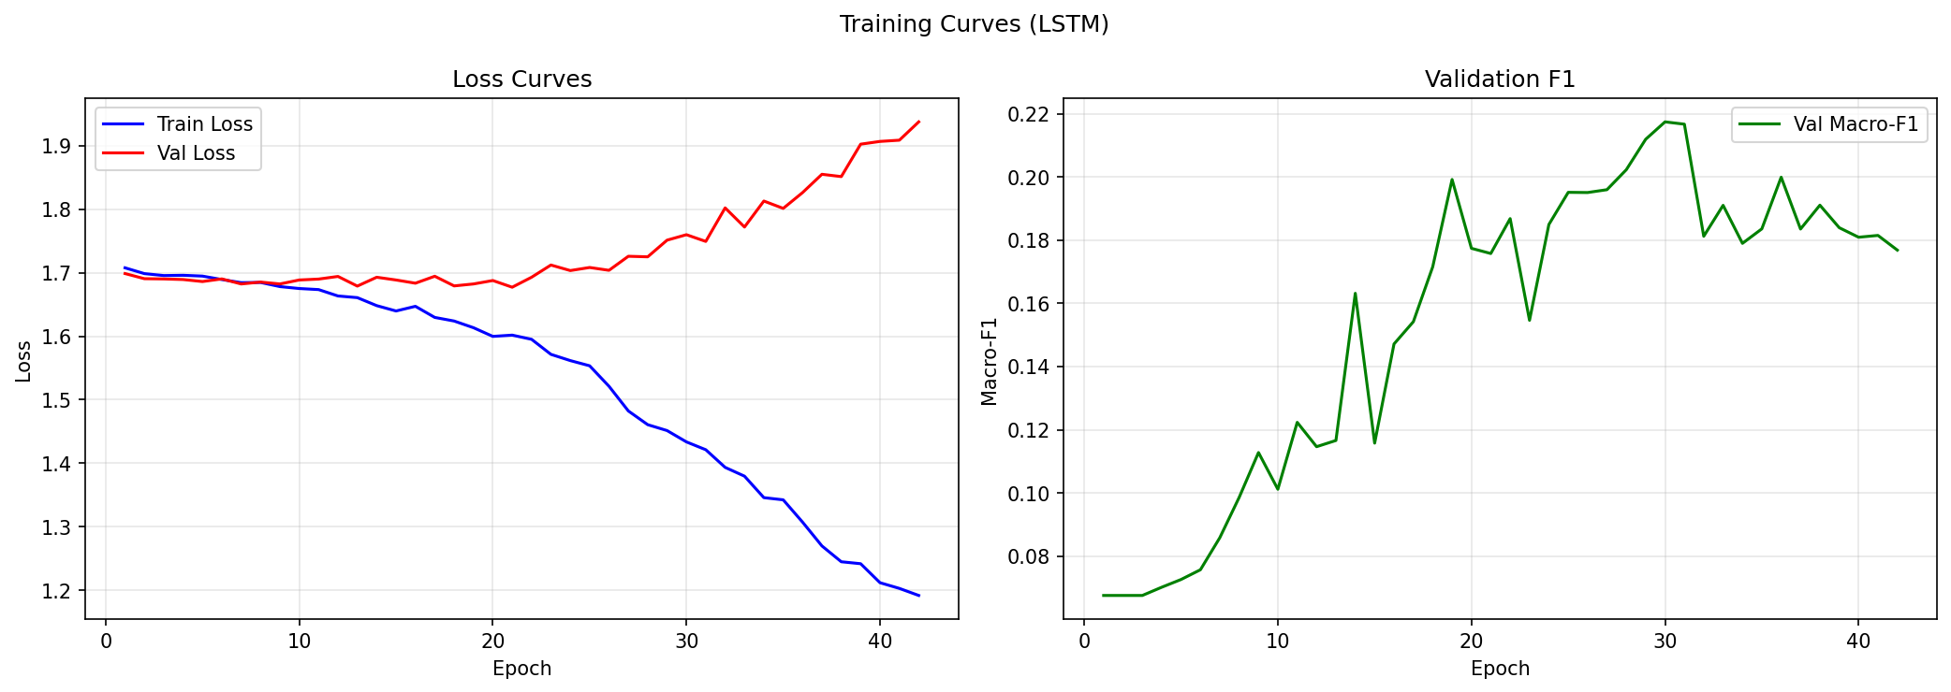
Milestones & Results
7-match run • 3,639 valid pose sequences • Heavy MediaPipe pose • 7-class taxonomy • CPU training
ACCOMPLISHED
Test-Set Performance (3-match subset)
Design & Specification
10-class taxonomy mapped from 19 ShuttleSet Chinese stroke labels; full 7-step pipeline spec.
Implementation
BiLSTM (527K params) + Spatial-Temporal Transformer (841K params); MediaPipe Tasks API; hip-center normalization; label smoothing CE; stratified split with small-sample fallback.
Validation
End-to-end run on 7 matches (7,350 clips → 3,639 valid sequences). 7-class taxonomy (merged pose-indistinguishable classes). LSTM converges; Transformer data-starved.
Evaluation Suite
Confusion matrices, training curves, per-class F1, t-SNE — generated for both models.
BiLSTM
Transformer
0.213
0.068
macro-F1 | 25.3% acc
collapsed | 31% (majority)
REMAINING
• Scale to full 44 matches (36,492 strokes)
• Heavy pose model (in progress, overnight run)
• Streamlit demo for live inference
• Final write-up and analysis
KEY FINDING — BiLSTM learns all 7 classes (+53% F1 vs baseline). Transformer remains data-hungry — collapses to majority-class on 2,547 train samples despite multiple config attempts.

Slide 3
Changes from Original Proposal
Pragmatic adjustments driven by API breakage, hardware limits, and dataset shape
01
MediaPipe API Migration
02
Subset Run, Not Full 44
03
Class Taxonomy Refinement
FROM: mp.solutions.pose
TO: Tasks API + PoseLandmarker
FROM: 44 matches end-to-end
TO: 7-match overnight run
FROM: 10 classes (incl. Drive, Cross-court, Drop)
TO: 7 classes (Drop merged into Overhead-Soft)
Legacy API removed in v0.10.33 — rewrote pose extractor to use new IMAGE-mode landmarker, reusable across clips.
Full 44-match run = 30+ hrs on CPU. 7 matches = 3,639 valid sequences, sufficient for pipeline validation + meaningful results.
Drop vs Clear pose-indistinguishable. Drive only 40 samples (untrainable). Cross-court always 0. New taxonomy is pose-discriminable.
04
Class Weights + Augmentation
05
Transformer Underperforms
FROM: Vanilla CE + light aug
TO: Inverse-sqrt class weights + stronger aug
FROM: Expected: SOTA on stroke recognition
TO: Reality: data-starved, LSTM wins
Class imbalance (Overhead-Soft 31%, Other 6%) hurt minority classes. Inverse-sqrt weighting + bigger aug ranges lifted minority-class F1.
Spatial-Temporal Transformer needs more data than 2.5K samples. Multiple LR/scheduler/size configs tried — all collapsed to majority class. LSTM is practical winner.
Core architecture (BiLSTM + Spatial-Temporal Transformer) and 10-class taxonomy unchanged from proposal.

