Slide 1
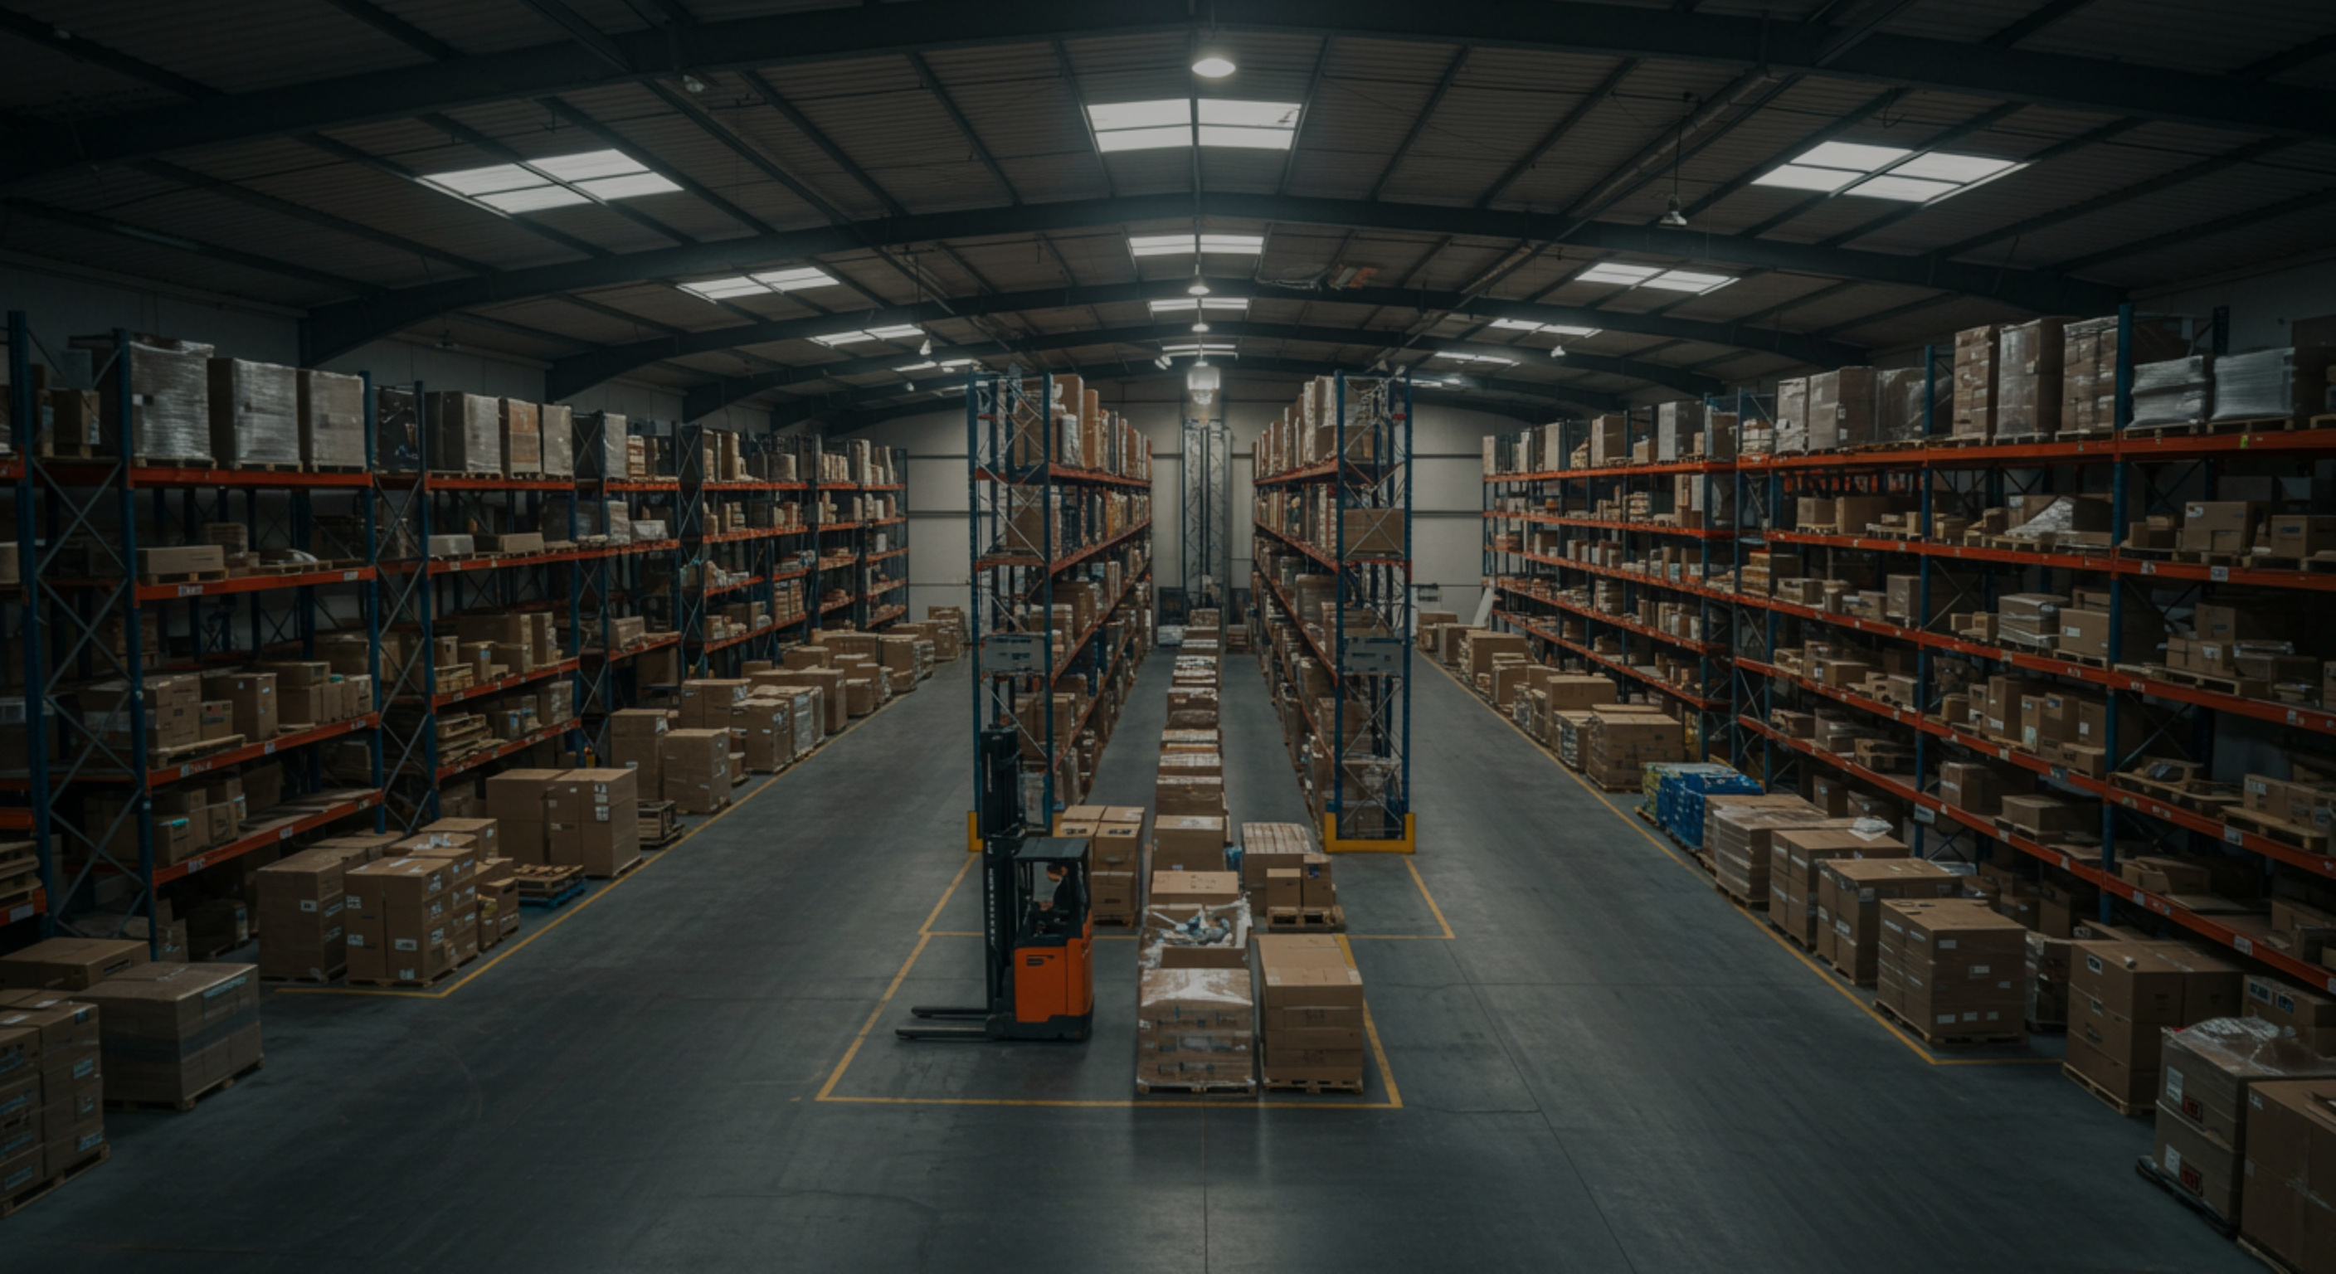
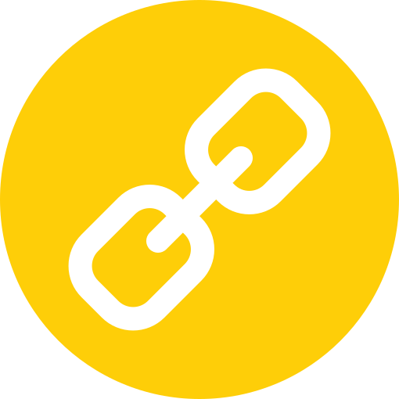

BOTTLENECK
A2A
MCP
CrewAI
ADK
BOTTLENECK
Multi-Agent Supply-Chain Disruption & Recovery
Aastha Thakur · 230552 | Shivani · Enrollment
Mayank · Enrollment | Lokesh · Enrollment
CSE3101 · November 2026
SLIDE 0

Slide 2
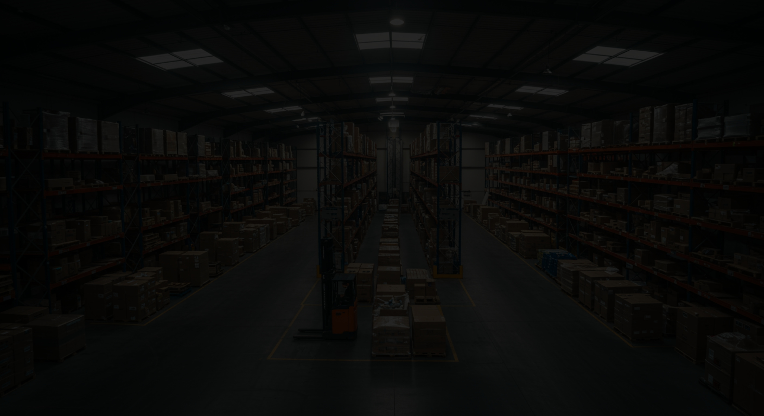
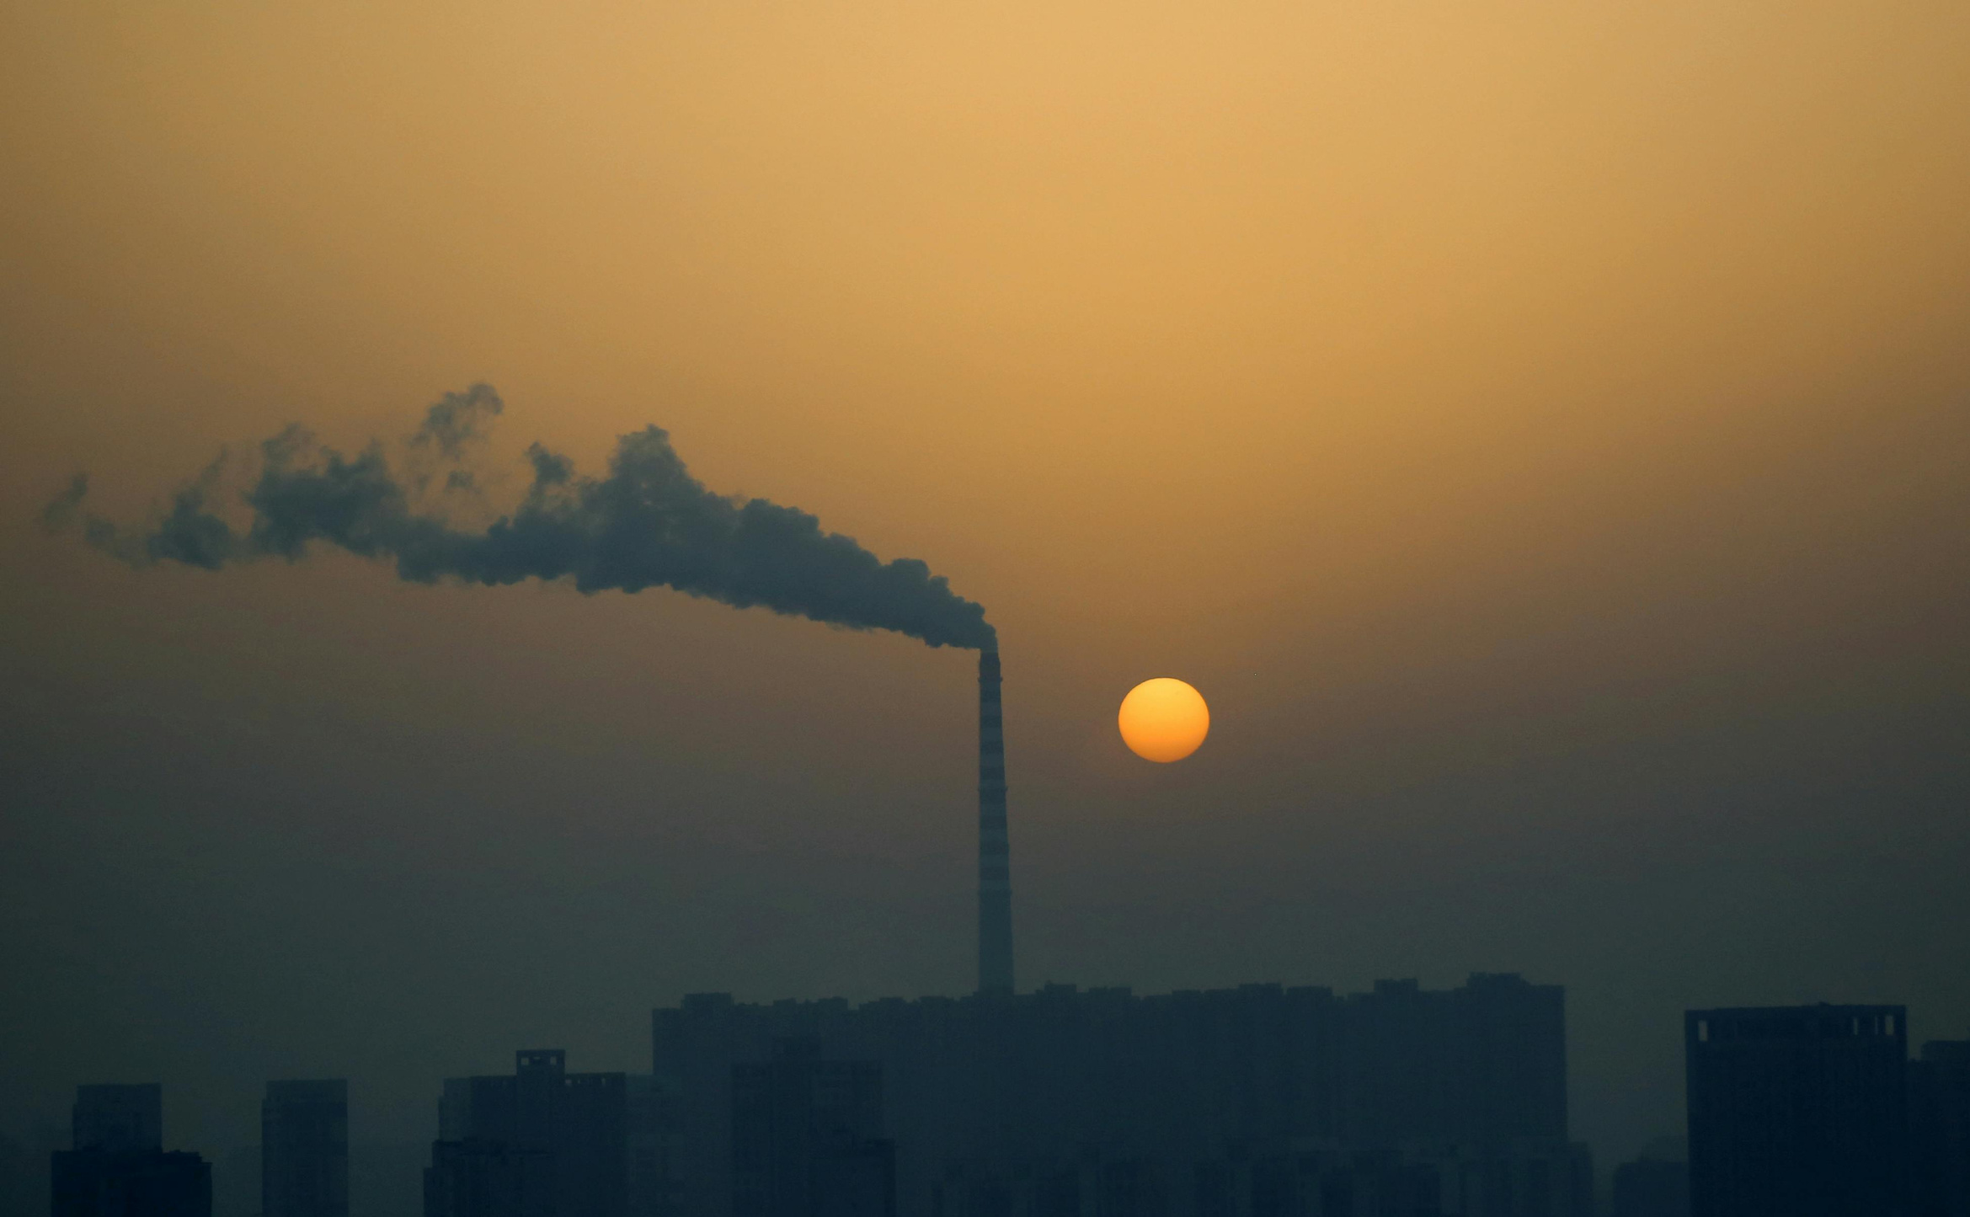
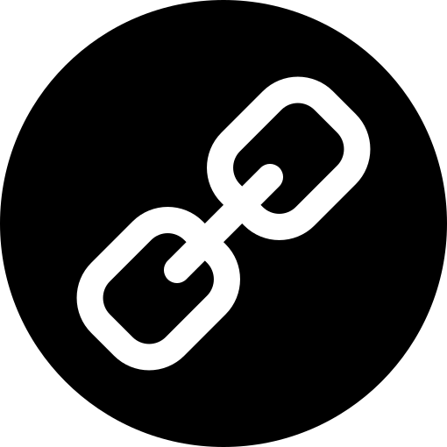
BOTTLENECK
A2A
MCP
CrewAI
ADK
Objectives & Deliverables
OBJECTIVES
• Detect supplier failures from email and structured events
• Coordinate grounded recovery decisions across agents
DELIVERABLES
• Live Cloud Run dashboard with approval workflow
• Auditable ADK + CrewAI outputs, evaluations and evidence
SLIDE 1

Slide 3
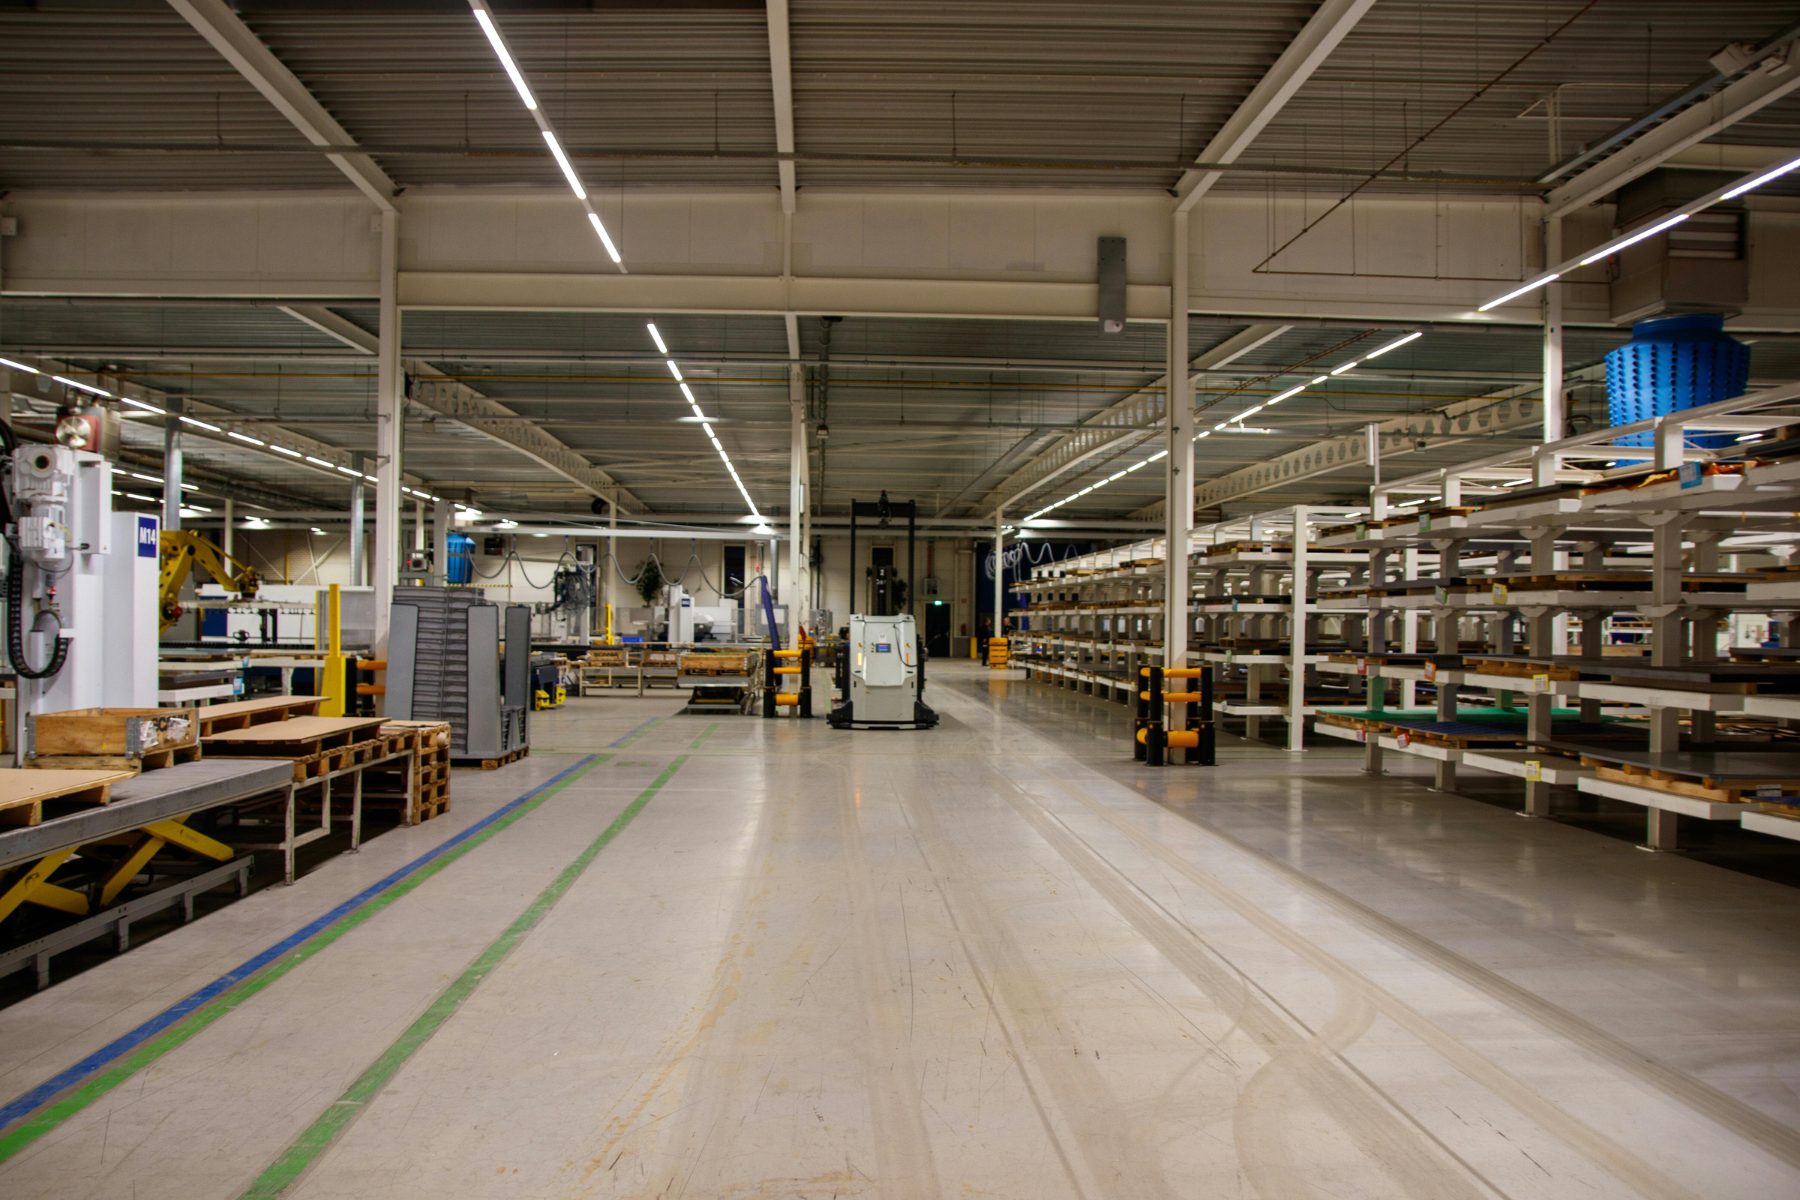

BOTTLENECK
A2A
MCP
CrewAI
ADK
Literature Review
PRODUCT / SERVICE | STRENGTH | GAP
SAP IBP | enterprise planning | limited agent transparency
Kinaxis | concurrent planning | proprietary orchestration
o9 | digital-brain analytics | costly deployment
Bottleneck | live agent evidence | academic synthetic scope
Sources: vendor documentation and framework specifications; full citations on Slide 11.
SLIDE 2

Slide 4

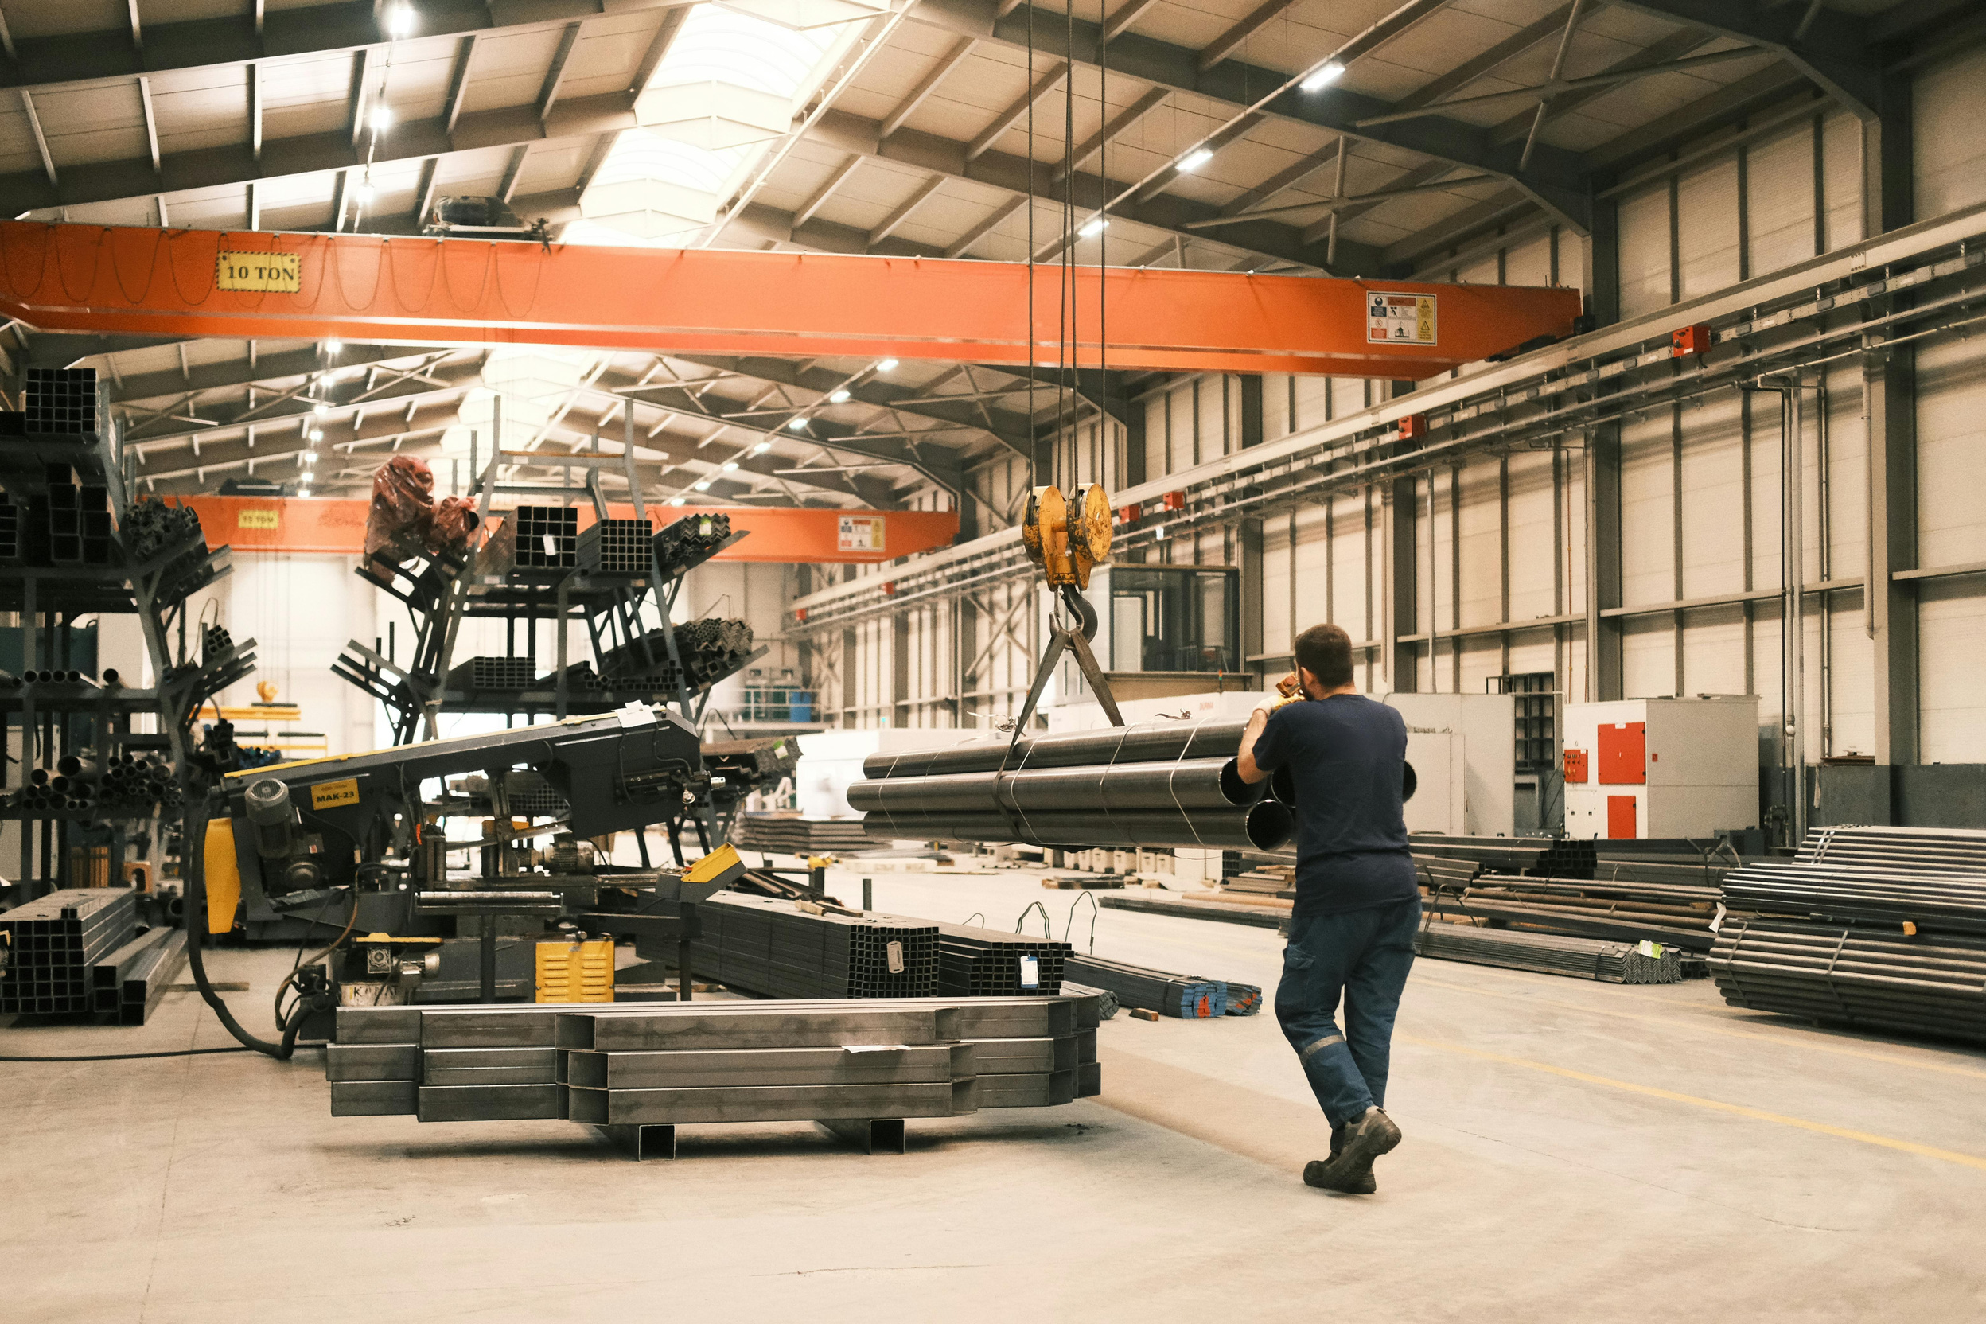
BOTTLENECK
A2A
MCP
CrewAI
ADK
Multi-Agent Architecture
EMAIL / EVENT → ADK TRIAGE
↓ shared Session State
SUPPLIER ─┬─ LOGISTICS ─┬─ INVENTORY ─┬─ PRODUCTION
└──── parallel fan-out / join ────┘
ADK state supervisor → deterministic risk → conditional A2A supplier research → recovery planning → reflection → human approval
Patterns: sequential, parallel, routing, reflection, bounded replanning, memory, HITL.
Next Slide

Slide 5
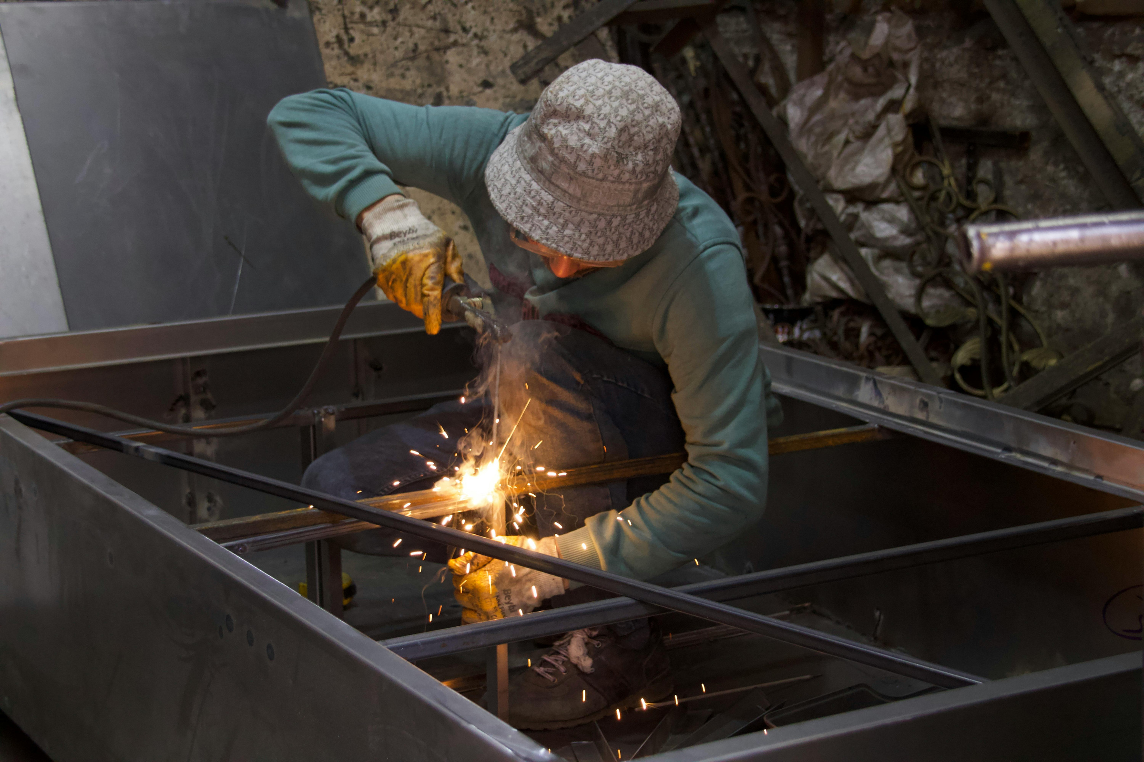

BOTTLENECK
A2A
MCP
CrewAI
ADK
Agent–Tool Communication · MCP
ADK Supplier Agent ──MCP stdio──▶ lookup_supplier / lookup_supplier_orders
ADK Logistics Agent ──MCP stdio──▶ lookup_order_shipments / calculate_delay_days
Validated tool result → callback → evidence store → shared state
All tools are read-only, typed and source-labelled.
Next Slide

Slide 6

BOTTLENECK
A2A
MCP
CrewAI
ADK
Agent–Agent Communication · A2A
GOOGLE ADK Alternative-Supplier Agent
│ JSON-RPC 2.0 · A2A v0.3
▼
CREWAI A2A ENDPOINT /a2a
Researcher → Analyst → Reviewer
Agent Card: /a2a/.well-known/agent-card.json
Request: component + quantity + shared evidence
Response: Pydantic candidate list + role outputs
Interoperability boundary is separately addressable and auditable.
Next Slide

Slide 7

BOTTLENECK
A2A
MCP
CrewAI
ADK
INPUT GUARDRAILS
Prompt-injection patterns · threat/toxicity checks · input-size limits · secret redaction
TOOL SAFEGUARDS
Allow-listed read-only tools · typed arguments · schema validation · timeout/retry bounds
CALLBACKS & VALIDATION
before_model_callback · before_tool_callback · after_tool_callback
Pydantic contracts · constraint engine · reflection gate · human approval
Secrets remain in Google Secret Manager; no credential is committed.
Securing the Agentic System
Next Slide

Slide 8
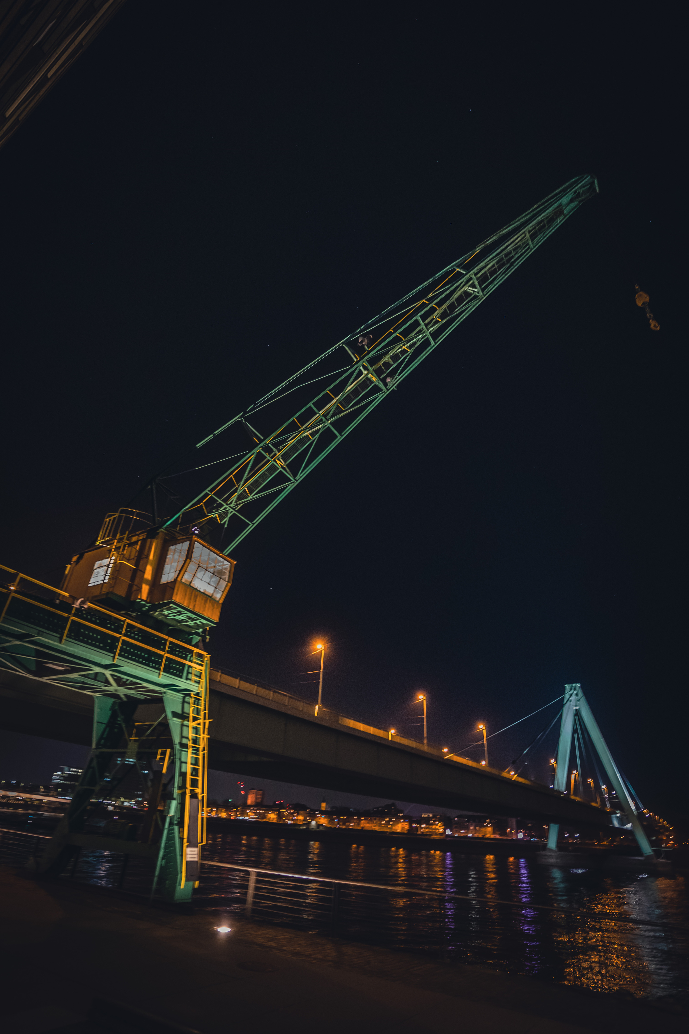
BOTTLENECK
A2A
MCP
CrewAI
ADK
Deployment Architecture
USER BROWSER
│ HTTPS
▼
GOOGLE CLOUD RUN · asia-south2
FastAPI + vanilla HTML/CSS/JS + ADK agents + CrewAI A2A + MCP server
├─ Gemini API (Secret Manager)
└─ revision-local seeded SQLite
CI/CD: GitHub main → Cloud Build trigger → Cloud Run revision
Zero-cost controls: min instances 0 · max instances 1 · request billing
Demo URL: bottleneck-545600829568.asia-south2.run.app
Next Slide

Slide 9

BOTTLENECK
A2A
MCP
CrewAI
ADK
Team Responsibility / Self-Contribution
EQUAL CONTRIBUTION — 25% EACH
Aastha Thakur (230552) | Agent design, multi-agent architecture, orchestration, state management
Shivani (Enrollment) | MCP design, A2A communication, guardrails and callbacks
Mayank (Enrollment) | Observability, integration and testing, evaluation and documentation
Lokesh (Enrollment) | Interface UI, deployment, live-demo validation and release quality
All four members: equal 25% contribution. Insert the three pending enrollment numbers before submission.
Next Slide

Slide 10

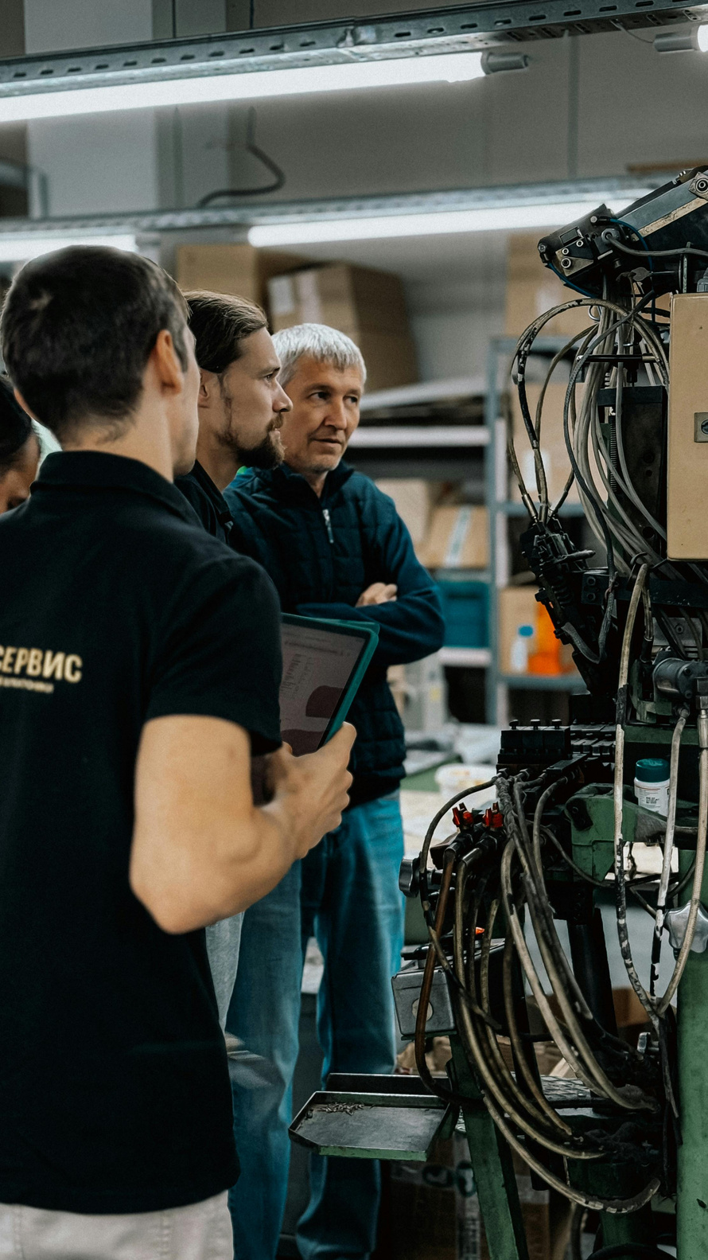
BOTTLENECK
A2A
MCP
CrewAI
ADK
Working System · Live Evidence
LIVE CLOUD RUN CASE
Email → incident b49a4b5e… → 28 agent/tool events → WAITING_FOR_APPROVAL
10-day delay · 1,280-unit shortage · 12.8-day modeled downtime
Selected recovery: SUP-B 450 + SUP-D 250 + SUP-C 300
EVALUATION
3/3 scenarios · 6/6 tools · 41/41 structured outputs
37.335 s end-to-end · $0.001609 estimated model cost
Next Slide

Slide 11
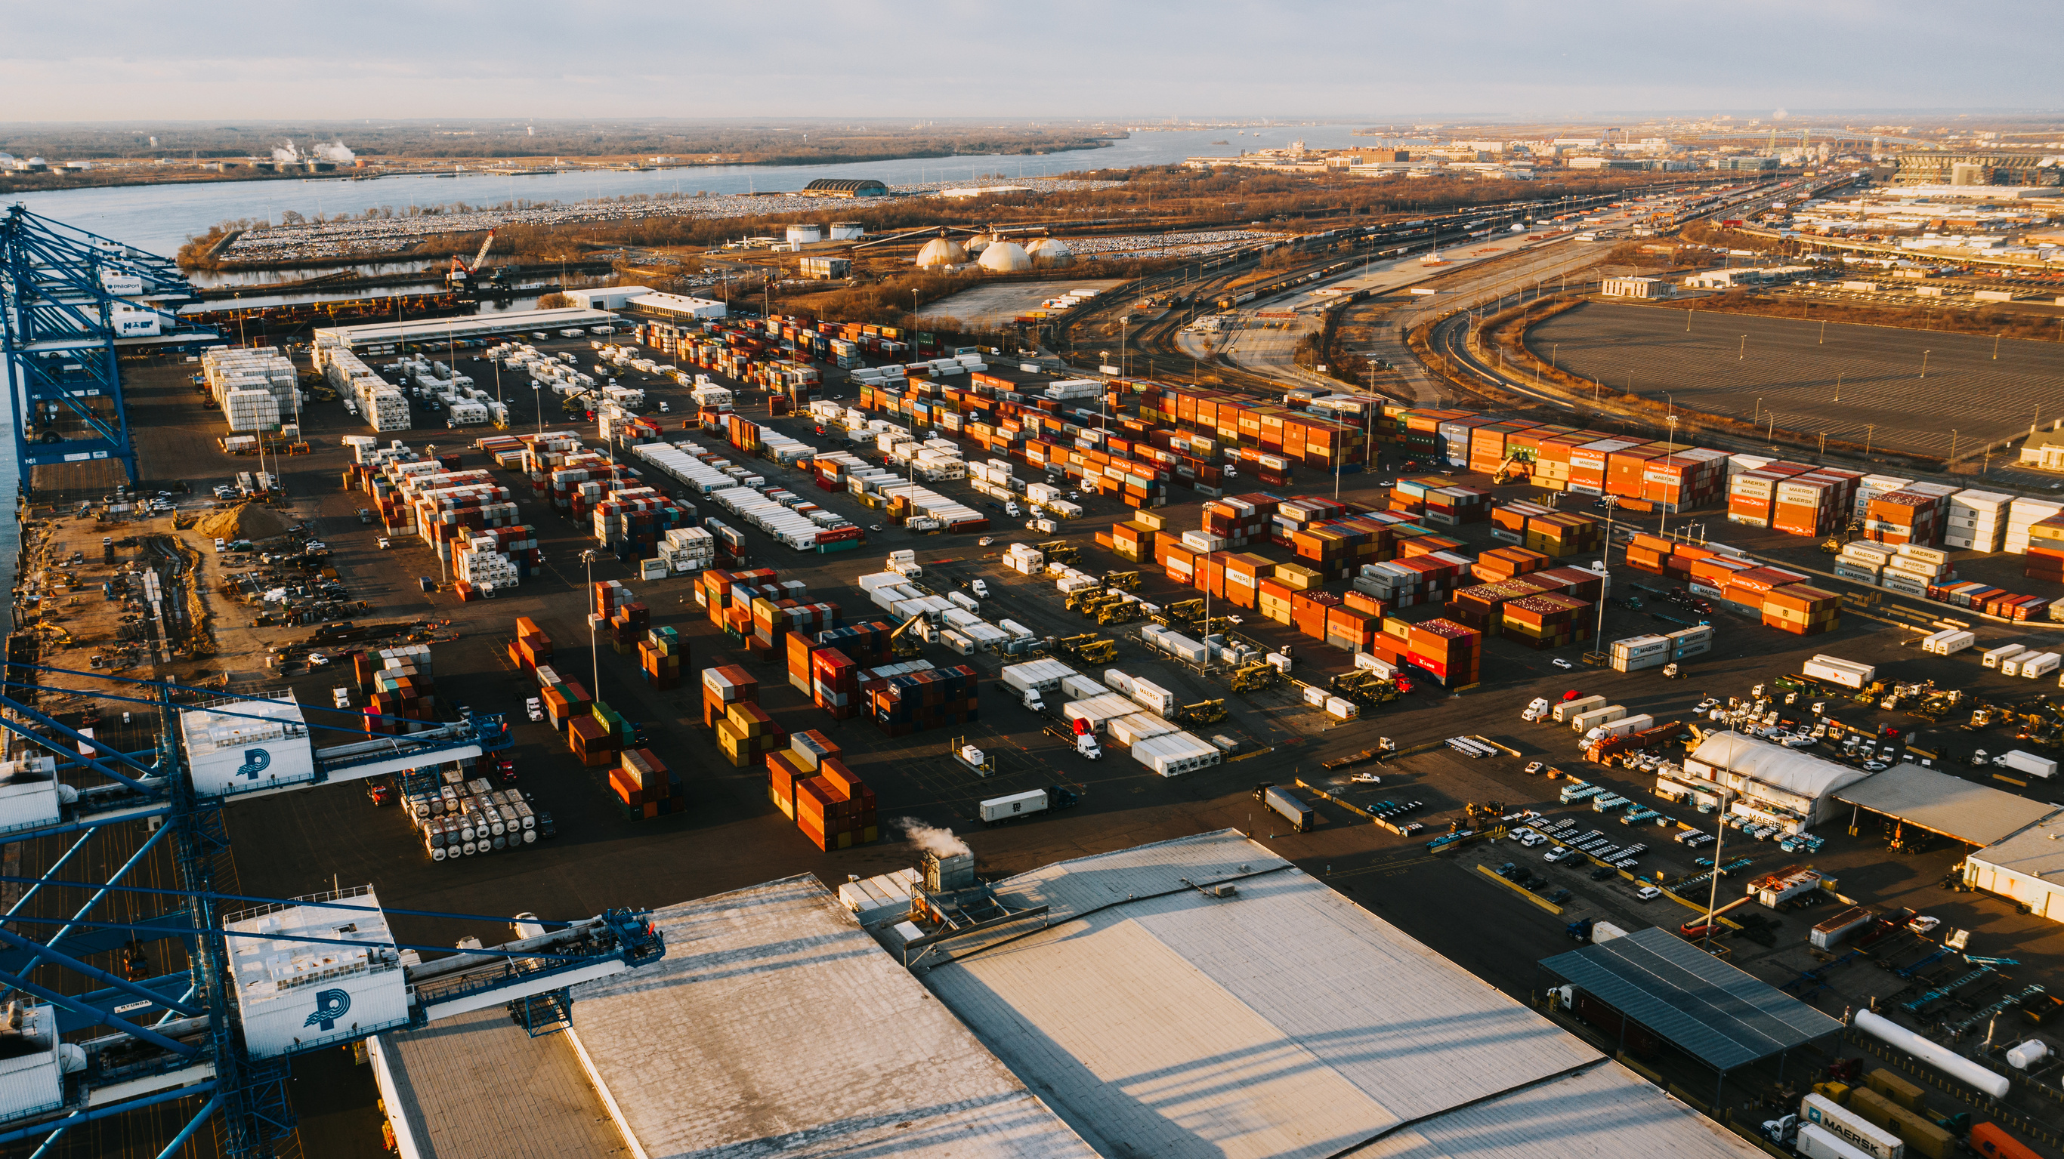

BOTTLENECK
A2A
MCP
CrewAI
ADK
Conclusions
• End-to-end supplier-failure recovery is deployed and independently demonstrable from Cloud Run.
• Google ADK shared-state orchestration and CrewAI specialist research interoperate through A2A.
• MCP tools, Pydantic contracts, callbacks, guardrails and provenance make every decision auditable.
MEASURED RESULT
100% completion, tool, grounding, structured-output, constraint and routing rates across the deterministic evaluation suite.
Scope: synthetic demonstration data; Cloud Run SQLite is revision-local.
Next Slide

Slide 12
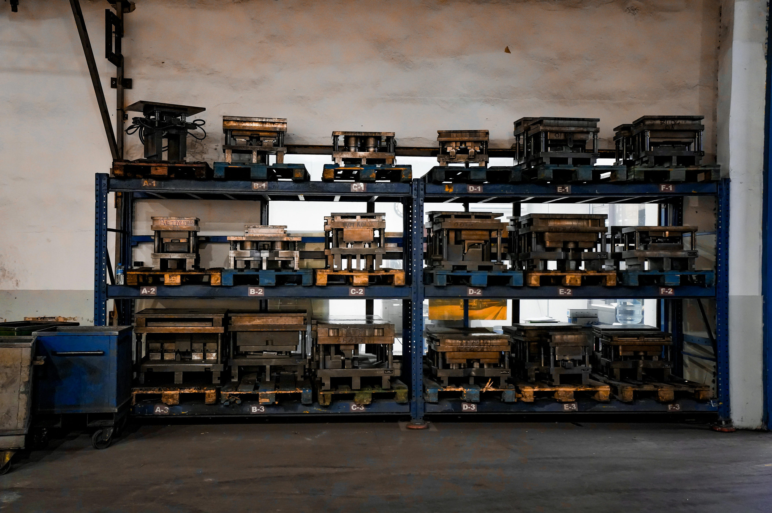

BOTTLENECK
A2A
MCP
CrewAI
ADK
References
[1] Google, Agent Development Kit documentation, 2026.
[2] CrewAI, Documentation, 2026.
[3] Linux Foundation, Agent2Agent Protocol Specification v0.3.
[4] Model Context Protocol, Specification, 2025–2026.
[5] Pydantic, Documentation v2.
[6] Google Cloud, Cloud Run documentation.
[7] FastAPI documentation.
[8] SAP IBP product overview.
[9] Kinaxis Maestro platform overview.
[10] o9 Solutions Digital Brain overview.
Repository: github.com/thakuraastha/Bottleneck
Next Slide

