Slide 1
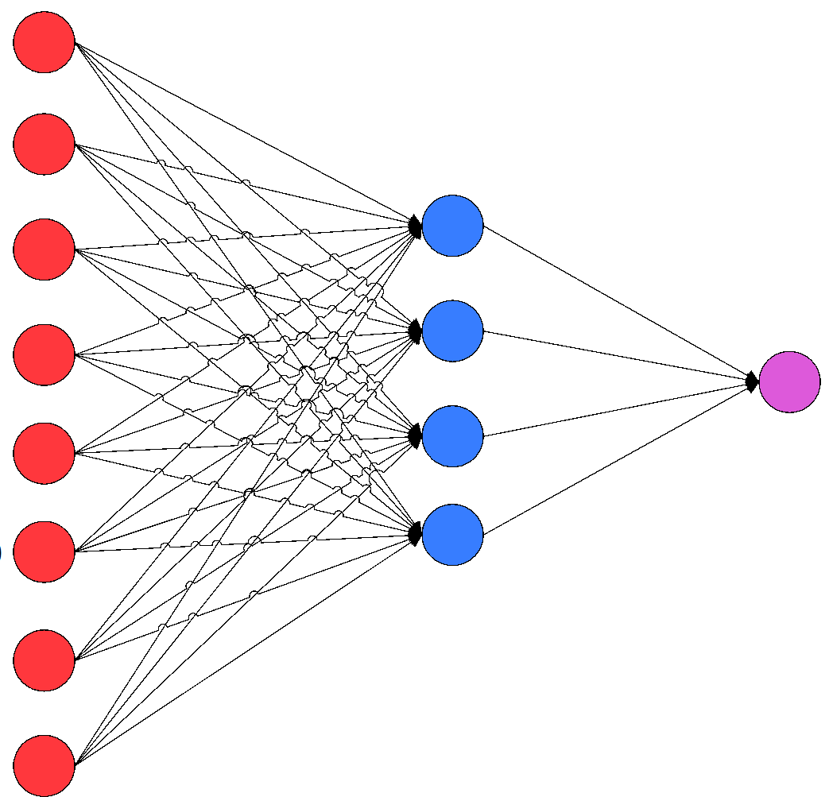
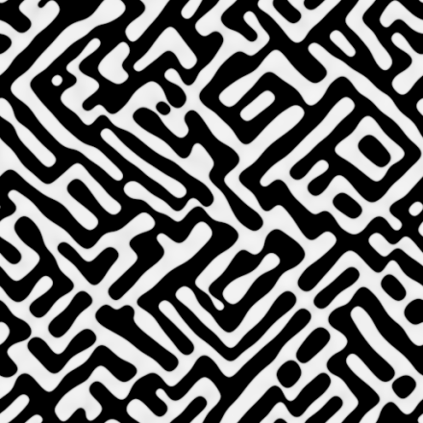
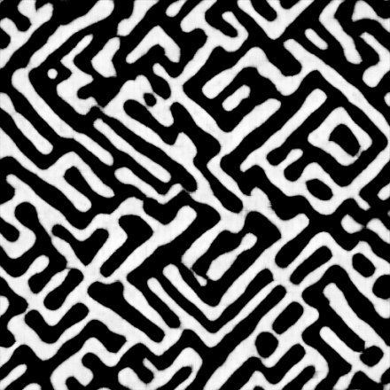
Statistical learning and modelling on Microstructural dataset
Abhishek Kumar Thakur
Materials Science & Engineering

Slide 2
Contents
Introduction
Microstructure
Data source
Supervised learning
Methodology
Results
Unsupervised learning
Methodology
Results
References

Slide 3
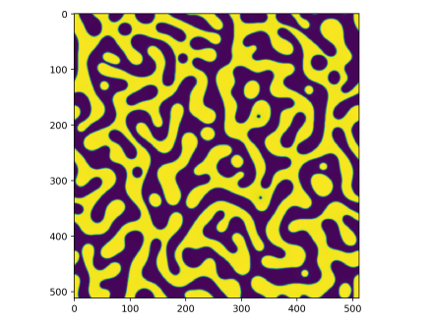
Introduction
Phase field code
Matrix
Precipitate
Input parameters & number of images
-1 <= Composition <= 1
-1 <= Precipitate <= 0
0 <= Matrix <= 1

Slide 4
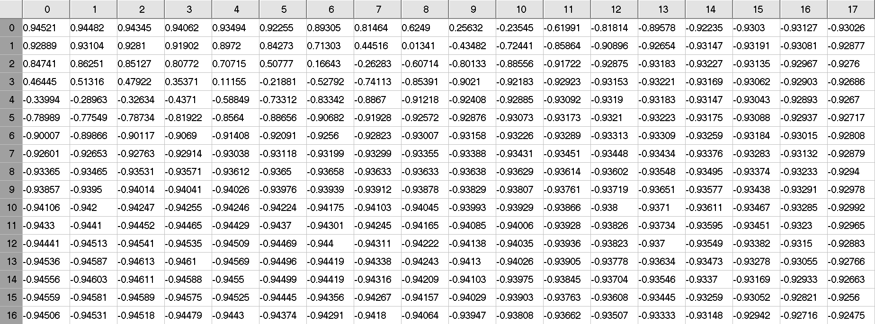
Microstructure
Elasticity constants (c110, c120 & c440)
Externally applied strain
Elastic energy factor etc.
Number of Images used = 128 × 128 × 200

Slide 5
Supervised learning

Slide 6
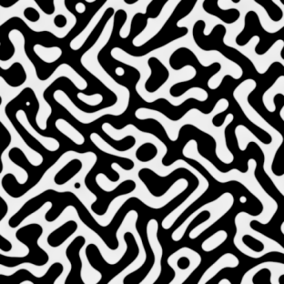
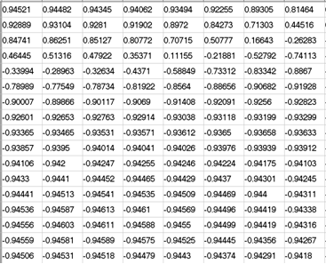
Supervised learning
256 × 256
128 × 128
64 × 64
32 × 32
16 × 16
8 × 8
4 × 4
Input Image 512 × 512 × 1
Stride = 2 Padding = 1
Convolutional Neural Network
8 Layers

Slide 7
Supervised learning
Layer 1
Upto 7 layers
Input image
Convolution
Batch Normalization
ReLU
… … … …
Output
Tanh activation
Convolution
Layer 8

Slide 8
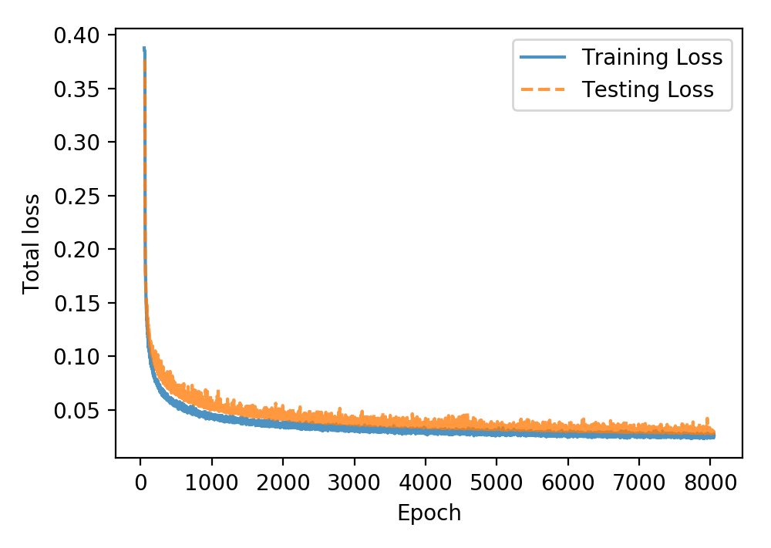
Supervised learning
Number of images used for training = 1648
Number of images used for testing = 400

Slide 9
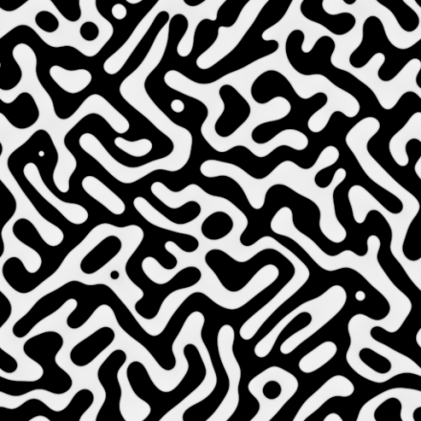
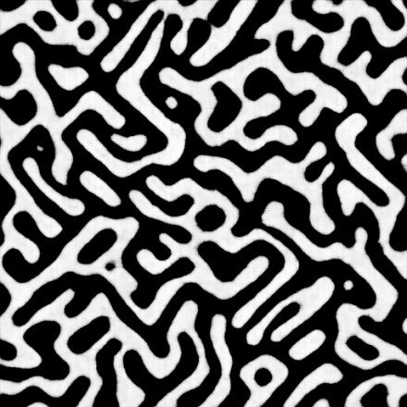
Supervised learning
Analysis of microstructures (Efficiency of prediction):
Using composition data
Using ImageJ software
Using random lines method
Original data
Neural network prediction

Slide 10
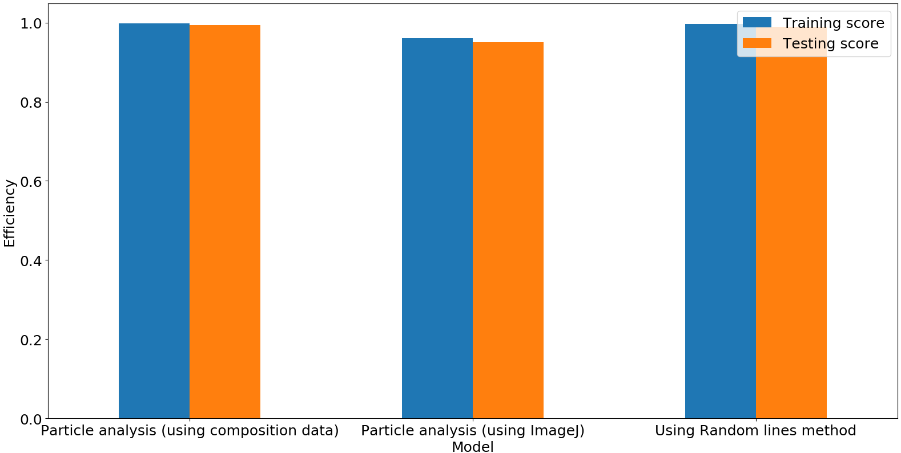
Supervised learning

Slide 11
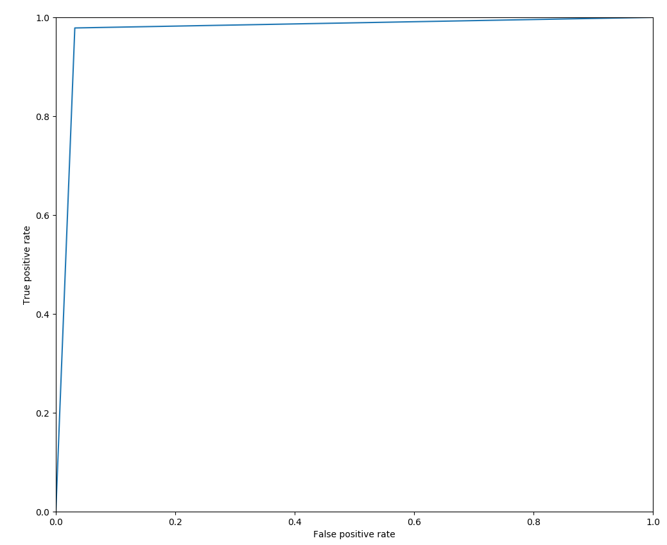
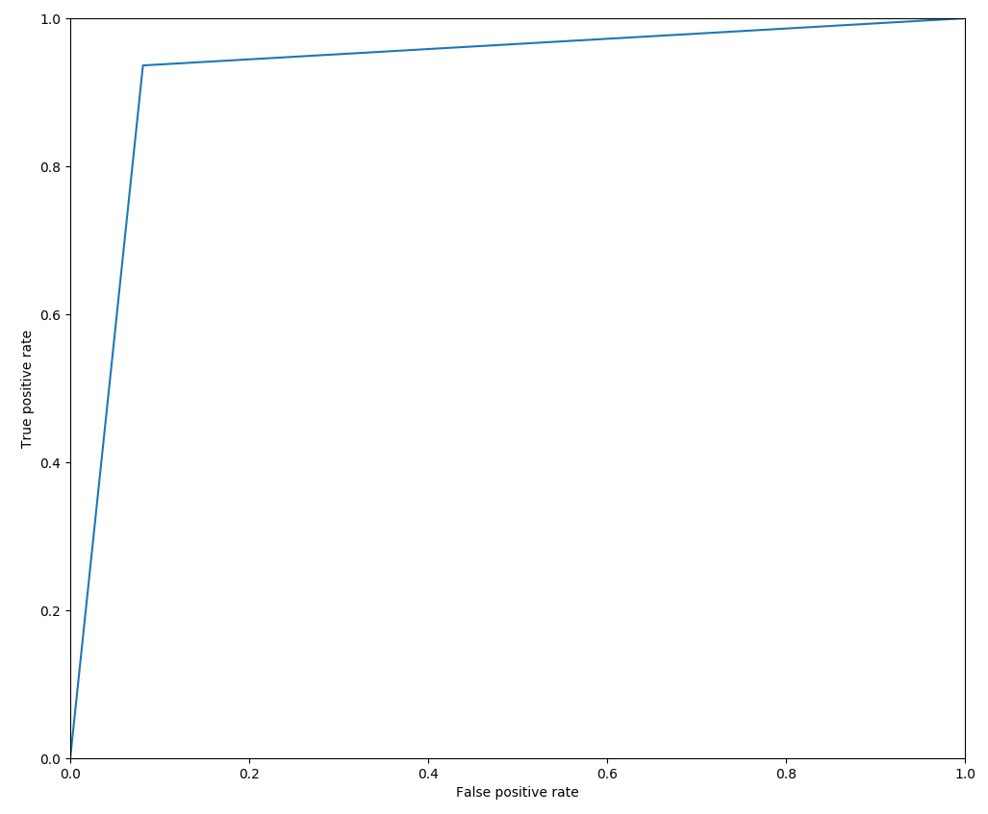
Supervised learning
Training (c110 = 1064, c120 = 532, c440 = 266, c111 = c121 = c441 = 0, x-strain = y-strain = 0)
Area under curve = 0.9734
Testing (c110 = 1000, c120 = 462, c440 = 269, c111 = c121 = c441 = 0, x-strain = y-strain = 0)
Area under curve = 0.9275
Figure: ROC curve for training and test cases.

Slide 12
Unsupervised learning

Slide 13
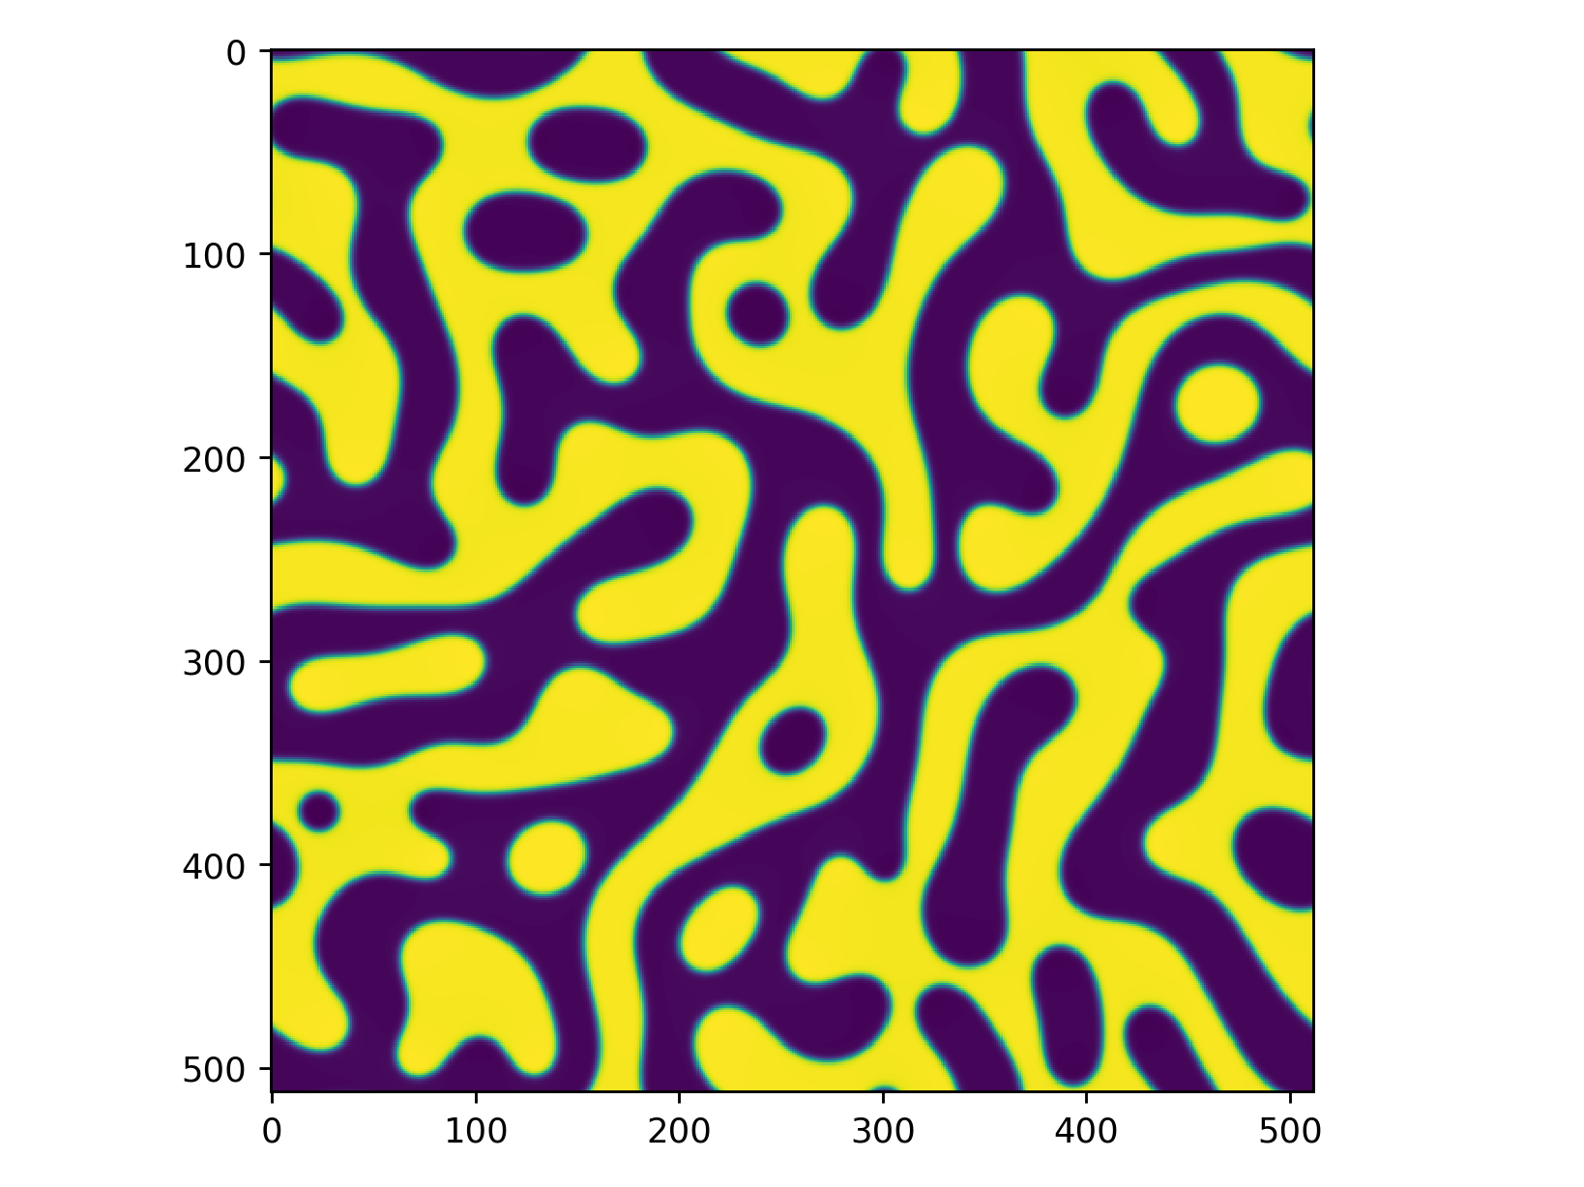
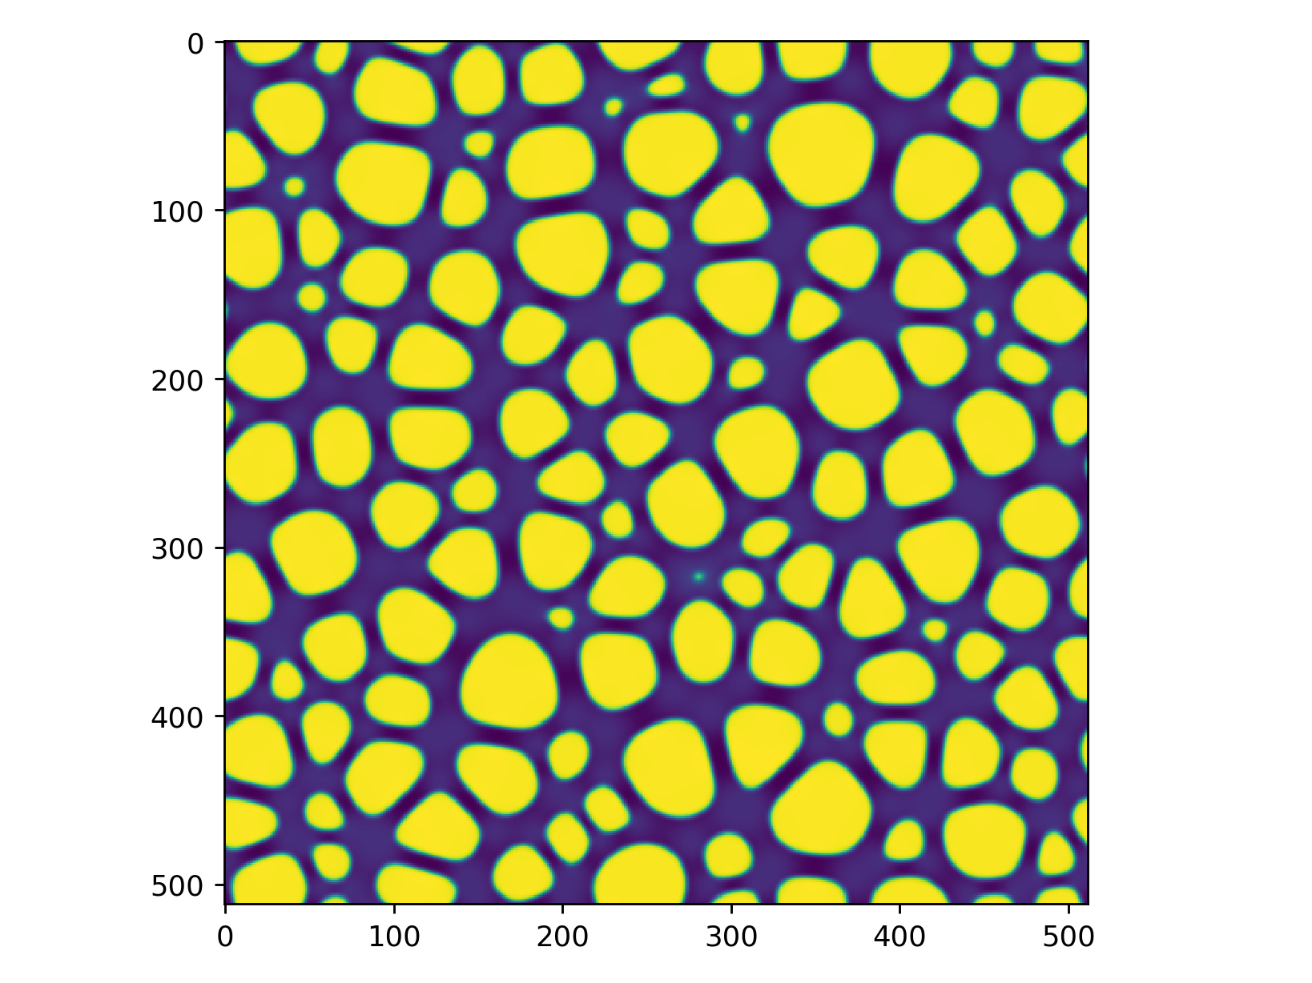
Unsupervised learning
Homogeneous microstructure
Heterogeneous microstructure
Elasticity constant difference between the 2 phases is Zero.
Elasticity constant difference between the 2 phases is Non-Zero.
c111 = c121 = c441 = 0
c111, c121 & c441 ≠ 0
No. of images used = 300
No. of images used = 300

Slide 14
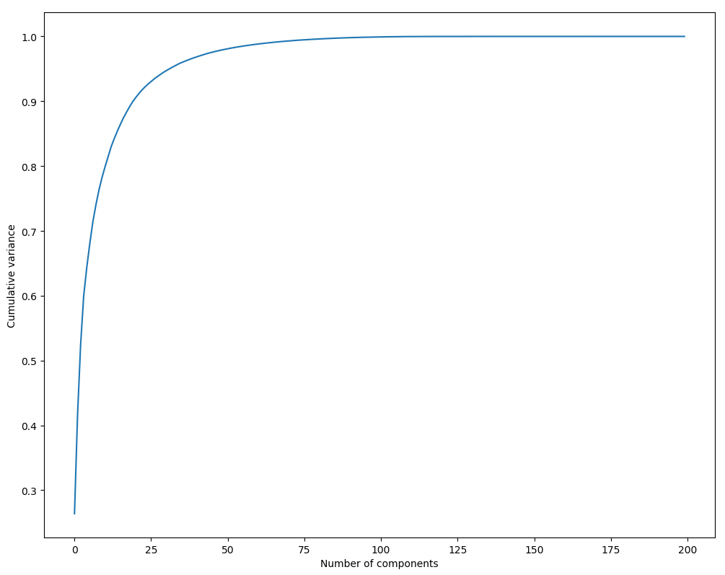
Unsupervised learning
Principle component analysis
About 50 components covers more than 95% of the variance

Slide 15
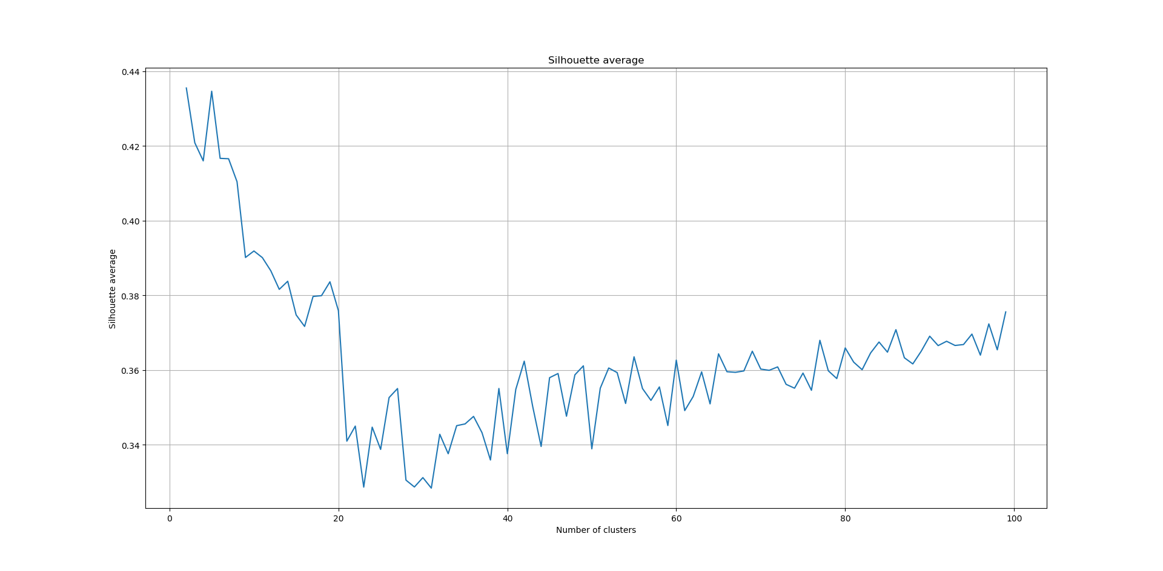
Unsupervised learning
K-Means clustering

Slide 16
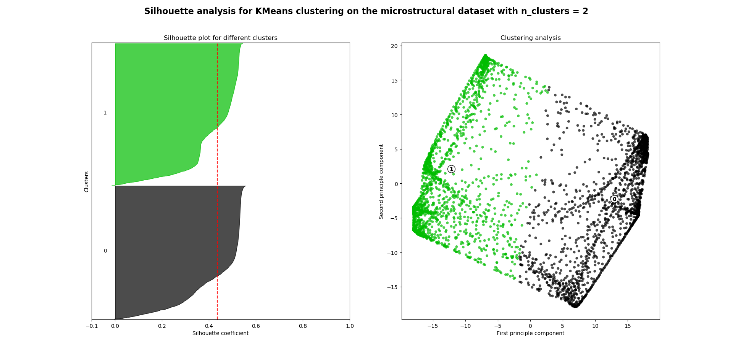
Unsupervised learning
K-Means clustering
Optimal number of clusters = 2

Slide 17
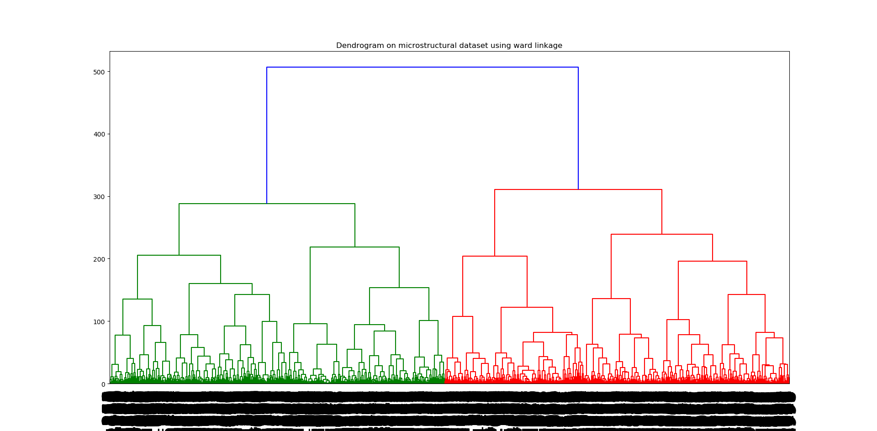
Unsupervised learning
Hierarchical clustering

Slide 18
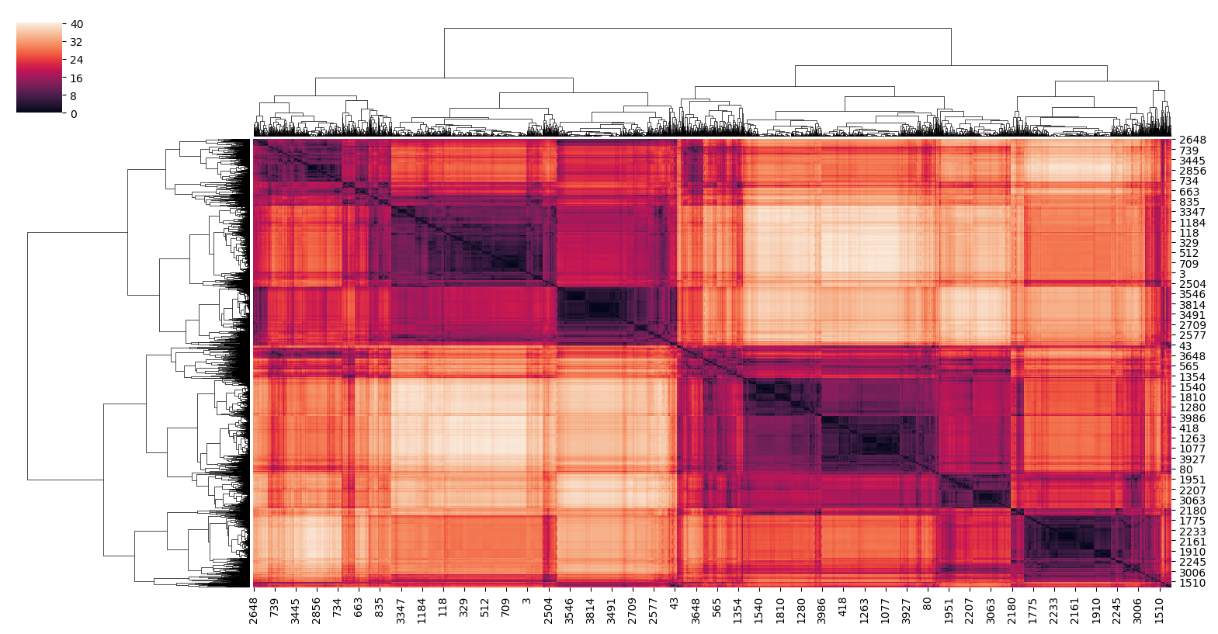
Using distance matrix
Distance between different images
Distance between same image

Slide 19
Further plan
To include classification methods.
To include association rules.

Slide 20
References
[1] Jingzhi Zhu et al 2001 Modelling Simul. Mater. Sci. Eng. 9 499
[2] Y. LeCun, L. Bottou, Y. Bengio, and P. Haffner, “Gradient-based learning applied to document recognition,” Proceedings of the IEEE, vol. 86, no. 11, pp. 2278–2324, 1998.
[3] B. B. Le Cun, J. S. Denker, D. Henderson, R. E. Howard, W. Hubbard, and L. D. Jackel, “Handwritten digit recognition with a backpropagation network,” in Advances in neural information processing systems. Citeseer, 1990.
[4] Khachaturyan A G 1983 Theory of structural transformations in Solids (New York: Wiley)
[5] Cahn J W 1961 Acta. Metall. 9 795

Slide 21
THANKS

