Slide 1
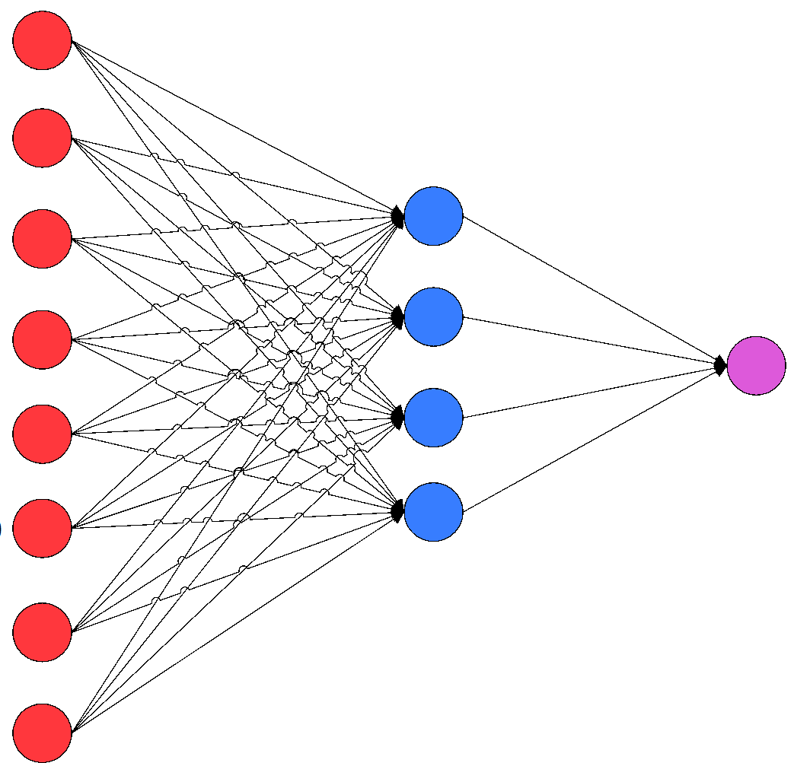

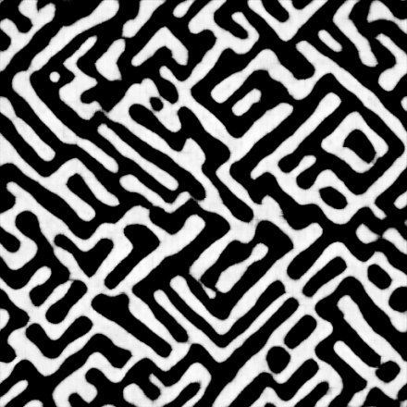
Statistical learning and modelling on Microstructural dataset
Abhishek Kumar Thakur
Materials Science & Engineering

Slide 2
Contents
Microstructure
Introduction
Data source
Supervised learning
Methodology
Results
Unsupervised learning
Methodology
Results
References

Slide 3
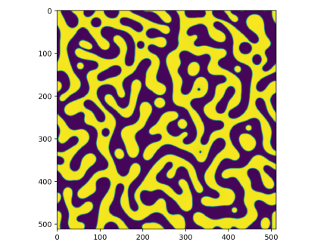
Microstructure
Phase field code
Matrix
Precipitate
Input parameters & number of images
-1 <= Composition <= 1
-1 <= Precipitate <= 0
0 <= Matrix <= 1

Slide 4
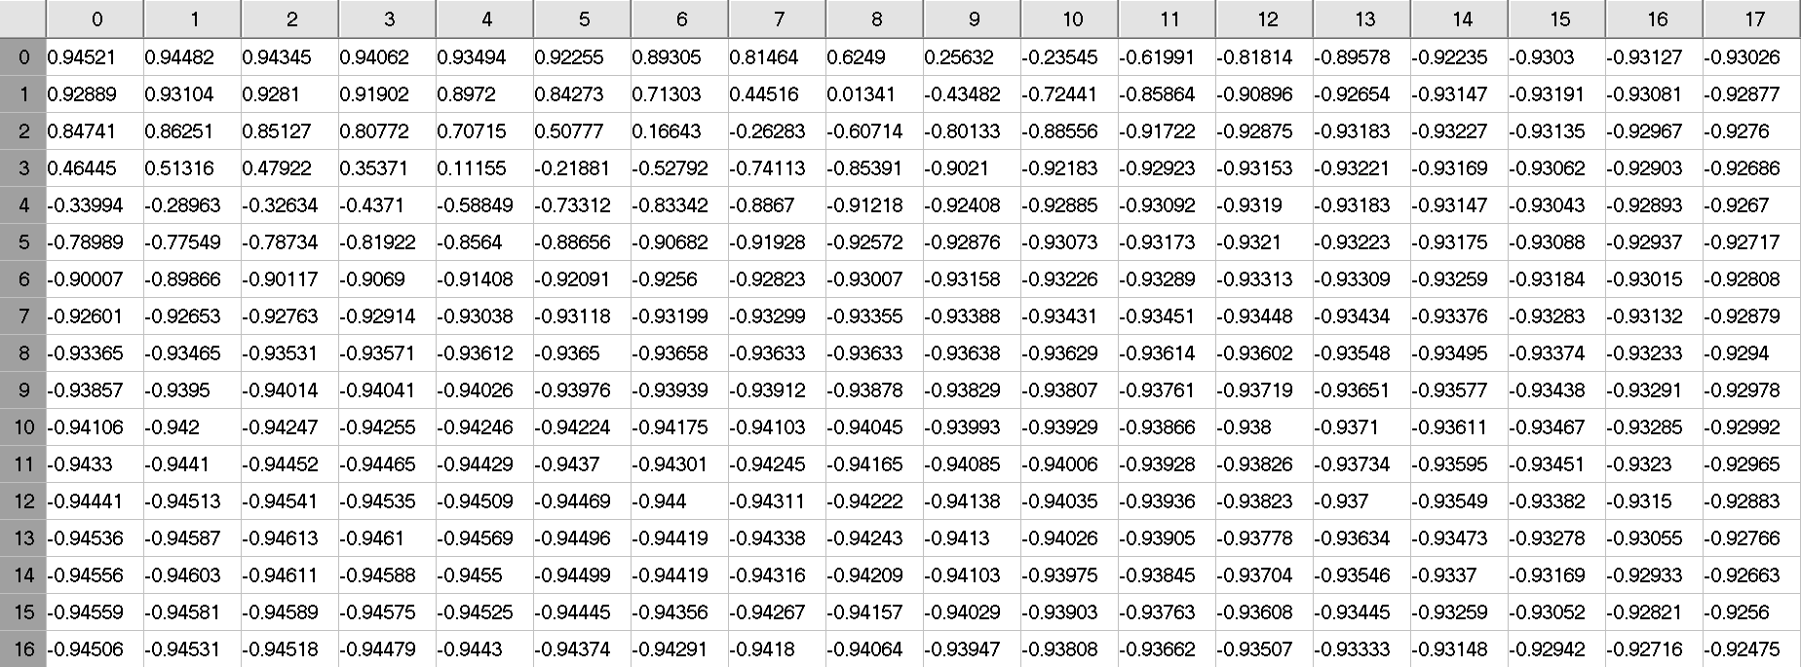
Microstructure
Elasticity constants (c110, c120 & c440)
Externally applied strain
Elastic energy factor etc.
Number of Images used = 128 × 128 × 200

Slide 5
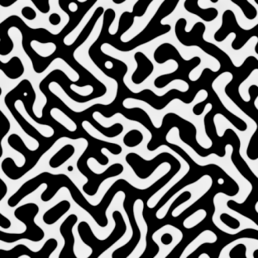
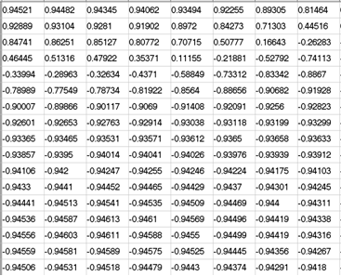
Supervised learning
256 × 256
128 × 128
64 × 64
32 × 32
16 × 16
8 × 8
4 × 4
Input Image 512 × 512 × 1
Stride = 2 Padding = 1
Convolutional Neural Network
8 Layers

Slide 6
Supervised learning
Layer 1
Upto 7 layers
Input image
Convolution
Batch Normalization
ReLU
… … … …
Output
Tanh activation
Convolution
Layer 8

Slide 7
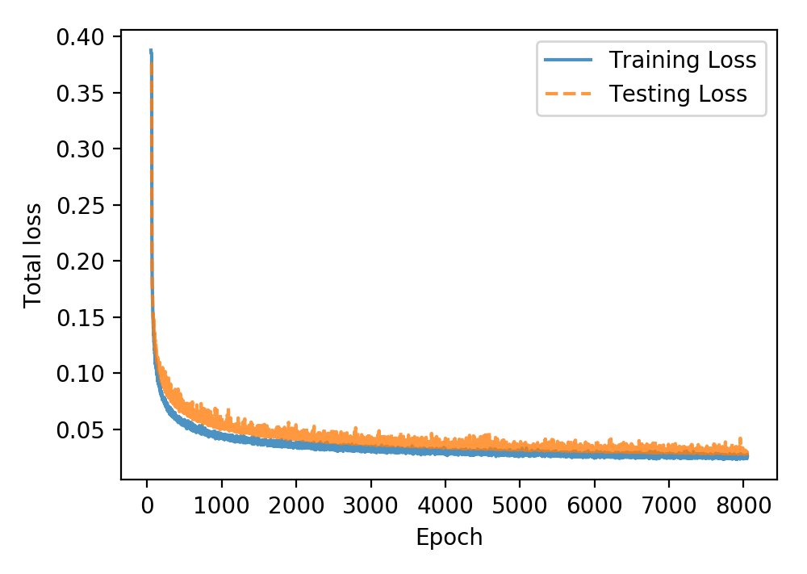
Supervised learning
Number of images used for training = 1648
Number of images used for testing = 400

Slide 8
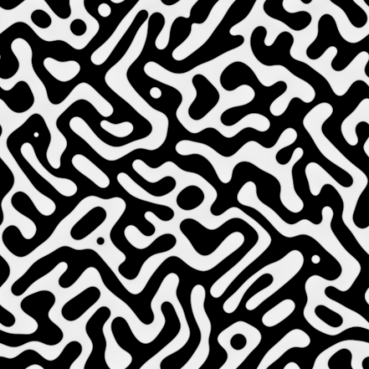
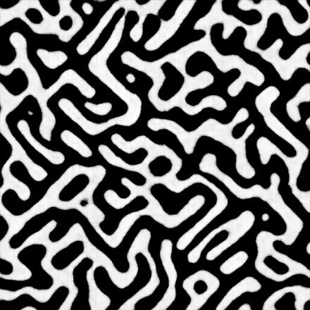
Supervised learning
Analysis of microstructures (Efficiency of prediction):
Using composition data
Using ImageJ software
Using random lines method
Original data
Neural network prediction

Slide 9
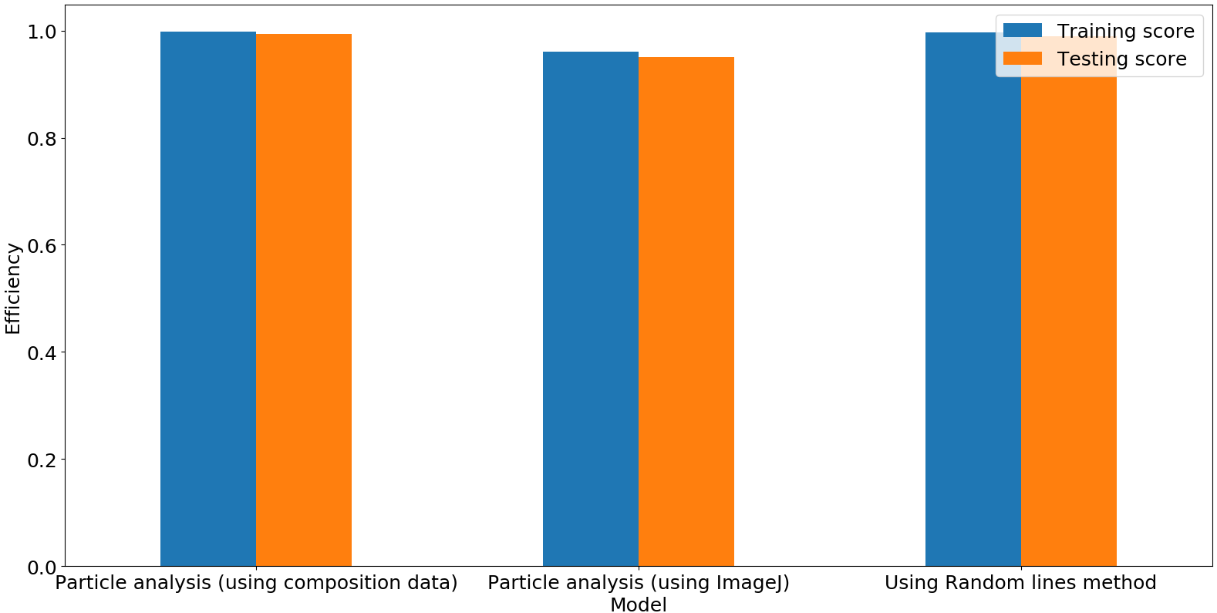
Supervised learning

Slide 10
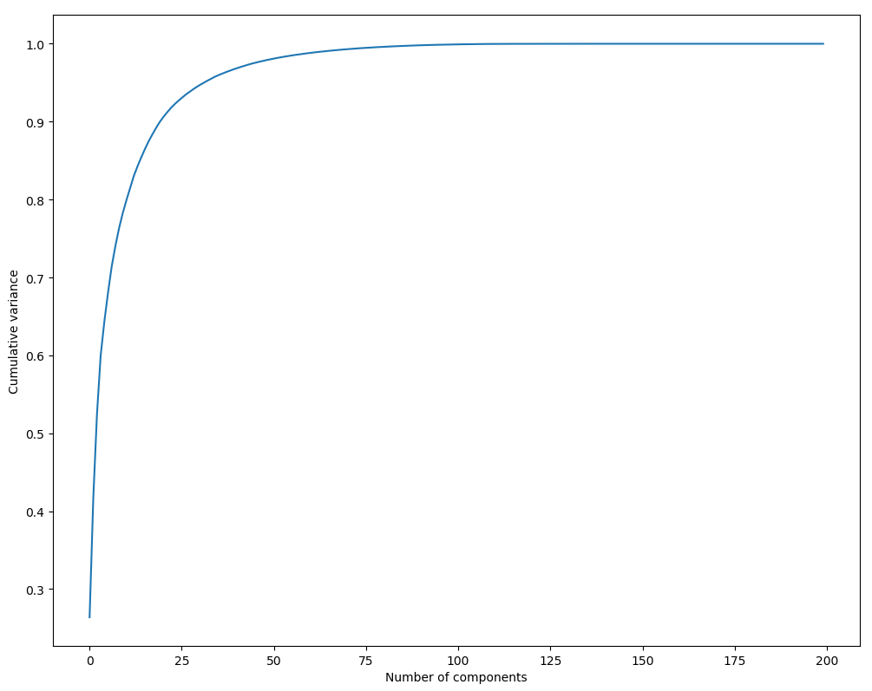
Unsupervised learning
Principle component analysis on the whole dataset
50 components covers more than 95% of the variance

Slide 11
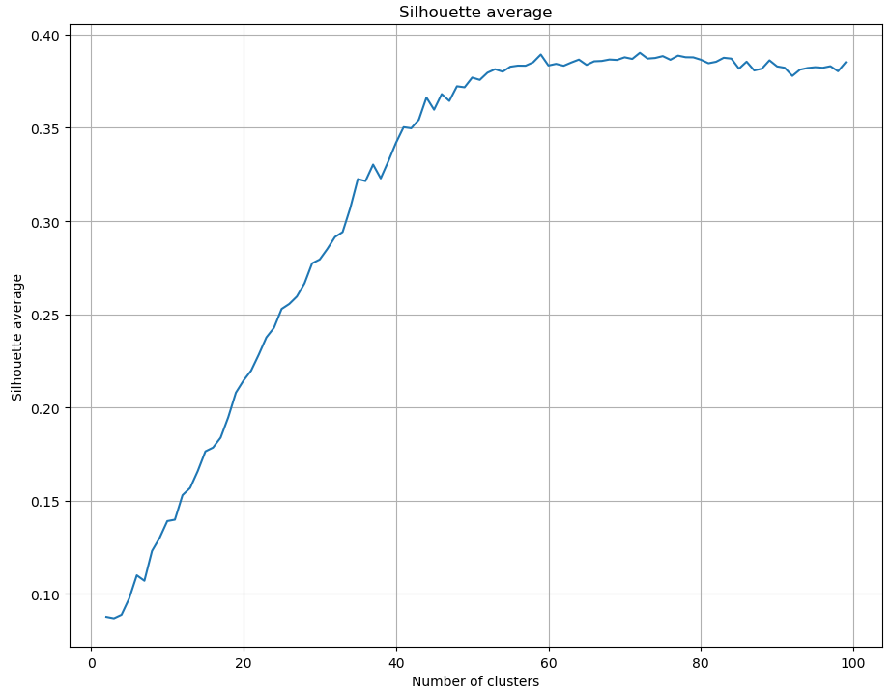
Unsupervised learning
K-Means clustering on single image
Optimal number of clusters = 72

Slide 12
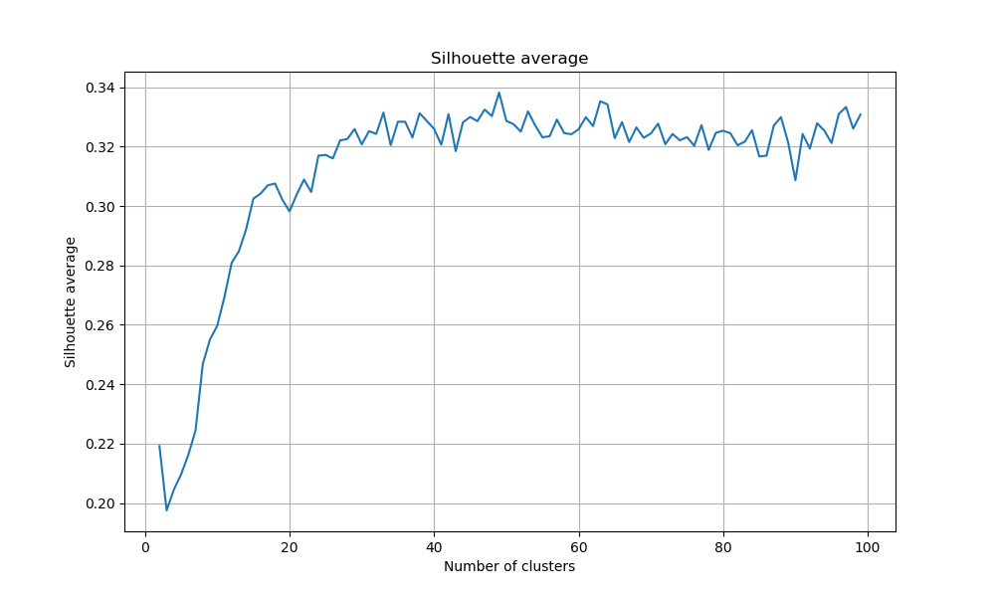
Unsupervised learning
K-Means clustering on the whole dataset
Optimal number of clusters = 49

Slide 13
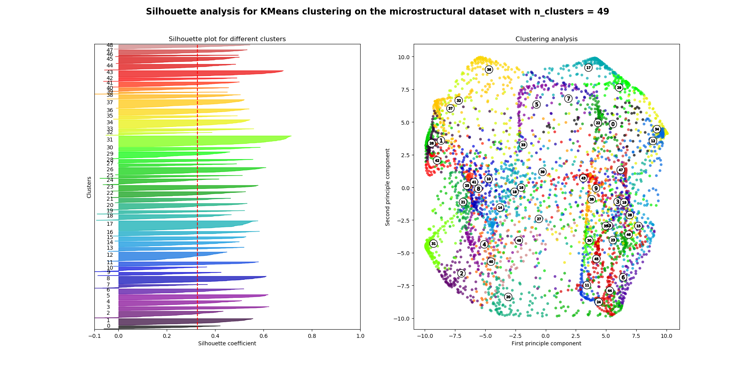
Unsupervised learning
K-Means clustering on the whole dataset
Optimal number of clusters = 49

Slide 14
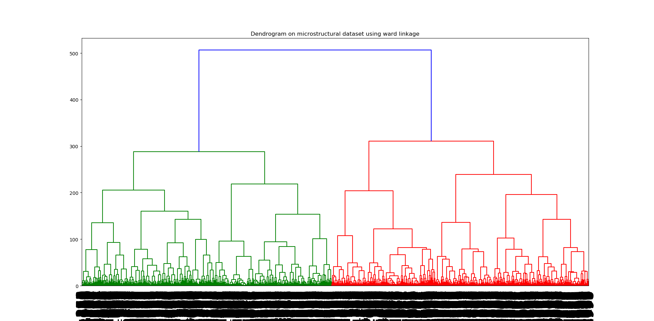
Unsupervised learning
Hierarchical clustering on the whole dataset

Slide 15
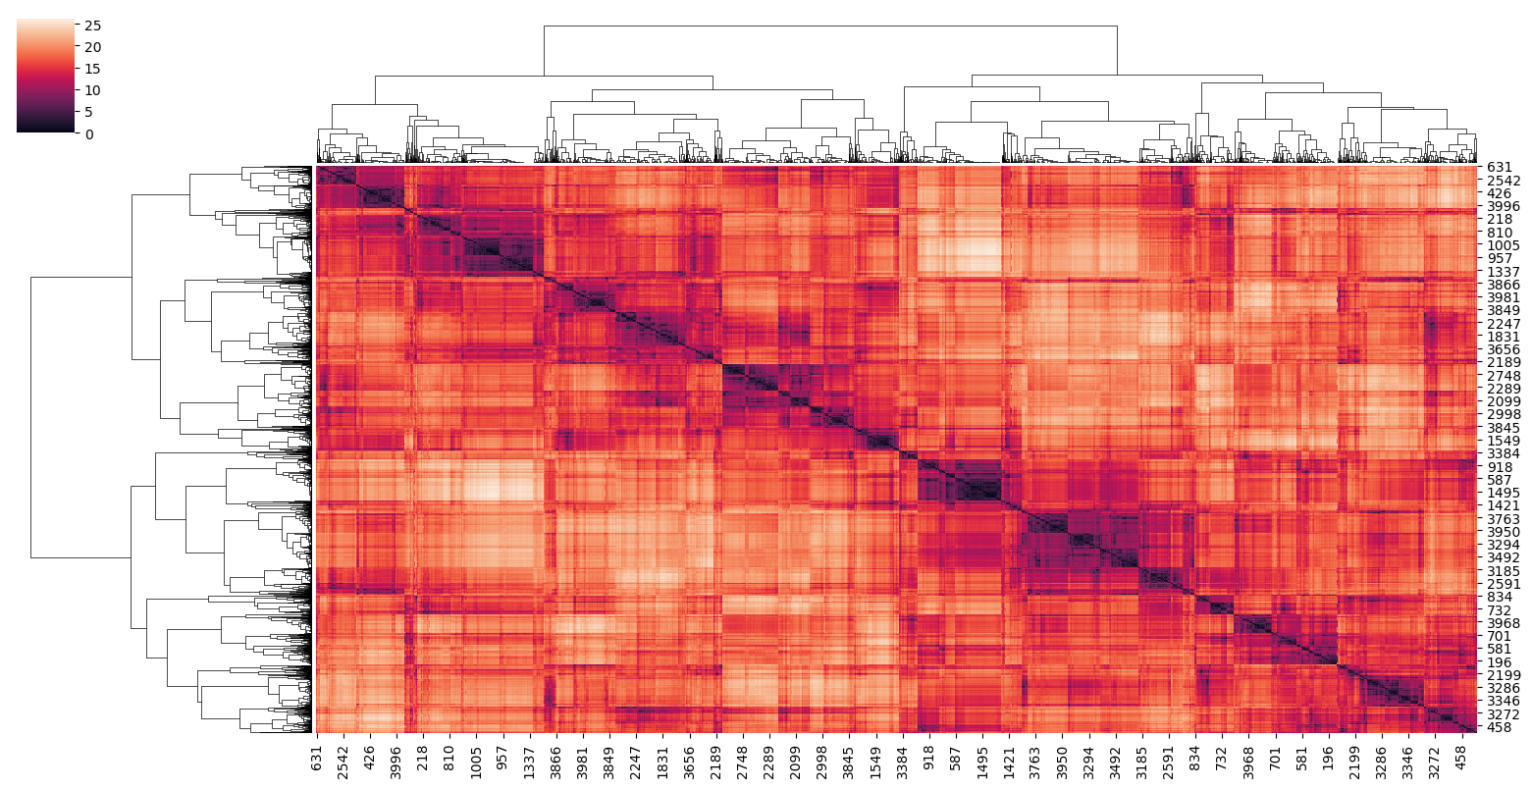
Using distance matrix
Distance between different images
Distance between same image

Slide 16
References
[1] Jingzhi Zhu et al 2001 Modelling Simul. Mater. Sci. Eng. 9 499
[2] Y. LeCun, L. Bottou, Y. Bengio, and P. Haffner, “Gradient-based learning applied to document recognition,” Proceedings of the IEEE, vol. 86, no. 11, pp. 2278–2324, 1998.
[3] B. B. Le Cun, J. S. Denker, D. Henderson, R. E. Howard, W. Hubbard, and L. D. Jackel, “Handwritten digit recognition with a backpropagation network,” in Advances in neural information processing systems. Citeseer, 1990.
[4] Khachaturyan A G 1983 Theory of structural transformations in Solids (New York: Wiley)
[5] Cahn J W 1961 Acta. Metall. 9 795

Slide 17
THANKS

