Slide 1
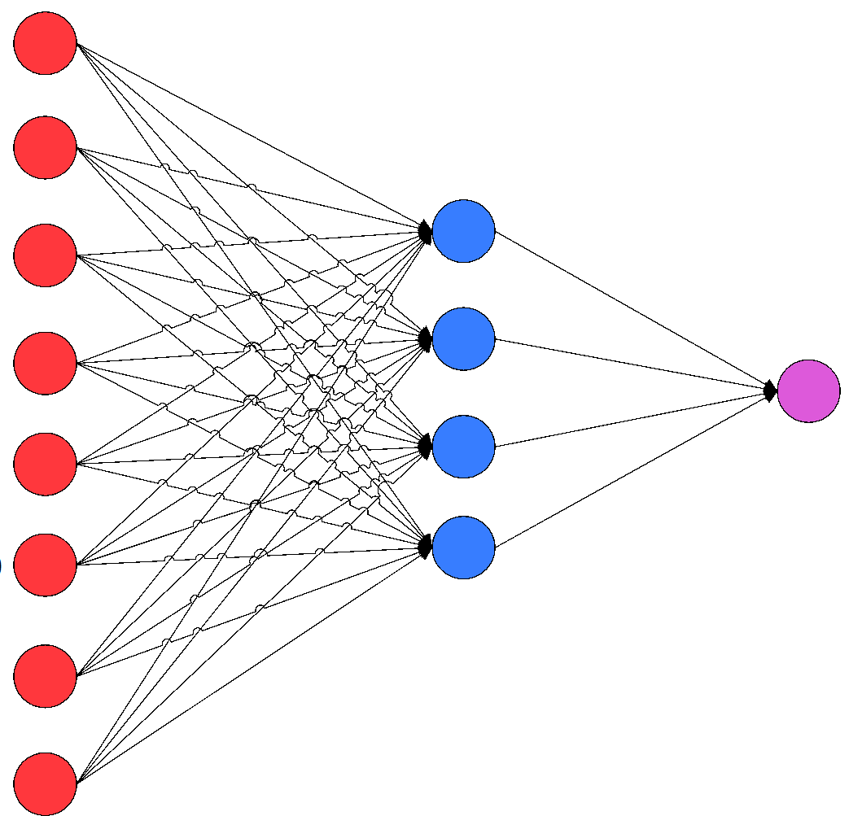
RECENT ADVANCES IN CONVOLUTIONAL NEURAL NETWORKS
Abhishek Kumar Thakur
Materials Science & Engineering

Slide 2
CONTENTS
Convolutional neural nets
How CNN works
Basic components of CNN
Improvements in CNN
Improvements in convolutional layer
Improvements in activation function
Improvements in loss function
Improvements in fast processing
Applications of CNN

Slide 3
CONVOLUTION NEURAL NETS (CNN)
CNN is first introduced by Yann LeCun et.al in 1998 and improved by B. B. LeCun in 1990.
Used widely for image recognition and classification.
Primary purpose is to extract features from input image.
4 major operations:
Convolution
Non-linearity (ReLU)
Pooling (sampling)
Classification

Slide 4
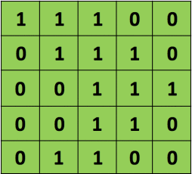
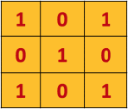
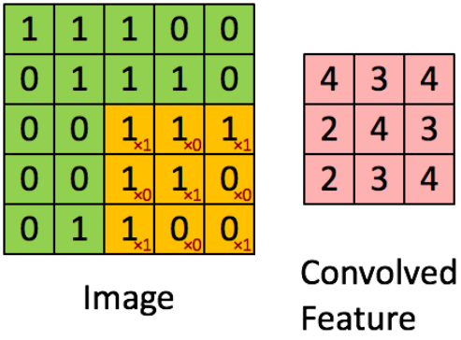
How CNN works ?
Input image
Filter

Slide 5
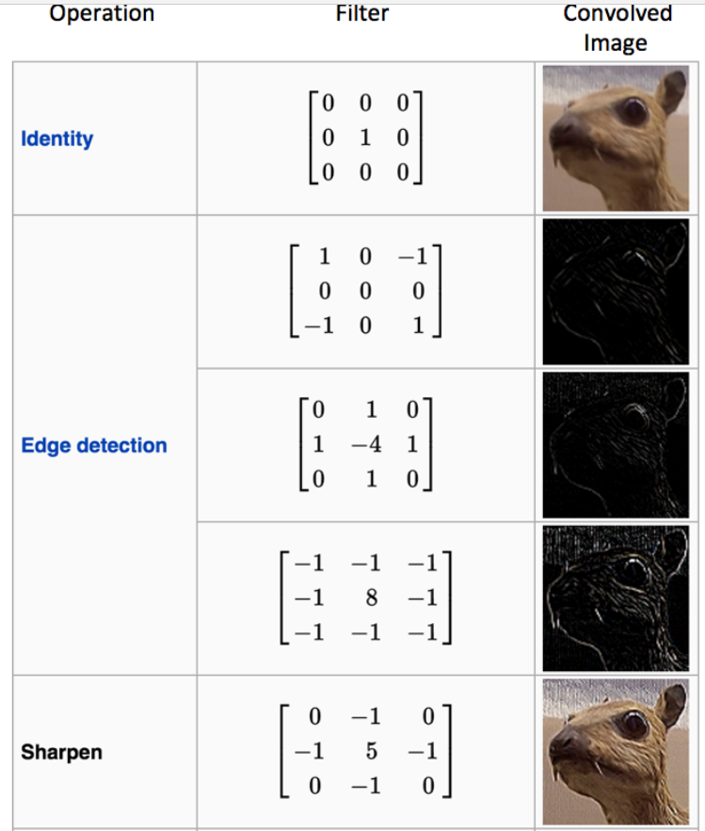
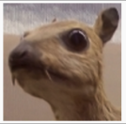
How CNN works ?

Slide 6
Basic components of CNN
Convolution layer
Pooling layer
Fully connected layer
To learn feature representation of input
To achieve spatial invariance by decreasing resolution
To perform high level reasoning

Slide 7
IMPROVEMENTS IN CNN

Slide 8
Improvements in Convolutional layer
Network in Network (NIN)
This is proposed by Lin et.al in 2013. This replaces the linear filter of the convolutional layer by a micro network which is capable of extracting more abstract information.
Inception Module
This is introduced by Szegedy et.al in 2014. It is a logical culmination of NIN which uses a variable filter size to compare different visual patterns of different sizes and approximates the optimal structure.

Slide 9
Improvements in Activation function
ReLU
This is acronym for Rectified Linear Unit. It is a non standard activation function.
ReLU = y_{i} = max(0, Z_{i})
where Z_{i} = Input of the i^{th} channel.

Slide 10
Improvements in Activation function
Leaky ReLU (LReLU)
Compared to ReLU, leaky ReLU compresses the negative part rather than mapping it to constant zero.
where, a = predefined parameter in range 0 to 1.
Parametric ReLU (PReLU)
This adaptively learns the parameters of the rectifiers in order to improve accuracy.
where, a_{i} = learned parameter of i^{th} channel.

Slide 11
Figure 2: LReLU/PReLU

Slide 12
Improvements in Activation function
Randomized ReLU (RReLU)
The parameters of the negative part are randomly sampled from a uniform distribution in learning and then fixed in testing.
where, Zi is the i^{th} channel in the j^{th} example, is the corresponding sampled parameter, is the corresponding output.

Slide 13
Improvements in Activation function
Exponential Linear Unit (ELU)
It enables faster learning of deep networks and leads to higher classification accuracy. It employs a saturation function to handle the negative parts.

Slide 14


Improvements in Loss function
L1 loss It is basically minimizing the sum of the absolute differences (S) between the target value (Yi) and the estimated values (f(xi)).
L2 loss
It is basically minimizing the sum of the square of the differences (S) between the target value (Y_{i}) and the estimated values (f(x_{i}):

Slide 15
Improvements in Loss function
Softmax Loss
Hinge Loss
Contrastive Loss

Slide 16
Improvements in Fast processing
Fast Fourier Transforms (FFT’s)
The fourier transformation of filters can be reused in a mini-batch operation. The fourier transforms of output gradients can be reused when backpropagating to both filters and input images.
Matrix Factorization
Given an (m × n) matrix ‘A’ of rank ‘r’, there exists a factorization A = B × C, where ‘B’ is an (m × r) full column rank matrix & ‘C’ is an (r × n) full row rank matrix. Thus we can replace A by B × C. This results in 30 – 50% speedup in training process & little loss in accuracy.
Vector Quantization
This is used to compress dense layers to make CNN models smaller. Generally a large set is mapped into a smaller set.

Slide 17
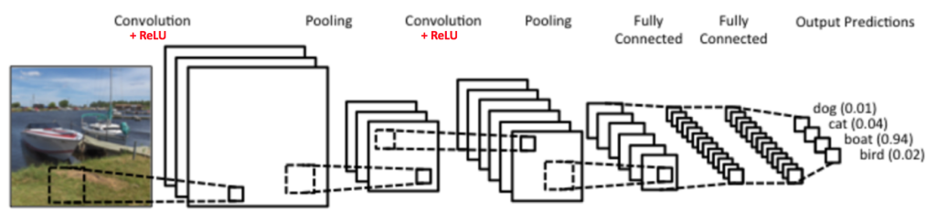
Application of CNN’s
Image Classification
CNN has been used for image classification for a long time and has better classification accuracy
CNN builds a tree-like structure to learn fine-grained features for subcategory recognition.

Slide 18
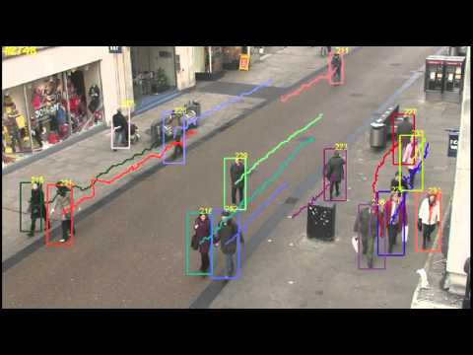
Application of CNN’s
Object Tracking
CNN is designed as a tracker with shift – variant architecture and trained inclemently during tracking with new examples online.

Slide 19
Other application of CNN’s
Pose Estimation
Text Detection & Recognition
Visual Saliency Discretion
Action Recognition
Scene Labelling

Slide 20
References
[1] Y. LeCun, L. Bottou, Y. Bengio, and P. Haffner, “Gradient-based learning applied to document recognition,” Proceedings of the IEEE, vol. 86, no. 11, pp. 2278–2324, 1998.
[2] B. B. Le Cun, J. S. Denker, D. Henderson, R. E. Howard, W. Hubbard, and L. D. Jackel, “Handwritten digit recognition with a backpropagation network,” in Advances in neural information processing systems. Citeseer, 1990.
[3] A. Krizhevsky, I. Sutskever, and G. E. Hinton, “Imagenet classification with deep convolutional neural networks,” in Advances in neural information processing systems, 2012, pp. 1097–1105.
[4] M. D. Zeiler and R. Fergus, “Visualizing and understanding convolutional networks,” in ECCV, 2014.
[5] C. Szegedy, W. Liu, Y. Jia, P. Sermanet, S. Reed, D. Anguelov, D. Erhan, V. Vanhoucke, and A. Rabinovich, “Going deeper with convolutions,” CoRR, vol. abs/1409.4842, 2014.

Slide 21
THANKS

