Slide 1
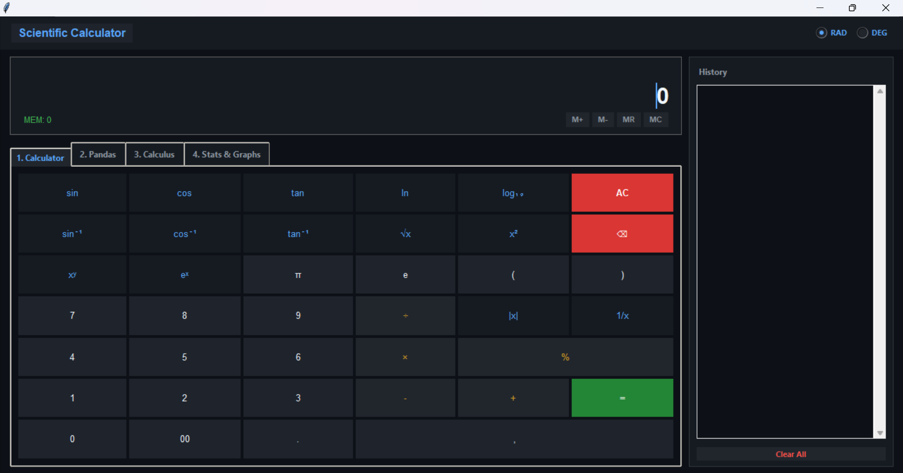
Advanced Calculator
A scientific and data science desktop application built with Python and Tkinter
NEXTHIKES IT SOLUTIONS
Presented by: Anushri Thakur
Notes:
Introduce the Advanced Calculator: a Python and Tkinter desktop application with four tools, built during the NextHikes IT Solutions programme.

Slide 2
01 / OVERVIEW
Project at a glance
The Advanced Calculator combines four everyday tools in one tab-based desktop application.
01
02
03
04
Calculator
Pandas
Calculus
Stats & Graphs
Keypad, trig with RAD/DEG, logs, powers and memory
describe, corr, cov, mean, std and skew on pasted or CSV data
Integral, derivatives, root finder, n!, nCr and nPr
Seven chart types with a live summary table
Technology stack
Python 3
Tkinter / ttk
pandas
SciPy
Matplotlib
pandas, SciPy and Matplotlib are optional: the app still opens if one is missing.
Notes:
Four tabs: Calculator, Pandas, Calculus, Stats & Graphs. Only Python and Tkinter are required.

Slide 3
02 / PURPOSE
Project objectives
01
Unify useful tools
Bring a scientific calculator, data analysis, calculus and graphing into one application.
02
Make interaction intuitive
Use a clear tab layout, readable display, on-screen keypad and keyboard shortcuts (Enter, Esc).
03
Support advanced calculations
Trigonometry in RAD or DEG, logarithms, powers, memory, factorials, combinations and permutations.
04
Improve reliability
Validate every expression and input, show clear error messages and never run unrestricted code.
05
Stay practical anywhere
Optional libraries come with built-in fallbacks, so the app works even when they are missing.
Notes:
Five goals: unify tools, intuitive interface, advanced maths, reliability, and working without extra libraries.

Slide 4
03 / DESIGN AND IMPLEMENTATION
How the application is structured
One main class builds the window, the tabs and the history; small helper functions do the maths.
Main window
Display card
Notebook tabs
History tape
AdvancedCalculator class: theme, layout and hotkeys
Formula line, input box and memory badge
Calculator, Pandas, Calculus, Stats & Graphs
Results list; double-click to reuse a value
Interface layer
Logic layer
Support layer
Tkinter widgets, ttk Notebook and Combobox, Matplotlib canvas and flat themed buttons.
Expression engine, statistics helpers, regression, Pearson correlation and descriptive summary.
re tokenizer, math, statistics, collections.Counter, plus optional pandas and SciPy.
Notes:
Explain the three layers: what the user sees, what calculates, and what supports it.

Slide 5
04 / FEATURES
Feature set: four tabs
01
Calculator
02
Pandas Analysis
Trig and inverse trig with a RAD / DEG switch
ln, log10, √x, x², xʸ, eˣ, π, e, |x|, 1/x
Memory M+, M-, MR, MC and a History tape
Paste CSV data or load a file
describe(), corr() and cov()
Mean, median, std, variance, skew, kurtosis
03
Calculus & SciPy
04
Stats & Graphs
Integral over [a, b] using SciPy quad
1st and 2nd derivative at a point
Root finder, n!, nCr and nPr
Normal curve, histogram, box plot, scatter + regression
Line plot, bar chart and correlation heatmap
Summary table, mouse-wheel zoom, save as image
Notes:
Walk through one tab at a time. Demo the calculator first, then paste the sample CSV in the Pandas and Stats tabs.

Slide 6
05 / CHALLENGES
Development difficulties and how they were addressed
Challenge
Problem
How it was solved
1
Safe expressions
Allow normal maths while stopping arbitrary code from running.
A regex whitelist checks every token before a restricted eval.
2
RAD and DEG modes
Trig functions must be correct in both angle units.
Convert to and from radians at the function boundary.
3
Missing libraries
The app must not crash without pandas, SciPy or Matplotlib.
Optional imports with fallbacks: Simpson's rule and bisection.
4
Messy data input
Users paste CSV, tabs, spaces or one row of numbers.
parse_dataset finds headers, checks rows and names bad values.
5
Invalid input
Empty, non-numeric or huge values must not crash the app.
InvalidInput error with clear messages: Div by 0, Math Error.
Notes:
Highlight the safe evaluator: plain eval would run any typed code, so every token is checked first.

Slide 7
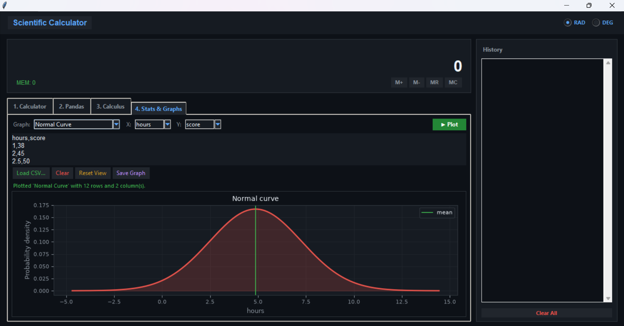
PROJECT OUTCOME
One application.
Four powerful tools.
The Advanced Calculator shows how Python can combine GUI development, safe input validation, statistics and graphing in a single desktop project.
CALCULATE
ANALYSE
SOLVE
VISUALISE
Scientific maths
pandas statistics
Calculus and SciPy
Seven graph types
Notes:
Close with the four verbs, then take questions or run a short live demo.

Slide 8
Thank You

