Slide 1
AI TRAINING · LG ELECTRONICS, NOIDA
Practical AI for the Factory Floor
A hands-on, 4-hour session - concepts, RAG, agents and orchestration, all no-code
Presented by Arjun Thakur
Principal AI Engineer · AI Trainer · Agentic AI Developer
arjunthakur.dev
Notes:
Title. Plain language, live demos, one running example - the IM-500 machine.

Slide 2
FIRST - A FEW HANDS
Before we start
▸ Who uses ChatGPT, Gemini or any AI chat - even once in a while?
▸ Who has ever written code or built an automation? (Excel formulas count!)
▸ Who has heard "AI agent" and wasn't quite sure what it means?
No wrong answers - this just helps me pitch the session at the right level for the room.
arjunthakur.dev
Notes:
Ice-breaker. Read the room: mostly non-coders? go slower on tech, heavier on the 'why'. Keep it warm.

Slide 3
TODAY IN 4 HOURS
What we'll cover
Concepts
RAG
One Agent
Orchestration
Log
the words, plainly
AI + your docs
AI that acts
agents together
to a Sheet
▸ One example, grown all day - predictive maintenance on an IM-500 machine.
▸ I build live; you watch and ask. Short breaks along the way.
▸ You leave with a manual, prompts and a glossary to redo it yourself, free.
arjunthakur.dev

Slide 4
HOW WE'LL WORK TODAY
A few house rules
▸ Ask the moment you have a question - don't wait for me to finish. The best time is right away.
▸ Stuck on a word or a term? Ask me to define it, anytime. No question is too basic.
▸ Language is no barrier - Hindi or English, whatever's comfortable. Hinglish is perfectly fine.
▸ Everything is no-code and free. I build live; you get the manual to redo it yourself.
arjunthakur.dev
Notes:
Set the tone: interactive, bilingual, judgement-free. The goal is understanding, not vocabulary.

Slide 5
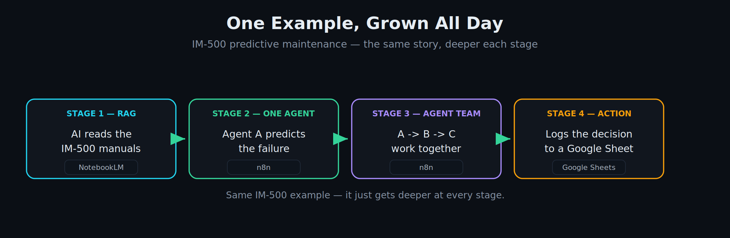
THE THREAD
One example, grown all day
arjunthakur.dev
Notes:
Spine of the session.

Slide 6
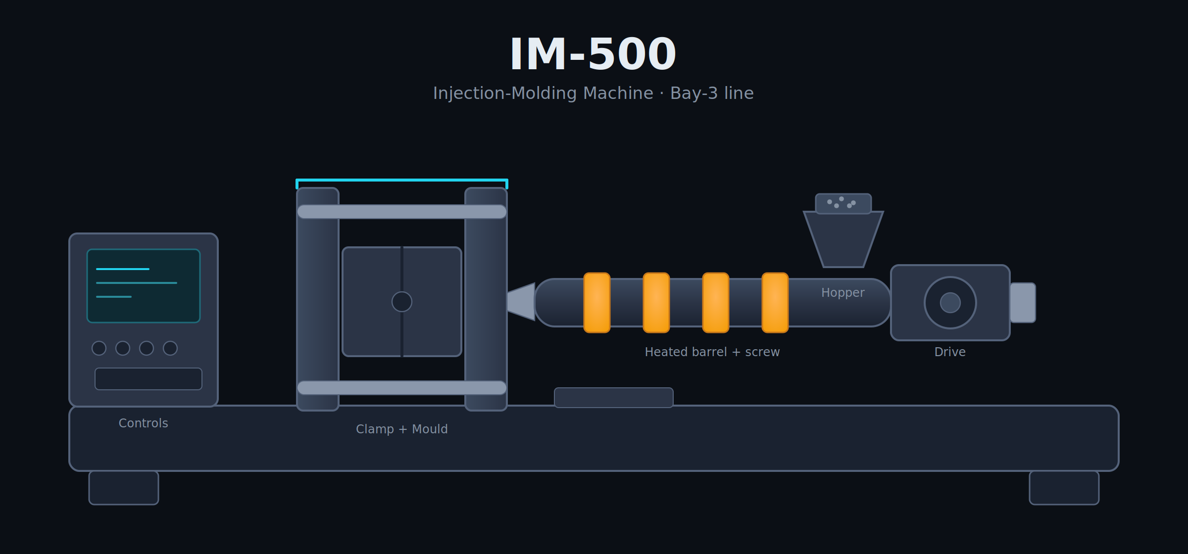
arjunthakur.dev
Notes:
The machine itself. Point at each part so the room has a physical picture before we talk sensors.

Slide 7
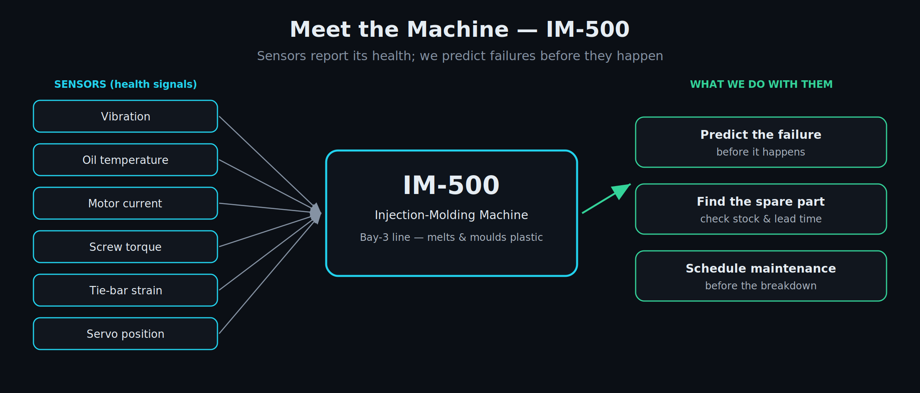
MEET THE MACHINE
The IM-500 - what we'll work on
arjunthakur.dev
Notes:
Ground the room in the machine first.

Slide 8
01
SECTION 1
Concepts
The four words everyone mixes up - on the IM-500
arjunthakur.dev

Slide 9
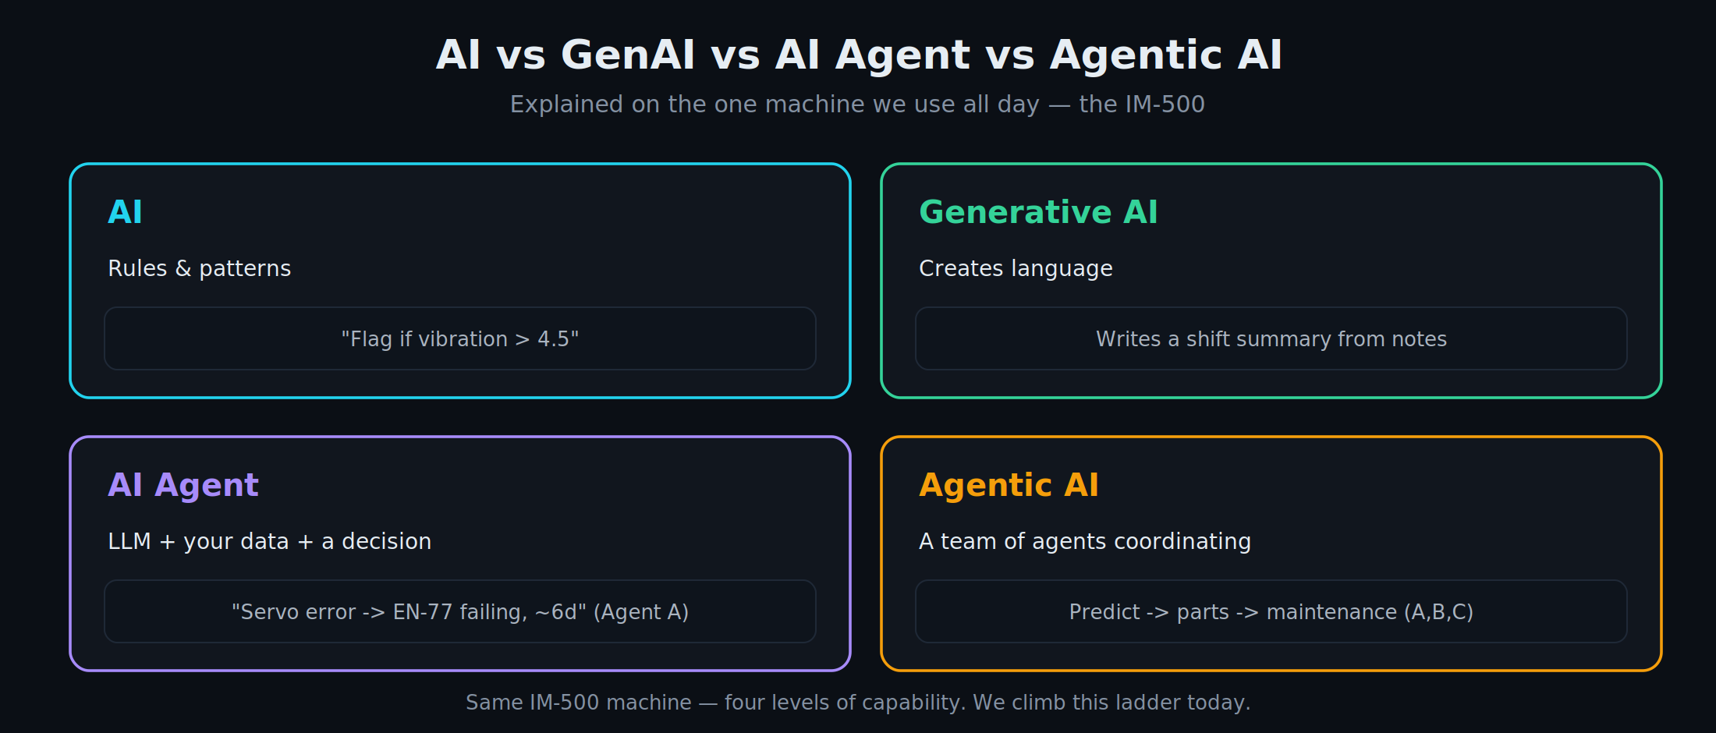
MODULE 1 · CONCEPTS
AI vs GenAI vs AI Agent vs Agentic AI
arjunthakur.dev
Notes:
Four levels, one machine.

Slide 10
MODULE 1 · CONCEPTS
The four terms, defined
AI
Generative AI
▸ Software that follows rules or spots patterns
▸ No language, no reasoning - just "if this, then that"
▸ e.g. flag the part if vibration > 4.5
▸ Creates new content - text, summaries, images
▸ Understands and writes language
▸ Doesn't know YOUR data unless you give it (that's RAG)
AI Agent
Agentic AI
▸ An LLM that can decide and take an action
▸ Uses your reference data (and tools) to finish a task
▸ e.g. reads a sensor alarm -> names the failing part
▸ Several agents working together toward a goal
▸ They hand off, coordinate, span many steps
▸ e.g. predict -> check parts -> raise maintenance
arjunthakur.dev
Notes:
Plain-word definitions of each term before the comparison table. Keep it quick - the next slide contrasts them side by side.

Slide 11
MODULE 1 · CONCEPTS
Four terms, side by side
 | What it is | Decides? | IM-500 example
AI | Rules & patterns | No | Flag if vibration > 4.5
Generative AI | Creates language | No | Writes a shift summary
AI Agent | LLM + data + decision | Yes, one task | Servo error -> EN-77, ~6d
Agentic AI | A team, many steps | Yes, end to end | Predict -> parts -> maintenance
Ask the room: which of these are you already using without calling it "AI"?
arjunthakur.dev

Slide 12
Q & A
Concepts - questions
▸ Which of your tasks today is really just automation?
▸ Where would a decision (an agent) actually help?
arjunthakur.dev

Slide 13
BREAK
7 minutes
We'll resume right on time.
arjunthakur.dev
Notes:
~37 min mark

Slide 14
02
SECTION 2
RAG
Making the AI answer from YOUR machine documents
arjunthakur.dev

Slide 15
MODULE 2 · RAG
The problem: a plain chatbot doesn't know your machine
▸ A raw AI model is smart, but it has never seen the IM-500 manuals.
▸ Ask it about servo error EN-77 and it guesses - a confident wrong answer.
▸ On the floor, a confident wrong answer can be worse than no answer.
arjunthakur.dev

Slide 16
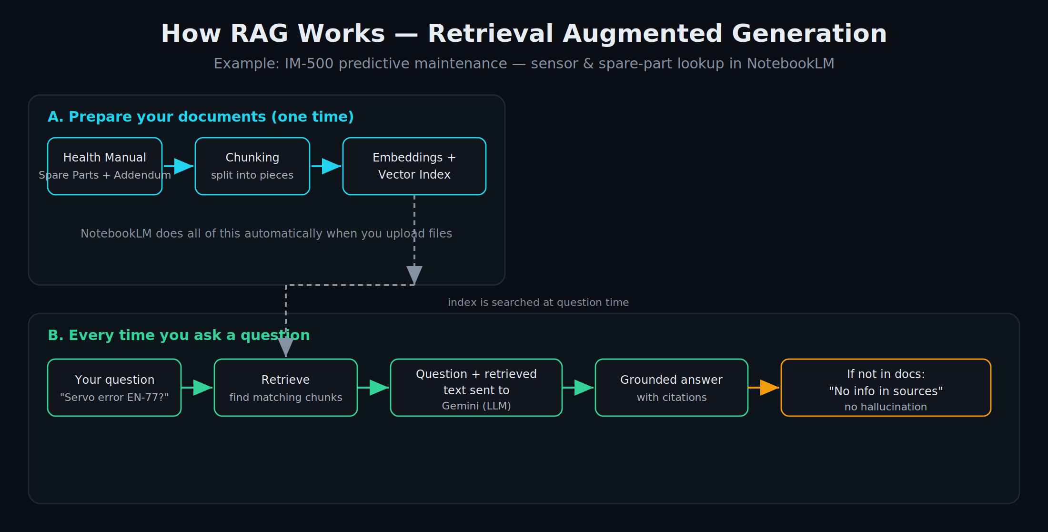
MODULE 2 · RAG
What RAG is
arjunthakur.dev
Notes:
Answer only from your docs, with citations.

Slide 17
MODULE 2 · RAG · WHY NOTEBOOKLM
Why we use NotebookLM
▸ No-code, free, Google-stable - upload PDFs and ask; no database to manage.
▸ Best "just works" tool for grounded answers in a live demo.
▸ Reliability first: fewer moving parts, nothing to break on the day.
↗ notebooklm.google.com · plain chatbot: gemini.google.com
arjunthakur.dev

Slide 18
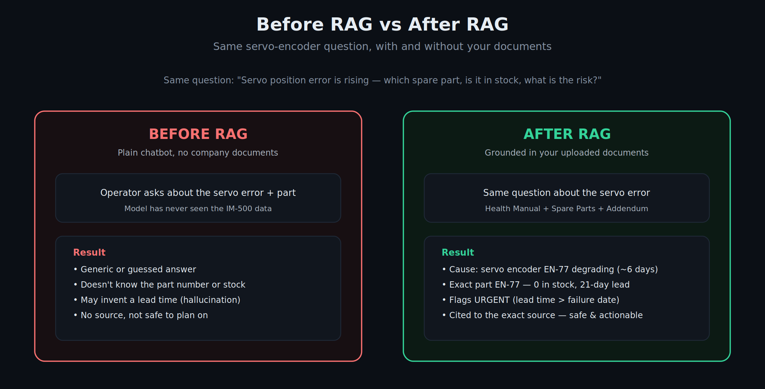
MODULE 2 · RAG · DEMO
Before vs After RAG - the EN-77 question
arjunthakur.dev
Notes:
Honest "not in sources" before; full cited answer after.

Slide 19
▶ LIVE DEMO
Before vs After RAG, live
Leave the deck → NotebookLM
▸ Ask the EN-77 question in plain Gemini (no docs) -> vague guess.
▸ Upload the IM-500 manuals + spare-parts catalog -> ask again -> "not in sources" for the addendum item.
▸ Add the EN-77 addendum PDF -> ask again -> exact part, 0 stock, 21-day lead, cited.
↗ notebooklm.google.com
arjunthakur.dev
Notes:
Show all three states.

Slide 20
Q & A
RAG - questions
▸ Which documents would you point this at first?
▸ What shape is that data in today - PDFs, scans, spreadsheets?
arjunthakur.dev

Slide 21
BREAK
10 minutes
We'll resume right on time.
arjunthakur.dev
Notes:
~92 min mark

Slide 22
03
SECTION 3
Build an Agent
AI that reads, decides and takes action - no code
arjunthakur.dev

Slide 23
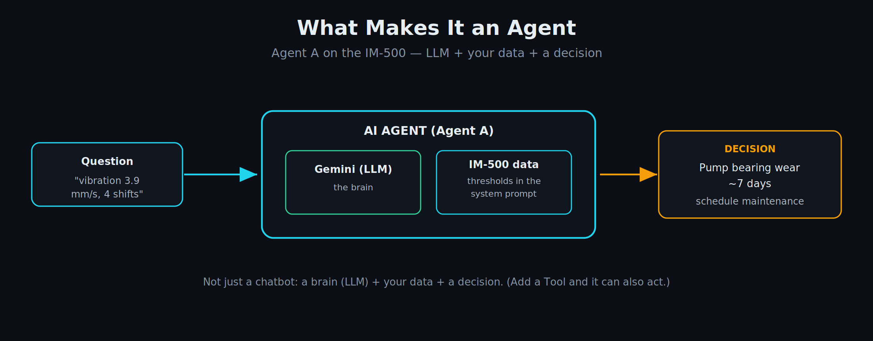
MODULE 3 · AGENTS
What makes it an agent
arjunthakur.dev
Notes:
A brain (LLM) + your data + a decision.

Slide 24
MODULE 3 · AGENTS · WHY N8N
Why we use n8n
▸ A no-code, visual builder with a free tier - drag boxes, connect them, done.
▸ Runs in a browser; no servers, no licences.
▸ You can rebuild everything yourself from the take-home manual.
↗ n8n.io
arjunthakur.dev

Slide 25
MODULE 3 · AGENTS · WHY GEMINI
Why Google Gemini - and a word on limits
▸ Free API tier, strong, instant key from Google AI Studio.
▸ Use a STABLE flash model (e.g. gemini-3.6-flash) - not a "preview" one.
▸ Preview models cap at ~20 requests/day; stable at ~1,500/day. Hit a limit? Switch to another stable model - the quota is per-model.
↗ aistudio.google.com (Get API key)
arjunthakur.dev

Slide 26
▶ LIVE DEMO
Build & run Agent A (Failure Prediction)
Leave the deck → n8n
▸ Chat Trigger -> AI Agent -> Google Gemini Chat Model -> paste the system prompt.
▸ Test: "vibration 3.9 mm/s for 4 shifts" -> pump bearing wear, ~7 days.
▸ Grounding check: ask something not in the data -> it refuses, no hallucination.
↗ your n8n workflows home
arjunthakur.dev
Notes:
Build one agent live.

Slide 27
MODULE 3 · AGENTS
Agent B - same pattern, different data
▸ Agent B = Spare Parts: given a failing part, returns stock + lead time + order decision.
▸ Identical steps to Agent A; only the reference data changes.
▸ Take-home: participants rebuild Agent B themselves from the manual.
Ask the room: what's one lookup your team does by hand that an agent could do?
arjunthakur.dev

Slide 28
Q & A
Agents - questions
▸ Which repetitive task could an agent take the first pass at?
▸ Where must a human always stay in the loop?
arjunthakur.dev

Slide 29
BREAK
7 minutes
We'll resume right on time.
arjunthakur.dev
Notes:
~144 min mark

Slide 30
04
SECTION 4
Agentic AI & Orchestration
Many agents, working together
arjunthakur.dev

Slide 31
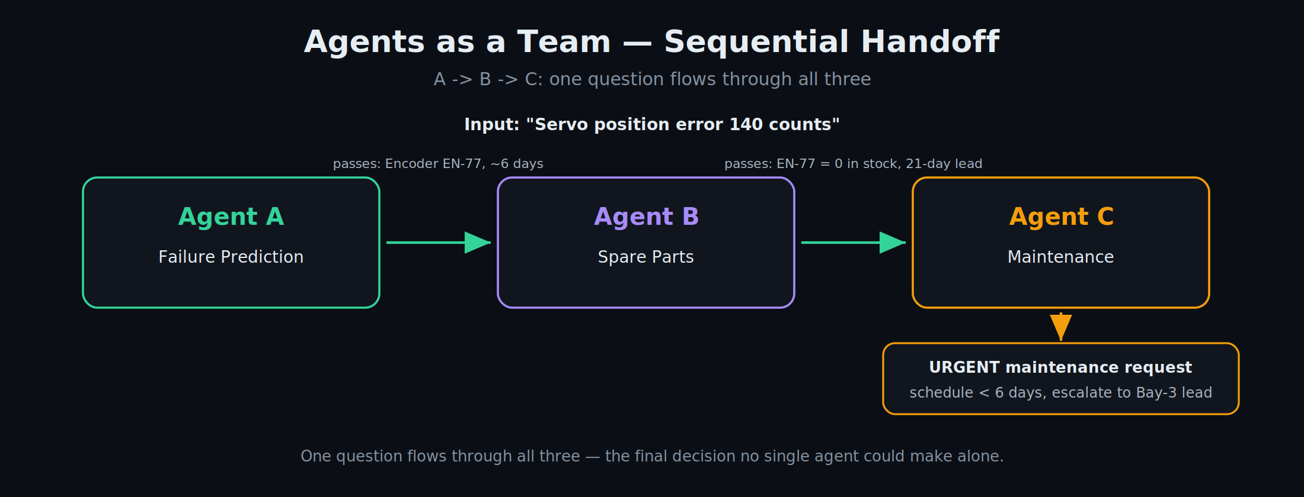
MODULE 4 · ORCHESTRATION
Agents as a team - A -> B -> C
arjunthakur.dev
Notes:
A decision no single agent makes alone.

Slide 32
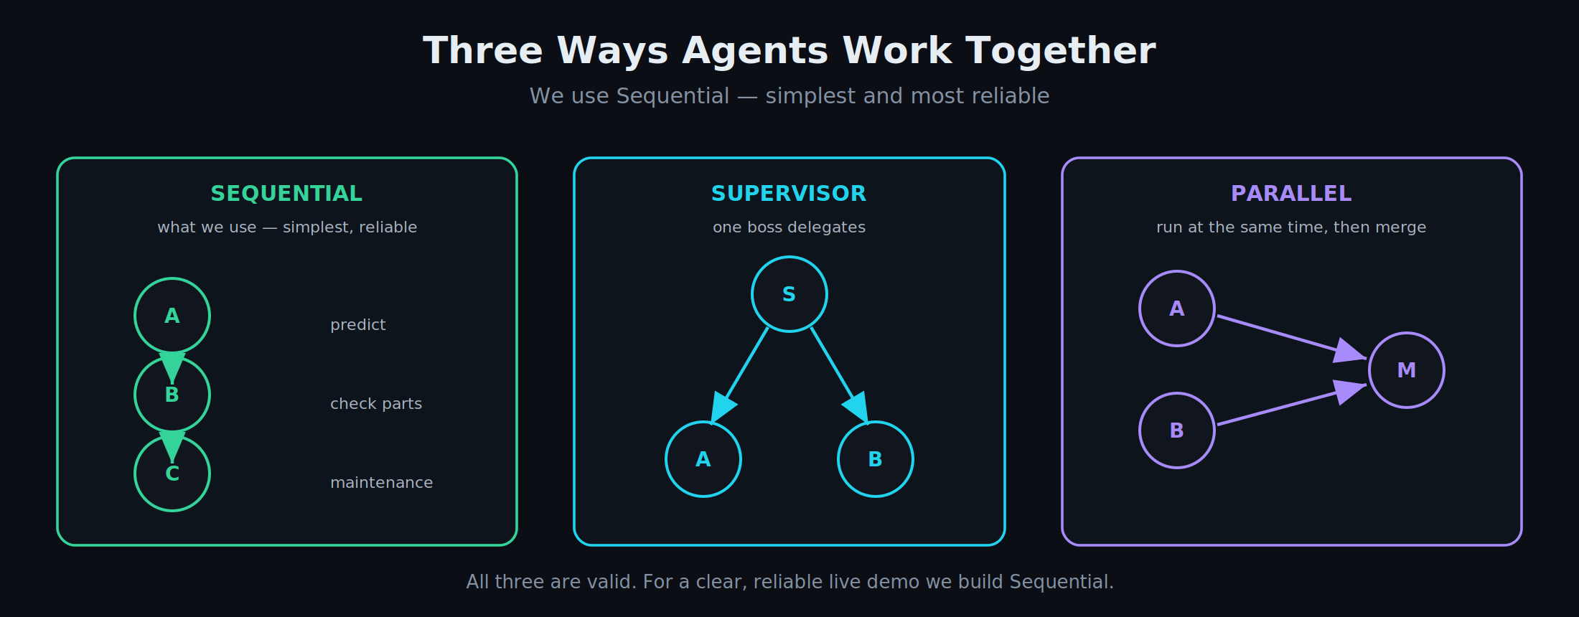
MODULE 4 · PATTERNS
Three ways agents work together
arjunthakur.dev
Notes:
We build Sequential - simplest and most reliable.

Slide 33
▶ LIVE DEMO
Wire A -> B -> C into one workflow
Leave the deck → n8n
▸ Copy the three agents onto one canvas; connect Chat -> A -> B -> C.
▸ Set the handoff prompts so each agent's output feeds the next.
▸ Ask ONE question - "servo error 140 counts" - and watch it flow to a final URGENT request.
arjunthakur.dev
Notes:
Centrepiece demo.

Slide 34
MODULE 4 · ORCHESTRATION
Why this is powerful
▸ No single agent could produce the final decision.
▸ The escalation - 21-day part vs 6-day failure - emerges from the team, not one agent.
▸ This is "agentic AI": specialists coordinating toward a goal.
Ask the room: where in your plant do several people already hand off like this?
arjunthakur.dev

Slide 35
MODULE 4 · ACTION · WHY A SHEET
Why log to a Google Sheet (not email)
▸ A sheet is a permanent record you can filter, sort and share; email is a one-off notification.
▸ Native n8n node, same Google login - no extra setup.
▸ This is the agent taking a real action: it records, not just answers.
↗ sheets.google.com
arjunthakur.dev

Slide 36
▶ LIVE DEMO
Agent C writes the decision to a Google Sheet
Leave the deck → n8n + Google Sheets
▸ Add a Google Sheets "Append Row" node after Agent C.
▸ Structured output maps cleanly into columns (component, part, priority...).
▸ Run the chat -> a new row appears in the sheet - the logged maintenance request.
↗ sheets.google.com
arjunthakur.dev
Notes:
Close the loop.

Slide 37
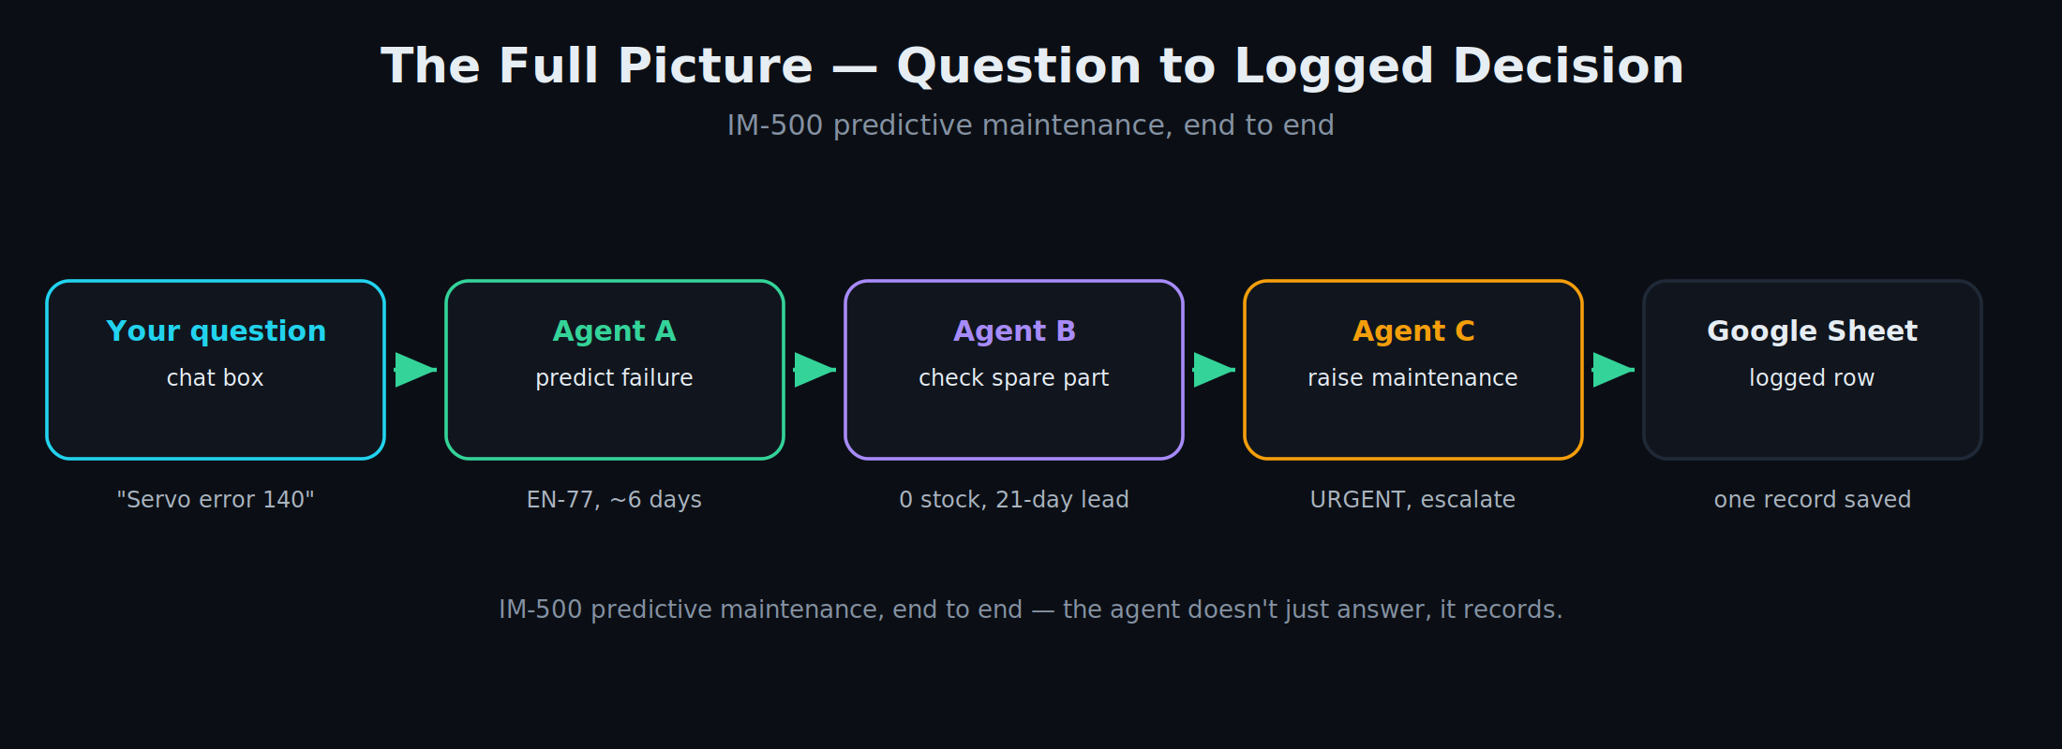
MODULE 4 · THE FULL PICTURE
Question to logged decision
arjunthakur.dev
Notes:
The agent doesn't just answer, it records.

Slide 38
Q & A
Orchestration - questions
▸ Which two departments would benefit from talking to each other?
▸ Where would you want a human approval step?
arjunthakur.dev

Slide 39
REFERENCE · KEY TERMS
Glossary - the words we used
Core AI concepts
RAG
Prompting & output
Model
LLM
AI
Generative AI (GenAI)
AI Agent
Agentic AI
Chatbot
Orchestration
Handoff
Sequential pattern
Supervisor pattern
Parallel pattern
Human-in-the-loop
RAG
Hallucination
Grounding
Citation
Chunking
Embedding
Vector index / store
Retrieval
Prompt
System prompt
User message
Structured output
Output parser
Memory
Tool
Grounding check
arjunthakur.dev
Notes:
Reference slide - full definitions are in the glossary handout. Don't read it out; point people to it.

Slide 40
REFERENCE · KEY TERMS
Glossary - the words we used
The tools
Models, keys & limits
n8n building blocks
NotebookLM
n8n
Google Gemini
Google AI Studio
Google Sheets
Flash model
Preview model
Stable model
API
API key
Credential
Token
Rate limit / quota
429 error
Workflow
Node
Canvas
Trigger
Chat Trigger
Manual Trigger
AI Agent node
Chat Model (sub-node)
Sub-node
Structured Output Parser
Append Row
Map Each Column
Execution / run
arjunthakur.dev
Notes:
Reference slide - full definitions are in the glossary handout. Don't read it out; point people to it.

Slide 41
REFERENCE · KEY TERMS
Glossary - the words we used
n8n expressions
Machine & maintenance
Expression {{ }}
$json.output
$('Agent A')
.first()
.item
$now
Take from previous / Define below
IM-500
Injection molding
Bay-3
Sensor reading
Threshold (Normal/Warning/Critical)
Failure signature
Predicted failure
Failure lead time
Part supply lead time
Health Index
Spare part / part number
BOM (component -> part)
In stock / min stock
Reorder
URGENT / NORMAL
Escalate
EN-77
arjunthakur.dev
Notes:
Reference slide - full definitions are in the glossary handout. Don't read it out; point people to it.

Slide 42
WRAP-UP
What we covered today
▸ Concepts: automation vs AI vs agents vs agentic - in plain words, on one machine.
▸ RAG: making AI answer from your own documents, with citations.
▸ Agents: AI that reads, decides and acts - built no-code in n8n.
▸ Orchestration: three agents working together, logging a real decision.
arjunthakur.dev

Slide 43
WRAP-UP
Take it home
▸ You get: the how-to manual, the agent prompts, a glossary, the sheet template, and this deck.
▸ Rebuild it yourself - then swap in your own machine and data.
▸ Pick one small, real problem on your line to try first.
↗ notebooklm.google.com · n8n.io · aistudio.google.com · sheets.google.com
arjunthakur.dev

Slide 44
Thank you
Questions any time - in Hindi or English.
◉
WEBSITE
arjunthakur.dev
arjunthakur.dev

