Slide 1

SELL MOBILES USING MICROSERVICES
Information Technology
Under the Supervision of: Submitted by:
Dr. Ashish Jain Dishant Thakur
Assistant Professor 159102038

Slide 2
Contents
INTRODUCTION
ADVANTAGES OF USING MICROSERVICES
TECH STACK
SERVICES
FUNCTIONAL PARTITIONING OF PROJECT
HIGH LEVEL ARCHITECTURE
WORK SCHEDULE

Slide 3
INTRODUCTION
Microservices is a form of service-oriented architecture style (one of the most important skills for Java developers) wherein applications are built as a collection of different smaller services rather than one whole app. Instead of a monolithic app, you have several independent applications that can run on their own and may be created using different coding or programming languages. Big and complicated applications can be made up of simpler and independent programs that are executable by themselves. These smaller programs are grouped together to deliver all the functionalities of the big, monolithic app.

Slide 4
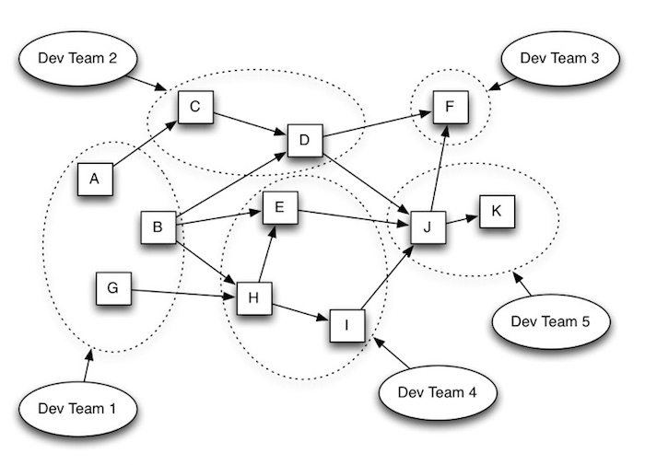
Microservice architectures let you split applications into distinct independent services, each managed by individual groups within your software development organization. They support the separation of responsibilities critical for building highly scaled applications, allowing work to be done independently on individual services without impacting the work of other developers in other groups working on the same overall application. In short, your application can grow as your company and its requirements grow. Your application looks more like this:

Slide 5
ADVANTAGES OF USING MICROSERVICES
Simpler To Deploy | Deploy in literal pieces without affecting other services.
Simpler To Understand | Follow code easier since the function is isolated and less dependent.
Reusability Across Business | Share small services like payment or login systems across the business.
Faster Defect Isolation | When a test fails or service goes down, isolate it quickly with microservices.
Minimized Risk Of Change | Avoid locking in technlogies or languages - change on the fly without risk.

Slide 6
TECH STACK
The Following is the Tech stack that we are considering for the project:
Service Registry, Discover and API Gateway: Netflix OSS & Eureka
Backend – Spring Boot
SCM – Git
Database – Mongo + MySQL
Security & Authorization: Spring Security
API Documentation: Swagger
Cloud Deployment :Azure
Container: Docker

Slide 7
Services
Product Search Service: In this service, customer can search for the mobiles based on multiple options such as product types, budget, seller types, budget, ratings as well as mobile name.
Order Management Service: This service will take care of placing order, updating order, cancelling order, view order and calculating the total based on the product ordered.
Customer Management Service: This service provides features like registration of the customer using social login using Oauth, updating customer details as well as they can unregister themselves from the application.
Review Management Service: In this service, there is facilities available for a customer to view and provide reviews and ratings for the product Customer can also update their reviews and ratings.

Slide 8
Functional partitioning of project
Design and Thinking
Creating POC (Proof Of Concept)
Creating all Micro Services
Deploying on cloud platform

Slide 9
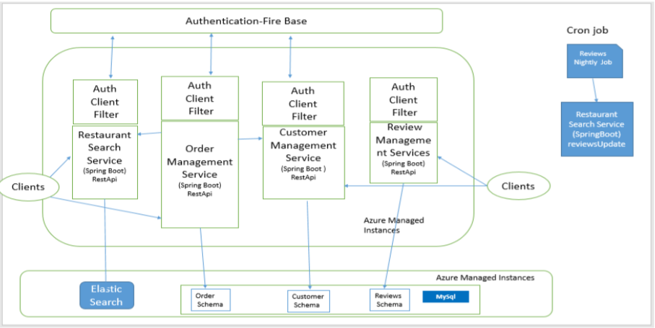
High Level Architecture

Slide 10
Work schedule (month wise)
Jan 2019 Base Camp
Feb 2019 Engineering Camp
Mar 2019 Design and Thinking and creating Proof of Concept (POC)
Apr 2019 Creating all the required Micro Services and Junit Testing
May 2019 Final code submission and report preparation (Tentative Plan)

Slide 11
THANK YOU !

