Slide 1

POWER BI PROJECT
Superstore Sales Performance Analysis
Summer Training — Power BI | CGC University Mohali
Presented by
Course
Guided by
Date
Rishav Thakur | 2419362
B.Tech — CSE
Dr. Ashima & Mrs.Mandeep
06 July 2026

Slide 2
Agenda
01
Problem Statement & Objective
06
Dashboard Walkthrough
02
Dataset Overview
07
Key Insights & Findings
03
Data Model — Star Schema
08
Publishing to Power BI Service
04
Power Query — Cleaning Steps
09
Challenges & Learnings
05
DAX Measures
10
Conclusion & Q&A

Slide 3
Problem Statement & Objectives
The Problem
Target User
The regional sales managers and executive leadership lack a centralized real-time view of business performance. Transaction data is trapped in raw tabular formats, making it highly difficult to identify localized profit losses, evaluate discount impacts, or track product category trends.
Sales Manager, Regional Directors, and Business Analysts who need a real-time, interactive view of regional revenue, product margins, and customer trends without waiting for manually weekly spreadsheet reports.
Project Objectives
Connect & clean the raw dataset using Power Query
Design an interactive multi-page layout with dynamic chart types for quick macro and micro analysis.
Build a star schema data model with correct relationships
Publish the final report to Power BI Service to enable seamless cross-team collaboration and scheduling.
Create at least 5 meaningful DAX measures

Slide 4
Dataset Overview
Kaggle
CSV
Source
File Type
10,194
23
Rows
Columns

Slide 5
Dataset Overview
Key Columns Used
Data Quality Steps (Power Query)
Column | Role in Dashboard
Order ID | Unique key per transaction
Order Date | Date dimension — time intelligence
Category | Product grouping for slicers
Sales | Revenue — base for SUM measures
Profit | Net profit — margin calculations
Region | Geographic distribution – base for mapping performance
Removed duplicate rows
Fixed null values in column
Changed data types (Date, Number)
Renamed columns for clarity
Filtered out [cancelled/test] rows
Verified correct data formatting for sales and profit values

Slide 6
DAX Measures
Total Sales : Calculates the absolute gross revenue generated across all transactions.
Total Profit : Calculates the cumulative net profit across all orders.
Total Quantity Sold : Tracks the total volume of inventory units moved.
Total Discount : Calculates the total monetary value given away as customer discounts.

Slide 7
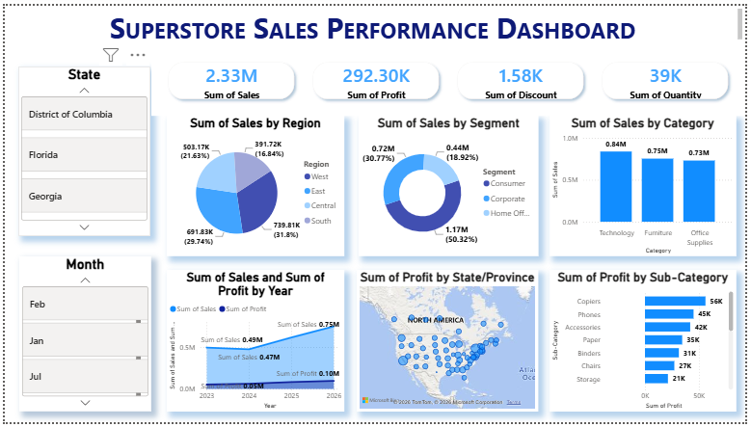
Dashboard — Overview
Visuals on this page
KPI Cards — Sales, Profit, Discount, Quantity
Bar Chart — Sales by Sub - Category
Column Chart — Sales by Category
[ Screenshot — Overview Page ]
Map — Sales by Region
Slicer — State. Month
Key Insight
The store generated 2.33M in gross sales and 292K in total net profit. The data reveals that the consumer segment is primary engine of business, driving over half of all sales at 50.3%.

Slide 8
Key Findings & Insights
The west region stands out as the store’s primary market, acting as the highest contributor to total revenue.
Product revenue is evenly balanced across categories, with Technology, Furniture, and Office Supplies pulling similar sales volume.
01
04
The consumer customer segment is the main engine of the business, driving over half of all generated dashboard sales at 50.32%.
Net profitability remains strong and is heavily backed by high-performing sub-categories like Copiers and Phones.
02
05
Sales and overall revenue streams show a healthy, consistent upward trajectory when tracked year-over-year.
03

Slide 9
Learning
Built a complete Power BI Pipeline to transform raw retail data into clear, interactive visuals.
Learned data cleaning in Power Query and created DAX measures to calculate precise profit margins.
Learned how to design centralized dashboards that help managers replace slow, manual spreadsheets with real-time decisions.

Slide 10
Conclusion & Thank You
Successfully built an end-to-end Power BI solution from raw data to published dashboard.
Acquired hands-on experience in structuring clean data relationships and optimizing analytical report layouts.
Established a scalable reporting framework that allows stakeholders to instantly identify and resolve regional profit drops.
Future scope: Integrate machine learning models to forecast upcoming seasonal demand and predict potential profit dips.
Questions & Feedback Welcome

