Slide 1



Slide 2

SHORT INTRODUCTION ABOUT HCL
The company name”HCL” used to stand for “Hindustan Computer limited” but now HCL is the only one name that the company goes by.
HCL is a global technology and IT Enterprise that operates in 31 countries. Its headquarters is in Noida, India.

Slide 3

1. Some interesting facts. 2. Strategies. 3.Overviews.
CONTENT

Slide 4

AMAZING FACTS ABOUT HCL COMPANY…….

Slide 5

The 360 degree feedback
Behaviour.
Not related for promotion.
Negative thoughts.

Slide 6
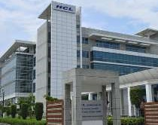
2. Results of HCL
It is the only company that gives more importance to its employee.
It provides all necessities to its employee and their families.
Because we know if employees are happy, it would lead to more profit in the end.

Slide 7

3. Employees first customer second.
Freedom.
Transparency.
Employees are more inclined in our work.

Slide 8

5. Directions
Wide event.
Mind set.

Slide 9
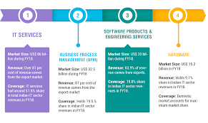
What is the GDP of IT sector in Indian economy?
The sector has increased its contribution to India's GDP from 1.2% in 1998 to 7.7% in 2019.

Slide 10

Is HCL a good company?
HCL is not a place for sincere and talented people. Their policy “employee first customer second is a total fake. Probably, it is the most “kanjoos” company of India.

Slide 11
THANK YOU……

