Slide 1
QUIETGUARD
Edge AI Acoustic Surveillance & Environmental Monitoring System
Dual-Core IoT Health Monitor & Real-Time Alert Engine
⚙
Hardware Platform
Arduino UNO Q (Linux Host + STM32 MCU)
●
Primary Sensors
Host Mic Array (Acoustics) & Adafruit SHT40 (Temp/Humidity)
■
Actuation & Display
4-Wire SPI OLED Display & Piezoelectric Alert Buzzer
⇄
Data Bridge
MsgPack RPC over /dev/ttyHS1 linking Linux host and STM32 MCU
QuietGuard | Edge AI Acoustic & Environmental Monitor
1

Slide 2
PROJECT OVERVIEW
Why QuietGuard Exists
A low-cost, standalone edge device for passive respiratory & environmental monitoring
The Problem
The Approach
Continuous respiratory symptom tracking (e.g. persistent coughing) is rarely done outside clinical settings, leaving gaps between checkups.
Ambient temperature and humidity swings in living or care spaces often go unmonitored, despite influencing respiratory comfort.
Existing consumer health wearables require active user participation and don't observe passive acoustic events.
Cloud-dependent monitoring devices raise latency, privacy, and connectivity concerns for always-on sensing.
Passive edge-AI acoustic monitoring — no wearables, no cloud round-trip required for detection.
Dual-core split: Linux host handles signal processing, STM32 handles real-time I/O and actuation.
Local OLED feedback and audible alerts give instant, private, on-device status.
Modular sensor bus (I2C/SPI) designed to scale to additional vitals sensors later.
QuietGuard | Edge AI Acoustic & Environmental Monitor
2

Slide 3
SYSTEM DESIGN
System Architecture Overview
Three-stage pipeline from raw signal capture to actuated feedback
01
●
02
⚙
03
■
Sensing
Processing
Actuation
Host mic array + SHT40 continuously capture acoustic and environmental signals.
→
Linux host runs the Python cough-detection engine; STM32 runs Zephyr RTOS for I/O.
→
OLED display and piezo buzzer surface live telemetry and threshold-based alerts.
Backbone: All three stages are unified by the Arduino_RouterBridge MsgPack RPC channel over /dev/ttyHS1, giving sub-second round trip between detection and on-device alert.
QuietGuard | Edge AI Acoustic & Environmental Monitor
3

Slide 4
DISTRIBUTED COMPUTING FRAMEWORK
Dual-Core Architecture & Bridge Telemetry
⌘
Linux Host Core
⚡
STM32 Microcontroller Core
Runs Python to capture laptop mic audio streams.
Processes decibel spikes in real time.
Calculates rolling 60-second cough rates.
Serializes detection events as MsgPack RPC frames.
Executes Zephyr RTOS firmware.
Polls physical sensors continuously.
Drives the OLED display and triggers audio alerts.
Owns all real-time, deterministic timing budgets.
INTER-CORE COMMUNICATION
Internal Channel: /dev/ttyHS1 high-speed serial bus
Protocol: Arduino_RouterBridge using MsgPack RPC packets
Payload: Transfers live cough counts directly to the display logic
Why split the workload? Python's audio & ML libraries need a full Linux runtime, while OLED/buzzer timing needs microsecond-level determinism only an RTOS-driven MCU can guarantee — the bridge lets each core do only what it's best at.
QuietGuard | Edge AI Acoustic & Environmental Monitor
4

Slide 5
IMPLEMENTATION
Software Stack & Technologies
The tools and libraries each core relies on
⌘
Host — Python Layer
⚡
MCU — Zephyr Firmware
⇄
Bridge & Tooling
sounddevice — real-time audio capture
numpy — RMS / decibel-energy computation
msgpack-python — RPC packet serialization
pyserial — /dev/ttyHS1 transport
Zephyr RTOS — real-time task scheduling
Zephyr I2C driver — SHT40 polling
Zephyr SPI driver — OLED frame writes
PWM API — buzzer tone generation
Arduino_RouterBridge — MsgPack RPC framing
Arduino App Lab — build & flash workflow
Git — firmware/host version control
Bench multimeter & logic probe — validation
QuietGuard | Edge AI Acoustic & Environmental Monitor
5

Slide 6
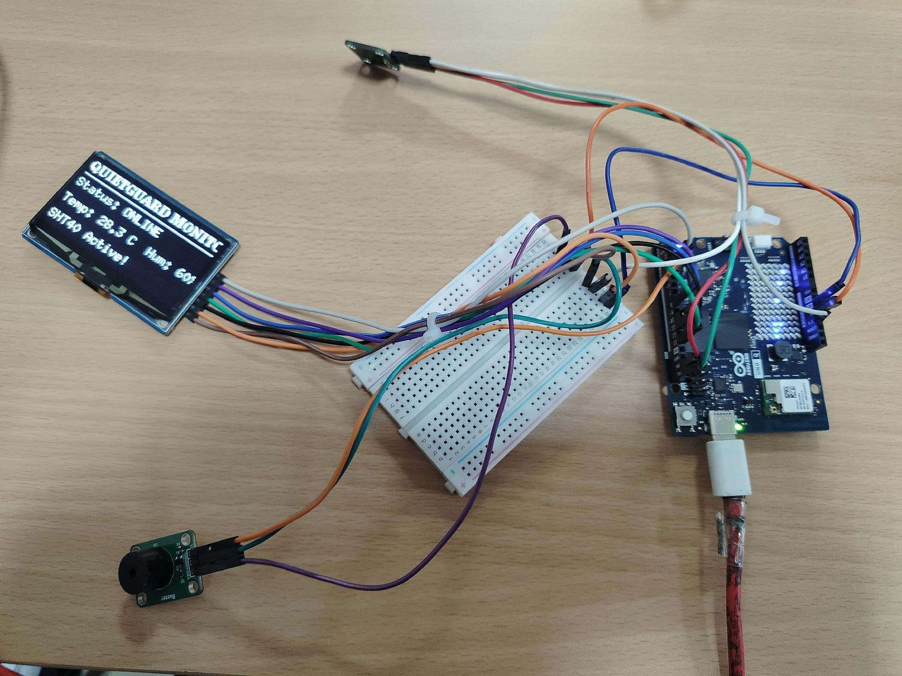
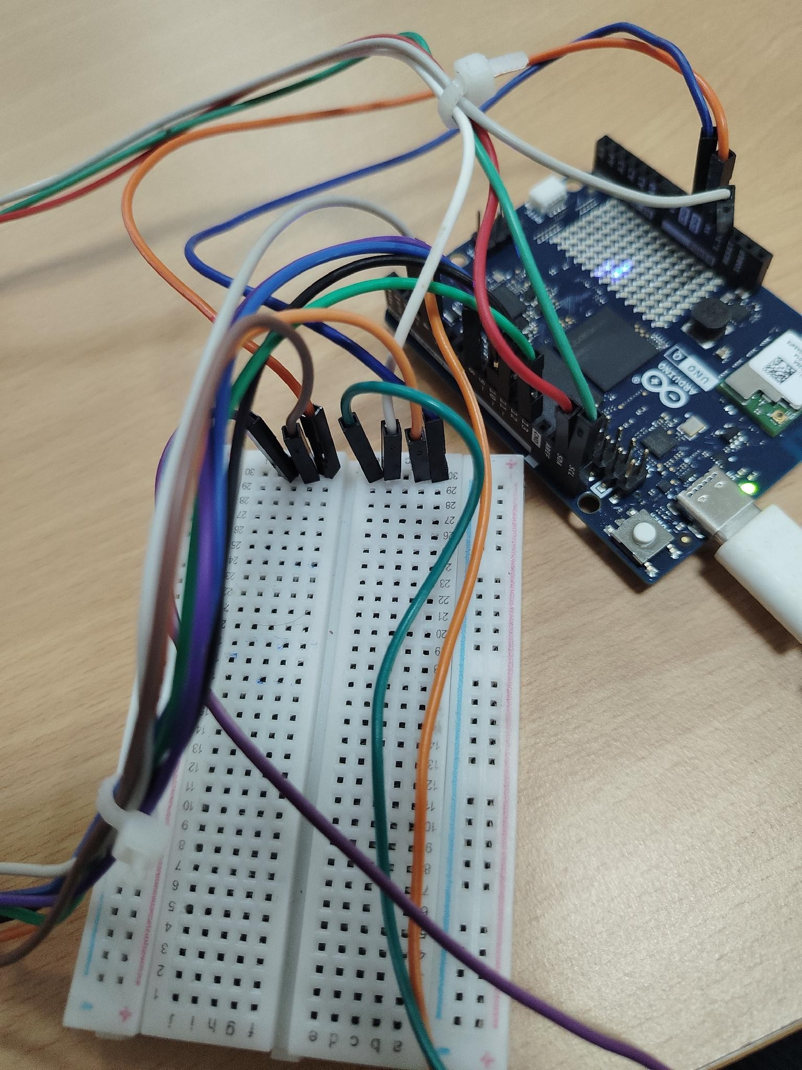
SYSTEM INTEGRATION VIEW
Live Hardware Layout & Wiring Assembly
Full Bench Setup — Live Telemetry
Breadboard & Bridge Wiring Close-Up
UNO Q Base
Power Rails
Peripheral Wiring
Connected via USB-C for power and Linux host communication
Centralized breadboard rails distribute 5V and GND to modules
Dedicated jumpers route SPI, I2C, and PWM to their modules
QuietGuard | Edge AI Acoustic & Environmental Monitor
6

Slide 7
Edge AI Audio Ingestion & Processing Pipeline
Host laptop microphone → Python sounddevice → cough-rate telemetry
01
02
03
04
Acoustic Input
Amplitude Filtering
Refractory Lockout
Sliding Buffer
Host laptop's internal microphone array, continuously sampled via Python's sounddevice library.
Evaluates real-time decibel energy norms against a calibrated baseline threshold (0.35) to isolate transient cough spikes from room background noise.
Applies a strict 1.5 second temporal lockout immediately following a detected peak to suppress echo tails and eliminate false double-counts.
Maintains a rolling 60-second queue to compute instantaneous frequency coughs/min, then dispatches live count updates over the /dev/ttyHS1 router bridge to the STM32 MCU.
→
→
→
QuietGuard | Edge AI Acoustic & Environmental Monitor
7

Slide 8
TUNING & CALIBRATION
Signal Processing Parameters
Key constants governing the cough-detection state machine
Parameter | Value | Purpose
Amplitude threshold | 0.35 (normalized RMS) | Separates cough transients from ambient room noise
Refractory lockout | 1.5 s | Prevents one cough from being counted multiple times
Rolling window | 60 s | Basis for the live coughs/min rate calculation
Alarm rate threshold | ≥ 3.0 coughs/min | Triggers the sustained 2500 Hz high-frequency alarm
Environmental poll interval | 2000 ms | SHT40 temperature/humidity refresh rate
High-temp alert threshold | > 30°C | Triggers periodic 1200 Hz thermal warning tone
QuietGuard | Edge AI Acoustic & Environmental Monitor
8

Slide 9
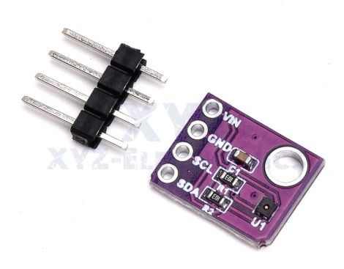
ADAFRUIT SHT40 BREAKOUT — TEMPERATURE & HUMIDITY
Environmental Sensing Stage
HARDWARE MODULE
Adafruit SHT40 Temperature & Humidity Sensor
INTERFACE PROTOCOL
I2C Bus via SDA and SCL lines
OPERATIONAL CHARACTERISTICS
Provides high-accuracy ambient thermal (°C) and relative humidity (%) readings.
Polled continuously by the microcontroller every 2000 ms to update live OLED metrics.
Shares the I2C bus with headroom for future vitals or air-quality sensors.
2000 ms
I2C
SHT40 breakout board with 4-pin header
Poll interval
Bus protocol
QuietGuard | Edge AI Acoustic & Environmental Monitor
9

Slide 10
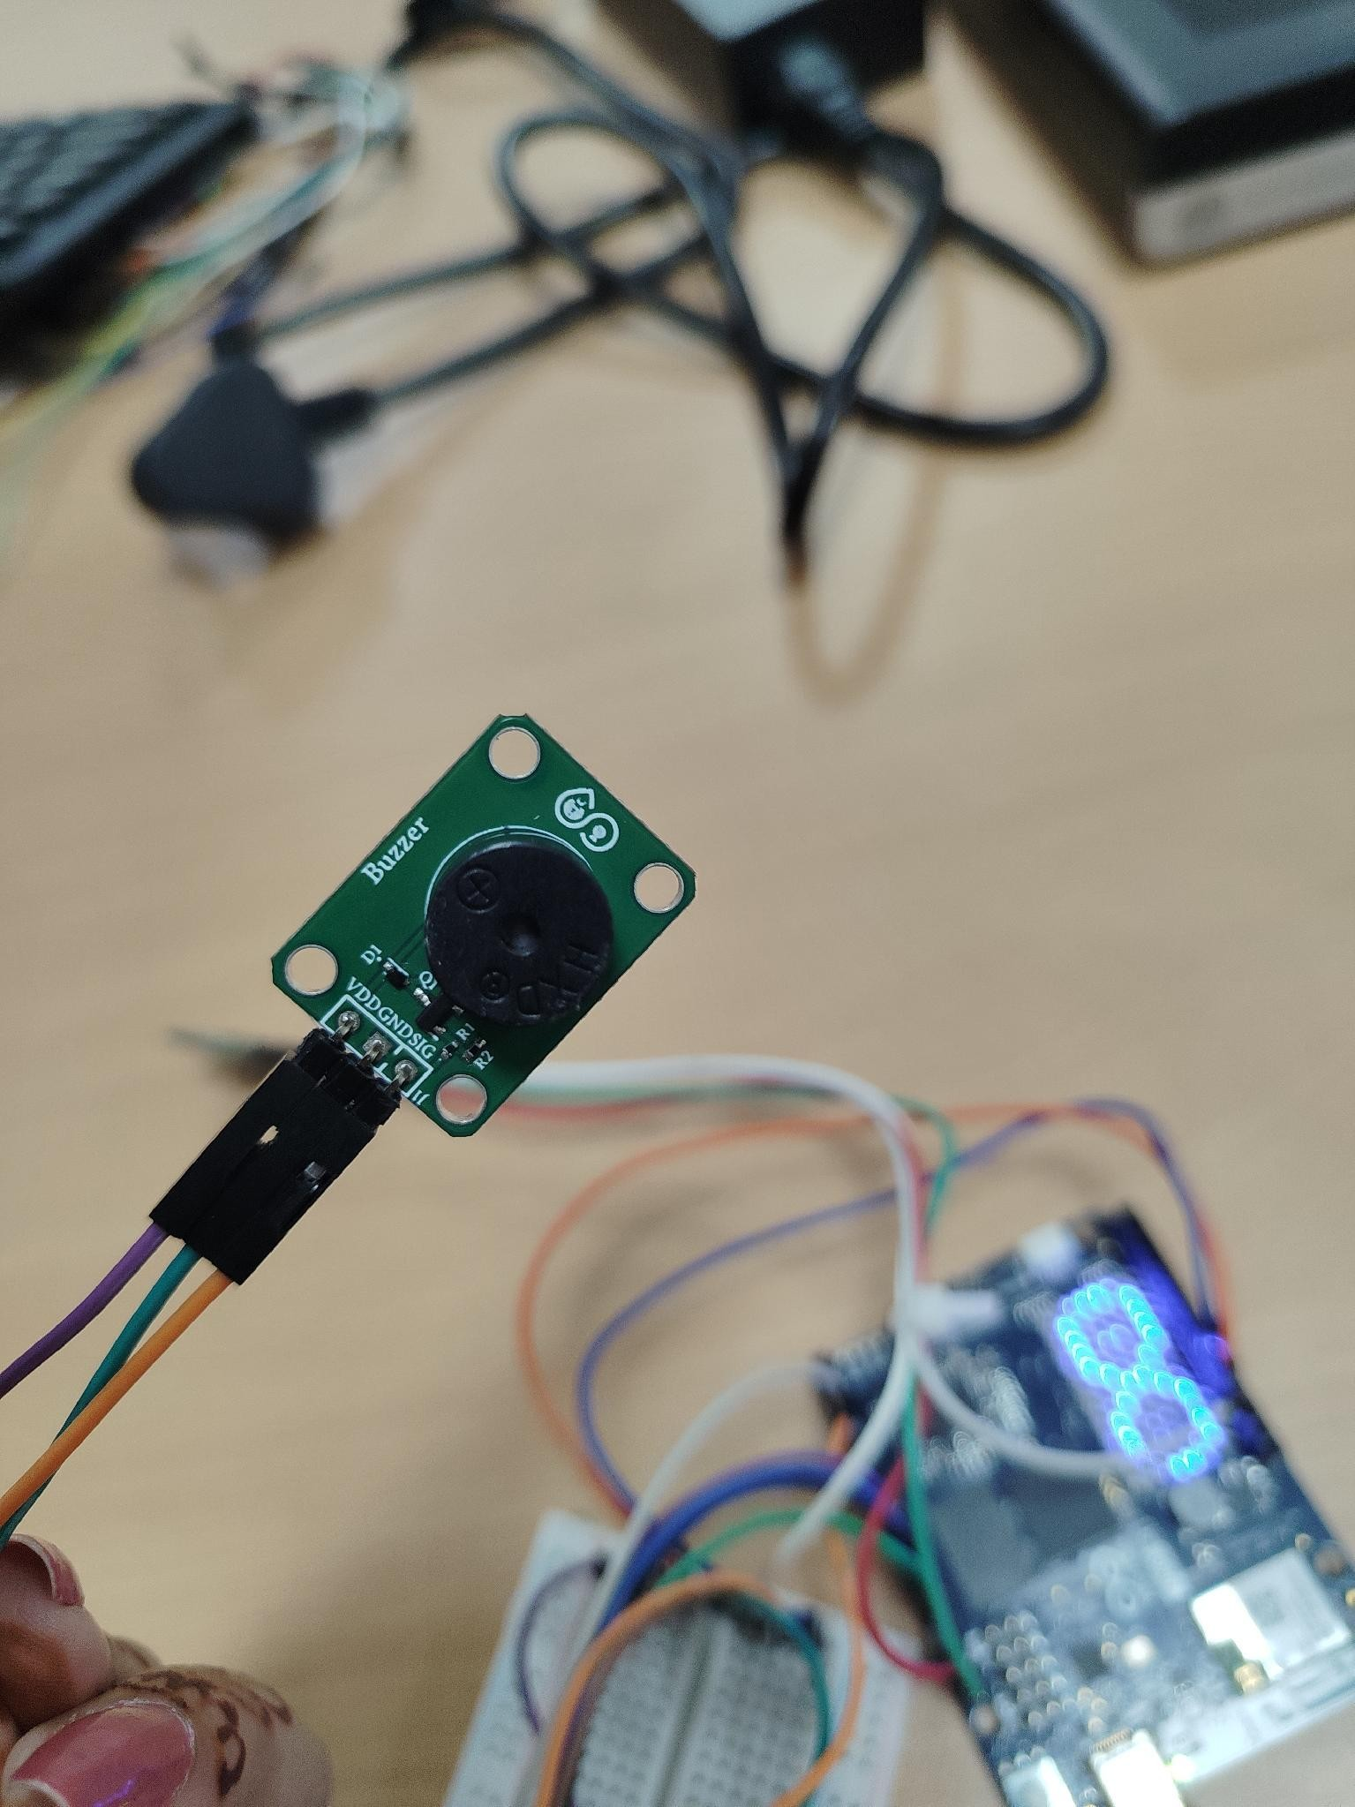
PIEZOELECTRIC BUZZER MODULE — DIGITAL PWM TONE OUTPUT ON PIN D4
Audio Actuation Stage
Single Event
1800 Hz
Short tone confirming a detected cough.
100 ms
High-Frequency Alarm
2500 Hz
Sustained alarm when cough rate ≥ 3.0 coughs/min.
300 ms
High Temp Alert
1200 Hz
Thermal warning beep when temperature > 30°C.
periodic
Piezo buzzer wired to the UNO Q signal bus
QuietGuard | Edge AI Acoustic & Environmental Monitor
10

Slide 11
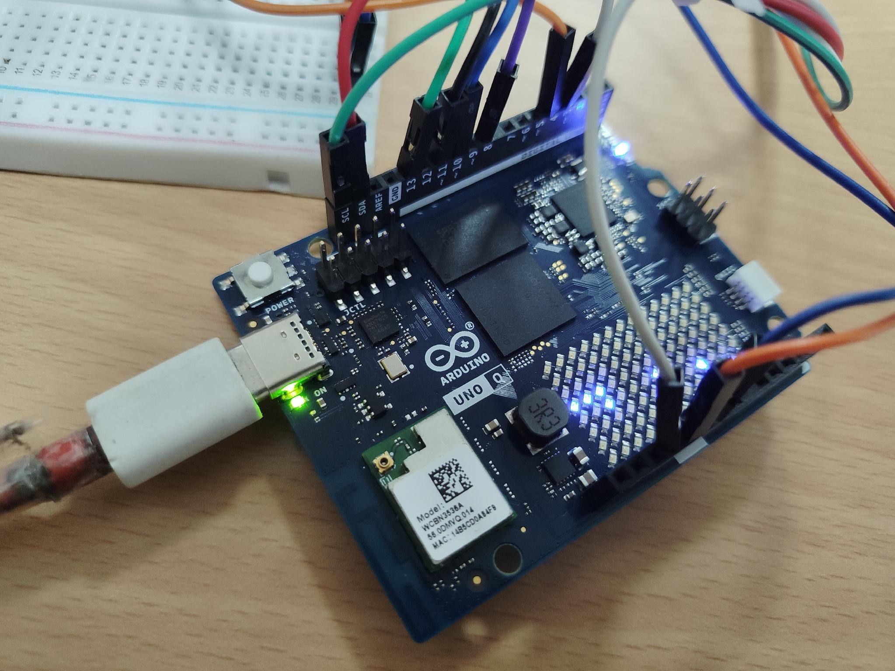
ARDUINO UNO Q — ONBOARD LED MATRIX & LINUX SYSTEM SUPPORT
Processing & Control Unit
PIN CONFIGURATION
I2C Bus
SDA, SCL
Connected to the SHT40 sensor
SPI Bus
13, 11, 10, 8, 7
CLK, DIN, CS, DC, RES — routed to the OLED screen
Audio Drive
D4
Linked to the buzzer signal line
Arduino UNO Q on the bench, LED matrix active
QuietGuard | Edge AI Acoustic & Environmental Monitor
11

Slide 12
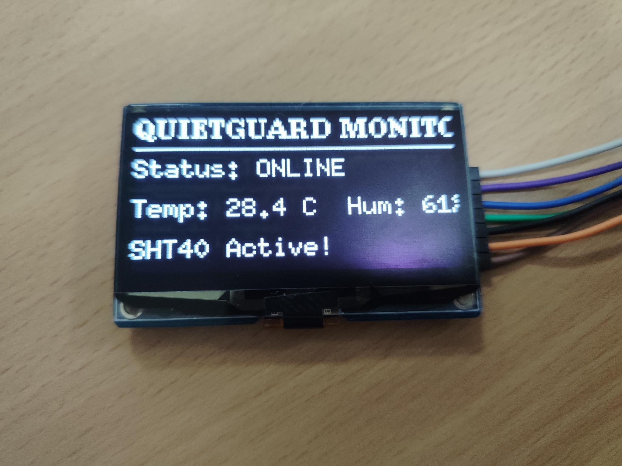
INITIALIZATION STATE
Real-Time OLED Interface
SCREEN LAYOUT & VISUAL HIERARCHY
Header
QUIETGUARD MONITOR
Line 1
System Status — Status: ONLINE
Line 2
Environment Readings — Temp: 28.4°C Hum: 61%
Line 3
Initialization Flag — SHT40 Active!
OLED display showing initialization telemetry
Displays primary environmental telemetry and system readiness prior to acoustic event triggers.
QuietGuard | Edge AI Acoustic & Environmental Monitor
12

Slide 13
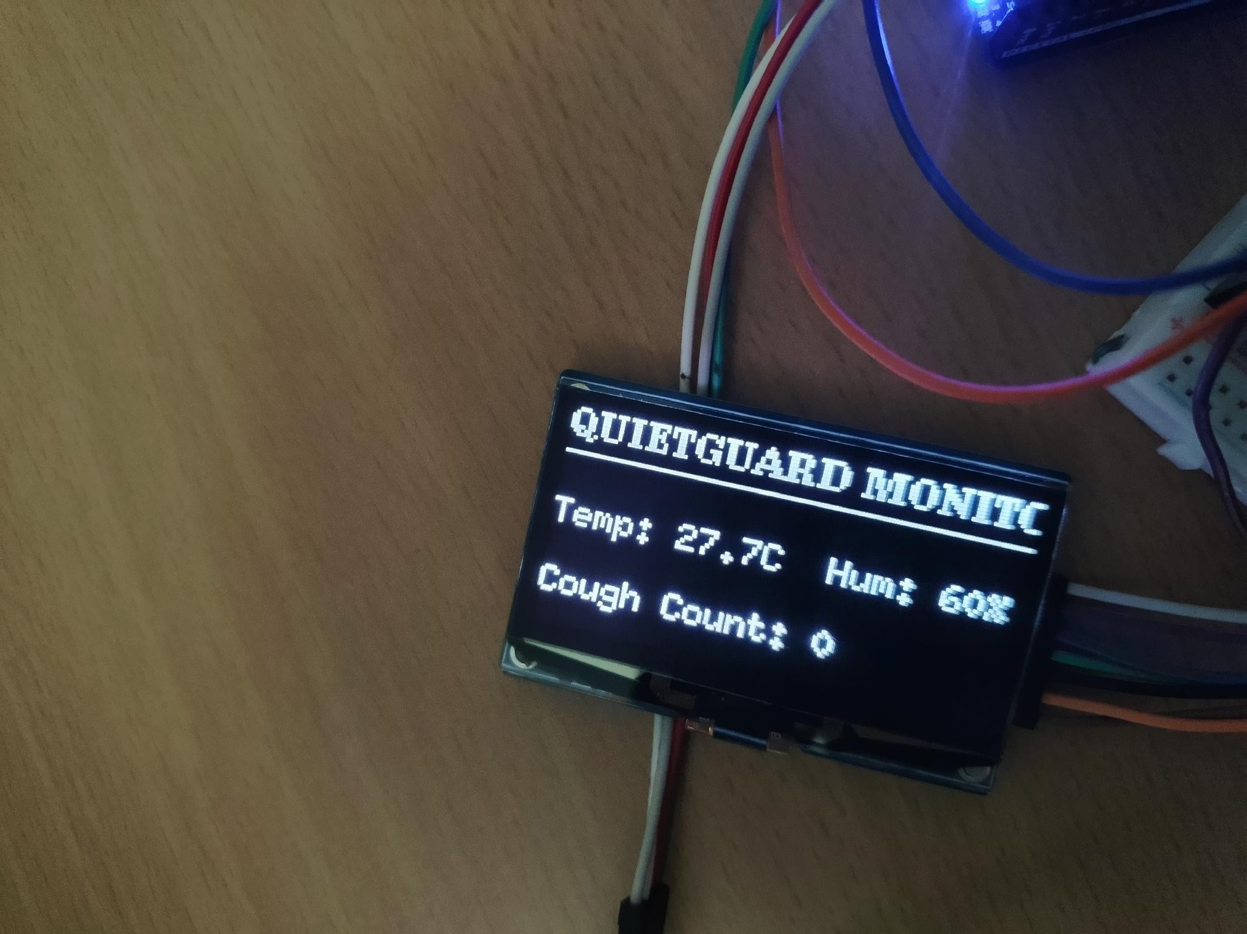
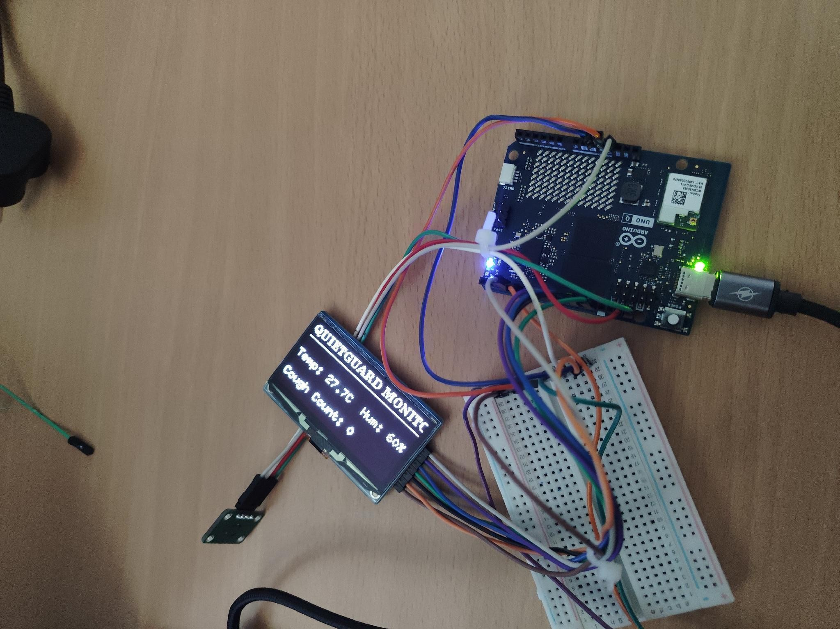
ACTIVE MONITORING STATE
Real-Time OLED Interface
LIVE TELEMETRY SCREEN LAYOUT
Header — QUIETGUARD MONITOR
Line 1 — Live Thermal Telemetry (Temp: 27.7°C, Hum: 60%)
Line 2 — Live Acoustic Metric (Cough Count: 0)
DYNAMIC UPDATING
Live telemetry close-up
Full bench, LED matrix active
The Cough Count value updates instantaneously when the Python acoustic engine detects a cough event and dispatches an RPC update.
Screen refresh keeps pace with the 1.5 s detection lockout, so no cough event is visually missed.
QuietGuard | Edge AI Acoustic & Environmental Monitor
13

Slide 14
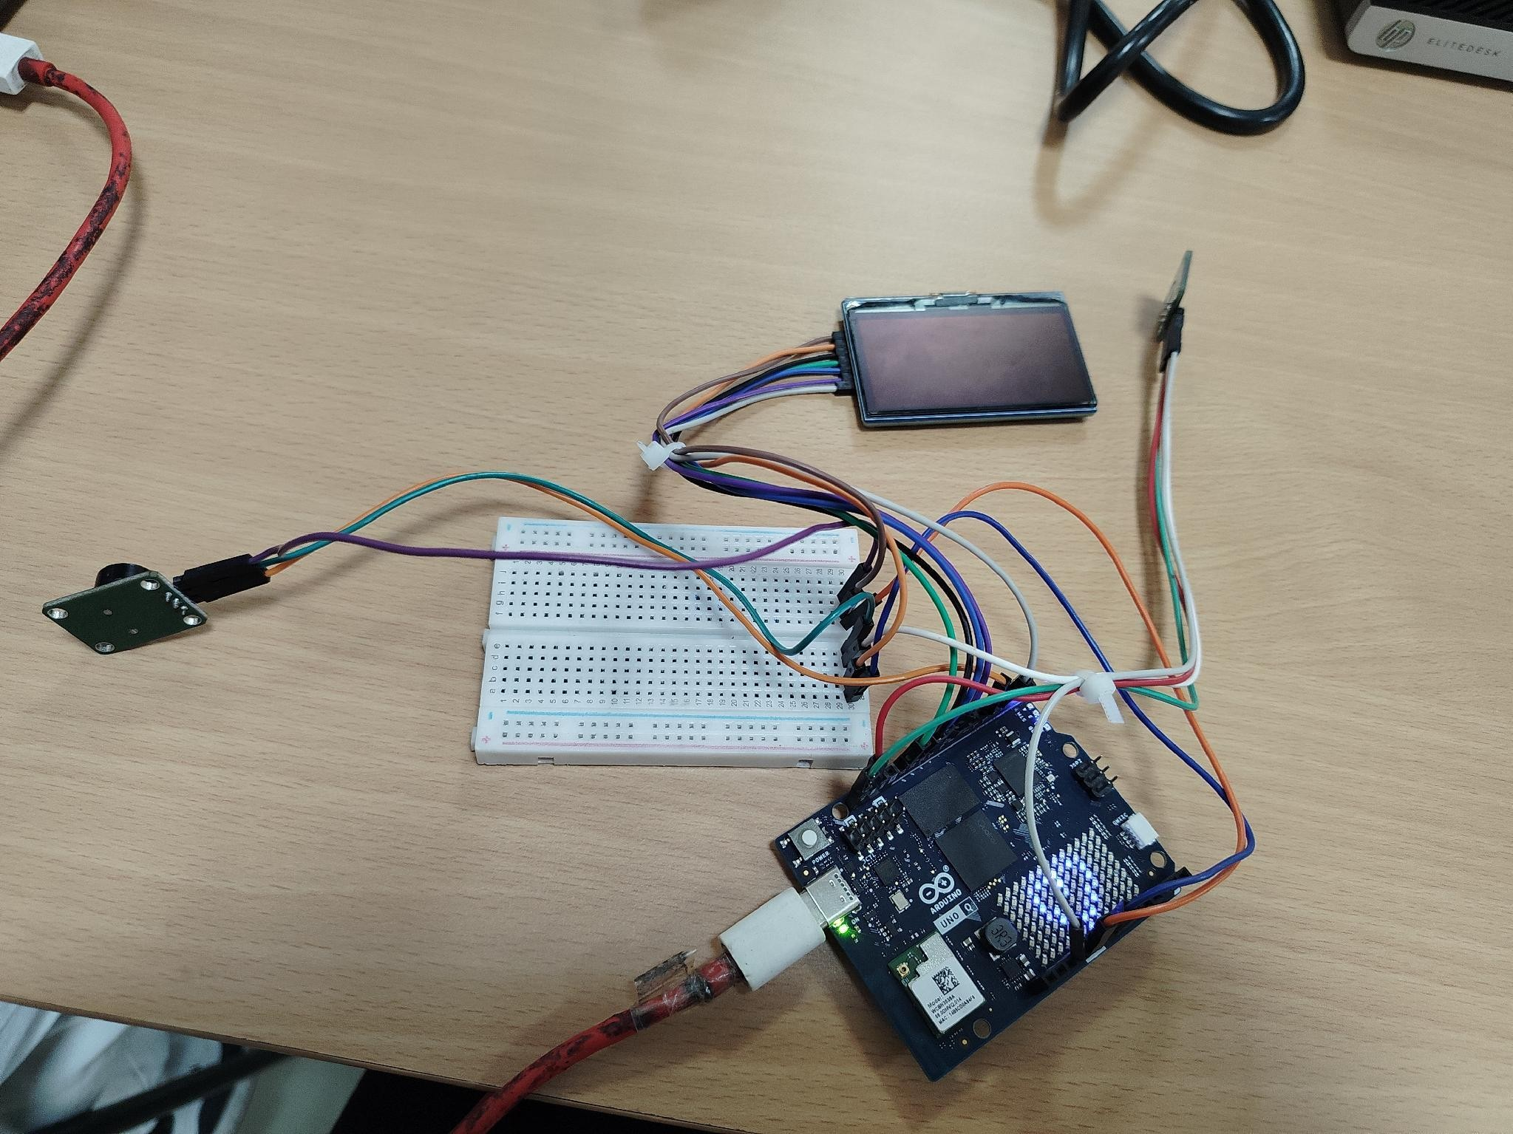
BUS ORGANIZATION & NOISE REDUCTION
Breadboard Wiring & Cable Management
✓
Bus Organization
Dual-side power rails supply unified 5V and GND across all external modules.
✓
Cable Management
Zip-ties consolidate jumper bundles to ensure reliable SPI signal integrity and prevent accidental disconnection.
✓
Noise Reduction
Dedicated ground return lines prevent analog noise coupling between the display driver and sensor lines.
✓
Serviceability
Consistent color-coding per bus (power, I2C, SPI, PWM) speeds up debugging and re-wiring during iteration.
QuietGuard | Edge AI Acoustic & Environmental Monitor
14

Slide 15
COMPLETE PIN AND PROTOCOL REFERENCE FOR THE QUIETGUARD BUILD
Hardware Interface Mapping Table
Module | Interface / Protocol | Pin(s) on UNO Q | Function
Adafruit SHT40 | I2C | SDA, SCL | Temperature & humidity sensing
SPI OLED Display | 4-Wire SPI | 13 (CLK), 11 (DIN), 10 (CS), 8 (DC), 7 (RES) | Real-time telemetry display
Piezoelectric Buzzer | Digital PWM | D4 | Audio alert tones
Host Microphone | USB / Internal Audio | Linux host (Python) | Acoustic cough-event capture
Inter-Core Bridge | MsgPack RPC | /dev/ttyHS1 (serial) | Host ↔ MCU telemetry transfer
QuietGuard | Edge AI Acoustic & Environmental Monitor
15

Slide 16
BENCH VERIFICATION
Testing & Validation Results
Measured behavior across repeated bench trials
27.7–28.4 °C
60–61 %
1.5 sec
<1 sec
Ambient temperature range logged on the SPI display
Relative humidity range logged over the same trials
Refractory lockout confirmed to prevent double-counting
Observed RPC latency from cough detection to buzzer response
VERIFIED DEMONSTRATION MILESTONES
Verified live ambient data sampling (27.7°C–28.4°C / 60%–61% RH) on the SPI display.
Verified host audio ingestion debouncing and inter-core bridge transmission.
Confirmed buzzer actuation response based on cough event triggers.
Confirmed OLED transition from initialization state to live monitoring state without manual restart.
Repeated trials showed consistent rolling coughs/min recalculation as the 60-second window slides.
QuietGuard | Edge AI Acoustic & Environmental Monitor
16

Slide 17
LESSONS FROM THE BENCH
Challenges & Engineering Trade-offs
False positives from ambient noise
Room chatter and chair creaks initially tripped the amplitude filter; the 0.35 threshold was tuned iteratively against recorded bench sessions.
Double-counting single coughs
A cough's echo tail could re-trigger detection; solved with the 1.5 s refractory lockout rather than a purely amplitude-based cutoff.
Cross-core timing drift
Early prototypes saw the OLED lag behind actual cough events; moving to a dedicated MsgPack RPC channel over /dev/ttyHS1 removed the bottleneck.
Breadboard signal noise
SPI display flicker traced to shared ground returns with sensor lines; resolved with dedicated ground paths per Cable Management practices.
QuietGuard | Edge AI Acoustic & Environmental Monitor
17

Slide 18
WHAT'S NEXT
Future Work & Roadmap
Priorities for moving from bench prototype to standalone product
Near-term
Dedicated hardware microphone module
Integrate a purpose-built mic directly onto the breadboard for a fully standalone unit, independent of the host laptop.
Near-term
Wi-Fi telemetry streaming
Implement Wi-Fi streaming to cloud healthcare dashboards for remote trend review.
Mid-term
On-device ML classification
Move from amplitude-threshold detection toward a lightweight on-device model to distinguish cough types from other noises.
Mid-term
Battery & enclosure design
Package the dual-core board, sensors, and buzzer into a powered, wall- or bedside-mountable enclosure.
Long-term
Multi-vitals expansion
Extend the I2C bus to additional sensors (e.g. SpO2, ambient air quality) for a broader passive health picture.
QuietGuard | Edge AI Acoustic & Environmental Monitor
18

Slide 19
System Demonstration & Conclusion
KEY DEMONSTRATION MILESTONES
Verified live ambient data sampling (27.7°C–28.4°C / 60%–61% RH) on the SPI display.
Verified host audio ingestion debouncing and inter-core bridge transmission.
Confirmed buzzer actuation response based on cough event triggers.
Project Summary
QuietGuard demonstrates that a low-cost, dual-core edge board can passively monitor respiratory acoustic events and environmental conditions without cloud dependence — giving instant local feedback through an OLED display and audible alerts.
QuietGuard — Dual-Core IoT Health & Acoustic Monitor
FUTURE WORK
3
2
60s
Integrating a dedicated hardware microphone module directly onto the breadboard for a fully standalone unit.
Implementing Wi-Fi telemetry streaming to cloud healthcare dashboards.
Actuation & display
alert modes
Independent
processing cores
Rolling detection
window
QuietGuard | Edge AI Acoustic & Environmental Monitor
19

Slide 20
Thank You
QuietGuard — Dual-Core IoT Health & Acoustic Monitor
QuietGuard | Edge AI Acoustic & Environmental Monitor
20

