Slide 1
Project Presentation of Co-Op Project at Industry (Module-2)
On
Shubham Thakur
2210992414
Aayush Ranjan
2210991137 Supervised By :
Shyam B G
Department of Computer Science and Engineering,
Chitkara University, Punjab

Slide 2
Introduction
Data processing has become an essential part of modern analytics systems due to the rapid growth of large-scale data from applications, logs, and online platforms. Traditional tools like Pandas perform efficiently on small datasets but face memory and scalability limitations as data size increases. On the other hand, PySpark provides distributed and parallel processing capabilities for handling big data workloads.
Data pipelines are essential for modern analytics systems to extract, clean, transform, and analyze large volumes of data.Exercise frequency and screen time
Pandas is widely used for fast and simple data processing but faces limitations with very large datasets.
PySpark uses distributed computing to efficiently process big data at scale.
This research compares Pandas and PySpark across different stages of a data pipeline using datasets from 10K to 10M rows.
The study focuses on execution time, memory usage, scalability, and identifying when PySpark becomes more efficient than Pandas.
2

Slide 3
Problem Statement
Modern data systems generate massive amounts of data that require efficient ETL processing. Pandas works well for small datasets but faces memory and scalability limitations on large data, while PySpark supports distributed processing with additional overhead.
Because of this:
The efficiency crossover point between Pandas and PySpark is unclear
Large datasets create scalability and memory challenges
Existing studies lack detailed stage-wise ETL analysis
This research compares both frameworks across ETL stages using datasets from 10K to 10M rows.

Slide 4
Objectives
The main goals of this study were:
Compare the performance of Pandas and PySpark across ETL and analytics stages
Analyze execution time, memory usage, and scalability on datasets from 10K to 10M rows
Identify the stage-wise bottlenecks affecting ETL pipeline performance
Determine the data size at which PySpark becomes more efficient than Pandas
Provide practical guidance for selecting the appropriate framework for real-world big data processing tasks

Slide 5
Methodology Overview
The study implemented identical ETL and analytics pipelines in Pandas and PySpark to ensure fair comparison across different dataset sizes. Synthetic datasets ranging from 10K to 10M rows were generated using the Faker library and processed through four stages: Extract, Transform, Load, and Analytics.
The methodology included:
CSV datasets generated with realistic transaction-based records using Faker
Data preprocessing including duplicate removal, null handling, type conversion, and revenue calculation
Execution time measured separately for Extract, Transform, Load, and Analytics stages
Memory utilization monitored using RSS-based profiling during execution
Performance comparison based on execution time, scalability, and memory efficiency across all dataset sizes

Slide 6
Methodology (Detailed Flow)
1. Dataset Generation
• Synthetic datasets created using the Faker library • Dataset sizes: 10K, 100K, 1M, 5M, and 10M rows
2. Extract Stage
• CSV datasets loaded into DataFrames • Pandas processed data sequentially • PySpark processed data in parallel using distributed execution
3. Transform Stage
• Removed duplicate records • Handled missing/null values • Standardized string formats and validated data types
4. Load Stage
• Cleaned datasets stored in Apache Parquet format with Snappy compression • Write performance measured for both frameworks

Slide 7
Tools and Technologies
The following tools and technologies were used:
Python 3.10 – core programming language for the ML pipeline
Scikit-learn – Logistic Regression, Random Forest, SVM implementation
Pandas & NumPy – data loading, preprocessing, and feature engineering
StandardScaler – feature normalisation before model training
Matplotlib & Seaborn – charts and visualisations for results
Google Forms – primary data collection from 23 respondents
Google Colab – cloud-based environment for running the pipeline

Slide 8
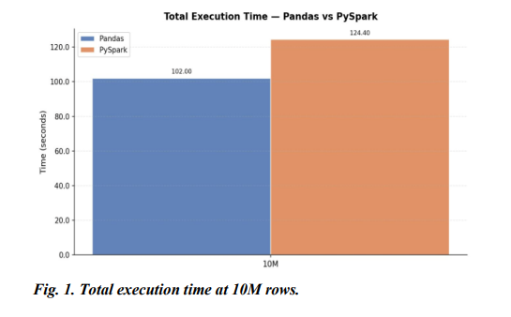
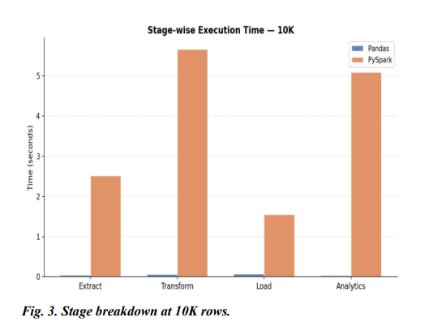
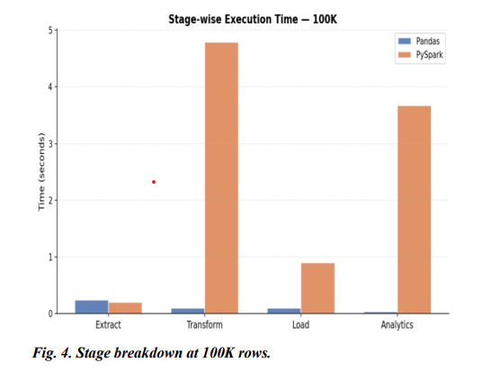
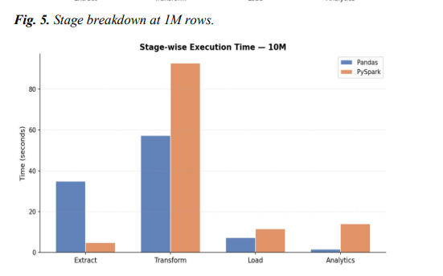
Results

Slide 9
The experimental evaluation showed significant differences between Pandas and PySpark in execution time and memory efficiency across different dataset sizes. At 10 million rows, Pandas completed the complete ETL pipeline in 102.0 seconds, while PySpark required 124.4 seconds. However, PySpark achieved much faster extraction performance, completing the Extract stage in 4.8 seconds compared to 34.9 seconds for Pandas, making it 7.2× faster.
Because of this:
• PySpark was 7.2× faster in the Extract stage due to parallel CSV processing • Pandas performed better in Transform, Load, and Analytics stages on datasets up to 10M rows • The Transform stage became the major bottleneck for PySpark because of shuffle and Python-JVM overhead • PySpark used only 145.6 MB memory at 10M rows compared to 1400.9 MB used by Pandas • Memory usage was reduced by 89.6% in PySpark, making it more scalable for very large datasets
The results indicate that Pandas is faster for moderate-sized datasets on a single machine, while PySpark becomes more practical for large-scale workloads where memory efficiency, scalability, and distributed processing are more important than total execution time.

Slide 10
Challenges and Learnings
Challenges
• Managing and processing very large datasets efficiently on a single workstation • Handling high memory consumption in Pandas for large-scale datasets • Dealing with shuffle operations and Python-JVM communication overhead in PySpark • Maintaining fair benchmarking by keeping identical ETL workflows across both frameworks • Measuring accurate stage-wise execution time and memory utilization during processing
Learnings
• Pandas performs better for small and medium-sized datasets on a single machine • PySpark provides superior memory efficiency and scalability for large-scale data processing • Distributed computing improves extraction speed but introduces coordination overhead • The Transform stage is the major performance bottleneck in PySpark pipelines • Memory efficiency is often more important than total execution time in real-world big data systems

Slide 11
References
[1] T. Hey, S. Tansley and K. Tolle, The Fourth Paradigm: Data-Intensive Scientific Discovery. Redmond, WA: Microsoft Research, 2009.
[2] R. Kimball and M. Ross The Data Warehouse Toolkit, 3rd edition. Indianapolis, IN: Wiley, 2013.
[3] W. McKinney says data structures are very important for computing in Python. He talked about it in Proc. 9Th Python in Science Conf. (SciPy) Austin, TX, 2010 pages 56–61.
[4] S. Owen, R. Anil, T. Dunning and E. Friedman wrote a book called Mahout in Action. It was published by Manning Publications in Greenwich, CT in 2011.
[5] M. Armbrust and others wrote about Spark SQL. They talked about data processing in Spark at the ACM SIGMOD Int. Conf. Management of Data in 2015. It was on pages 1383–1394.
[6] A. Alexandrov and others wrote about The Stratosphere platform. They talked about data analytics in VLDB J., volume 23 number 6 pages 939–964 in 2014.

Slide 12
Thank You
12

