Slide 1

Chatbot

Slide 2
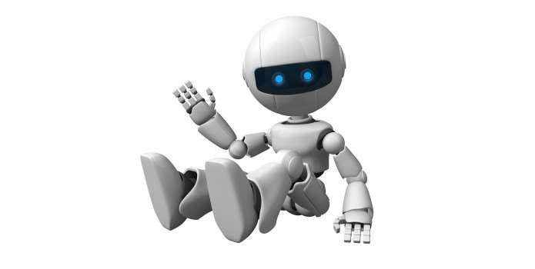
What Is A Chatbot ?
chat robot, a computer program that simulates human conversation, or chat, through artificial intelligence. Typically, a chat bot will communicate with a real person.

Slide 3
Why Chatbot ?
Bots are a lot easier to install than mobile apps.
Bots are easily distributed.
Quality mobile apps are expensive to build, maintain and deploy.
Moving complexity to the cloud reduces a user’s cognitive load.

Slide 4
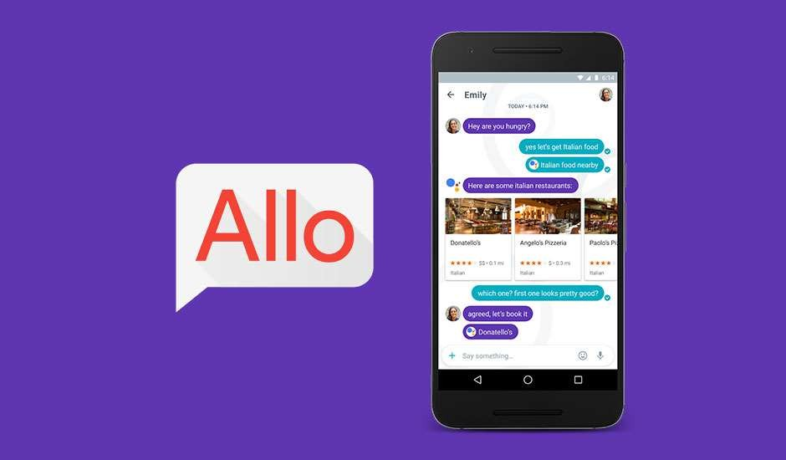

Slide 5

How to create the bot for telegram :
First install the Telegram App.
Then start chat with BotFather (it is the one bot to rule them
all) .
Then follow a few simple steps to create a bot and receive
authorization token, we will use that token later.
For AI Agent:
Api.ai
FlowXo.com
We have to add our token to these websites for enabling AI to our Bot.

Slide 6

Natural Language Processing
Natural language processing (NLP) is the ability of a computer program to understand human speech as it is spoken. NLP is a component of artificial intelligence .
It makes computer to perform useful tasks with the natural languages humans use.
Current approaches to NLP are based on machine learning
The input and output of an NLP system can be −
Speech
Written Text

Slide 7
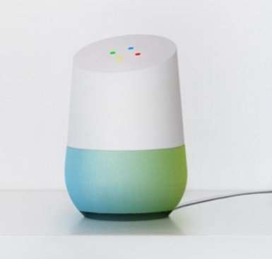
Google Home
Google Home is a voice-activated home product that allows you and your family to get answers from Google, stream music, and manage everyday tasks.

Slide 8
JAVA SWING
Java swing components are platform-independent.
Swing components are lightweight.
Swing supports pluggable look and feel.
Swing provides more powerful components such as tables, lists, scroll panes, color chooser, tabbed pane etc.
Swing follows MVC.

Slide 9
ABOUT PROJECT
This is IPL CHAT BOT.
Here we can get details regarding IPL-2020
Such as number of teams,team names, venues
History of each team.

Slide 10
FRAMES AND METHOD’S USED
Java Jlabel- The object of JLabel class is a component for placing text in a container. It is used to display a single line of read only text. The text can be changed by an application but a user cannot edit it directly. It inherits JComponent class.
Java Jframe- JFrame works like the main window where components like labels, buttons, textfields are added to create a GUI..
Java JTextField-The object of a JTextField class is a text component that allows the editing of a single line text. It inherits JTextComponent class..
Java JTextArea- The object of a JTextArea class is a multi line region that displays text. It allows the editing of multiple line text. It inherits JTextComponent class

Slide 11
FRAMES AND METHOD’S USED
Java JColorChooser- The JColorChooser class is used to create a color chooser dialog box so that user can select any color. It inherits JComponent class.
Java Jdialog- The JDialog control represents a top level window with a border and a title used to take some form of input from the user. It inherits the Dialog class.
Java Jpanel- The JPanel is a simplest container class. It provides space in which an application can attach any other component. It inherits the JComponents class.

Slide 12
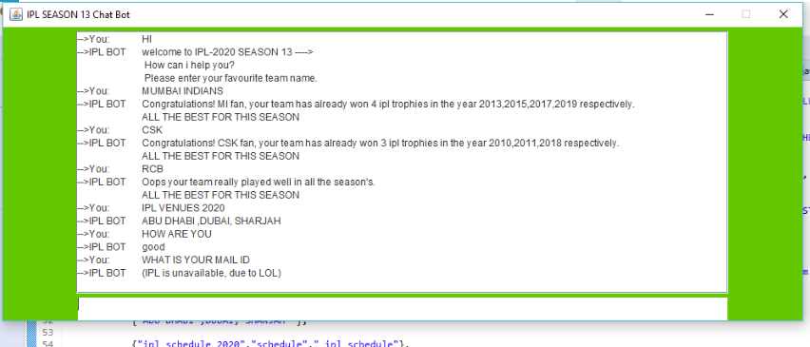
RESULTS

Slide 13
Thank You

