Slide 1

Nearby locations
Shilpa Kumari

Slide 2
Mentor Details
Name : Vijay Kumar
Email id :vijayk@greysprings.com
Designation : Senior Software Developer
Name : Manish Kumar
Email id: mj@greysprings.com
Designation :Senior Software Developer

Slide 3
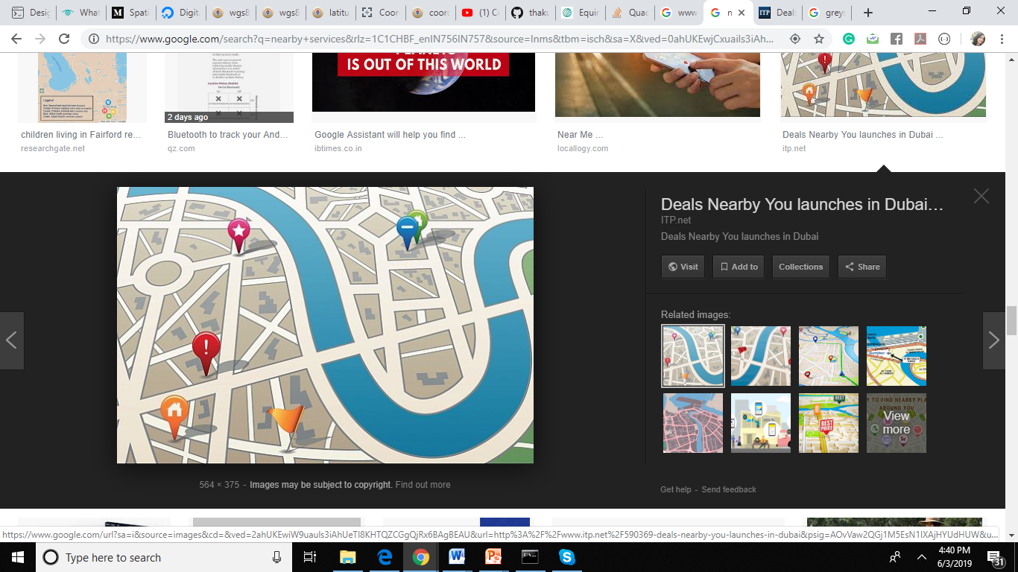
Introduction
Nearby location is a user friendly interface which links user with its nearby places.
User get information about all places with in a particular radius.
Result contains name of location and distance between the locations.
Search time of finding places is between 0 to 5 ms.

Slide 4
Objective
The aim of this project is to reduce search time.
In this project we use quadtree data structure.
We compare search time of linear search and quadtree search and result will tell us which one is faster.

Slide 5
Technology used
Node.js
Express
Google maps API
Postman
Github
Git
Digital Ocean

Slide 6
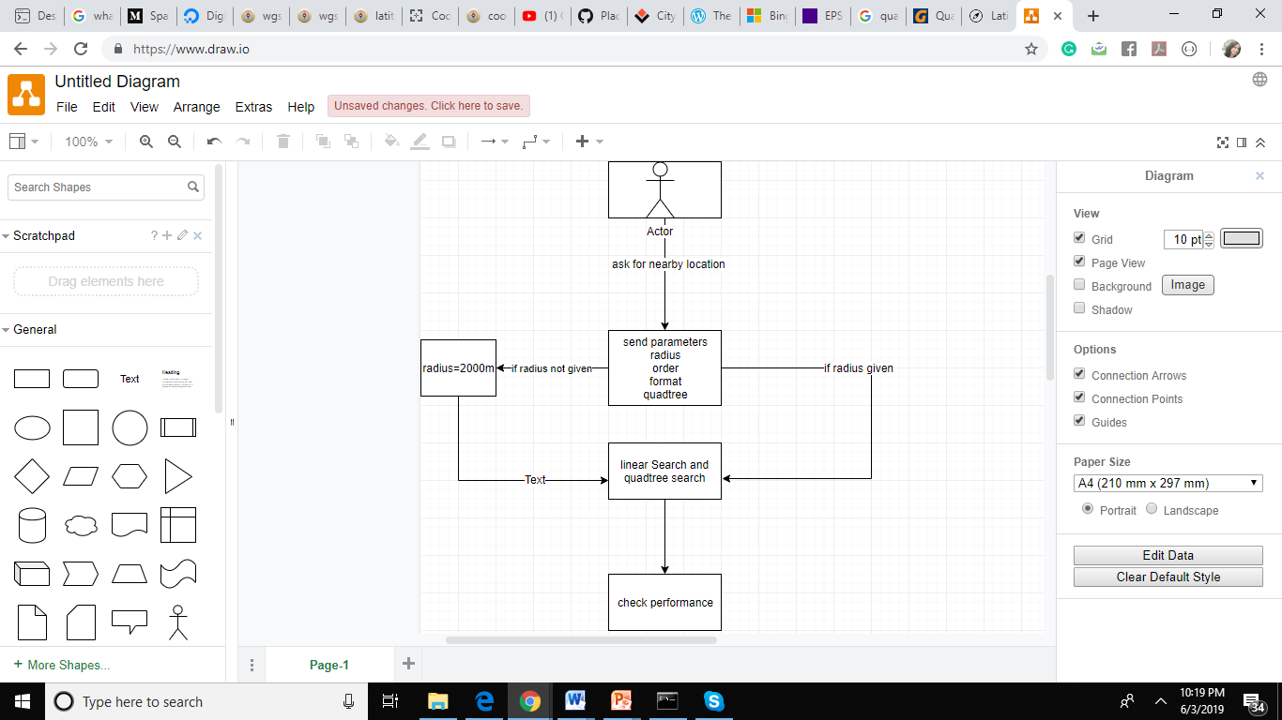
Architecture

Slide 7
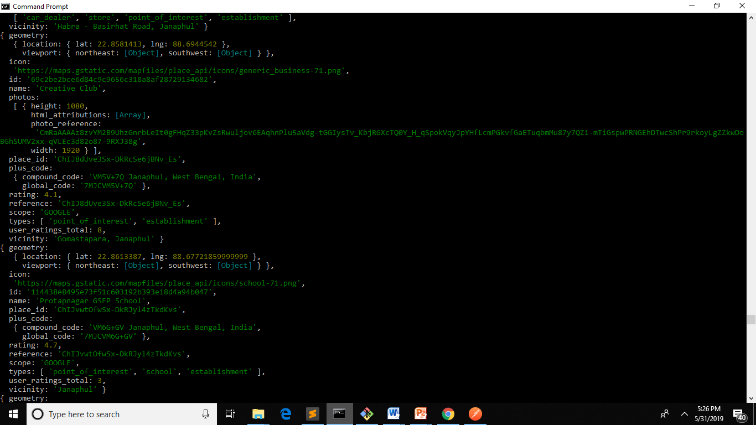
Steps
Gather information of places from Google maps nearby API
Information is in the form of json.

Slide 8
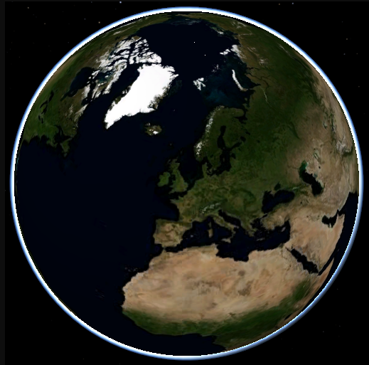
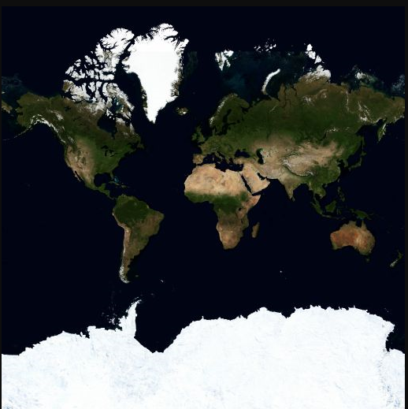
Convert earth(Spherical) in to rectangle (Projection)

Slide 9
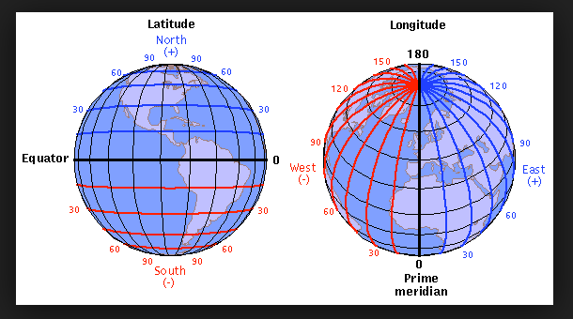
Location data
Latitude and Longitude are the units that represent the coordinates at geographic coordinate system.

Slide 10
Spherical Trigonometry is used to conversion
double x = lon * 20037508.34 / 180;
double y = Math.Log(Math.Tan((90 + lat) * Math.PI / 360)) / (Math.PI / 180);
y = y * 20037508.34 / 180;
lon is longitude and lat is latitude.
The EPSG:3857 projection suggests a Mercator projection of coordinates defined on the WGS84 ellipsoid
WGS84 comprises a standard coordinate frame for the Earth, a datum/reference ellipsoid.
The projected Pseudo-Mercator coordinate system takes the WGS84 coordinate system and projects it onto a square

Slide 11
Put location data in quadtree
Quadtree is a data structure that encode a two-dimensional space into adaptable cells. Similar to binary trees, quadtrees are a tree structure where every non-leaf node has exactly four children. In the context of location, these nodes represent the four quadrants: NW, NE, SW, and SE. Each node in a quadtree can be recursively subdivided, with successive subdivisions resulting in smaller and smaller cells.
A quadtree can be depicted as a grid, with each square representing a node in the tree.

Slide 12
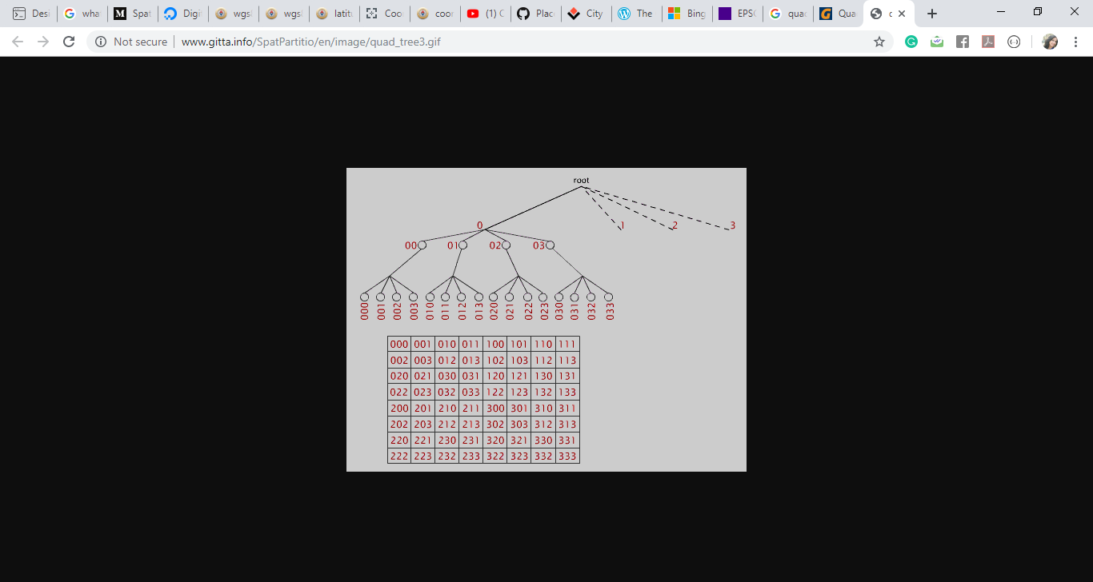
Quadtree
When conversion is done we add points in the qadtree.
In quadtree cut each map into tiles for quick retrieval and display.

Slide 13
Quadtree
In a quadtree, each node represents a bounding box covering some part of the space being indexed, with the root node covering the entire area.
Starting at the root, determine which quadrant your point occupies. Recurs to that node and repeat, until you find a leaf node. Then, add your point to that node's list of points. If the list exceeds some pre-determined maximum number of elements, split the node, and move the points into the correct sub nodes.

Slide 14
Parameters
format: full|min radius: number order: asc/desc algorithm: quadtree/linear
Format: format specify result format For eg. Complete information or some information of location .
Radius: distance of user’s choice up to which user want nearby places.
Order: Order of result
Algorithm: it is used for check performance.

Slide 15
Performance result of linear search and quadtree search
Latitude | longitude | radius | linear_search | quadtree_search
32.2209194 | 76.159186 | 6 | 10 | 1
32.223211 | 76.159186 | 6 | 9 | 0
29.938175 | 76.7893 | 6 | 9 | 1
22.07474 | 82.125164 | 6 | 9 | 0
30.901225 | 76.964439 | 6 | 9 | 0
32.010202 | 77.314151 | 6 | 9 | 0
31.04453 | 76.702256 | 6 | 11 | 0
27.169108 | 77.999869 | 6 | 10 | 0
31.72741 | 76.50832 | 6 | 8 | 0
30.548327 | 76.56265 | 6 | 9 | 0

