Slide 1


Slide 2
Company Background
Goldman Sachs Consumer Finance | From institutional finance to digital consumer lending
WALL STREET HERITAGE
REGULATORY SHIFT
Founded in 1869, Goldman Sachs built a long-standing business serving institutions, corporations and high-net-worth clients.
After the 2008 financial crisis, Goldman Sachs became a bank holding company, enabling it to accept retail deposits.
THE RETAIL PIVOT
DIGITAL-FIRST MODEL
Marcus launched in 2016 as a digital consumer-finance business intended to diversify revenue beyond trading and investment banking.
A branchless model reduced reliance on physical branches and supported online savings accounts and personal loans.
INITIAL OFFERINGS
ECOSYSTEM PARTNERSHIPS
Marcus offered high-yield savings accounts and fixed-rate personal loans with no origination fees.
Goldman Sachs partnered with Apple to launch Apple Card in 2019, expanding its reach through embedded finance.
PORTFOLIO EXPANSION
INTERNAL RESTRUCTURING
The firm acquired GreenSky and issued co-branded credit cards, including a partnership with General Motors.
Consumer activities were grouped within Platform Solutions as Goldman Sachs reassessed the economics and risks of consumer finance.
FINANCIAL HURDLES
STRATEGIC REALIGNMENT
Elevated operating costs, loan-loss provisions and consumer credit exposure pressured the economics of the retail expansion.
Goldman Sachs subsequently moved away from much of its retail-lending strategy, including the sale of GreenSky and an announced transfer of the Apple Card portfolio to JPMorgan Chase.
CONSUMER FINANCE LOAN ANALYTICS | DATA ANALYTICS CAPSTONE
02

Slide 3
Project Objectives
Translate loan-level data into evidence-led decisions for lending leadership
01 CUSTOMER & REGION
02 APPROVAL EFFICIENCY
Customer & Region: Analyze regional customer distribution; South leads with 97,683 customers
Approval Efficiency: Assess approval rates, but approved/rejected statuses are unavailable
03 CREDIT RISK
04 PORTFOLIO GROWTH
Credit Risk: Identify 548 high-risk loans using grade, income, and loan amount
Portfolio Growth: Loans increased from 2,594 in 2012 to 43,368 in 2016
05 PRICING & PURPOSE
06 REPAYMENT HEALTH
Pricing & Purpose: Debt consolidation leads with 152,285 loans and a 7.34% charged-off/default rate
Repayment Health: Monitor late and charged-off loans; individual missed-payment histories are unavailable
CONSUMER FINANCE LOAN ANALYTICS | DATA ANALYTICS CAPSTONE
03

Slide 4
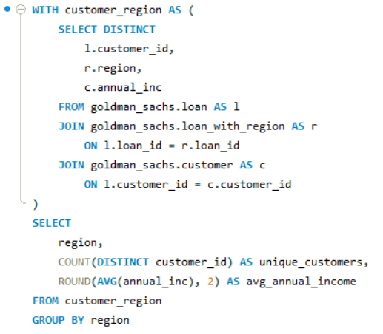
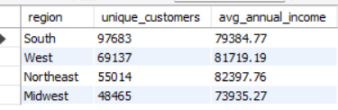
SQL Analysis 01 | Regional Customer & Credit Profile
Retrieve the number of unique customers by region.
SQL QUERY
QUERY OUTPUT
KEY OBSERVATIONS & BUSINESS INSIGHTS
Observation: The South has the largest customer base (97,683), followed by the West (69,137), Northeast (55,014), and Midwest (48,465).
Business Insight: The South is a potential target for expansion due to its larger customer base. Average credit scores cannot be compared because the dataset lacks a credit-score column; loan grades can be used as a risk indicator.
CONSUMER FINANCE LOAN ANALYTICS | DATA ANALYTICS CAPSTONE
04

Slide 5
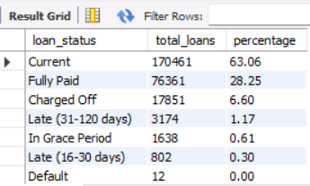
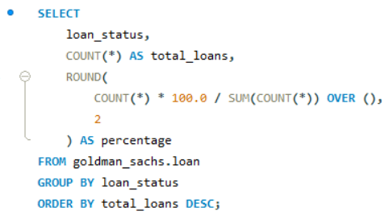
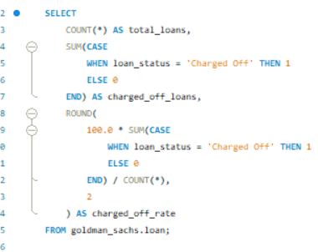

SQL Analysis 02 | Loan Approval Efficiency
Calculate the percentage of approved loans out of total applications.
SQL QUERY
QUERY OUTPUT
KEY OBSERVATIONS & BUSINESS INSIGHTS
Observation: Out of 270,299 total loans, 17,851 were charged off, representing 6.60% of the loan portfolio.
Business Insight: The 6.60% charged-off rate highlights potential credit-risk exposure.
Global FinBank should strengthen borrower risk assessment and monitor loan performance to reduce future losses.
The actual loan approval rate cannot be calculated because approved and rejected application statuses are unavailable.
CONSUMER FINANCE LOAN ANALYTICS | DATA ANALYTICS CAPSTONE
05

Slide 6
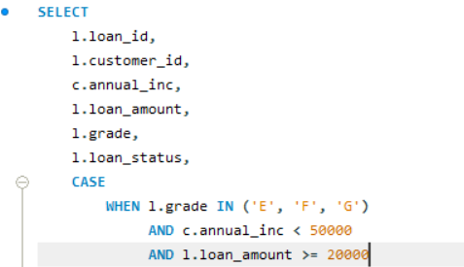
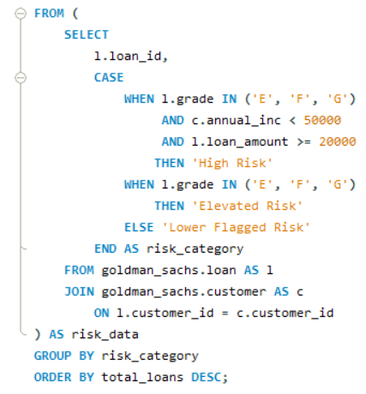
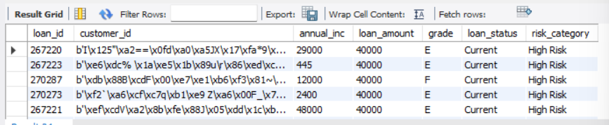
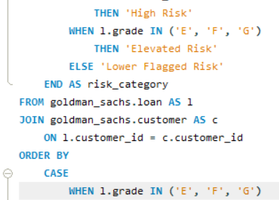
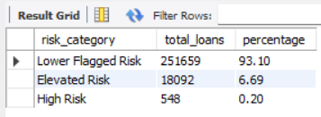
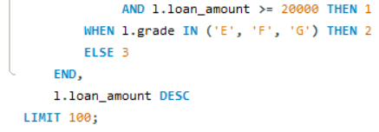
SQL Analysis 03 | High-Risk Loan Identification
Flag applications with low credit scores, lower income and higher loan amounts.
SQL QUERY
QUERY OUTPUT
KEY OBSERVATIONS & BUSINESS INSIGHTS
Observation: Out of 270,299 loans, 251,659 (93.10%) were classified as Lower Flagged Risk, 18,092 (6.69%) as Elevated Risk, and 548 (0.20%) as High Risk.
Business Insight: The 548 High Risk loans meet all three selected criteria: grades E–G, annual income below $50,000, and loan amounts of at least $20,000. These borrowers may require closer monitoring to reduce potential credit losses.
CONSUMER FINANCE LOAN ANALYTICS | DATA ANALYTICS CAPSTONE
06

Slide 7
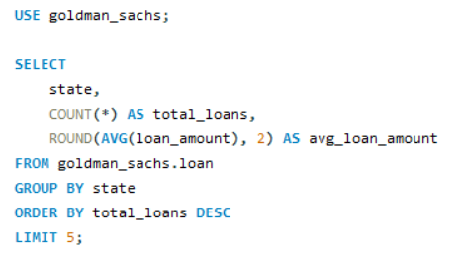
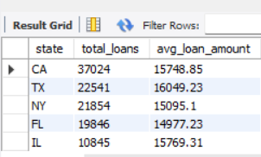
SQL Analysis 04 | State Approval Leaders
Find the top five states by loan approval rate and compare their average approved loan amounts.
SQL QUERY
QUERY OUTPUT
KEY OBSERVATIONS & BUSINESS INSIGHTS
Observation: California leads with 37,024 loans and an average loan amount of $15,748.85, followed by Texas (22,541), New York (21,854), Florida (19,846), and Illinois (10,845).
Business Insight: California has the highest loan volume among the top five states, making it a key market for lending operations. Average loan amounts range from $14,977.23 in Florida to $16,049.23 in Texas, indicating differences in borrowing patterns across states.
CONSUMER FINANCE LOAN ANALYTICS | DATA ANALYTICS CAPSTONE
07

Slide 8
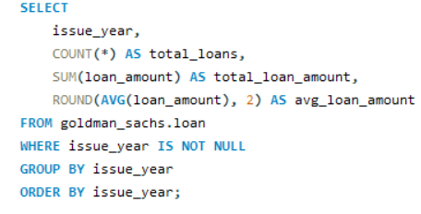
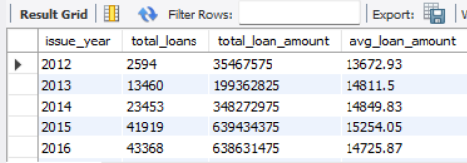
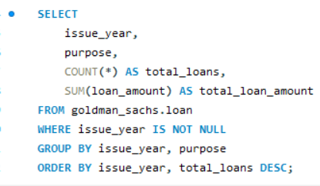
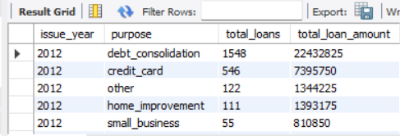
SQL Analysis 05 | Yearly Disbursement & Growth
Analyze yearly disbursement trends and identify the fastest-growing loan categories.
SQL QUERY
QUERY OUTPUT
KEY OBSERVATIONS & BUSINESS INSIGHTS
Observation: In 2012, debt consolidation was the most common loan purpose, with 1,548 loans totaling $22.43 million, followed by credit card loans with 546 loans totaling $7.40 million.
Business Insight: Debt consolidation dominates lending demand, followed by credit card financing. Global FinBank can prioritize these loan categories while monitoring their repayment performance and credit risk.
CONSUMER FINANCE LOAN ANALYTICS | DATA ANALYTICS CAPSTONE
08

Slide 9
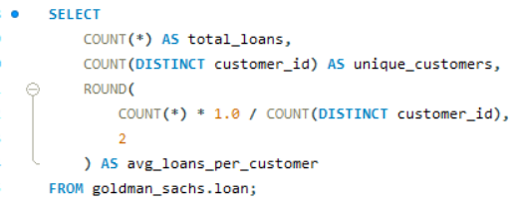

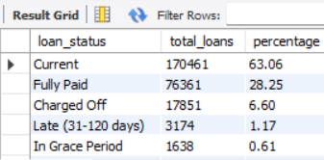
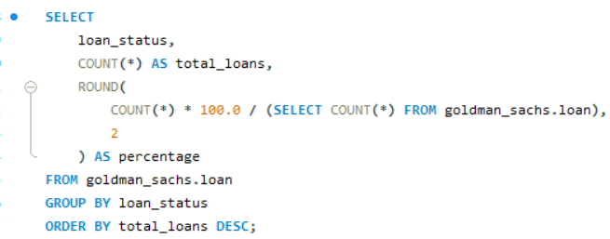
SQL Analysis 06 | Borrowing & Repayment Patterns
Find the average number of loans per customer and summarize repayment history.
SQL QUERY
QUERY OUTPUT
KEY OBSERVATIONS & BUSINESS INSIGHTS
Observation: Current loans account for 63.06% (170,461), followed by Fully Paid loans at 28.25% (76,361). Charged Off loans represent 6.60% (17,851), while late and grace-period loans indicate additional repayment concerns.
Business Insight: Although most loans are current or fully paid, the 6.60% charged-off share highlights potential credit risk. Global FinBank should strengthen repayment monitoring and focus on early intervention for borrowers showing signs of delinquency.
CONSUMER FINANCE LOAN ANALYTICS | DATA ANALYTICS CAPSTONE
09

Slide 10
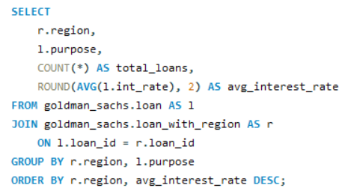
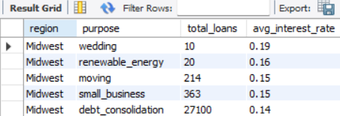
SQL Analysis 07 | Interest Rates by Category & Region
Calculate average interest rates by loan category and region.
SQL QUERY
QUERY OUTPUT
KEY OBSERVATIONS & BUSINESS INSIGHTS
Observation: In the Midwest, wedding loans have the highest average interest rate at 19% across 10 loans, followed by renewable energy loans at 16% across 20 loans. Moving and small-business loans average 15%, while debt consolidation loans average 14% across 27,100 loans.
Business Insight: Higher interest rates on certain loan categories may reflect greater perceived lending risk, although the small sample sizes for wedding and renewable energy loans limit comparisons. Global FinBank should evaluate interest rates alongside loan performance to balance profitability and borrower affordability.
CONSUMER FINANCE LOAN ANALYTICS | DATA ANALYTICS CAPSTONE
10

Slide 11
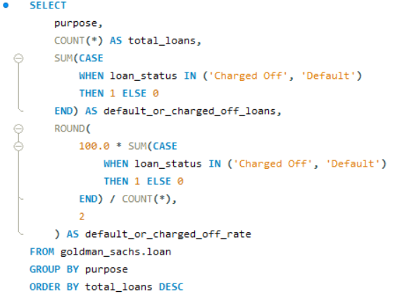
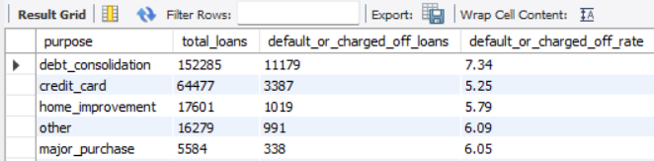
SQL Analysis 08 | Loan Purpose & Default Rates
Identify the most common loan purposes and their associated default rates.
SQL QUERY
QUERY OUTPUT
KEY OBSERVATIONS & BUSINESS INSIGHTS
Observation: Debt consolidation is the most common loan purpose, with 152,285 loans and a 7.34% charged-off/default rate. Credit card loans follow with 64,477 loans and a 5.25% rate, while home improvement loans have a 5.79% rate.
Business Insight: Debt consolidation has both the highest loan volume and the highest charged-off/default rate among the categories shown. Global FinBank should closely monitor this category to manage credit risk while continuing to serve strong customer demand.
CONSUMER FINANCE LOAN ANALYTICS | DATA ANALYTICS CAPSTONE
11

Slide 12
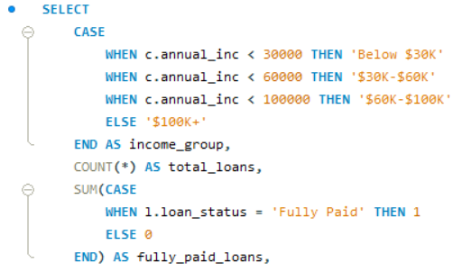
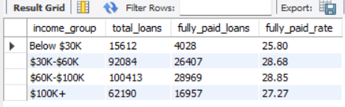
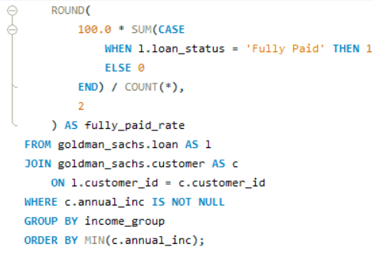
SQL Analysis 09 | Income & Approval Relationship
Analyze the relationship between income levels and loan approval rates.
SQL QUERY
QUERY OUTPUT
KEY OBSERVATIONS & BUSINESS INSIGHTS
Observation: The $60K–$100K income group has the highest fully paid rate at 28.85%, followed by the $30K–$60K group at 28.68%. The below-$30K group has the lowest rate at 25.80%, while the $100K+ group records 27.27%.
Business Insight: Middle-income borrowers show slightly higher fully paid rates than the other income groups. Global FinBank should consider income alongside loan grade and loan amount when assessing lending risk. These results reflect repayment outcomes, not loan approval rates.
CONSUMER FINANCE LOAN ANALYTICS | DATA ANALYTICS CAPSTONE
12

Slide 13
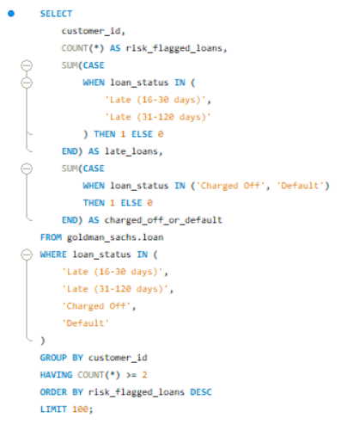
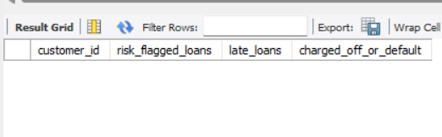
SQL Analysis 10 | Repeated Missed Payments
List customers who have missed multiple payments and may be at higher risk of default.
SQL QUERY
QUERY OUTPUT
KEY OBSERVATIONS & BUSINESS INSIGHTS
Observation: No customers were identified with multiple risk-flagged loan records using the available loan-status data.
Business Insight: The dataset does not provide individual missed-payment histories, so customers with multiple missed payments cannot be directly identified. Global FinBank should monitor loans marked Late, Charged Off, or Default to identify potential credit risks.
CONSUMER FINANCE LOAN ANALYTICS | DATA ANALYTICS CAPSTONE
13

Slide 14
What the Analysis Reveals
Synthesis framework | Replace these prompts with evidence from your actual query outputs
CUSTOMER & REGIONAL MIX
APPROVAL FAIRNESS & EFFICIENCY
Customer & Regional Mix: South leads with 97,683 customers; Northeast has the highest average income ($82,397.76)
Approval Fairness & Efficiency: Approval rate unavailable; 63.06% Current and 28.25% Fully Paid loans
PORTFOLIO GROWTH
RISK CONCENTRATION
Portfolio Growth: Loans rose from 2,594 (2012) to 43,368 (2016)
Risk Concentration: 548 loans (0.20%) classified as high risk
PRICING & PURPOSE
DATA LIMITATIONS
Pricing & Purpose: Debt consolidation leads with 152,285 loans and a 7.34% charged-off/default rate
Data Limitations: Credit scores, approval decisions, and individual missed-payment records are unavailable
CONSUMER FINANCE LOAN ANALYTICS | DATA ANALYTICS CAPSTONE
14

Slide 15
Business Recommendations
Action plan for responsible lending, portfolio performance and customer outcomes
01 RISK-BASED UNDERWRITING
02 EARLY-WARNING MONITORING
Risk-Based Underwriting: Use loan grades, income, and loan amounts; 548 loans met the selected high-risk criteria
Early-Warning Monitoring: Monitor late loans (3,976) and charged-off loans (17,851) for potential risk
03 STATE & SEGMENT REVIEW
04 PORTFOLIO STEWARDSHIP
State & Segment Review: Focus on California, with 37,024 loans, and compare regional lending patterns
Portfolio Stewardship: Monitor debt consolidation, with 152,285 loans and a 7.34% charged-off/default rate
05 PRICING WITH CONTEXT
06 MODEL GOVERNANCE
Pricing with Context: Compare interest rates and repayment outcomes; Midwest wedding loans averaged 19%
Model Governance: Validate risk thresholds against actual outcomes; credit scores and individual missed-payment records are unavailable
CONSUMER FINANCE LOAN ANALYTICS | DATA ANALYTICS CAPSTONE
15

