Slide 1
HOME AUTOMATION with Telegram
Presented by: Valiveti Manaswini Thalari pradeep Pulli koushik Lokkidi Rahul

Slide 2
Contents
Introduction
Literature Survey
Methodology
Implementation
Results
Future Scope
Conclusion

Slide 3
Introduction
Objective: To enable users to remotely control and monitor smart home devices using Telegram bots or messages. The project typically integrates IOT devices (e.g., lights, fans, locks, sensors) with a Telegram bot, allowing users to send commands via Telegram to control appliances, receive real-time status updates, and automate tasks.
Key objectives:
1. Remote Control
2. Security &Surveillance
3.Automation &Scheduling
4. Sensor Monitoring
5. User-Friendly Interface
6.Multi-User Access
7.Cost-Effective Solution
8.Security &Authentication

Slide 4
Introduction
The Internet of Things (IoT) has become ubiquitous in the engineering field and is perceived as paradigms for applications such as a home automation system where data can be exchanged and shared easily across the Internet. This project focuses on the implementation of the home automation system with Telegram using Wireless-Fidelity (Wi-Fi) network access on any smart- phone and laptop devices. It is highly beneficial for elderly, physically-challenged people and travellers to control home appliances effortlessly.

Slide 5
Literature Survey
RESEARCH PAPER 1: presents a step-by-step procedure of a smart home automation controller. It uses IOT to convert home appliances to smart and intelligent devices, with the help of design control. An energy efficient system is designed that accesses the smart home remotely using IOT connectivity. The smart home is implemented with a main controller unit that is connected with the 24-hour available Wi-Fi network.

Slide 6
RESEARCH PAPER2: focuses on asystem that provides features of Home Automation relying on IOT to operate easily, in addition to that it includes a camera module and provides home security. The android application basically converts Smartphones into a remote for all home appliances.This notification will be received by the owner of the house via the internet such that the app can trigger a notification. So the owner can raise an alaram. Home automation that consists; fan and light.

Slide 7
RESEARCH PAPER 3 : proposed by an optimization of home power consumption based on PLC (Power Line Communication) for an easy to access home energy consumption. This also proposes a PLC based renewable energy gateway to monitor the energy generation of renewable energies. Devices with particular features are assigned to these groups. It aims to establish a real time processing scheme to address variable sensor network topologies.

Slide 8
RESEARCH PAPER 4 : illustrates a methodology to provide a low cost Home Automation System (using Wireless Fidelity (Wi-Fi).This crystallizes the concept of internetworking of smart devices. A Wi- Fi based Wireless Sensor Network is designed for the purpose of monitoring and controlling environmental, safety and electrical parameters of a smart interconnected home. The primary focus of the paper is to develop a solution cost effective, flexible in control of devices and implementing a wide range of sensors to capture various parameters.

Slide 9
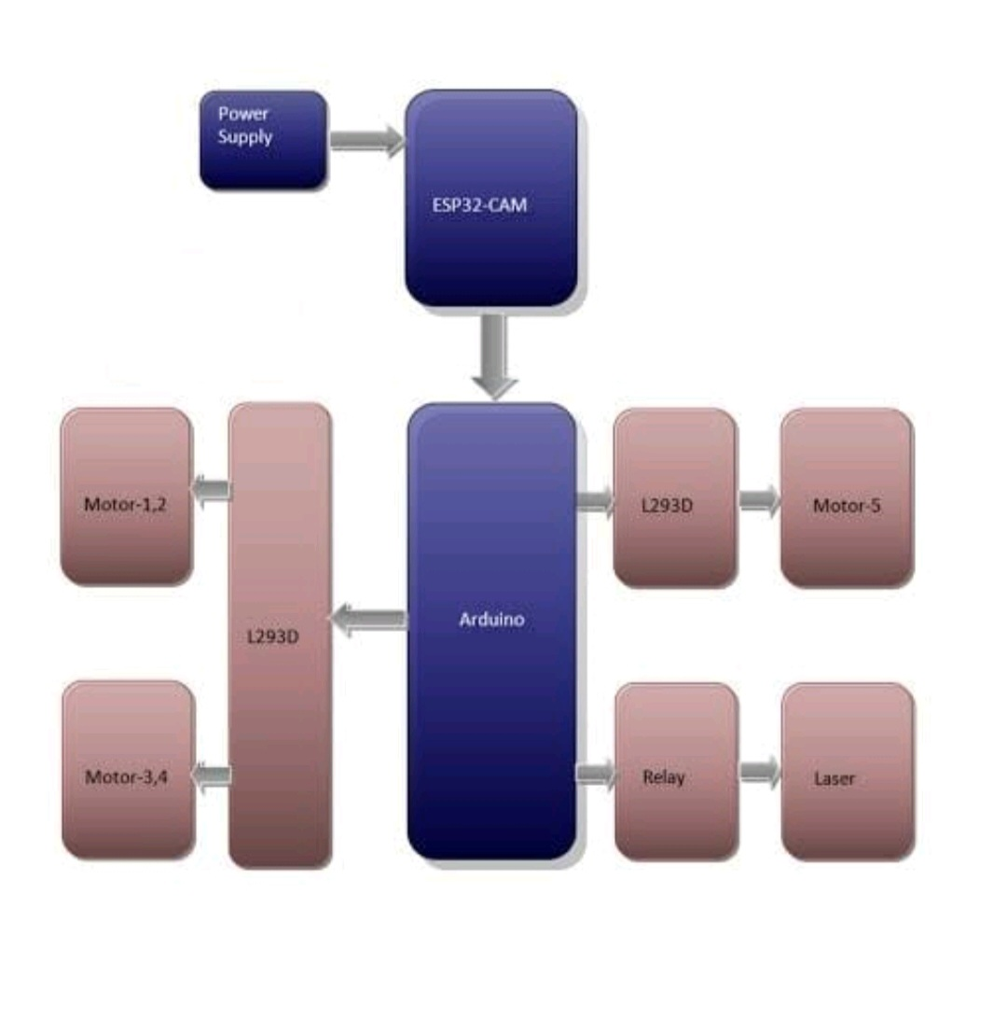
Methodology
Block Diagram

Slide 10
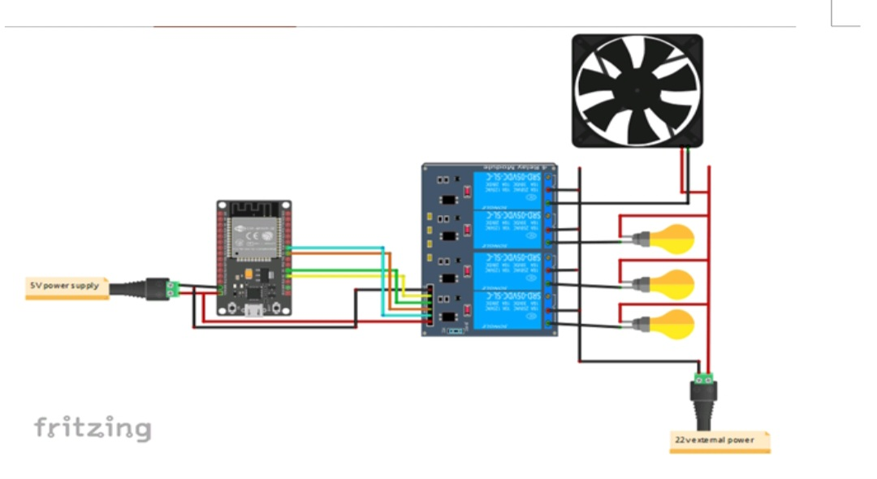
Implementation
Circuit Diagram

Slide 11
Implementation
Working:
Allows you to control smart devices remotely through a Telegram bot. This setup typically involves a microcontroller (like ESP8266, ESP32, or Raspberry Pi) communicating with home automation systems via Wi-Fi.
1. Create a Telegram Bot → Use @BotFather to generate a bot token.
2. Set Up Microcontroller (ESP8266/ESP32/Raspberry Pi) → Connect it to Wi-Fi and home devices (relays, sensors).

Slide 12
Working: Allows you to control smart devices remotely through a Telegram bot. This setup typically involves a microcontroller (like ESP8266, ESP32, or Raspberry Pi) communicating with home automation 3. Write Code (Using Python or Arduino IDE) → Use Telegram Bot API to receive commands and control devices. 4. Deploy & Test → Send commands via Telegram to turn devices ON/OFF.

Slide 13
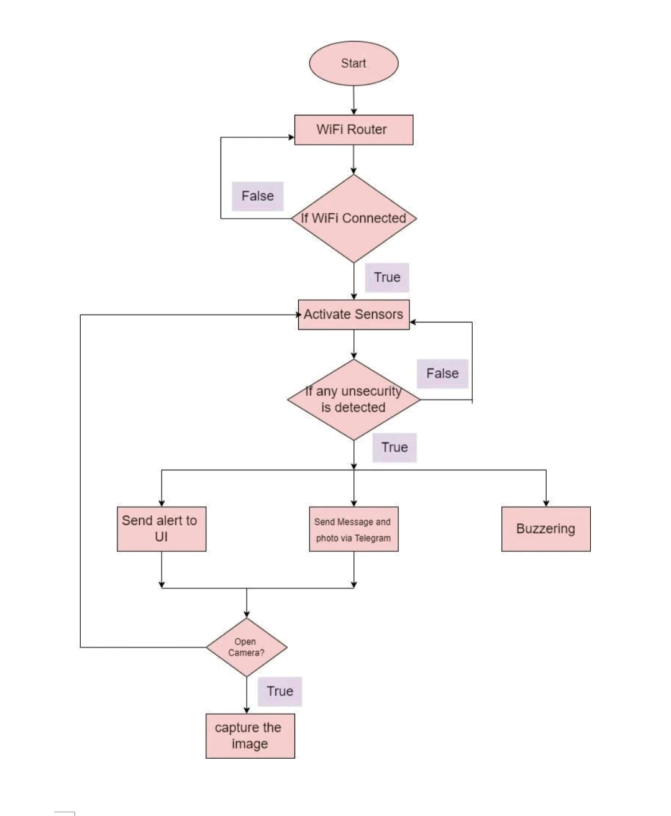
Implementation
Flow chart/Code

Slide 14
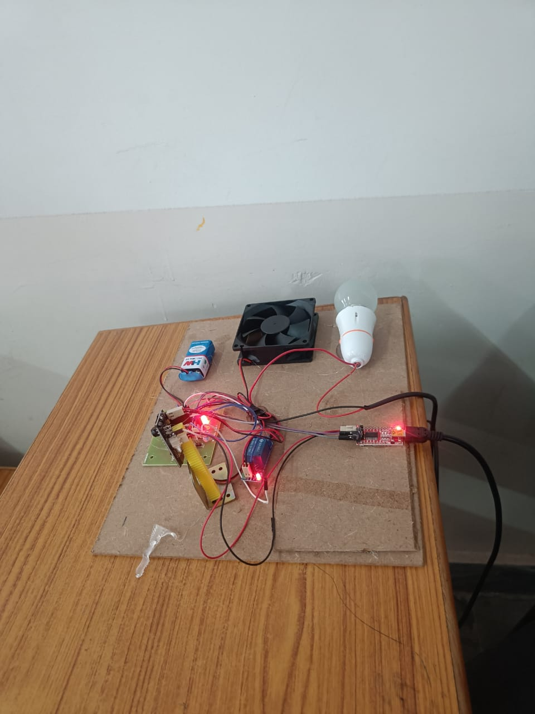
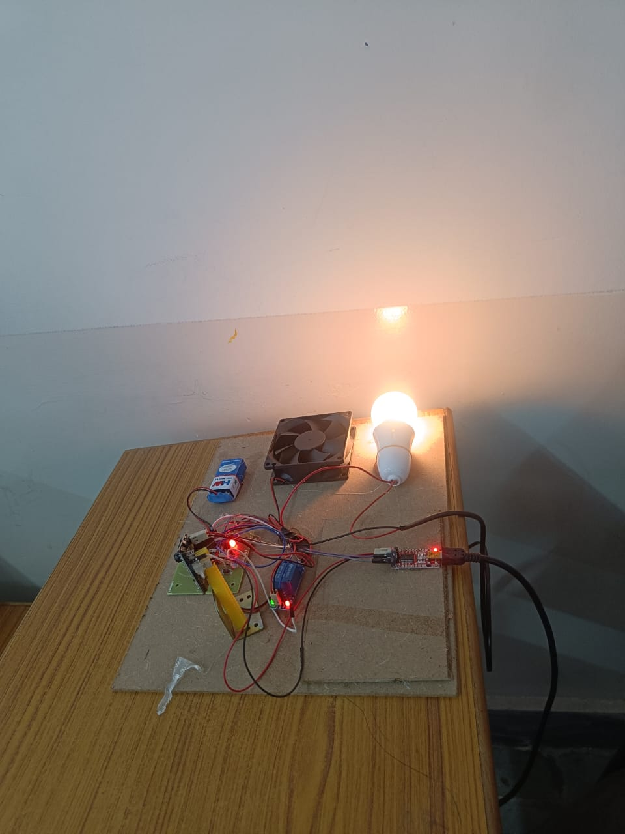
Result and Discussions

Slide 15
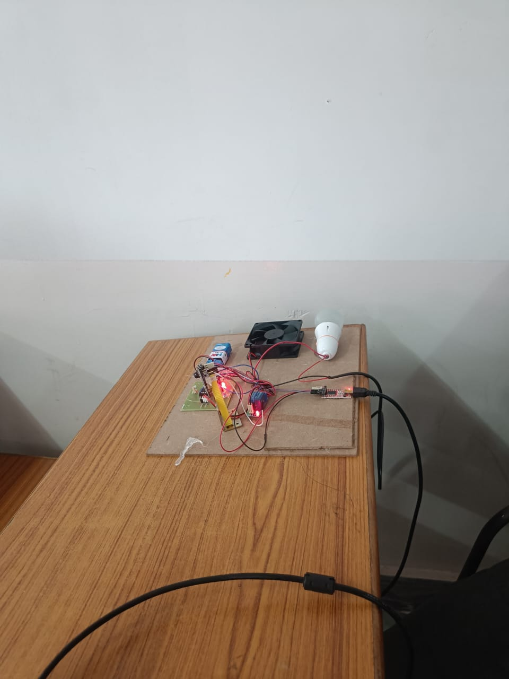
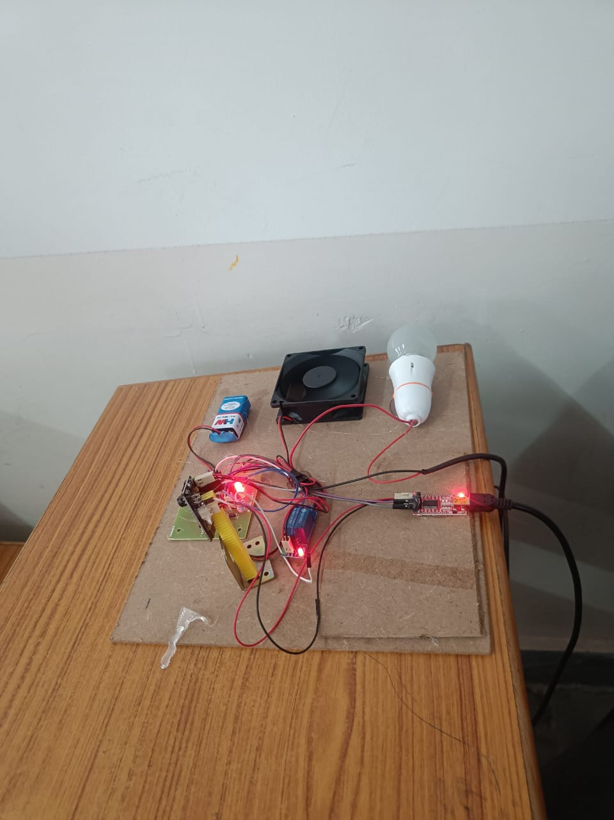

Slide 16
Conclusion
Home automation with Telegram provides a cost-effective, secure, and convenient way to control smart devices remotely. By integrating a Telegram bot with a microcontroller (ESP8266, ESP32, or Raspberry Pi), users can send commands to manage lights, fans, security systems, and more. This setup enhances home automation by enabling real-time control from anywhere, making it a simple yet powerful solution for smart homes.

Slide 17
Future Scope
1. AI-Powered Automation – Integrating AI chatbots with Telegram for intelligent responses and automation based on user habits.
2. Voice Control Integration – Using voice commands via Telegram bots for hands-free control.
3. IoT & Cloud Connectivity – Expanding automation with cloud-based services for better scalability and real-time monitoring.
4. Security Enhancements – Adding two-factor authentication and encrypted communication for improved safety.

Slide 18
5. Smart Home Expansion – Connecting with multiple IoT platforms like Google Home, Alexa, and Matter for a unified experience.
6. Machine Learning for Predictive Control – Learning user behavior to Role-Based Access – Allowing devices without manual input.
7. Multi-User & different users Role-Based Access – Allowing control specific devices based on permissions.

Slide 19
Thank You

